Slide 1
So-Show
The Adult Social Hub

Slide 2
The Loneliness Epidemic in the U.S.
Nearly half of Americans report sometimes or always feeling alone (46 percent) or left out (47 percent).
One in four Americans (27 percent) rarely or never feel as though there are people who really understand them.
Two in five Americans sometimes or always feel that their relationships are not meaningful (43 percent) and that they are isolated from others (43 percent).
One in five people report they rarely or never feel close to people (20 percent) or feel like there are people they can talk to (18 percent).
Americans who live with others are less likely to be lonely (average loneliness score of 43.5) compared to those who live alone (46.4). However, this does not apply to single parents/guardians (average loneliness score of 48.2) – even though they live with children, they are more likely to be lonely.
Only around half of Americans (53 percent) have meaningful in-person social interactions, such as having an extended conversation with a friend or spending quality time with family, on a daily basis.
Generation Z (adults ages 18-22) is the loneliest generation and claims to be in worse health than older generations.
Social media use alone is not a predictor of loneliness; respondents defined as very heavy users of social media have a loneliness score (43.5) that is not markedly different from the score of those who never use social media (41.7).
https://www.cigna.com/newsroom/news-releases/2018/new-cigna-study-reveals-loneliness-at-epidemic-levels-in-america

Slide 3
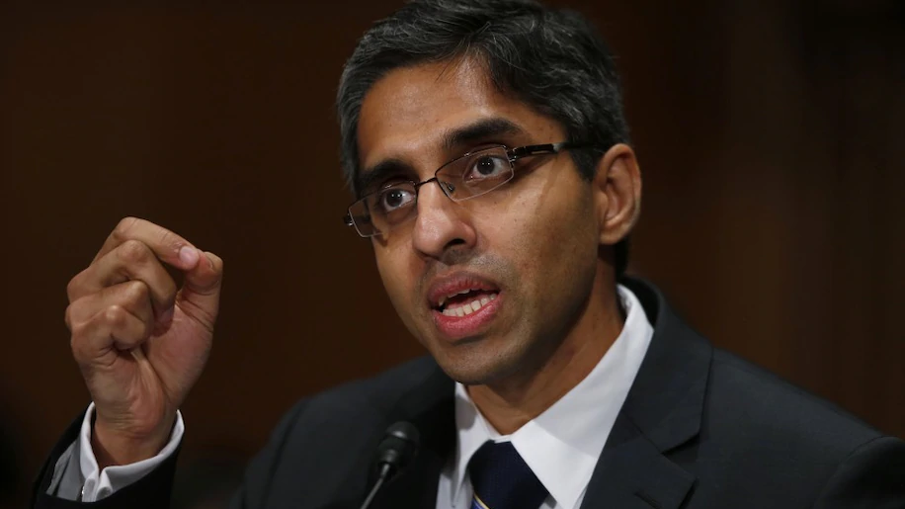
The Loneliness Epidemic in the U.S. (continued)
Former U.S. surgeon general, Vivek H. Murthy, emphasizes the unseen, but catastrophic effects of the loneliness epidemic.
https://www.washingtonpost.com/news/on-leadership/wp/2017/10/04/this-former-surgeon-general-says-theres-a-loneliness-epidemic-and-work-is-partly-to-blame/

Slide 4
Health Effects of Loneliness
“Current evidence indicates that heightened risk for mortality from a lack of social relationships is greater than that from obesity…”
“Researchers have predicted that loneliness will reach epidemic proportions by 2030 unless action is taken (Linehan et al., 2014).”
https://pubmed.ncbi.nlm.nih.gov/25910392/

Slide 5
Mission
To mitigate the loneliness epidemic in the U.S. by creating a platform that allows people to form deep and meaningful connections within their local community.

Slide 6
App Saturation in the Digital Age: What has fallen?
Religious attendance has decreased:
https://www.pewforum.org/2016/08/23/2-religious-attendance-fluid-for-many-americans/
Binge drinking has decreased among teens: https://www.nytimes.com/2017/07/31/well/family/binge-drinking-drops-among-teenagers.html
http://www.monitoringthefuture.org/pubs/monographs/mtf-overview2016.pdf
Heterosexual sex among young men: https://www.reuters.com/article/us-usa-health-sex/young-u-s-men-having-a-lot-less-sex-in-the-21st-century-study-shows-idUSKBN23J2LI

Slide 7
App Saturation in the Digital Age: What has risen?
Gaming
Dating Apps
Take-out food
We have more debt than ever, yet we order food more than ever
We want to relax and/or we don’t know how to cook

Slide 8
The Current Method of Meeting People
Joining a special interest community (gardening, cycling, gaming, or people from work)
What if no one is interesting to you in this community? (e.g. lack of gender diversity, lack of personality diversity)
The social stigma of loneliness:
Not performing well in a special interest activity or looking like an outcast signals that either your interest is not genuine or you’re not fit for the group.
There may be an assumption that you came to the activity just to meet people.
It may be obvious that you’re lonely and vulnerable.
There is an assumption that you must be lonely for a reason.

Slide 9
The Old Method of Meeting People
Attending bars after work
Going to the park
Church and other religious organizations
Less social stigma because everyone is doing it
Religious organizations were once the epicenter of local life

Slide 10
Appealing to Human Nature
Universal Languages
Dancing
Cooking
PCs and gaming
Amenities of a theoretical brick-and-mortar location:
Dance Area
Cooking Area
Eating Area
PC and gaming Area

Slide 11
Becoming a platform: Appealing to Local Professionals and Businesses
Weekdays:
Invite local dance groups, chefs, and tech developers or entrepreneurs to teach dancing, cooking, and coding or entrepreneurship.
We profit from entry fees and membership fees.
Professionals earn 100% of their teaching fees from students who sign up
Weekends:
The dance studio is converted to a night club space
The PC room is converted to a PC gaming space for friendly competition
Either high-end chefs hold classes or classes are targeted towards young people
Single’s nights, couples nights

Slide 12
Practical Challenges

Slide 13
Getting people through the door
Professionals or experienced individuals can reserve time.
Win-win situation:
The business/professional receives our marketing channels, profit from teaching fees, and networking opportunities
We receive endorsement from businesses/professionals, profit from entry fees, and networking opportunities

Slide 14
Screening Unknown Professionals and Experienced Individuals
Open every day
Our Sunday and weekday business hours will be 2pm to 10pm
Weekend (Friday and Saturday) business hours will be 6pm to 2am
Screening hours are flexible but must end 2 hours prior to opening
Screening criteria
Resume
In-person personality assessment
Mock Performance and Review: cooking, dancing, or coding/entrepreneurship
Chefs must bring in their own food for their performance

Slide 15
Maintaining Long-term Relevancy
Flexibility in space usage and brand
Three routes: professional development route, community education route, entertainment route.
If one activity becomes overwhelmingly profitable, we may transform a space to another kind of space.
Incorporation of tech at the very beginning to future-proof the space

Slide 16
Avoiding Liability in the Kitchen
Chefs will be either encouraged or required to bring an assistant to supervise and dismiss people at will
Liability waivers and allergy forms.
Separating food into food-specific fridges and shelves to prevent cross-contamination

Slide 17
Type of Business
Will likely operate as a for-profit, LLC
Unlikely, but it’s also possible to operate as a non-profit because we are technically working on a public health issue

Slide 18
Target Demographic: 18-80 year-olds in the New Haven County Area, CT
Target Demographic: 18-80 year-olds
Target Demographic size in New Haven County: ~620,000 people
Percent of people needed to break even: 0.035%
Percent of people needed to reach max capacity: 0.098%

Slide 19
Finances
Monthly operating costs: $18,500
Overhead: $79,400
Funding estimate total: $222,000 for the first six months of operation
Break-even point: an engaged community of 214 people
Max community engagement capacity: 580 people

Slide 20
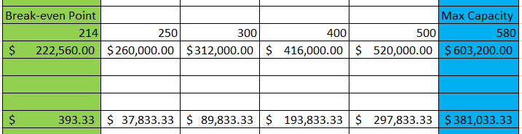
Profit Projections
Membership fee: $40 per month
Weekday Entry fee: $10
Weekend Entry fee: $20
Community
Gross
Profit

Slide 21
Formula Community Breakdown
80% 20% = 100% of total Community
(Weekday + Weekend) + Members
80% 20% 80% 20% 80% 20%
(2) (3) (1) (2) (3) (5)
The 80/20 rule is used to approximate profit from sub-communities of engagement.
Assumes exclusive sub-communities.
Weekly Visiting Frequency

