Slide 1
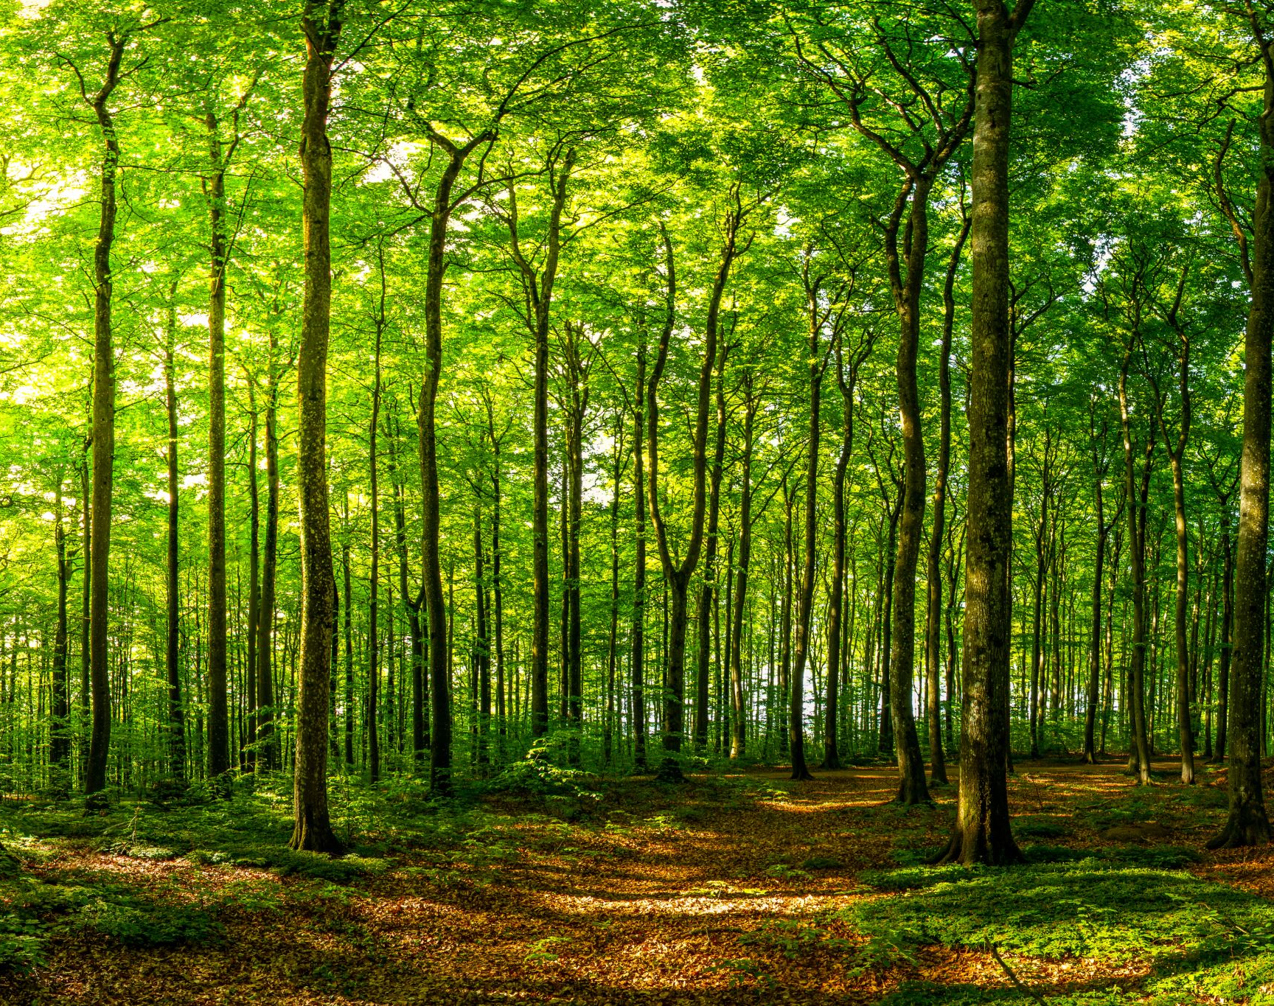
Project skill-tree
Thomas Francis
toj320@gmail.com

Slide 2
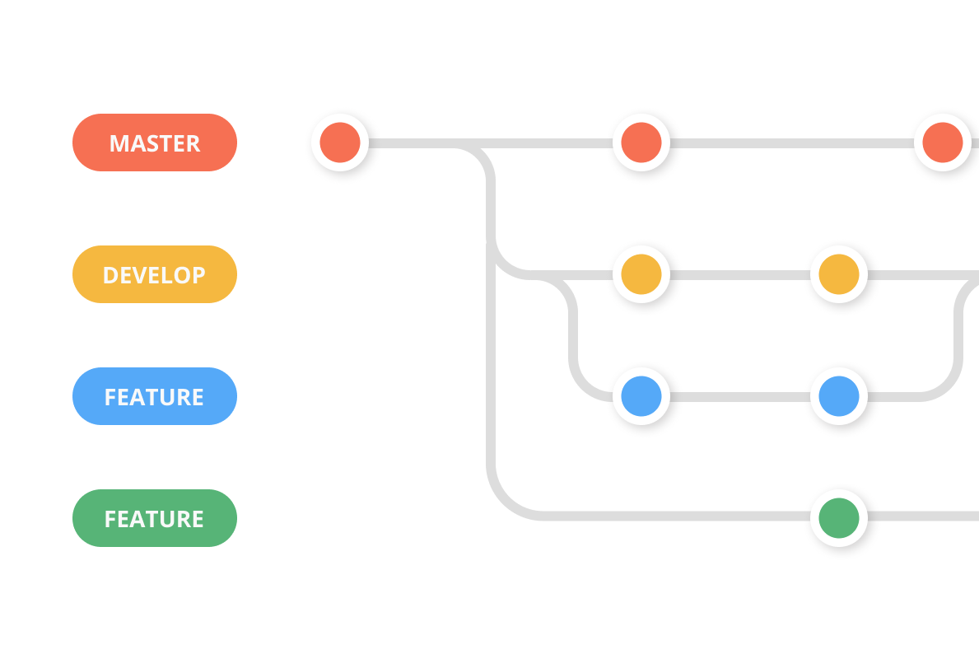
Project skill-tree is a free application that allows users to create, share, and link to existing skill trees.
Think GitHub but focused on learning.

Slide 3

Solutions for Common Problems in Education

Slide 4
Basic Idea
https://miro.com/app/board/o9J_ltxi12g=/

Slide 5
Help teachers create a self-paced curriculum for students, as well as keep track of their student's interests and progress.
Students can always choose different learning paths.

Slide 6
Allow students of all ages to find high quality online resources through educational links and book ISBNs embedded in the skill tree nodes curated by the skill tree author.

Slide 7
Make education fun, visually appealing, and decentralized through gamification.

Slide 8
Solve the "What next?" question through well-trodden learning paths in the form of recommendations.

Slide 9
Encourage academic experimentation by putting options to create one's own path first.

Slide 10
Decentralize the grading or verification process: a system of professional graders (teachers, professors, instructors) can log in and grade their student's work. Each node will have an end-product project link for graders to view their project somewhere on the web.

Slide 11

Secondary Goal: Passively Creating the Human Knowledge Tree

Slide 12
Passively create a decentralized method of recording the process of world knowledge acquisition across many people.

