Slide 1
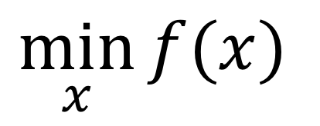
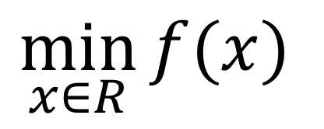
$$\min_{x∈R}{f(x)}$$
$$\min_{x}{f(x)}$$

Slide 2
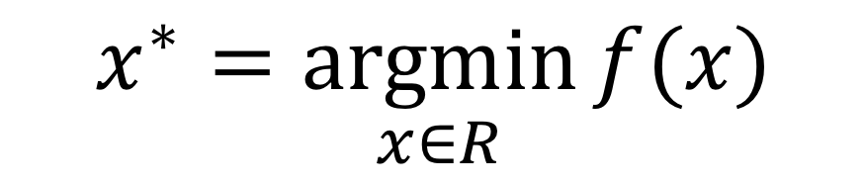
$$x^{∗}=\underset{x∈R}{argmin}{f(x)}$$

Slide 3
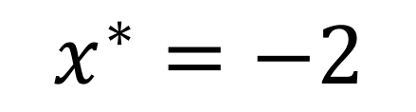
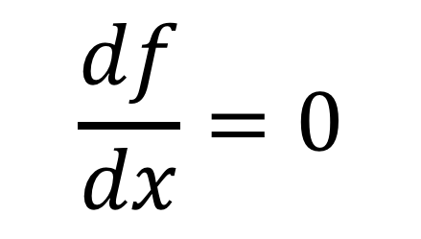
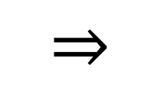
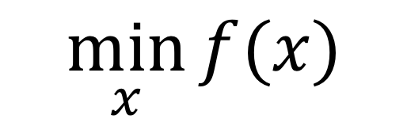
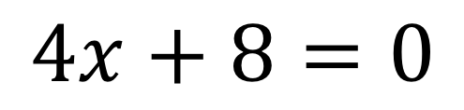
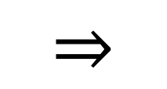
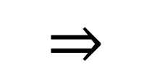
$$\frac{df}{dx}=0$$
$$\min_{x}{f(x)}$$
$$⇒$$
$$⇒$$
$$4x+8=0$$
$$⇒$$
$$x^{∗}=−2$$

Slide 4
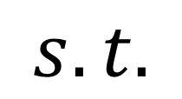
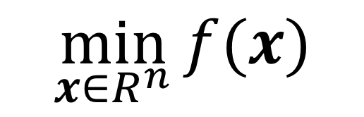
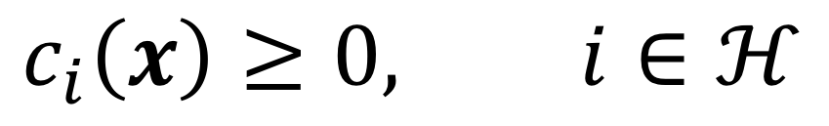
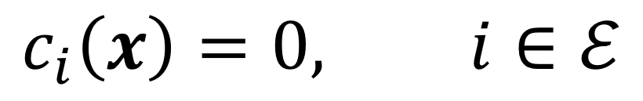
$$\min_{x∈R^{n}}{f(x)}$$
$$s.t.$$
$$c_{i}\left(x\right)=0, i∈ℰ$$
$$c_{i}\left(x\right)≥0, i∈ℋ$$

Slide 5

$$f\left(x_{k}\right)<f(x_{k+1})$$

Slide 6
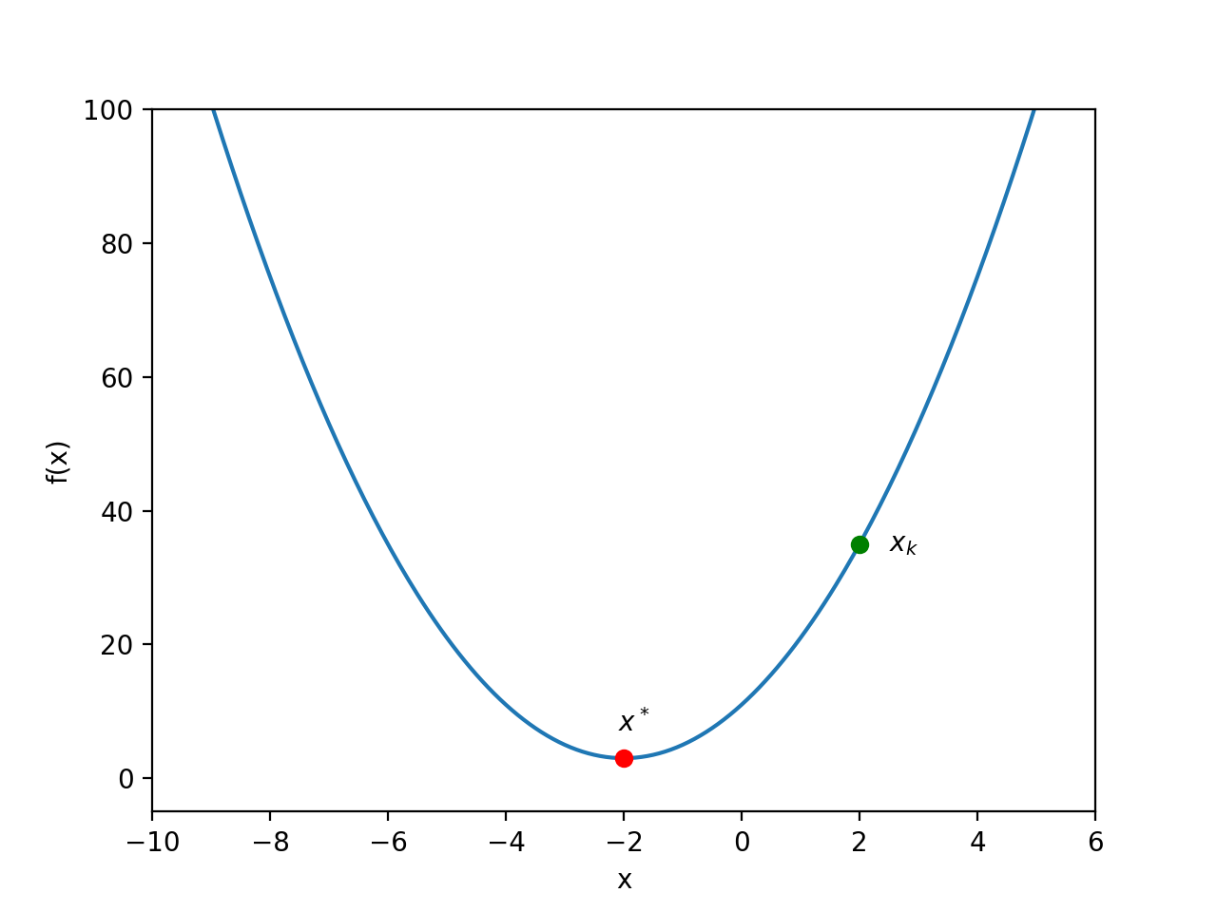

Slide 7
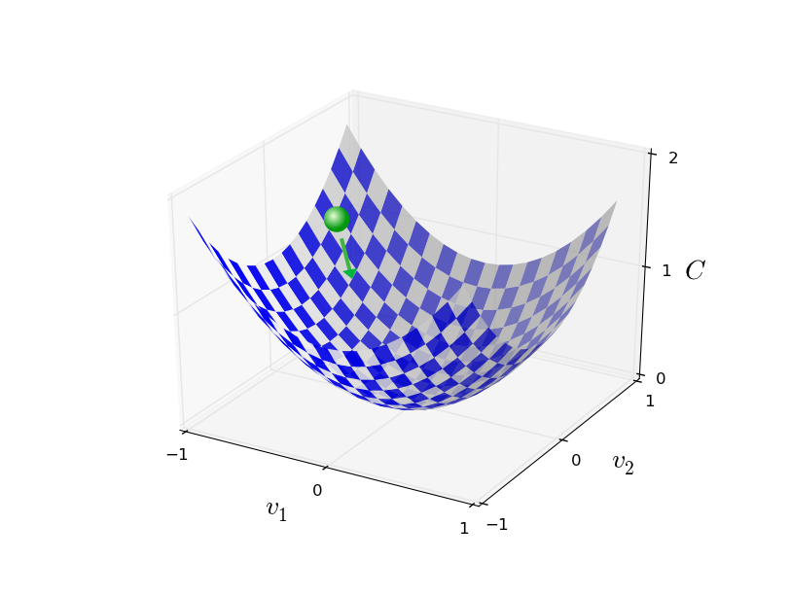





$$f(x)$$
$$x_{2}$$
$$x_{1}$$

Slide 8
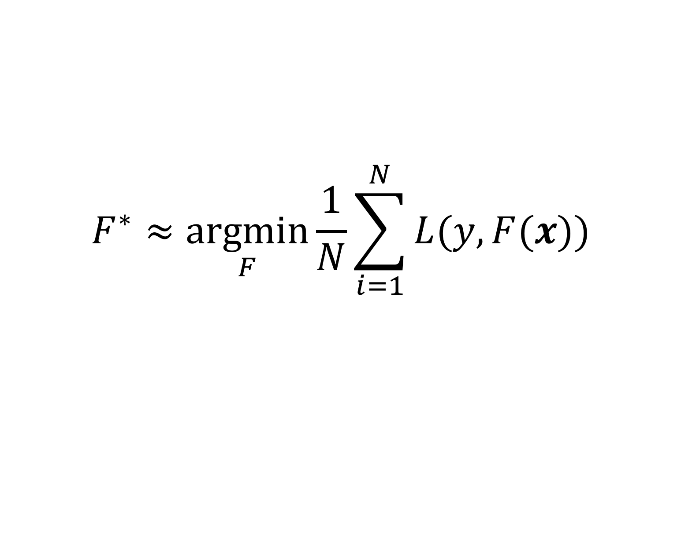
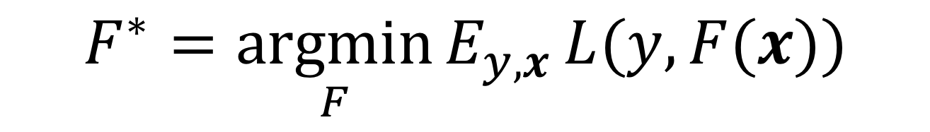
$$F^{∗}=\underset{F}{argmin}{E_{y,x}}L(y,F(x))$$
$$F^{∗}≈\underset{F}{argmin}{\frac{1}{N}\sum_{i=1}^{N}{L(y,F(x))}}$$

