Slide 1


Slide 2
Why net neutrality matters?
Simon Wächter, FHNW e3, 2016

Slide 3
About me
Simon Wächter, 22, Basel
Software developer, focus IT Security
Study CS at the FHNW

Slide 4
Overview
What is net neutrality
Modern problems arise
Need for a solution
+ Summary
+ Questions

Slide 5
What is net neutrality
Pre-Internet: Wired phone cables
No restrictions
Low traffic
Internet invented
In two words: Net neutrality
What is net neutrality / Modern problems arise / Need for a solution

Slide 6
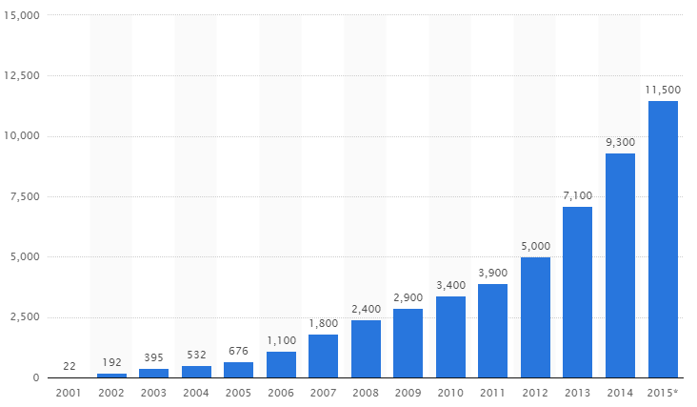
Modern problems arise
What is net neutrality / Modern problems arise / Need for a solution

Slide 7
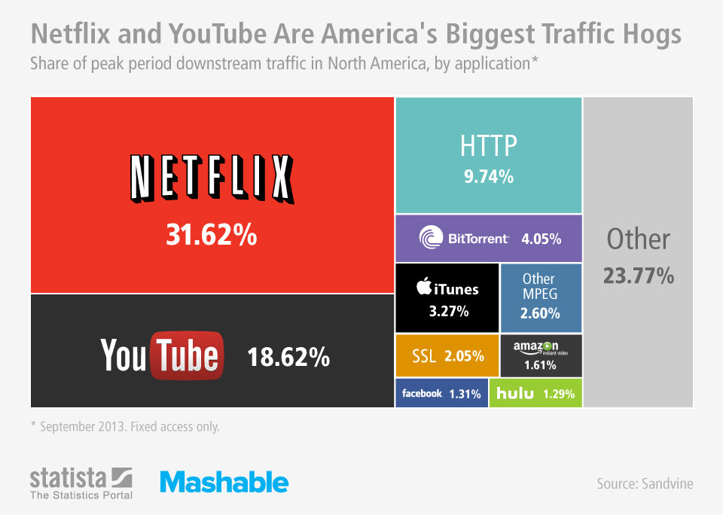
Modern problems arise
What is net neutrality / Modern problems arise / Need for a solution

Slide 8
Modern problems arise
Increasing traffic requires better infrastructure
Internet Service Providers (ISP) become gatekeepers
They restrict speed/access → Censorship
We have to live with these problems
Free market destroyed: Netflix vs. Swisscom TV
Problem: We are depending on ISP’s
What is net neutrality / Modern problems arise / Need for a solution

Slide 9
Need for a solution
Fact: Better infrastructure costs money (SBB, high ways)
Restriction is always a bad idea
Government needs to take action
Create law and recreate net neutrality
Free market results in a growing economy
But please: Regulate and control the gatekeepers
What is net neutrality / Modern problems arise / Need for a solution

Slide 10
Summary
Increasing internet traffic will require better infrastructure
We have to pay for it
But we need to have free content choice
Restore net neutrality!

Slide 11
Questions?

