Slide 2
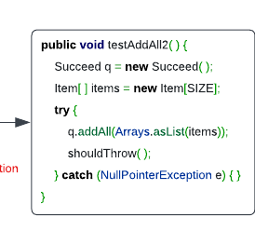
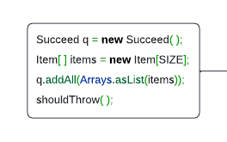
Multi-tasking
Try-catch Necessity Checker (XBlock)
No
Yes
Code representation learning (CodeBERT)
Try-catch Statement Detector (XState)
O
O
B-Try
I-Try
Exception Type Recommender
NullPointerException

Slide 3
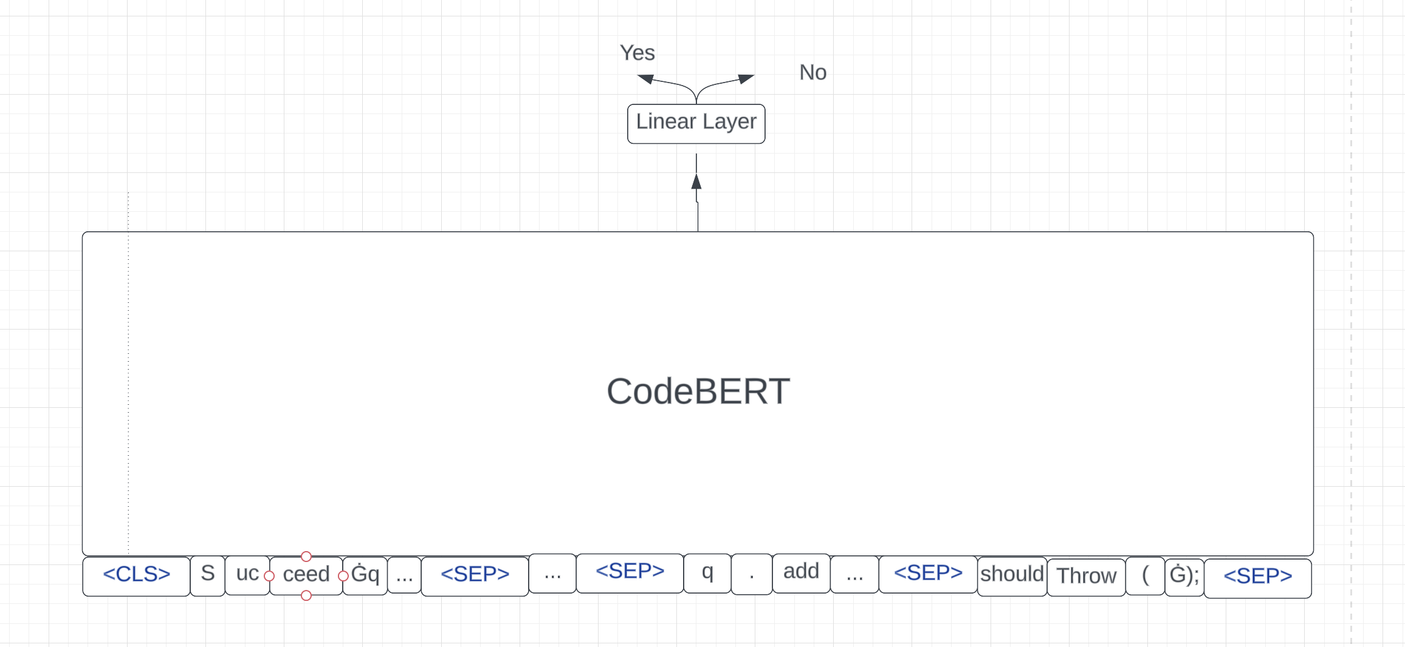
Task1

Slide 4
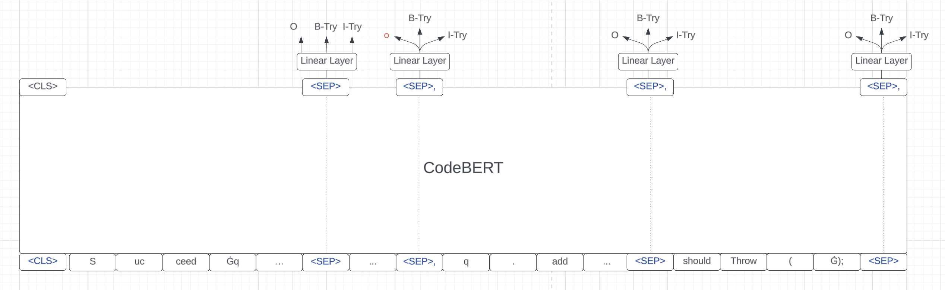
Task2

Slide 5
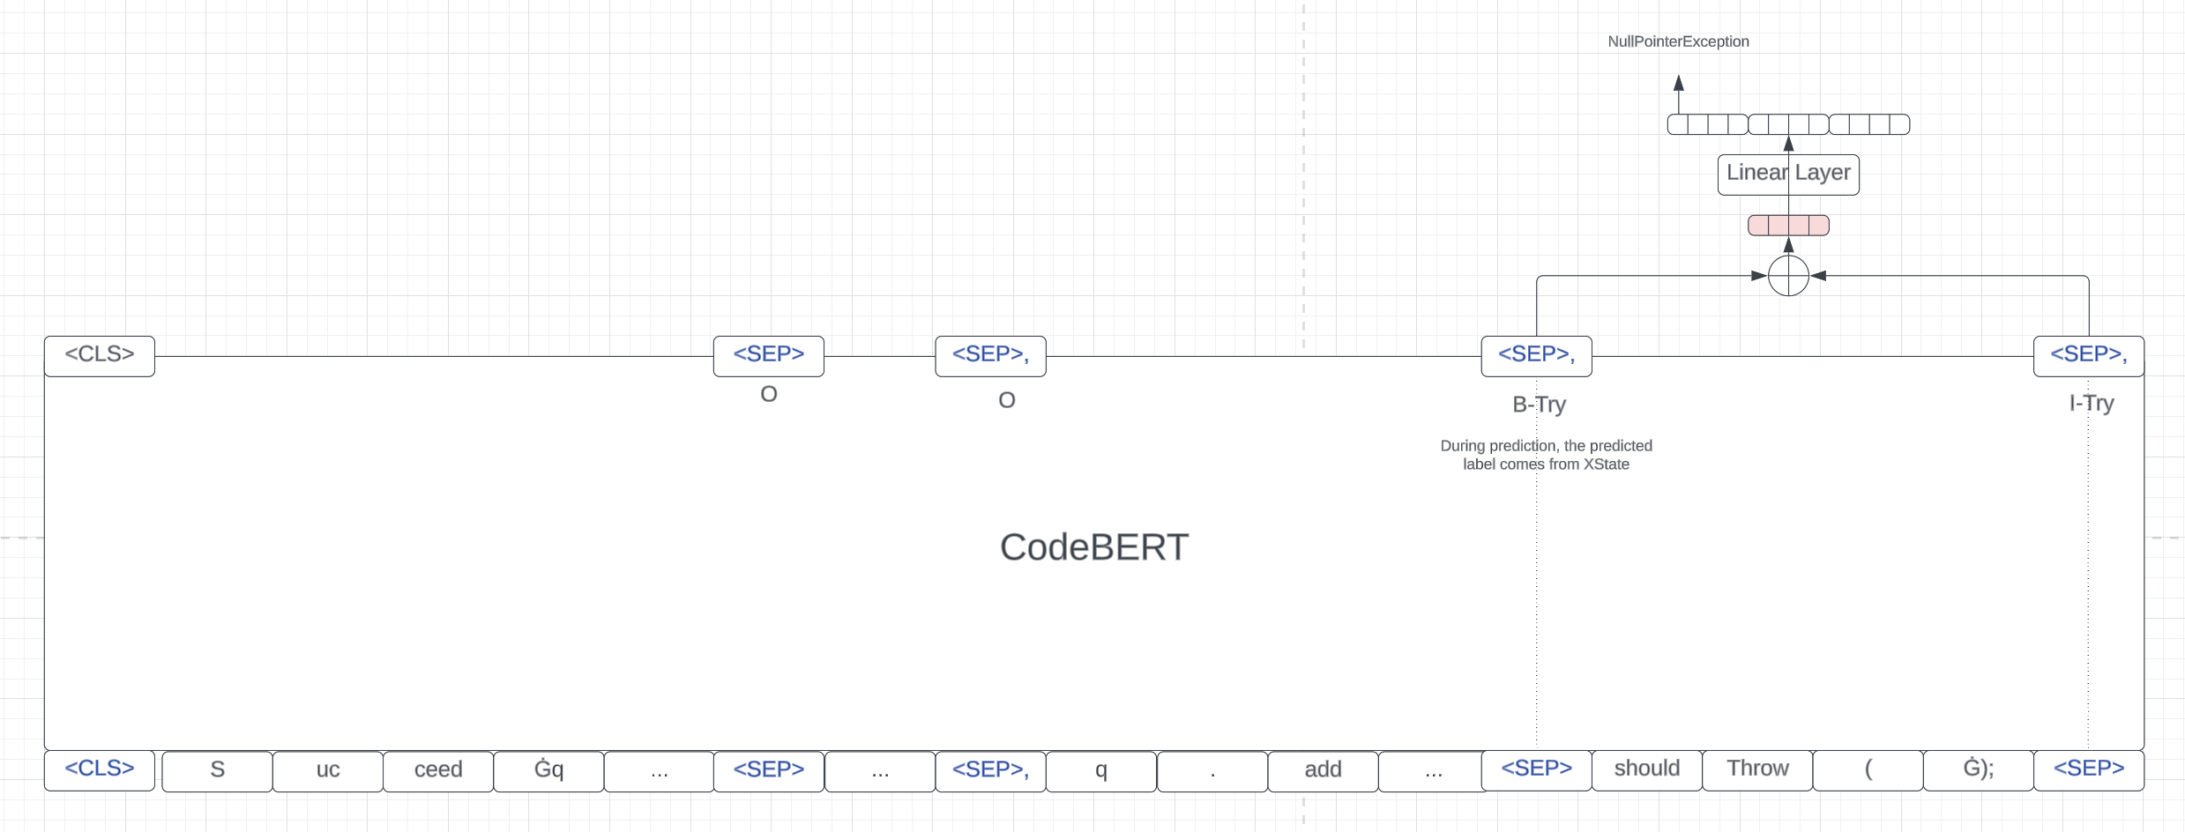
Task3

