Slide 1
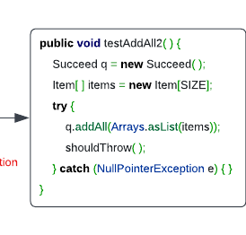
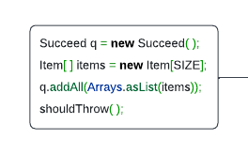
Multi-tasking
Try-catch Necessity Checker (XBlock)
No
Yes
Code representation learning (CodeBERT)
Try-catch Statement Detector (XState)
O
O
B-Try
I-Try
Exception Type Recommender
NullPointerException

Slide 2
@Override @DefinedBy(Api.COMPILER_TREE)
public Void visitEscape(EscapeTree node, Void p) {
try {
out.write("@");
print(node.getBody()); }
catch (IOException e) {
throw new UncheckedIOException(e);
}
return null;
}
Yes
No
FFNN + Softmax
CodeBERT
[CLS] out . Write ( “ @ “ ) ; [SEP] print ( node . get Body ( ) ) ; [SEP] return null ; [SEP]
XBlock Figure

Slide 3
@Override @DefinedBy(Api.COMPILER_TREE)
public Void visitEscape(EscapeTree node, Void p) {
try {
out.write("@");
print(node.getBody()); }
catch (IOException e) {
throw new UncheckedIOException(e);
}
return null;
}
O
B-Try
I-Try
O
B-Try
I-Try
O
B-Try
I-Try
FFNN + Softmax
FFNN + Softmax
FFNN + Softmax
CodeBERT
[CLS] out . Write ( “ @ “ ) ; [SEP] print ( node . get Body ( ) ) ; [SEP] return null ; [SEP]
XState Figure

Slide 4
@Override @DefinedBy(Api.COMPILER_TREE)
public Void visitEscape(EscapeTree node, Void p) {
try {
out.write("@");
print(node.getBody()); }
catch (IOException e) {
throw new UncheckedIOException(e);
}
return null;
}

Slide 5
Obsolete

Slide 6
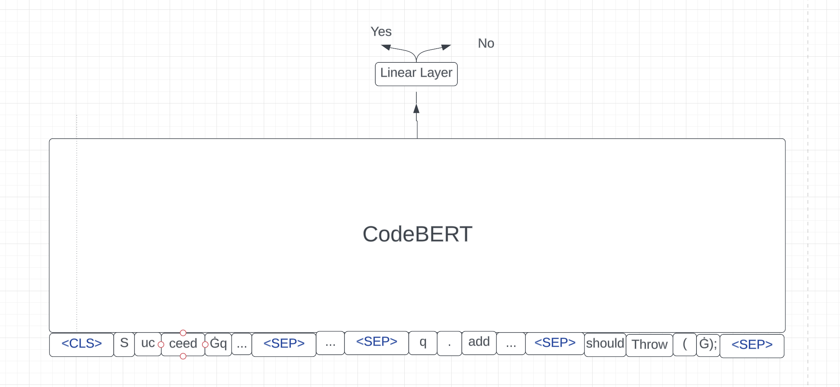
Task1

Slide 7
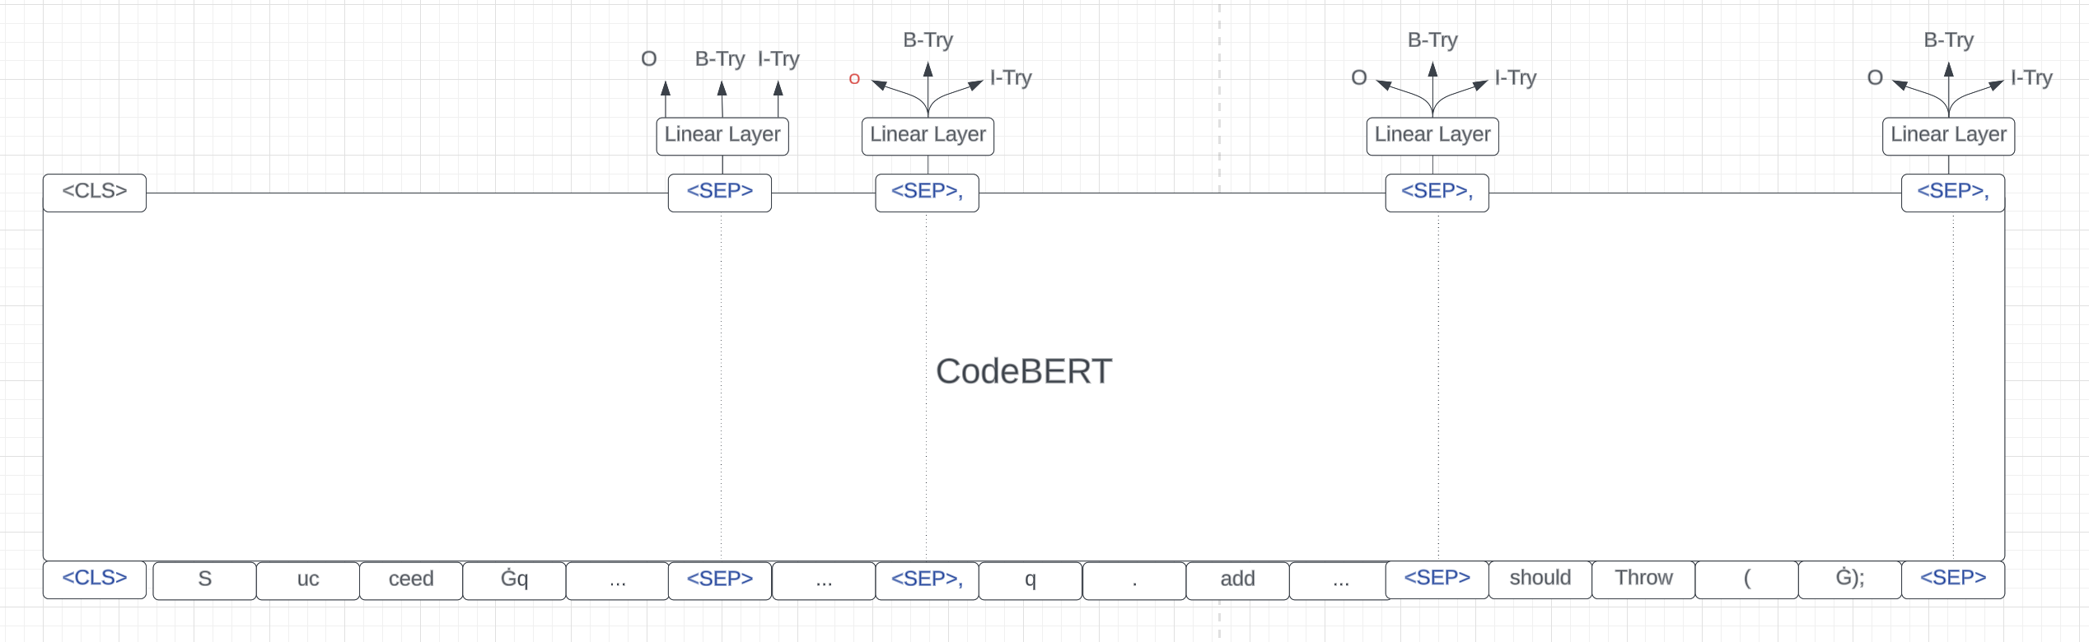
Task2

Slide 8
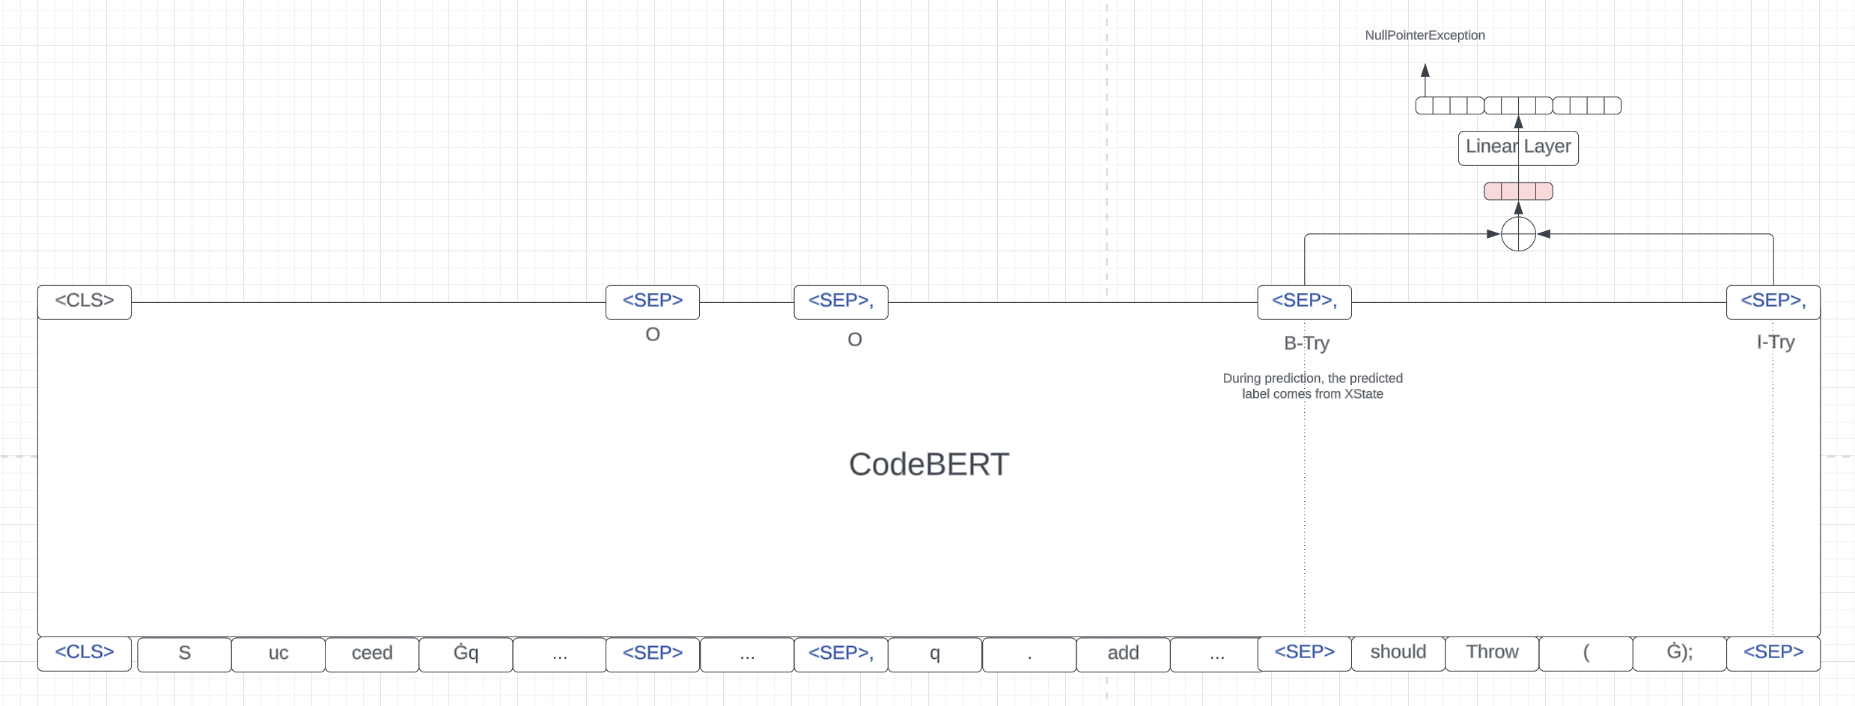
Task3

Slide 9


Slide 11


Slide 12



Multi-tasking
Try-catch Necessity Checker (XBlock)
1 Charset charset = Charset.forName ("US");
2 try {
3 BufferedReader reader =
Files.newBufferedReader(file, charset);
4 String line = null;
5 while ((line = reader.readLine() != null) {
6 System.out.println(line);
7 }
8 } catch (IOException x) {
9 …
10 }
1 | O
2 | B-try
3 | I-try
4 | I-try
5 | I-try
6 | I-try
1 Charset charset = Charset.forName ("US");
2 BufferedReader reader =
Files.newBufferedReader(file, charset);
3 String line = null;
4 while ((line = reader.readLine() != null) {
5 System.out.println(line);
6 }
Code Representation Learning
Try-catch Statement Detector (XState)
Exception Type Recommender (Xtype)
 | IOException
 | NullPointerException
 | IndexOutofBoundException
 | …

Slide 13
try {
out.write("@");
print(node.getBody()); }
catch (IOException e) {
throw new …(e);
}
return null;
FFNN + Softmax
CodeBERT
[CLS] out . Write ( “ @ “ ) ; [SEP] print ( node . get Body ( ) ) ; [SEP] return null ; [SEP]

Slide 14
@Override @DefinedBy(Api.COMPILER_TREE)
public Void visitEscape(EscapeTree node, Void p) {
try {
out.write("@");
print(node.getBody()); }
catch (IOException e) {
throw new UncheckedIOException(e);
}
return null;
}
O
B-Try
I-Try
O
B-Try
I-Try
O
B-Try
I-Try
FFNN + Softmax
FFNN + Softmax
FFNN + Softmax
CodeBERT
[CLS] out . Write ( “ @ “ ) ; [SEP] print ( node . get Body ( ) ) ; [SEP] return null ; [SEP]
XState Figure

Slide 15
try {
out.write("@");
print(node.getBody()); }
catch (IOException e) {
throw new …(e);
}
return null;
stmt 1
stmt 2
O
B-Try
I-Try
for stmt 1
O
B-Try
I-Try
O
B-Try
I-Try
stmt 3
FFNN + Softmax
FFNN + Softmax
FFNN + Softmax
V[SEP]
V[SEP]
V[SEP]
for stmt 1
for stmt 2
for stmt 3
CodeBERT
[CLS] out . Write ( “ @ “ ) ; [SEP] print ( node . get Body ( ) ) ; [SEP] return null ; [SEP]

Slide 16
@Override @DefinedBy(Api.COMPILER_TREE)
public Void visitEscape(EscapeTree node, Void p) {
try {
out.write("@");
print(node.getBody()); }
catch (IOException e) {
throw new UncheckedIOException(e);
}
return null;
}
IOException
SQLException
NullPointerException
…
…
0.8
0.1
0.3
During prediction, the predicted label comes from XState
FFNN + Sigmoid
sum
B-Try
I-Try
O
CodeBERT
[CLS] out . Write ( “ @ “ ) ; [SEP] print ( node . get Body ( ) ) ; [SEP] return null ; [SEP]
XType Figure

Slide 17
IOException
NullPointerException
…
…
…
try {
out.write("@");
print(node.getBody()); }
catch (IOException e) {
throw new …(e);
}
return null;
0.8
0.1
0.1
FFNN + Sigmoid
sum
V[SEP]
V[SEP]
V[SEP]
B-Try
I-Try
O
CodeBERT
[CLS] out . Write ( “ @ “ ) ; [SEP] print ( node . get Body ( ) ) ; [SEP] return null ; [SEP]

Slide 18
Multi-tasking
1 Charset charset = Charset.forName ("US");
2 try {
3 BufferedReader reader =
Files.newBufferedReader(file, charset);
4 String line = null;
5 while ((line = reader.readLine() != null) {
6 System.out.println(line);
7 }
8 } catch (IOException x) {
9 …
10 }
Try-catch Necessity Checker (XBlock)
1 Charset charset = Charset.forName ("US");
2 BufferedReader reader =
Files.newBufferedReader(file, charset);
3 String line = null;
4 while ((line = reader.readLine() != null) {
5 System.out.println(line);
6 }
1 | O
2 | B-Try
3 | I-Try
4 | I-Try
5 | I-Try
6 | I-Try
Code Representation Learning
Try-catch Statement Detector (XState)
Exception Type Recommender (Xtype)
 | IOException
 | NullPointerException
 | IndexOutOfBoundException
 | …

Slide 19
try {
out.write("@");
print(node.getBody()); }
catch (IOException e) {
throw new …(e);
}
return null;
FFNN + Softmax
CodeBERT
[CLS] out . write ( `` @ ‘’ ) ; [SEP] print ( node . get body ( ) ) ; [SEP] return null ; [SEP]

Slide 20
try {
out.write("@");
print(node.getBody()); }
catch (IOException e) {
throw new …(e);
}
return null;
stmt 1
stmt 2
O
B-Try
I-Try
for stmt 1
O
B-Try
I-Try
O
B-Try
I-Try
stmt 3
FFNN + Softmax
FFNN + Softmax
FFNN + Softmax
V[SEP]
V[SEP]
V[SEP]
for stmt 1
for stmt 2
for stmt 3
CodeBERT
[CLS] out . write ( `` @ ‘’ ) ; [SEP] print ( node . get body ( ) ) ; [SEP] return null ; [SEP]

Slide 21
IOException
NullPointerException
…
try {
out.write("@");
print(node.getBody()); }
catch (IOException e) {
throw new …(e);
}
return null;
…
…
0.8
0.4
0.3
FFNN + Sigmoid
sum
V[SEP]
V[SEP]
V[SEP]
B-Try
I-Try
O
CodeBERT
[CLS] out . write ( `` @ ‘’ ) ; [SEP] print ( node . get body ( ) ) ; [SEP] return null ; [SEP]

