Slide 1
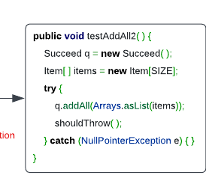
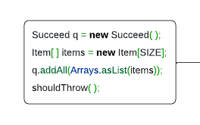
Multi-tasking
Try-catch Necessity Checker (XBlock)
No
Yes
Code representation learning (CodeBERT)
Try-catch Statement Detector (XState)
O
O
B-Try
I-Try
Exception Type Recommender
NullPointerException

Slide 2
@Override @DefinedBy(Api.COMPILER_TREE)
public Void visitEscape(EscapeTree node, Void p) {
try {
out.write("@");
print(node.getBody()); }
catch (IOException e) {
throw new UncheckedIOException(e);
}
return null;
}
Yes
No
FFNN + Softmax
CodeBERT
[CLS] out . Write ( “ @ “ ) ; [SEP] print ( node . get Body ( ) ) ; [SEP] return null ; [SEP]
XBlock Figure

Slide 3
@Override @DefinedBy(Api.COMPILER_TREE)
public Void visitEscape(EscapeTree node, Void p) {
try {
out.write("@");
print(node.getBody()); }
catch (IOException e) {
throw new UncheckedIOException(e);
}
return null;
}
O
B-Try
I-Try
O
B-Try
I-Try
O
B-Try
I-Try
FFNN + Softmax
FFNN + Softmax
FFNN + Softmax
CodeBERT
[CLS] out . Write ( “ @ “ ) ; [SEP] print ( node . get Body ( ) ) ; [SEP] return null ; [SEP]
XState Figure

Slide 4
@Override @DefinedBy(Api.COMPILER_TREE)
public Void visitEscape(EscapeTree node, Void p) {
try {
out.write("@");
print(node.getBody()); }
catch (IOException e) {
throw new UncheckedIOException(e);
}
return null;
}
IOException
SQLException
NullPointerException
…
…
0.8
0.1
0.3
During prediction, the predicted label comes from XState
FFNN + Sigmoid
sum
B-Try
I-Try
O
CodeBERT
[CLS] out . Write ( “ @ “ ) ; [SEP] print ( node . get Body ( ) ) ; [SEP] return null ; [SEP]
XType Figure

Slide 5
Case Studies

Slide 6
Obsolete

Slide 7
protected Class << ? > loadClass(String name, boolean resolve) throws ClassNotFoundException {
if (name.startsWith(Test.class.getName())) {
Class << ? > c = findLoadedClass(name);
if (c != null) {
return c;
}
try {
COUNTER++;
InputStream in = getSystemResourceAsStream(name.replace('.', File.separatorChar) + ".class");
byte[] buf = in .readAllBytes();
return defineClass(name, buf, 0, buf.length);
} catch (IOException e) {
throw new ClassNotFoundException(name);
}
}
return super.loadClass(name, resolve);
}
0.01
0.04
- 0.008
- 0.052
- 0.022
0.012
0.329
0.076
6.94e-05
0.029
- 0.011

Slide 8
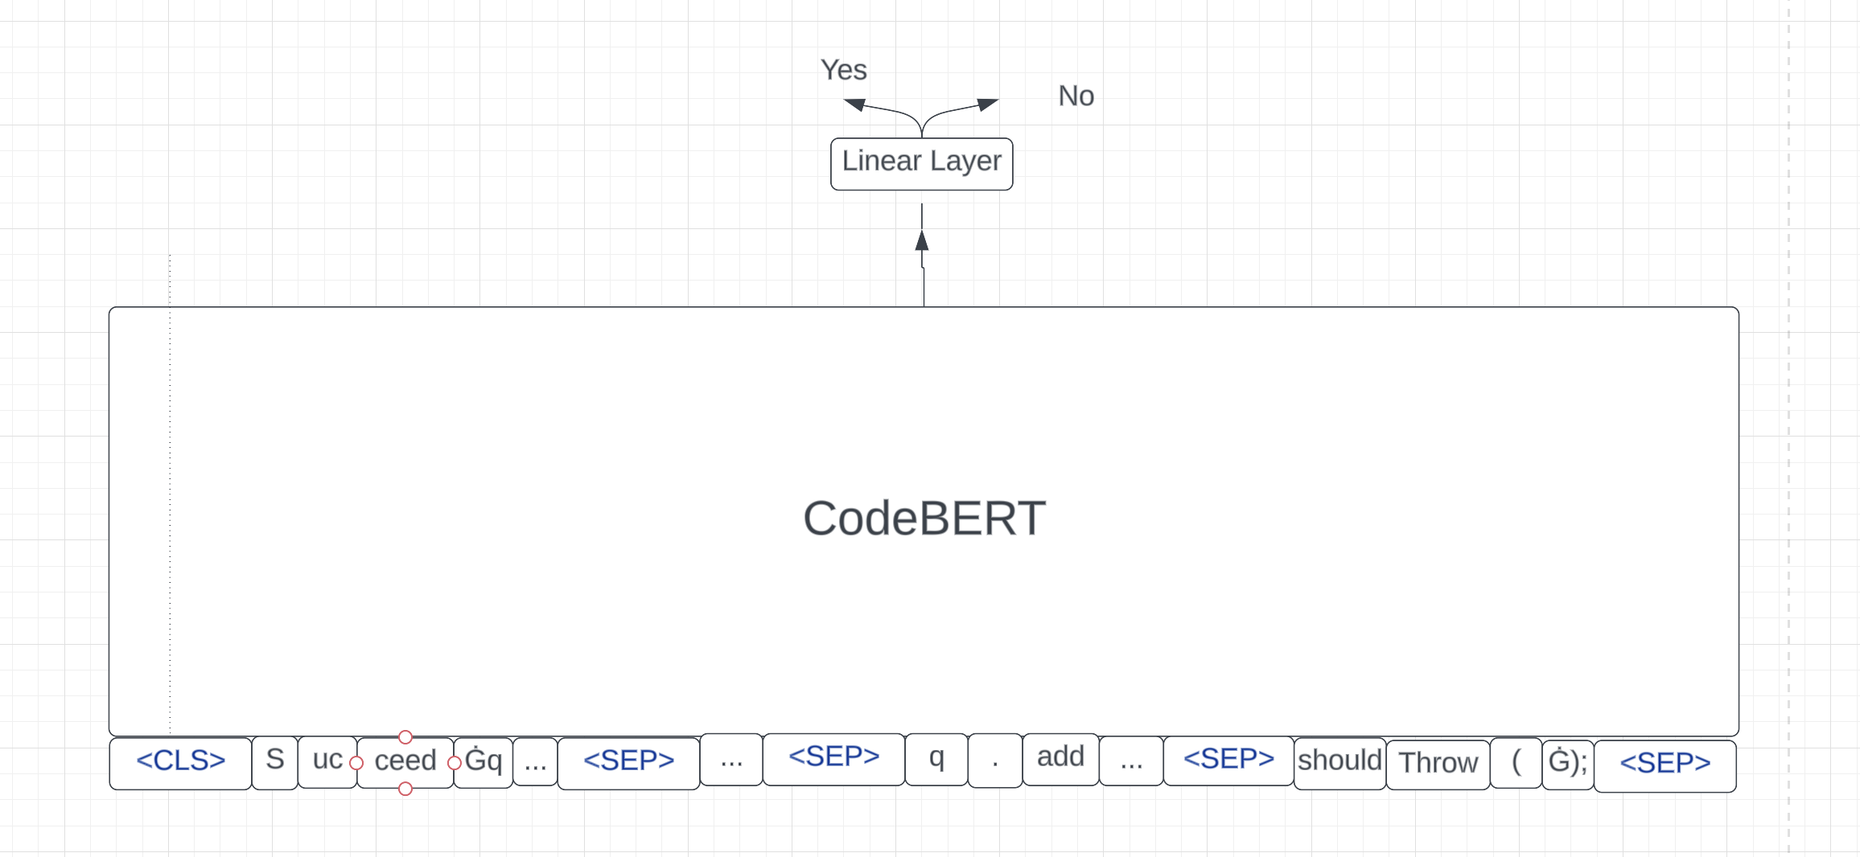
Task1

Slide 9
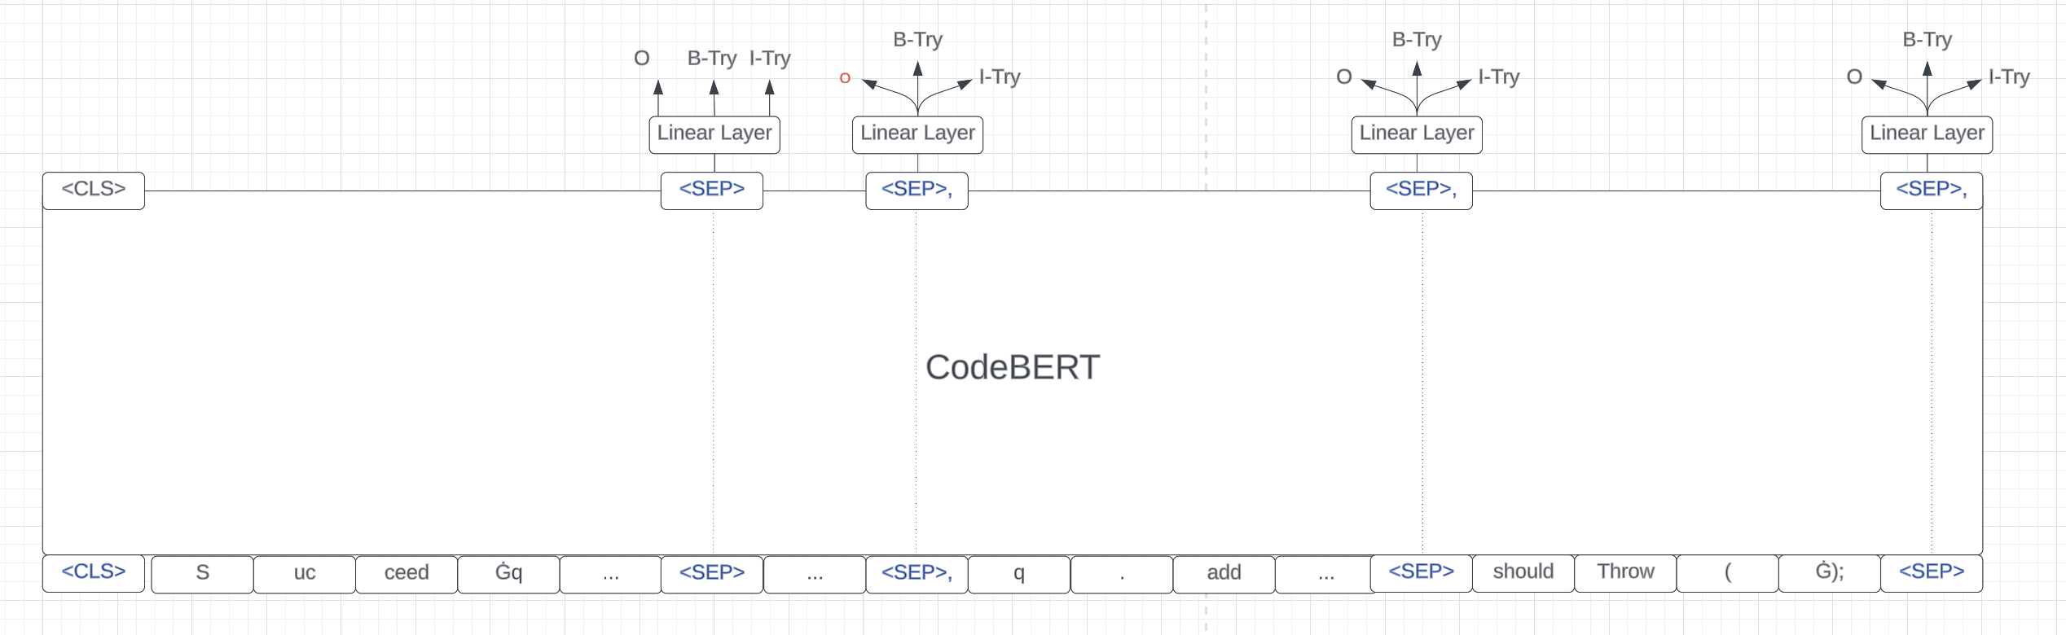
Task2

Slide 10
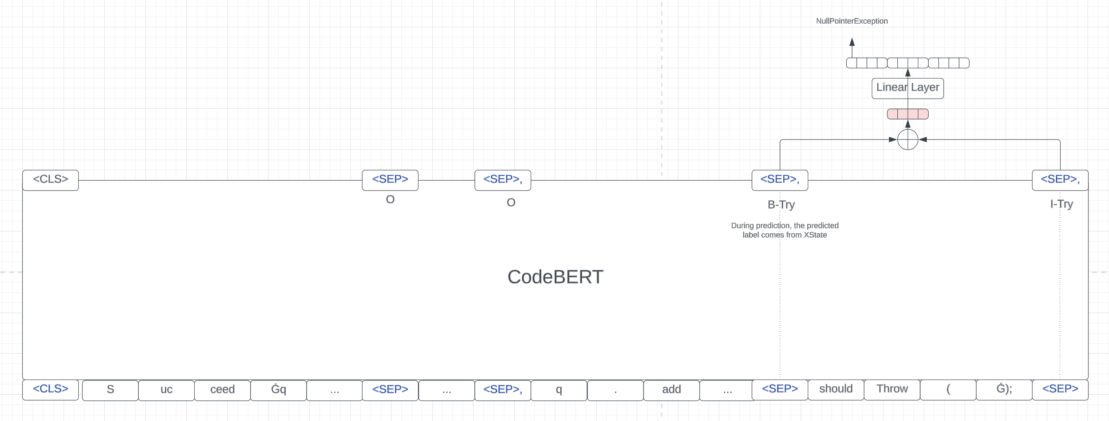
Task3

