Slide 1
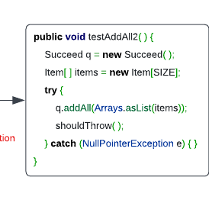
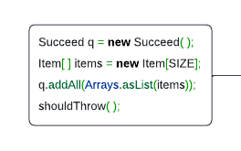
Multi-tasking
Try-catch Necessity Checker (XBlock)
No
Yes
Code representation learning (CodeBERT)
Try-catch Statement Detector (XState)
O
O
B-Try
I-Try
Exception Type Recommender
NullPointerException

Slide 2
@Override @DefinedBy(Api.COMPILER_TREE)
public Void visitEscape(EscapeTree node, Void p) {
try {
out.write("@");
print(node.getBody()); }
catch (IOException e) {
throw new UncheckedIOException(e);
}
return null;
}
Yes
No
FFNN + Softmax
CodeBERT
[CLS] out . Write ( “ @ “ ) ; [SEP] print ( node . get Body ( ) ) ; [SEP] return null ; [SEP]
XBlock Figure

Slide 3
@Override @DefinedBy(Api.COMPILER_TREE)
public Void visitEscape(EscapeTree node, Void p) {
try {
out.write("@");
print(node.getBody()); }
catch (IOException e) {
throw new UncheckedIOException(e);
}
return null;
}
O
B-Try
I-Try
O
B-Try
I-Try
O
B-Try
I-Try
FFNN + Softmax
FFNN + Softmax
FFNN + Softmax
CodeBERT
[CLS] out . Write ( “ @ “ ) ; [SEP] print ( node . get Body ( ) ) ; [SEP] return null ; [SEP]
XState Figure

Slide 4
@Override @DefinedBy(Api.COMPILER_TREE)
public Void visitEscape(EscapeTree node, Void p) {
try {
out.write("@");
print(node.getBody()); }
catch (IOException e) {
throw new UncheckedIOException(e);
}
return null;
}
IOException
SQLException
NullPointerException
…
…
0.8
0.1
0.3
During prediction, the predicted label comes from XState
FFNN + Sigmoid
sum
B-Try
I-Try
O
CodeBERT
[CLS] out . Write ( “ @ “ ) ; [SEP] print ( node . get Body ( ) ) ; [SEP] return null ; [SEP]
XType Figure

Slide 5
Obsolete

Slide 6
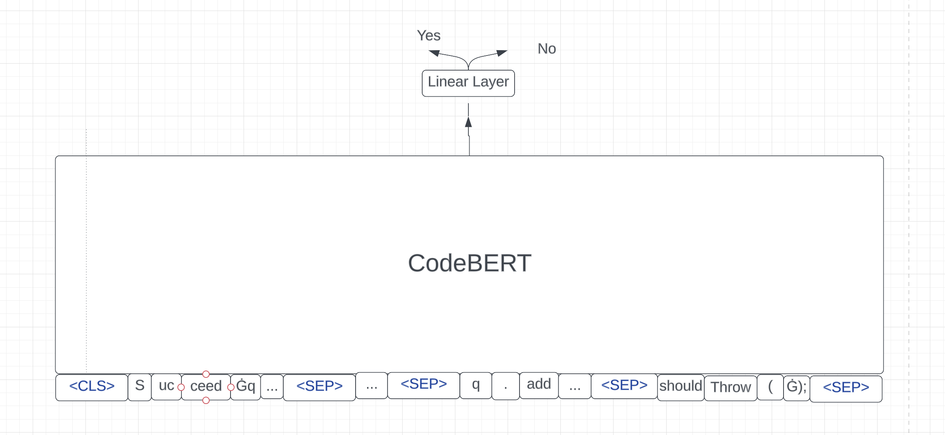
Task1

Slide 7
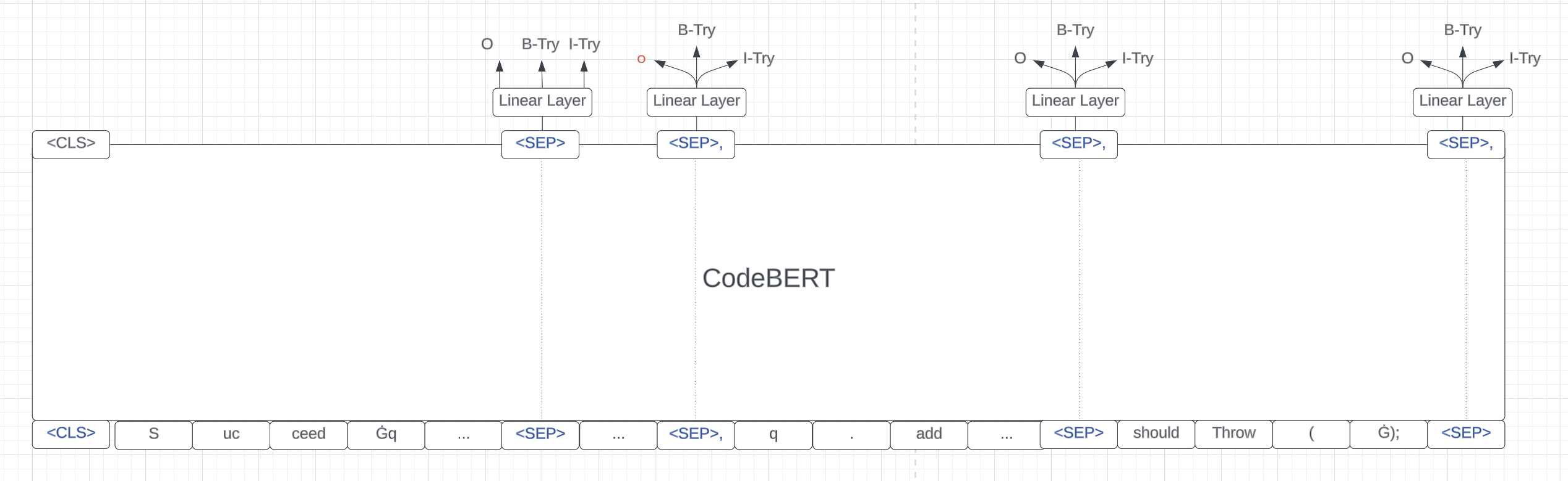
Task2

Slide 8
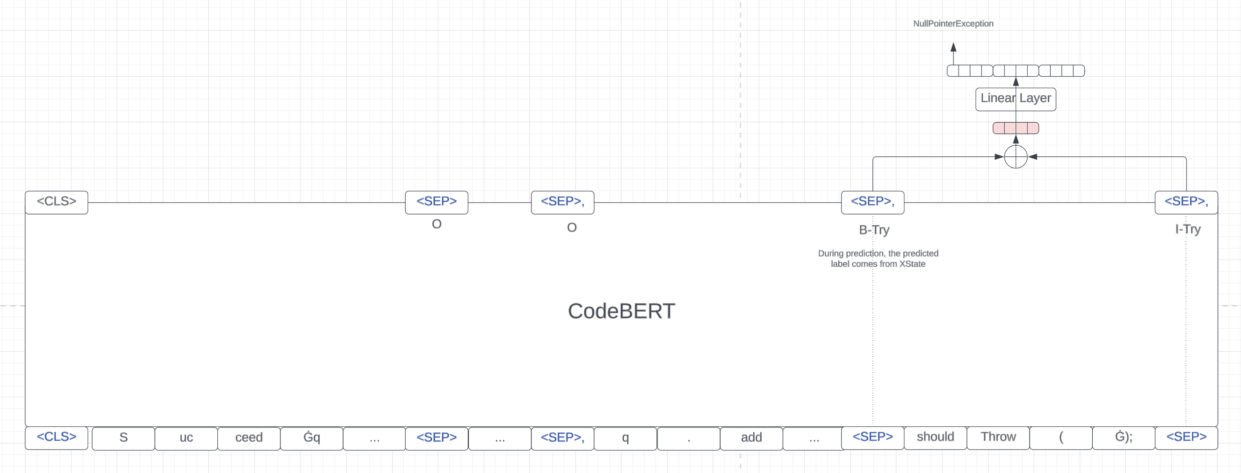
Task3

