Slide 1
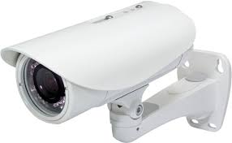





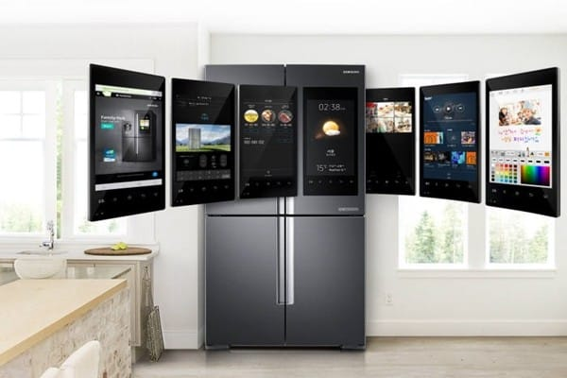

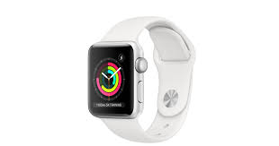
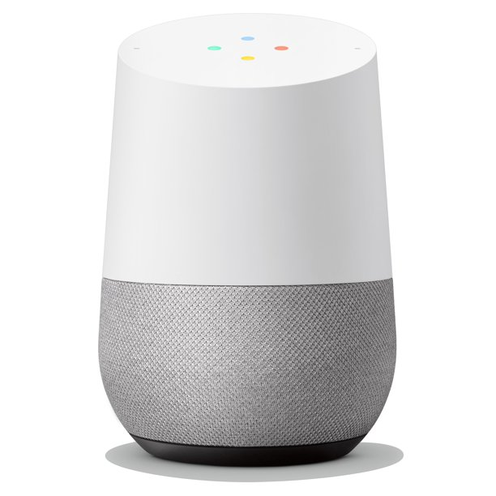
camera
Data acquisition
Forensic Analysis Tool
Motion detector
Data acquisition
Forensic Analysis Tool
Network hub
Data acquisition
Forensic Analysis Tool
Wireless speaker
Data acquisition
Forensic Analysis Tool
Forensic
Analyst
Smart Fridge
Data acquisition
Forensic Analysis Tool
Smart phone
Data acquisition
Forensic Analysis Tool
Smart watch
Data acquisition
Forensic Analysis Tool
Google Hub
Data acquisition
Forensic Analysis Tool

Slide 2
camera
Data acquisition
Forensic Analysis Tool
Motion detector
Data acquisition
Forensic Analysis Tool
Network hub
Data acquisition
Forensic Analysis Tool
Wireless speaker
Data acquisition
Forensic Analysis Tool
Forensic
Analyst
Smart Fridge
Data acquisition
Forensic Analysis Tool
Smart phone
Data acquisition
Forensic Analysis Tool
Smart watch
Data acquisition
Forensic Analysis Tool
Google Hub
Data acquisition
Forensic Analysis Tool

Slide 3
camera
Data acquisition
Forensic Analysis Tool
Motion detector
Data acquisition
Forensic Analysis Tool
Network hub
Data acquisition
Forensic Analysis Tool
Wireless speaker
Data acquisition
Forensic Analysis Tool
Forensic
Analyst
Explainable AI-powered
Human-in-the-Loop
IoT Forensic Investigation
System (XAI-HIFI)
Cyber-investigation Analysis Standard Expression (CASE)
Smart Fridge
Data acquisition
Forensic Analysis Tool
Smart phone
Data acquisition
Forensic Analysis Tool
Smart watch
Data acquisition
Forensic Analysis Tool
Forensic
Analyst
Google Hub
Data acquisition
Forensic Analysis Tool

Slide 4
camera
Data acquisition
Video Processing & Recognition
Unified Cyber Ontology (UCO) and CASE Ontology
Motion detector
Data acquisition
Image Processing & Recognition
Network hub
Data acquisition
AI/ML Cyber Object Identification
Data and Pattern Mining
Wireless speaker
Cyber-investigation Analysis Standard Expression (CASE)
Data acquisition
AI/ML Cyber Object (Co)Relation Detection
Smart Fridge
Audio and Signal Processing & Recognition
Forensic Analysis
Data acquisition
AI/ML Cyber Object
De-Duplication
Result Visualization
Smart phone
AI/ML Explanation & Viz Generation
Result XAI Explanation
Data acquisition
Operational and Log Data Processing and Mining
Smart watch
Data Integration Results
XAI-powered HIFI Data Integration
Data acquisition
Google Hub
Texts and Natural Language Processing (NLP)
Data acquisition
Forensic Analyst
Notes:
Unified Cyber Ontology (UCO), which defines classes of cyber objects (e.g., items, tools, people, places), the relations to other cyber objects, provenance of items and actions taken in an action life-cycle. The CASE domain of discourse is focused on “investigation” concentrated on Observable Objects and their associated Facets, whereas the UCO serves as an ontological foundation for modeling the broader cyber-domain, treating observable cyber-items and their associated facets more generally.
Object identification, Relationships, De-Duplications, Explanations.

Slide 5
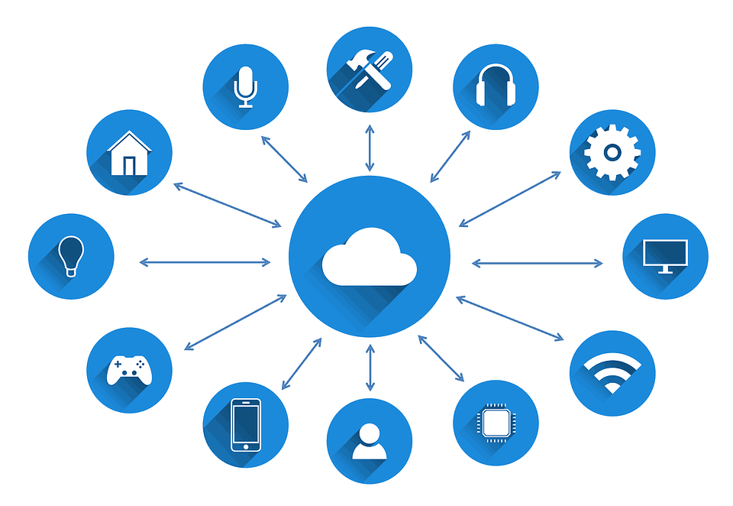
Google Hub
Smart watch
Smart phone
Smart fridge
Wireless speaker
Network hub
Motion detector
Camera
Other IoT
Devices
Data acquisition
Data acquisition
Data acquisition
Data acquisition
Data acquisition
Data acquisition
Data acquisition
Data acquisition
Data acquisition
Forensic Analysis
Forensic Analysis
Forensic Analysis
Forensic Analysis
Forensic Analysis
Forensic Analysis
Forensic Analysis
Forensic Analysis
Forensic Analysis
Forensic
Analyst/
Investigator

Slide 6
Google Hub
Smart watch
Smart phone
Smart fridge
Wireless speaker
Network hub
Motion detector
Camera
Other IoT
Devices
Data acquisition
Data acquisition
Data acquisition
Data acquisition
Data acquisition
Data acquisition
Data acquisition
Data acquisition
Data acquisition
Explainable AI-powered
Human-in-the-Loop
IoT Forensic Investigation
System (XAI-HIFI)
Forensic
Analyst
Cyber-investigation
Analysis Standard
Expression (CASE)
Forensic Analysis
Forensic Analysis
Forensic Analysis
Forensic Analysis
Forensic Analysis
Forensic Analysis
Forensic Analysis
Forensic Analysis
Forensic Analysis
Forensic
Analyst

Slide 7
Google Hub
Smart watch
Smart phone
Smart fridge
Wireless speaker
Network hub
Motion detector
Camera
Other IoT
Devices
Data acquisition
Data acquisition
Data acquisition
Data acquisition
Data acquisition
Data acquisition
Data acquisition
Data acquisition
Data acquisition
Video Processing & Recognition
Image Processing & Recognition
Data and Pattern Mining
Audio and Signal Processing & Recognition
Operational & Log Data Processing & Mining
Texts and Natural Language Processing (NLP)
AI/ML Cyber Object Identification
AI/ML Cyber Object (Co)Relation Detection
AI/ML Cyber Object
De-Duplication
AI/ML Explanation & Viz Generation
Unified Cyber Ontology (UCO) and CASE Ontology
XAI-powered HIFI Data Integration
Forensic
Analyst
Result Visualization
Cyber-investigation Analysis Standard Expression (CASE)
Data Integration Results
Result XAI Explanation
Forensic Analysis
Forensic Analysis
Forensic Analysis

Slide 8
IoT Devices
Data acquisition
Explainable AI-powered
Human-in-the-Loop
IoT Forensic Investigation
System (XAI-HIFI)
Forensic
Analyst
Cyber-investigation
Analysis Standard
Expression (CASE)
Forensic Analysis
Forensic
Analyst

Slide 9
Google Hub
Smart watch
Smart phone
Smart fridge
Wireless speaker
Network hub
Motion detector
Camera
Other IoT
Devices
Data acquisition
Data acquisition
Data acquisition
Data acquisition
Data acquisition
Data acquisition
Data acquisition
Data acquisition
Data acquisition
Video Processing & Recognition
Image Processing & Recognition
Data and Pattern Mining
Audio and Signal Processing & Recognition
Operational & Log Data Processing & Mining
Texts and Natural Language Processing (NLP)
Section 2.1
Section 2.2
AI/ML Cyber Object Identification
AI/ML Cyber Object (Co)Relation Detection
AI/ML Cyber Object
De-Duplication
AI/ML Explanation & Viz Generation
Unified Cyber Ontology (UCO) and CASE Ontology (Section 2.4)
XAI-powered HIFI Data Integration
Forensic
Analyst
(Section 2.3)
Result Visualization
Cyber-investigation Analysis Standard Expression (CASE)
Data Integration Results
Result XAI Explanation
Forensic Analysis
Forensic Analysis
Forensic Analysis

Slide 10

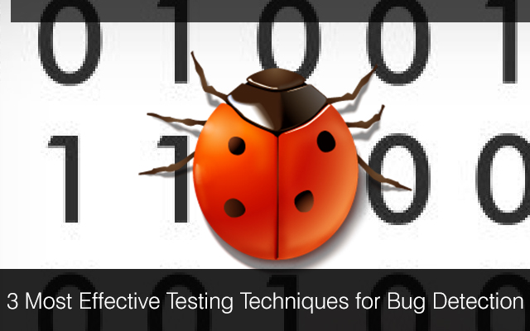
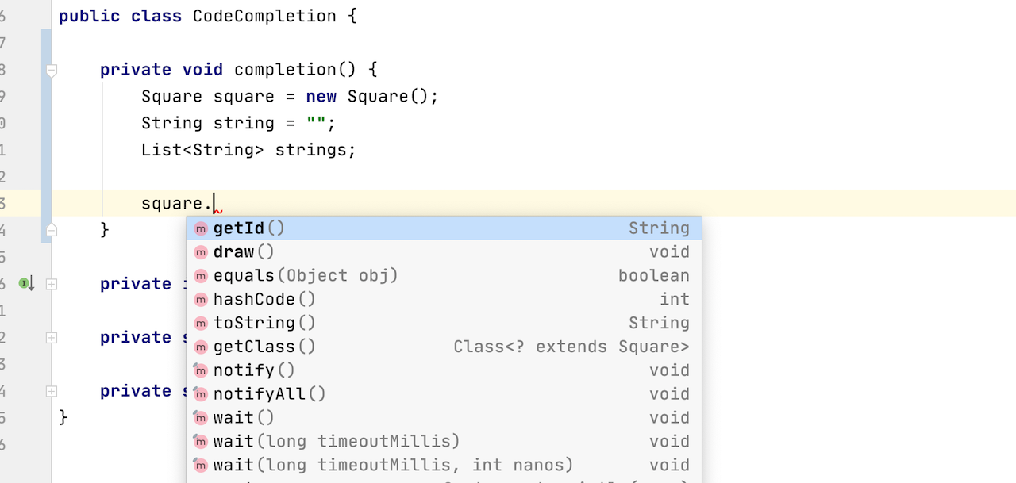
Security Vulnerability Detection
Software Fault Localization
Code
Completion
…
Applications
Lexical Level
Language Identification
Code-text Classification
Code-Token Type Tagging
Syntactic Level
Partial AST Building
Syntactic Type Tagging
Semantic Level
Neural Dependence Analysis
Neural Type Resolution
External Library Identification
Execution Level
Execution Trace Rep Learning
Stack Trace RL
Coverage RL
NeuralPPA: ML-based Partial Program Analysis Infrastructure

Slide 11
Security Vulnerability Detection
Software Fault Localization
Code
Completion
…
Applications
Structure Level
Partial AST Building
Syntactic Type Tagging
Semantic Level
External-Library Identification
Neural Type Inference
Neural Dependence Analysis
Execution Level
Execution-Trace Modeling
Stack-Trace Modeling
Code-Coverage Modeling
NeuralPPA: ML-based Partial Program Analysis Infrastructure

Slide 12

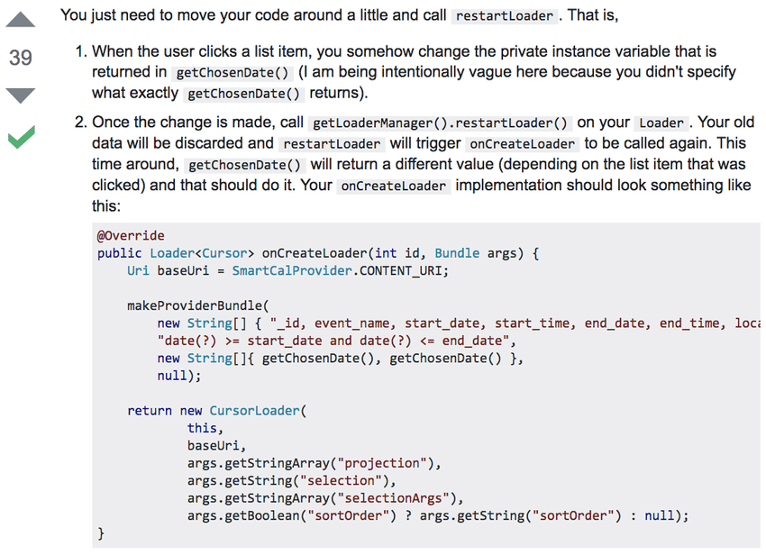

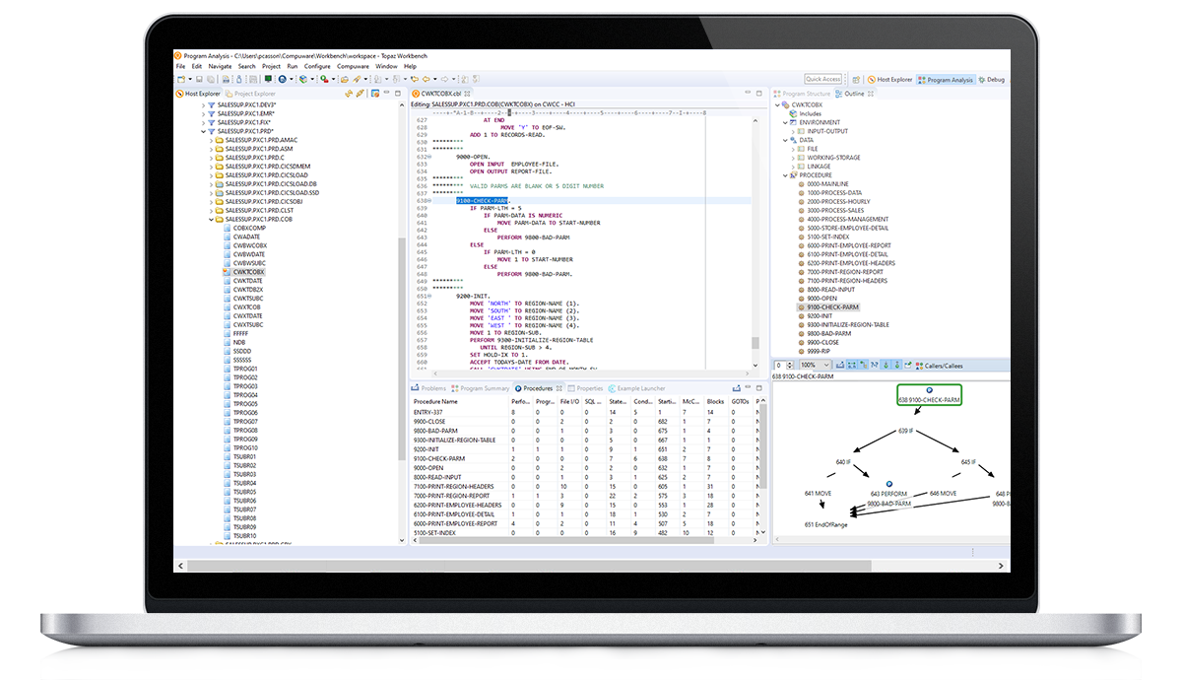
Partial AST Building
Syntactic Type Tagging
Structure Level
Applications
External-Library Identification
Neural Type Inference
Neural Dependence Analysis
Semantic Level
Security Vulnerability Detection
Execution-Trace Modeling
Stack-Trace Modeling
Code-Coverage Modeling
Execution Level
NeuralPPA
ML-based,
Neural Program Analysis Infrastructure
Fault Localization
Empowering PA with AI/ML
Traditional Program Analysis (PA)
Code Completion
Incomplete Code Fragments
Configurable Code Analysis
Complete Code
…

Slide 13
Partial AST Building
Syntactic Type Tagging
Structure Level
Applications
External-Library Identification
Neural Type Inference
Neural Dependence Analysis
Semantic Level
Security Vulnerability Detection
Neural Symbolic Execution
Symbolic Exec. Trace Modeling
Symbolic Execution
NeuralPPA
ML-based,
Neural Program Analysis Infrastructure
Fault Localization
Traditional Program Analysis (PA)
Empowering PA with AI/ML
Code Completion/
Recommendation
Incomplete Code Fragments
Configurable Code Analysis
Complete Code
…

Slide 14
NeuralPA
Applications
ML-based,
Neural Program Analysis Infrastructure
Incomplete Code Fragments
Security Vulnerability Detection
Structure Level
Semantic Level
Execution Level
Partial AST
Syntactic Type
External-Library
Type Inference
Dependence Analysis
Static Slicing
Predictive Execution
Predictive Slicing
Security Vulnerability Assessment

Slide 15



Predictive Program Analysis
Downstream PA Tasks
Corr?
Yes
Approx Code
Data-flow
Analysis
Feedbacks
Data Dependence Graph
Partial
Code
No
1. Var Decls
2. Setup APIs
Refinement
Approximation
Initial
Feedbacks
Exception
Handling
Analysis
Exception Handling
Recommendation
Approx Code
Import
Statement
Recomender
3. Type Info
Import Statements

Slide 16
Predictive Program Analysis
PA Tasks
Corr?
Yes
Approx Code
Feedbacks
Data-flow
Analysis
Partial
Code
No
1. Var Decls
2. Setup APIs
Refinement
Approximation
Exception
Handling
Analysis
Initial
Feedbacks
Approx Code
Import
Statement
Recomender
3. Type Info

Slide 17
Predictive Static Code
Corr?
Yes
Approx Code
Feedbacks
No
1. Var Decls
2. Setup APIs
Refinement
Approximation
Initial
Feedbacks
Partial
Code
Approx Code
3. Type Info

Slide 18
X=8, Y=3, Z=1
Next-Statement Predictor
main()
count = 0
width = 2*Z+Y
while (x >= width):
count += 1
width += Z+Y
myPrint(count)
myPrint(int count)
...
print(count)
Predictive Executor
(PredEx)
Condition expr
Value Evaluator
LLM
While
stmt
...
…
Store
Predicted values
next = s
Predictive
Backward
Slicing (PBS)
Condition Evaluator
True or False
next = s

Slide 19

Static Code Prediction
Feedbacks
c
Approx Code
Var Decls
Setup APIs
Type info
Refinement
Approximation
Static Analysis
Partial
Code
Approx Code
Predictive Execution
c

Slide 20

Static Code Prediction
Approx Code
c
Feedbacks
Var Decls
Setup APIs
Type info
Refinement
Approximation
1
Multi-agent LLMs
Approx Code
Static Analysis
2
Pre-trained,
LLMs
Code
under
editing
Execution Prediction
c
3
Multi-agent LLMs
Predictive Execution
Dynamic,
Runtime Behavior
Analysis
4
Pre-trained, Execution-aware LLMs

Slide 21
Static Code Prediction
Approx Code
c
Feedbacks
Var Decls
Setup APIs
Type info
Refinement
Approximation
1
Multi-agent LLMs
Static
Analysis
Approx Code
2
Pre-trained,
LLMs
(in)complete
code
Predictive Execution
c
3
Multi-agent LLMs
Predictive Execution
Dynamic,
Runtime
Behavior
Analysis
4
Pre-trained, Execution-aware LLMs

Slide 22
ML-based,
Neural Program Analysis Infrastructure
Incomplete Code
Security Vulnerability Detection
Structure Level
Semantic Level
Execution Level
Partial AST
Syntactic Type
External-Library
Type Inference
Dependence Analysis
Static Slicing
Predictive Execution
Predictive Slicing
Security Vulnerability Assessment

