Slide 1
gchar *absolute_filename;
x
(1)
gchar *absolute_filename;
y
(2)
if (g_file_test (filename, G_FILE_TEST_EXISTS) || g_path_is_absolute (filename)) {
x
if (g_path_is_absolute (filename)) {
y
absolute_filename = g_strdup (filename);
x
absolute_filename = g_strdup (filename);
y
gchar *tmpcdir;
x
(3)
gchar *tmpcdir;
y
gchar *absolute_filename;
x, y
x
if (g_file_test (filename, G_FILE_TEST_EXISTS) || g_path_is_absolute (filename)) {
if (g_path_is_absolute (filename)) {
y
absolute_filename = g_strdup (filename);
x, y
(*)
gchar *tmpcdir;
x, y
1 gchar *_rsvg_io_get_file_path (const gchar *filename, const gchar * base_uri) {
2 gchar *absolute_filename;
3- if (g_file_test (filename, G_FILE_TEST_EXISTS) || g_path_is_absolute (filename)) {
4+ if (g_path_is_absolute (filename)) {
5 absolute_filename = g_strdup (filename);
} else {
7 gchar *tmpcdir;
……
9 }

Slide 2
Multi-task Learning on Assessment Classification
Code Change Representation Learning
Assessment Classification
Task 1
Vector for Commit
Confidentiality
Multi-version PDG Generation
…
…
…
Code Change Representation Learning
Code Change
In A Commit
Multi-version PDG
Assessment Classification
Task 7
Vector for Commit
Availability

Slide 3
Fully-connected Layer
v
x,y
Label-GCN
2
δ-PDG
v
v
v
f
v
5
ctx
Fully-connected
Layer
S2
2
2
v
v
v
7
Fully-connected
Layer
f
f
v'
5
3
v
v
3
v
SoftMax
S5
S3
5
3
Fully-connected Layer
M1
v
v'
f
v
v
f
2
4
com
4
v
v
S7
7
S4
v
v
v
7
4
5
ctx
v
v
……
Mn
7
Vulnerability Assessment
for a VAT

Slide 4
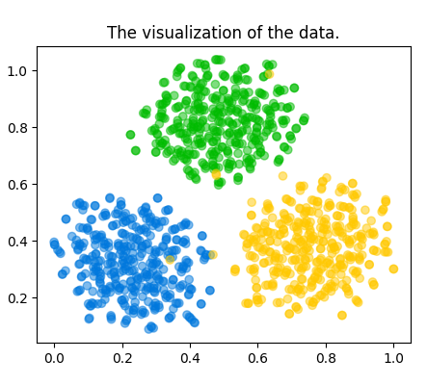
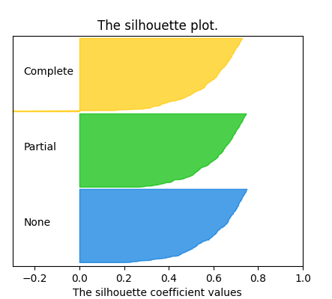
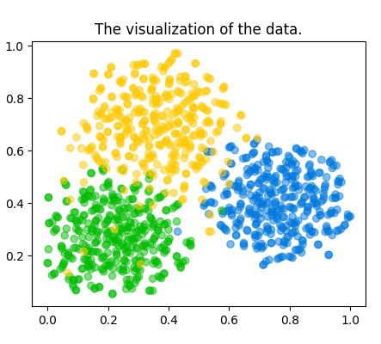
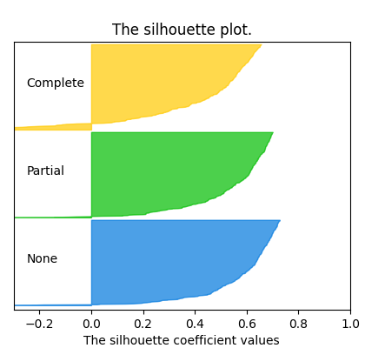
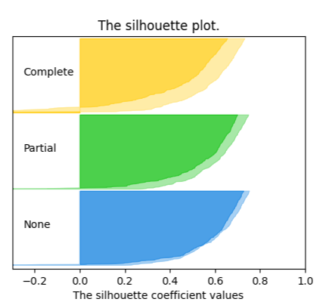
Embeddings produced by CAT
for commits w.r.t. three classes
Silhouette plot for
CAT embeddings
Embeddings from DeepCVA
for commits w.r.t. three classes
Silhouette plot for
DeepCVA embeddings
Silhouette plot for Embeddings
from CAT and DeepCVA
CAT
a.
b.
DeepCVA
c.
d.
Both
e.

Slide 5
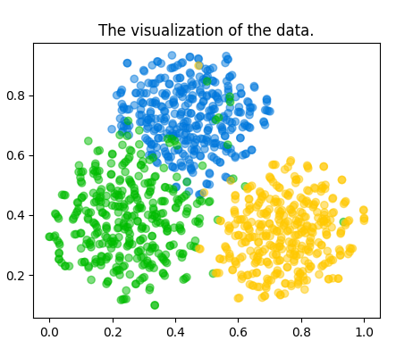
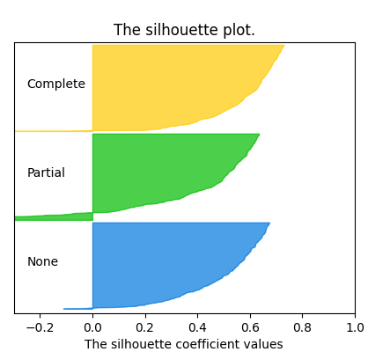
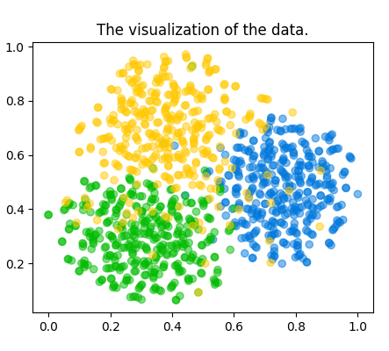
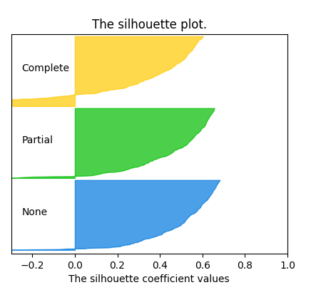
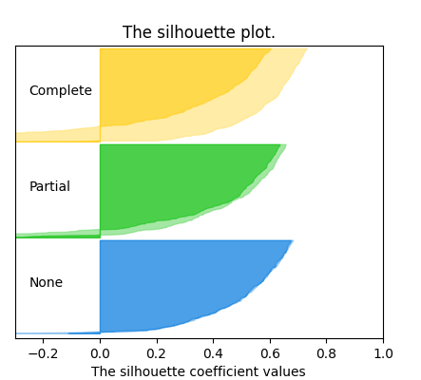
Embeddings produced by CAT
for commits w.r.t. three classes
Silhouette plot for
CAT embeddings
Embeddings from DeepCVA
for commits w.r.t. three classes
Silhouette plot for
DeepCVA embeddings
Silhouette plot for Embeddings
from CAT and DeepCVA
b.
d.
CAT
a.
b.
DeepCVA
c.
Both
e.

Slide 6
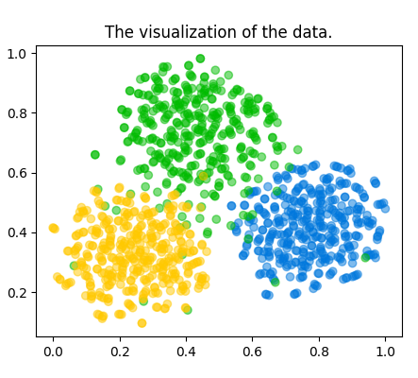
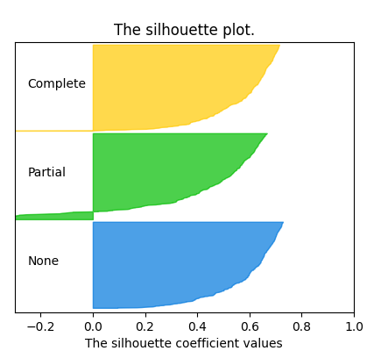
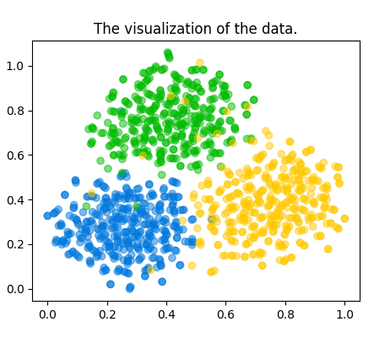

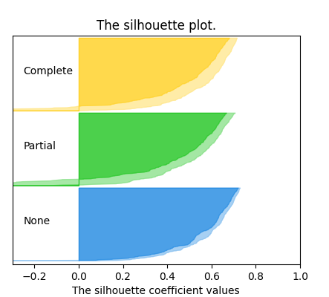
Embeddings produced by CAT
for commits w.r.t. three classes
Silhouette plot for
CAT embeddings
Embeddings from DeepCVA
for commits w.r.t. three classes
Silhouette plot for
DeepCVA embeddings
Silhouette plot for Embeddings
from CAT and DeepCVA
CAT
a.
b.
DeepCVA
c.
d.
Both
e.

Slide 7
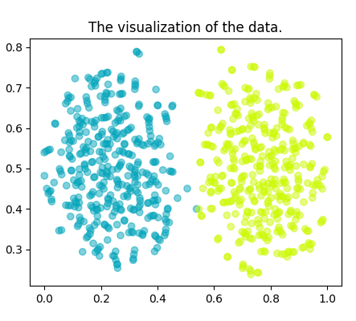
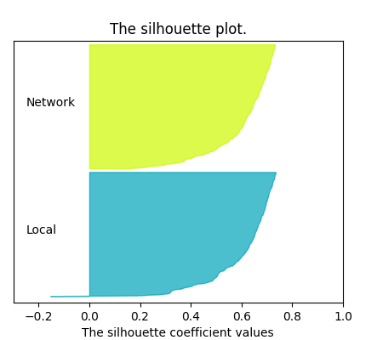
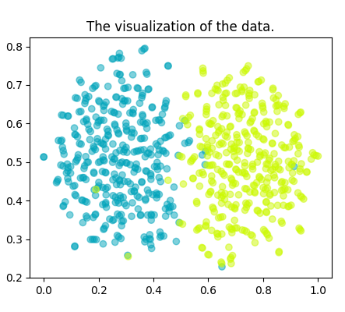
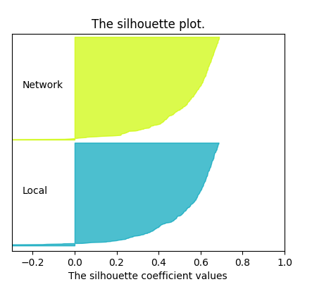
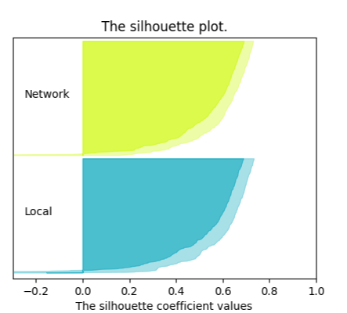
Embeddings produced by CAT
for commits w.r.t. two classes
Silhouette plot for
CAT embeddings
Embeddings from DeepCVA
for commits w.r.t. two classes
Silhouette plot for
DeepCVA embeddings
Silhouette plot for Embeddings
from CAT and DeepCVA
CAT
a.
b.
DeepCVA
c.
d.
Both
e.

Slide 8
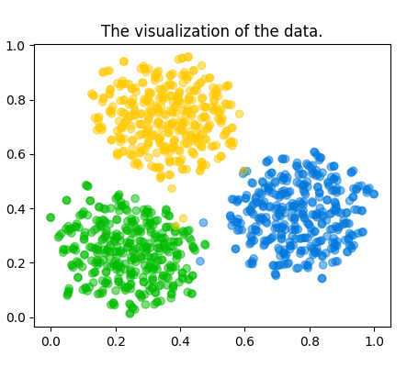
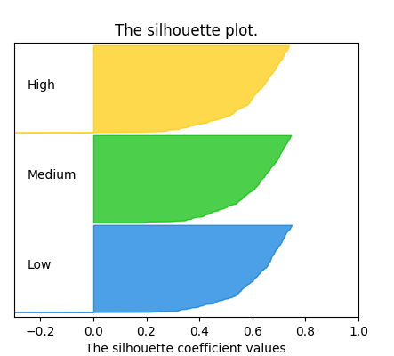
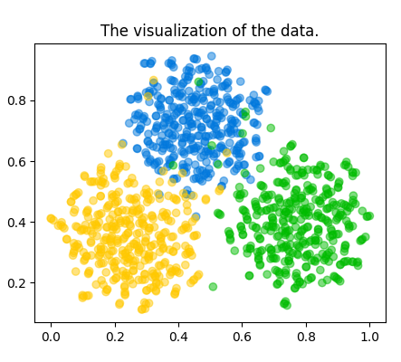
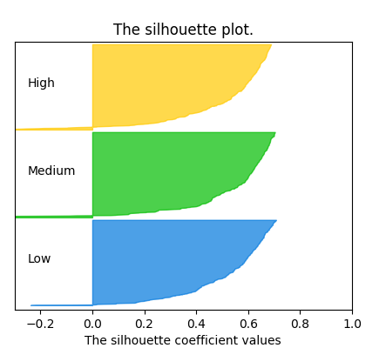

Embeddings produced by CAT
for commits w.r.t. three classes
Silhouette plot for
CAT embeddings
Embeddings from DeepCVA
for commits w.r.t. three classes
Silhouette plot for
DeepCVA embeddings
Silhouette plot for Embeddings
from CAT and DeepCVA
CAT
a.
b.
DeepCVA
c.
d.
Both
e.

Slide 9
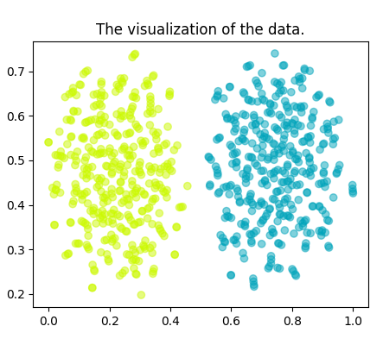
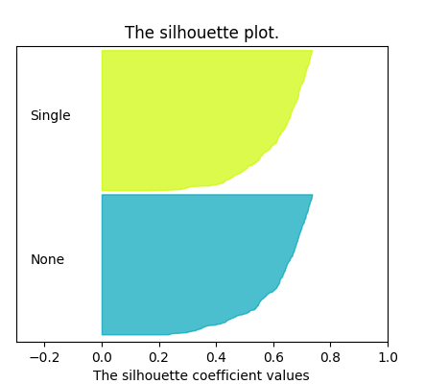
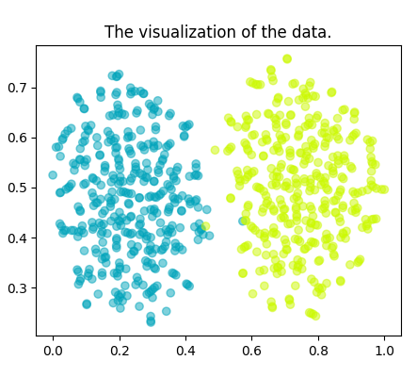


Embeddings produced by CAT
for commits w.r.t. two classes
Silhouette plot for
CAT embeddings
Embeddings from DeepCVA
for commits w.r.t. two classes
Silhouette plot for
DeepCVA embeddings
Silhouette plot for Embeddings
from CAT and DeepCVA
CAT
a.
b.
DeepCVA
c.
d.
Both
e.

Slide 10
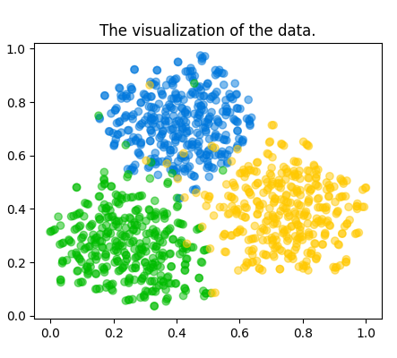

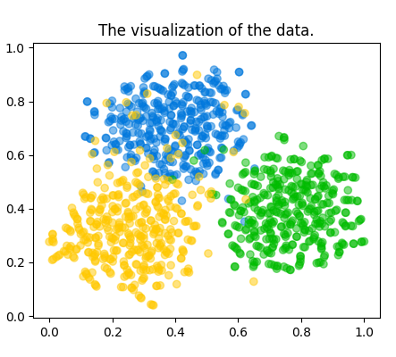


Embeddings produced by CAT
for commits w.r.t. three classes
Silhouette plot for
CAT embeddings
Embeddings from DeepCVA
for commits w.r.t. three classes
Silhouette plot for
DeepCVA embeddings
Silhouette plot for Embeddings
from CAT and DeepCVA
CAT
a.
b.
DeepCVA
c.
d.
Both
e.

Slide 11
CAT
DeepCVA
CAT
DeepCVA
216
149
176
37
29
32

Slide 12
Code Change & contexts
Multi-version PDG Building
Multi-task Learning on Assessment Classification
Code Change Representation Learning
Assessment Classification
Task 1
Vector for Commit
Confidentiality
Multi-
version
PDG
…
…
…
…
Code Change Representation Learning
Assessment Classification
Task 7
Vector for Commit
Availability

Slide 13
Code Change & contexts
Step 1
Multi-version PDG Building
Multi-task Learning on Assessment Classification
Step 3
Step 2
Code Change Representation Learning
Assessment Classification
Task 1
Vector for Commit
Confidentiality
Multi-
version
PDG
…
…
…
…
Code Change Representation Learning
Assessment Classification
Task 7
Vector for Commit
Availability

Slide 14
Code Change & contexts
Step 1
Multi-version PDG Building
Step 3
Multi-task Learning on Assessment Classification
Step 2
Code Change Representation Learning
Assessment Classification
Task 1
Vector for Commit
Confidentiality
Multi-
version
PDG
…
…
…
…
Code Change Representation Learning
Assessment Classification
Task 7
Vector for Commit
Availability

Slide 15
Vulnerability
(Y/N)
Confidentiality
(non, partial, complete)
Availability
(non, partial, complete)
Vul. Detection Classification
Assessment Classification
Assessment Classification
Code
Change
Embeddings
…
Step 2
Code Change Representation Learning
Code Change Representation Learning
Code Change Representation Learning
Task 1
Task 2
Task 8
Multi-task Learning
Multi-version PDG Building
Step 3
Step 1
Code Change

Slide 16
Fully-connected Layer
v
x,y
Label-GCN
2
δ-PDG
v
v
v
f
v
5
ctx
Fully-connected
Layer
S2
2
2
v
v
v
7
Fully-connected
Layer
f
f
v'
5
3
v
v
3
v
SoftMax
S5
S3
5
3
Fully-connected Layer
M1
v
v'
f
v
v
f
2
4
com
4
v
v
S7
7
S4
v
v
v
7
4
5
ctx
v
v
……
Mn
7
v
v
Classifier
ctx
x
4

Slide 17
Fully-connected Layer
v
x,y
Label-GCN
2
δ-PDG
v
v
v
f
v
5
ctx
Fully-connected
Layer
S
2
v
2
2
7
v
v
Fully-connected
Layer
f
f
v'
5
3
v
v
3
v
SoftMax
S
S
5
3
5
3
Fully-connected Layer
M
v
v'
1
f
v
v
f
2
4
com
4
v
v
S
7
S
v
v
v
7
4
7
4
5
ctx
v
v
……
M
n
7
v
v
Classifier
ctx
x
4

