Slide 1
Injection
an injection vulnerability is when an attacker sends malicious data as part of a command or query to an interpreter. If successful, this malicious input will be executed as code, causing the interpreter to execute unintended commands or reveal data which should otherwise be inaccessible.

Slide 2
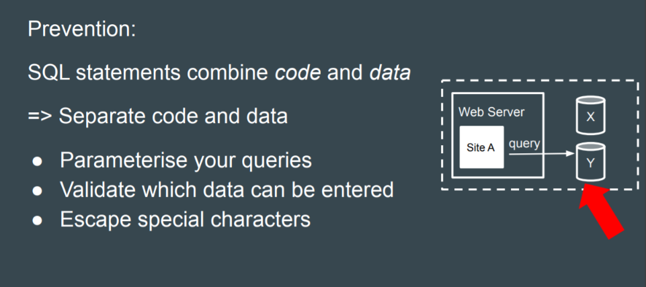
Injection

Slide 3
Broken Authentication and Session Management
Failure to deny automated attacks (brute-forcing, credential stuffing etc).
Allows users to have weak or well-known passwords such as password123.
Exposes username/password information based on error messages/response times.
Implements weak credential recovery and forgotten-password measures. (An interesting article on the weak nature of security questions was published by the NCSC here).
Exposes Session IDs in URLs.
Fails to implement Session ID switching after a user logs in.
Sessions remain active for too long — after a session has exited and remained inactive for a significant period of time.

Slide 4
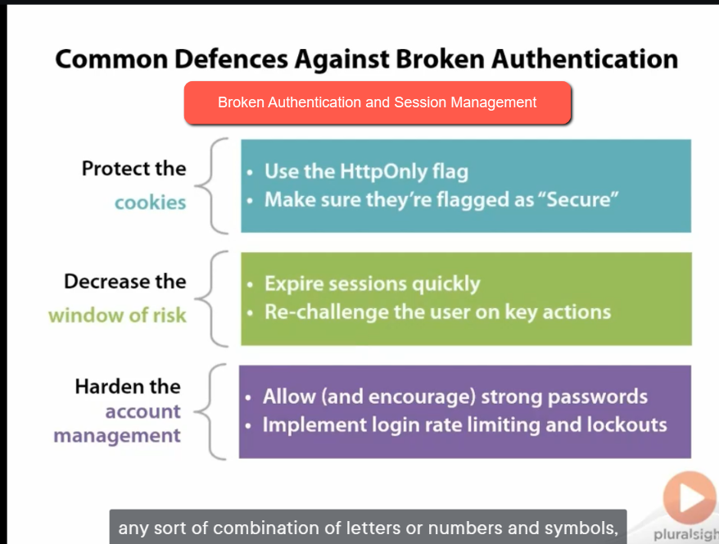

Slide 5
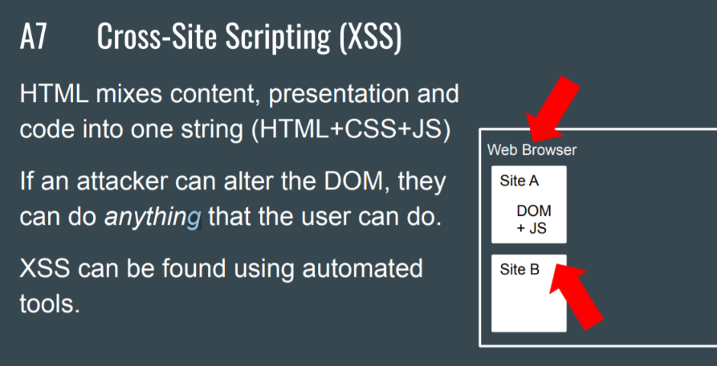
Cross-Site Scripting (XSS)

Slide 6
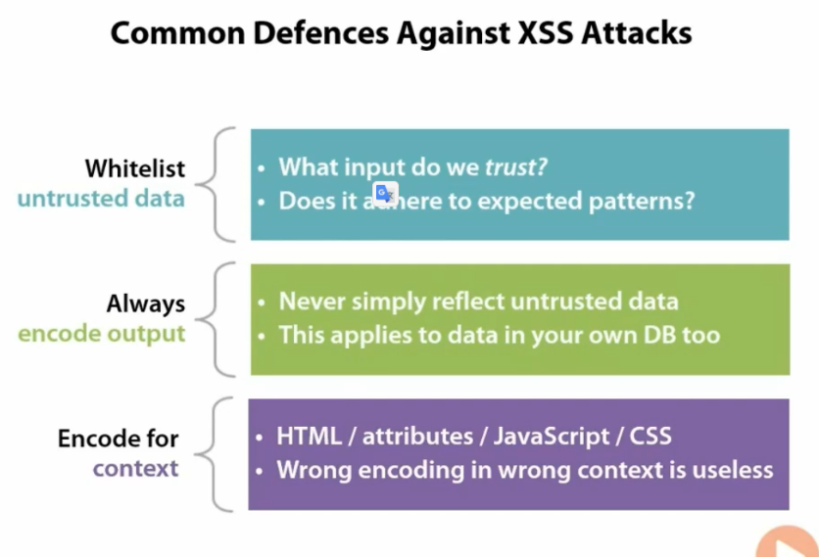
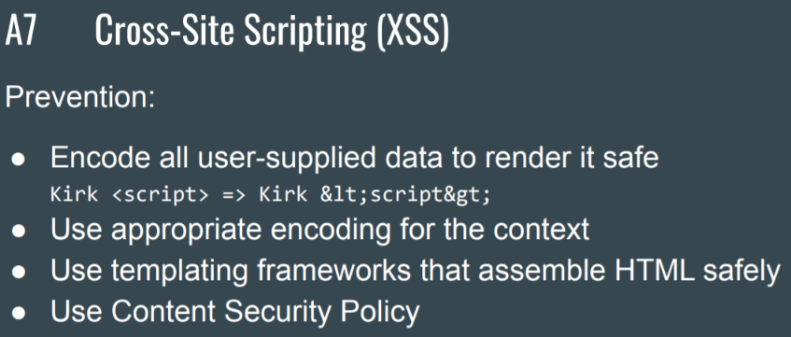
Cross-Site Scripting (XSS)

Slide 7
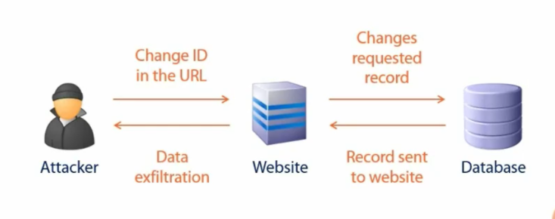
Insecure Direct Object References

Slide 8
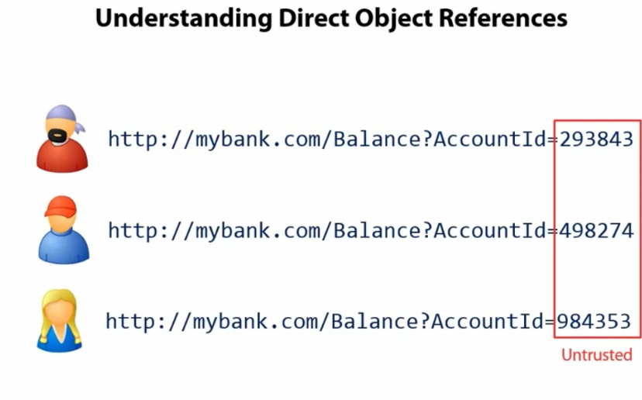

Slide 9
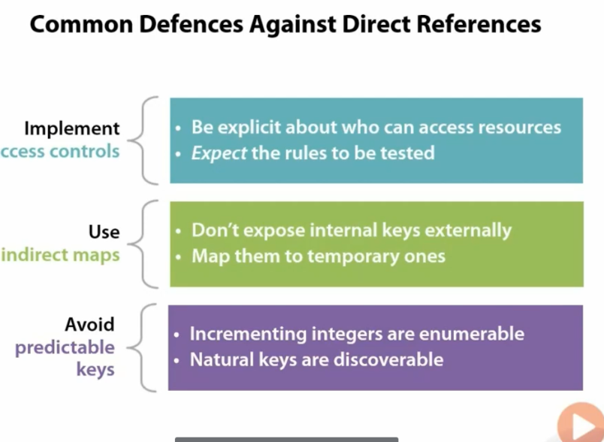

Slide 10
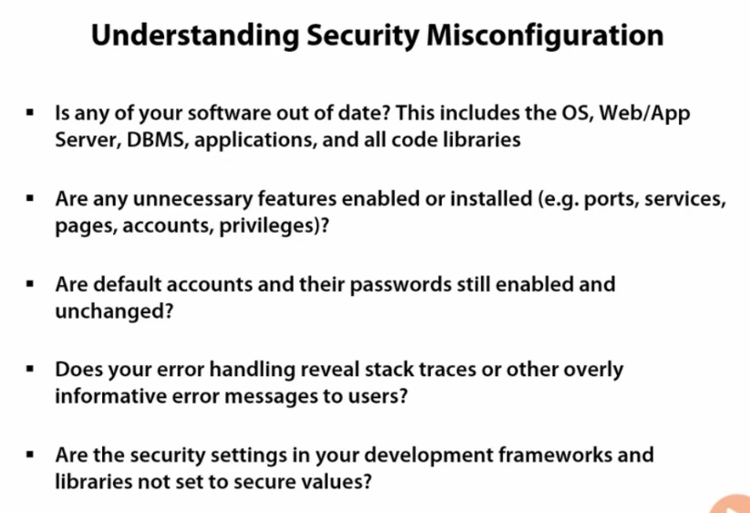
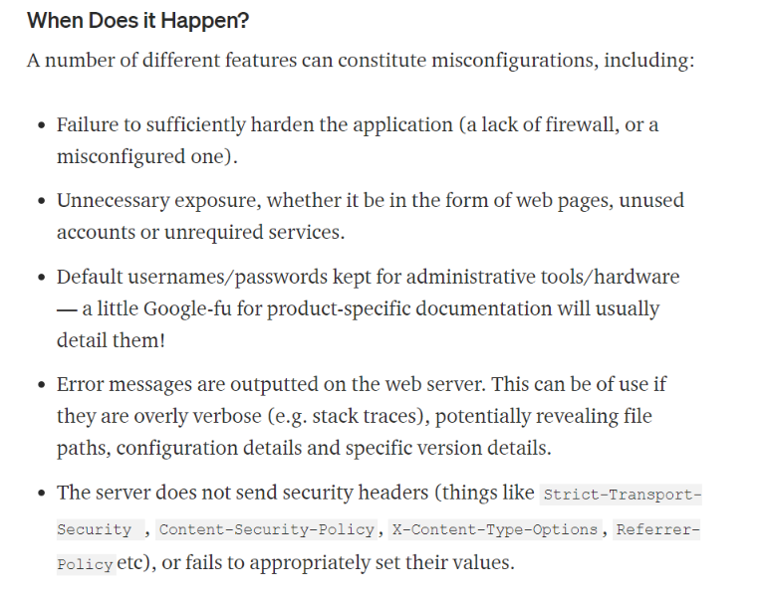
Security Misconfiguration

Slide 11
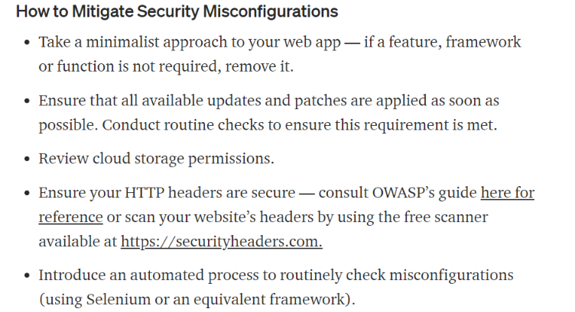
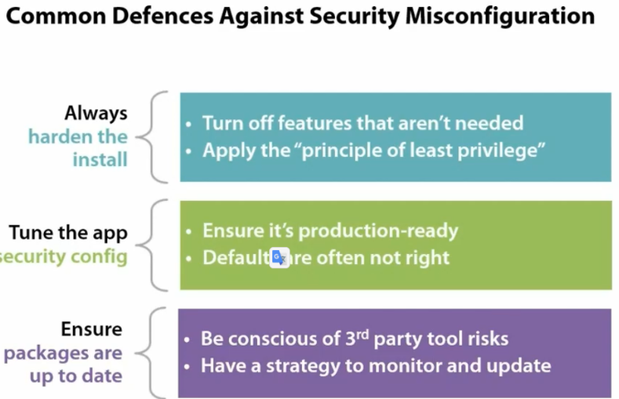
Security Misconfiguration

Slide 12
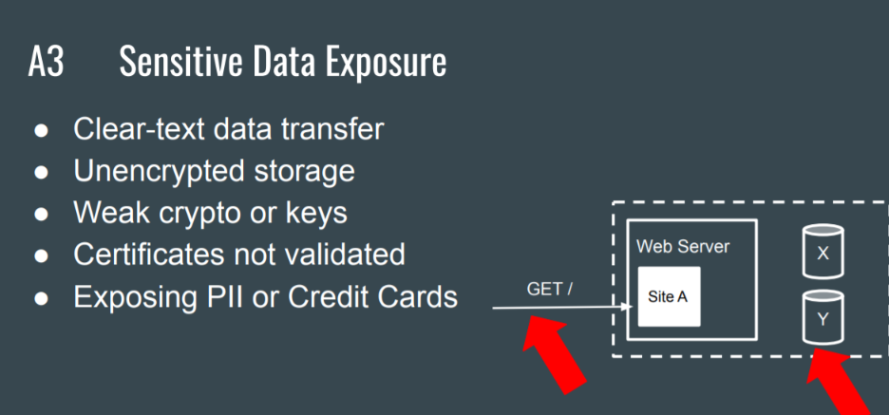
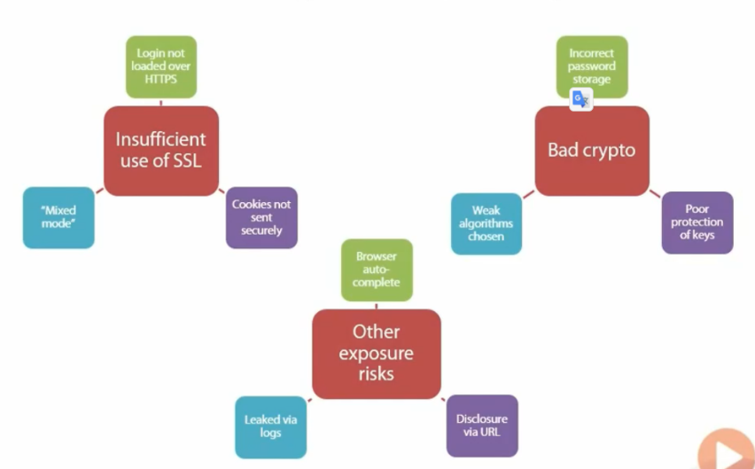
Sensitive Data Exposure

Slide 13
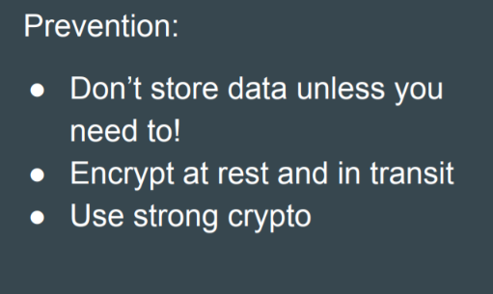
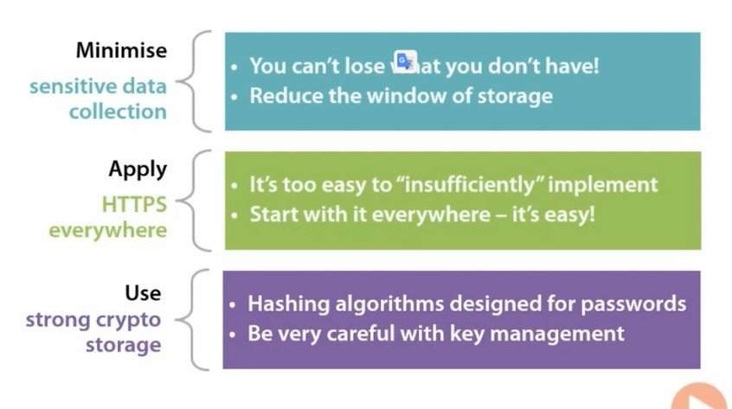
Sensitive Data Exposure

Slide 14
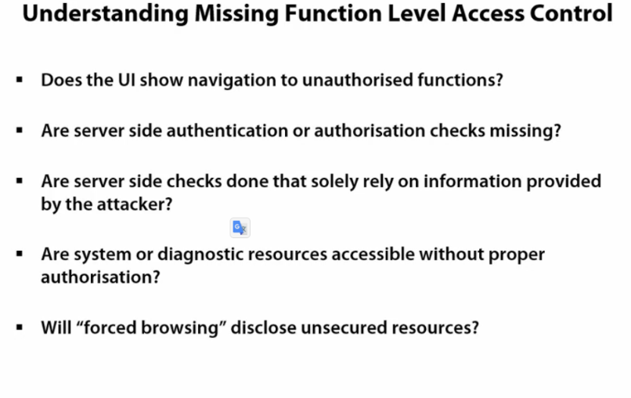
Missing Function Level Access Control

Slide 15
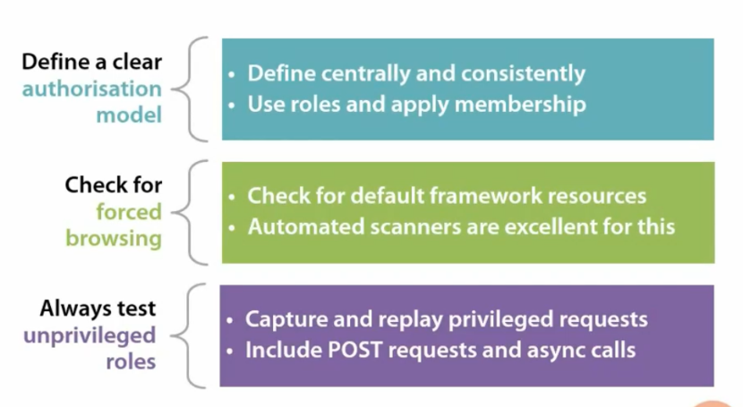
Missing Function Level Access Control

Slide 16
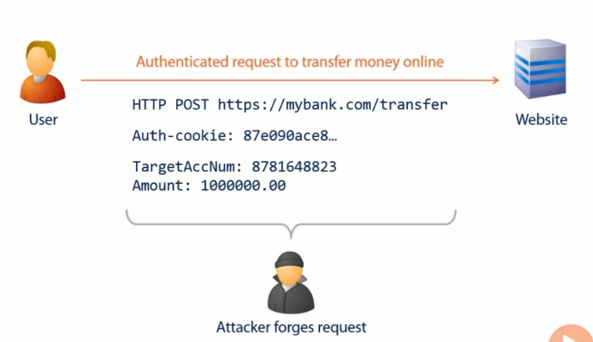
Cross-Site Request Forgery (CSRF)

Slide 17
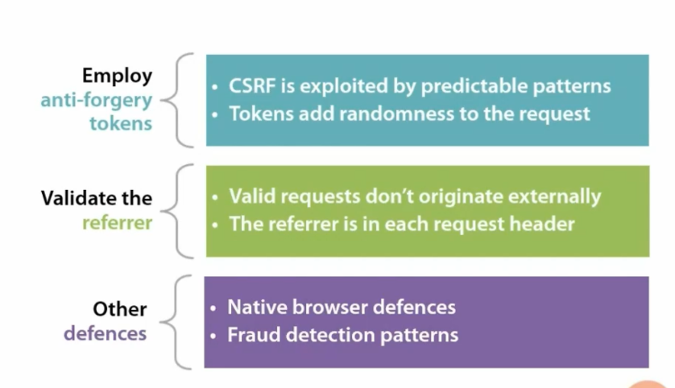
Cross-Site Request Forgery (CSRF)

Slide 18
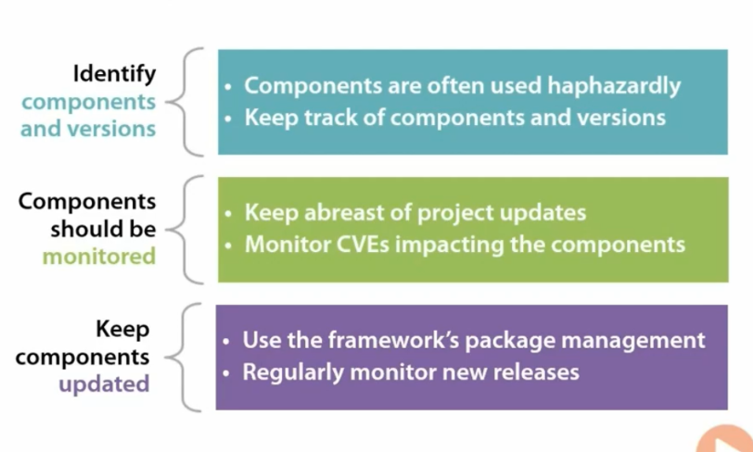
Using Components with Known Vulnerabilities

Slide 19
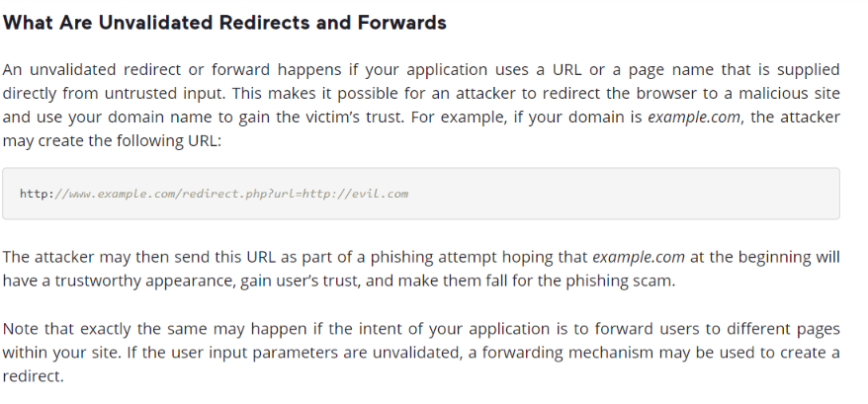
Unvalidated Redirects and Forwards

Slide 20
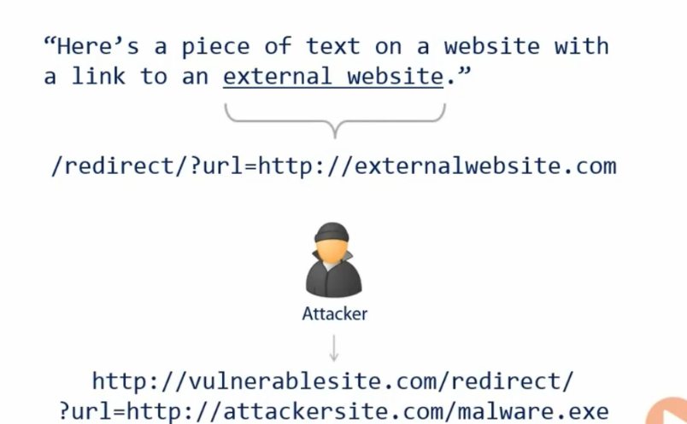
Unvalidated Redirects and Forwards

Slide 21
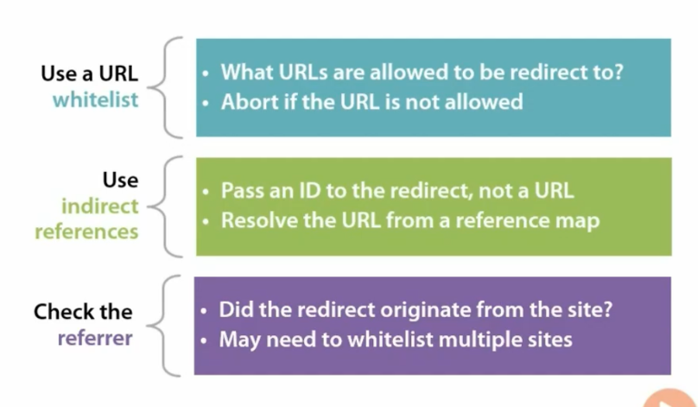
Unvalidated Redirects and Forwards

