Slide 1

Outline
Hanging Product Store
Supervisor: Kiều Trọng Khánh
Team Member:
Nguyễn Huy Hoàng
Quản Tiến Dân
Huỳnh Công Đức

Slide 2
Outline
Outline
Current Situation And Scenario Problem
Our Solution
Demonstration
Future Plan
Questions And Answers

Slide 3


Outline
Current Situation
Notes:
Nguoi VN thich mua hang hieu, tuy nhien chi su dung 1 vai lan roi cat di va tiep tuc mua nhung mon khac → khi san pham du thua qua nhieu, co nhu cau ban bot de tiet kiem hoac mua mon moi, tuy nhien khong biet ban cho ai va ban gia bao nhieu → hinh thanh cua hang nhan ban hang ky gui

Slide 4
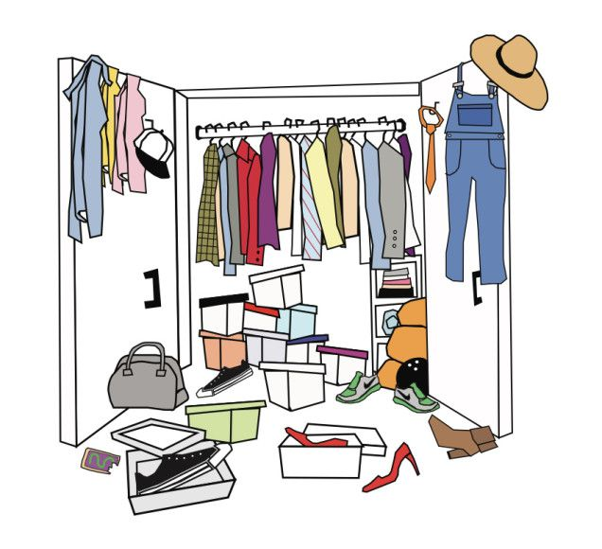

Outline
Current Situation
Save money
How to sell?
Notes:
Hiện Nay, nhu cầu kí gửi -→ hệ thống kí gửi
Đặc điểm chung của những hệ thống kí gưi hiện nay là: Khi khách hàng muốn kí gửi,hộ phải tự ước lượng giá sản phẩm sau đó phải tự tìm cửa hàng nhận sản phẩm của mình, tiếp theo phải mang hàng đến cửa hàng để định giá → quyết định kí gửi hay không?

Slide 5



Outline
Current Situation
Some success consignment’s store
Notes:
Hiện Nay, nhu cầu kí gửi -→ hệ thống kí gửi
Đặc điểm chung của những hệ thống kí gưi hiện nay là: Khi khách hàng muốn kí gửi,hộ phải tự ước lượng giá sản phẩm sau đó phải tự tìm cửa hàng nhận sản phẩm của mình, tiếp theo phải mang hàng đến cửa hàng để định giá → quyết định kí gửi hay không?

Slide 6


Outline
Current Situation
Estimate Price
Consignor
Common consigning process

Slide 7

Outline
Current Situation
Estimate Price
Find Store
Consignor
Common consigning process

Slide 8

Outline
Current Situation
Estimate Price
Find Store
Bring Product To Store
Consignor
Common consigning process

Slide 9

Outline
Current Situation
Estimate Price
Find Store
Bring Product To Store
Consignor
Negotiate And Decision
Common consigning process

Slide 10






Outline
Current Situation
Handwriting
Store Owner
Common consigned product management

Slide 11

Outline
Current Situation
Handwriting
Store Owner
Sell
Common consigned product management

Slide 12
Outline
Current Situation
Handwriting
Store Owner
Return
Sell
Consignor
Common consigned product management

Slide 13
Outline
Scenario Problem
Take too much time to research price
Hard to find store
Consignor
Bring product to store

Slide 14




Outline
Scenario Problem
Difficult in storing and managing.
Take times of hand writing.
Store Owner
Can be damaged or lost.
Notes:
Hiện Nay, nhu cầu kí gửi -→ hệ thống kí gửi
Đặc điểm chung của những hệ thống kí gưi hiện nay là: Khi khách hàng muốn kí gửi,hộ phải tự ước lượng giá sản phẩm sau đó phải tự tìm cửa hàng nhận sản phẩm của mình, tiếp theo phải mang hàng đến cửa hàng để định giá → quyết định kí gửi hay không?

Slide 15

Outline
Our Solution
HPS System
Web Application
Notes:
Xay dung 1 web app cho cac cua hang tham gia kinh doanh hang ky gui, va ho tro nguoi ky gui khong phai di toi cua hang

Slide 16

Outline
Our Solution
Take too much time to research price and store
HPS System
Consign
Consignor
Support Price Suggestion

Slide 17

Outline
Our Solution
Take too much time to research price and store
HPS System
Consign
Search
+
Consignor
Support Price And Store Suggestion

Slide 18
Outline
Our Solution
Take too much time to research price and store
HPS System
Consign
Search
+
Suggest
Consignor
Support Price And Store Suggestion

Slide 19
Outline
Our Solution
HPS System
Consignor
Tracking Product’s Status
Notes:
Hiện Nay, nhu cầu kí gửi -→ hệ thống kí gửi
Đặc điểm chung của những hệ thống kí gưi hiện nay là: Khi khách hàng muốn kí gửi,hộ phải tự ước lượng giá sản phẩm sau đó phải tự tìm cửa hàng nhận sản phẩm của mình, tiếp theo phải mang hàng đến cửa hàng để định giá → quyết định kí gửi hay không?

Slide 20

Outline
Our Solution
HPS System
Tracking
Consignor
Product’s status
Tracking Product’s Status
Notes:
Hiện Nay, nhu cầu kí gửi -→ hệ thống kí gửi
Đặc điểm chung của những hệ thống kí gưi hiện nay là: Khi khách hàng muốn kí gửi,hộ phải tự ước lượng giá sản phẩm sau đó phải tự tìm cửa hàng nhận sản phẩm của mình, tiếp theo phải mang hàng đến cửa hàng để định giá → quyết định kí gửi hay không?

Slide 21
Outline
Our Solution
HPS System
Tracking
Consignor
Product’s status
Notify
Tracking Product’s Status
Notes:
Hiện Nay, nhu cầu kí gửi -→ hệ thống kí gửi
Đặc điểm chung của những hệ thống kí gưi hiện nay là: Khi khách hàng muốn kí gửi,hộ phải tự ước lượng giá sản phẩm sau đó phải tự tìm cửa hàng nhận sản phẩm của mình, tiếp theo phải mang hàng đến cửa hàng để định giá → quyết định kí gửi hay không?

Slide 22


Outline
Our Solution
Bring product to store
Get
Store Owner
Product
Store Owner Comes And Receives Product

Slide 23
Outline
Our Solution
HPS System
Store Owner
Manage Consignment’s Request And Consigned Product

Slide 24


Outline
Our Solution
Manage
Consigned Product
HPS System
Store Owner
Manage
Consignment’s request
Manage Consignment’s Request And Consigned Product

Slide 25
Outline
Our Solution
HPS System
Store Owner
Manage Sale And Online Payment

Slide 26


Outline
Our Solution
Manage
HPS System
Sale
Store Owner
Support
Online Payment
Manage Sale And Online Payment

Slide 27
Outline
Consignment’s State
Consignment’s Status |  | Description
Waiting | “Chờ xử lí” | Consignor requests new consignment
Refused | “Từ chối” | Storeowner refuses consignment’s request
Accepted | “Chấp nhận” | Storeowner accepts consignment’s request
Received | “Đã nhận” | Storeowner receives product
Completed | “Hoàn tất” | Storeowner pays for customer
Request Cancel | “Yêu cầu hủy” | Consignor requests cancel consignment
Canceled | “Đã hủy” | Storeowner accepts request cancel
Expired | “Hết hạn” | Consignment is overdue

Slide 28



Outline
Consignment’s Process
Accept Request
Receive Product
3
2
Consignment Status
Waiting
Accepted
Refused
Received
Completed
Refuse Product
3.1
Request Consignment
Refuse Request
1
Store Owner
2.1
Consignor
4
Sell Product and Return to Consignor

Slide 29
Outline
Consignment’s Process
Accept Request
Receive Product
3
2
Consignment Status
Waiting
Accepted
Refused
Received
Completed
Refuse Product
3.1
Request Consignment
Refuse Request
1
Store Owner
2.1
Consignor
4
Sell Product and Return to Consignor

Slide 30
Outline
Consignment’s Process
Accept Request
Receive Product
3
2
Consignment Status
Waiting
Accepted
Refused
Received
Completed
Refuse Product
3.1
Request Consignment
Refuse Request
1
Store Owner
2.1
Consignor
4
Sell Product and Return to Consignor

Slide 31
Outline
Consignment’s Process
Accept Request
Receive Product
3
2
Consignment Status
Waiting
Accepted
Refused
Received
Completed
Refuse Product
3.1
Request Consignment
Refuse Request
1
Store Owner
2.1
Consignor
4
Sell Product and Return to Consignor

Slide 32
Outline
Consignment’s Process
Accept Request
Receive Product
3
2
Consignment Status
Waiting
Accepted
Refused
Received
Completed
Refuse Product
3.1
Request Consignment
Refuse Request
1
Store Owner
2.1
Consignor
4
Sell Product and Return to Consignor

Slide 33
Outline
Consignment’s Process
Accept Request
Receive Product
3
2
Consignment Status
Waiting
Accepted
Refused
Received
Completed
Refuse Product
3.1
Request Consignment
Refuse Request
1
Store Owner
2.1
Consignor
4
Sell Product and Return to Consignor

Slide 34
Outline
Consignment’s Process
Accept Request
Receive Product
3
2
Consignment Status
Waiting
Accepted
Refused
Received
Completed
Refuse Product
3.1
Request Consignment
Refuse Request
1
Store Owner
2.1
Consignor
4
Sell Product and Return to Consignor

Slide 35
Outline
Consignment’s Process
Accept Request
Receive Product
3
2
Consignment Status
Waiting
Accepted
Refused
Received
Completed
Refuse Product
3.1
Request Consignment
Refuse Request
1
Store Owner
2.1
Consignor
4
Sell Product and Return to Consignor

Slide 36
Outline
Price Suggestion
Consignor
Has
Product name
Product category
Product brand

Slide 37
Outline
Price Suggestion
Consignor
Has
Consign
HPS System
Product name
Product category
Product brand

Slide 38

Outline
Price Suggestion
Consignor
Has
Consign
HPS System
Product name
Product category
Product brand

Slide 39
Outline
Price Suggestion
Consignor
Has
Consign
HPS System
Search
Product name
Product category
Product brand

Slide 40
Outline
Price Suggestion
Step 1: Creating request
HPS System
Consign
Create
Product brand
Product category
Product name
Sample HTTP Request

Slide 41
Outline
Price Suggestion
Step 1: Creating request
HPS System
Consign
Create
Product brand
Product category
Product name
Sample HTTP Request

Slide 42
Outline
Price Suggestion
Step 1: Creating request
HPS System
Consign
Create
Product brand
Product category
Product name
Sample HTTP Request

Slide 43
Outline
Price Suggestion
Step 1: Creating request
HPS System
Consign
Create
Product brand
Product category
Product name
Sample HTTP Request

Slide 44
Outline
Price Suggestion
Step 1: Creating request
+ Send request
HPS System
Search
Response

Slide 45
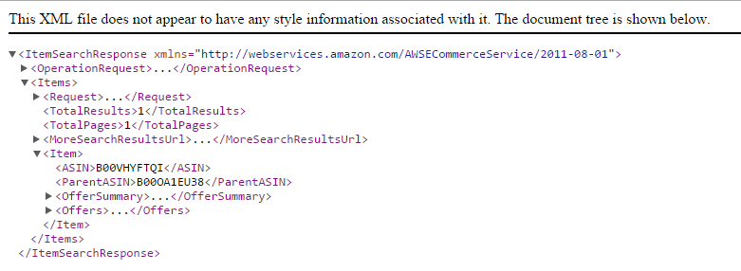
Outline
Price Suggestion
Step 2: Fetch data
Sample XML response

Slide 46
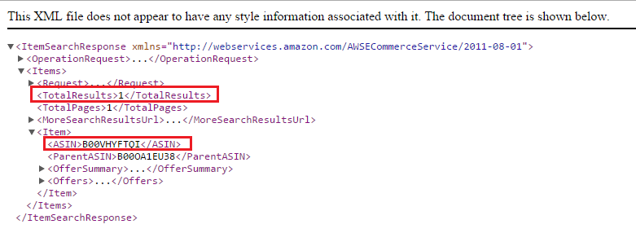
Outline
Price Suggestion
Step 2: Fetch data
List of products
+ Size
+ Product
ASIN
+ ……
Sample XML response

Slide 47
Outline
Price Suggestion
Step 2: Fetch data
List of products
+ Size
+ Product
ASIN
+ ……
Sample XML response

Slide 48

Outline
Price Suggestion
Step 3: Fetch product detail
+ Create get product detail request
HPS System
Create
List of products
+ Size
+ Product
ASIN
+ ……
Sample HTTP Request

Slide 49
Outline
Price Suggestion
Step 3: Fetch product detail
+ Send request
HPS System
Search
Response

Slide 50
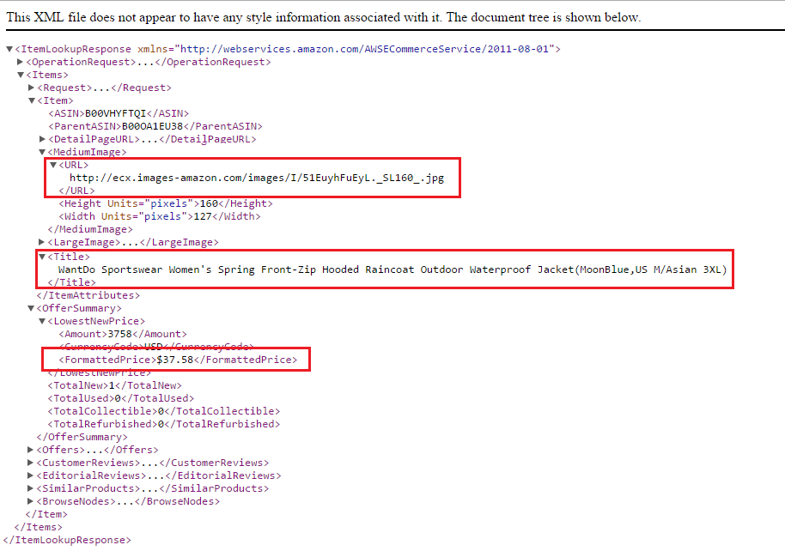
Outline
Price Suggestion
Step 3: Fetch product detail
+ Create get product detail request
Sample XML Response

Slide 51
Outline
Price Suggestion
Step 3: Fetch product detail
+ Create get product detail request
List of products
+ Size
+ Product
ASIN
Name
+ ……
Sample XML Response

Slide 52
Outline
Price Suggestion
Step 3: Fetch product detail
+ Create get product detail request
List of products
+ Size
+ Product
ASIN
Name
Image
+ ……
Sample XML Response

Slide 53
Outline
Price Suggestion
Step 3: Fetch product detail
+ Create get product detail request
List of products
+ Size
+ Product
ASIN
Name
Image
Price
+ ……
Sample XML Response

Slide 54
Outline
Price Suggestion
Return
Consignor
Has
Consign
HPS System
Search
Product name
Product category
Product brand

Slide 55
Outline
Price Suggestion
Return
Return
Consignor
Has
Consign
HPS System
Search
Product name
Product category
Product brand

Slide 56

Outline
Price Suggestion
Demonstration 1:
?
Consign
An
Casio Gshock Ga 1000-2b

Slide 57
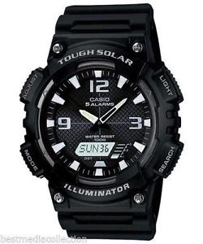
Outline
Price Suggestion
Demonstration 2:
?
Consign
Bình
Serial number: 1111111111111

Slide 58

Outline
Manage Request
Accept Request
Store Owner
Refuse Request
Consignment Status
Waiting
Accepted
Refused

Slide 59
Outline
Manage Request
Accept Request
Store Owner
Refuse Request
Consignment Status
Waiting
Accepted
Refused

Slide 60
Outline
Manage Request
Accept Request
Store Owner
Refuse Request
Consignment Status
Waiting
Accepted
Refused

Slide 61
Outline
Manage Request
Accept Request
Store Owner
Refuse Request
Consignment Status
Waiting
Accepted
Refused

Slide 62
Outline
Manage Request
Accept Request
Store Owner
Refuse Request
Consignment Status
Waiting
Accepted
Refused

Slide 63
Outline
Manage Request
Demonstration 3:
Accept request
Refuse request
Store Owner 1

Slide 64

Outline
Receive Product
Receive Product
Product
Store Owner
Refuse Product
Consignment Status
Accepted
Received
Refused

Slide 65
Outline
Receive Product
Receive Product
Product
Store Owner
Refuse Product
Consignment Status
Accepted
Received
Refused

Slide 66
Outline
Receive Product
Receive Product
Product
Store Owner
Refuse Product
Consignment Status
Accepted
Received
Refused

Slide 67
Outline
Receive Product
Receive Product
Product
Store Owner
Refuse Product
Consignment Status
Accepted
Received
Refused

Slide 68
Outline
Receive Product
Receive Product
Store Owner
Refuse Product
Consignment Status
Accepted
Received
Refused

Slide 69

Outline
Receive Product
Receive Product
Store Owner
Product
Internet Connection

Slide 70


Outline
Receive Product
Receive Product
Store Owner
Product

Slide 71

Outline
Receive Product
Receive Product
Store Owner
Product
Send Data
Server
Internet Connection

Slide 72

Outline
Receive Product
Product
Status | Committed
Store Data
Receive Product
Store Owner
Product
Send Data
Local DB
Server
Internet Connection

Slide 73

Outline
Receive Product
Receive Product
Store Owner
Product
No Internet Connection

Slide 74
Outline
Receive Product
Store Owner
Receive Product
Product
No Internet Connection

Slide 75
Outline
Receive Product
Product
Status | NotCommit
Store Data
Store Owner
Receive Product
Local DB
Product
No Internet Connection

Slide 76
Outline
Receive Product
Product
Status | NotCommit
Store Data
Store Owner
Receive Product
Local DB
Product
Synchronize
No Internet Connection
Server

Slide 77
Outline
Receive Product
Product
Status | Committed
Store Data
Store Owner
Receive Product
Local DB
Product
Synchronize
No Internet Connection
Server

Slide 78
Outline
Receive Product
Demonstration 3:
Store Owner 1

Slide 79






Outline
Manage Product
Manage
Raise Product On Web
Product’s Status
Available
On Web
Ordered
Sold
Completed
Store Owner
Product
Manage
Return
Sell
Consignor
Ordered Product

Slide 80
Outline
Manage Product
Manage
Raise Product On Web
Product’s Status
Available
On Web
Ordered
Sold
Completed
Store Owner
Product
Manage
Return
Sell
Consignor
Ordered Product

Slide 81
Outline
Manage Product
Manage
Raise Product On Web
Product’s Status
Available
On Web
Ordered
Sold
Completed
Store Owner
Product
Manage
Return
Sell
Consignor
Ordered Product

Slide 82
Outline
Manage Product
Manage
Raise Product On Web
Product’s Status
Available
On Web
Ordered
Sold
Completed
Store Owner
Product
Manage
Return
Sell
Consignor
Ordered Product

Slide 83
Outline
Manage Product
Manage
Raise Product On Web
Product’s Status
Available
On Web
Ordered
Sold
Completed
Store Owner
Product
Manage
Return
Sell
Consignor
Ordered Product

Slide 84
Outline
Manage Product
Manage
Raise Product On Web
Product’s Status
Available
On Web
Ordered
Sold
Completed
Store Owner
Product
Manage
Return
Sell
Consignor
Ordered Product

Slide 85
Outline
Raise On Web
Manage
Raise Product On Web
Store Owner
Product
Product’s Status
Available
On Web

Slide 86
Outline
Raise On Web
Manage
Raise Product On Web
Store Owner
Product
Product’s Status
Available
On Web

Slide 87
Outline
Raise On Web
Manage
Raise Product On Web
Store Owner
Product
Product’s Status
Available
On Web

Slide 88
Outline
Raise On Web
DEMO

Slide 89
Outline
Manage Ordered Product
Manage
Sell
Store Owner
Ordered Product
Product’s Status
Ordered
Sold

Slide 90
Outline
Manage Ordered Product
Manage
Sell
Store Owner
Ordered Product
Product’s Status
Ordered
Sold

Slide 91
Outline
Manage Ordered Product
Manage
Sell
Store Owner
Ordered Product
Product’s Status
Ordered
Sold

Slide 92
Outline
Manage Ordered Product
DEMO

Slide 93
Outline
Return Money
Return
Store Owner
Consignor
Product’s Status
Sold
Completed

Slide 94
Outline
Return Money
Return
Store Owner
Consignor
Product’s Status
Sold
Completed

Slide 95
Outline
Return Money
Return
Store Owner
Consignor
Product’s Status
Sold
Completed

Slide 96
Outline
Return Money
DEMO

Slide 97

Outline
Future Plan

Slide 98



Outline
Future Plan
Suggest price from other websites

Slide 99

Outline
Future Plan
Support statistics

Slide 100
Outline
Hanging Product Store
Thank you for your listening !!!

Slide 101
Outline
Hanging Product Store
Q & A

