Slide 1

GA-stacking for Predictive Maintenance (Final Report)
Group 7
Nguyen Tien Dat, 21520707
Lecturer: Nguyen Tat Bao Thien

Slide 2
Content
2
● Introduction
● Why choose that topic
● Related work
● Methodology
● Experiment and result
● Conclusion and future work

Slide 3
Introduction

Slide 4
What is Predictive Maintenance?
4
Definition: PdM uses data analysis to predict and prevent equipment failures before they occur.
Objective: Minimize unplanned downtime, reduce maintenance frequency, and lower costs.
Importance:
Reduces downtime and maintenance costs.
Extends equipment lifespan.
Optimizes maintenance planning and spare parts management.

Slide 5
Challenges & Key Approach
Challenges:
Data: Requires accurate, high-quality sensor data; limited free-access datasets.
Integration: Difficulty embedding PdM into existing systems.
Modeling: Needs historical data and knowledge of failure modes.
Key Approaches:
AI & Machine Learning: Predict Remaining Useful Life (RUL) and detect failures.
Explainable AI (XAI): Ensures transparency and supports decision-making.

Slide 6
Why Choose That Topic

Slide 7
Predictive Maintenance vs. forecasting energy consumption: similarity
7
Time Series Analysis: Both tasks involve analyzing time-series data to uncover trends, patterns, and anomalies.
Prediction Objective: Energy demand forecasting predicts future energy consumption. Predictive maintenance forecasts potential equipment failures.
Modeling Techniques: Similar algorithms (e.g., regression, neural networks, ensemble methods) are commonly used for both tasks.
Real-Time Application: Both rely on real-time data to generate dynamic, updated predictions—whether it's energy demand or maintenance alerts.

Slide 8
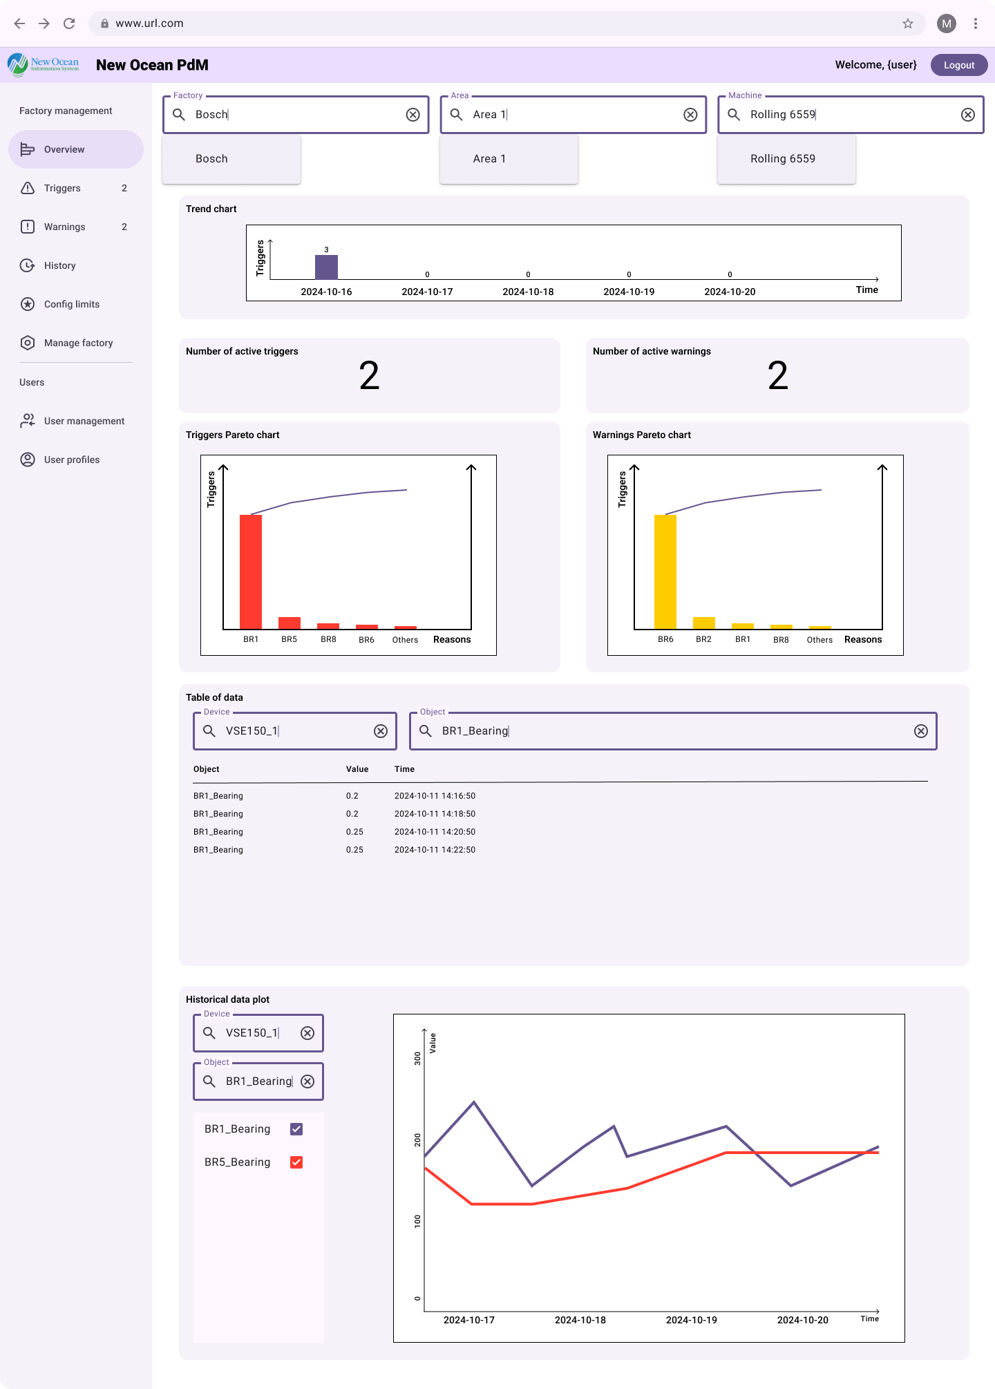
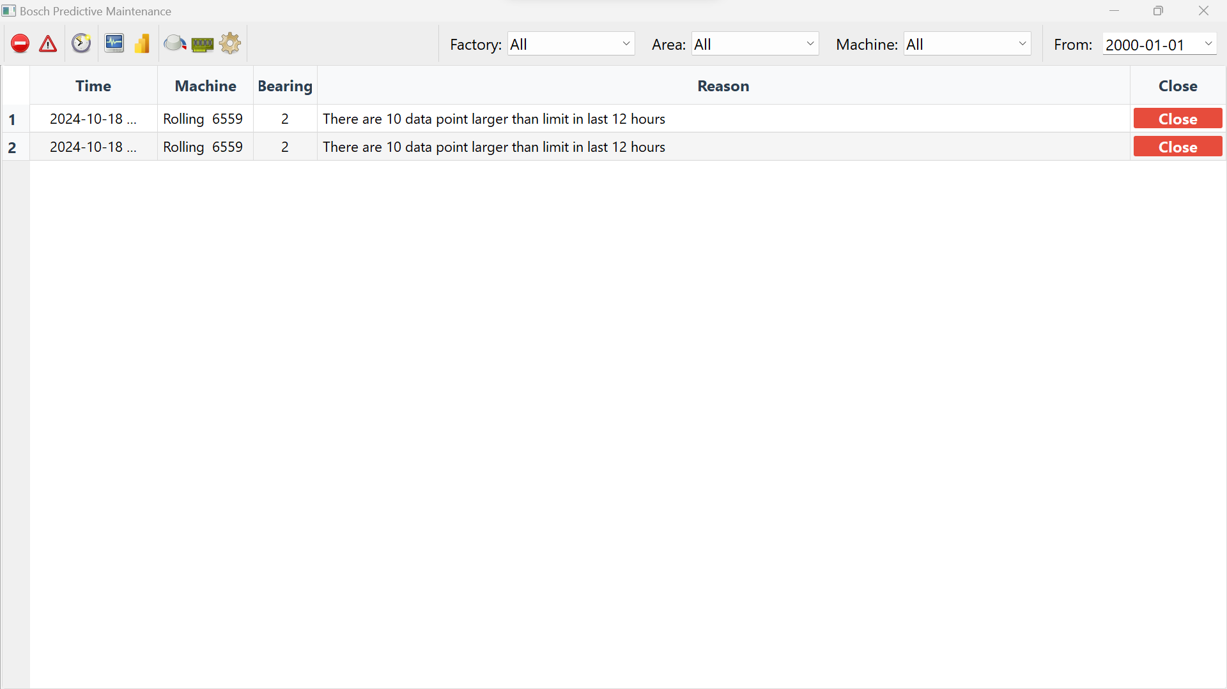
Currently working
8
Ongoing work
Completed work

Slide 9
Related Work

Slide 10
Related Work
"Explainable Artificial Intelligence for Predictive Maintenance Applications" (Matzka, 2020): Focuses on the AI4I Predictive Maintenance dataset and the application of Explainable AI (XAI) for machine failure prediction.
"Federated Learning for Predictive Maintenance and Quality Inspection": Explores federated learning approaches for predictive maintenance, using datasets like AI4I for decentralized model training.
"A GA-Stacking Ensemble Approach for Forecasting Energy Consumption" (Dostmohammadi et al., 2024): Discusses the use of GA-stacking for time-series forecasting, providing a foundation for its adaptation to predictive maintenance tasks.
Additional Work on GitHub: Various practitioners use datasets (e.g., AI4I) for machine failure prediction with models like XGBoost, Random Forest, and others.

Slide 11
Methodology

Slide 12
From Stacking to GA-Stacking
Stacking Ensemble Method:
Combines multiple base models (e.g., Decision Trees, SVMs, Neural Networks) to improve prediction performance.
Meta-model aggregates the predictions from base models for final output.
Genetic Algorithms: Optimizes model combinations by evolving solutions.
GA-Stacking: Uses Genetic Algorithms to optimize the stacking ensemble combinations.

Slide 13
Workflow
Based models
LR
kNN
SVM
Preprocess dataset
Dataset
Training dataset
Tuning
Tuned models
GA
Selected models
Stacking model
Final prediction
DT
RF
ADA
GB
NB
ANN
Meta model

Slide 14
Workflow
Based models
LR
kNN
SVM
Preprocess dataset
Dataset
Training dataset
Tuning
Tuned models
GA
Selected models
Stacking model
Final prediction
DT
RF
ADA
GB
NB
ANN
Meta model

Slide 15
Revisit AI4I 2020 Predictive Maintenance Dataset
Dataset Overview: Synthetic dataset with 10,000 data points (9661 no failure, 339 failure) and 14 variables.
Key Metrics: Precision, Recall, F1-score for evaluating model performance.
Target Label: Predicts machine failure across five failure modes: Tool Wear Failure (TWF), Heat Dissipation Failure (HDF), Power Failure (PWF), Overstrain Failure (OSF), and Random Failures (RNF).

Slide 16
Microsoft Azure PdM Dataset
A real-world, time-series dataset for predictive maintenance tasks. Focuses on real-time sensor data from industrial machines.
Consists of 875381 non-failure data points and 761 failure data points in total of all machines.
Contains time-series data of operational metrics such as temperature, vibration, pressure, etc.
Usage: Evaluates predictive maintenance models in a real-world context, focusing on failure prediction and remaining useful life (RUL) estimation.
Target: No target.

Slide 17
Experiment and Result

Slide 18
AI4I Experiment
Dataset and Preprocessing:
AI4I 2020 Predictive Maintenance Dataset used for experimentation.
Data Preprocessing: Basic preprocessing steps (data cleaning, feature scaling).
Base Models:
Models Used: Logistic Regression, KNN, Decision Tree, Random Forest, AdaBoost, Gradient Boosting Tree, Naïve Bayes, Neural Network.
SVM Removed: Excluded due to extensive fitting time and poor performance observed during preliminary tests.

Slide 19
AI4I Experiment
GA-Stacking Setup:
Meta-Model: Experiment with different meta models.
Genetic Algorithm Parameters:
Crossover probability = 0.2
Mutation probability = 0.2
20 generations, 10 individuals per population.
Fitness Function: Based on F1-score, evaluated on the validation data.

Slide 20
Experiment Correction from Mid-Term
Incorrect Implementation (from mid-term) | Correct Implementation
Data Split: 80-20 split, using the test set for tuning GA-stacking as fitness. No strastification, therefore target distribution was not preserved between training and test sets. | Data Split: 80-10-10 split. Training (80%), Validation (10%), Test (10%). Validation data used for tuning GA-stacking. Strastified split to ensures the target distribution (failure or not) is preserved across all splits (training, validation, and test sets).
Training Setup: Model was trained in the training data, but tuned and tested using the test data (incorrect). | Training Setup: Training data used to train the models, validation data used for tuning, and test data for final evaluation.
Fitness Evaluation: F1-score calculated on test set (incorrect). | Fitness Evaluation: F1-score calculated on validation data (correct).
Impact from incorrect implementation: leading to unrepresentative results and overfitting.

Slide 21
GA-Stacking with Default Params
Experiment Setup:
All models used with default parameters.
GA-Stacking Results:
F1-score for GA-Stacking: The result after applying the correct data split and using default parameters.
Best meta model: Gradient Boosting Tree.
Best Combination of Base Models: [Logistic Regression, AdaBoost, Gradient Boosting, Naive Bayes]

Slide 22
GA-Stacking with Default Params
 | LR | KNN | DT | RF | ADA | GB | NB | ANN | GA-stacking
Precision | 0.70 | 0.57 | 0.63 | 0.87 | 0.53 | 0.72 | 0.32 | 1.00 | 0.79
Recall | 0.21 | 0.11 | 0.70 | 0.59 | 0.47 | 0.62 | 0.18 | 0.09 | 0.76
F1-score | 0.32 | 0.19 | 0.67 | 0.70 | 0.5 | 0.67 | 0.23 | 0.16 | 0.78

Slide 23
GA-Stacking with Tuned Params
Experiment Setup:
Defined a fit limit:
Models exceeding this limit use Random Search.
Otherwise, Grid Search is applied.
Fit Limit: 100.
For SMOTE: Applied SMOTE to oversample failure cases in the training set only, ensuring the test and validation sets remain untouched.
GA-Stacking Results:
F1-score for GA-Stacking: The result after applying the correct data split and using tuned parameters.
Best meta model: Random Forest (Without SMOTE), Logistic Regression (With SMOTE)
Best Combination of Base Models:
Without SMOTE: [Logistic Regression, Random Forest, Gradient Boosting Tree]
With SMOTE: [Logistic Regression, Random Forest, AdaBoost, Neural Network]

Slide 24
GA-Stacking with Tuned Params
Without SMOTE:
 | LR | KNN | DT | RF | ADA | GB | NB | ANN | GA-stacking
Precision | 0.78 | 0.47 | 0.69 | 0.80 | 0.55 | 0.77 | 0.32 | 1.00 | 0.83
Recall | 0.21 | 0.21 | 0.71 | 0.59 | 0.50 | 0.71 | 0.18 | 0.24 | 0.71
F1-score | 0.33 | 0.29 | 0.70 | 0.68 | 0.52 | 0.74 | 0.23 | 0.38 | 0.76
With SMOTE:
 | LR | KNN | DT | RF | ADA | GB | NB | ANN | GA-stacking
Precision | 0.35 | 0.24 | 0.40 | 0.59 | 0.36 | 0.59 | 0.24 | 0.91 | 0.62
Recall | 0.65 | 0.50 | 0.68 | 0.65 | 0.59 | 0.76 | 0.32 | 0.29 | 0.68
F1-score | 0.46 | 0.32 | 0.50 | 0.62 | 0.45 | 0.67 | 0.28 | 0.44 | 0.65

Slide 25
Comparing with Federated Learning
F30-score | Federated Learning
 | #client | Central | Local | FedAvg | FedProx | qFedAvg | FedYogi
 | 5 | 0.95 | 0.89 | 0.93 | 0.93 | 0.48 | 0.67
 | 10 | 0.95 | 0.80 | 0.77 | 0.78 | 0.39 | 0.39
 | 15 | 0.95 | 0.78 | 0.75 | 0.75 | 0.42 | 0.42
F30-score | GA-stacking
 | Default | Tuned | Tuned + SMOTE
F30-score | 0.76 | 0.71 | 0.68

Slide 26
Microsoft Azure PdM Dataset Experiment
Dataset and Preprocessing:
Microsoft Azure PdM Dataset used for experimentation.
Data Preprocessing: Time-series processing step. Generating seconds for machine to fail as target.
Choosing machine with model 3 for simplicity.
Metrics: Mean Squared Error.
Base Models:
Models Used: ElasticNet, Decision Tree, Random Forest, KNN, Gradient Boosting Tree, AdaBoost.
Best Combination of Base Models: [Decision Tree, AdaBoost]
Meta Model: ElasticNet.

Slide 27
Microsoft Azure PdM Dataset Experiment
 | ElasticNet | KNN | DT | RF | ADA | GB | GA-stacking
MSE | 0.0111 | 0.0283 | 0.0235 | 0.0202 | 0.0131 | 0.0219 | 0.0111

Slide 28
Conclusion and future work

Slide 29
Conclusion
GA-stacking demonstrates robust performance for predictive maintenance tasks, especially with tuned parameters.
A strong alternative to state-of-the-art methods, offering flexibility and consistent performance across different settings.
Further optimization and testing on diverse datasets can enhance its applicability and performance.

Slide 30
Future work
Further tuning of GA parameters and base models, along with alternate fitness functions, for improved performance.
Investigate the possibility of combining GA-Stacking with other SOTA approach, especially Federated Learning models, for scalable, decentralized systems.
Test GA-Stacking on real-world datasets to assess its generalizability and robustness in real predictive maintenance applications.

Slide 31
References
Mahziyar Dostmohammadi, Mona Zamani Pedram, Siamak Hoseinzadeh, Davide Astiaso Garcia, “A GA-stacking ensemble approach for forecasting energy consumption in a smart household: A comparative study of ensemble methods,” Journal of Environmental Management, Volume 364, 2024, 121264, ISSN 0301-4797, https://doi.org/10.1016/j.jenvman.2024.121264.
A. Torcianti and S. Matzka, "Explainable Artificial Intelligence for Predictive Maintenance Applications using a Local Surrogate Model," 2021 4th International Conference on Artificial Intelligence for Industries (AI4I), Laguna Hills, CA, USA, 2021, pp. 86-88, doi: 10.1109/AI4I51902.2021.00029.
Pruckovskaja, Viktorija, Axel Weissenfeld, Clemens Heistracher, Anita Graser, Julia Kafka, Peter Leputsch, Daniel Schall and Jana Kemnitz, “Federated Learning for Predictive Maintenance and Quality Inspection in Industrial Applications,” 2023 Prognostics and Health Management Conference (PHM) (2023): 312-317.

