Slide 1
Basic Java – Part 1
Nhan Nguyen - AxS

Slide 2
Content
Hello Java
Eclipse IDE
Types In Java
Operators
Control Flow Statements
OOP - Basic concepts
Keywords In Java
Exceptions

Slide 3

Hello Java

Slide 4
Hello World
public class HelloWorld {
public static void main(String args[]){
System.out.println(“Hello world!”);
}
}
C:\javaprojects\HelloWorld.java
Build & Run HelloWorld class
C:\Users\Administrator>cd C:\javaprojects
C:\javaprojects>javac HelloWorld.java
C:\javaprojects>java HelloWorld
Hello world!
C:\javaprojects>

Slide 5
Commandline Arguments
public class HelloWorld {
public static void main(String args[]){
System.out.println(“Hello ” + args[0]);
}
}
    Build & Run HelloWorld
C:\javaprojects\HelloWorld.java
C:\javaprojects>javac HelloWorld.java
C:\javaprojects>java HelloWorld Nhan
Hello Nhan
C:\javaprojects>

Slide 6
System.in – Reading An Integer Value
import java.io.BufferedReader;
import java.io.InputStreamReader;
public class HelloWorld{
public static void main(String args[]){
System.out.print("Enter an integer: ");
BufferedReader reader = null;
try{
reader = new BufferedReader(new InputStreamReader(System.in));
String strValue = reader.readLine();
Integer intValue = Integer.valueOf(strValue);
System.out.println(strValue + " + 12 = " + (intValue + 12));
}catch(Exception e){
System.err.println(e.getMessage());
}finally{
if(reader != null){
try{
reader.close();
}catch(Exception ex){
//do nothing
}
}
}
}
}
C:\javaprojects\HelloWorld.java

Slide 7
System.in – Reading An Integer Value
  Build & Run Helloworld
C:\javaprojects>javac HelloWorld.java
C:\javaprojects>java HelloWorld
Enter an integer: 12
12 + 12 = 24
C:\javaprojects>

Slide 8
The Compilation Progress
Editor
Source code
(File.java)
Byte codes
(File.class)
Java compiler
Java Runtime Environment
Runtime System
Just-In-Time Compiler
ByteCode Verifier
Class loader
Java Interpreter
Java Class Libraries
OS & Hardware

Slide 9
Eclipse IDE

Slide 10
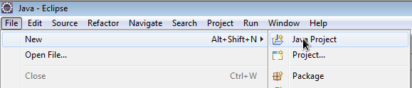
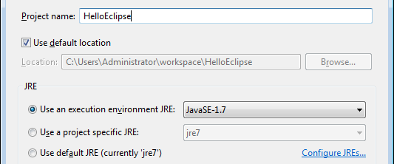
Create New Project

Slide 11
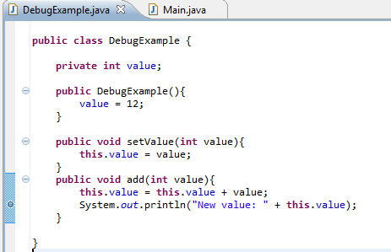
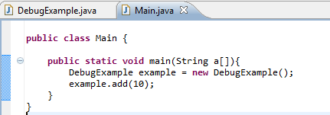
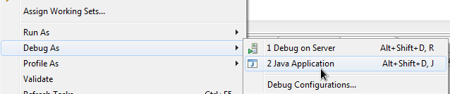
Debug With Eclipse

Slide 12
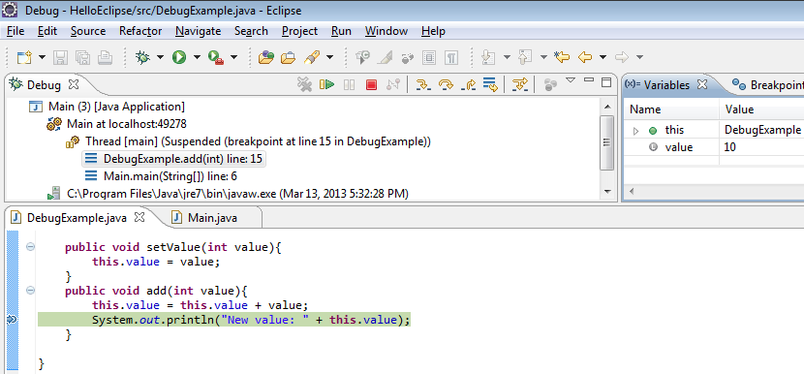
Debug With Eclipse
F6
F8
Ctrl + F2
Lookup the value of all variables
All our breakpoints

Slide 13
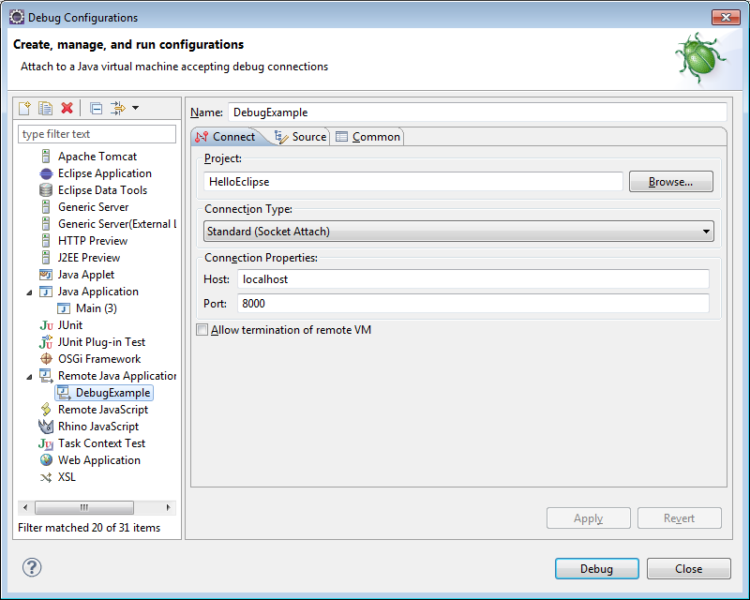
Remote Debug
JAVA_OPTS="$JAVA_OPTS -Xdebug -Xrunjdwp:transport=dt_socket,address=192.168.95.103:8787,server=y,suspend=y"

Slide 14
Types In Java

Slide 15
Primitive Types
Name | Min Value | Max Value
short | -32,768 | 32,767
int | -2,147,483,648 | 2,147,483,647
long | -9,223,372,036,854,775,808 | 9,223,372,036,854,775,807
float | 1.4E–45 | 3.4028235E38
double | 4.9E-324 | 1.7976931348623157E308
byte | -128 | 127
char |  | ?

Slide 16
Reference Types
Defined by user (User, Student, …)
Provided by Java (LinkedList, HashSet, …)
name: test
user
name: test2
user
changeName(user)
User user1 = new User(“test”);
user1
name: test
user
User user2 = user1;
user2

Slide 17
Operators

Slide 18
Operators
The Arithmetic Operators
  +, -, *, /, %
The Unary Operators
  +, -, ++, --, !
int i = 4;
System.out.println(++i == 5);
System.out.println(i);
System.out.println(i++ == 6);
true
5
false

Slide 19
Operators
Equality & Relational Operators
  ==, !=, <, <=, >, >=
Conditional Operators
  &&, ||
Type Comparison Operators
  instanceof
if(object instanceof Student){
Student s = (Student)object;
…
}

Slide 20
Operators
Bitwise and Bit Shift Operators
  ~ operator
  ^, &, | operators
  >> and << operators
~00001111 → 11110000
Bit 1 | Bit 2 | OR(|) | AND(&) | XOR(^)
0 | 0 | 0 | 0 | 0
0 | 1 | 1 | 0 | 1
1 | 0 | 1 | 0 | 1
1 | 1 | 1 | 1 | 0
170 << 10
00000000000000000000000010101010 → 00000000000000101010100000000000
170 >> 10
00000000000000000000000010101010 → 00000000000000000000000000000000
170 << 26
00000000000000000000000010101010 → 10101000000000000000000000000000
170 >> 4
00000000000000000000000010101010 → 00000000000000000000000000001010

Slide 21
Control Flow Statements
If – Then statement
If – Then –Else statement
if(condition){
…
}
if(condition){
…
}else{
…
}
if(condition){
…
}else if{
…
}else{
…
}

Slide 22
Control Flow Statements
Swith … Case statement
  java< 1.7: int, char, enum.
  java >=1.7: int, char, enum, String.
switch(variable)
case value1:
…
break;
case value2:
…
break;
…
default:
…
break;
}

Slide 23
Control Flow Statements
For statement
  Normal Syntax
  For Forever
  For in array, list and set:
for(initialization; termination; increment){
…
}
for(; ; ){
…
}
for(Type value : values){
…
}

Slide 24
Control Flow Statements
While & Do … While statements
while(condition){
…
}
do{
…
}while(condition);

Slide 25
Control Flow Statements
Break statement
Continue statement
for(int i = 0; i < 12; i++){
…
if(condition){
break; //Exit for
}
…
}
for(int i = 0; i < 12; i++){
…
if(condition){
continue;//Skip this loop
}
…
}

Slide 26
Q&A

Slide 27
OOP – Basic Concepts

Slide 28
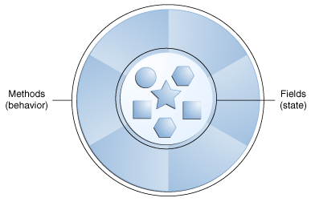
Class, Object, Method And Field
Object, Method & Field
  Real Object
    Example: a dog
    State: name, color, hungry
    Behavior: biting, fetching, barking
  Software Object
    Stores its state in fields
    Exposes its behavior through methods

Slide 29
Class, Object, Method And Field
Class
  Many individual objects of the same kind
  Your bicycle is an instance of the class of bicycles
  A class is the blueprint from which individual objects are created
speed = 10
gear = 2
Bicycle
speed
gear
speed = 20
gear = 5

Slide 30
Encapsulation
Methods operate on an internal state of the object
The primary mechanism for object-to-object communication
Hiding the internal state
Requiring all interaction to be performed through object's methods
Interaction
method
field

Slide 31
Interface
In real world, it is a tool which used to interact with an object
Example: The buttons in front of your television
In software world, it is a group of the methods with empty bodies.
Detail of methods will be implemented at some places…
Interface
interface Calculator{
public int add(int a, int b);
}
class CalculatorImpl implements Calculator{
public int add(int a, int b){
return a + b;
}
}

Slide 32
Interface
Defines a protocol of communication between two objects
A class implements an interface must implement all methods of that interface
Use the interface as a type instead of the class
class B{
Calculator calculator = null;
public void setCalculator(Calculator calculator){
this.calculator = calculator;
}
}
→ Solve the integrated problem between programmers in a group

Slide 33
Inheritance
An object usually has a certain amount in common with another object
Need to inherit commonly used state & behavior
Person
Person
name
address
name
address
Inherit
Student
Programmer
Student
Programmer
name
address
class
…
name
address
expert languages
…
class
…
expert languages
…

Slide 34
Overriding & Hiding Methods
Overriding Method
  An instance method in a subclass with the same signatures (name, number of parameters and parameters type), and the same return type.
  An overriding method can also return a subtype of the type returned by the overridden method (covariant return type).
  Allows a class to inherit from a superclass whose behavior is "close enough" and then to modify behavior as needed.
  Use @Override before the overriding method.
Hiding Method
  A class method in a subclass with the same signatures (name, number of parameters and parameters type), and the same return type.

Slide 35
Overriding & Hiding Methods
public class A {
public static void testClassMethod(){
System.out.println("A");
}
public void testInstanceMethod(){
System.out.println("a");
}
}
public class B extends A{
public static void testClassMethod(){
System.out.println("B");
}
public void testInstanceMethod(){
System.out.println("b");
}
}
public class Main {
public static void main(String args[]){
B b = new B();
A a = b;
B.testClassMethod();
b.testInstanceMethod();
A.testClassMethod();
a.testInstanceMethod();
}
}
B
b
A
b

Slide 36
Overloading
Methods within a class can have the same name if they have different parameter lists.
Defining the methods with the same name but have different parameter is called “Overload”.
Can be applied for the constructor methods.
This is the polymorphism in compile time.
public class DataArtist {
...
public void draw(String s) {
...
}
public void draw(int i) {
...
}
public void draw(double f) {
...
}
public void draw(int i, double f) {
...
}
}

Slide 37
Polymorphism
An organism can has many difference forms or stages.
Example: There are many kinds of pizza: Italian Pizza, HCM Pizza, Ha Noi Pizza…
Similar to the real world, in OOP, subclasses of a class can define their own unique behaviors and yet share some of the same functionality of the parent class.
class Pizza{
public void printDescription(){
System.out.println(“Pizza is a popular dish in many countries”);
}
}
class SaiGonPizza extends Pizza{
@Override
public void printDescription(){
super.printDescription();
System.out.println(“SaiGon description”);
}
}
class ItalianPizza extends Pizza{
@Override
public void printDescription(){
super.printDescription();
System.out.println(“Italian description”);
}
}

Slide 38
Abstract Class
An abstract class is a class that is declared abstract.
An abstract method is a method that is declared without an implementation.
An abstract class can provide a partial implementation. It can contain the abstract methods or not or only contains abstract methods.
Abstract class versus interface
  Abstract class can contain fields (non-static and non-final)
  If an abstract class only contains abstract methods, it should be declared as an interface instead.
abstract class A{
void anImplementedMethod(){
…
}
abstract void anAbstractMethod();
}

Slide 39
Package
A namespace that organizes a set of related classes and interfaces
Be easier to lookup, maintain, …
com
com.tma.calculator.api
com.tma.calculator.app
tma
calculator
api
app

Slide 40
Keywords

Slide 41



Public, Protected, Private
Modifier | Class | Package | Subclass | World
public | Y | Y | Y | Y
protected | Y | Y | Y | N
no modifier | Y | Y | N | N
private | Y | N | N | N
B extends A
A
protected
C
public
private

Slide 42
Static & Final
static keyword
  Belongs to the class, not to object
  Initialized once, before the initialization of any instance variables
  Shared by all the instances of the class
  Static method: cannot refer to this & super keyword.
final keyword
  Can not be changed later
  Final class
    Can not be a super-class (a class can not extend from a final class)
  Final method
    Can not be overridden
  Final variable
    Initialized at the definition time or in the constructor of the class

Slide 43
Exception

Slide 44
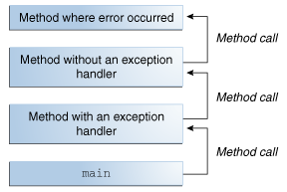
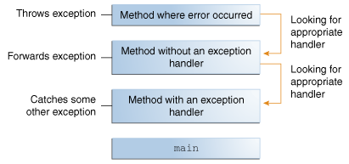
Exception
An event, which occurs during the execution of a program.
Disrupts the normal flow of the program's instructions.
The method where the error is occurred, will create an object and hands it off to the runtime system → is called throwing the exception.
The call stack:
Searching the call stack for the exception handler:

Slide 45
Try Catch Block And Finally
Use this code to catch the exception:
Finally
  The finally block always executes when the try block exits.
  Used to close the resources.
try[
//Do something which can cause exceptions
}catch(ExceptionType ex){
//Catch the exception which has the type ExceptionType
}
InputStream stream = null;
try[
//Init the stream
//Do something which can cause exceptions
}catch(ExceptionType ex){
//Catch the exception which has the type ExceptionType
}finally{
//Close the stream
if(stream != null){
try{
stream.close();
}catch(Exception ex){
//Do nothing
}
}
}

Slide 46
Thank you all!
Q&A

