Slide 1
Coding Guideline
Nhan Nguyen – AxS Dev

Slide 2
Contents
File organization
Indentation
Comments
Declarations
Statements
White space
Naming conventions
Programming practices

Slide 3

File organization

Slide 4
Java Source Files
File organization
Indentation
Comments
Declarations
Statements
White space
Naming conventions
Programming practices
File size: no longer 900 lines
Ordering:
  Beginning comments
  Package and import statements
/*
* Beginning comments
*/
package com.interceptor;
import java.lang.reflect.Method;
import java.util.HashMap;
import java.util.Map;

Slide 5
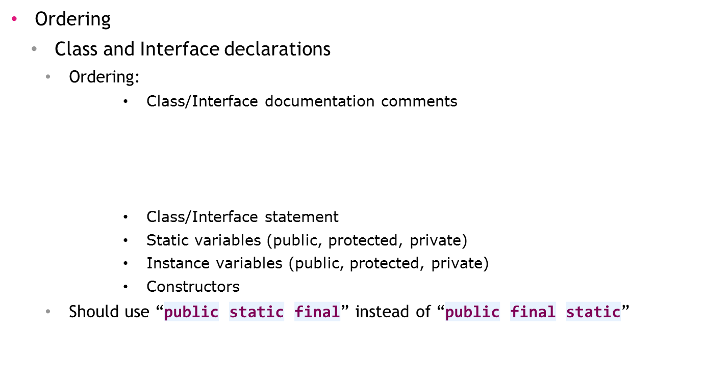
Java Source Files
File organization
Indentation
Comments
Declarations
Statements
White space
Naming conventions
Programming practices
/**
*
* @author Administrator
* @version 1.0
*
*/

Slide 6
Indentation

Slide 7
Indentation & Line length
File organization
Indentation
Comments
Declarations
Statements
White space
Naming conventions
Programming practices
Four spaces should be used as the unit of indentation
Tab must be exactly 4 spaces
The line is not longer than 140 characters.
public void addInterceptor(Interceptor interceptor) {
if(interceptor instanceof BeforeExcution){
beforeInterceptors.put(interceptor.getId(), interceptor);
}else if(interceptor instanceof AfterException){
afterExceptiomInterceptors.put(interceptor.getId(), interceptor);
}else{
afterInterceptors.put(interceptor.getId(), interceptor);
}
}

Slide 8
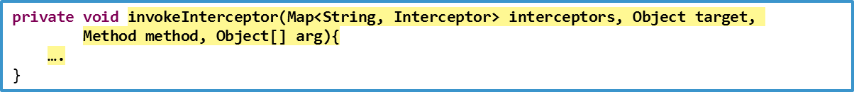
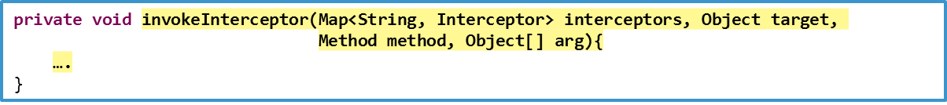
Wrapping Lines
File organization
Indentation
Comments
Declarations
Statements
White space
Naming conventions
Programming practices
Break the line after a comma
Break the line after an operator
Prefer higher level break to lower level break
Align the new line with the beginning of the expression at the same level on the previous line
longName1 = longName2 * (longName3 + longName4 - longName5)
+ 4 * longname6; // PREFER
longName1 = longName2 * (longName3 + longName4 - longName5)
+ 4 * longname6; // PREFER
longName1 = longName2 * (longName3 + longName4
- longName5) + 4 * longname6; // AVOID

Slide 9
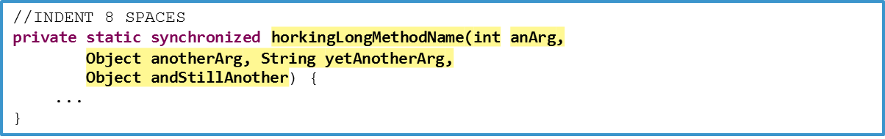
Wrapping Lines
File organization
Indentation
Comments
Declarations
Statements
White space
Naming conventions
Programming practices
If the above rules lead to confusing code or to code that’s squished up against the right margin, just indent 8 spaces instead

Slide 10
Wrapping Lines
File organization
Indentation
Comments
Declarations
Statements
White space
Naming conventions
Programming practices
//DON’T USE THIS INDENTATION
if ((condition1 && condition2)
|| (condition3 && condition4)
||!(condition5 && condition6)) { //BAD WRAPS
doSomethingAboutIt(); //EASY TO MISS
}
//USE THIS INDENTATION INSTEAD
if ((condition1 && condition2)
|| (condition3 && condition4)
||!(condition5 && condition6)) {
doSomethingAboutIt();
}
//OR USE THIS
if ((condition1 && condition2) || (condition3 && condition4)
||!(condition5 && condition6)) {
doSomethingAboutIt();
}

Slide 11
Comments

Slide 12
Comments
File organization
Indentation
Comments
Declarations
Statements
White space
Naming conventions
Programming practices
Block comments
  Block comments are used to provide descriptions of ﬁles, methods, data structures and algorithms
  Should be preceded by a blank line
End of line comments
  Short comments can appear on the line as the code they describe
/*
* Block comments
*/
if (a == 2) {
// special case
return TRUE;
} else {
// works only for odd a
return isprime(a);
}

Slide 13
Declarations

Slide 14
Number Per Line
File organization
Indentation
Comments
Declarations
Statements
White space
Naming conventions
Programming practices
One declaration per line is recommended
int level; // indentation level
int size; // size of table

Slide 15
Placement
File organization
Indentation
Comments
Declarations
Statements
White space
Naming conventions
Programming practices
Put declarations only at the beginning of blocks
void doMethod() {
int int1;
if (condition) {
int int2;
...
}
}

Slide 16
Initialization
File organization
Indentation
Comments
Declarations
Statements
White space
Naming conventions
Programming practices
Try to initialize local variables where they’re declared.
Not to initialize a variable where it’s declared is if the initial value depends on some computation occurring ﬁrst.

Slide 17
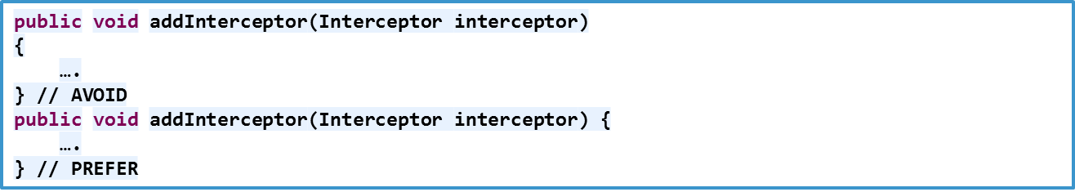
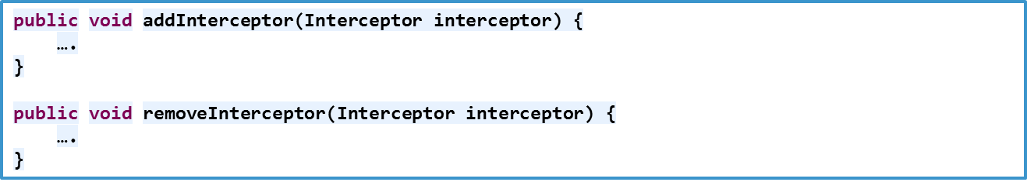
Class and Interface Declarations
File organization
Indentation
Comments
Declarations
Statements
White space
Naming conventions
Programming practices
  No space between a method name and the parenthesis “(“ starting its parameter list
  Open brace “{” appears at the end of the same line as the declaration statement
  Methods are separated by a blank line

Slide 18
Statements

Slide 19
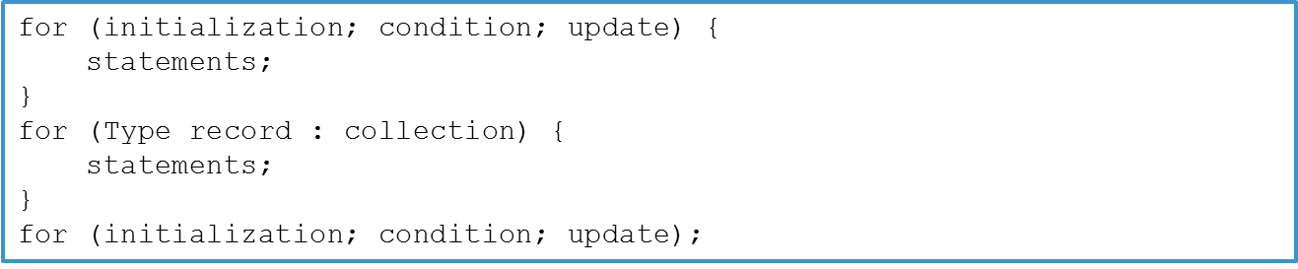
if – else and for Statements
File organization
Indentation
Comments
Declarations
Statements
White space
Naming conventions
Programming practices
Note: if statements always use braces {}
if (condition) {
statements;
} else if (condition) {
statements;
} else {
statements;
}

Slide 20
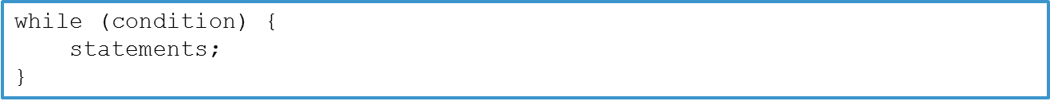

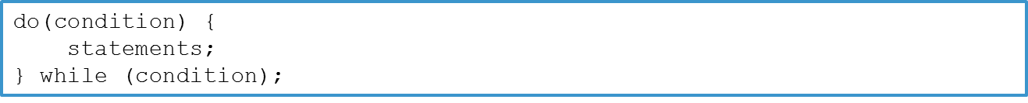
while and do – while Statements
File organization
Indentation
Comments
Declarations
Statements
White space
Naming conventions
Programming practices
while (condition);

Slide 21
switch – case Statement
File organization
Indentation
Comments
Declarations
Statements
White space
Naming conventions
Programming practices
Every switch statement should include a default case
switch (condition) {
case ABC:
statements;
/* falls through */
  case DEF:
  statements;
  break;
  case XYZ:
  statements;
  break;
  default:
  statements;
  break;
}

Slide 22
try – catch Statement
File organization
Indentation
Comments
Declarations
Statements
White space
Naming conventions
Programming practices
Notes:
  Don’t use e.printStackTrace(), let’s use a logger.
  Don’t catch an exception then only throw it
try {
statements;
} catch (ExceptionClass e) {
statements;
m_logger.debug(“error message”);
}
try {
statements;
} catch (ExceptionClass e) {
throw e; //Bad catch
}

Slide 23
White Space

Slide 24
Blank line
File organization
Indentation
Comments
Declarations
Statements
White space
Naming conventions
Programming practices
Two blank lines should always be used in the following circumstances
  Between sections of a source file
  Between class and interface definitions
One blank line should always be used in the following circumstances
  Between methods
  Between the local variables in a method and its first statement
  Before a block
interface AnInterface{
public void doMethod();
}
public class AClass implements AnInterface{
@Override
public void doMethod() {
int a = 0;
//statements
}
}

Slide 25
Blank space
File organization
Indentation
Comments
Declarations
Statements
White space
Naming conventions
Programming practices
A blank space should appear after commas in argument lists
All binary operators except “.”, “++”, “--” should be separated from their operands by spaces
Casts should be followed by a blank
myMethod((byte) aNum, (Object) x);
myFunc((int) (cp + 5), ((int) (i + 3)) + 1);

Slide 26
Naming Conventions

Slide 27
Class/Interface
File organization
Indentation
Comments
Declarations
Statements
White space
Naming conventions
Programming practices
Class/Interface names should be nouns, in mixed case with the first letter of each internal word capitalized
Use whole words—avoid acronyms and abbreviations

Slide 28
Method
File organization
Indentation
Comments
Declarations
Statements
White space
Naming conventions
Programming practices
Methods should be verbs, in mixed case with the first letter lowercase, with the first letter of each internal word capitalized

Slide 29
Variables
File organization
Indentation
Comments
Declarations
Statements
White space
Naming conventions
Programming practices
A lower-case first letter. Internal words start with capital letters
Variable names should be short yet meaningful
One-character variable names should be avoided except for temporary “throwaway” variables. Common names for temporary variables are i, j, k, m, and n for integers; c, d, and e for characters

Slide 30
Constants
File organization
Indentation
Comments
Declarations
Statements
White space
Naming conventions
Programming practices
Should be all uppercase with words separated by under scores (“_”)

Slide 31
Programming Practices

Slide 32
Static Variable & Method Accessing
File organization
Indentation
Comments
Declarations
Statements
White space
Naming conventions
Programming practices
Avoid using an object to access a class (static) variable or method. Use a class name instead
Example
AClass.classMethod(); //OK
anObject.classMethod(); //AVOID!

Slide 33
Variable Assignment
File organization
Indentation
Comments
Declarations
Statements
White space
Naming conventions
Programming practices
Avoid assigning several variables to the same value in a single statement
Do not use embedded assignments in an attempt to improve run-time performance
d = (a = b + c) + r;

Slide 34
Returning Value
File organization
Indentation
Comments
Declarations
Statements
White space
Naming conventions
Programming practices
if(isTrue() == true) {
return a;
} else {
return b;
}
if(isTrue()) {
return a;
} else {
return b;
}
if(isTrue()) {
return a;
}
return b;
return isTrue() ? a : b;

Slide 35
Compare an Object with a Constant
File organization
Indentation
Comments
Declarations
Statements
White space
Naming conventions
Programming practices
Should use constant.equals(ref) instead of ref.equals(constant)
Should use String.valueOf(ref) instead of ref.toString()

Slide 36
Null Checking
File organization
Indentation
Comments
Declarations
Statements
White space
Naming conventions
Programming practices
Always check null an instance before invoking its methods. And check null first in conditions
if(a != null && a.isEmpty()) {
//Statements
}

Slide 37
Thank you all!
Q & A

