Slide 1
DNS
Edit: To Nguyen Thanh Vu
Version: 1.0 RC 1
Modified date: 2011/11/08

Slide 2
Summary Slide
Overview
DNS
Domain
Resource Record
Delegation
Zone
Name server
Term
DNS Organization
DNS Servers Clients
DNS Message Format
Samples
Summary
End

Slide 3
Naming History
1970’s ARPANET
  Host.txt maintained by the SRI-NIC
  pulled from a single machine
  Problems
    traffic and load
    Name collisions
    Consistency
DNS reated in 1983 by Paul Mockapetris (RFCs 1034 and 1035), modified, updated, and enhanced by a myriad of subsequent RFCs

Slide 4
DNS
A lookup mechanism for translating objects into other objects
A globally distributed, loosely coherent, scalable, reliable, dynamic database
Comprised of three components
  A “name space”
  Servers making that name space available
  Resolvers (clients) which query the servers about the name space

Slide 5
DNS Features: Global Distribution
Data is maintained locally, but retrievable globally
  No single computer has all DNS data
DNS lookups can be performed by any device
Remote DNS data is locally cachable to improve performance

Slide 6
DNS Features: Loose Coherency
The database is always internally consistent
  Each version of a subset of the database (a zone) has a serial number
    The serial number is incremented on each database change
Changes to the master copy of the database are replicated according to timing set by the zone administrator
Cached data expires according to timeout set by zone administrator

Slide 7
DNS Features: Scalability
No limit to the size of the database
  One server has over 20,000,000 names
    Not a particularly good idea
No limit to the number of queries
  24,000 queries per second handled easily
Queries distributed among masters, slaves, and caches

Slide 8
DNS Features: Reliability
Data is replicated
  Data from master is copied to multiple slaves
Clients can query
  Master server
  Any of the copies at slave servers
Clients will typically query local caches
DNS protocols can use either UDP or TCP
  If UDP, DNS protocol handles retransmission, sequencing, etc.

Slide 9
DNS Features: Dynamicity
Database can be updated dynamically
  Add/delete/modify of any record
Modification of the master database triggers replication
  Only master can be dynamically updated
    Creates a single point of failure

Slide 10
DNS Names 1
The namespace needs to be made hierarchical to be able to scale.
The idea is to name objects based on
  location (within country, set of organizations, set of companies, etc)
  unit within that location (company within set of company, etc)
  object within unit (name of person in company)

Slide 11
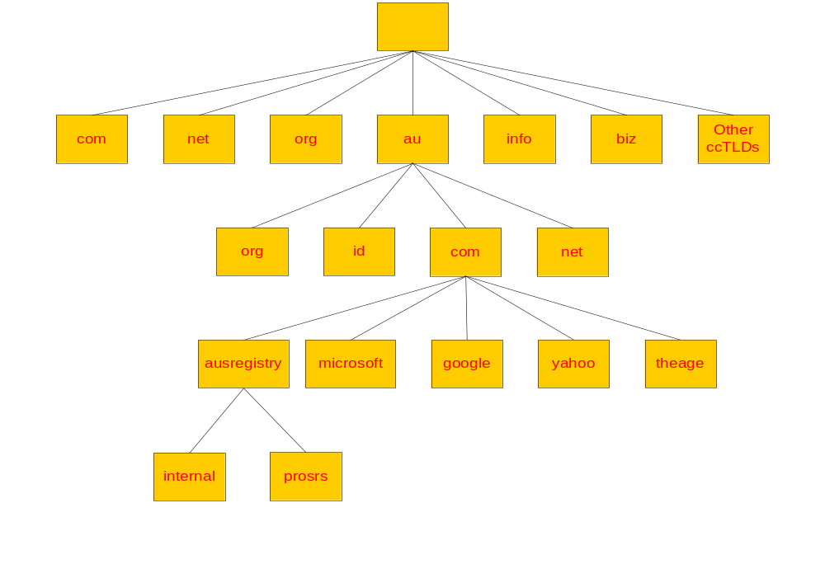
“root” zone
TLDs & ccTLDs
2lds
3lds
4lds
Notes:
TLD: Top Level Domain
ccTLD: country code Top Level Domain

Slide 12
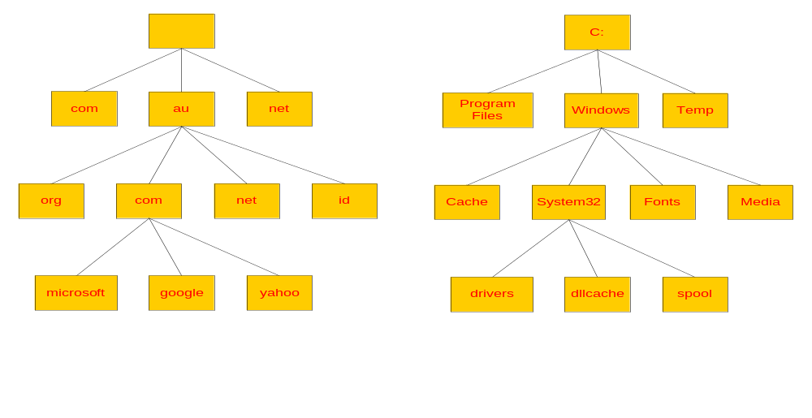
DNS vs File System

Slide 13
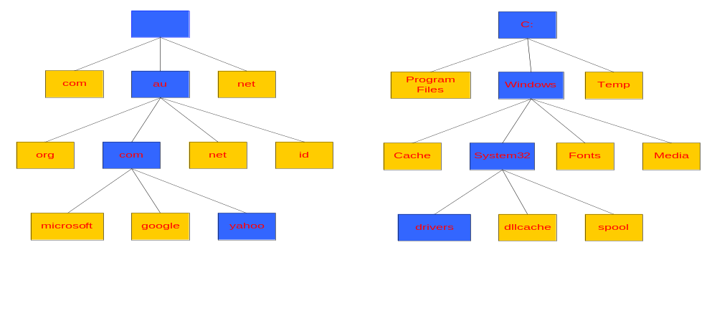
Naming
Naming a Domain Naming a Directory
Start Here
Start Here
yahoo.com.au.
C:\windows\system32\drivers\
A “.” is used as separator
A “\” is used as separator

Slide 14

“root” zone
TLDs & ccTLDs
2lds
“zone cuts” or delegation points
3lds
4lds

Slide 15
What is a domain?
A domain is a sub tree of a larger tree identified by a domain name
Contains resource records and sub-domains
Some resource records point to authoritative server for sub-domains / zones
eg. the root contains pointers to .au
google.com.au is a domain

Slide 16
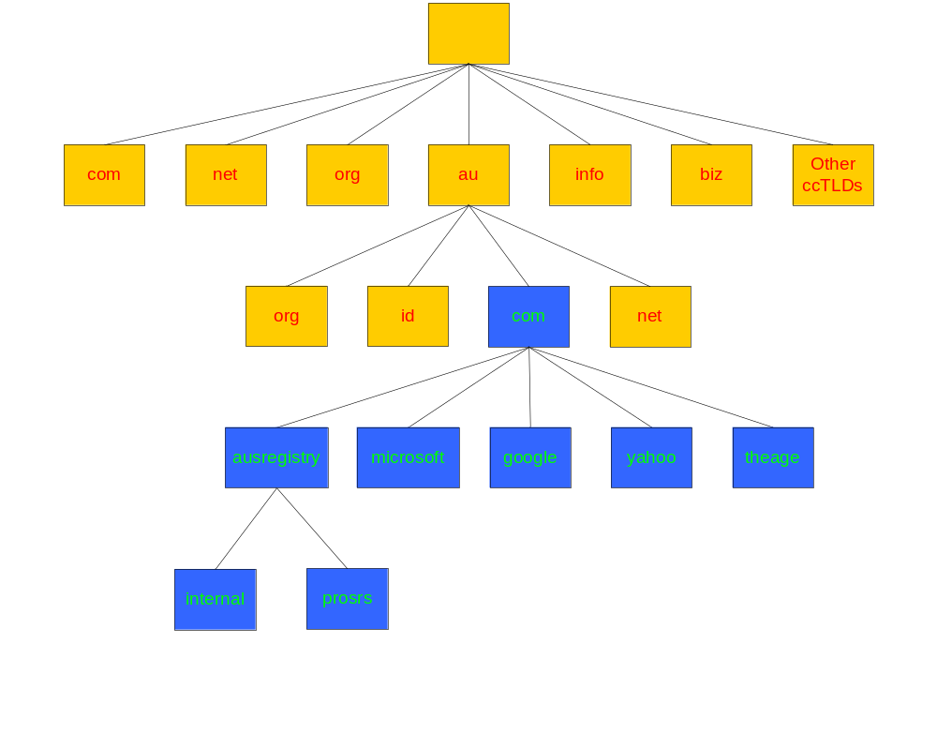
Domain com.au
The ausregistry.com.au sub-domain of com.au

Slide 17
What is a resource record?
A domain contains resource records
Resource records are analogous to files
Classified into types
Some of the important types are SOA, NS, A, AAAA*, CNAME and MX
Normally defines in “zone files”

Slide 18
RRs in a zone file
ripe.net. 7200 IN SOA ns.ripe.net. olaf.ripe.net. (
2001061501 ; Serial
43200 ; Refresh 12 hours
14400 ; Retry 4 hours
345600 ; Expire 4 days
7200 ; Negative cache 2 hours
)
ripe.net. 7200 IN NS ns.ripe.net.
ripe.net. 7200 IN NS ns.eu.net.
pinkje.ripe.net. 3600 IN A 193.0.1.162
host25.ripe.net. 2600 IN A 193.0.3.25
Label
ttl
class
type
rdata

Slide 19
SOA and NS
The SOA and NS records are used to provide information about the DNS itself.
The NS indicates where information about a given zone can be found:
The SOA record provides information about the start of authority, i.e. the top of the zone, also called the APEX.
ripe.net. 7200 IN NS ns.ripe.net.
ripe.net. 7200 IN NS ns.eu.net.

Slide 20
SOA
Master server
Contact address
net. 3600 IN SOA A.GTLD-SERVERS.net. nstld.verisign-grs.com. (
2002021301 ; serial
30M ; refresh
15M ; retry
1W ; expiry
1D ) ; neg. answ. ttl
Version number
Timing parameter

Slide 21
TTL and other Timers
TTL is a timer used in caches
  An indication for how long the data may be reused
  Data that is expected to be ‘stable’ can have high TTLs
SOA timers are used for maintaining consistency between primary and secondary servers

Slide 22
The “A” Record
The “Address” record
One or more normally defines a host
Contains an IPv4 Address (the address computers use to uniquely identify each other on the internet)
Eg. The record:
  www A 203.18.56.31
  In the ausregistry.com.au domain, defines the host uniquely identifiable as “www.ausregistry.com.au” to be reachable at the IPv4 Address 203.18.56.31
  IPv6 we can use AAAA
  linux AAAA 3ffe:1900:4545:2:02d0:09ff:fef7:6d2c

Slide 23
The “CNAME” Record
A CNAME defines an alias
The alias will then be resolved, if another CNAME is encountered then the process continues until an A record is found
Eg. The record:
  Search CNAME www.google.com.
  In the ausregistry.com.au domain, defines the name uniquely identifiable as “search.ausregistry.com.au” to be and alias to “www.google.com”

Slide 24
The “MX” Record
An MX record defines the mail servers for a particular domain
Mail eXchange records hold the name of hosts, and their priorities, able to deliver mail for the domain.
Eg. The record:
  ausregistry.com.au MX 10 mail
  In the ausregistry.com.au domain, defines the host mail to be the priority 10 mail server for the “ausregistry.com.au” domain

Slide 25
The “NS” Record
An NS record defines the authoritative Name servers for the domain.
The “Name Server” records also define the name servers of children domains
Eg. The record:
  internal NS ns1.hosting.com.au.
  In the ausregistry.com.au domain, defines the host “ns1.hosting.com.au” to be a name sever for the “internal.ausregistry.com.au” sub-domain

Slide 26
What is a Delegation?
Delegation refers to the act of putting NS records in a domain name “delegating” control of a sub-domain to another entity
This entity then has the ability to control the resource records in this sub-domain and delegate further children domains to other entities.
Eg. IANA delegating control of a country code domain to the country.

Slide 27
What is a zone?
Its records are held in a database (“zonefile”) and served from an authoritative name server
Zone refers to all the resource records in a domain but not its sub domains, the com.au zone contains delegations records for ausregistry.com.au, but not the resource records for ausregistry.com.au, however all of these records are part of the com.au domain

Slide 28
What is a Name Sever?
Server responsible for answering DNS queries
Exists at all levels of hierarchy
Authoritative name servers hold part of the DNS database
One name server can serve more then one zone
Many name servers “should” serve the same zone
Some name servers are authoritative for certain zones
Several types of name servers
  Authoritative servers
    master (primary)
    slave (secondary)
  (Caching) recursive servers
    also caching forwarders
  Mixture of functionality

Slide 29

Authoritative name server
Give authoritative answers for one or more zones.
The master server normally loads the data from a zone file
A slave server normally replicates the data from the master via a zone transfer
slave
master
slave

Slide 30
Iterative vs Recursive Name Servers
Serve two very different functions
Shouldn’t mix the two
Generally the DNS your computer points to is recursive
Zones are hosted in iterative name servers
Iterative servers can only answer information they know or have cached
Recursive know how to ask others for information

Slide 31
Some Important Terminology
TLD, ccTLD, 2ld, 3ld …
resolver, name server, iterative, recursive
delegation, authoritative, domain, sub-domain
zone, zone cut, zonefile
start of authority (SOA), TTL, negative TTL, expiry, serial number
primary, secondary

Slide 32
Who runs what?
ICANN/IANA have been granted the power by the US department of commerce to run the root zone.
Root ‘zone’ is split into all the ISO ccTLD and some other TLD’s eg. .com, .net, .info
Domain name Registries are appointed to operate the “major” zones.
Each country elects a delegate whom controls their ccTLD eg in Australia the delegate is auDA.
Modify TLD and ccTLD resource records on behalf of registrants through a system of registrars eg. MelbourneIT.

Slide 33
DNS Organization
Distributed Database
  The organization that owns a domain name is responsible for running a DNS server that can provide the mapping between hostnames within the domain to IP addresses.
  So - some machine ru DNS Organization n by RPI is responsible for everything within the rpi.edu domain.

Slide 34
DNS Distributed Database
There is one primary server for a domain, and typically a number of secondary servers containing replicated databases.
rpi.edu DNS server
rpi.edu
DNS DB
rpi.edu
DNS DB
rpi.edu
DNS DB
rpi.edu
DNS DB
Authoritative
Replicas

Slide 35
DNS Clients
A DNS client is called a resolver.
A call to gethostbyname()is handled by a resolver (typically part of the client).
Most Unix workstations have the file /etc/resolv.conf that contains the local domain and the addresses of DNS servers for that domain.

Slide 36
/etc/resolv.conf
domain rpi.edu
128.113.1.5
128.113.1.3

Slide 37
nslookup
nslookup is an interactive resolver that allows the user to communicate directly with a DNS server.
nslookup is usually available on Unix workstations. (dig and host are also DNS clients).

Slide 38
DNS Servers
Servers handle requests for their domain directly.
Servers handle requests for other domains by contacting remote DNS server(s).
Servers cache external mappings.

Slide 39
DNS Message Format
HEADER
QUERIES
Response RESOURCE RECORDS
Response AUTHORITY RECORDS
Response ADDITIONAL INFORMATION

Slide 40
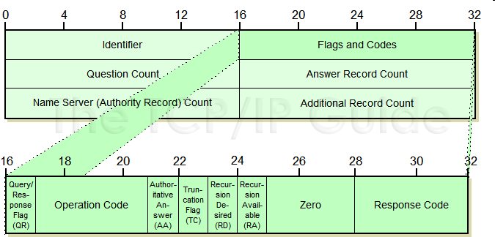
DNS Message Header

Slide 41
Message Flags
QR: Query=0, Response=1
Opcode
AA: This bit is set to 1 in a response to indicate that the server that created the response is authoritative for the zone in which the domain name specified in the Question section is located. If it is 0, the response is non-authoritative.
TC: When set to 1, indicates that the message was truncated due to its length being longer than the maximum permitted for the type of transport mechanism used. TCP doesn't have a length limit for messages, while UDP messages are limited to 512 bytes, so this bit being sent usually is an indication that the message was sent using UDP and was too long to fit. The client may need to establish a TCP session to get the full message. On the other hand, if the portion truncated was part of the Additional section, it may choose not to bother.
RD: When set in a query, requests that the server receiving the query attempt to answer the query recursively, if the server supports recursive resolution. The value of this bit is not changed in the response.
RA: Set to 1 or cleared to 0 in a response to indicate whether the server creating the response supports recursive queries. This can then be noted by the device that sent the query for future use.
rcode

Slide 42
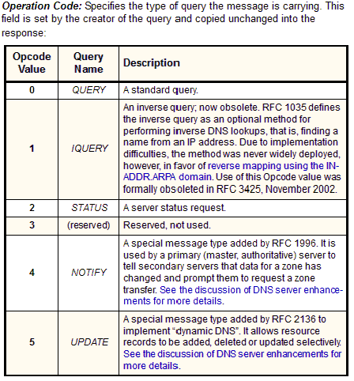
Opcode

Slide 43
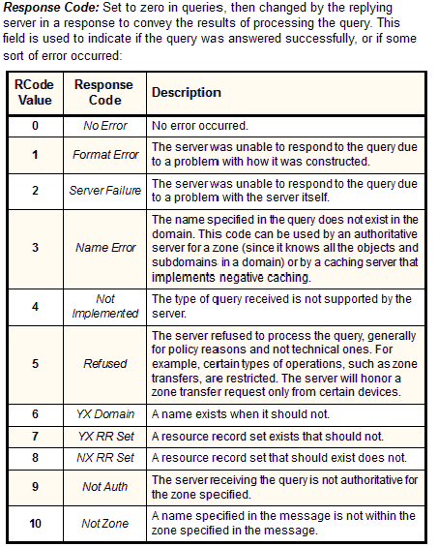
Response code

Slide 44
Recursion
A request can indicate that recursion is desired - this tells the server to find out the answer (possibly by contacting other servers).
If recursion is not requested - the response may be a list of other name servers to contact.

Slide 45
Question Format
Name: domain name (or IP address)
Query type (A, NS, MX, …)
Query class (1 for IP)

Slide 46
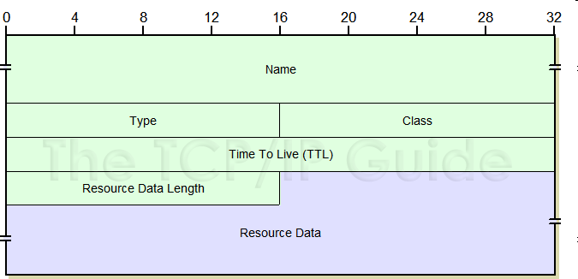
Response Resource Record
Domain Name
Response type
Class (IP)
Time to live (in seconds)
Length of resource data
Resource data

Slide 47
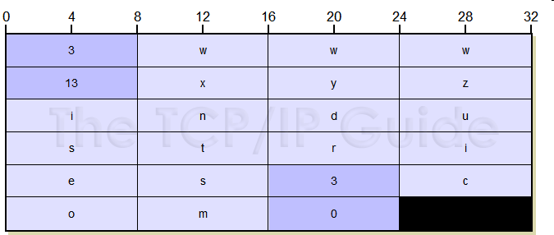
DNS Name Notation

Slide 48
UDP & TCP
Both UDP and TCP are used:
  TCP for transfers of entire database to secondary servers (replication).
  UDP for lookups
  If more than 512 bytes in response - requestor resubmits request using TCP.

Slide 49
Lots more
This is not a complete description !
If interested - look at:
  RFC 1034: DNS concepts and facilities.
  RFC 1035: DNS implementation and protocol specification.
  play with nslookup.
  Look at code for BIND (DNS server code).

Slide 50
Accessing a web page
You type http://www.google.com into your web browser and hit enter.
What happens now?

Slide 51
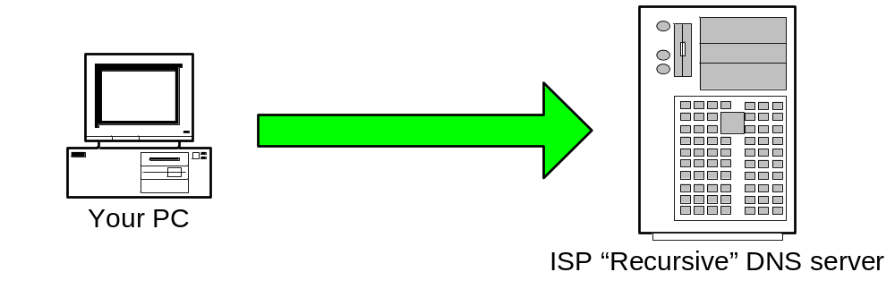
Web access: Step 1
Your PC sends a resolution request to its configured DNS Server, typically at your ISP.
Tell me the Address of “www.google.com”

Slide 52
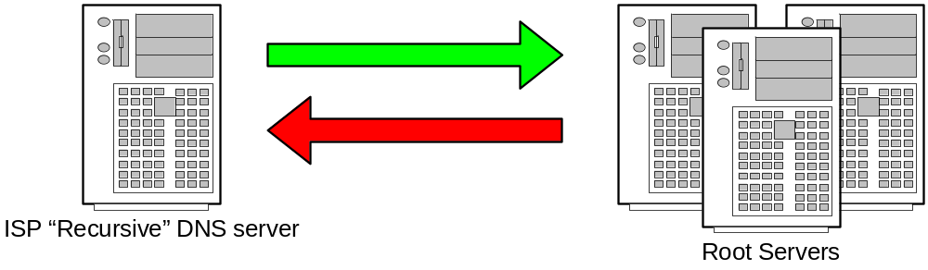
Web access: Step 2
Your ISPs recursive name server starts by asking one of the root servers predefined in its “hints” file.
Tell me the Address of “www.google.com”
I don’t know the address but I know who’s authoritative for the ”com” domain ask them

Slide 53
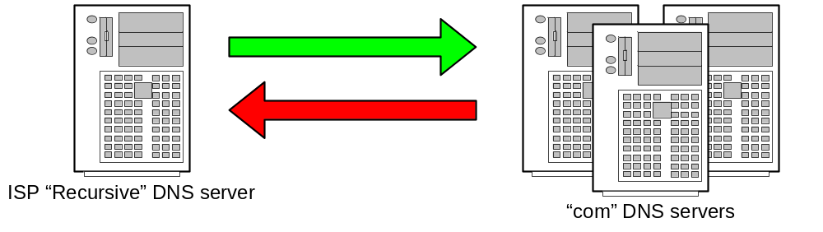
Web access: Step 3
Your ISPs recursive name server then asks one of the “com” name servers as directed.
Tell me the Address of “www.google.com”
I don’t know the address but I know who’s authoritative for the ”google.com” domain ask them

Slide 54
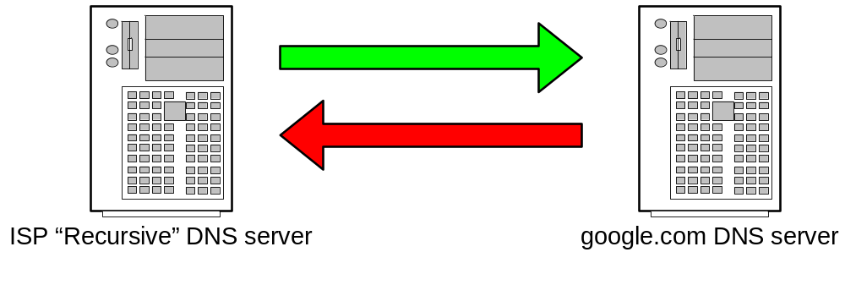
Web access: Step 4
Your ISPs recursive name server then asks one of the “google.com” name servers as directed.
Tell me the Address of “www.google.com”
The Address of www.google.com is 216.239.53.99

Slide 55
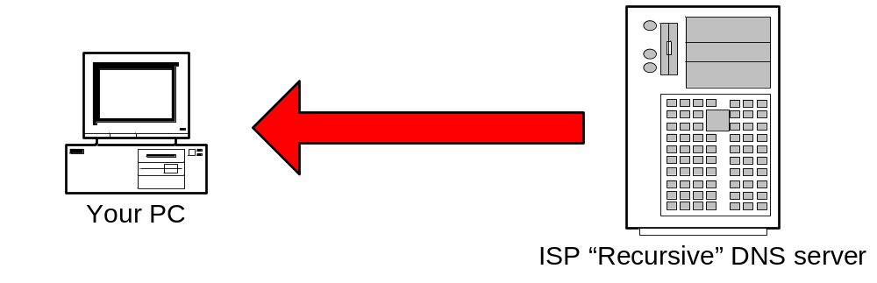
Web access: Step 5
ISP DNS server then send the answer back to your PC. The DNS server will “remember” the answer for a period of time.
The Address of www.google.com is 216.239.53.99

Slide 56
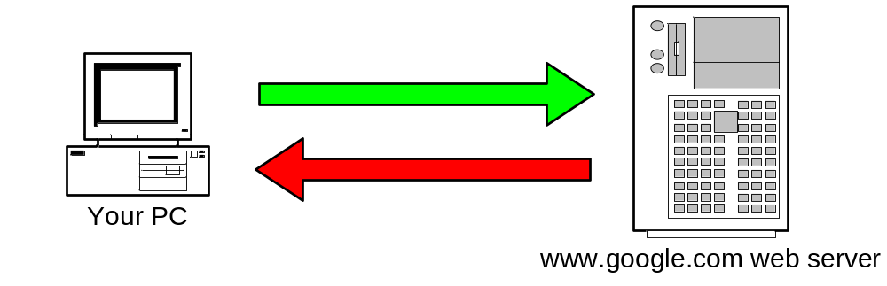
Web access: Step 6
Your PC can then make the actual HTTP request to the web server.
Send me the www.google.com.au web page
Here it is!

Slide 57
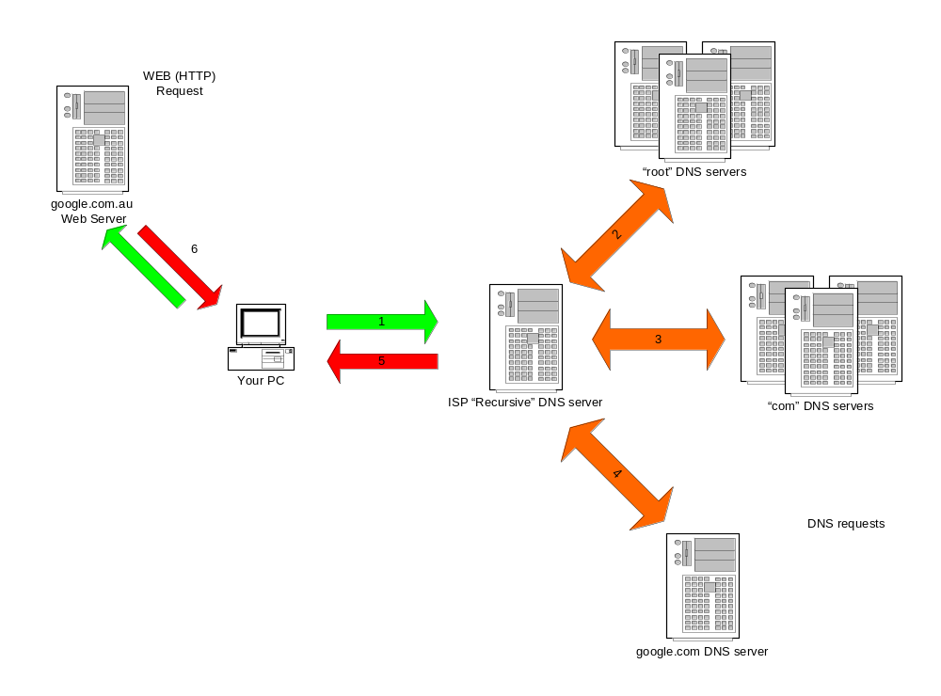
Summary
The actual web request
DNS

Slide 58
Sending an Email
DNS is not just used in HTTP protocol (web pages)
DNS is involved in almost every protocol in use on the internet
Next example is how DNS facilitates the transfer of electronic mail.

Slide 59

Mail access: Step 1
Your PC sends the e-mail to its configured outbound mail server. A DNS request similar to the previous example is required to find the address of the mail server.
Please send this message to “someone@example.com”

Slide 60
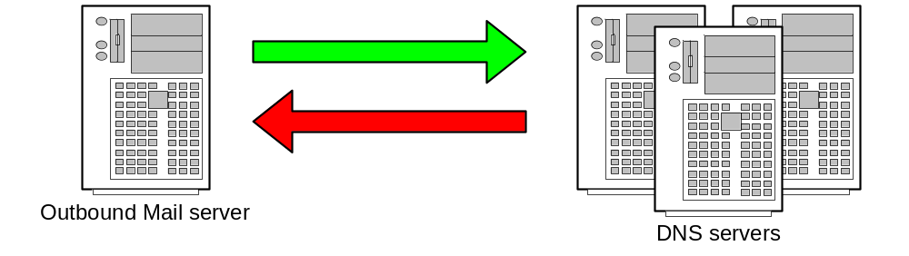
Mail access: Step 2
Your mail server follows the same intensive process to find the authoritative servers for “example.com”.
Tell me the name servers for “example.com”
Here are the name servers for “example.com”

Slide 61
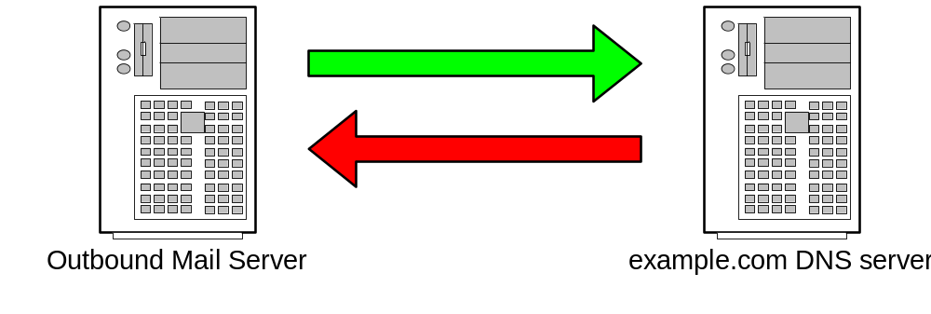
Mail access: Step 3
Ask the “example.com” name server for the list of “Mail eXchangers (MX) for that domain.
Tell me the MX’s for “example.com”
The MXs are mx10.example.com and mx20.backmail.com

Slide 62

Mail access: Step 4
Select a Mail server and deliver the mail.
Here is some mail for the “example.com” domain
Mail accepted for delivery

Slide 63
Summary
DNS is integral part in most protocols used on the internet
Makes the internet human friendly for us all
Is the world largest distributed database system
Fits the international model perfectly
In simple terms is a mapping between names and IP addresses

Slide 64
Thank you

