Slide 1
Domain Name System (DNS)
Luu Vo
Sep 2013

Slide 2
Agenda
Host Name Resolution
Domain Name System
DNS Overview
Name Resolution
Name Server Roles
Resource Records and Zones
Zone Transfers
DNS Dynamic Update
DNS Messages
DNS Client Configuration and Name Resolution Behavior (Windows)
Nslookup Tool

Slide 3
Agenda
Host Name Resolution
Domain Name System
DNS Overview
Name Resolution
Name Server Roles
Resource Records and Zones
Zone Transfers
DNS Dynamic Update
DNS Messages
DNS Client Configuration and Name Resolution Behavior (Windows)
Nslookup Tool

Slide 4
Host Name Resolution - Contents
TCP/IP Naming Schemas
Host Name Resolution Process
The Hosts File
DNS Client Resolver Cache

Slide 5
TCP/IP Naming Schemas
Before communication can take place, each interface on each TCP/IP node must be assigned a unicast IP address.
A TCP/IP host and its interfaces can also be assigned names.
The naming scheme affects the way that a host or interface is referenced in applications
Sockets applications:
a user specifies either an IP address or a host name (aka. a domain name).
if the user specifies a host name, TCP/IP attempts to resolve the name to an IP (IPv4 or IPv6) address.
if the user specifies an IP address, name resolution is not necessary.
Network basic input/output system (NetBIOS) applications:
a user specifies a computer name, which the application converts into a 16-character NetBIOS name.
TCP/IP attempts to resolve the NetBIOS name to an IPv4 address
Notes:
With NetBIOS applications, users must always specify the NetBIOS name and not the IPv4 address. Sockets applications allow users to specify the destination host by its host name or IP address.

Slide 6
TCP/IP Naming Schemas (Cont.)
Host name overview
The host name does not have to match the NetBIOS computer name
Multiple host names can be assigned to the same host.
A user can specify host name instead of an IP address when using socket applications (e.g., the Ping tool or Internet Explorer).
A host name should correspond to an IP address mapping that is stored either in the local Hosts file or in a database on a DNS server.
TCP/IP for Windows also use NetBIOS name resolution methods for host names.
in Windows: host name can be configured from the Computer Name tab of the System item of Control Panel, Hostname tool can be used to display the computer name

Slide 7
Host Name Resolution Process
Host name resolution is the process of resolving a host name to an IP address before the source host sends the initial IP packet.
Standard methods of host name resolution for TCP/IP
Local host name
Hosts file: maps host names to IP addresses
DNS server

Slide 8
Host Name Resolution Process (Cont.)
Additional methods used by TCP/IP for Windows to resolve names
Host names
DNS client resolver cache: a RAM-based table of the entries listed in the local Hosts file and the names that were attempted for resolution by using a DNS server
Link-local Multicast Name Resolution (LLMNR): a simple request-reply protocol to resolve names of computers on the local subnet in the absence of a DNS server (supported by Windows Vista and Windows Server 2008)
NetBIOS name
NetBIOS name cache: a RAM-based table of recently resolved NetBIOS names and their associated IPv4 addresses
NetBIOS name server (NBNS): A server that resolves NetBIOS names to IPv4 addresses, as specified by RFCs 1001 and 1002. The Microsoft implementation of an NBNS is a Windows Internet Name Service (WINS) server
Local broadcast: up to three NetBIOS Name Query Request messages are broadcast on the local subnet to resolve the IPv4 address of a specified NetBIOS name
Lmhosts file: a local text file that maps NetBIOS names to IPv4 addresses

Slide 9
Host Name Resolution Process (Cont.)
TCP/IP for Windows attempts to resolve the name in the following order
checks local host name
searches the DNS client resolver cache
sends DNS Name Query Request messages to its configured DNS servers
sends multicast LLMNR query messages (if host name is a single-label name e.g., server1)
converts the host name to a NetBIOS name (if host name is a single-label name and less than 16 characters) and checks its local NetBIOS name cache
contacts configured WINS servers to resolve the NetBIOS name that corresponds to the host name
broadcasts NetBIOS Name Query Request messages on the directly attached subnet
searches the local Lmhosts file

Slide 10
Host Name Resolution Process (Cont.)
Resolving Names with local host name and Hosts File (Windows example)
Entries in the Hosts file are automatically loaded into the DNS client resolver cache
Windows checks whether the host name matches the local host name.
If the host name is the same as the local host name, the host name is resolved to an IP address that is assigned to the local host, and the name resolution process stops.
If the host name is not the same as the local host name, Windows searches the DNS client resolver cache for an entry containing the host name.
If Windows does not find the host name in the DNS client resolver cache and no other name resolution methods are configured or enabled (such as DNS or NetBIOS name resolution methods), the name resolution process stops, and an error condition is indicated to the Windows Sockets application.
If Windows finds the host name in the DNS client resolver cache, the host name is resolved to the IP address that corresponds to the entry in the cache.
After the host name is resolved to a destination IP address, Windows forwards the packet to the next-hop IP address for the destination (either the destination or a neighboring router).
Notes:
Unlike the Lmhosts file, which is used for remote NetBIOS-based hosts and IPv4 addresses only, the Hosts file maps host names of both neighboring and remote hosts to their IPv4 or IPv6 addresses.

Slide 11
Host Name Resolution Process (Cont.)
Resolving Names with a DNS Server (Windows example)
If TCP/IP is configured with the IP address of a DNS server, the name resolution process is as follows:
When a user uses a socket application and specifies an FQDN for the destination host and the FQDN does not match the local host name or any entries in the DNS client resolver cache, the DNS client component of TCP/IP constructs and sends a DNS Name Query Request message to the DNS server.
The DNS server determines whether a mapping for the name to an IP address is stored either locally or on another DNS server. Whether or not a mapping is found, the DNS server sends back a DNS Name Query Response message to the DNS client.
If the DNS server does not respond to the request, the DNS client sends additional DNS Name Query Request messages. If the DNS server does not respond to any of the attempts, no other DNS servers are configured, and NetBIOS over TCP/IP is not enabled, an error condition is indicated to the socket application
After the FQDN is resolved to a destination IP address, TCP/IP forwards the packet to the next-hop IP address for the destination (either the destination or a neighboring router)

Slide 12
Host Name Resolution Process (Cont.)
Resolving Names with LLMNR
LLMNR is in RFC 4795, provides an additional method to resolve the names of neighboring computers.
LLMNR allows name resolution on networks where a DNS server is not present or practical.
LLMNR uses a simple exchange of request and reply messages to resolve computer names to IPv4 or IPv6 addresses.
Typical LLMNR message exchange for a name query:
a multicast query (a querying host sends a LLMNR Name Query Request message to the IPv4 multicast address of 224.0.0.252)
and a unicast response to the requestor (if a host on the subnet is authoritative for the requested name)

Slide 13
The Hosts File
The Hosts file is a common way to resolve a host name to an IP address through a locally stored text file that contains IP-address-to-host-name mappings.
On most UNIX-based computers, this file is /etc/hosts.
On Windows-based computers, this file is the Hosts file in the systemroot\System32\Drivers\Etc folder.
Attributes of the Hosts file for Windows:
A single entry consists of an IP (IPv4 or IPv6) address and one or more host names.
The Hosts file is dynamically loaded into the DNS client resolver cache.
When you create entries in the Hosts file and save it, its contents are automatically loaded into the DNS client resolver cache.
The Hosts file contains a default entry for the host name localhost.
Each host name is limited to 255 characters
Entries in the Hosts file for Windows–based computers are not case sensitive.
Notes:
Entries can be case sensitive depending on the platform. Entries in the Hosts file for UNIX computers are case sensitive. Entries in the Hosts file for Windows 2000 and Windows NT–based computers are not case sensitive.
See http://technet.microsoft.com/en-us/library/cc958812.aspx

Slide 14
The Hosts File (Cont.)
An entry in the Hosts file has the following format:
Address Names
The Address portion of the entry is either an IPv4 or IPv6 unicast address.
The Names portion of the entry is one or more names (nicknames or FQDNs) separated by at least one space character.
One or multiple space or tab characters must separate the address from the first name.
Example
127.0.0.1 localhost
131.107.34.1 router
172.30.45.121 server1.central.example.com s1

Slide 15
DNS Client Resolver Cache
built dynamically from the Hosts file and from DNS queries.
entries obtained from DNS queries are kept only for a period of time known as the Time to Live (TTL), which is set by the DNS server that has the name-to-IP address mapping stored in a local database.
entries obtained from the Hosts file do not have a TTL and are kept until the entry is removed from the Hosts file.
stores entries for both successful and unsuccessful DNS name resolutions.
a name that was queried but was not successfully resolved is known as a negative cache entry
to view the contents of the DNS client resolver cache:
ipconfig /displaydns
to flush and refresh the DNS client resolver cache with just the entries in the Hosts file:
ipconfig /flushdns

Slide 16
Agenda
Host Name Resolution
Domain Name System
DNS Overview
Name Resolution
Name Server Roles
Resource Records and Zones
Zone Transfers
DNS Dynamic Update
DNS Messages
DNS Client Configuration and Name Resolution Behavior (Windows)
Nslookup Tool

Slide 17
DNS Overview - Contents
Introduction
DNS Components
DNS Names
Domains and Subdomains
DNS Servers and the Internet
Zones

Slide 18
Introduction
Initial solution for name resolution on the Internet was a file named Hosts.txt (used on the Advanced Research Projects Agency network)
Computers on the ARPANET periodically downloaded Hosts.txt file from a central location and used it for local name resolution.
As the ARPANET grew into the Internet, the number of hosts began to increase dramatically and the centralized administration and manual distribution of a text file containing the names for computers on the Internet became unwieldy
The original design goal for DNS was to replace the existing cumbersome, centrally administered text file with a lightweight, distributed database that would allow for a hierarchical name space, delegation and distribution of administration, extensible data types, virtually unlimited database size, and reasonable performance

Slide 19
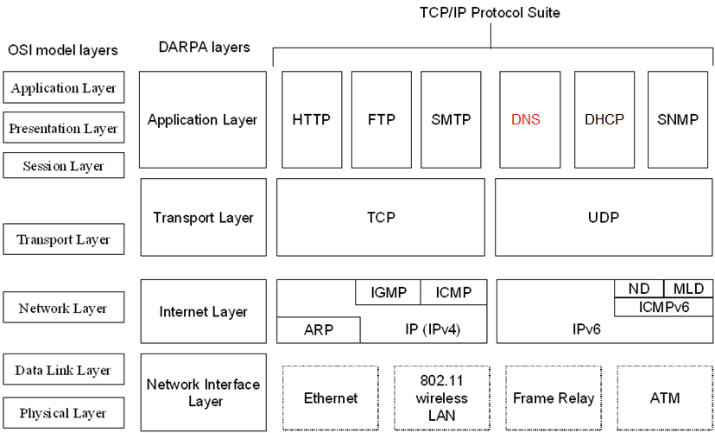
Introduction (Cont.)

Slide 20
Introduction (Cont.)
DNS is specified in RFCs 1034 and 1035
DNS defines a namespace and a protocol for name resolution and database replication:
The DNS namespace is based on a hierarchical and logical tree structure.
The DNS protocol defines a set of messages sent over either User Datagram Protocol (UDP) port 53 or Transmission Control Protocol (TCP) port 53.
Hosts that originate DNS queries (known as DNS clients) send name resolution queries to servers over UDP first because it’s faster.
DNS clients resort to TCP only if the returned data is truncated.
Hosts that store portions of the DNS database, known as DNS servers, use TCP when replicating database information.
Historically, the most popular implementation of the DNS protocol is Berkeley Internet Name Domain (BIND), which was originally developed at the University of California at Berkeley for the 4.3 Berkeley Software Distribution release of the UNIX operating system.

Slide 21
DNS Components
DNS comprises the following three components:
The domain namespace and resource records
Name servers (aka., DNS database servers, DNS servers)
Resolvers
The domain namespace and resource records
DNS defines a specification for a structured namespace as an inverted tree in which each node and leaf of the tree names a set of information.
Resource records are records in the DNS database that can be used
to configure the DNS database server (such as the Start of Authority [SOA] record)
or to contain information of different types to process client queries (such as Address [A] records or Mail Exchanger [MX] records).
Typical resource records contain resources by name and their IP addresses.
Name queries to DNS database servers are attempts to extract information of a certain type from the namespace.
The name query requests a name of interest and a specific type of record. For example, a name query would provide a host name and ask for the corresponding IPv4 or IPv6 address.

Slide 22
DNS Components (Cont.)
Name servers
Name servers store resource records and information about the domain tree structure and attempt to resolve received client queries.
Name servers either contain the requested information in their resource records or have pointer records to other name servers that can help resolve the client query.
If the name server contains the resource records for a given part of the namespace, the server is said to be authoritative for that part of the namespace.
Authoritative information is organized into units called zones.
Resolvers
Resolvers are programs that run on DNS clients and DNS servers and that create queries to extract information from name servers.
A DNS client uses a resolver to create a DNS name query.
A DNS server uses a resolver to contact other DNS servers to resolve a name on a DNS client's behalf.
Resolvers are usually built into utility programs or are accessible through library functions, such as socket functions getaddrinfo() or gethostbyname().

Slide 23
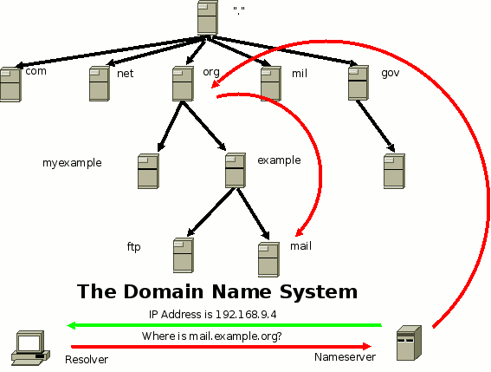
DNS Components (Cont.)

Slide 24
DNS Names
DNS names have a specific structure which identifies the location of the name in the DNS namespace.
A fully qualified domain name (FQDN) is a DNS domain name that has been constructed from its location relative to the root of the namespace (known as the root domain).
FQDNs have the following attributes:
FQDNs consist of the series of names from the name of the host or computer to the root domain.
A period character separates each name.
Each FQDN ends with the period character, which indicates the root domain.
Each name within the FQDN can be no more than 63 characters long.
The entire FQDN can be no more than 255 characters long.
FQDNs are not case-sensitive.
RFC 1034 requires the names that make up a FQDN to use only the characters a-z, A-Z, 0-9, and the dash or minus sign (-). RFC 2181 allows additional characters and is supported by the DNS Server service in Windows.

Slide 25
Domains and Subdomains
The DNS namespace is in the form of a logical inverted tree structure.
Each node in the tree is given a name
A domain is a branch of the tree and can occur at any point in the tree structure.
Domains can be further partitioned at node points within the domain into subdomains for the purposes of administration or load balancing.
The domain name identifies the domain's position in the DNS hierarchy.
Domain names and FQDNs are created by combining the names of the nodes from the designated domain node back to the root and separating each node with a period (.)

Slide 26
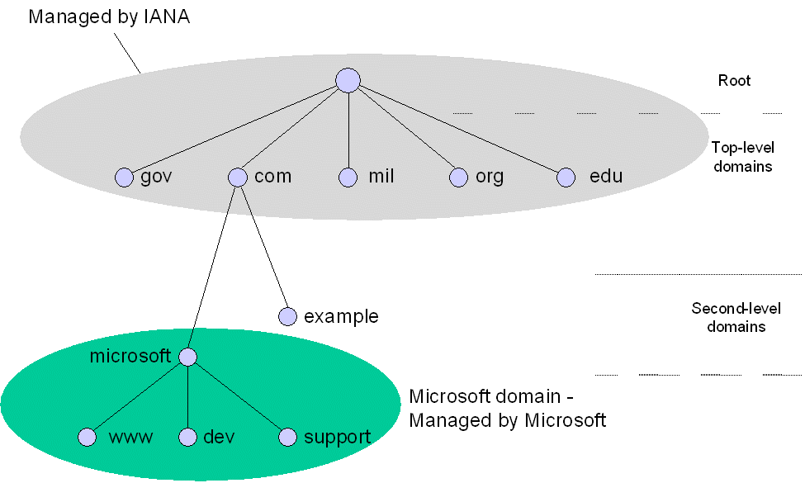
Domains and Subdomains (Cont.)

Slide 27
DNS Servers and the Internet
Domains define different levels of authority in a hierarchical structure. The top of the hierarchy is called the root domain.
The DNS namespace on the Internet has the following structure:
Root domain
Top-level domains
Second-level domains
The root domain uses a null label (written as a single period). In the United States, the Internet Assigned Names Authority (IANA) manages several root domain name servers.
The next level in the hierarchy is divided into a series of nodes called the top-level domains. The top-level domains are assigned by organization type and by country/region

Slide 28
DNS Servers and the Internet (Cont.)
common top-level domains are the following:
com – Commercial organizations in the United States (for example, microsoft.com for the Microsoft Corporation)
edu – Educational organizations in the United States.
gov – United States governmental organizations.
int – International organizations.
mil – United States military organizations.
net – Networking organizations.
org – Noncommercial organizations.
xx – Two-letter country code names that follow the International Standard 3166 (e.g., “.vn” is the country code for Vietnam).
arpa – Used to store information for DNS reverse queries.

Slide 29
Zones
A zone is a contiguous portion of a domain of the DNS namespace whose database records exist and are managed in a particular DNS database file stored on one or multiple DNS servers.
A single DNS server can manage one or multiple zones. Each zone is anchored at a specific domain node, referred to as the zone's root domain.
Zone files do not necessarily contain the complete branch (that is, all subdomains) under the zone's root domain.
e.g., you can partition a domain into several subdomains, which are controlled by separate DNS servers.

Slide 30
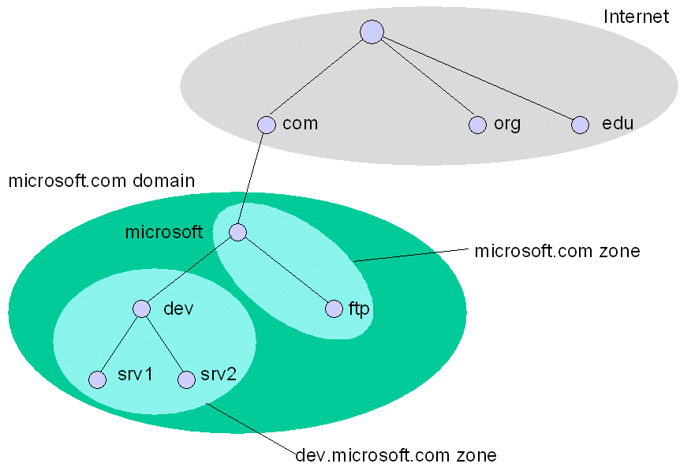
Zones (Cont.)

Slide 31
Agenda
Host Name Resolution
Domain Name System
DNS Overview
Name Resolution
Name Server Roles
Resource Records and Zones
Zone Transfers
DNS Dynamic Update
DNS Messages
DNS Client Configuration and Name Resolution Behavior (Windows)
Nslookup Tool

Slide 32
Name Resolution - Contents
Types of Queries
Name Resolution Example
Reverse Queries
Caching and TTL
Negative Caching
Round Robin Load Balancing

Slide 33
Types of Queries
A DNS resolver (either a DNS client or another DNS server) can make the following types of queries to a DNS server
Recursive queries
In a recursive query, the queried name server is requested to respond with the requested data or with an error stating that data of the requested type or the specified domain name does not exist.
The name server cannot just refer the DNS resolver to a different name server.
A DNS client typically sends this type of query.
Iterative queries
In an iterative query, the queried name server can return the best answer it currently has back to the DNS resolver.
The best answer might be the resolved name or a referral to another name server that is closer to fulfilling the DNS client's original request.
DNS servers typically send iterative queries to query other DNS servers.

Slide 34
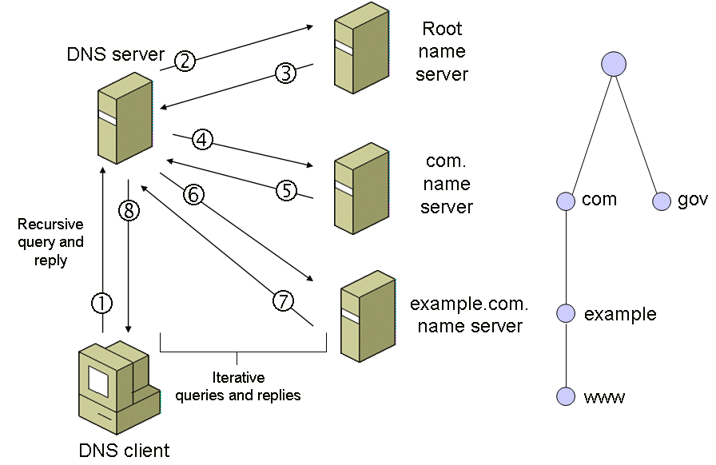
Name Resolution Example

Slide 35
Reverse Queries
Forward lookups are queries in which a DNS client attempts to resolve an FQDN to its corresponding IP address.
Zones that contain FQDN-to-IP address mappings are known as forward lookup zones.
In a reverse query, instead of supplying a name and asking for an IP address, the DNS client provides the IP address and requests the corresponding host name.
E.g., the Tracert tool uses reverse queries to display the names of the routers in a routing path
Reverse queries are also known as reverse lookups, and zones that contain IP address-to-FQDN mappings are known as reverse lookup zones.
To prevent an exhaustive search of all domains for a reverse query, reverse name domains and pointer (PTR) resource records were defined.
To use reverse queries, reverse lookup zones and PTR records must be created in a DNS server

Slide 36
Reverse Queries (Cont.)
To support reverse lookups for IPv4 addresses, a special domain named in-addr.arpa. was created.
Nodes in the in-addr.arpa domain are named after the numbers in the dotted decimal representation of IPv4 addresses.
the order of IPv4 address octets must be reversed when building the in-addr.arpa domain name corresponding to the IPv4 address.
e.g., for the generalized IPv4 address w.x.y.z, the corresponding reverse query name is z.y.x.w.in-addr.arpa.
IANA delegates responsibility for administering the reverse query namespace below the in-addr.arpa domain to organizations as they are assigned IPv4 address prefixes.

Slide 37
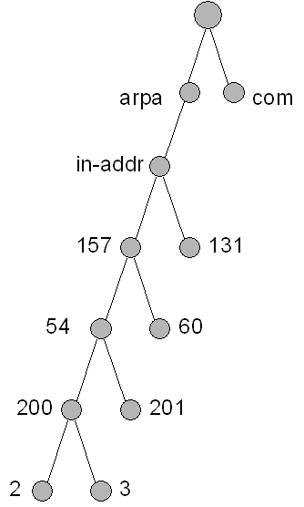
Reverse Queries (Cont.)
Within the in-addr.arpa domain, special pointer (PTR) resource records are added to associate the IPv4 addresses to their corresponding host names.
Reverse queries use the same name resolution process as forward lookups (a combination of recursive and iterative queries).
Example:
To find a host name for the IPv4 address 157.54.200.2, a DNS client sends a DNS query for a PTR record for the name 2.200.54.157.in-addr.arpa.
The DNS server finds the PTR record that contains the FQDN that corresponds to the IPv4 address 157.54.200.2 and sends that FQDN back to the DNS client.

Slide 38
Caching and TTL
For each resolved query (either recursive or iterative), the DNS resolver caches the returned information for a time that is specified in each resource record in the DNS response. This is known as positive caching.
The amount of time in seconds to store the record data in the cache is referred to as the Time To Live (TTL).
The network administrator of the zone that contains the record decides on the default TTL for the data in the zone.
After a DNS resolver caches data, it must start counting down from the received TTL so that it will know when to remove the data from its cache.
For queries that can be satisfied by this cached data, the TTL that is returned is the current amount of time left before the data is flushed from the DNS cache.
DNS client resolvers also have data caches and honor the TTL value so that they know when to remove the data.

Slide 39
Negative Caching
Negative caching is the caching of failed name resolutions.
A failed name resolution occurs when a DNS server returns a DNS Name Query Response message with an indication that the name was not found.
Negative caching can reduce response times for names that DNS cannot resolve for both the DNS client and DNS servers during an iterative query process.
Like positive caching, negative cache entries eventually time out and are removed from the cache based on the TTL in the received DNS Name Query Response message.

Slide 40
Round Robin Load Balancing
DNS Name Query Response messages can contain multiple resource records.
e.g., the DNS Name Query Response message can contain multiple Address (A) records that contain the IPv4 addresses associated with the desired host.
When multiple resource records for the same resource record type exist, the following issues arise:
DNS server: how to order the resource records in the DNS Name Query Response message
DNS client: how to choose a specific resource record in the DNS Name Query Response message

Slide 41
Round Robin Load Balancing (Cont.)
RFC 1794 describes a mechanism named round robin or load sharing to share and distribute loads for network resources.
The central assumption is that when multiple resource records for the same resource record type and the same name exist, multiple servers are offering the same type of service to multiple users.
e.g., the www.microsoft.com Web site is actually hosted by multiple Web servers with different IPv4 addresses.
To attempt to distribute the load of servicing all the users who access a host by a FQDN (e.g., www.microsoft.com), the DNS servers that are authoritative for the domain name (e.g., microsoft.com) modify the order of the resource records for the host name (e.g., www.microsoft.com) in successive DNS Name Query Response messages.
The DNS client uses the data in the first resource record in the response.

Slide 42
Round Robin Load Balancing (Cont.)
Example:
if there were three A records for www.microsoft.com with the following IPv4 addresses
131.107.0.99,
131.107.0.100,
131.107.0.101
the round robin scheme works as follows:
for the first request, the order of the resource records in the DNS Name Query Response message is
131.107.0.99
131.107.0.100
131.107.0.101.
for the second request, the order of the resource records in the DNS Name Query Response message is
131.107.0.100
131.107.0.101
131.107.0.99.
for the third request, the order of the resource records in the DNS Name Query Response message is
131.107.0.101
131.107.0.99
131.107.0.100.
the pattern repeats for subsequent queries

Slide 43
Agenda
Host Name Resolution
Domain Name System
DNS Overview
Name Resolution
Name Server Roles
Resource Records and Zones
Zone Transfers
DNS Dynamic Update
DNS Messages
DNS Client Configuration and Name Resolution Behavior (Windows)
Nslookup Tool

Slide 44
Name Server Roles - Contents
Primary and Secondary Name Servers
Forwarders
Caching-only Name Servers

Slide 45
Primary and Secondary Name Servers
When name servers have one or more zones for which they are responsible, they are said to be authoritative servers for those zones
Configuration of a DNS server includes adding name server (NS) resource records for all the other name servers that are in the same domain
These NS records provide pointers to the other authoritative servers for the domain
DNS defines two types of name servers:
Primary name server
A primary name server gets the data for its zones from locally stored and maintained files.
To change a zone, such as adding subdomains or resource records, we need to change the zone file at the primary name server.
Secondary name server
A secondary name server gets the data for its zones across the network from another name server (either a primary name server or another secondary name server).
The process of obtaining this zone information (that is, the database file) across the network is referred to as a zone transfer.
Zone transfers occur over TCP port 53.

Slide 46
Primary and Secondary Name Servers (Cont.)
Reasons to have secondary name servers within an enterprise network:
Redundancy
At least two DNS servers, a primary and at least one secondary, serving each zone are needed for fault tolerance.
Remote locations
Secondary name servers (or other primary servers for subdomains) are needed in remote locations that have a large number of DNS clients. Clients should not have to communicate across slower wide area network (WAN) links for DNS queries.
Load distribution
Secondary name servers reduce the load on the primary name server.

Slide 47
Primary and Secondary Name Servers (Cont.)
The primary or secondary name server designation is defined at a zone level.
a specific name server may be a primary name server for certain zones and a secondary name server for other zones.
When defining a zone on a secondary name server, we configure the zone with the name server from which the zone information is to be obtained.
The source of the zone information for a secondary name server is referred to as a master name server.
A master name server can be either a primary or secondary name server for the requested zone.
When a secondary name server starts up, it contacts the master name server and initiates a zone transfer for each zone for which it is acting as a secondary name server.
Zone transfers also can occur periodically (provided that data on the master name server has changed) as specified in the SOA record of the zone file

Slide 48
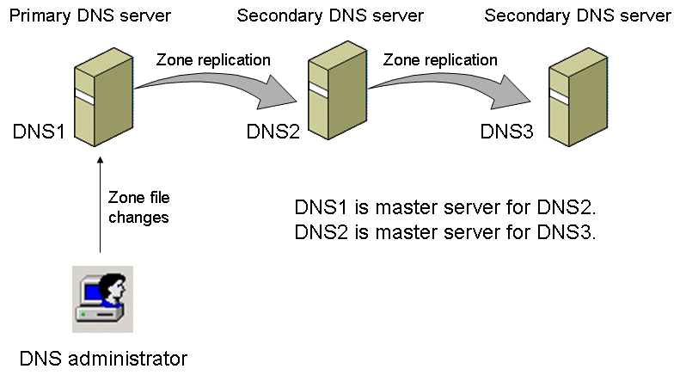
Primary and Secondary Name Servers (Cont.)

Slide 49
Forwarders
DNS queries for names that do not use the second-level domain name of the organization might require interaction with DNS servers across WAN links outside of the organization.
To prevent all the DNS servers in the organization from sending their queries over the Internet, we can configure forwarders.
A forwarder sends queries across the Internet.
Other DNS servers in the organization are configured to forward their queries to the forwarder.

Slide 50
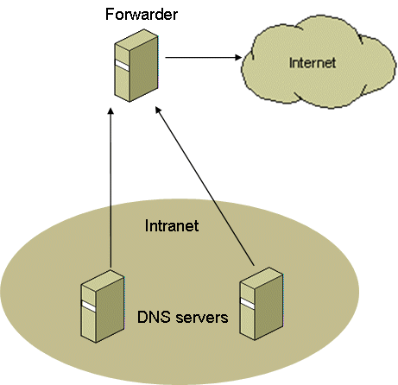
Forwarders (Cont.)

Slide 51
Forwarders (Cont.)
A name server can use a forwarder in non-exclusive or exclusive mode.
Forwarders in Non-exclusive Mode
Name servers attempt to resolve the query on their own if the forwarder is unable to satisfy the request
when a name server receives a DNS query that it cannot resolve through its own zone files, it sends a recursive query to its forwarder.
The forwarder attempts to resolve the query and returns the results to the requesting name server.
If the forwarder is unable to resolve the query, the name server that received the original query attempts to resolve the query using iterative queries.
A name server using a forwarder in non-exclusive mode does the following when attempting to resolve a name:
Checks its local cache.
Checks its zone files.
Sends a recursive query to a forwarder.
Attempts to resolve the name through iterative queries to other DNS servers.

Slide 52
Forwarders (Cont.)
Forwarders in Exclusive Mode
Name servers make no attempt to resolve the query on their own if the forwarder is unable to satisfy the request
When a name server in exclusive mode receives a DNS query that it cannot resolve through its own zone files, it sends a recursive query to its designated forwarder.
The forwarder then carries out whatever communication is necessary to resolve the query and returns the results to the originating name server.
If the forwarder is unable to resolve the request, the originating name server returns a query failure to the original DNS client.
A name server using a forwarder in exclusive mode does the following when attempting to resolve a name:
Checks its local cache.
Checks its zone files.
Sends a recursive query to a forwarder.

Slide 53
Caching-only Name Servers
Caching-only servers are DNS servers that only perform queries, cache the answers, and return the results.
Caching-only servers are not authoritative for any domains and contain only the information that they have cached while attempting to resolve queries.
When caching-only servers are started, they do not perform any zone transfers because they have no zones and no entries exist in their caches.
Initially, the caching-only server must forward queries until the cache has been built up to a point where it can service commonly used queries by just using its cache entries

Slide 54
Agenda
Host Name Resolution
Domain Name System
DNS Overview
Name Resolution
Name Server Roles
Resource Records and Zones
Zone Transfers
DNS Dynamic Update
DNS Messages
DNS Client Configuration and Name Resolution Behavior (Windows)
Nslookup Tool

Slide 55
Resource Records and Zones - Contents
Resource Record Format
Resource Record Types
The Root Hints Files

Slide 56
Resource Record Format
Resource records have the following formats:
owner [TTL] [class] type RDATA
owner [class] [TTL] type RDATA
owner:
the domain name of the resource record.
TTL (Time to Live):
the length of time in seconds that a DNS resolver should wait before it removes from its cache an entry that corresponds to the resource record.
type:
the type of resource record.
class:
the protocol family in use, which is typically IN for the Internet class.
RDATA:
the resource data for the resource record type.
e.g.,, for an Address (A) resource record, RDATA is the 32-bit IPv4 address that corresponds to the FQDN in the owner field.

Slide 57
Resource Record Format (Cont.)
In text-based DNS database files, most resource records are represented as a single line of text
Example A resource record stored in a DNS database file:
srv1.dev.microsoft.com. 3600 IN A 157.60.221.205
Each resource record starts with the owner in the first column (srv1.dev.microsoft.com.).
If the first column is blank, then it is assumed that the owner for this record is the owner of the previous record.
If the TTL value is not present, the DNS server sets the value to the TTL specified in the SOA (Start of Authority) record of the zone or the $TTL directive.
Comments always start with a semicolon (;) and end with a carriage return.
Resource records are represented in binary form in DNS request and response messages

Slide 58
Resource Record Types
DNS standards define many types of resource records
Most commonly used resource records:
SOA (Start Of Authority)
Identifies the start of a zone of authority.
Every zone contains an SOA resource record at the beginning of the zone file, which stores information about the zone, configures replication behavior, and sets the default TTL for the zone.
domain-name [ttl] IN SOA mname rname (
serial
refresh
retry
expire
minimum)
domain-name: domain name of this zone
mname: domain name of the name server that was the original or primary (master) source of data for this zone.
rname: the mailbox of the person responsible for this zone (a "." is used instead of an "@“)
serial: version number of the original copy of the zone. Zone transfers preserve this value
refresh: the time (in seconds) a secondary DNS server waits before querying the primary DNS server's SOA record to check for changes and request a zone transfer
retry: the time (in seconds) a secondary server waits before retrying a failed zone transfer
expire: the time (in seconds) that a secondary server will keep trying to complete a zone transfer, if this time expires prior to a successful zone transfer, the secondary server will expire its zone file (i.e., it will stop answering queries)
minimum: TTL (in seconds), has 3 meanings
minimum TTL field that should be exported with any RR from this zone (deprecated)
default TTL of RRs which did not contain a TTL value (relevant only at the primary server)
TTL of negative responses ($TTL directive can be used to define default TTL of RRs which did not contain a TTL value)
Notes:
From RFC 2308: The Master File format [RFC 1035 Section 5] is extended to include the following directive:
$TTL <TTL> [comment]
All resource records appearing after the directive, and which do not explicitly include a TTL value, have their TTL set to the TTL given in the $TTL directive.

Slide 59
Resource Record Types (Cont.)
Most commonly used resource records (cont.):
SOA (cont.)
example:
example.com. IN SOA ns.example.com. username.example.com. (
1 ; serial number of this zone file
3600 ; refresh every 1 hour
600 ; retry every 10 minutes
86400 ; expire after 1 day
3600) ; negative Cache TTL is 1 hour

Slide 60
Resource Record Types (Cont.)
Most commonly used resource records (cont.):
A (Address)
Maps an FQDN to an IPv4 address.
example.com. A 192.0.2.1 ;IPv4 address for example.com
ns.example.com. A 192.0.2.2 ;IPv4 address for ns.example.com
AAAA
Maps an FQDN to an IPv6 address.

Slide 61
Resource Record Types (Cont.)
Most commonly used resource records (cont.):
NS (Name Server)
Indicates the servers that are authoritative for a zone.
NS records indicate primary and secondary servers for the zone specified in the SOA resource record, and they indicate the servers for any delegated zones.
Every zone must contain at least one NS record at the zone root.
; ns.example.com is a name server for example.com
example.com. NS ns.example.com.
PTR (Pointer)
Maps an IP address to an FQDN for reverse lookups.
1.2.0.192.IN-ADDR.ARPA. IN PTR example.com.

Slide 62
Resource Record Types (Cont.)
Most commonly used resource records (cont.):
CNAME (Canonical Name)
Specifies an alias (synonymous name).
; www.example.com is an alias for example.com
www.example.com. CNAME example.com.
MX (Mail Exchange)
Specifies a mail exchange server for a DNS domain name. Each mail exchange server has a preference value (lower values are preferred).
domain-name [ttl] IN MX preference-value exchange-name
example.com. IN MX 10 mail.example.com.
example.com. IN MX 20 backupmail.example.com.
SRV (Server)
Specifies the IP addresses of servers for a specific service, protocol, and DNS domain.

Slide 63
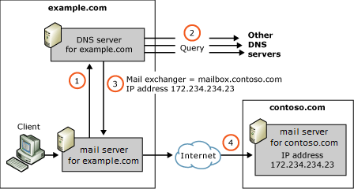
Resource Record Types (Cont.)
Mail Exchange resource record usage

Slide 64
Resource Record Types (Cont.)
Microsoft-specific resource record types:
WINS
Indicates the IPv4 address of a Windows Internet Name Service (WINS) server for WINS forward lookup.
Windows DNS Server service can use a WINS server for looking up the host portion of a DNS name.
WINS-R
Indicates the use of WINS reverse lookup (find the host portion of the DNS name given its IPv4 address).

Slide 65
Resource Record Types (Cont.)
Delegation and Glue Records
used to indicate the delegation of a subdomain to a separate zone.
A delegation is an NS record in the parent zone that lists the name server that is authoritative for the delegated zone.
A glue record is an A record for the name server that is authoritative for the delegated zone.
Glue records are needed when the name of the name server that is authoritative for the delegated zone is in the domain of the name server attempting name resolution.
A glue record is not needed when the name of the authoritative name server for the delegated zone is in a domain that is different than the domain of the zone file.
In this case, the DNS server would use normal iterative queries to resolve the name to an IP address.

Slide 66
Resource Record Types (Cont.)
Delegation and Glue Records (cont.)
Example: the name server for the microsoft.com. domain has delegated authority for the dev.microsoft.com zone to the name server devdns.dev.microsoft.com at the IPv4 address of 157.60.41.59.
In the zone file for the microsoft.com. zone, the following records must be added:
dev.microsoft.com. IN NS devdns.dev.microsoft.com.
devdns.dev.microsoft.com. IN A 157.60.41.59
Without the delegation record for dev.microsoft.com, queries for all names ending in dev.microsoft.com would fail.
Without the glue record, the microsoft.com. DNS server would be unable to locate the name server for the dev.microsoft.com. zone

Slide 67
The Root Hints Files
The root hints file (aka. the cache file) contains the names and addresses of root name servers.
For resolving domain names on the Internet, the root hints file has the records for the root servers of the Internet.
For installations not connected to the Internet, the file contains the name servers authoritative for the root of the private network.
For Windows DNS Server, The root hints file is Cache.dns stored in the systemroot/System32/Dns folder.

Slide 68
Agenda
Host Name Resolution
Domain Name System
DNS Overview
Name Resolution
Name Server Roles
Resource Records and Zones
Zone Transfers
DNS Dynamic Update
DNS Messages
DNS Client Configuration and Name Resolution Behavior (Windows)
Nslookup Tool

Slide 69
Zone Transfers - Contents
Full Zone Transfer
Incremental Zone Transfer
DNS Notify

Slide 70
Full Zone Transfer
The original DNS RFCs defined zone transfers as a transfer of the entire zone file (full zone transfer), regardless of how the file has changed since the last time it was transferred.
Full zone transfer process:
The secondary server waits until the next refresh time (as specified in the SOA resource record) and then queries the master server for the SOA resource record for the zone.
The master server responds with the SOA resource record.
The secondary server checks the Serial Number field of the returned SOA resource record.
If the serial number in the SOA resource record is higher than the serial number of the SOA resource record of the locally stored zone file, then there have been changes to the zone file on the master server and a zone transfer is needed.
Whenever a resource record is changed on the master name server, the serial number in the SOA resource record is updated.
The secondary server sends an AXFR request (a request for a full zone transfer) to the master server.
The secondary server initiates a TCP connection with the master server and requests all of the records in the zone database.
After the zone transfer, the Serial Number field in the SOA record of the local zone file matches the Serial Number field in the SOA record of the master server.

Slide 71
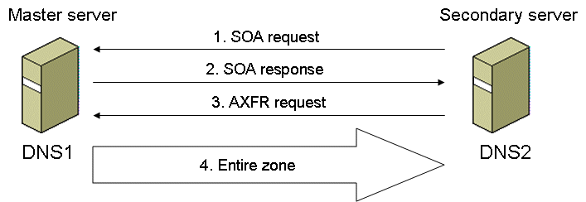
Full Zone Transfer (Cont.)

Slide 72
Full Zone Transfer (Cont.)
If the secondary server does not receive a response to the SOA query, it retries SOA queries using a retry time interval specified in the SOA resource record in the local zone file.
The secondary server continues to retry until the time elapsed since attempting to perform a zone transfer reaches an expiration time specified in the SOA resource record in the local zone file.
After the expiration time, the secondary server closes the zone file and does not use it to answer subsequent queries.
The secondary server keeps attempting to perform the zone transfer. When the zone transfer succeeds, the local zone file is opened and used for subsequent queries.

Slide 73
Incremental Zone Transfer
To minimize the amount of information that is sent in a zone transfer for changes to zone records, RFC 1995 specifies a standard method of performing incremental zone transfers.
In an incremental zone transfer, only the resource records that have changed (been added, deleted, or modified) are sent during the zone transfer.
Incremental zone transfer process
The secondary server performs the same query for the SOA record of the master server
The master server responds with the SOA resource record
The secondary server checks the Serial Number field of the returned SOA resource record. If changes exist, the secondary server sends an IXFR request (a request for an incremental zone transfer) to the master server.
The master server sends the records that have changed, and the secondary server builds a new zone file from the records that have not changed and the records in the incremental zone transfer.

Slide 74
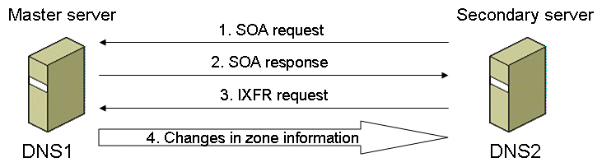
Incremental Zone Transfer (Cont.)
For the master server to determine the records that have changed, it must maintain a history database of changes made to its zone files.
The zone file changes are linked to a serial number so that the master server can determine which changes were made to the zone past the serial number indicated in the IXFR request from the secondary server.

Slide 75
DNS Notify
The original DNS RFCs do not define a notification mechanism if the master server wanted to immediately propagate a large number of changes to its secondary servers.
To improve the consistency of data among secondary servers, RFC 1996 specifies DNS Notify, an extension of DNS that allows master servers to send notifications to secondary servers that a zone transfer might be needed.
Upon receipt of a DNS notification, secondary servers request the SOA record of their master server and initiate a full or incremental zone transfer as needed.
To determine the secondary servers to which notifications should be sent, the master server maintains a notify list (a list of IP addresses) for each zone.
The master server sends notifications to only the servers in the notify list when the zone is updated.

Slide 76
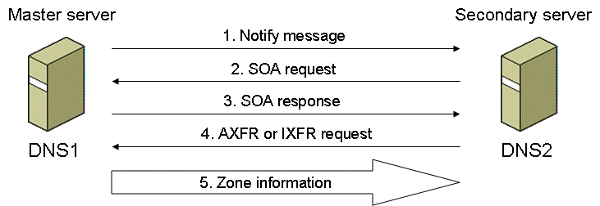
DNS Notify (Cont.)

Slide 77
Agenda
Host Name Resolution
Domain Name System
DNS Overview
Name Resolution
Name Server Roles
Resource Records and Zones
Zone Transfers
DNS Dynamic Update
DNS Messages
DNS Client Configuration and Name Resolution Behavior (Windows)
Nslookup Tool

Slide 78
DNS Dynamic Update
Manual administration of resource records in zone files works well when server and client computers that are statically configured, in which the client computers communicate only with the server computers and address configuration does not change.
In an environment where client computers often communicate directly with each other and are automatically configured using DHCP, to communicate with each other, client computers must be able to resolve each other's names; therefore they must have corresponding DNS resource records.
With DHCP, the address configuration of client computers could change every time they start.
Manually administering DNS records for this environment is obviously impractical.

Slide 79
DNS Dynamic Update (Cont.)
RFC 2136 defines DNS dynamic update to provide an automated method to populate the DNS namespace with the current names and addresses for client and server computers by dynamically updating zone data on a zone's primary server.
With DNS dynamic update, DNS records are automatically created, modified, and removed by either host computers or DHCP servers on their behalf.
A client computer that supports DNS dynamic update sends UPDATE messages to its DNS server to automatically add A, AAAA, and PTR records.
The DNS server, which must also support DNS dynamic update, verifies that the sender is permitted to make the updates and then updates its local zone files.

Slide 80
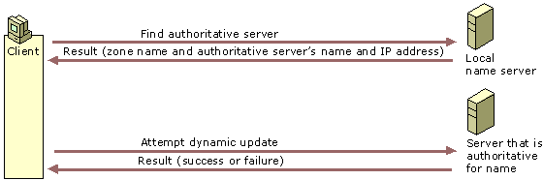
DNS Dynamic Update (Cont.)
Typical dynamic update process
The client queries its configured DNS server to find the Start of Authority (SOA) resource record for the DNS zone of the DNS name that is being updated.
The DNS client's configured DNS server performs the standard name resolution process and sends the SOA record, which contains the IP address of the primary name server for the queried DNS zone.
The client sends a dynamic update request to the primary name server for the zone of the DNS name that is being updated.
The primary name server checks the prerequisites, if fulfilled then performs the requested update else the update fails. The primary DNS server replies to the client, indicating whether the update succeeded.

Slide 81
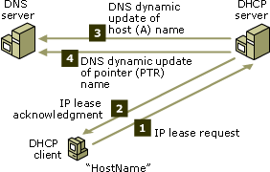
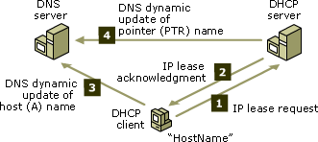
DNS Dynamic Update (Cont.)
Example dynamic update for auto-configured IP address

Slide 82
Agenda
Host Name Resolution
Domain Name System
DNS Overview
Name Resolution
Name Server Roles
Resource Records and Zones
Zone Transfers
DNS Dynamic Update
DNS Messages
DNS Client Configuration and Name Resolution Behavior (Windows)
Nslookup Tool

Slide 83
DNS Messages - Contents
Types of DNS Messages
Message Structure
Name Query Request and Response
DNS Update and Update Response

Slide 84
Types of DNS Messages
DNS Name Query Request:
sent by a DNS client or a DNS server to a DNS server to perform name resolution.
DNS Name Query Response:
sent by a DNS server to a DNS client or a DNS server to respond to a DNS name query request.
DNS Update:
sent by a DNS client to a DNS server to perform name registration.
DNS Update Response:
sent by a DNS server to a DNS client to respond to a DNS update.

Slide 85
Message Structure - Name Query Request and Response
Header
contains fields that describe the type of message and provide important information about it.
also contains fields that indicate the number of entries in the other sections of the message.
Question Entries
carries one or more “questions” (queries being sent to a DNS name server).
Answer RRs
carries one or more resource records that answer the question(s) indicated in the Question section above.
Authority RRs
contains one or more resource records that point to authoritative name servers that can be used to continue the resolution process.
Additional RRs
conveys one or more resource records that contain additional information related to the query that is not strictly necessary to answer the queries (questions) in the message.
DNS Header
(12 byte fixed length)
Question Entries
(variable length)
Answer RRs
(variable length)
Authority RRs
(variable length)
Additional RRs
(variable length)

Slide 86
Message Structure - Name Query Request and Response (Cont.)
Message Header
Transaction ID: ID created by sender to identify a specific DNS transaction (responder copies it into the response message)
allows DNS client or server to match the responses that it received from a DNS server with their requests
allows DNS server to identify duplicate requests from a DNS client.
Flags: see next slide
Question Entry Count: number of entries in the Question Entries section of the DNS message.
Answer RR Count: number of RRs in the Answer RRs section of the DNS message.
Authority RR Count: number of RRs in the Authority RRs section of the DNS message.
Additional RR Count: number of RRs in the Additional RRs section of the DNS message.
Transaction ID
Flags
Question Entry Count
Answer RR Count
Authority RR Count
Additional RR Count

Slide 87
Message Structure - Name Query Request and Response (Cont.)
Message Header - Flags
Request/Response: set to 0 for a name query request and 1 for a name query response.
Operation Code: set to 0 for a query operation.
Authoritative Answer: set to 1 in a name query response means the responder is authoritative for the FQDN in the Question RRs section
Truncation: set to 1 in a name query response means the total number of responses could not fit into the UDP-based response (response is truncated, only the first 512 bytes are returned).
Recursion Desired: set to 1 in a name query request to indicate that the query is recursive, set to 0 to indicate an iterative query.
Recursion Available: set to 1 in a name query response to indicate that the DNS server can perform recursive queries. DNS clients always set this value to zero in name query requests.
Reserved: set to 0.
Return Code: indicates the return code in a name query response.
0: successful response; the answer to the name query is in the name query response.
2: a DNS server failure because of an invalid configuration, a resource allocation error, or another critical failure.
3: a name error (FQDN being queried does not exist).
Request/Response
Operation Code
Authoritative Answer
Truncation
Recursion Desired
Recursion Available
Reserved
Return Code
= 0
Notes:
http://www.iana.org/assignments/dns-parameters

Slide 88
Message Structure - Name Query Request and Response (Cont.)
Question Entry Format
Question Name
contains the FQDN being queried, expressed as a sequence of labels e.g., contoso.com consists of two labels (contoso and com).
The maximum size of a label is 63 bytes.
the domain name is encoded as a series of length-value pairs consisting of a 1-byte Length field that indicates the length of the value, followed by the value (the label).
example: the FQDN contoso.com is expressed as 0x07contoso0x03com0x00 ([7]contoso[3]com[0])
Question Type
indicates the type of RRs to return in the Answer RRs section of the successful DNS name query response
Question Class
indicates the question class, always set to 1 to indicate the Internet (IN) question class
Question Name
Question Type
Question Class
. . .
= 0x00-01

Slide 89
Message Structure - Name Query Request and Response (Cont.)
Question Entry Format - Question Types
Type
Description
1 Host address (A)
2 Name server (NS)
5 Alias (CNAME)
6 Start of Authority (SOA)
12 Reverse-lookup (PTR)
15 Mail exchanger (MX)
28 IPv6 host (AAAA)
33 Server selection (SRV)
251 Incremental zone transfer (IXFR)
252 Standard zone transfer (AXFR)
255 All records (also means “ANY”)
Notes:
Note: it is described in RFC 6895 that resource type 255 means either ALL or ANY

Slide 90
Message Structure - Name Query Request and Response (Cont.)
Resource Record Format (Answer RRs, Authority RRs, Additional RRs)
RR Name: indicates an FQDN, can use the following formats:
length-value encoding
a 2-byte pointer value that indicates where the entire name already exists in the DNS message
a combination of a length-value encoded name and 2-byte pointer.
Record Type: indicates the RR type, same as question type (except for the value of 255).
Record Class: indicates the record class, always set to 1 to indicate the Internet (IN) class.
Time To Live: indicates the number of seconds that the information in the RR should be considered valid and can be cached by the requestor. A value of 0 indicates the requestor should not cache the RR.
Resource Data Length: indicates the length of the resource data e.g., for an A record, the length is set to 4 for the size of an IPv4 address.
Resource Data: contains the data for the RR type e.g., for an A record, the data contains an IPv4 address
RR Name
Record Type
Record Class
Time to Live
Resource Data Length
Resource Data
. . .
= 0x00-01
. . .

Slide 91
Message Structure - Name Query Request and Response (Cont.)
Resource Record Format - RR Name as a Pointer (message compression)
0 1 2 3 4 5 6 7 8 9 0 1 2 3 4 5
RR Name
1
1
0
0
0
0
0
0
0
0
0
0
1
1
0
0
Indicates
Pointer
Indicates 12th Byte Offset (starting from 0)

Slide 92
Message Structure - Name Query Request and Response (Cont.)
Resource Record Format - message compression examples
a client asks for an MX record for “contoso.com”. The response to this client will contain:
an MX Record:
Name = “contoso.com”
Type = MX
RData = “mail.contoso.com”
an A Record: assuming the name server knows the IP address of “mail.contoso.com”, the Additional section will contain an A record with
Name = “mail.contoso.com”
Type = A
RData = IPv4 Address of mail.contoso.com.
the Name field of the A record can be a pointer pointing to the RData field of the MX record
the RData field of the MX record can be a combination of length-value encoding and a pointer to its Name field:
[4] mail [pointer-to-Name-field]

Slide 93
Message Structure - DNS Update and Update Response
Header
contains fields that describe the type of message and provide important information about it.
also contains fields that indicate the number of entries in the other sections of the message.
Zone Entries
specifies the zone of the records being updated.
all records to be updated must be in the same zone (this section is allowed to contain exactly one record).
Prerequisite RRs
contains a set of RRset prerequisites which must be satisfied at the time the UPDATE packet is received by the primary master server.
Update RRs
contains RRs to be added to or deleted from the zone.
Additional RRs
contains RRs which are related to the update itself, or to new RRs being added by the update.
e.g., glue records (A RRs referred to by new NS RRs) should be presented in this section.
DNS Header
(12 byte fixed length)
Zone Entries
(variable length)
Prerequisite RRs
(variable length)
Update RRs
(variable length)
Additional RRs
(variable length)

Slide 94
Message Structure - DNS Update and Update Response (Cont.)
Message Header
Transaction ID: ID created by sender to identify a specific DNS transaction (responder copies it into the response message)
allows DNS client or server to match the responses that it received from a DNS server with their requests
allows DNS server to identify duplicate requests from a DNS client.
Flags: see next slide
Zone Entry Count: number of entries in the Zone Entries section of the DNS message.
Prerequisite RR Count: number of RRs in the Prerequisite RRs section of the DNS message.
Update RR Count: number of RRs in the Update RRs section of the DNS message.
Additional RR Count: number of RRs in the Additional RRs section of the DNS message.
Transaction ID
Flags
Zone Entry Count
Prerequisite RR Count
Update RR Count
Additional RR Count

Slide 95
Message Structure - DNS Update and Update Response (Cont.)
Message Header - Flags
Request/Response: set to 0 for an update request and 1 for an update response.
Operation Code: set to 5 for an update operation.
Reserved: set to 0.
Return Code: indicates the return code in an update response.
0: successful update.
1: DNS server could not process the request (format error)
2: DNS server encountered an internal error
3: a name that should exist doesn’t exist
4: operation code not supported
5: DNS server refuses to perform the update (due to policy or security reasons)
6: a name that should not exist does exist
7: an RR set that should not exist does exist
8: an RR set that should exist does not exist
9: server not authoritative for the zone specified
10: a name used in the Prerequisite or Update sections is not within the zone specified by the Zone Entries section
Request/Response
Operation Code
Reserved
Return Code
= 5
= 0

Slide 96
Message Structure - DNS Update and Update Response (Cont.)
Zone Entry Format
Zone Name:
contains the FQDN of the zone
expressed as a sequence of labels using the length-value format
Zone Type:
set to 6 to indicate the SOA type
Zone Class:
indicates the zone class.
always set to 1 to indicate the Internet (IN) zone class
Zone Name
Zone Type
Zone Class
. . .
= 0x00-06
= 0x00-01

Slide 97
Message Structure - DNS Update and Update Response (Cont.)
Resource Record Format (Prerequisite RRs, Update RRs, Additional RRs)
RR Name
Record Type
Record Class
Time to Live
Resource Data Length
Resource Data
RR Name: indicates an FQDN
Record Type: indicates the RR type or 255(ANY)
Record Class: indicates the record class; value can be 1(IN), 254(NONE), 255(ANY).
Time To Live: indicates the number of seconds that the information in the RR should be considered valid and can be cached by the requestor. A value of 0 means “should not cache” or “not applicable”.
Resource Data Length: indicates the length of the resource data, set to 0 if not applicable.
Resource Data: contains the data for the RR type, set to empty if not applicable
. . .
. . .
Notes:
Note: it is described in RFC 6895 that resource type 255 means either ALL or ANY
Another reference is: http://technet.microsoft.com/en-us/library/jj590781.aspx

Slide 98
Message Structure - DNS Update and Update Response (Cont.)
Prerequisite RRs
possible sets of values:
RR Set Exists (Value Independent)
at least one RR with a specified name and type (in the zone and class specified by the Zone Entries section) must exist.
a requestor adds to the section a single RR whose NAME and TYPE are equal to that of the zone RR set whose existence is required
RR Set Exists (Value Dependent)
a set of RRs with the same name and type exists and has the same members with the same data as the RR set specified in this section.
a requestor adds to the section an entire RR set whose preexistence is required
RR Set Does Not Exist
no RRs with a specified name and type (in the zone and class denoted by the Zone Entries section) exist.
a requestor adds to the section a single RR whose NAME and TYPE are equal to that of the RR set whose nonexistence is required

Slide 99
Message Structure - DNS Update and Update Response (Cont.)
Prerequisite RRs (cont.)
possible sets of values (cont.):
Name is in Use
at least one RR with a specified name (in the zone and class specified by the Zone Entries section) exists.
a requestor adds to the section a single RR whose NAME is equal to that of the name whose ownership of an RR is required
Name is Not in Use
no RR of any type is owned by a specified name
a requestor adds to the section a single RR whose NAME is equal to that of the name whose non-ownership of any RRs is required

Slide 100
Message Structure - DNS Update and Update Response (Cont.)
Prerequisite RRs (cont.)
RR contents:
Prerequisite | Name | Type | Class | TTL | RDLength | RData
RR Set Exists (Value Independent) |  |  | ANY | 0 | 0 | empty
RR Set Exists (Value Dependent) |  |  | is that of the zone | 0
RR Set Does Not Exist |  |  | NONE | 0 | 0 | empty
Name Is In Use |  | ANY | ANY | 0 | 0 | empty
Name Is Not In Use |  | ANY | NONE | 0 | 0 | empty

Slide 101
Message Structure - DNS Update and Update Response (Cont.)
Update RRs
operations that can be performed during the update:
Add RRs to an RR set
RRs are added to the Update section whose NAME, TYPE, TTL, RDLENGTH and RDATA are those being added
Delete an RR set
one RR is added to the Update section whose NAME and TYPE are those of the RR set to be deleted.
Delete all RR sets from a name
one RR is added to the Update section whose NAME is that of the name to be cleansed of RR sets
Delete an RR from an RR set
RRs to be deleted are added to the Update Section. The NAME, TYPE, RDLENGTH and RDATA must match the RR being deleted.

Slide 102
Message Structure - DNS Update and Update Response (Cont.)
Update RRs (cont.)
RR contents:
Operation | Name | Type | Class | TTL | RDLength | RData
Add RRs to an RR set |  |  | is that of the zone
Delete an RR set |  |  | ANY | 0 | 0 | empty
Delete all RR sets from a name |  | ANY | ANY | 0 | 0 | empty
Delete an RR from an RR set |  |  | NONE | 0

Slide 103
Agenda
Host Name Resolution
Domain Name System
DNS Overview
Name Resolution
Name Server Roles
Resource Records and Zones
Zone Transfers
DNS Dynamic Update
DNS Messages
DNS Client Configuration and Name Resolution Behavior (Windows)
Nslookup Tool

Slide 104
DNS Client Configuration and Name Resolution Behavior - Contents
DNS Client Configuration
Name Resolution Behavior

Slide 105
DNS Client Configuration
View current DNS configuration:
ipconfig /all
netsh interface ipv4 show dns
netsh interface ip show dns
GUI (network connection status)
Configure DNS manually
netsh interface ipv4 set dnsservers
netsh interface ip set dnsservers
GUI (network connection status)
Configure DNS automatically using DHCP
DNS Servers DHCP option (option 6)
DNS Domain Name DHCP option (option 15)
If DNS servers or the connection-specific domain name are manually configured in the properties of the TCP/IP component, the DNS Client service ignores the DHCP-based DNS settings.

Slide 106
Name Resolution Behavior
An application can submit one of the following types of names:
Fully qualified domain name (FQDN)
Names that are terminated with a period, indicating the name relative to the root domain of the DNS.
e.g., host7.example.com.
Single-label, unqualified domain names
Names that consist of a single label and contain no periods.
e.g., host7
Multiple-label, unqualified domain names
Names that contain more than one label and one or more periods but are not terminated with a period.
e.g., host7.example or example.com

Slide 107
Name Resolution Behavior (Cont.)
Name Resolution for FQDNs
The resolver queries DNS using the FQDN. No other combinations are tried.
Name Resolution for Single-Label, Unqualified Domain Names
The resolver appends the DNS suffixes to the single-label, unqualified domain name based on DNS Settings in the Advanced TCP/IP Settings of the TCP/IP component.
If the Append primary and connection specific DNS suffixes check box is selected,
the resolver appends the following names and sends separate queries:
the primary DNS suffix, as specified on the Computer Name tab of the System item of Control Panel.
each connection-specific DNS suffix, assigned either through DHCP or specified in the DNS suffix for this connection box on the DNS tab in the Advanced TCP/IP Settings dialog box for each connection.

Slide 108
Name Resolution Behavior (Cont.)
Name Resolution for Single-Label, Unqualified Domain Names (cont.)
If resolution is still not successful and the Append parent suffixes of the primary DNS suffix check box is selected,
the resolver creates new FQDNs by appending the single-label, unqualified domain name with the parent suffix of the primary DNS suffix name, and the parent of that suffix, and so on, stopping at the second-level domain name.
e.g., if the application specified the name emailsrv7 and the primary DNS suffix is central.example.com., the resolver tries to resolve the FQDNs of emailsrv7.central.example.com. and emailsrv7.example.com.
If resolution is still not successful and the Append these suffixes check box is selected
the resolver appends each suffix from the search list in order and submits the FQDN to the DNS server until the resolver finds a match or reaches the end of the list.
e.g., if the application specified the name filesrv11 and the DNS suffix list consists of admin.wcoast.example.com., admin.ecoast.example.com., and admin.central.example.com., the resolver tries the FQDNs of filesrv11.admin.wcoast.example.com., filesrv11.admin.ecoast.example.com., and filesrv11.admin.central.example.com.

Slide 109
Name Resolution Behavior (Cont.)
Name Resolution for Multiple-Label, Unqualified Domain Names
The DNS resolver uses the same process as that for a single-label, unqualified domain name to resolve the name.

Slide 110
Agenda
Host Name Resolution
Domain Name System
DNS Overview
Name Resolution
Name Server Roles
Resource Records and Zones
Zone Transfers
DNS Dynamic Update
DNS Messages
DNS Client Configuration and Name Resolution Behavior (Windows)
Nslookup Tool

Slide 111
Nslookup Tool
Used to display any resource record on any DNS server
noninteractive mode: individual command-line queries
interactive mode: issue successive commands from an Nslookup prompt
Syntax:
interactive mode using default server
nslookup [-opt ...]
interactive mode using server
nslookup [-opt ...] - server
just look up 'host' using default server
nslookup [-opt ...] host
just look up host using server
nslookup [-opt ...] host server
to view available options and interactive mode commands: enter interactive mode and type help

Slide 112
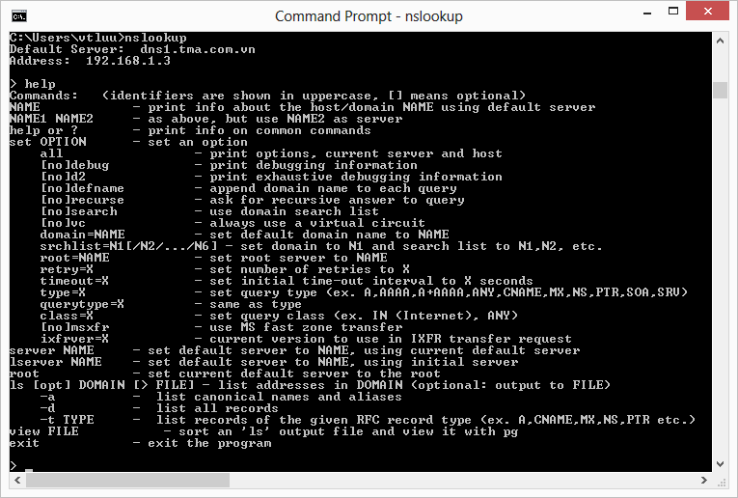
Nslookup Tool (Cont.)

Slide 113
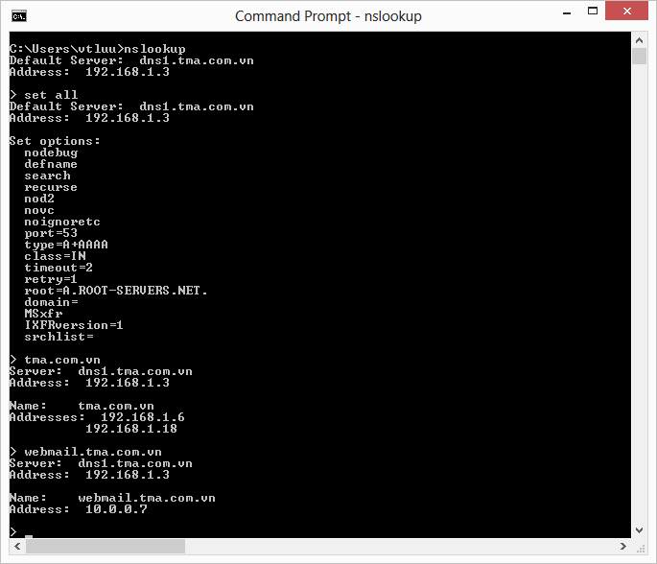
Nslookup Tool (Cont.)

Slide 114
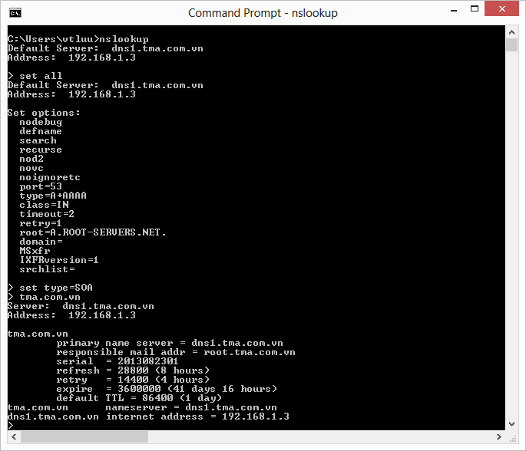
Nslookup Tool (Cont.)

Slide 115
References
RFCs 974, 1034, 1035, 1995, 1996, 2136, 2308
TCP/IP Fundamentals For Microsoft Windows (Joseph Davies, Microsoft)
Windows Server 2008 TCP/IP Protocols and Services (Joseph Davies, Microsoft)

