Slide 1



Understanding DNS

Slide 2
CONTENTS
I. Background
II.DNS in protocol
III. DNS in configuration
IV. Advanced features
V. Tools
VI. Demo
VII. ALU DNS 6.0
VIII. References

Slide 3
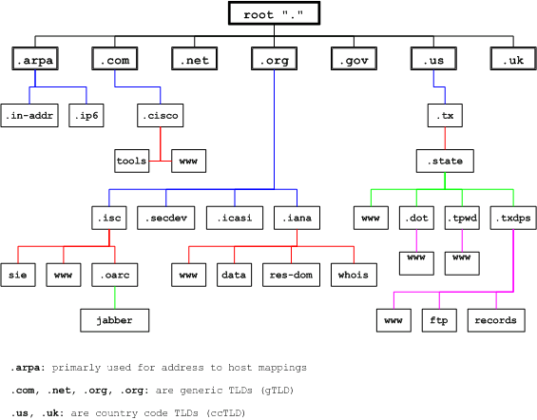
BACKGROUND
  What is DNS (Domain Name System)? distributed, scalable, hierarchical and dynamic database provide mapping between host name, IP address (IPv4 and IPv6), name server, text record and mail exchange information, … :

Slide 4
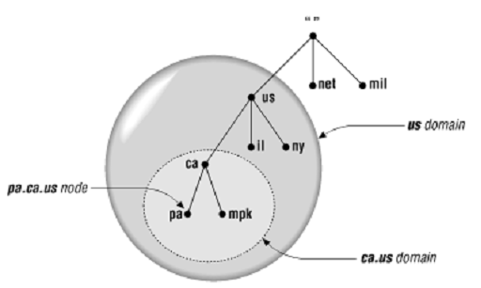
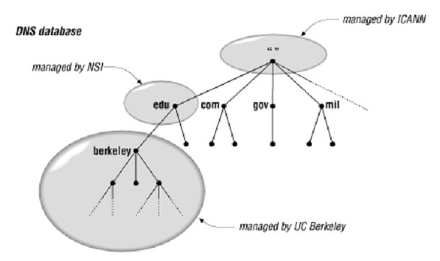
BACKGROUND
  Important DNS terminology:
  Domain and subdomain

Slide 5
BACKGROUND
  Important DNS terminology:
  TLD (Top level domain): child of root
Us, vn are ccTLDs (country code TLD)
Mil, net are gTLDs (Generic TLD)

Slide 6
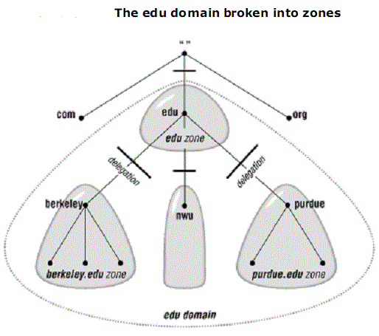
BACKGROUND
  Important DNS terminology:
  Name server and zone
  -Name server: The programs that store information about the domain name space.
  -Name servers generally have complete information a zone, which they load from a file or from another name server.
  -The name server is then said to have authority for that zone
  -Name servers can be authoritative for multiple zones

Slide 7
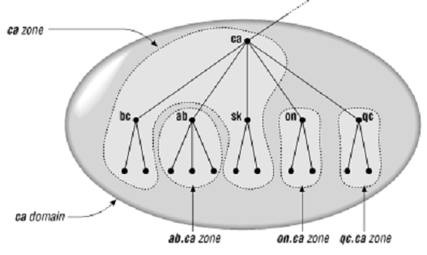
BACKGROUND
  Important DNS terminology:
  Domain name and zone
  Zone and domain can share the domain name (ca) but contain different node
  Domain name ca contains all data in ca + all data in ab.ca, on.ca and qc.ca
  Zone ca only contains all data in ca
Imagine if a root name server loaded the root domain instead of the root zone: it would be loading the
entire namespace!
That’s why name servers load zones instead of domains !!!

Slide 8
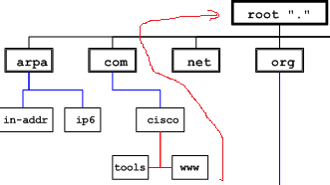
BACKGROUND
  Important DNS terminology:
  Name server type
  Master and slave. Slave gets zone data from master server.
  A name server can be a primary master for one zone and a slave for another
Label “com”
  Label, domain name and FQDN
  Each domain name (cisco.com) is composed one or more labels. Maximum length of a label is 63 characters (letter, digit and hyphen “-”)
  FQDN (E.g: www.cisco.com.) contains a maximum of 255 characters.
FQDN: www.cisco.com.”

Slide 9


BACKGROUND
  Important DNS terminology:
  Recursive query
“.” root NS
2
Local NS
3
www.tma.com.vn
9
8
1
Vn. ns
10
www.tma.com.vn A IN 221.133.0.1
4
If host queries www.fpt.com.vn, local ns sends to which ns?
7
com.vn. ns
5
6
Tma.com.vn. ns

Slide 10
BACKGROUND
  Important DNS terminology:
  Recursive query
“.” root ns
Local NS
www.fpt.com.vn
13
14
Vn. ns
18
www.fpt.com.vn IN A 193.2.3.4
17
com.vn. ns
16
15
Fpt.com.vn. ns
Tma.com.vn. ns

Slide 11
BACKGROUND
  Important DNS terminology:
  Iterative query
“.” root NS
What happens if host queries www.fpt.com.vn?
4 ask vn
3
Local NS
www.tma.com.vn
1
2 ask root
5
4
Vn. ns
6 ask com.vn
7
9 www.tma.com.vn IN A 221.133.0.1
com.vn. ns
8
8 ask tma.com.vn
Tma.com.vn. ns

Slide 12
BACKGROUND
  Important DNS terminology:
  Real deployment
Iterative mode
“.” root NS
NS is configured as forwarder and recursive mode
4
Lab 3 NS
Vn. ns
Iterative mode
10
9
3
6
1
5
2
com.vn. ns
7
Iterative mode
8
Tma.com.vn. ns
Recursive mode

Slide 13
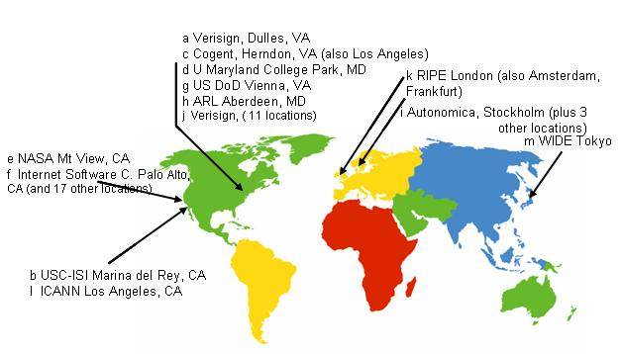
BACKGROUND
  Important DNS terminology:
  Root servers

Slide 14
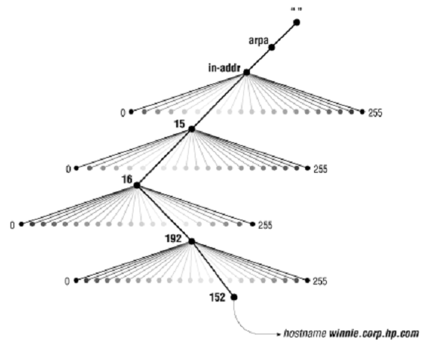
BACKGROUND
  Important DNS terminology:
  Mapping addresses to names:
A: 15.16.192.152.
152.192.16.15.in-addr.arpa
Q: What is IP address of winnie.corp.hp.com?

Slide 15
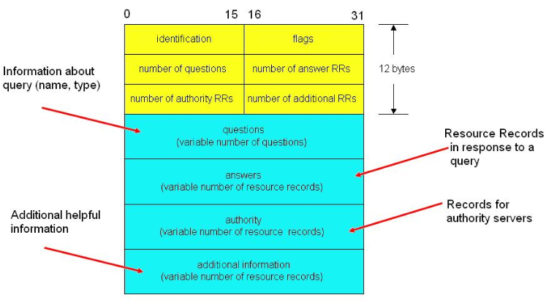
II. DNS in Protocol
  Message format
Resolver generates ID and is copied in the coresponding reply

Slide 16
II. DNS in Protocol
QR | Opcode | AA | TC | RD | RA | Z | RCODE
  Flags
- QR (1bit): Query(0)/Response(1)
- OpCode (4bits):
0: a standard query (QUERY)
1: a inverse query (IQUERY)
2: Server status req (STATUS)
3-15: Reserved
- AA (1 bit): Authoritative Answer. Set in response, server is an authority for domain name in question
TC (1bit): Truncation: message was truncated due to length greater than transmission channel
RD (1 bit): Recursion Desired. It is set in Query that directs the name server to pursue the query recursively
RA (1bit): Recursion Available. It is set in Response which denotes whether recursive query support is available in the name server
Z (3bits): Reserved. Must be in Zero
RCODE (4bits): Response code
ID | FLAGS
nb of Question RRs | nb of Answer RRs
nb ofAuthority RRs | nb of Additional RRs
Questions
Answers
Authority
Additional Info

Slide 17
II. DNS in Protocol
  Question section format
QTYPE:Name – Value - Meaning
  A 1 a host address
  NS 2 an authoritative name server
  MD 3 a mail destination (Obsolete - use MX)
  MF 4 a mail forwarder (Obsolete - use MX)
  CNAME 5 the canonical name for an alias
  SOA 6 marks the start of a zone of authority
  MB 7 a mailbox domain
  MG 8 a mail group member
  MR 9 a mail rename domain name
  NULL 10 a null RR
  WKS 11 a well known service description
  PTR 12 a domain name pointer
  HINFO 13 host information
  MINFO 14 mailbox or mail list information
  MX 15 mail exchange
  TXT 16 text strings
1 |  |  |  | 15
QNAME
QTYPE
QCLASS
ID | FLAGS
nb of Question RRs | nb of Answer RRs
nb ofAuthority RRs | nb of Additional RRs
Questions
Answers
Authority
Additional Info

Slide 18
II. DNS in Protocol
  Question section format
1 |  |  |  | 15
QNAME
QTYPE
QCLASS
QCLASS:
  IN 1 the Internet
  CS 2 the CSNET class (Obsolete)
  CH 3 the CHAOS class
  HS 4 Hesiod
ID | FLAGS
nb of Question RRs | nb of Answer RRs
nb ofAuthority RRs | nb of Additional RRs
Questions
Answers
Authority
Additional Info

Slide 19
II. DNS in Protocol
  Answer, Authoritive and Additional section format
1 |  |  |  | 15
NAME
TYPE
CLASS
TTL
RLENGTH
RDATA
TTL: interval that RR may be cached before it should be discarded. 0 should not be cached
ID | FLAGS
nb of Question RRs | nb of Answer RRs
nb ofAuthority RRs | nb of Additional RRs
Questions
Answers
Authority
Additional Info

Slide 20
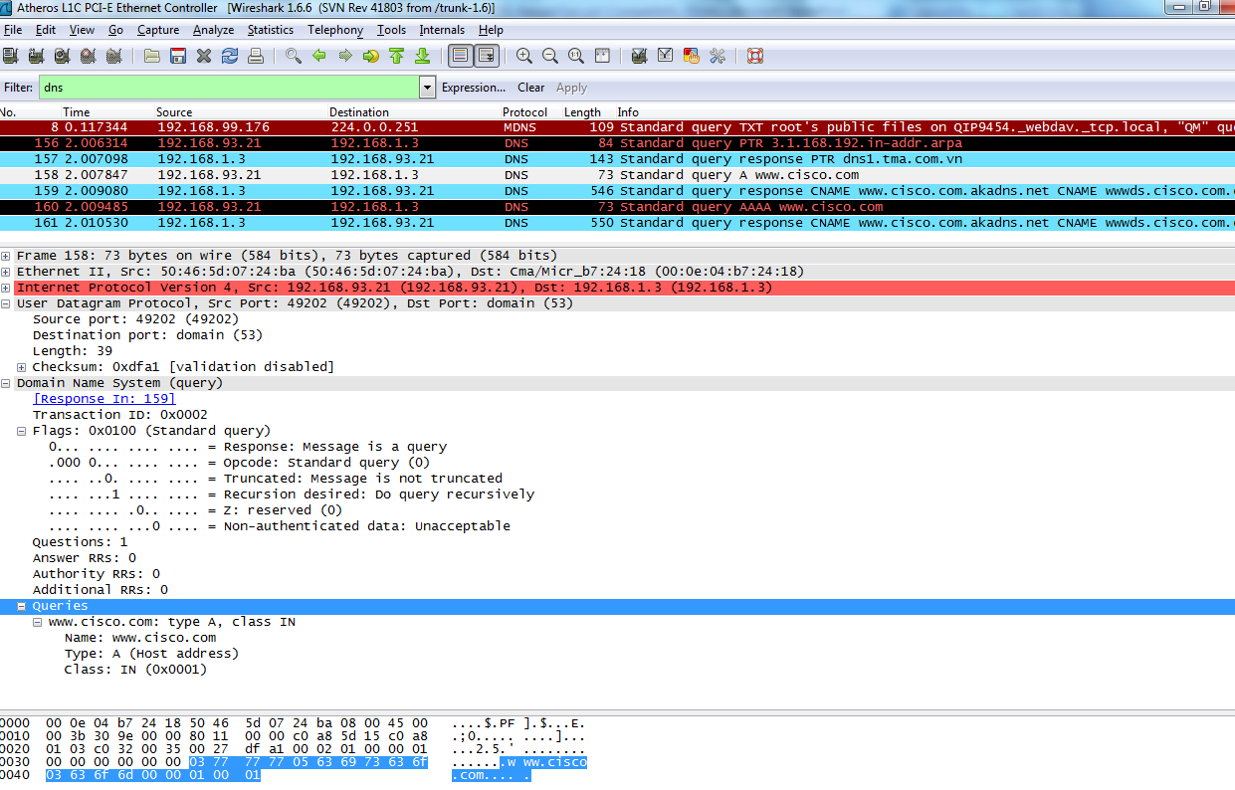
II. DNS in Protocol
  Message format

Slide 21
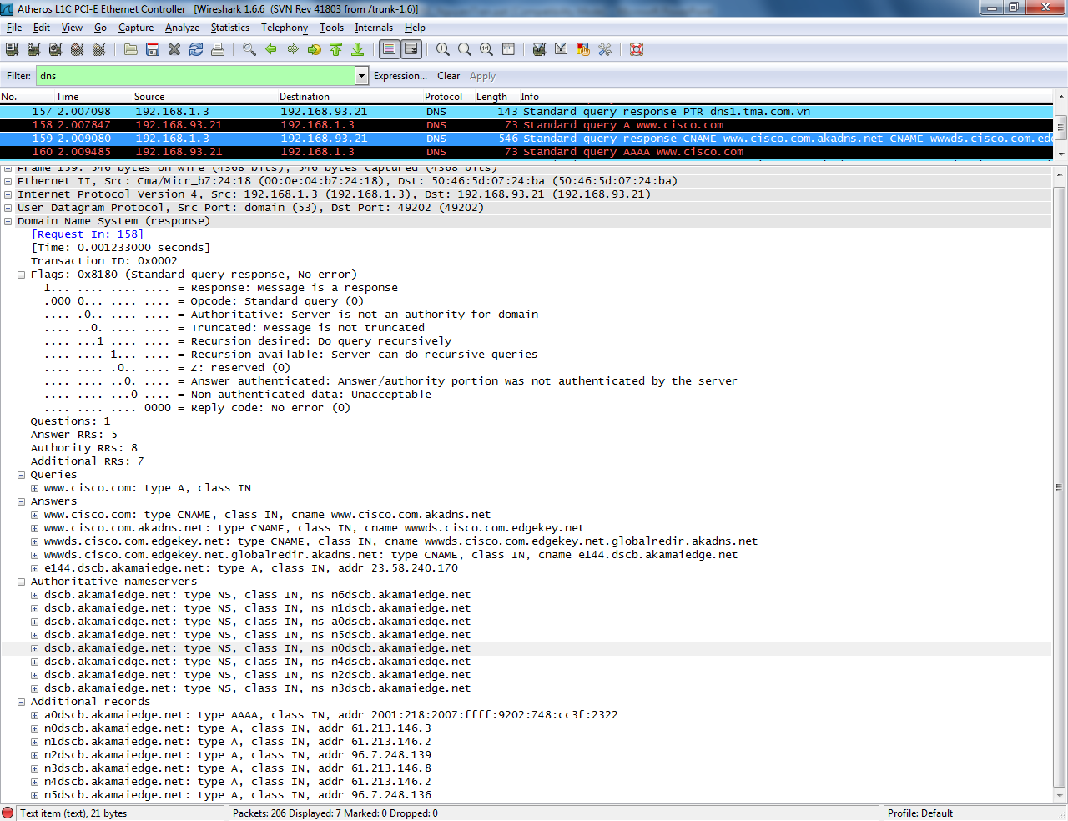
II. DNS in Protocol
  Mapping addresses to names:

Slide 22
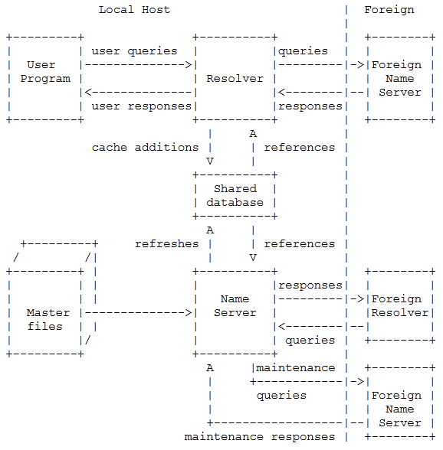
II. DNS in Protocol
  Typical information flows:

Slide 23
II. DNS in Protocol
  Size limits in DNS:
  Label: 63 octets or less
  Name: 255 octets or less
  UDP message: 512 bytes
  Labels is in a case insensitive manner ( a=A)
  Transport:
  DNS can run on TCP or UDP (both in port 53)

Slide 24



II. DNS in Protocol
  Scenario of RRs: CNAME
www.tma.com.vn IN CNAME srv1.tma.com.vn
ftp.tma.com.vn IN CNAME srv1.tma.com.vn
srv1.tma.com.vn IN A 192.168.1.11
11.1.168.192.in-addr-apra IN PTR srv1.tma.com.vn
Name IN CNAME real name
Q: www.tma.com.vn type A
DNS
Q: www.tma.com.vn type A
A:www.tma.com.vn IN CNAME srv1.tma.com.vn
Srv1.tma.com.vn IN A 192.168.1.11
srv1.tma.com.vn
192.168.1.11

Slide 25
II. DNS in Protocol
  Scenario of RRs: CNAME
www.tma.com.vn IN CNAME srv1.tma.com.vn
ftp.tma.com.vn IN CNAME srv1.tma.com.vn
srv1.tma.com.vn IN A 192.168.1.11
11.1.168.192.in-addr-apra IN PTR srv1.tma.com.vn
Name IN CNAME real name
Q: www.tma.com.vn type CNAME
DNS
Q: www.tma.com.vn type A
A:www.tma.com.vn IN CNAME srv1.tma.com.vn
srv1.tma.com.vn
192.168.1.11

Slide 26
II. DNS in Protocol
  Scenario of RRs: MX
Gmail.com IN MX 5 mail1.gmail.com
Gmail.com IN MX 10 mail2.gmail.com
mail1.gmail.com IN A 192.168.10.17
Mail2.gmail.com IN A 192.168.10.18
Name IN MX preference exchange
Q: gmail.com type MX
DNS
Q: gmail.com type MX
A: Gmail.com IN MX 5 mail1.gmail.com
Gmail.com IN MX 10 mail2.gmail.com
mail1.gmail.com IN A 192.168.10.17
Mail2.gmail.com IN A 192.168.10.18
Send email to mail1
mail1.gmail.com
192.168.10.17
mail2.gmail.com
192.168.10.18
Lower preference high priority !!!

Slide 27
II. DNS in Protocol
  Scenario of RRs: HINFO
Name IN HINFO “CPU” “OS”
Srv1.tma.com.vn IN HINFO “Sandy bridge” “CenOS”
Q: srv1.tma.com.vn type HINFO
DNS
Q: srv1.tma.com.vn type HINFO
A:www.tma.com.vn IN CNAME srv1.tma.com.vn
srv1.tma.com.vn
192.168.1.11

Slide 28
II. DNS in Protocol
  Scenario of RRs: HINFO
Name IN HINFO “CPU” “OS”
Srv1.tma.com.vn IN HINFO “Sandy bridge” “CenOS”
Q: srv1.tma.com.vn type HINFO
DNS
Q: srv1.tma.com.vn type HINFO
A:srv1.tma.com.vn IN HINFO “sandy Bridge” Cenos
srv1.tma.com.vn
192.168.1.11

Slide 29
II. DNS in Protocol
  Scenario of RRs: TXT
Name IN TXT string
Srv1.tma.com.vn IN TXT lab1 “111 NDC QPN”
Q: srv1.tma.com.vn type TXT
DNS
Q: srv1.tma.com.vn type TXT
A: srv1.tma.com.vn IN TXT lab “111NDC QPN”
srv1.tma.com.vn
192.168.1.11

Slide 30
II. DNS in Protocol
  Scenario of RRs: AAAA
Name IN AAAA string
www.tma.com.vn IN AAAA 2001::2
Q: www.tma.com.vn type AAAA
DNS
Q: www.tma.com.vn type AAAA
A: www.tma.com.vn AAAA=2001::2
srv1.tma.com.vn
192.168.1.11
2001::2

Slide 31

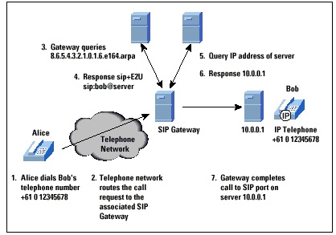
II. DNS in Protocol
  Scenario of ENUM:

Slide 32
III.DNS in Configuration
  Name server configuration file: named.conf
options {
directory "/opt/qip/named";
//place additional options here
};
zone “tma.com.vn" in {
type master;
file “db.tma.com.vn";
};
zone "93.168.192.in-addr.arpa" in {
type master;
file "db.93.168.192.in-addr.arpa";
};

Slide 33
III.DNS in Configuration
  Zone configure file: e.g: db.tma.com.vn
SOA record
Indicates authority for this zone
NS record
Lists a name server for this zone
Other records
Data about hosts in this zone

Slide 34
III.DNS in Configuration
  Zone configure file: e.g: db.tma.com.vn
SOA record
Indicates authority for this zone
NS record
Lists a name server for this zone
Other records
Data about hosts in this zone
Name server
Email of administrator of this zone, @ replaced by “.”
tma.com.vn. IN SOA srv1.tma.com.vn. admin.tma.com.vn. (
1 ; Serial – for zone transfer
3h ; Refresh after 3 hours – to slave poll master update
1h ; Retry after 1 hour – to slave send update if the first time request fail
1w ; Expire after 1 week- to slave continue using data if primary fail
1h ) ; Negative caching TTL- to cache negative responses to reduce traffic bw resolver and ns
Domain name with dot “.” in the end

Slide 35
III.DNS in Configuration
  Zone configure file: e.g: db.tma.com.vn
SOA record
Indicates authority for this zone
NS record
Lists a name server for this zone
Other records
Data about hosts in this zone
tma.com.vn. IN NS srv1.tma.com.vn.

Slide 36
III.DNS in Configuration
  Zone configure file: e.g: db.tma.com.vn
SOA record
Indicates authority for this zone
NS record
Lists a name server for this zone
Other records
Data about hosts in this zone
srv1 IN A 192.168.1.13
tma.com.vn IN MX 10 srv2.tma.com.vn

Slide 37
III.DNS in Configuration
  Reverse Zone configure file: db.192.168.1.in-addr.arpa
SOA record
Indicates authority for this zone
NS record
Lists a name server for this zone
PTR records
Data about hosts in this zone
3 IN PTR srv1.tma.com.vn
11 IN PTR srv2.tma.com.vn

Slide 38
IV. Advanced features
  rndc (remote name daemon control)
Rndc can control many name servers
To run rndc: rndc –s srv1.tma.com.vn -c rndc.conf reload
To dump cache: rndc –c rndc.conf dumpdb –cache
To clear cache: Rndc –c rndc.conf flush
To check version of name server: Rndc –c rndc.conf status
To stop name server: Rndc –c rndc.conf stop
To start name server: Rndc –c rndc.conf start
To restart name server: Rndc –c rndc.conf restart
To reload name server without stop service: Rndc –c rndc.conf reload

Slide 39
IV. Advanced features
  TSIG (transaction signatures)
TSIG uses shared secrets and a one-way hash function (MD5) to authenticate DNS messages, particularly responses and
updates.
DNS message m
m
MD5(m,k)
NS A
NS B
Shared secret k
Shared secret k

Slide 40
IV. Advanced features
  TSIG (transaction signatures)
TSIG uses shared secrets and a one-way hash function (MD5) to authenticate DNS messages, particularly responses and
updates.
DNS message m
m
MD5(m,k’)
m
MD5(m,k)
NS A
NS B
Attacker
Shared secret k
Shared secret k
Caveats:
- If someone compromises NS A, there is no security
- TSIG uses shared secret key, no practical to configure TSIG among many servers
Md5(m,k) != MD5(m,k’) => NS B knows NS A is attacked

Slide 41
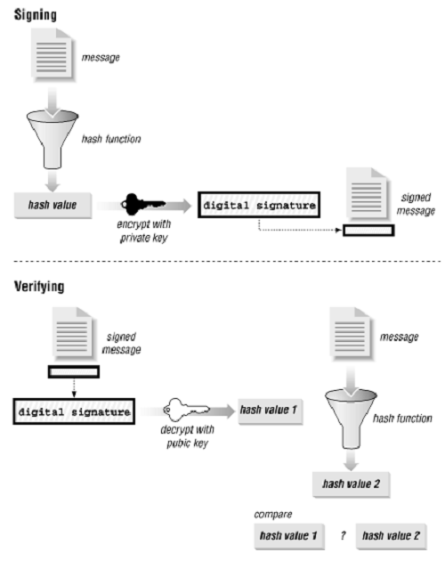
IV. Advanced features
  DNSSEC (DNS SECurity Extensions)
To solve TSIG limitations by using public key cryptography for authenticity.
Private key is stored in a file
Public key is stored in KEY record

Slide 42
IV. Advanced features
  DNSSEC (DNS SECurity Extensions) : KEY record of a zone
vital.com. IN KEY 256 3 1 AQPdWbrGbVv1eDhNgRhpJMPonJfA3reyEo82ekwRnjbX7+uBxB11BqL7 LAB7/C+eb0vCtI53FwMhkkNkTmA6bI8B
key
Flags
Purpose of key: 0(reserved), 1(TLS), 2(MIME, 3 (DNSSEC), 4 (IPSEC), 4…255 (future use)
Algorithm: 0 (reserves), 1(RSA/MD5), 2(Diffie Hellman), 3 (DSA)

Slide 43
IV. Advanced features
  DNSSEC (DNS SECurity Extensions) : SIG record
Algorithm
Type record signed: A mean Address record
Nb of labels
Original TTL of record
Srv1.tma.com.vn. SIG A 1 4 86400 20010102235426 (
20001203235426 27791 tma.com.vn.
1S/LuuxhSHs2LknPC7K/7v4+PNxESKZnjX6CtgGLZDWf
Rmovkw9VpW7htTNJYhzlFck/BO/k17tRj0fbQ6JWaA== )
Expiration
Inception: time when ran the program
Key tag: in case many pb/pr key pairs
Signer’s name
Signature field

Slide 44
IV. Advanced features
  ACLs (access control list)
Acl aclname {acl match list} // to use in security feature
e.g: acl internal {192.168.0.0/16; 137.116.158.0/24; 192.168.93.4/32};

Slide 45
IV. Advanced features
  Bogus and blackhole
options {
/* Ignore traffic from ns 8.8.8.8 because it tries to destruct my name server
server 8.8.8.8 {
bogus yes;
}
};
options {
/* Don't waste your time trying to respond to queries from RFC 1918 private addresses */
blackhole {
10/8;
172.16/12;
192.168/16;
};
};

Slide 46
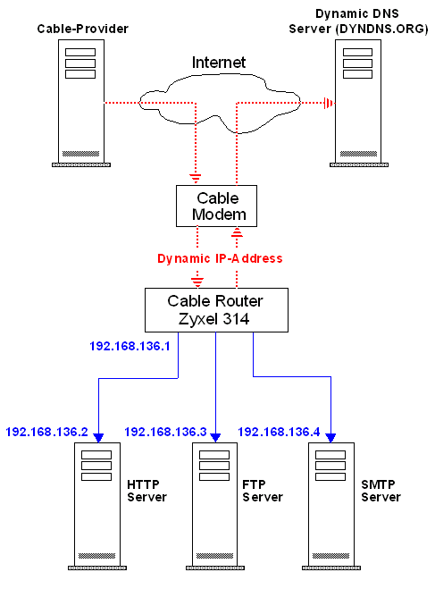
IV. Advanced features
  DNS Dynamic Update
Dynamic update enables DNS client computers to register and dynamically update their resource records with a DNS server whenever changes occur. The Dynamic DNS service allows you to alias a dynamic IP address to a static hostname

Slide 47
IV. Advanced features
  DNS manual Update
Can do adding or deleting RR manually
e.g: Check if mib.fx.movie.edu already had MX records. If yes, delete the old Mxes and then add 2 new MXes
% nsupdate
> prereq yxrrset mib.fx.movie.edu. MX
> update delete mib.fx.movie.edu. MX
> update add mib.fx.movie.edu. 600 MX 10 mib.fx.movie.edu.
update add mib.fx.movie.edu. 600 MX 50 postmanrings2x.movie.edu.

Slide 48
IV. Advanced features
  DNS NOTIFY (Zone change notification)
If primary DNS has any changes, it sends a signal to slave for zone transfer. Configure as below:
options {
notify yes; //to apply for all zones, globally mode
};
Or
zone “tma.com.vn" {
type master;
file "db.tma.com.vn";
notify yes; //to apply for only zone tma.com.vn
};

Slide 49
V. Tools: Nslookup
  1 nslookup: talks to only 1 ns at a time while resolver can talk more
> set all
Default Server: dns1.tma.com.vn
Address: 192.168.1.3
Set options:
nodebug
defname
search
recurse
nod2
novc
noignoretc
port=53
type=A+AAAA
class=IN
timeout=2
retry=1
root=A.ROOT-SERVERS.NET.
domain=tma.com.vn
MSxfr
IXFRversion=1
srchlist=tma.com.vn/com.vn
Common examples:
Nslookup www.abc.com //make query A in recursive mode
Nslookup –d2 www.abc.com // show debug
Nslookup 192.168.1.2 // make query PTR
Nslookup –norecur www.abc.com //make query A in iterative mode
Nslookup –querytype=cname www.abc.com // make query CNAME

Slide 50
V. Tools – DIG Domain Information Groper
  2.Dig
dig www.abc.com //make query A for www.abc.com
dig abc.com mx //make query MX for abc.com
dig @192.168.1.3 abc.com.edu. soa //make query SOA of abc.com in server 192.168.1.3
dig @ns1.abc.com abc.com axfr //transfer zone abc.com from server ns1.abc.com
dig www.abc.com +norecur //make query A for www.abc.com in iterative mode

Slide 51
V. Tools – Wireshark filter
  3.Wireshark filters
Udp.port ==Port 53 //capture dns packets
udp.port ==67 or udp.port==68 //capture dhcp packets
Dns //capture dns packets
ip.addr == 10.0.0.1 //capture packets have ip addr=10.0.0.1
ip.addr==10.0.0.1 && ip.addr==10.0.0.2

Slide 52

VI. Demo
  Example topology: Organization vitalqip.com
dns,dhcp
Lab3
Srv1:192.168.93.218
Srv2:192.168.93.219
192.168.1.0/24
Lab1
192.168.93.0/24
Lab5
ftp,mail, www
137.116.157.0/24
Srv3:192.168.93.195
Srv4:192.168.93.196

Slide 53
VII. ALU DNS 6.0
  ALU DNS is BINDv9 that maintained by the Internet Systems Consortium
  News in BINDv9:
  + port to different platforms
  + support DNSSEC, TSIG, notify, DNS notify, nsupdate, IPv6, rndc
  News in ALU DNS 6.0:
  + SNMP, slave updates,
  + External Dynamic Update (EDUP)
  + QDDNS policies/options (for dynamic DNS update)
  + Enhanced statistics support
  + Special named.conf policies

Slide 54
VIII. REFERENCES and BIBLIOGRAPHY
  RFC 1034 Domain Concepts and Facilities November 1987
  DOMAIN NAMES - IMPLEMENTATION AND SPECIFICATION November 1987
  OReilly DNS and BIND 4th Edition

Slide 55

For more information, please contact:
Nguyen Tran
Email: tvnguyen@tma.com.vn
111 Nguyen Dinh Chinh St.
Phu Nhuan District., Ho Chi Minh City, Vietnam
Tel: (84-8) 990-3848 - Fax: (84-8) 990-3303
www.tmasolutions.com

Slide 56
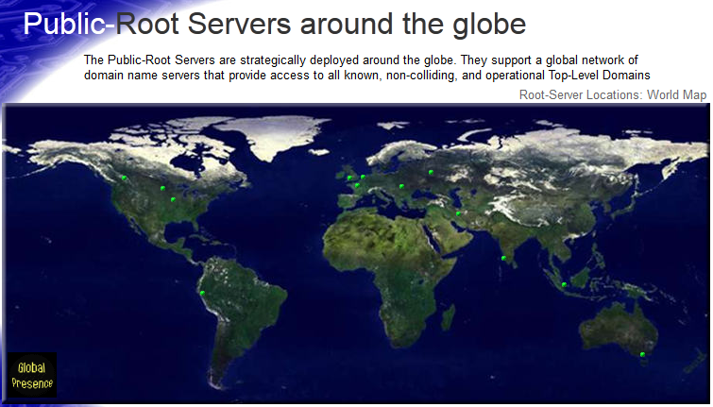
BACKGROUND (12/13)
  Important DNS terminology:
  Root servers
a.public-root.net
Amsterdam, The Netherlands
IP 84.22.106.2
d.public-root.net
London, UK
IP 80.252.121.2
k.public-root.net
Moscow, Russia
IP 82.146.40.113
h.public-root.com
Des Moines, Iowa, USA
208.71.35.13
e.public-root.net
Kelowna, British Columbia, Canada
IP 209.97.212.120
l.public-root.com
Tehran, Iran
IP 128.65.160.37
g.public-root.net
Chicago, Illinois, USA
IP 199.5.157.131
i.public-root.com
Chennai, Tamilnadu, India
122.183.133.220
m.public-root.com
Chimbote, Peru
IP 200.37.61.62
c.public-root.com
Paris, France
IP 91.121.45.127
j.public-root.net
Singapore
IP 84.22.100.89
b.public-root.com
Budapest, Hungary
IP 79.172.201.120
f.public-root.com
Melbourne, Victoria, Australia
IP 84.22.100.250

