Slide 1
Dynamic Host Configuration Protocol (DHCP)
Luu Vo
Sep 2013

Slide 2
Agenda
DHCP Overview
How DHCP Works
DHCP Options
DHCP Server Overview
Ipconfig Tool

Slide 3
Agenda
DHCP Overview
How DHCP Works
DHCP Options
DHCP Server Overview
Ipconfig Tool

Slide 4
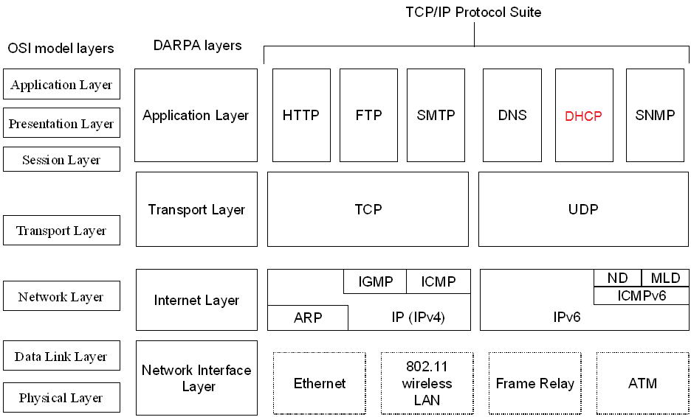
DHCP Overview

Slide 5
DHCP Overview (Cont.)
a TCP/IP standard that reduces the complexity and administrative overhead of managing network client IPv4 addresses and other configuration parameters
A DHCP infrastructure consists of the following elements
DHCP servers: computers that offer dynamic configuration of IPv4 addresses and related configuration parameters to DHCP clients.
DHCP clients: network nodes that support the ability to communicate with a DHCP server to obtain a dynamically leased IPv4 address and related configuration parameters.
DHCP relay agents: network nodes (e.g., routers) that listen for broadcast and unicast DHCP messages and relay them between DHCP servers and DHCP clients.
Without DHCP relay agents, you would have to install a DHCP server on each subnet that contains DHCP clients.

Slide 6
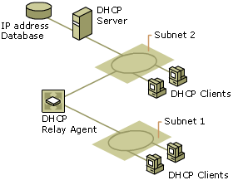
DHCP Overview (Cont.)

Slide 7
DHCP Overview (Cont.)
RFC 2131 and 2132 define the operation of DHCP clients and servers.
RFC 1542 defines the operation of DHCP relay agents.
All DHCP messages are sent using the User Datagram Protocol (UDP).
DHCP clients listen on UDP port 67.
DHCP servers listen on UDP port 68.
DHCP relay agents listen on both UDP ports

Slide 8
DHCP Overview (Cont.)
Each time a DHCP client starts:
it requests IPv4 addressing information from a DHCP server, including:
IPv4 address
Subnet mask
Additional configuration parameters:
default gateway address,
Domain Name System (DNS) server addresses,
DNS domain name,
Windows Internet Name Service (WINS) server addresses.
it uses the alternate configuration when it cannot contact a DHCP server (Windows)
Automatic Private IP Addressing (APIPA) address or an alternate configuration that has been configured manually

Slide 9
DHCP Overview (Cont.)
When a DHCP server receives a request:
it selects an available IPv4 address from a pool of addresses defined in its database (along with other configuration parameters) and offers it to the DHCP client.
if the client accepts the offer, the IPv4 addressing information is leased to the client for a specified period of time

Slide 10
DHCP Overview (Cont.)
Benefits of using DHCP
Users no longer need to acquire IPv4 address configurations from a network administrator to properly configure TCP/IP.
When a DHCP client is started, it automatically receives an IPv4 address configuration that is correct for the attached subnet from a DHCP server.
When the DHCP client moves to another subnet, it automatically obtains a new IPv4 address configuration for that subnet.
The DHCP server supplies all of the necessary configuration information to all DHCP clients.
As long as the DHCP server has been correctly configured, all DHCP clients of the DHCP server are configured correctly

Slide 11
Agenda
DHCP Overview
How DHCP Works
DHCP Options
DHCP Server Overview
Ipconfig Tool

Slide 12
How DHCP Works - Contents
Basic DHCP Process
Overview of DHCP Messages and Client States
DHCP Message Format
The Initializing State
The Selecting State
The Bound State
The Renewing State
The Rebinding State
Restarting DHCP Client
Messages From DHCP Clients in Various States
Changing Subnets
Detecting Unauthorized DHCP Servers
Updating DNS Entries

Slide 13
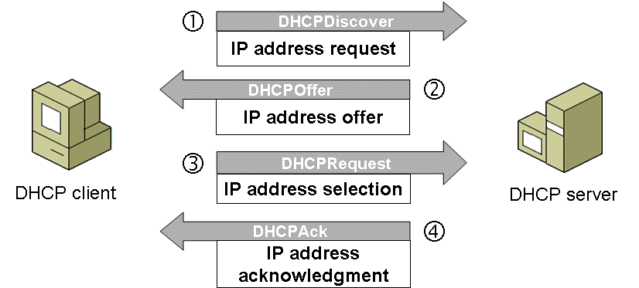
Basic DHCP Process

Slide 14
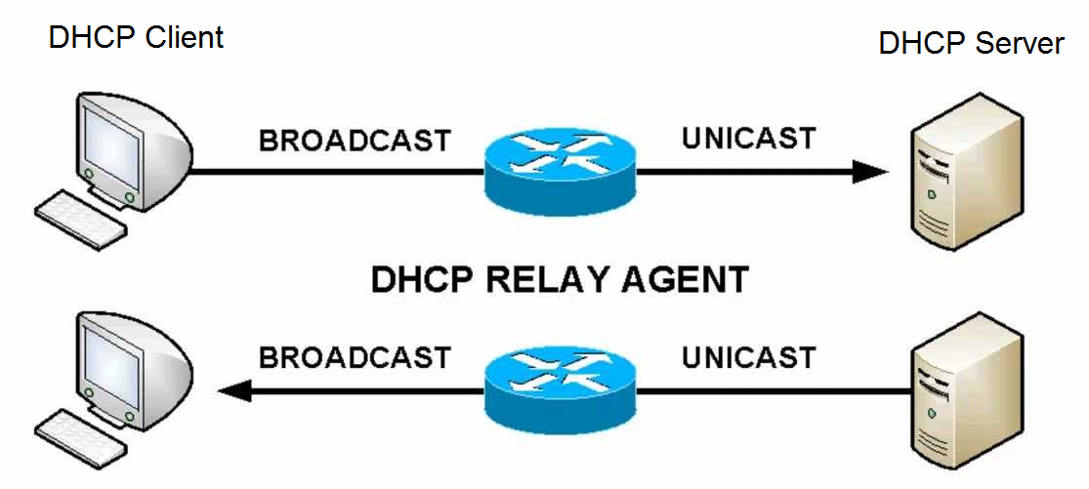
Basic DHCP Process (Cont.)

Slide 15
Overview of DHCP Messages and Client States
DHCP client states:
Initializing
Selecting
Requesting
Bound
Renewing
Rebinding

Slide 16
Overview of DHCP Messages and Client States
DHCP messages:
DHCPDiscover: client requesting an IP address (sent from client to server)
DHCPOffer: server offering a lease (sent from server to client)
DHCPRequest: client requesting a specific lease (sent from client to server)
DHCPAck: server confirming lease (sent from server to client)
DHCPNak: server denying lease (sent from server to client)
DHCPDecline: client refusing offered address (sent from client to server)
DHCPRelease: client relinquishing its lease (sent from client to server)
Windows DHCP client uses an additional message:
DHCPInform: detects authorized DHCP servers, obtain additional configuration parameters.

Slide 17
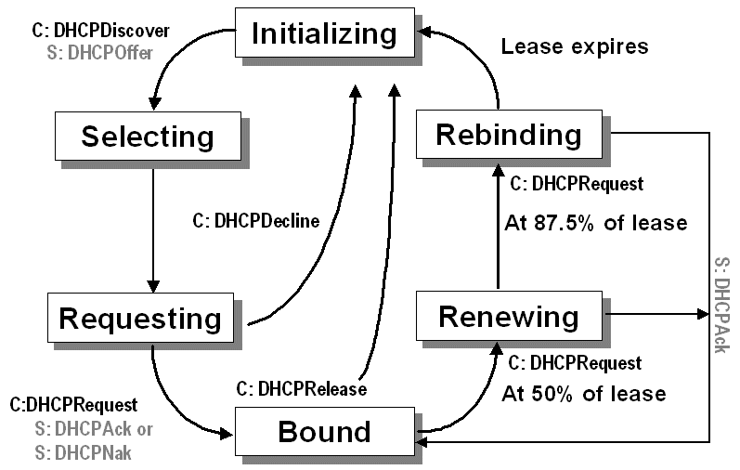
Overview of DHCP Messages and Client States (Cont.)

Slide 18
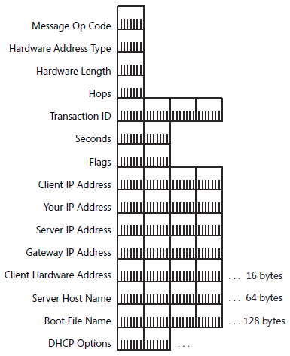
DHCP Message Format
. . .

Slide 19
DHCP Message Format (Cont.)
Message Op Code (Op): a 1-byte field indicating whether the message is a request (set to 1) or a reply (set to 2)
Hardware Address Type (Htype): a 1-byte field indicating the type of hardware being used by the DHCP client (e.g., Ethernet, Frame Relay, ATM)
Hardware Address Length (Hlen): a 1-byte field indicating the number of high order bytes within the fixed-length Client Hardware Address field that contains the client’s hardware address (= 6 for Ethernet)
Hops: a 1-byte field indicating how many DHCP relay agents have forwarded the message. The initial value is 0.
When a DHCP relay agent forwards a DHCP message on behalf of either a DHCP client or a DHCP server, it increments this field.
The maximum number of hops in a DHCP infrastructure is 16. If the value is greater than 16, the receiving DHCP relay agent silently discards the message.
DHCP relay agents can also discard DHCP messages if this field exceeds a configurable value (e.g., Windows Server 2008 uses a default maximum of 4 hops)
Note: this field is different from the Time to Live (TTL) field in the IPv4 header
Notes:
Hardware address types: http://www.iana.org/assignments/arp-parameters

Slide 20
DHCP Message Format (Cont.)
Transaction ID (Xid): a 4-byte field containing a random number derived by the DHCP client to group all of the DHCP messages of a given message exchange together
Seconds (Secs): a 2-byte field set by the DHCP client to indicate the number of seconds that have elapsed since the client began the address acquisition process (may be used by a busy DHCP server to prioritize replies when multiple client requests are outstanding.)
Flags: a 2-byte field indicating flags set by the DHCP client. RFC 2131 defines the leftmost bit as the Broadcast flag (set to 1 to indicate client cannot receive unicast IP datagrams)
Some clients cannot accept IP unicast datagrams before the TCP/IP software is configured (packets delivered to the client's hardware address is not forwarded to IP layer)
Windows Server 2008 and Windows Vista: DHCP client set the Broadcast flag to 1 (responses must be broadcast).
Windows Server 2003 and XP: DHCP client sets Broadcast flag to 0 (allows unicast responses)
By default, Windows DHCP servers ignore the Broadcast bit on the client requests (DHCP responses are sent as IP broadcasts to the limited broadcast address 255.255.255.255). To configure the DHCP Server to process the Broadcast flag, create and set the IgnoreBroadcastFlag registry value to 0

Slide 21
DHCP Message Format (Cont.)
Client IP Address (Ciaddr): A 4-byte field indicating a DHCP client’s IP address,
set by the DHCP client when it has been successfully configured with the IP address (Bound, Renewing, and Rebinding states) and can respond to ARP requests to defend the use of the address.
client does not use this field to request a particular IP address in a lease; it uses the Requested IP Address option
Your IP Address (Yiaddr): a 4-byte field indicating the IP address being allocated to the DHCP client by the DHCP server
Server IP Address (Siaddr): a 4-byte field indicating the IP address of the server that the client should use for the next step in the bootstrap process (which may or may not be the server sending this reply), returned in DHCPOFFER, DHCPACK by server
The sending server always includes its own IP address in the Server Identifier option

Slide 22
DHCP Message Format (Cont.)
Gateway IP Address (Giaddr): a 4-byte field indicating an IP address assigned to the interface on the initial DHCP relay agent that received the message from the DHCP client.
The initial DHCP relay agent is located on the same subnet as the DHCP client that broadcast the DHCP request message (either a DHCPDISCOVER or DHCPREQUEST message).
By recording an IP address for the subnet of the DHCP client in this field, the DHCP server can determine the proper scope from which to assign an IP address to the requesting DHCP client.

Slide 23
DHCP Message Format (Cont.)
Client Hardware Address (Chaddr): a 16-byte field indicating the hardware address of the DHCP client (contains the 6-byte MAC address for Ethernet)
Server Host Name (Sname): a 64-byte field indicating a name for the DHCP server (DHCP Server in Windows Server 2008 does not use this field)
Boot File Name (File): a 128-byte field indicating the name of the file containing a boot image for a BOOTP client.
BOOTP was developed before DHCP to allow a diskless host computer to obtain an IP address configuration, the name of a boot file, and the location of a Trivial File Transfer Protocol (TFTP) server from which the computer loads the boot file.
DHCP message exchanges do not use this field.
Options: a variable-length set of fields containing DHCP options.

Slide 24
DHCP Message Format (Cont.)
Fields used by DHCP clients
Field | DHCPDISCOVER, DHCPINFORM | DHCPREQUEST | DHCPDECLINE, DHCPRELEASE
'op' | BOOTREQUEST | BOOTREQUEST | BOOTREQUEST
'htype' | (from RFC) | (from RFC) | (from RFC)
'hlen' | (length in octets) | (length in octets) | (length in octets)
'hops' | 0 | 0 | 0
'xid' | selected by client | 'xid' from server DHCPOFFER message | selected by client
'secs' | 0 or seconds since DHCP process started | 0 or seconds since DHCP process started | 0
'flags' | Set 'BROADCAST' flag if client requires broadcast reply | Set 'BROADCAST' flag if client requires broadcast reply | 0
'ciaddr' | 0 (DHCPDISCOVER) or client's network address (DHCPINFORM) | 0 or client's network address (BOUND/RENEW/REBIND) | 0 (DHCPDECLINE) or client's network address (DHCPRELEASE)
'yiaddr' | 0 | 0 | 0
'siaddr' | 0 | 0 | 0
'giaddr' | 0 | 0 | 0
'chaddr' | client's hardware address | client's hardware address | client's hardware address
'sname' | options, if indicated in 'sname/file' option; otherwise unused | options, if indicated in 'sname/file' option; otherwise unused | (unused)
'file' | options, if indicated in 'sname/file' option; otherwise unused | options, if indicated in 'sname/file' option; otherwise unused | (unused)
'options' | options | options | (unused)

Slide 25
DHCP Message Format (Cont.)
Fields used by DHCP servers
Field | DHCPOFFER | DHCPACK | DHCPNAK
'op' | BOOTREPLY | BOOTREPLY | BOOTREPLY
'htype' | (from RFC) | (from RFC) | (from RFC)
'hlen' | (length in octets) | (length in octets) | (length in octets)
'hops' | 0 | 0 | 0
'xid' | 'xid' from client DHCPDISCOVER message | 'xid' from client DHCPDISCOVER message | 'xid' from client DHCPDISCOVER message
'secs' | 0 | 0 | 0
'ciaddr' | 0 | 'ciaddr' from DHCPREQUEST or 0 | 0
'yiaddr' | IP address offered to client | IP address assigned to client | 0
'siaddr' | IP address of next bootstrap server | IP address of next bootstrap server | 0
'flags' | 'flags' from client DHCPDISCOVER message | 'flags' from client DHCPREQUEST message | 'flags' from client DHCPREQUEST message
'giaddr' | 'giaddr' from client DHCPDISCOVER message | 'giaddr' from client DHCPREQUEST message | 'giaddr' from client DHCPREQUEST message
'chaddr' | 'chaddr' from client DHCPDISCOVER message | 'chaddr' from client DHCPREQUEST message | 'chaddr' from client DHCPREQUEST message
'sname' | Server host name or options | Server host name or options | (unused)
'file' | Client boot file name or options | Client boot file name or options | (unused)
'options' | options | options | (unused)

Slide 26
The Initializing State
When DHCP client is in the Initializing state
its IPv4 address is 0.0.0.0 (unspecified address)
it tries to obtain an IPv4 address configuration by broadcasting a DHCPDiscover message from UDP port 67 to UDP port 68.
the source IPv4 address is 0.0.0.0
the destination is 255.255.255.255
DHCPDiscover message contains the DHCP client’s media access control (MAC) address and computer name.
If a DHCP server is on the DHCP client's subnet, the server receives the broadcast DHCPDiscover message.
If no DHCP server on the DHCP client’s subnet, a DHCP relay agent on the DHCP client’s subnet receives the broadcast DHCPDiscover message and relays it as a unicast DHCPDiscover message from the DHCP relay agent to one or more DHCP servers

Slide 27
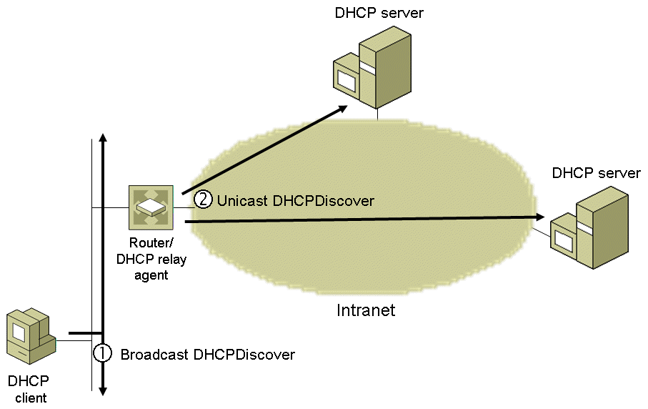
The Initializing State (Cont.)

Slide 28
The Initializing State (Cont.)
Before forwarding the original DHCPDiscover message, the DHCP relay agent makes the following changes:
Increments the Hops field in the DHCP header
If the value of the Giaddr (Gateway IP Address) field in the DHCP header is 0.0.0.0 (as set by the originating DHCP client), changes the value to the IPv4 address of the interface on which the DHCPDiscover message was received.
Changes the source IPv4 address of the DHCPDiscover message to an IPv4 address assigned to the DHCP relay agent.
Changes the destination IPv4 address of the DHCPDiscover message to the unicast IPv4 address of a DHCP server.

Slide 29
The Selecting State
All DHCP servers that receive DHCPDiscover message and have a valid IPv4 address configuration for the DHCP client respond with a DHCPOffer message from UDP port 68 to UDP port 67.
In the Selecting state, the DHCP client can select from the set of IPv4 address configurations that the DHCP servers offered.
The DHCP server uses the following process to determine the scope from which an IPv4 address for the DHCP client is to be selected and included in the DHCPOffer message:
If Giaddr is 0.0.0.0, set Giaddr to IPv4 address of the interface on which the DHCPDiscover message was received.
For each scope, perform a bit-wise logical AND of Giaddr with subnet mask of the scope. If the result matches the subnet prefix of the scope, the DHCP server allocates an IPv4 address from that scope.

Slide 30
The Selecting State (Cont.)
If the DHCPDiscover message was received as a unicast, the DHCP server sends the DHCPOffer message to the DHCP relay agent.
The DHCP relay agent uses the Giaddr value to determine the interface to use to forward the DHCPOffer message
If DHCPOffer needs to be sent to client as unitcast message: DHCP server/relay agent uses the offered IPv4 address as the destination IPv4 address and the client's MAC address as the destination MAC address
The DHCPOffer messages contain the DHCP client’s MAC address, an offered IPv4 address, appropriate subnet mask, a server identifier (IPv4 address of the offering DHCP server), the length of the lease, and other configuration parameters

Slide 31
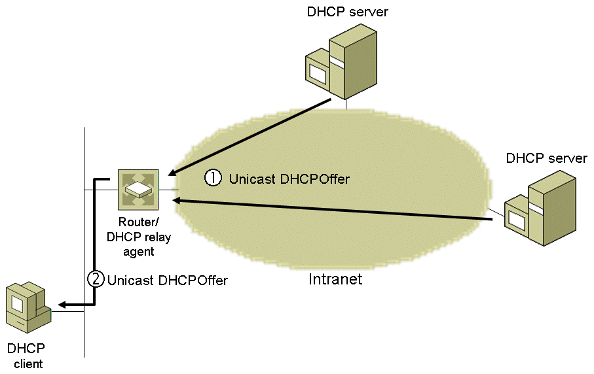
The Selecting State (Cont.)

Slide 32
The Requesting State
In the Requesting state, DHCP client requests a specific IP address configuration by broadcasting a DHCPRequest message from UDP port 67 to UDP port 68
source IPv4 address is 0.0.0.0
destination IPv4 address is 255.255.255.255.
DHCPRequest message contains IPv4 address of DHCP server if IPv4 address configuration of the DHCP client was just obtained with a DHCPDiscover/DHCPOffer message exchange
the specified DHCP server will respond and all other DHCP servers to retract their DHCP offers to the client
DHCPRequest message doesn't contain IPv4 address of DHCP server if IPv4 address configuration of the client was previously known (e.g., the computer was restarted and is trying to renew its lease on its previous address)
when restarting, the DHCP client can renew its IPv4 address configuration from any DHCP server.
If DHCP client does not have a DHCP server on its subnet, a DHCP relay agent on its subnet receives the broadcast DHCPRequest message and relays it as a unicast DHCPRequest message from the DHCP relay agent to one or more DHCP servers.

Slide 33
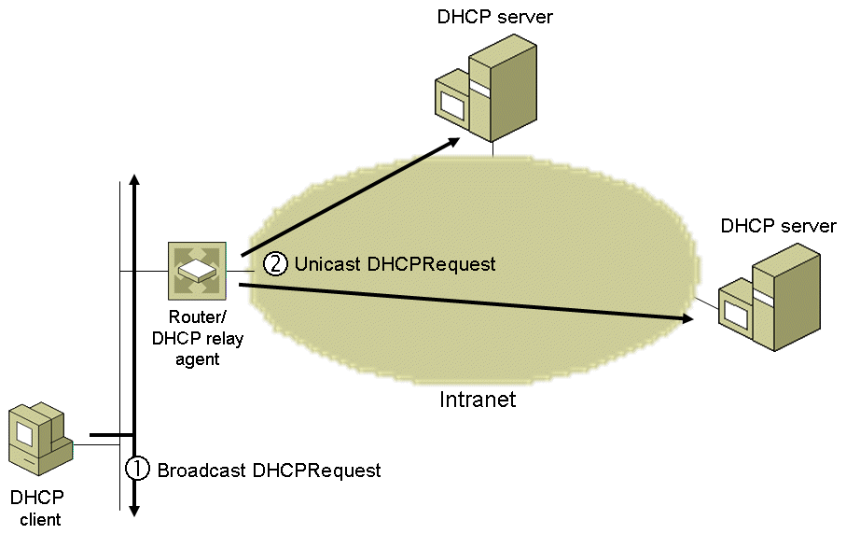
The Requesting State (Cont.)

Slide 34
The Bound State
In the Bound state, DHCP client receives confirmation that DHCP server has allocated and reserved the offered IPv4 address configuration to the DHCP client.
The DHCP server that leased the requested IPv4 address responds with either a successful acknowledgment (DHCPAck) or a negative acknowledgment (DHCPNak).
The DHCP server sends DHCPAck message from UDP port 68 to UDP port 67, and the message contains a lease period for the requested IPv4 address configuration as well as any additional configuration parameters.
If the DHCPRequest message was received as a unicast, the DHCP server sends the DHCPAck message to the DHCP relay agent.
The DHCP relay agent uses the Giaddr value to determine the interface to use to forward the DHCPAck message
If DHCPAck needs to be sent to client as unitcast message: DHCP server/relay agent uses the offered IPv4 address as the destination IPv4 address and the client's MAC address as the destination MAC address

Slide 35
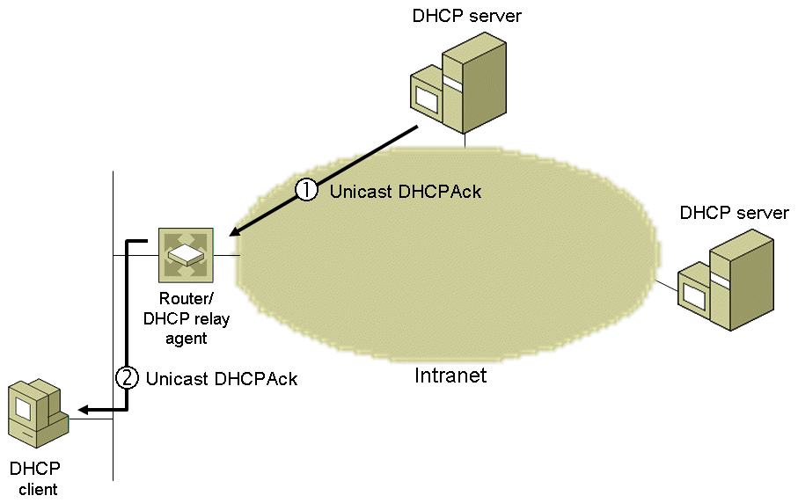
The Bound State (Cont.)

Slide 36
The Bound State (Cont.)
When receiving DHCPAck message, DHCP client verifies that the IPv4 address is unique on the subnet.
If the IPv4 address is not unique, DHCP client broadcasts a DHCPDecline message and returns to the Initializing state.
When the DHCP server receives the DHCPDecline message (as broadcast msg from client or unicast msg from relay agent), it marks the offered IPv4 address as unusable.
A DHCP server sends a DHCPNak message if:
The client is trying to lease its previous IPv4 address and the IPv4 address is no longer available.
The IPv4 address is invalid because the client has been physically moved to a different subnet.
The DHCPNak message is forwarded to the DHCP client's subnet using the same method as the DHCPAck message.
When the DHCP client receives a DHCPNak, it returns to the Initializing state.

Slide 37
The Renewing State
In the Renewing state, DHCP client is attempting to renew the lease on its IPv4 address configuration.
By default, DHCP clients first try to renew their lease when 50% of the lease time has expired.
To renew its lease, a DHCP client sends a unicast DHCPRequest message to the DHCP server from which it obtained the lease.
The DHCP server renews the lease and responds with a DHCPAck message.
DHCPAck message contains the new lease and additional configuration parameters so that the DHCP client can update its settings.
When the DHCP client has renewed its lease, it returns to the Bound state.

Slide 38
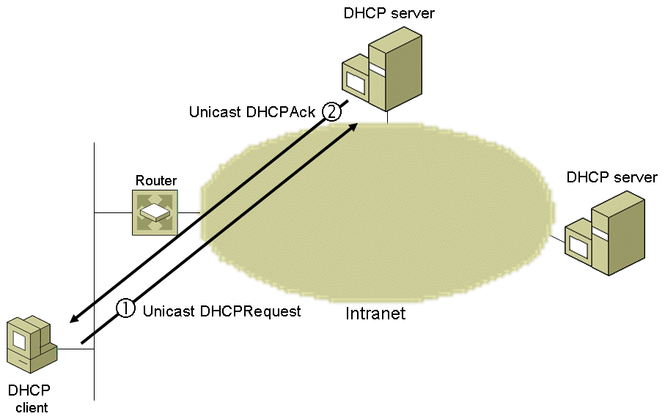
The Renewing State (Cont.)

Slide 39
The Rebinding State
In the Rebinding state, DHCP client is attempting to renew the lease on its IPv4 address configuration by broadcasting a DHCPRequest message.
when 87.5% of the lease time has expired and the DHCP client has been unsuccessful in contacting its DHCP server to renew its lease, the DHCP client attempts to contact any available DHCP server.
Any DHCP server can respond with a DHCPAck message renewing the lease or a DHCPNak message denying the continued use of the IPv4 address configuration.
If the lease expires or the DHCP client receives a DHCPNak message, it must immediately discontinue using the IPv4 address configuration and return to the Initializing state.
If the client loses its IPv4 address, communication over TCP/IP will stop until a different IPv4 address is assigned to the client.
this condition will cause network errors for any applications that attempt to communicate using the invalid address.

Slide 40
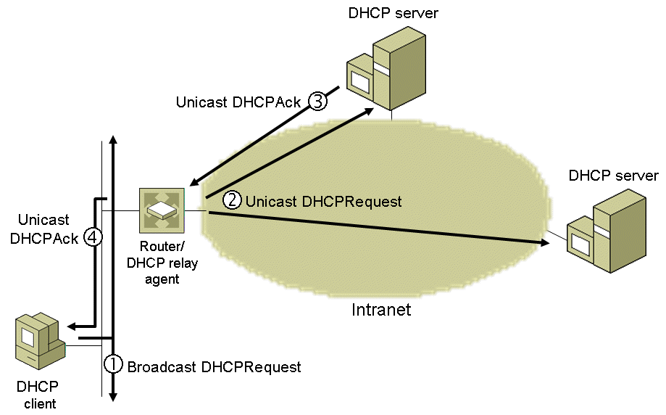
The Rebinding State (Cont.)

Slide 41
Restarting DHCP Client
When a Windows-based DHCP client is shut down, by default it does not release the IPv4 address configuration.
it does not send a DHCPRelease message and the client is still in the Bound state from the perspective of the DHCP server
When a Windows-based DHCP client is restarted, it enters the Requesting state and attempts to lease its previously allocated IPv4 address configuration through a broadcasted DHCPRequest.
the message contains the MAC address and the previously allocated IPv4 address of the DHCP client.
User can change the default behavior of a Windows-based DHCP client (so that the client sends a DHCPRelease message when it shuts down) by using the Microsoft vendor-specific DHCP option named Release DHCP Lease on Shutdown.

Slide 42
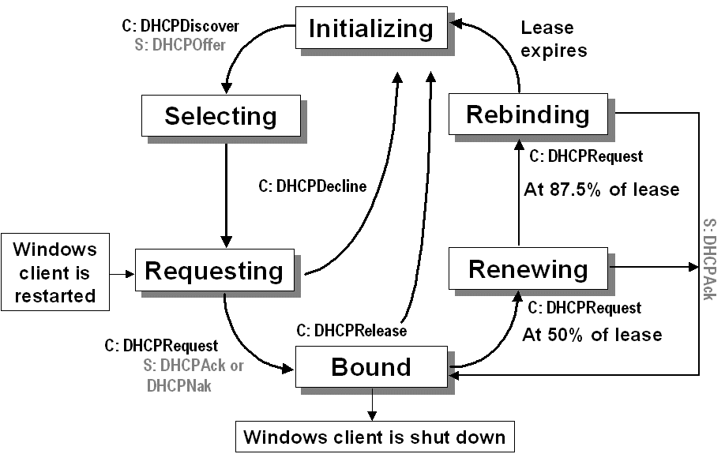
Restarting DHCP Client (Cont.)

Slide 43
Messages From DHCP Clients in Various States
Differences between messages from DHCP clients in various states
 | INIT-REBOOT | SELECTING | RENEWING | REBINDING
broadcast/unicast | broadcast | broadcast | unicast | broadcast
server-ip | MUST NOT | MUST | MUST NOT | MUST NOT
requested-ip | MUST | MUST | MUST NOT | MUST NOT
ciaddr | zero | zero | IP address | IP address

Slide 44
Changing Subnets
Examples of changing subnets:
DHCP client shuts down without releasing its address and starts up on a different subnet
when an IEEE 802.11 wireless client roams to a wireless access point that is connected to a different subnet
Client broadcasts a DHCPREQUEST message to renew its lease.
When the DHCP server receives the broadcast, it compares the address being requested with the scopes configured on the server and the subnet the DHCPREQUEST message was received from.
If it is not possible to satisfy the client request, the DHCP server issues a DHCPNAK, and the DHCP client then acquires a new lease

Slide 45
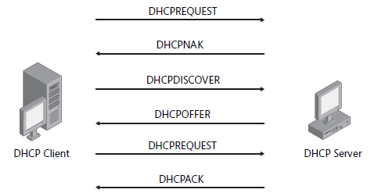
Changing Subnets (Cont.)

Slide 46
Detecting Unauthorized DHCP Servers
An unauthorized DHCP server on a network can disrupt network operations by allocating incorrect addresses or configuration options.
Windows DHCP Server service is integrated with Active Directory to provide authorization for DHCP servers.
During initialization, Windows Server 2008-based DHCP servers perform rogue server detection.
If the DHCP server is a member server and is not authorized in Active Directory domain services, the DHCP Server service automatically shuts down.
If the DHCP server is a standalone server, it relies on an exchange of DHCPINFORM and DHCPACK messages for rogue server detection
initializing DHCP server sends DHCPINFORM messages to determine whether there are other authorized DHCP servers on any attached subnet.
authorized servers respond with a DHCPACK message that contains the name of the domain in which they have been authorized.
if authorized DHCP servers are found, the standalone DHCP server sends Lightweight Directory Access Protocol (LDAP) queries to an Active Directory domain controller to verify whether or not the found servers are authorized.
if any of the found servers are authorized, the DHCP Server service shuts down

Slide 47
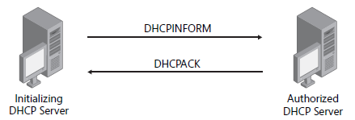
Detecting Unauthorized DHCP Servers (Cont.)

Slide 48
Updating DNS Entries
When a DHCP lease is allocated to an IP host, the host name and IP address mapping should be added to DNS.
Traditionally, this was a manual task that involved creating the DNS forward and reverse lookup entries.
Windows support DNS dynamic update protocol which allows automatically updating DNS entries for forward and reverse lookups on the DNS server.
Each time a DHCP client receives a new lease or renews an existing lease, the client sends its FQDN to the DHCP server in the DHCPREQUEST message (DHCP Option 81 - Dynamic DNS Update).
The DHCPREQUEST message requests that the DHCP server register a reverse lookup mapping in the DNS server on behalf of the DHCP client.
The DHCP client usually handles the forward lookup registration on its own, if it is capable.
User can configure the DHCP Server service in Windows to register both the forward and reverse lookup address mappings in DNS on the DHCP client’s behalf. This is useful for DHCP clients that do not support DNS dynamic updates.

Slide 49
Agenda
DHCP Overview
How DHCP Works
DHCP Options
DHCP Server Overview
Ipconfig Tool

Slide 50
DHCP Options
DHCP messages consist of a fixed portion 236 bytes long and a variable-length portion for DHCP options
A DHCP option is an IP address configuration setting that is not already included in the fixed DHCP header e.g.,
options for lease management (e.g., the lease timeout values),
options for configuration settings explicitly requested by DHCP clients (e.g., the default gateway IP address).
For Ethernet, with an IP MTU of 1500 bytes, DHCP messages can contain up to 1236 bytes of DHCP options (1500 - (20 + 8 + 236))

Slide 51
DHCP Options (Cont.)
DHCP Option Format
fixed-length options without data:
Pad option (Option Type 0)
End option (Option Type 255)
fixed-length options with data
variable length options with data
Option Type: a 1-byte field indicating the type of DHCP option.
Option Length: a 1-byte field indicating the number of bytes in the DHCP option past the Option Length field.
Option Data: a variable-length field containing the data for the DHCP option.
Option Type
Option Length
Option Data
. . .
Notes:
Option types: http://www.iana.org/assignments/bootp-dhcp-parameters

Slide 52
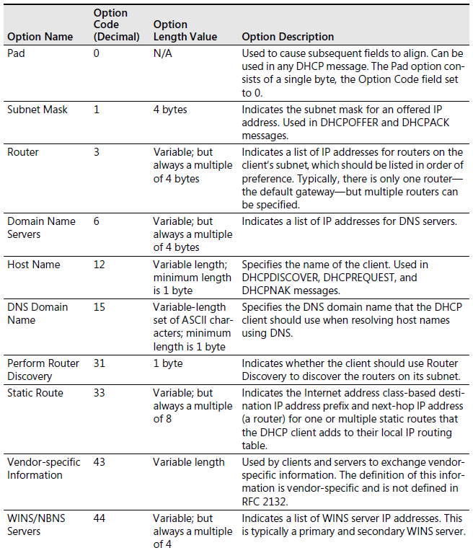
DHCP Options (Cont.)

Slide 53
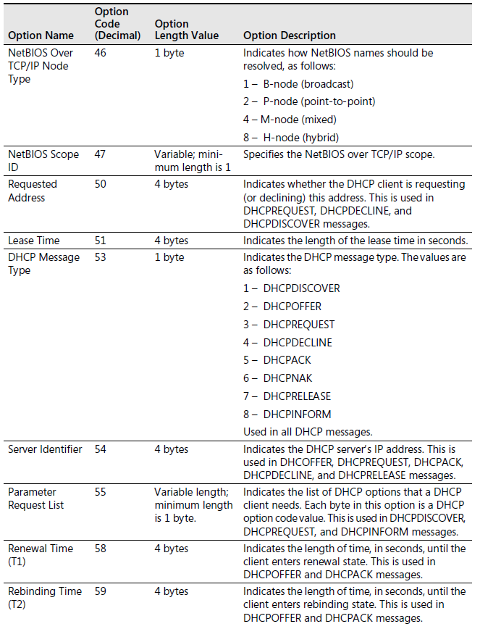
DHCP Options (Cont.)
Notes:
The 'server identifier' field is used both to identify a DHCP server in a DHCP message and as a destination address from clients to servers. A server with multiple network addresses MUST be prepared to to accept any of its network addresses as identifying that server in a DHCP message
The client broadcasts a DHCPREQUEST message that MUST include the 'server identifier' option to indicate which server it has selected
DHCP clients MUST use the IP address provided in the 'server identifier' option for any unicast requests to the DHCP server.
The 'requested IP address' option MUST be set to the value of 'yiaddr' in the DHCPOFFER message from the server

Slide 54
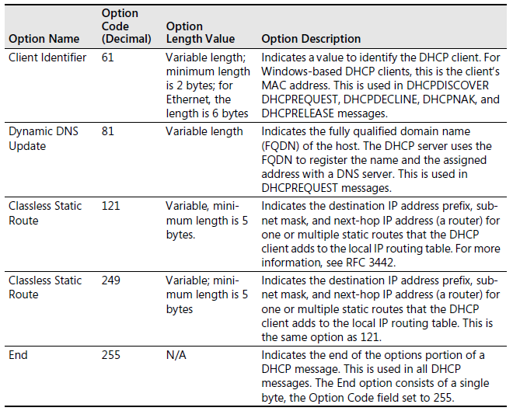
DHCP Options (Cont.)
Notes:
The client MAY choose to explicitly provide the identifier through the 'client identifier' option. If the client supplies a 'client identifier', the client MUST use the same 'client identifier' in all subsequent messages, and the server MUST use that identifier to identify the client. If the client does not provide a 'client identifier' option, the server MUST use the contents of the 'chaddr' field to identify the client. It is crucial for a DHCP client to use an identifier unique within the subnet to which the client is attached in the 'client identifier' option. Use of 'chaddr' as the client's unique identifier may cause unexpected results, as that identifier may be associated with a hardware interface that could be moved to a new client

Slide 55
DHCP Options (Cont.)
Options used by DHCP clients
Option | DHCPDISCOVER | DHCPREQUEST | DHCPDECLINE,
 | DHCPINFORM |  | DHCPRELEASE
Requested IP address | MAY (DISCOVER) | MUST (in SELECTING or INIT-REBOOT) | MUST (DHCPDECLINE),
 | MUST NOT (INFORM) | MUST NOT (in BOUND or RENEWING) | MUST NOT (DHCPRELEASE)
IP address lease time | MAY (DISCOVER) | MAY | MUST NOT
 | MUST NOT (INFORM)
Use 'file'/'sname' fields | MAY | MAY | MAY
DHCP message type | DHCPDISCOVER/ DHCPINFORM | DHCPREQUEST | DHCPDECLINE/DHCPRELEASE
Client identifier | MAY | MAY | MAY
Vendor class identifier | MAY | MAY | MUST NOT
Server identifier | MUST NOT | MUST (after SELECTING) | MUST
 |  | MUST NOT (after INIT-REBOOT, BOUND, RENEWING or REBINDING)
Parameter request list | MAY | MAY | MUST NOT
Maximum message size | MAY | MAY | MUST NOT
Message | SHOULD NOT | SHOULD NOT | SHOULD
Site-specific | MAY | MAY | MUST NOT
All others | MAY | MAY | MUST NOT

Slide 56
DHCP Options (Cont.)
Options used by DHCP servers
Option | DHCPOFFER | DHCPACK | DHCPNAK
Requested IP address | MUST NOT | MUST NOT | MUST NOT
IP address lease time | MUST | MUST (DHCPREQUEST) | MUST NOT
 |  | MUST NOT (DHCPINFORM)
Use 'file'/'sname' fields | MAY | MAY | MUST NOT
DHCP message type | DHCPOFFER | DHCPACK | DHCPNAK
Parameter request list | MUST NOT | MUST NOT | MUST NOT
Message | SHOULD | SHOULD | SHOULD
Client identifier | MUST NOT | MUST NOT | MAY
Vendor class identifier | MAY | MAY | MAY
Server identifier | MUST | MUST | MUST
Maximum message size | MUST NOT | MUST NOT | MUST NOT
All others | MAY | MAY | MUST NOT

Slide 57
Agenda
DHCP Overview
How DHCP Works
DHCP Options
DHCP Server Overview
Ipconfig Tool

Slide 58
DHCP Server Overview (Windows)
DHCP Scopes
Deploying Multiple DHCP Servers
Managing DHCP Options
DHCP Options Classes
Client Reservations

Slide 59
DHCP Scopes
A DHCP scope is the consecutive range of possible IPv4 unicast addresses that DHCP clients on a subnet can use.
Scopes are the primary way for the DHCP server to manage distribution and assignment of IPv4 addresses and any related configuration parameters to DHCP clients on the network.
Every DHCP server requires at least one scope with a pool of IPv4 addresses available for leasing to DHCP clients.
Typically, we create multiple scopes - one for each subnet for which the DHCP is offering addresses.
If a subnet contains manually configured TCP/IP nodes, we should exclude their IPv4 addresses from the scope. Otherwise, the DHCP server might allocate an address that is already in use on the subnet, causing problems with duplicate addresses.
Scope configuration usually includes the address range, exclusions, lease duration, and DHCP options (default gateway, DNS settings, WINS settings etc.)

Slide 60
Deploying Multiple DHCP Servers
To ensure that DHCP clients can lease IPv4 addresses even if a DHCP server becomes unavailable, we should create multiple scopes for each subnet and distribute them among the DHCP servers in the network.
As a general rule, we should do the following for each subnet:
On a DHCP server that is designated the primary DHCP server for the subnet, create a scope containing approximately 80% of the IPv4 addresses available to DHCP clients.
On a DHCP server that is designated as the secondary DHCP server for the subnet, create a scope containing approximately 20 percent of the IPv4 addresses available to DHCP clients.
When the primary DHCP server for a subnet becomes unavailable, the secondary DHCP server can still service DHCP clients on the subnet.
Because DHCP servers do not share scope information, it is important that each scope contain a unique range of IPv4 addresses.
If the scopes of different DHCP servers contain the same IPv4 addresses (i.e., overlapping scopes), multiple servers can lease the same IPv4 addresses to different DHCP clients on a subnet, causing problems with duplicate IPv4 addresses.

Slide 61
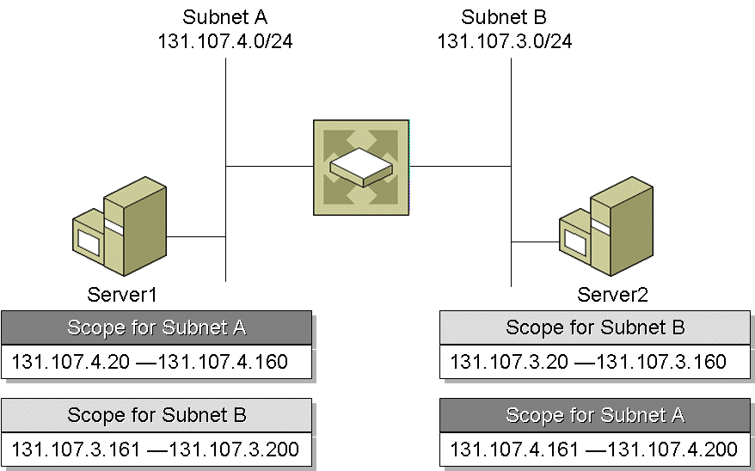
Deploying Multiple DHCP Servers (Cont.)

Slide 62
Managing Options
DHCP options can be managed at the following levels
Server options
apply to all scopes defined on a DHCP server, available to all DHCP clients of the DHCP server.
used when all clients on all subnets require the same configuration information (e.g., DNS domain name)
are always used, unless overridden by scope, class, or reservation options.
Scope options
apply to all DHCP clients that obtain a lease within a particular scope (e.g., each subnet has a different IPv4 address as its default gateway address)
override global options for the same configuration parameter.
Class options
apply only to clients that are identified as members of a specified vendor or user class when obtaining a lease.
Reservation options
apply only to a single reserved client computer and require a reservation to be used in an active scope.
override server and scope options for the same configuration parameter.

Slide 63
DHCP Options Classes
An options class is a way for you to further manage options provided to DHCP clients.
When you add an options class to the DHCP server, it can provide DHCP clients of that class with class-specific option types for their configuration.
Windows DHCP clients can also specify a class ID when they communicate with the server.
To support earlier DHCP clients that do not support class IDs, you can configure the DHCP server with default classes.
Options classes can be of two types: vendor classes and user classes.

Slide 64
DHCP Options Classes (Cont.)
Vendor Classes
DHCP clients can use vendor-defined options classes to identify the client's vendor type and configuration to the DHCP server when the client obtains a lease.
For a client to identify its vendor class during the lease process, the client needs to include the Vendor Class ID option (option code 60) in the DHCPDiscover and DHCPRequest messages.
The vendor class identifier is a string of character data that DHCP servers interpret.
Vendors can define specific vendor class identifiers to convey particular configuration or other identification information about a client.
Most vendor types are derived from standard reserved hardware and operating system-type abbreviation codes listed in RFC 1700.
If the vendor class is not recognized, the server ignores the vendor class identified in the client request, and returns options allocated to the default vendor class (the DHCP Standard Options vendor class).
If the matching scope contains options configured specifically for use with clients in this vendor-defined class, the server returns those options using the Vendor-specific option type (option code 43) in the DHCPAck message.

Slide 65
DHCP Options Classes (Cont.)
User Classes
used to allow DHCP clients to differentiate themselves by specifying what types of clients they are (e.g., a remote access client computer or desktop computer)
Windows DHCP clients allow defining specific user class identifiers (via ipconfig tool) to convey information about a client's software configuration, its physical location in a building, or its user preferences.
e.g., user class "5nd floor, VitalQIP" needs a special set of router, DNS, and WINS server settings.
DHCP client computers can identify themselves as part of a specific user class by including DHCP user class options (option 77) when sending DHCP request messages to the DHCP server.
DHCP servers can recognize and interpret the DHCP user class options from clients and provide additional options (or a modified set of DHCP options) based on the client's user class identity.

Slide 66
Client Reservations
Some DHCP clients cannot change their IPv4 address configuration.
A client reservation is used to ensure that a specified interface of a network node is always allocated the same IPv4 address.
To provide fault tolerance for client reservations, the reservation must exist on at least two DHCP servers.
the client can receive its lease from any DHCP server and will be guaranteed the same IPv4 address.
The only way to have the same client reservations on multiple DHCP servers is to have overlapping scopes.
if any dynamic addresses are allocated from these overlapping scopes, addresses will conflict.
we should not use overlapping scopes unless all of the addresses in the overlap of the scopes are client reservations.

Slide 67
Agenda
DHCP Overview
How DHCP Works
DHCP Options
DHCP Server Overview
Ipconfig Tool

Slide 68
Ipconfig Tool
ipconfig tool can be used to display a computer’s TCP/IP configuration and to manage an IPv4 address configuration that was allocated using DHCP.
To display basic information about the TCP/IP configuration:
ipconfig
ipconfig /all
Renewing a lease:
ipconfig /renew
Releasing a lease:
ipconfig /release
Setting, removing, and displaying the Class ID
ipconfig /setclassid Adapter ClassID
ipconfig /setclassid Adapter
ipconfig /showclassid Adapter

Slide 69
References
RFCs 2131, 2132, 1542
TCP/IP Fundamentals For Microsoft Windows (Joseph Davies, Microsoft)
Windows Server 2008 TCP/IP Protocols and Services (Joseph Davies, Microsoft)

