Slide 1

QOOXDOO
Author : Cuc Nguyen
Date : 2011/10/31
Last modified : 2011/11/03
Version : 1.0 RC

Slide 2
CONTENTS
Introduction
Development
OO Programming
Troubleshooting
Reference

Slide 3
Introduction
1. WHAT IS QOOXDOO?
Qooxdoo is a JavaScript framework for creating rich internet applications (RIA).
Open source (LGPL/EPL dual license)
2. SETUP THE FRAMEWORK?
- Requirement: client (browser); server (HTTP-aware backend); operation system (any); tools (Python)
Download: http://qooxdoo.org/download
Install: unzip sdk archive
Reference: \\192.168.98.229\soft\
Notes:
Purely client-side JavaScript (client-side -> browser dependency)
Framework is fully class-based (currently about 350 classes)
Besides regular classes, it offers abstract, static or singleton classes
Constructors and destructors
Public, protected and private members by naming convention, that can (partly) be enforced during development
Single inheritance, full polymorphism
Current version : 1.2.1

Slide 4
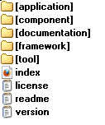
Introduction
3. QOOXDOO STRUCTURE?
application: sample applications
component: help applications
documentation: manual documents
framework: main front-end part of QooXDoo
tool: toolchain of the framework
Notes:
framework-mainfrontendpartoftheframework
• source folder
– class -JavaScriptclasses
– resource (images)
tool-toolchain of the framework
• bin- various scripts are located here, most importantly generator.py
• data –lots of data to be used by different tools, e.g. for localization ,migration ,etc.
• pylib-Python modules used by the platform-independent toolchain

Slide 5

Introduction
3. QOOXDOO APPLICATION STRUCTURE
a. Level 1:
build: contains the deployment version of app
source: contains the development version of app
config.json: configuration file for build process and all other integrated developer tools
Manifes.json: qooxdoo app meta information file
generate.py: platform-independent script to generate the development and deployment

Slide 6
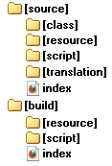
Introduction
3. QOOXDOO APPLICATION STRUCTURE
b. Level 2:
source: contains the development version of app
  class: all javascript classes
  resource: static resources (images, icon…)
  script: contains generated JavaScript code of app (generate.py source)
    [appName].js: loader script that includes all required files individually.
  translation: internationalize (multi-language) data files
build: contains the deployment version of app
  resource:= app resources + (#asset) + (framework resource)
  script: contains generated JavaScript code of app (generate.py build)
    [appName].js: contains all the JavaScript code your app requires, in a compressed and optimized form.
Notes:
Organize resource folder well so that app can be themable

Slide 7
DEMO
Create qooxdoo application
Build qooxdoo application
Run qooxdoo application
Instruction link: http://qooxdoo.org/documentation/1.1/helloworld

Slide 8
CONTENTS
Introduction
Development
OO Programming
Troubleshot
Reference

Slide 9
DEVELOPMENT
CREATE A QOOXDOO APPLICATION
BUILD A QOOXDOO APPLICATION
DEPLOY A QOOXDOO APPLICATION
Notes:
THIS PART INTRODUCE HOW OBJECT ORIENATION APPLIED IN QOOXOO, SPECIFICLY CLASS AND MIXIN BEHAVEVIORS
When trying to get a grip of the framework code ,you should probably understand all those three concepts. As a regular
Application developer you often get by with ignoring interfaces and mixins when starting and just getting familiar with
classes.

Slide 10
DEVELOPMENT
CREATE A QOOXDOO APPLICATION
Preparing a folder to store your applicaion
Using command line below:
  [QXDDir]\tool\bin\create-application.py --name=custom --out=C:
  Check your application structure
Notes:
THIS PART INTRODUCE HOW OBJECT ORIENATION APPLIED IN QOOXOO, SPECIFICLY CLASS AND MIXIN BEHAVEVIORS
When trying to get a grip of the framework code ,you should probably understand all those three concepts. As a regular
Application developer you often get by with ignoring interfaces and mixins when starting and just getting familiar with
classes.

Slide 11
DEVELOPMENT
BUILD QOOXDOO APPLICATION
Open cmd
Go to project
Type generate.py build/source
Notes:
Type
Regular : may contain class (static) variables/methods (in ‘static’ section) and instance variables/methods (in ‘member’ sections ). An instance of class can be created by ‘new’ keyword, a constructor needs to be given in ‘construct’
Static: only contains static variable/methods. Often a helper or util class
Abstract: does not allow an instance to be created. Typically classes derive from it and provide concrete implementations.
Singleton: not more than a single instance of the class may exists at any time. A static method getInstance() returns the instance.
Inheritance
JavaScript supports the concept of single inheritance. It does not support multiple inheritance likeC++ .Most
People agree on the fact that such a concep t ends to be very complex and error-prone. There are other ways to shoot
you in the foot . Qooxdoo only allows for single inheritance as well:
qx.Class.define("qx.test.Cat",{
extend: qx.test.Animal
});
There are more practical and less error-prone solutions that allow for typical features of multiple
inheritance: Interfaces and Mixins
Polymorphism
Properties: a powerful feature: dynamic properties. This declaration generates not only a corresponding accessor method getAge() and a mutator method setAge() but would allow for many more features

Slide 12
DEVELOPMENT
DEPLOY A QOOXDOO APPLICATION
Copy all subfolder inside build folder to web root
Notes:
Type
Regular : may contain class (static) variables/methods (in ‘static’ section) and instance variables/methods (in ‘member’ sections ). An instance of class can be created by ‘new’ keyword, a constructor needs to be given in ‘construct’
Static: only contains static variable/methods. Often a helper or util class
Abstract: does not allow an instance to be created. Typically classes derive from it and provide concrete implementations.
Singleton: not more than a single instance of the class may exists at any time. A static method getInstance() returns the instance.
Inheritance
JavaScript supports the concept of single inheritance. It does not support multiple inheritance likeC++ .Most
People agree on the fact that such a concep t ends to be very complex and error-prone. There are other ways to shoot
you in the foot . Qooxdoo only allows for single inheritance as well:
qx.Class.define("qx.test.Cat",{
extend: qx.test.Animal
});
There are more practical and less error-prone solutions that allow for typical features of multiple
inheritance: Interfaces and Mixins
Polymorphism
Properties: a powerful feature: dynamic properties. This declaration generates not only a corresponding accessor method getAge() and a mutator method setAge() but would allow for many more features

Slide 13
CONTENTS
Introduction
Development
OO Programming
Troubleshot
Reference

Slide 14
OO PROGRAMMING
The main actors of qooxdoo OO are:
  Classes
  Interfaces
  Mixins
Notes:
THIS PART INTRODUCE HOW OBJECT ORIENATION APPLIED IN QOOXOO, SPECIFICLY CLASS AND MIXIN BEHAVEVIORS
When trying to get a grip of the framework code ,you should probably understand all those three concepts. As a regular
Application developer you often get by with ignoring interfaces and mixins when starting and just getting familiar with
classes.

Slide 15
CLASSES
OO PROGRAMMING
1. Declaration
Syntax:
qx.Class.define("my.cool.Class",{
type: <type>
//declare constructor, properties, members,...
});
Type: regular, static, abstract, singleton
Notes:
Type
Regular : may contain class (static) variables/methods (in ‘static’ section) and instance variables/methods (in ‘member’ sections ). An instance of class can be created by ‘new’ keyword, a constructor needs to be given in ‘construct’
Static: only contains static variable/methods. Often a helper or util class
Abstract: does not allow an instance to be created. Typically classes derive from it and provide concrete implementations.
Singleton: not more than a single instance of the class may exists at any time. A static method getInstance() returns the instance.
Inheritance
JavaScript supports the concept of single inheritance. It does not support multiple inheritance likeC++ .Most
People agree on the fact that such a concep t ends to be very complex and error-prone. There are other ways to shoot
you in the foot . Qooxdoo only allows for single inheritance as well:
qx.Class.define("qx.test.Cat",{
extend: qx.test.Animal
});
There are more practical and less error-prone solutions that allow for typical features of multiple
inheritance: Interfaces and Mixins
Polymorphism
Properties: a powerful feature: dynamic properties. This declaration generates not only a corresponding accessor method getAge() and a mutator method setAge() but would allow for many more features

Slide 16
CLASSES
OO PROGRAMMING
2. Inheritance
Syntax:
qx.Class.define("my.cool.Class",{
extend : my.great.SuperClass
});
Single Inheritance: allow
Multiple Inheritance: not allow
Polymorphism (overriding): allow
Calling the Superclass Constructor:
construct: function(x) {
this.base(arguments, x);
}
Notes:
Type
Regular : may contain class (static) variables/methods (in ‘static’ section) and instance variables/methods (in ‘member’ sections ). An instance of class can be created by ‘new’ keyword, a constructor needs to be given in ‘construct’
Static: only contains static variable/methods. Often a helper or util class
Abstract: does not allow an instance to be created. Typically classes derive from it and provide concrete implementations.
Singleton: not more than a single instance of the class may exists at any time. A static method getInstance() returns the instance.
Inheritance
JavaScript supports the concept of single inheritance. It does not support multiple inheritance likeC++ .Most
People agree on the fact that such a concep t ends to be very complex and error-prone. There are other ways to shoot
you in the foot . Qooxdoo only allows for single inheritance as well:
qx.Class.define("qx.test.Cat",{
extend: qx.test.Animal
});
There are more practical and less error-prone solutions that allow for typical features of multiple
inheritance: Interfaces and Mixins
Polymorphism
Properties: a powerful feature: dynamic properties. This declaration generates not only a corresponding accessor method getAge() and a mutator method setAge() but would allow for many more features

Slide 17
CLASSES (cont)
OO PROGRAMMING
3. Properties
Syntax :
qx.Class.define("my.cool.Class",{
extend : my.great.SuperClass,
…
properties : {
age: {
refine: true,
init: 10,
check: "Integer" ,
nullable : true,
event : "changeCustomValue“,
apply: “applyCustomValue“
}
}
});
Notes:
Type
Regular : may contain class (static) variables/methods (in ‘static’ section) and instance variables/methods (in ‘member’ sections ). An instance of class can be created by ‘new’ keyword, a constructor needs to be given in ‘construct’
Static: only contains static variable/methods. Often a helper or util class
Abstract: does not allow an instance to be created. Typically classes derive from it and provide concrete implementations.
Singleton: not more than a single instance of the class may exists at any time. A static method getInstance() returns the instance.
Inheritance
JavaScript supports the concept of single inheritance. It does not support multiple inheritance likeC++ .Most
People agree on the fact that such a concep t ends to be very complex and error-prone. There are other ways to shoot
you in the foot . Qooxdoo only allows for single inheritance as well:
qx.Class.define("qx.test.Cat",{
extend: qx.test.Animal
});
There are more practical and less error-prone solutions that allow for typical features of multiple
inheritance: Interfaces and Mixins
Polymorphism
Properties: a powerful feature: dynamic properties. This declaration generates not only a corresponding accessor method getAge() and a mutator method setAge() but would allow for many more features

Slide 18
CLASSES (cont)
OO PROGRAMMING
4. Members
Syntax :
qx.Class.define("my.cool.Class",{
extend : my.great.SuperClass,
…
members : {
hello: function(){
alert(“Hello Qooxdoo");
}}
});
Assorting member: There are two kind of members
  Class members (also called "static" members) are attached to the class itself, not to individual instances
  Instance members are attached to each individual instance of a class
Notes:
Type
Regular : may contain class (static) variables/methods (in ‘static’ section) and instance variables/methods (in ‘member’ sections ). An instance of class can be created by ‘new’ keyword, a constructor needs to be given in ‘construct’
Static: only contains static variable/methods. Often a helper or util class
Abstract: does not allow an instance to be created. Typically classes derive from it and provide concrete implementations.
Singleton: not more than a single instance of the class may exists at any time. A static method getInstance() returns the instance.
Inheritance
JavaScript supports the concept of single inheritance. It does not support multiple inheritance likeC++ .Most
People agree on the fact that such a concep t ends to be very complex and error-prone. There are other ways to shoot
you in the foot . Qooxdoo only allows for single inheritance as well:
qx.Class.define("qx.test.Cat",{
extend: qx.test.Animal
});
There are more practical and less error-prone solutions that allow for typical features of multiple
inheritance: Interfaces and Mixins
Polymorphism
Properties: a powerful feature: dynamic properties. This declaration generates not only a corresponding accessor method getAge() and a mutator method setAge() but would allow for many more features

Slide 19
CLASSES (cont)
OO PROGRAMMING
5. Events
Syntax :
qx.Class.define("my.cool.Class",{
extend : my.great.SuperClass,
…
events : {
name_event : <event type>
}
});
Event Type: There are many events in packet qx.event.type.*
Typically:
  qx.event.type.Data: fired by method fireDataEvent
  qx.event.type.Event: fired by method fireEvent
Notes:
Type
Regular : may contain class (static) variables/methods (in ‘static’ section) and instance variables/methods (in ‘member’ sections ). An instance of class can be created by ‘new’ keyword, a constructor needs to be given in ‘construct’
Static: only contains static variable/methods. Often a helper or util class
Abstract: does not allow an instance to be created. Typically classes derive from it and provide concrete implementations.
Singleton: not more than a single instance of the class may exists at any time. A static method getInstance() returns the instance.
Inheritance
JavaScript supports the concept of single inheritance. It does not support multiple inheritance likeC++ .Most
People agree on the fact that such a concep t ends to be very complex and error-prone. There are other ways to shoot
you in the foot . Qooxdoo only allows for single inheritance as well:
qx.Class.define("qx.test.Cat",{
extend: qx.test.Animal
});
There are more practical and less error-prone solutions that allow for typical features of multiple
inheritance: Interfaces and Mixins
Polymorphism
Properties: a powerful feature: dynamic properties. This declaration generates not only a corresponding accessor method getAge() and a mutator method setAge() but would allow for many more features

Slide 20
CLASSES (cont)
OO PROGRAMMING
5. Statics
Syntax:
qx.Class.define("my.cool.Class",{
extend : my.great.SuperClass,
statics : {
f_statics: function(){}
}
});
6. Access: publicMember,_protectedMember,__privateMember
Notes:
Type
Regular : may contain class (static) variables/methods (in ‘static’ section) and instance variables/methods (in ‘member’ sections ). An instance of class can be created by ‘new’ keyword, a constructor needs to be given in ‘construct’
Static: only contains static variable/methods. Often a helper or util class
Abstract: does not allow an instance to be created. Typically classes derive from it and provide concrete implementations.
Singleton: not more than a single instance of the class may exists at any time. A static method getInstance() returns the instance.
Inheritance
JavaScript supports the concept of single inheritance. It does not support multiple inheritance likeC++ .Most
People agree on the fact that such a concep t ends to be very complex and error-prone. There are other ways to shoot
you in the foot . Qooxdoo only allows for single inheritance as well:
qx.Class.define("qx.test.Cat",{
extend: qx.test.Animal
});
There are more practical and less error-prone solutions that allow for typical features of multiple
inheritance: Interfaces and Mixins
Polymorphism
Properties: a powerful feature: dynamic properties. This declaration generates not only a corresponding accessor method getAge() and a mutator method setAge() but would allow for many more features

Slide 21
INTERFACE
OO PROGRAMMING
1. Defining Interfaces
Interface definitions look very similar to normal class definitions.
Example:
qx.Interface.define("qx.test.ISample", {
properties: {
"color": {}, "name": {}
},
members: {
meth1: function() {},
meth2: function(a, b) {
this.assertArgumentsCount(arguments, 2, 2); },
meth3: function(c) {
this.assertInterface(c, qx.some.IInterface); }
},
statics: { PI : 3.14, staticMethod: function(z) { ... } },
events : { keydown : "qx.event.type.KeyEvent" }
});
Notes:
Type
Regular : may contain class (static) variables/methods (in ‘static’ section) and instance variables/methods (in ‘member’ sections ). An instance of class can be created by ‘new’ keyword, a constructor needs to be given in ‘construct’
Static: only contains static variable/methods. Often a helper or util class
Abstract: does not allow an instance to be created. Typically classes derive from it and provide concrete implementations.
Singleton: not more than a single instance of the class may exists at any time. A static method getInstance() returns the instance.
Inheritance
JavaScript supports the concept of single inheritance. It does not support multiple inheritance likeC++ .Most
People agree on the fact that such a concep t ends to be very complex and error-prone. There are other ways to shoot
you in the foot . Qooxdoo only allows for single inheritance as well:
qx.Class.define("qx.test.Cat",{
extend: qx.test.Animal
});
There are more practical and less error-prone solutions that allow for typical features of multiple
inheritance: Interfaces and Mixins
Polymorphism
Properties: a powerful feature: dynamic properties. This declaration generates not only a corresponding accessor method getAge() and a mutator method setAge() but would allow for many more features

Slide 22
INTERFACE
OO PROGRAMMING
2. Implementing Interfaces
Interface be implemented by class with implement keyword. The class must implement all properties, members and events declared in the interfaces. Otherwise a runtime error will be thrown
Example:
qx.Class.define("qx.test.Sample", {
implement: [qx.test.ISample],
properties: { "color": { check: "color"}, "name": { check: "String"} },
members: {
meth1: function() { return 42; },
meth2: function(a, b) { return a+b },
meth3: function(c) { c.foo() } }
events : { keydown : "qx.event.type.KeyEvent" }
});
Notes:
With implement key of the class declaration, a list of interfaces can be listed, which the class implements. The class must implement all properties, members and events declared in the interfaces. Otherwise a runtime error will be thrown.

Slide 23
INTERFACE
OO PROGRAMMING
3. validating Interfaces
qx.Class contains several static methods to check, whether a class or an object implements an interface:
qx.Class.hasInterface(): Whether a given class or any of its superclasses includes a given interface.
qx.Class.implementsInterface(): Checks whether all methods defined in the interface are implemented in the class. The class does not need to implement the interface explicitly.
Notes:
With implement key of the class declaration, a list of interfaces can be listed, which the class implements. The class must implement all properties, members and events declared in the interfaces. Otherwise a runtime error will be thrown.

Slide 24
MIXIN
OO PROGRAMMING
Definition: qx.Mixin.define("my.cool.MMixin");
Use:
  To share functionality without inheritance
      qx.Class.define("my.cool.Class",
      {
      include : [my.cool.MMixin,my.other.cool.MMixin]
      ...
      });
  To expand/patch functionality of existing class
qx.Class.include(qx.ui.core.Widget, qx.MWidgetExtensions);
Notes:
A mixin can have all the things a class can have, like properties, constructor, destructor and members
Add mixins to definition of a class: all member of the mixin are added to the class definition
Add a mixin to a class after class is defined: enhances the functionality but is not allowed to overwite existing memebers.
Patch existing classes: change the implementation of existing methods (should normailly avoided or need to define a clean way to do)

Slide 25
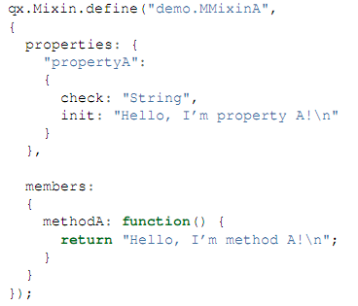
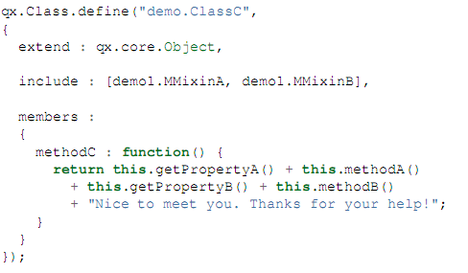
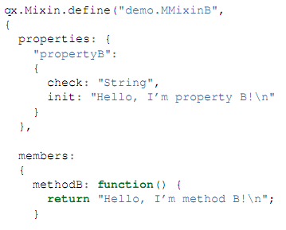
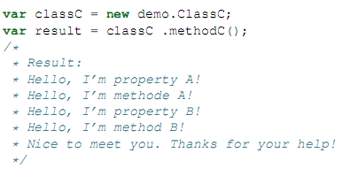
MIXIN EXAMPLE: Use mixins (MMxinA, MMXinB) with a class (ClassC)
Example

Slide 26
AJAX
OO PROGRAMMING
Request object:
  var req = new qx.io.remote.Request(url, "GET", "text/plain");
  Methods: setRequestHeader(), setParameter(), setData(), send()…
Reponse object: qx.io.remote.Response
  Store all the returning data of Request object
  Methods: getContent(), getResponHeader(), getStatusCode()…
Event: sending, receiving, completed. Failed, timeout, aborted
Notes:
THIS PART INTRODUCE HOW AJAX WORK IN QOOXDOO
AJAX : (Asynchronous JavaScript and XML ) is a group of interrelated web development techniques used on the client-side to create interactive web applications. With Ajax, web applications can retrieve data from the server asynchronously in the background without interfering with the display and behavior of the existing page
XMLHttpRequest is wrapped into qooxdoo object: qx.io.remote.Request

Slide 27
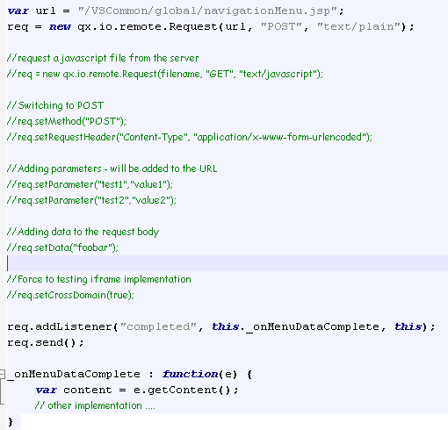
AJAX EXAMPLE

Slide 28
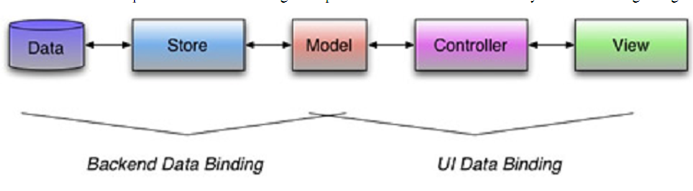
Data Binding using MVC
OO PROGRAMMING
The main idea of qooxdoo’s data binding component is best summarized by the following diagram:

Slide 29
Data Binding using MVC (cont)
OO PROGRAMMING
Single value binding
Binding a single property to another property
Ex:
var label1 =new qx.ui.basic.Label();
var label2 =new qx.ui.basic.Label();
label1.bind(“content”, label2, “content”);
=>Thus, the label2 content same as the label1 content.

Slide 30
Data Binding using MVC (cont)
OO PROGRAMMING
Single value binding
Binding a data event to property
var textField=new qx.ui.form.TextField();
var label=new qx.ui.basic.Label();
//binding input value of textField to label content property.
textField.bind(“input”, label, “content”);
In there: “input” is a data event and not a property name.

Slide 31
Data Binding using MVC (cont)
OO PROGRAMMING
II. Controller binding
The general idea of controllers is connecting a view component to a set of data stored in a model.
** Some controller supported by Qooxdoo.
a. qx.data.controller.Tree
=>use to bind a tree widget
b. qx.data.controller.List
=>use to bind a list widget
c. qx.data.controller.Object
=>use to bind single values
d. qx.data.controller.Form
=>use to bind a form widget

Slide 32
Data Binding using MVC (cont)
OO PROGRAMMING
III. Stores
The main purpose of the store components is to load data from
a source and convert that data into a model. The task of loading
data and converting the data into a model has been split up. The
store it self takes care of loading the data but delegates the
reation of model classes and instances to a marshaler.
Qooxdoo’s Stores currently available is for JSON data.

Slide 33
Data Binding using MVC (cont)
OO PROGRAMMING
III. Stores
1. JSON Data.
Json var data: Store json content in a var
var data={
  fieldName1: value1,
  fieldName2: value2,
  .
  .
  fieldName-n : value-n
}
In there: value1..n can be String or json data.
Json file data: Store json content in a file with extension name is json.
var url = "json/data.json";
var store = new qx.data.store.Json(url);

Slide 34
Data Binding using MVC (cont)
OO PROGRAMMING
III. Stores
2. Json Marshaler:
The marshaler takes care of converting Javascript object into qooxdoo classes and instances.
Supported by the static method below:
qx.data.marshal.Json.createModel().
3. Create model.
a. Use json var data + Json Marshaler
Ex: var model = qx.data.marshal.Json.createModel({a: {b: {c: "test"}}});
b. Use json file data + Json store
Ex:
var url = "json/data.json";
var store = new qx.data.store.Json(url);
var model=store.getModel().

Slide 35
Data Binding using MVC (cont)
OO PROGRAMMING
IV. Example: (Json – List)
a. List.json file
{
"items":
[
  {"name": "a", "type": "media-video"},
  {"name": "b", "type": "office-calendar" },
  {"name": "c", "type": "media-audio" },
  {"name": "d", "type": "office-presentation" }
]
}

Slide 36
Data Binding using MVC (cont)
OO PROGRAMMING
b. Bind data to list.
// create the list
var list = new qx.ui.form.List();
// create the controller
var controller = new qx.data.controller.List(null, list);
// set the name for the label property
controller.setLabelPath("name");
// set a converter for the icons
controller.setIconOptions({converter : function(data) { return "icon/16/mimetypes/" + data + ".png"; }});

Slide 37
Data Binding using MVC (cont)
OO PROGRAMMING
// set the name of the icon property
controller.setIconPath("type");
// create the data store
var url = "json/list.json";
var store = new qx.data.store.Json(url);
// create the status label
var status = new qx.ui.basic.Label("Loading...");
// connect the store and the controller
store.bind("model.items", controller, "model");
// bind the status label
store.bind("state", status, "value");

Slide 38
THEME
Font
Color
Icon
Decoration
Appearance
What is Theme?
Theme is a meta theme including five keys above. Currently, qooxdoo supported two themes.

Slide 39
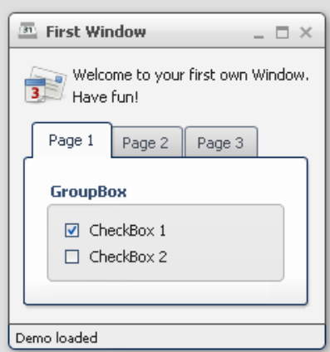
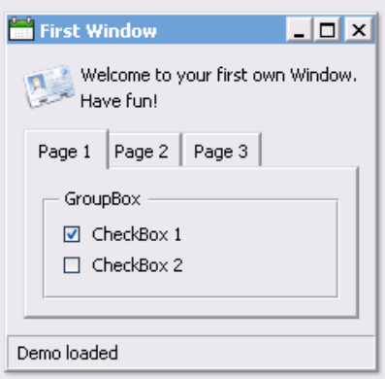
THEME
Modern - a graphically rich theme, showcasing many UI capabilities of qooxdoo 0.8
Classic - a more lightweight, MS Windows oriented theme
Modern
Classic
Notes:
Qooxdoo provide 2 themes: modern & classic
A theme is made from: Font, Color, Icon and Decoration
Appearance theme describe themable widget (this widget using which font, color, icon & decoration). This is the center meeting point where other themes get together.

Slide 40

THEME STRUCTURE
Theme1.js is called META THEME
Notes:
Meta theme collect part of a theme.
Application’s config file refer to meta theme file only

Slide 41
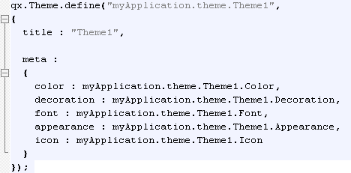
CONTENT OF Theme1 file
THEME STRUCTURE
Notes:
Meta theme collect part of a theme.
Application’s config file refer to meta theme file only

Slide 42
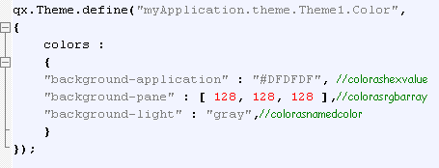
CONTENT OF Color file
THEME STRUCTURE
Notes:
Color: define color use by application, color can be defined in hex, rgb or named color.
Font: information about font used by application, we can see ‘if’ conditional applied here.
Icon:
The icon alias ,which is used to reference icons in qooxdoo applications, is set to the value of this key
The icons key is to define additional icons which are not part of the icon theme. As qooxdoo uses the free available Tango and Oxygen icon sets it is not necessary to extend these.

Slide 43
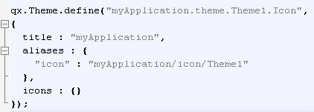
CONTENT OF Icon file
THEME STRUCTURE
Notes:
Color: define color use by application, color can be defined in hex, rgb or named color.
Font: information about font used by application, we can see ‘if’ conditional applied here.
Icon:
The icon alias ,which is used to reference icons in qooxdoo applications, is set to the value of this key
The icons key is to define additional icons which are not part of the icon theme. As qooxdoo uses the free available Tango and Oxygen icon sets it is not necessary to extend these.

Slide 44
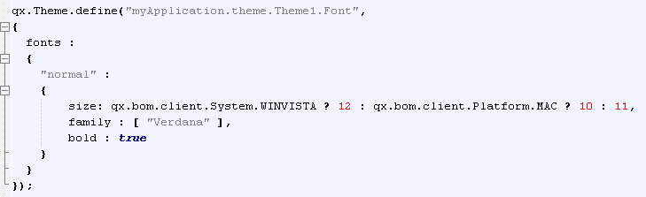
CONTENT OF Font file
THEME STRUCTURE
Notes:
Color: define color use by application, color can be defined in hex, rgb or named color.
Font: information about font used by application, we can see ‘if’ conditional applied here.
Icon:
The icon alias ,which is used to reference icons in qooxdoo applications, is set to the value of this key
The icons key is to define additional icons which are not part of the icon theme. As qooxdoo uses the free available Tango and Oxygen icon sets it is not necessary to extend these.

Slide 45
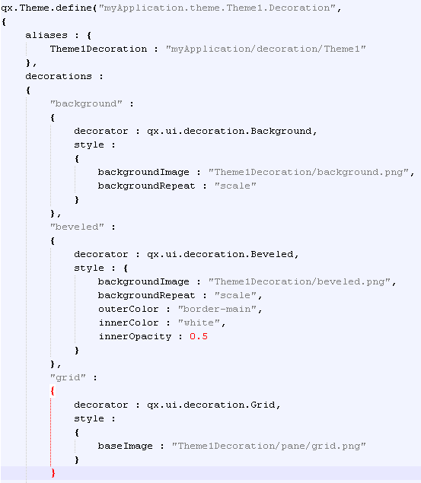
CONTENT OF Decoration file
THEME STRUCTURE
Used to set background-color or –image, border, shadow for widgets.
Type of decorator:
  qx.ui.decoration.Background
  qx.ui.decoration.Uniform
  qx.ui.decoration.Single
  qx.ui.decoration.Double
  qx.ui.decoration.Beveled
  qx.ui.decoration.Grid
Notes:
Decorator:
Each widget can be equipped with an independent decoration which can be used to set a background-color or -image, defined a border or add a shadow.
Background: render background image or color
Uniform: like background but adds support for a uniform border (identical for all edges)
Single: like background but add support for separate border for each edge
Double: like Single but with the option to add two separate border to each edge
Beveled: light rounded border with support for inner glow
Grid: complex decorator based on nine images. Allows very customized styles (rounded borders, alpha transparenct, gradients,…)

Slide 46
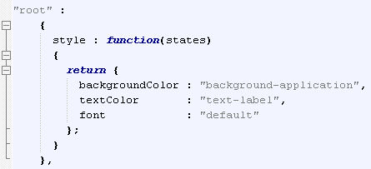
CONTENT OF Appearance file
THEME STRUCTURE
  Collection of theme entries
  Describe themeable widgets and their child controls
  Center meeting point where (decorator, color, font and icon) get together

Slide 47
CONTENT OF Appearance file (cont)
THEME STRUCTURE
Selector (appearance ID)
  Each widget must have a appearance selector
  Hierarchy structure for child controls:
    Combo = textfield + button + popup + list
    → combobox, combobox/textfield, combobox/button, combobox/popup, combobox/list

Slide 48
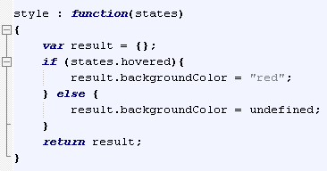
THEME STRUCTURE
CONTENT OF Appearance file (cont)
Style method
  Return set of properties to apply to the target widget.
  State parameter: indicate state of current widget: hovered, focused, selected….
Notes:
The first parameter is named states. This is a map which contain keys (boolean values) to signalize which state are on. State could be : hovered, focused….
State could be enable or disable via API addState or removeState

Slide 49
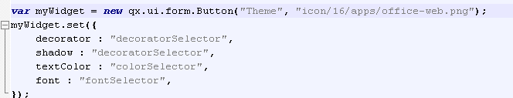


THEME STRUCTURE
CONTENT OF Appearance file (cont)
Usage
C1:
C2:
Notes:
- Decorator: Decorations are used for both, the shadow and the decorator property (separately or together)

Slide 50


THEME STRUCTURE
How does Theme work?
Current
app
theme
Usage 1
Usage 2

Slide 51
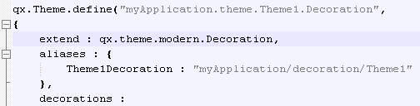
THEME STRUCTURE
Extending
Extended Theme
Syntax: extend: themeName

Slide 52
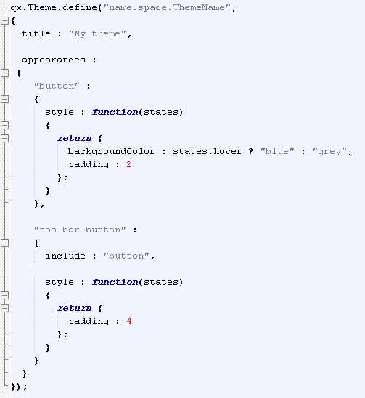
THEME STRUCTURE
Extending
Included Theme
The toolbar-button will include all the styles from button and update the padding from 2 to 4.
The include mechanism only works for appearances , not for fonts or any other type of theme.

Slide 53
THEME STRUCTURE
Applying Theme
  Build-time (config.json):
    QXTHEME : myapplication.theme.Theme1
  Run-time
    Qx.manager.Meta.getInstance().setTheme(myapplication.theme.Theme1)

Slide 54

CUSTOM WIDGET
User control
  Combination of already existing, basic widgets
  A widget made for a specific application (as an extension to the existing feature)
vsqxd.base.ui.Granulation
vsqxd.base.ui.TableNavigation
Notes:
THIS PART INTRODUCE HOW TO CREATE A USER CONTROL CLASS IN QOOXDOO

Slide 55
CUSTOM WIDGET
Inheritance
  Extend: qx.iu.core.Widget
  Method for managing:
    _setLayout(); _getLayout()
    _getChildren();
    _add(); _addAt(); _addBefore(); _addAfter()
    _remove(); _removeAt(); removeAll
Notes:
THIS PART INTRODUCE HOW TO CREATE A USER CONTROL CLASS IN QOOXDOO

Slide 56
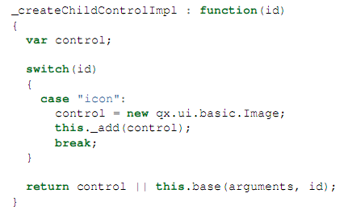
CUSTOM WIDGET
Child control
  Override method _createChildControlImpl
  Supported methods:
  getChildControl(id, notcreate); _showChildControl(id); _excludeChildControl(id); _isChildControlVisible(id); hasChildControl(id);
Notes:
Qooxdoo support a mechanism call child control (a widget as part of another widget) to make easy to access and refine child controls when a class be extended. Each child control using an id which is a lower-case string.
This mechanism

Slide 57
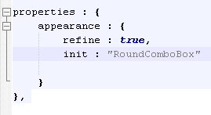
CUSTOM WIDGET
Appearance
  Appearance of widget: manually indicated in properties section of widget class
  Child control appearance: supported by appearance system : selector created automatically
    RoundComboBox/list
    RoundComboBox/popup
    RoundComboBox/button
    RoundComboBox/textfield
  IMPORTANT: all appearance selectors must be defined in appearance.js of current theme
Notes:
Qooxdoo support a mechanism call child control (a widget as part of another widget) to make easy to access and refine child controls when a class be extended. Each child control using an id which is a lower-case string.
This mechanism

Slide 58
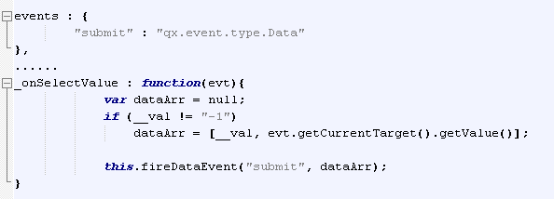
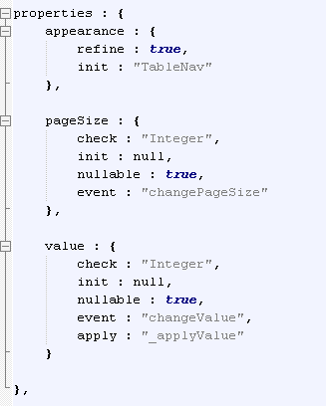
CUSTOM WIDGET
Events
  Class events
    Fire: fireDataEvent() called
    Defined in event section
  Properties event
    Fire: properties value change
    Defined in properties section
Notes:
Qooxdoo support a mechanism call child control (a widget as part of another widget) to make easy to access and refine child controls when a class be extended. Each child control using an id which is a lower-case string.
This mechanism

Slide 59
DEVELOPMENT TOOL
Spket IDE, notepad++, Text Editor
\\192.168.98.229\soft\spket-1.6.18.jar

Slide 60
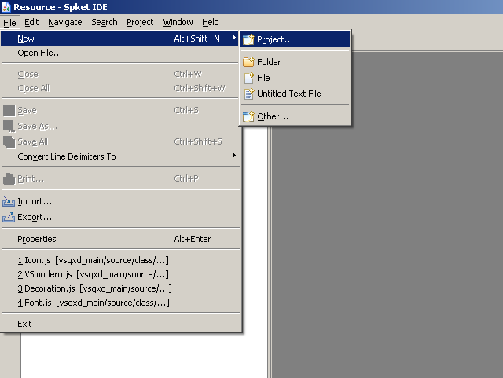
Create a new project with spket IDE
DEVELOPMENT TOOL
From the workbench window, click File -> New -> Project....

Slide 61
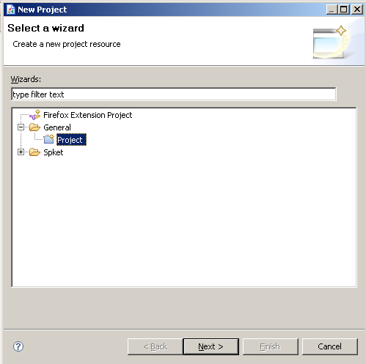
Create a new project with spket IDE
DEVELOPMENT TOOL
When dialog open, choose General project->Click Next

Slide 62
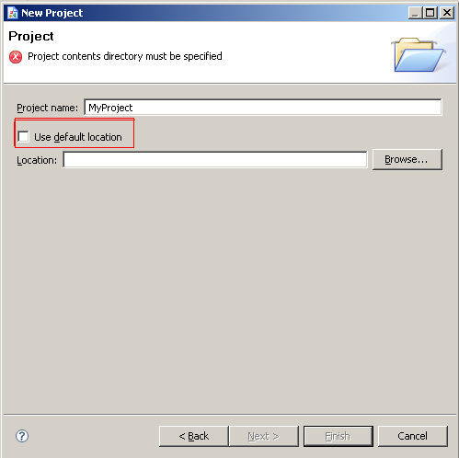
Create a new project with spket IDE
DEVELOPMENT TOOL
When dialog open
Enter project name
Uncheck this option
Find to your qxd project
Finish

Slide 63
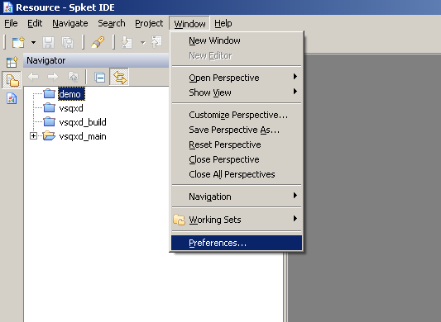
Add reference to QXD Framework
DEVELOPMENT TOOL
From the workbench window, click Windows -> References …

Slide 64
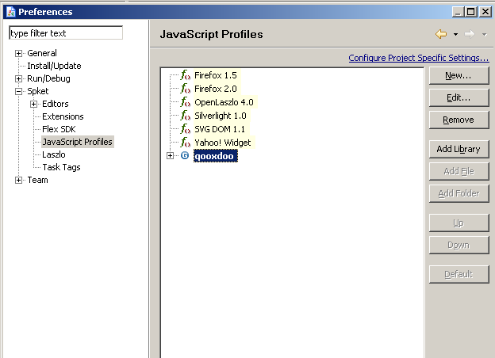
Add reference to QXD Framework
DEVELOPMENT TOOL
When dialog open, click spket -> Javascript profile -> qooxdoo -> Add library

Slide 65
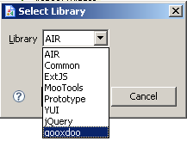
Add reference to QXD Framework
DEVELOPMENT TOOL
When dialog open, select qooxdoo -> Ok

Slide 66
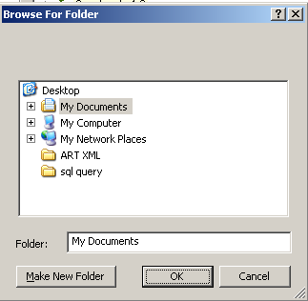
Add reference to QXD Framework
DEVELOPMENT TOOL
After select dialog close, click Add Folder
Here find to qooxdoo framework

Slide 67
TROUBLESHOOTING
Firefox plugins: web developer, firebug, colorzilla, measureit

Slide 68
Reference
http://qooxdoo.org/demo
http://qooxdoo.org/documentation
http://demo.qooxdoo.org/current/apiviewer/#qx
http://qooxdoo.org/documentation/0.6/tutorials

Slide 69
THANK YOU

