Slide 1
CS 5249
MULTI-F0 ESTIMATION OF MUSICAL SINAL
Nguyen Tien Dung
Feng Shuyu
Luong Chi Vu

Slide 2
Content
Introduction
Sound sources: Harnomic v.s Inharmonic
F0 Estimation: Time-domain v.s Freq Domain
Klapuri’s Methods
Implementation
Evaluation Database
Results
Conclusion
Notes:
Hello everybody, today I will present our work on mutiple-F0 estimation using Klapuri’s method. The talk includes:
- Introduction
- Harmonic and Inharmonic sound sources
- Different in Time-domain and Freq-domain methods
- Then, I will present the main ideals of Klapuri methods described in two recent papers in 2005 and 2006
How we build an evaluation database
Results and Conclution

Slide 3
About me !
“Nguyen Tien Dung” from Vietnam, 25 year old
Master student by coursework => No supervisor ☺
My research:
Speech Technology (for Vietnamese)
  Speech Recognition (Hidden Markov Model)
  Speech Synthesis (PSOLA, Unit Selection, Fujisaki Model)
  Tookits: HTK, Sphinx, PRAAT, Festival, HTS
“Amateur” in Audio Processing (Muti-F0 Estimation), and Text Processing
Notes:
Some information about me.
My name is Nguyen Tien Dung. You can call me “Dung” for short. I am twenty five year old, master student by coursework. That why I have no supervisor. In Vietnam, I do research about Speech Recognition and Speech Synthesis.
I am a amateur in Audio Processing. (You know why?) I have to admit that I just learn to use Matlab from September 2006 for Dr. Wang Ye course. I am also interested in Text Processing. I have worked with CDTL (Center for Development of Teaching and Learning) to help them process student feedbacks.
I am not an expert in this area. It means that I do not good enough to give a tutorial about F0 estimation or cannot answer all questions related to this topic. I just know enough to understand and implement Klapuri methods. I would like to get help from Dr. Wang Ye or anybody who know the answer.

Slide 4
About me !
I am not an expert in this area
I am not good enough to give a tutorial about F0 estimation
Cannot answer all questions related to this topic
Just know enough to understand and implement Klapuri methods

Slide 5
Introduction
Multi-F0 Estimation:
  Extract Musical Notes from a music signal
  It is a part of music transcription
    Given a music signal, find the played music notes.
    Combine with other information to form a music composition
We focus on (1) “Finding the notes”
With following assumption about the input signal
  No noise (only periodic signals)
  Signal energies are equal
  Already know number of sources
Notes:
So, what is Muti-F0 Estimation? From music transcription view Mutile-F0 Estimation is “the process of extracting musical Notes from a music signal”
Muti-F0 Estimation is an interesting research topic but is not well explored. There are a lot of challenges:
How we deal with Noise, the input sinal is a mixing of Multiple Sound Sources and these sources are both Harmonic and Inharmonic. It make the problem is not easy to solve.
Our project focus on “Finding the notes” a music signal with following assumption:
There are no noise, or very little noise in the input singal
Signal energies are equal
We already know number of source

Slide 6
Sound Source
Harmonic v.s Inharmonic
Sound sources can be roughly divided into two main groups according their capability to create a clear pitch perception
  harmonic sound sources
    spectral peaks at multiple of the fundamental frequency
  quasi harmonic sound source
    slight deviations from the harmonic case due to
    Noise
    Slight deviation from partial position (vibrating strings, bars)
Axel2006

Slide 7
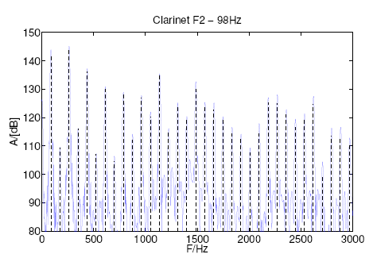
Example of harmonic sound
Harmonic spectrum of a Clarinet, Note F2 - 87.3Hz. The first harmonics with odd frequency factors are rather weak.
Axel2006

Slide 8
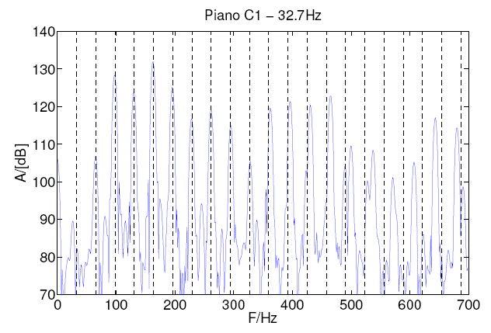
Example of Inharmonic sound
Inharmonic spectrum of a Piano, Note C1 - 32.7Hz. The higher frequency partials clearly deviate from the harmonic positions (from 11*F0).
Axel2006
Notes:
The deviation clearly observed fom eleventh harmonic component.

Slide 9
F0-Estimation Methods
Time domain v.s Frequency Domain
Time-Domain:
  ACF (Auto Correlation Function), AMDF
  Less computation
  Adequate for single F0-Estimation (speech, single note)
Frequency domain:
  Various Techniques
  More computation
  Best choise for mutile F0-Estimation
Notes:
There are two main measurement in time-domain. They are
ACF: Auto Correlation Function
ADMF: Average Magnitude Different Function

Slide 10
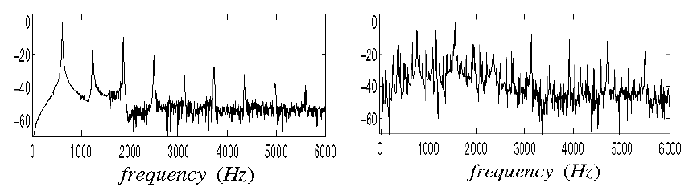
Multi-F0 vs. single-F0 estimation
Complexity difference
When two sounds overlap in time and frequency, there is no straightforward way of separating them
Spectrum of one vs. four concurrent harmonic sounds
Klapuri2004
Notes:
When two sounds overlap in time and frequency, there is no straightforward way of separating them

Slide 11
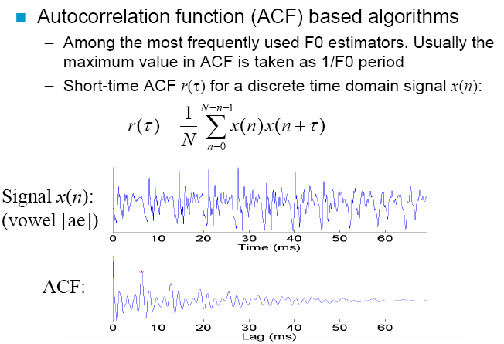
Time-domain periodicity
Klapuri2004

Slide 12
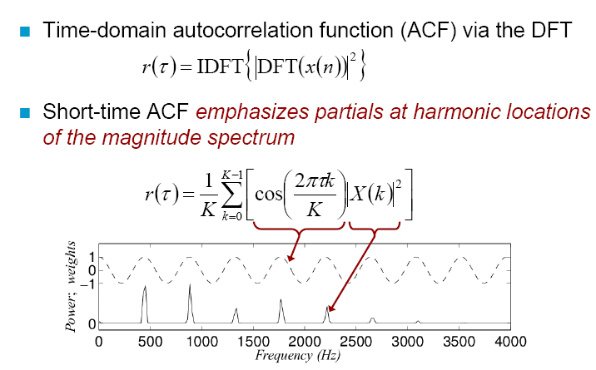
ACF in Frequency-domain
Klapuri2004
Notes:
We can learn two things from ACF.
First, ACF try to select harmonic partials implicitly.
Second, I weight harmonic partials equally
ACF methodslook for partials at harmonic locations of the spectrum
Drawback of these algorithms:
– perfect harmonicity cannot be assumed
– higher partials of many real musical instruments are not exactly at harmonic spectral positions (overtone partials)

Slide 13
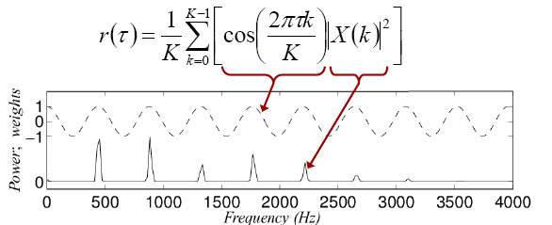
ACF in Frequency-domain
Implicit harmonic selection (prefer value at n*F0)
Weight harmonic partials equally
Klapuri2004

Slide 14
How to improve selection and weighting harmonic partials?
Klapuri calculate “relative strength, or, salient, of fundamental period T by”
  Explicit Harmonic Partial Selection
  => Explicit Partial Value
  Weighting Partials Differently
  => Weighting function

Slide 15
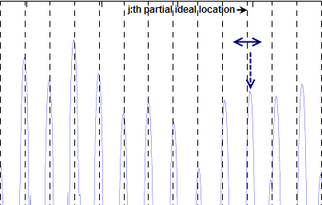
Klapuri’s Partial Selection
Search for maximum value in a small range
“defines a range of frequency bins in the vicinity of the j:th overtone partial of the F0 candidate fs/tau” Klapuri2005, page 3

Slide 16
Klapuri2005 method
Use audio filterbank as pre-processing
Weighting function based on “resovelability”
“The resolvability is approximately inversely proportional to the harmonic index j when tau is fixed” Klapuri2005, page 3

Slide 17
Klapuri2006 method
Use spectrum directly (after spectral whitening)
Optimal weighting function learned from training marterial
Notes:
Energy of higher harmonic components are reflect to F0 position.

Slide 18
Summary
 | Partial Selection | Weighting Function
Autocorrelation | Implicit | Equal (const)
Klapuri2005 | Explicit | Base on Resovevability
Klapuri2006 | Explicit | Learn from data

Slide 19
How to do mutiple-F0 estimation?
Iterative Estimation and Cancellation
  Estimate Predomient-F0
  Cancel F0 detected in (1)
    count = count + 1
  If count < NumberOfNotes then goto (1)
Joint Estimation
  Estimate all notes together
I call them “Strategies”
Notes:
The described iterative multiple-F0 estimator is efficient and produces good results, but it also leaves us with a couple of open questions.
How much does the iterative search algorithm affect the result?
Is it possible to compute saliences of the found sounds so that the order of detecting them would not affect?
Joint estimator come as answer these questions.

Slide 20
Strategies: strength and weakness
Iterative Estimation and Cacellation
  Strength: Fast & Good results
  Weakness: The order of detecting affects results (the latter the worse)
Joint Estimation
  Strength: Higher Accuracy (than Iterative)
  Weakness: Slow !! (impractical)

Slide 21
Framework
We combine both methods in a single framework.
Salient function Calculation:
how strong a F0 candidate is
Stratergy: How to use salient funcion to estimate F0s given number of F0
Spectrum Magnitude Estimation
Salience Function Calculation
Multiple F0 Estimation
(using salience function of
fundamental period T)
Windowed
Signal
Multiple F0s
Method Dependent
Joint Estimation
Auditory Filter Bank (Klapuri2005)
Whitened Spectrum (Klapuri2006)
Iterative Estimation and Cancellation

Slide 22
Klapuri2005 Implementation
Auditory Filterbank and neural transduction
Spectrum Magnitude Estimation
Salience Function Calculation
Multiple F0 Estimation
(Using salience function of
fundamental period T)
Windowed
Signal
Multiple F0s
Method Dependent
Auditory Filter Bank (Klapuri2005)
Iterative Estimation and Cancellation

Slide 23
Klapuri2006 Implementation
Spectral whitening
Spectrum Magnitude Estimation
Salience Function Calculation
Multiple F0 Estimation
(Salience function of
fundamental period T)
Windowed
Signal
Multiple F0s
Method Dependent
Whitened Spectrum (Klapuri2006)
Iterative Estimation and Cancellation

Slide 24
The DSV Database
Collect samples from Iowa’s Instrument Sample Database (~20 instruments with various notes)
For some wind instruments, there are vibrato and non-vibrato samples.
For violin, there are acro and pizz samples

Slide 25
DSV Database Building
Build Single-Note samples
  PRAAT marking and separating process
  Onset Detection (described in Klapuri2005)
  YIN pitch estimation for verification
  Energy normalization
Build Multiple-Note samples
  Mixing randomly in Matlab

Slide 26
Evaluation
Objectives
1. Predominant-F0 (the first detected F0):
2. Multi-F0:

Slide 27
Evaluation Settings
Frame length: 46 ms and 93 ms
Number of concurrent notes: 1, 2, 4, 6
Test dataset size:
  632 monotone
  1000 for 2,4,and 6 concurrent tones, respectively

Slide 28
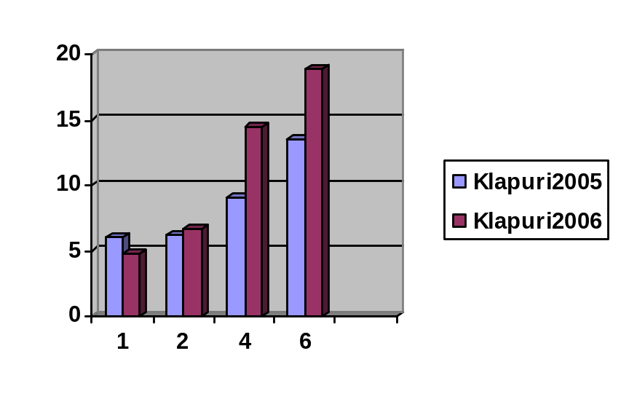
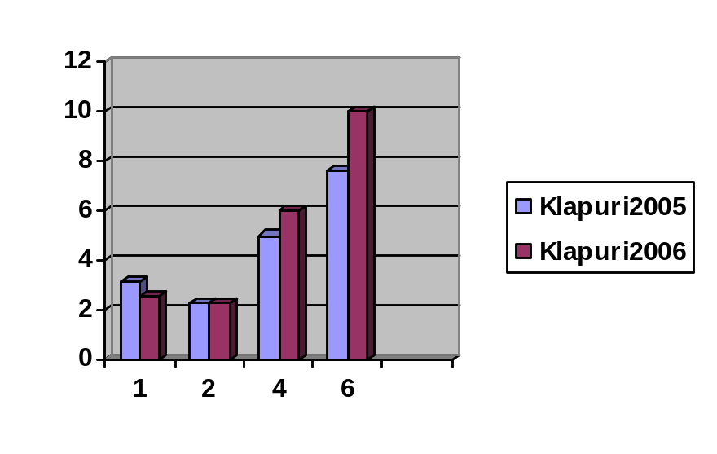
Comparison
Predominant-F0 Error Rates
46ms
93ms

Slide 29
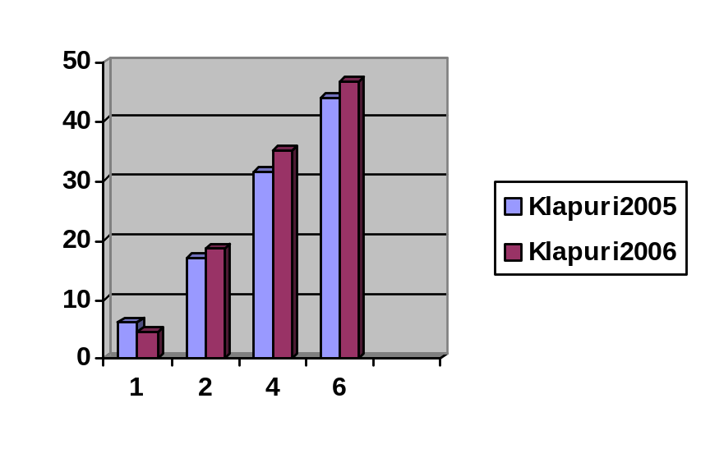
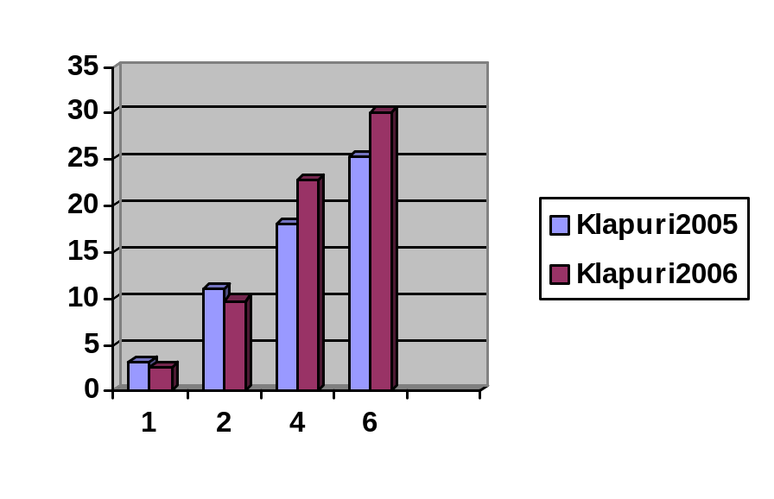
Comparison
Mutiple F0 Error Rates
46ms
93ms

Slide 30
Conclusion
Two state-of-the-arts multi-F0 estimation methods were implemented in a single framework
Little worse than author’s results. Why?
  Different evaluation databases
  Cancellation part is self-invented
Auditory-based method is more stable and data independent than summing spectrum amplitude method but slower (due to auditory filterbank)

Slide 31
Future Works
Enhance Cancellation part to get closer to authors’ results
Improve Computational Efficiency to apply to a real music transcription application
Implement Joint F0 estimation strategy?
better result v.s slower runtime
Notes:
The last word I want to say is “Thank you!”.

Slide 32
References
[Axel2006] Axel Robel, “Fundamental frequency estimation”, summer 2006 lecture
[Klapuri2004] Klapuri, “Fundamental frequency estimation”, ISMIR Graduate School, October 4th-9th, 2004
[Klapuri2005] Klapuri, “A perceptually motivated multiple-f0 estimation method,” in Proc. IEEE Workshop on Applications of Signal Processing to Audio and Acoustics, Oct. 2005
[Klapuri2006] Klapuri, “Multiple fundamental frequency estimation by summing harmonic amplitudes,” in 7th ICMIR, Victoria, Canada, Oct. 2006.

Slide 33
Thank you !

Slide 34

Q & A

