Slide 1
Time Domain Pitch & Time Scale Modification of Speech Signal
Nguyen Tien Dung, Nguyen Dinh Hai
School of Computing
National University of Singapore

Slide 2
Contents
What is pitch and time scaling?
Pitch Estimation
Pitch Marking
TD-PSOLA
Low-band spectrum reconstruction
Evaluation results
Conclusion
Demo

Slide 3
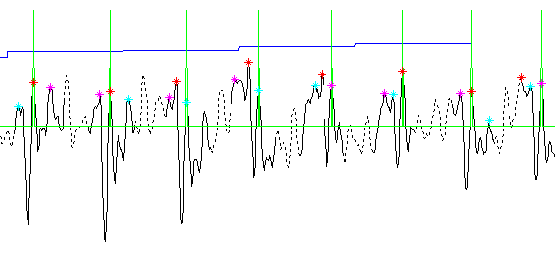
What is pitch and time scaling?
Original Speech signal characterized by:
  Pitch contour
  Speed (Duration)
  Timbre (Formants)
A pitch cycle
An unit waveform
Pitch mark
Notes:
When play a wave file at a higher sampling frequency, we have a higher pitch, shorter time and high formant shifting. If we play it at a lower sampling frequency, we have lower pitch, shorter time and low formant shifting. All three parameters (pitch scale, time scale and formant shifting) are constrained to each other. How to control each parameter independently?

Slide 4

What is pitch and time scaling?
Play original signal at a lower sampling frequency
=> lower pitch, longer duration, lower formants
  Original Fs
  0.8*Fs
  PitchScale = 0.8
  TimeScale = 1.25
  FormantShifting = 0.8
Notes:
When play a wave file at a higher sampling frequency, we have a higher pitch, shorter time and high formant shifting. If we play it at a lower sampling frequency, we have lower pitch, shorter time and low formant shifting. All three parameters (pitch scale, time scale and formant shifting) are constrained to each other. How to control each parameter independently?

Slide 5
What is pitch and time scaling?
Play original signal at a higher sampling frequency
=> higher pitch, shorter duration, higher formants
  Original Fs
  1.3*Fs
  PitchScale = 1.3
  TimeScale = 0.77
  FormantShifting = 1.3
Notes:
When play a wave file at a higher sampling frequency, we have a higher pitch, shorter time and high formant shifting. If we play it at a lower sampling frequency, we have lower pitch, shorter time and low formant shifting. All three parameters (pitch scale, time scale and formant shifting) are constrained to each other. How to control each parameter independently?

Slide 6
Can we modify pitch and time independently?
  Yes!

Slide 7
But how?
Frequency Domain:
  Phase Vocoder
  Harmonic & Noise model
Time-Domain:
  PSOLA
  Pitch Synchronized Overlap and Add

Slide 8
Why choose PSOLA?
Effective for speech signal
Computational saving
Well studied

Slide 9
Pitch Estimation
Input: Speech signal
Output: Pitch contour
Method: Autocorrelation
Input speech
Pitch Estimation
Pitch Marking
TD-PSOLA
Synthetic speech

Slide 10
Pitch Estimation
Speech
Input speech
Low pass Filter
Pitch Estimation
Speech frames
Center Clipping
Pitch Marking
Autocorrelation
TD-PSOLA
Voiced / Unvoiced
Decision
Pitch Calculation
Synthetic speech
Frame pitch
Median Filter
Pitch contour

Slide 11
Pitch Marking
Input: Speech Signal,Pitch Contour
Output: Pitch Marks in time
Method: Dynamic Programming
Input speech
Pitch stimation
Pitch Marking
TD-PSOLA
Synthetic speech

Slide 12
Pitch Marking
Input speech
Pitch stimation
Pitch contour
Search Region
Dividing
Peaks Candidates
Selection
Pitch Marking
Pitch marks
Fine-turn
Dynamic
Programming
TD-PSOLA
Synthetic speech

Slide 13
TD-PSOLA
Input: Speech signal, pitch marks, pitch scale, time scale
Output: Synthetic speech
Method:
  Target pitch mark calculation
  Unit waveform extraction
  Synthetic unit waveform allocation (base on new pitch mark)
Input speech
Pitch Estimation
Pitch Marking
TD-PSOLA
Synthetic speech

Slide 14
TD-PSOLA
Input speech
Pitch Estimation
Analysis speech
Unit Waveform
Extraction
Low band Spectrum
Reconstruction
Analysis
Pitch Marks
Pitch Marking
Target Pitch Mark
Calculation
Synthesis Unit
Waveforms
TD-PSOLA
- Pitch Scale
- Time Scale
Synthetic speech
Overlap and Add
Synthetic speech

Slide 15
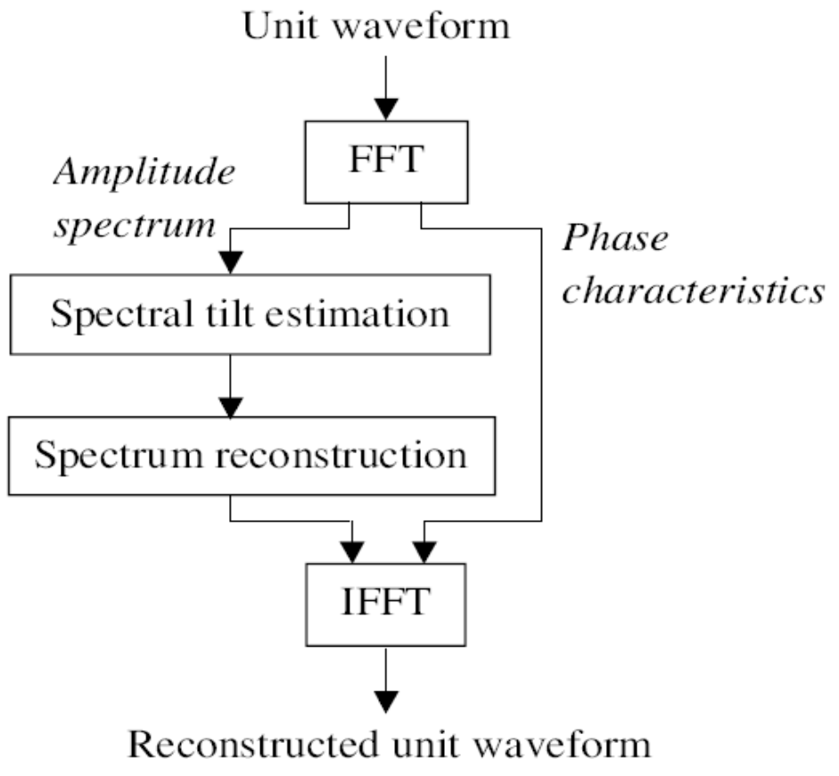
Low-band Spectrum Reconstruced

Slide 16
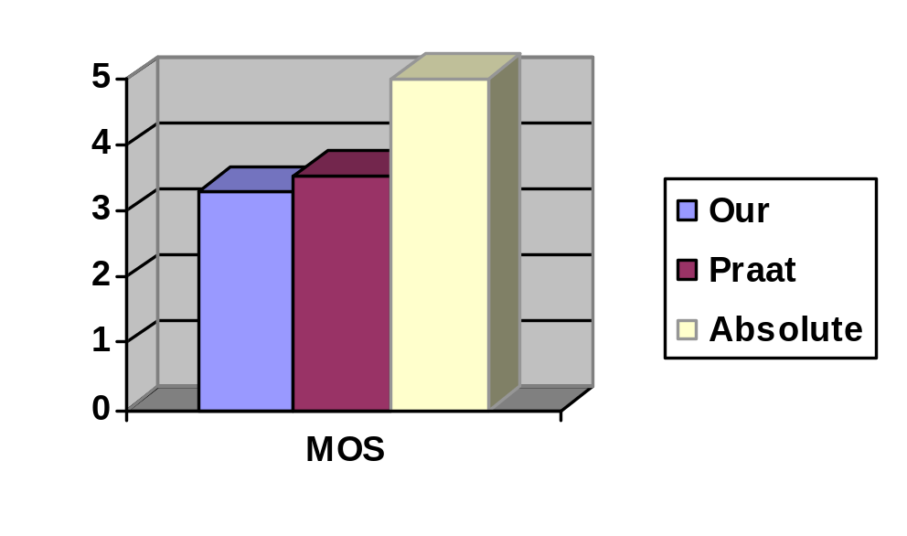
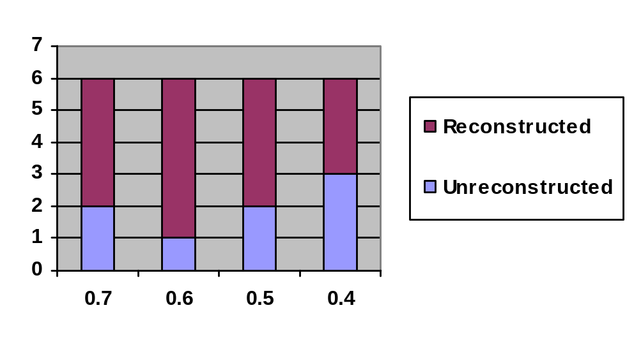
Evaluation Results

Slide 17
Conclusion
Our implementation has equivalent quality to that of Praat
Low-band spectrum reconstruction method improves the quality in case of downward pitch scale modification

Slide 18

Demo
Original Male Utterance
Praat pitchScale=1.5, timeScale=0.9
Our program pitchScale=1.5, timeScale=0.9
Original Female Utterance
pitchScale=0.6, timeScale=1.0, without reconstruction
pitchScale=0.6, timeScale=1.0, with reconstruction
Original Male Voice
Gender Changing by formant shifting
(pitchScale=1.3, timeScale=0.7,resamplingScale=1.3)

Slide 19
Thank you

