Slide 1

Last update: 2 March 2010
Web Mining –
An introduction to Web content (text) mining
Bettina Berendt
.

Slide 2
Agenda
Basics of automated text analysis / text mining
Motivation/example: classifying blogs by sentiment
Data cleaning
Further preprocessing: at word and document level
Text mining and WEKA

Slide 3
Agenda
Basics of automated text analysis / text mining
Motivation/example: classifying blogs by sentiment
Data cleaning
Further preprocessing: at word and document level
Text mining and WEKA

Slide 4
The steps of text mining
Application understanding
Corpus generation
Data understanding
Text preprocessing
Search for patterns / modelling
Evaluation
Deployment

Slide 5
Application understanding; Corpus generation
  What is the question?
  What is the context?
  What could be interesting sources, and where can they be found?
  Crawl
  Use a search engine and/or archive
    Google blogs search
    Technorati
    Blogdigger
    ...

Slide 6
The goal: text representation
  Basic idea:
    Keywords are extracted from texts.
    These keywords describe the (usually) topical content of Web pages and other text contributions.
  Based on the vector space model of document collections:
    Each unique word in a corpus of Web pages = one dimension
    Each page(view) is a vector with non-zero weight for each word in that page(view), zero weight for other words
  ➔ Words become “features” (in a data-mining sense)

Slide 7
Data Preparation Tasks for Mining Text Data
Feature representation for texts
  each text p is represented as a k-dimensional feature vector, where k is the total number of extracted features from the site in a global dictionary
  feature vectors obtained are organized into an inverted file structure containing a dictionary of all extracted features and posting files for pageviews
Conceptually, the inverted file structure represents a
document-feature matrix, where each row is the feature vector for a page and each column is a feature

Slide 8
Document Representation as Vectors
Starting point is the raw term frequency as term weights
Other weighting schemes can generally be obtained by applying various transformations to the document vectors
Document Ids
Features
nova galaxy heat actor film role diet
A 1.0 0.5 0.3
B 0.5 1.0
C 0.4 1.0 0.8 0.7
D 0.9 1.0 0.5
E 0.5 0.7 0.9
F 0.6 1.0 0.3 0.2 0.8
a document
vector

Slide 9
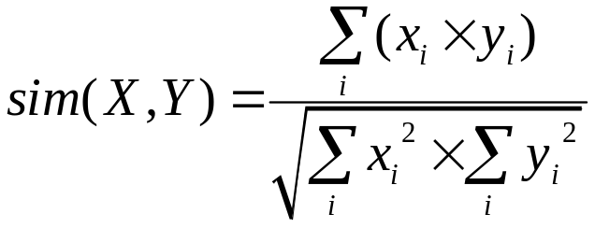
Computing Similarity Among Documents
Advantage of representing documents as vectors is that it facilitates computation of document similarities
Example (Vector Space Model)
  the dot product of two vectors measures their similarity
  the normalization can be achieved by dividing the dot product by the product of the norms of the two vectors
  given vectors X = <x₁, x₂, …, x_{n}> and Y = <y₁, y₂, …, y_{n}>
  the similarity of vectors X and Y is:
Note: this measures the cosine of the angle between two vectors

Slide 10
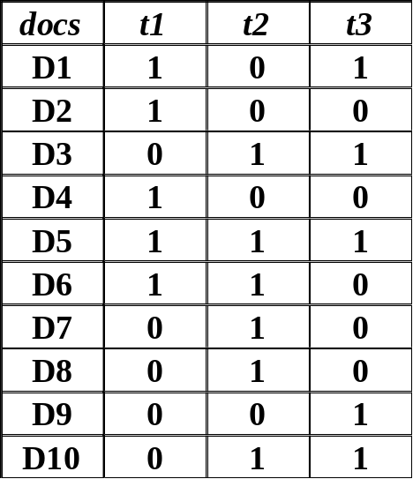
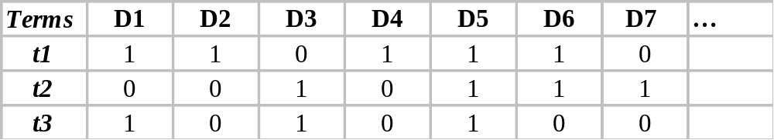
Inverted Indexes
An Inverted File is essentially a vector file “inverted” so that rows become columns and columns become rows
Term weights can be:
- Binary
- Raw Frequency in document (Text Freqency)
- Normalized Frequency
- TF x IDF

Slide 11
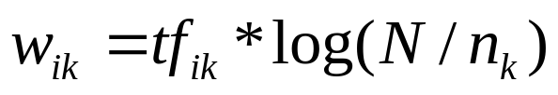
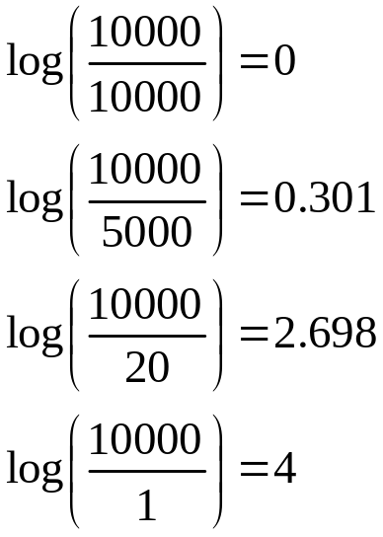
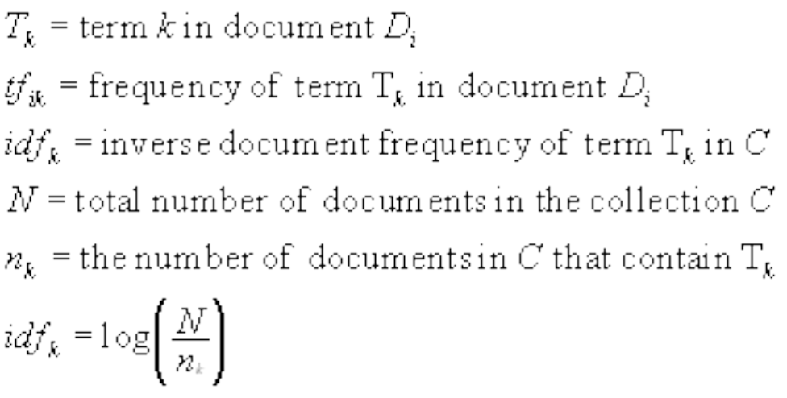
Assigning Weights
tf x idf measure:
term frequency (tf) x inverse document frequency (idf)
  Want to weight terms highly if they are frequent in relevant documents … BUT infrequent in the collection as a whole
Goal: assign a tf x idf weight to each term in each document

Slide 12
Feature construction
  Raw terms are often not the most expressive features
  Synonymy, homonymy, ...
  One solution class: LSA (aka LSI) and similar dimensionality-reduction techniques for feature construction

Slide 13
Agenda
Basics of automated text analysis / text mining
Motivation/example: classifying blogs by sentiment
Data cleaning
Further preprocessing: at word and document level
Text mining and WEKA

Slide 14
What is text mining?
  The application of data mining to text data
  „the discovery by computer of new, previously unknown information, by automatically extracting information from different written resources.
  A key element is the linking together of the extracting information [...] to form new facts or new hypotheses to be explored further by more conventional means of experimentation.
  Text mining is different from [...] web search. In search, the user is typically looking for something that is already known and has been written by someone else. [...] In text mining, the goal is to discover heretofore unknown information, something that no one yet knows and so could not have yet written down.“
    (Marti Hearst, What is Text Mining, 2003, http://people.ischool.berkeley.edu/~hearst/text-mining.html)

Slide 15
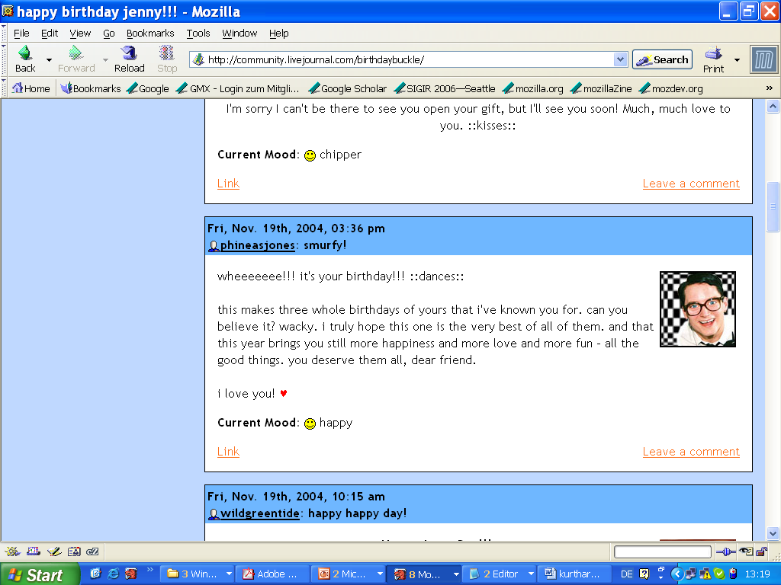
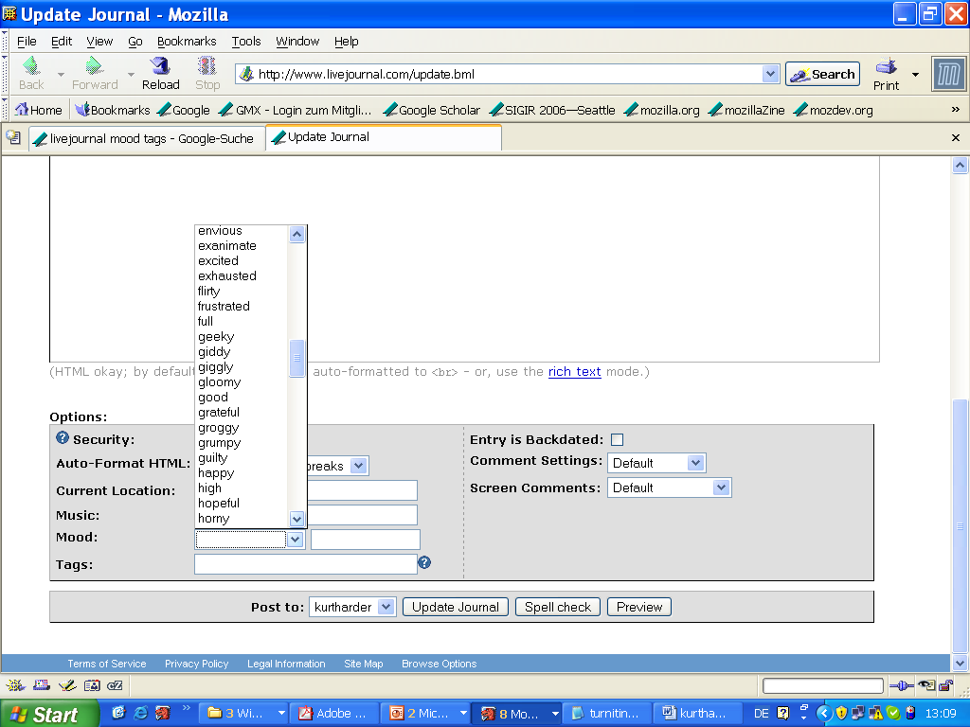
Happiness in the blogosphere
Notes:
http://charles.robinsontwins.org/twinsdays_96/john/smiley.jpg
http://members.iinet.net.au/~sauterp@iinet.net.au/funny/smiley.gif
http://www.nonprofitmailers.org/images/smiley.jpg

Slide 16


Well kids, I had an awesome birthday thanks to you. =D Just wanted to so thank you for coming and thanks for the gifts and junk. =) I have many pictures and I will post them later. hearts
current
mood:
What are the
characteristic words
of these two moods?
Home alone for too many hours, all week long ... screaming child, headache, tears that just won’t let themselves loose.... and now I’ve lost my wedding band. I hate this.
current
mood:
[Mihalcea, R. & Liu, H. (2006). A corpus-based approach to finding happiness,
In Proceedings of the AAAI Spring Symposium on Computational Approaches to Analyzing Weblogs.]
Slide based on Rada Mihalcea‘s slides in the presentation.

Slide 17
Data, data preparation and learning
LiveJournal.com – optional mood annotation
10,000 blogs:
  5,000 happy entries / 5,000 sad entries
  average size 175 words / entry
  post-processing – remove SGML tags, tokenization, part-of-speech tagging
quality of automatic “mood separation”
  naïve bayes text classifier
    five-fold cross validation
  Accuracy: 79.13% (>> 50% baseline)
Based on Rada Mihalcea`s talk at CAAW 2006

Slide 18
Results: Corpus-derived happiness factors
yay 86.67
shopping 79.56
awesome 79.71
birthday 78.37
lovely 77.39
concert 74.85
cool 73.72
cute 73.20
lunch 73.02
books 73.02
goodbye 18.81
hurt 17.39
tears 14.35
cried 11.39
upset 11.12
sad 11.11
cry 10.56
died 10.07
lonely 9.50
crying 5.50
Based on Rada Mihalcea`s talk at CAAW 2006

Slide 19
Bayes‘ formula and its use for classification
1. Joint probabilities and conditional probabilities: basics
  P(A & B) = P(A|B) * P(B) = P(B|A) * P(A)
  ➔ P(A|B) = ( P(B|A) * P(A) ) / P(B) (Bayes´ formula)
  P(A) : prior probability of A (a hypothesis, e.g. that an object belongs to a certain class)
  P(A|B) : posterior probability of A (given the evidence B)
2. Estimation:
  Estimate P(A) by the frequency of A in the training set (i.e., the number of A instances divided by the total number of instances)
  Estimate P(B|A) by the frequency of B within the class-A instances (i.e., the number of A instances that have B divided by the total number of class-A instances)
3. Decision rule for classifying an instance:
  If there are two possible hypotheses/classes (A and ~A), choose the one that is more probable given the evidence
  (~A is „not A“)
  If P(A|B) > P(~A|B), choose A
  The denominators are equal ➔ If ( P(B|A) * P(A) ) > ( P(B|~A) * P(~A) ), choose A

Slide 20
Simplifications and Naive Bayes
4. Simplify by setting the priors equal (i.e., by using as many instances of class A as of class ~A)
  ➔ If P(B|A) > P(B|~A), choose A
5. More than one kind of evidence
  General formula:
  P(A | B₁ & B₂ ) = P(A & B₁ & B₂ ) / P(B₁ & B₂) = P(B₁ & B₂ | A) * P(A) / P(B₁ & B₂) = P(B₁ | B₂ & A) * P(B₂ | A) * P(A) / P(B₁ & B₂)
  Enter the „naive“ assumption: B₁ and B₂ are independent given A
  ➔ P(A | B₁ & B₂ ) = P(B₁|A) * P(B₂|A) * P(A) / P(B₁ & B₂)
  By reasoning as in 3. and 4. above, the last two terms can be omitted
  ➔ If (P(B₁|A) * P(B₂|A) ) > (P(B₁|~A) * P(B₂|~A) ), choose A
  The generalization to n kinds of evidence is straightforward.
  In machine learning, features are the evidence.

Slide 21
Example: Texts as bags of words
Common representations of texts
  Set: can contain each element (word) at most once
  Bag (aka multiset): can contain each word multiple times (most common representation used in text mining)
Hypotheses and evidence
  A = The blog is a happy blog, the email is a spam email, etc.
  ~A = The blog is a sad blog, the email is a proper email, etc.
  B_{i} refers to the i^{th} word occurring in the whole corpus of texts
Estimation for the bag-of-words representation:
  Example estimation of P(B₁|A) :
    number of occurrences of the first word in all happy blogs, divided by the total number of words in happy blogs (etc.)

Slide 22
The „happiness factor“
“Starting with the features identified as important by the Naïve Bayes classifier (a threshold of 0.3 was used in the feature selection process), we selected all those features that had a total corpus frequency higher than 150, and consequently calculate the happiness factor of a word as the ratio between the number of occurrences in the happy blogposts and the total frequency in the corpus.”
→ What is the relation to the Naïve Bayes estimators?

Slide 23
Agenda
Basics of automated text analysis / text mining
Motivation/example: classifying blogs by sentiment
Data cleaning
Further preprocessing: at word and document level
Text mining and WEKA

Slide 24
Preprocessing (1)
Data cleaning
  Goal: get clean ASCII text
  Remove HTML markup*, pictures, advertisements, ...
  Automate this: wrapper induction
  * Note: HTML markup may carry information too (e.g., <b> or <h1> marks something important), which can be extracted! (Depends on the application)

Slide 25
Agenda
Basics of automated text analysis / text mining
Motivation/example: classifying blogs by sentiment
Data cleaning
Further preprocessing: at word and document level
Text mining and WEKA

Slide 26
Preprocessing (2)
Further text preprocessing
  Goal: get processable lexical / syntactical units
  Tokenize (find word boundaries)
  Lemmatize / stem
    ex. buyers, buyer → buyer / buyer, buying, ... → buy
  Remove stopwords
  Find Named Entities (people, places, companies, ...); filtering
  Resolve polysemy and homonymy: word sense disambiguation; “synonym unification“
  Part-of-speech tagging; filtering of nouns, verbs, adjectives, ...
  ...
  Most steps are optional and application-dependent!
  Many steps are language-dependent; coverage of non-English varies
  Free and/or open-source tools or Web APIs exist for most steps

Slide 27
Preprocessing (3)
Creation of text representation
  Goal: a representation that the modelling algorithm can work on
  Most common forms: A text as
    a set or (more usually) bag of words / vector-space representation: term-document matrix with weights reflecting occurrence, importance, ...
    a sequence of words
    a tree (parse trees)

Slide 28
(Fin)

Slide 29
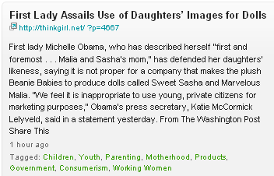

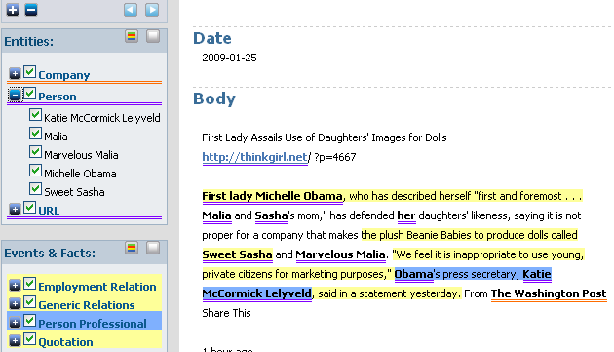
An important part of preprocessing:
Named-entity recognition (1)
Notes:
www.opencalais.com, generated on Jan 25th, 2009

Slide 30
An important part of preprocessing:
Named-entity recognition (2)
  Technique: Lexica, heuristic rules, syntax parsing
  Re-use lexica and/or develop your own
    configurable tools such as GATE
  A challenge: multi-document named-entity recognition
    See proposal in Subašić & Berendt (Proc. ICDM 2008)

Slide 31
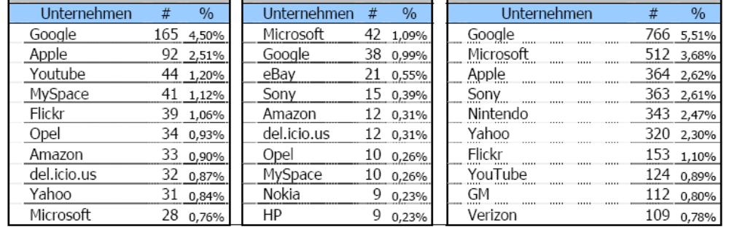
The simplest form of content analysis is based on NER
Berendt, Schlegel und Koch
In Zerfaß et al. (Hrsg.) Kommunikation, Partizipation und Wirkungen im Social Web, 2008

Slide 32
Agenda
Basics of automated text analysis / text mining
Motivation/example: classifying blogs by sentiment
Data cleaning
Further preprocessing: at word and document level
Text mining and WEKA

Slide 33
From HTML to String to ARFF
Problem: Given a text file: How to get to an ARFF file?
Remove / use formatting
    HTML: use html2text (google for it to find an implementation in your favourite language) or a similar filter
    XML: Use, e.g., SAX, the API for XML in Java (www.saxproject.org)
Convert text into a basic ARFF (one attribute: String): http://weka.sourceforge.net/wiki/index.php/ARFF_files_from_Text_Collections
Convert String into bag of words (this filter is also available in WEKA‘s own preprocessing filters, look for filters – unsupervised – attribute – StringToWordVector)
    Documentation: http://weka.sourceforge.net/doc.dev/weka/filters/unsupervised/attribute/StringToWordVector.html

