Slide 1

A System for Automatic Personalized Tracking of Scientific Literature on the Web
Tzachi Perlstein
Yael Nir

Slide 2
Overview
Introduction – The problem
Digital library – A partial solution
Introducing the Tracking System
  Solving the problem
  Examples
Conclusion

Slide 3
Abstract
Objective:
  Track & Recommend topically relevant papers.
Method:
  Common used measures (e.g keyword).
  Heterogeneous profile to represent user’s interests.

Slide 4
Introduction
Motivation:
  The human’s need to be updated on important
  matters.
Potential users:
  Researchers, Students, Journalists, The common man.
The Problem:
  Enormous time and effort:
    Information overload.
    Growing rate of publications.

Slide 5
A Partial Solution – The Digital Library

Slide 6
CiteSeer – A Digital Library
Unique Features:
  ACI - Autonomous Citation Indexing.
  Browsing by citation links to find citing and cited papers.
  Summarizes citation context.
  Provide citation statistics.
  Works with scientific literature only.

Slide 7
Disadvantage:
The User’s Effort for Searching Is Forgotten and Lost.

Slide 8
Introducing Tracking System Into CiteSeer.

Slide 9
Features
Using profile to represent user’s interests.
Using heterogeneous relatedness measure.
Determine whether a new paper matches a user interest.
Alert the user (e.g e-mail).
Monitoring.
Configure the user profile.

Slide 10
Determining Paper Relevance
Two methods:
Constraint matching:
  Constrains: Keywords, Citation links, URL.
  Simple, yet highly effective.
Feature relatedness:
  The user specify interesting papers.
  CiteSeer tries to find related papers.
A paper is relevant if it satisfies one method

Slide 11
Constrain Matching

Slide 12
Keyword
Commonly used.
CiteSeer allows Keyword matching to specific parts of the paper:
  Title, Header, Abstract, Main Body.
Choosing ’good’ keywords can be difficult.

Slide 13
Citation Links
Citation gives an indication of the cited work effect.
CiteSeer allows a user to specify interesting citations and it tracks them.
When new citing paper appears the user is informed.

Slide 14
Metadata
Metadata - A Descriptive tag associated with a document (e.g URL).
User can specify a URL to track.
When a new paper appear linked from it the system notify the user.

Slide 15

“Tell Me More About New Papers That Are Related to This One.”

Slide 16
Related Papers

Slide 17
Tracking Related Papers
The goal:
  Capture the user’s notion of related papers.
The challenges:
  Identify features that represents useful semantic information on documents.
  Create ‘semantic distance’ functions between two documents.
The relatedness measures:
  Text-based.
  Citation-based.

Slide 18

The Concept
The TFIDF\CCIDF scheme:
Term\Citation Frequency Inverse Doc Frequency
The idea is that obscure term\citation is more powerful indicator than a very common term\citation.
Same idea for both
text-relatedness & citation-relatedness…
Still, different.

Slide 19
Text Relatedness Functions
F(d) : Features vector for document d.
The vector holds the ‘unique words’ frequencies in document d above collection of documents D.
RTFIDF(Fd,Fe) : Relatedness measure function.
calculation is done by a dot product of the two F vectors.

Slide 20

F(d) : The Features Vector
F(d) is |W| dimensional vector of wds.
  fds: Frequency of word stem s in document d.
  f dmax: Highest term frequency in document d.
  D: Total number of documents.
  ns: Number of documents having stem s

Slide 21

RTFIDF(Fd,Fe): Relatedness Func.
The relatedness between two documents d and e is a dot product or Euclidean distance on the two word vectors Fd and Fe.
Small value when d and e are about mostly unrelated topics and concepts.
Large value when d and e talk about very related issues and ideas.

Slide 22
Continue
The TFIDF distance is calculate for the abstract & text bodies, and determines whether a new paper is related to one of the papers specified by a user.
Today: Threshold tuned by CiteSeer hand.
Tomorrow: By user or by machine learning.

Slide 23
Citation Relatedness
Taking advantage of specific features in scientific publications.
Two papers that cite some same previous publications may be related.
Using the CCIDF scheme.
Common Citation X Inverse Document Frequency
The idea is that obscure citation is more powerful indicator.

Slide 24

RCCIDF(Xd,Xe): Relatedness Func.
Xd : Boolean vector, indicates which citations document d contains.
The CCIDF between new downloaded document e,
and document d that was specified by the user is:
WD : Vector of the inverse frequencies.
tr( ): The trace function.

Slide 25
Profile Creation

Slide 26
User Profile
A CiteSeer Profile is:
A machine representation of the user’s notion of an interesting paper.
Features:
  Contains: keywords, URLs, documents, citations.
  Creation of profile is integrated into the search process.
  Identifying a user using cookie (or e-mail address).
  User can configure his profile manually.

Slide 27
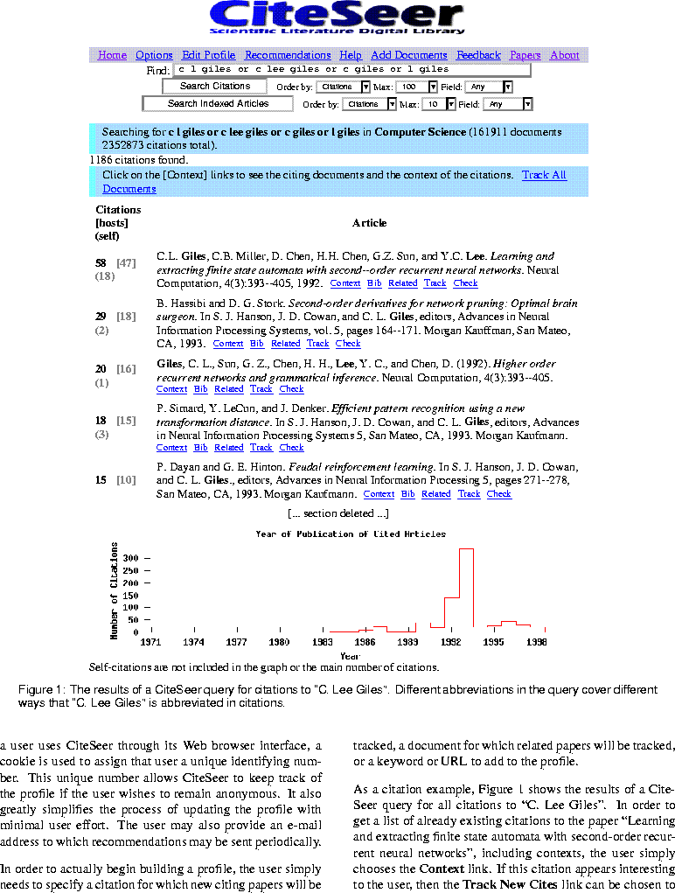
Citation Example:

Slide 28
Citation Example Cont.
Keyword search: “C. Lee Giles”.
The Context link related to the paper “Learning and extracting…”, gives a list of already existing citations to the paper, including context.
The Track New Cites link adds this citation to the user profile. When new papers that make this citation are added to the database, they can be recommended to user.

Slide 29
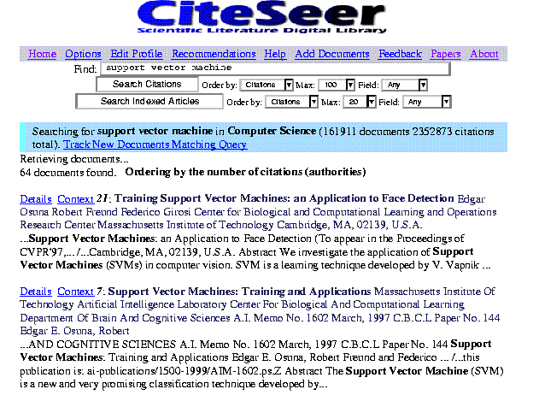
Documents Example:

Slide 30
Document Example Cont.
Keyword search: “support vector machine”.
The Details link related to the paper “Training support vector…” gives more information as will be shown on the next example…
The Track New Documents Matching Query link is used to add keywords to the user profile. As a new papers that match a given query are found, they will be recommended to the user.

Slide 31
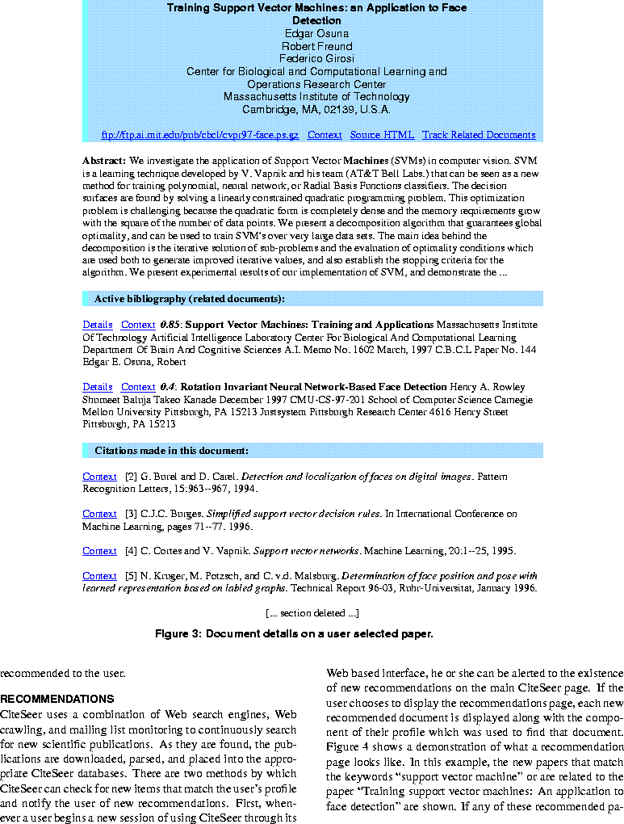
Details Page:

Slide 32
Details Example Cont.
The active bibliography section gives the CCIDF related document, with the degree of similarity.
The Track Related Documents link will add those documents to the user profile.
The Details link will lead to new related documents. And so on and on…

Slide 33
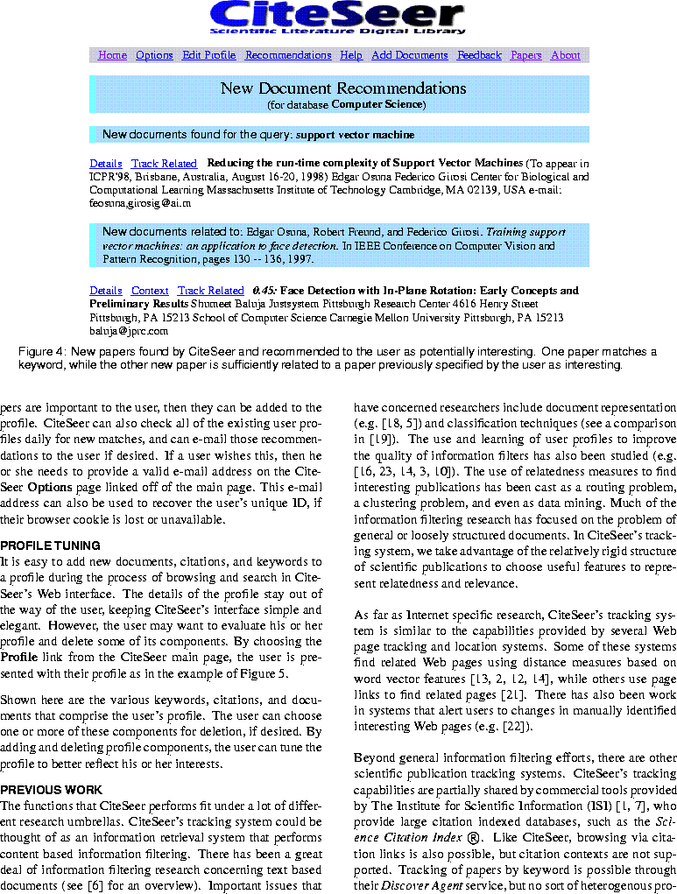
Recommendations:

Slide 34
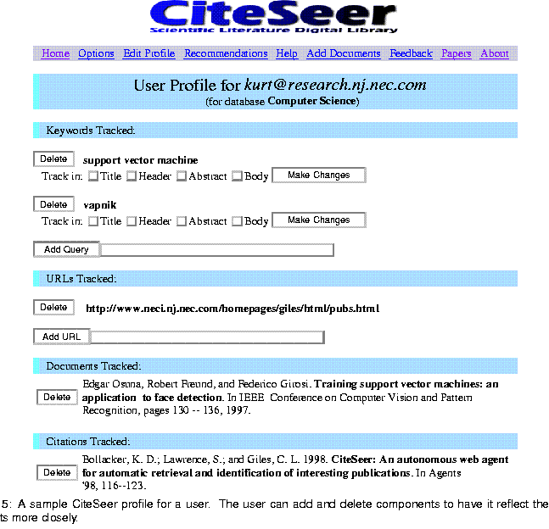
User Profile:

Slide 35
Credits
NEC Research Institute, Prinston, NJ
Kurt D. Bollacker
Steve Lawrence
C. Lee Giles

Slide 36
Conclusion
Automatically up-date user.
User can easily define his profile.
The system finds new items that match the profile.
Unique use of heterogeneous measures.
Minimal user effort.
Non – commercial use.

