Slide 1
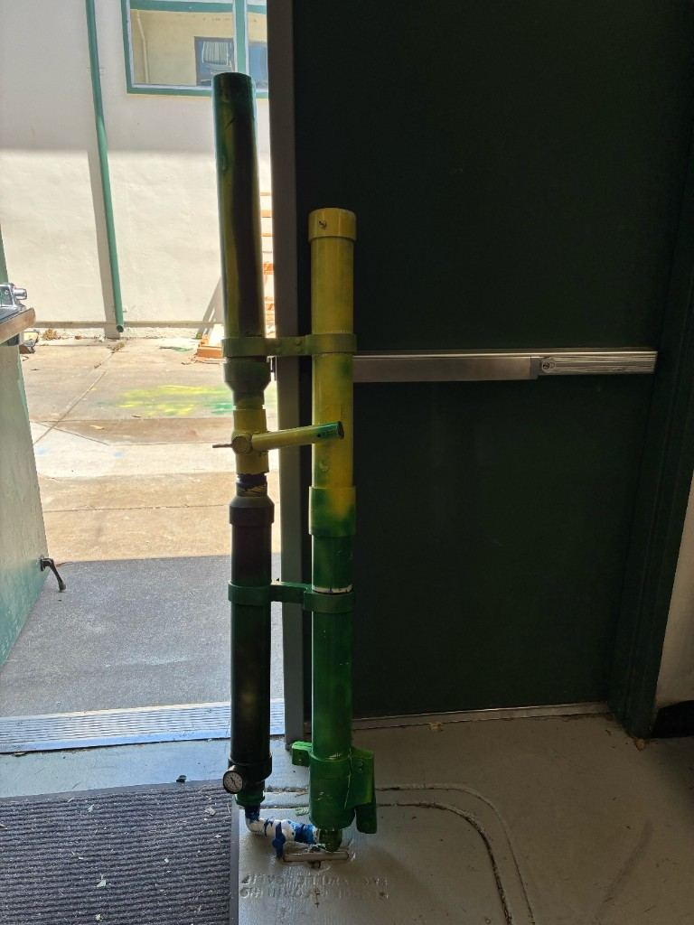
Slide 01
Air Pressure Multi-Purpose Event Cannon
Hudson Tien
Castro Valley High School
Engineering Design and Development
Final Defense
Hudson Tien | PLTW Engineering Design and Development | Replace placeholder data before final submission

Slide 2
Slide 02
Five Facts
• Built for Leadership, sports teams, rallies, and school events
• Designed for shirts, confetti, and light event payloads
• Pivoted from spring force to regulated air pressure
• Focused on ease of use, repeatability, and safety
• Prototype is functional and ready for live demonstration
Hudson Tien | PLTW Engineering Design and Development | Replace placeholder data before final submission

Slide 3
Slide 03
Problem Statement
• CVHS needs a safe, reliable, easy-to-use launcher.
• The launcher must send event items farther than a normal throw.
• The user should not need to understand complex pneumatics.
Hudson Tien | PLTW Engineering Design and Development | Replace placeholder data before final submission

Slide 4
Slide 04
Stakeholders and Justification
• Leadership class needs fast setup.
• Sports teams and coaches need safe event equipment.
• Students benefit when event items reach more of the crowd.
• Prior launcher was returned because setup was not intuitive.
Hudson Tien | PLTW Engineering Design and Development | Replace placeholder data before final submission

Slide 5
Slide 05
Existing Solutions
• Hand throwing: cheap but inconsistent.
• Commercial launchers: powerful but expensive.
• Existing school cannon: usability problems.
• Spring concept: high force and risky manufacturing.
Hudson Tien | PLTW Engineering Design and Development | Replace placeholder data before final submission

Slide 6
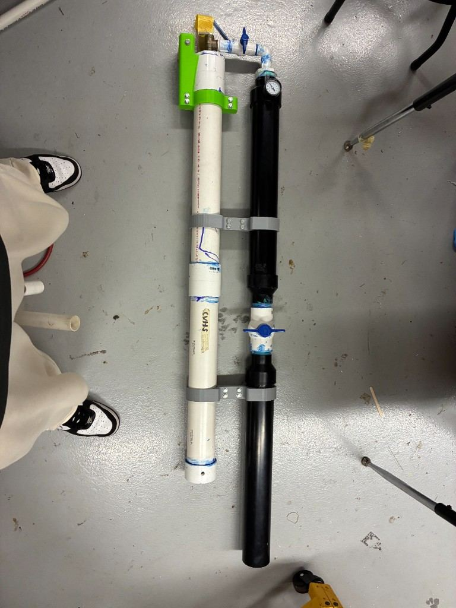
Slide 06
Design Pivot
• The spring-loaded concept looked simple at first.
• Force and manufacturing requirements made it a poor fit.
• Regulated air pressure is adjustable, testable, and easier to explain.
Hudson Tien | PLTW Engineering Design and Development | Replace placeholder data before final submission

Slide 7
Slide 07
Requirements
• First-time user learns operation in under 2 minutes.
• Reload time under 60 seconds.
• Launch reaches at least 60 feet with shirt bundle.
• Prototype stays within safe pressure range.
• Device can be carried by one or two students.
Hudson Tien | PLTW Engineering Design and Development | Replace placeholder data before final submission

Slide 8
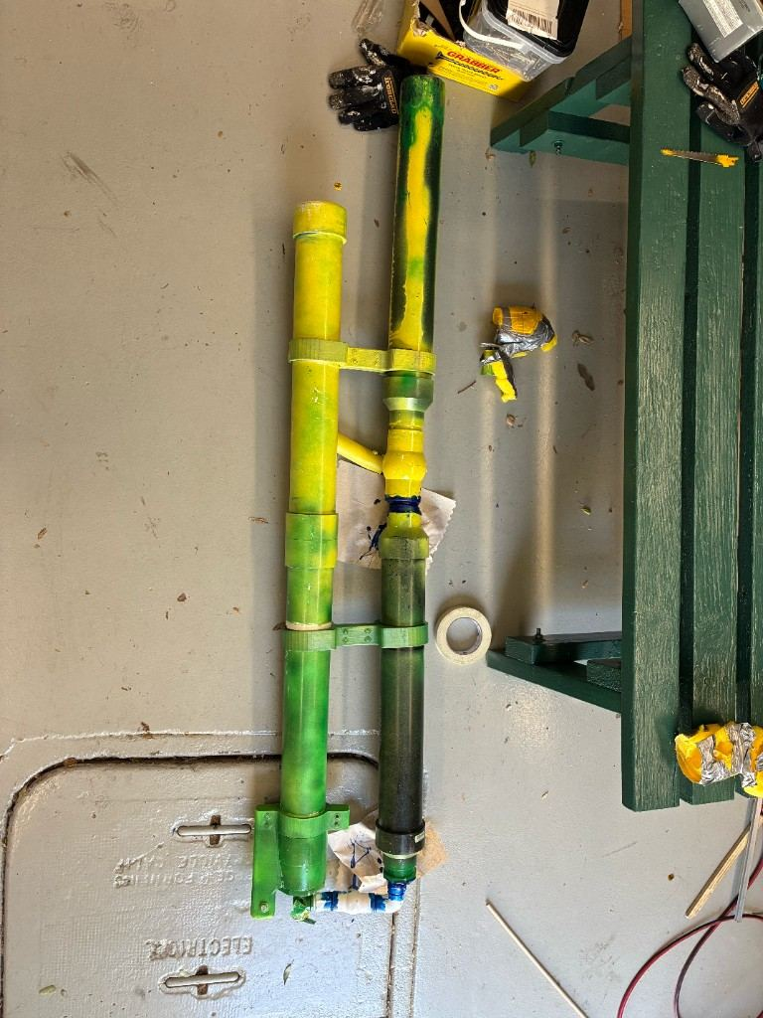
Slide 08
Final Prototype
• Black pressure chamber stores compressed air.
• Pressure gauge confirms operating state.
• Blue valve hardware controls the pressure path.
• Yellow release handle operates the launch.
• Green/yellow launch tube guides the payload.
• Brackets keep the assemblies aligned.
Hudson Tien | PLTW Engineering Design and Development | Replace placeholder data before final submission

Slide 9
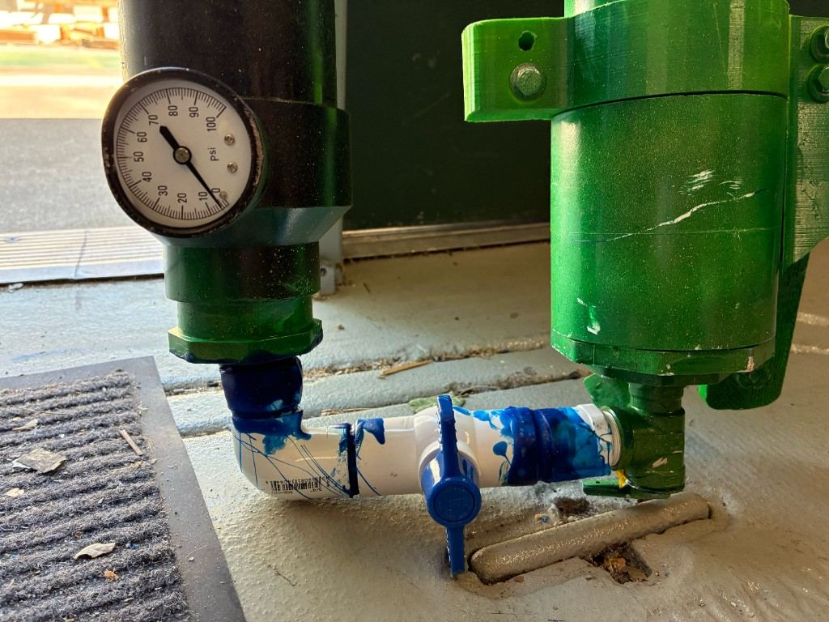
Slide 09
Pressure and Valve System
• Gauge gives the operator a visible pressure reading.
• Valve path controls fill, release, and reset.
• Hardware needs leak checks before launch.
• Pressure limits must come from the weakest rated part.
Hudson Tien | PLTW Engineering Design and Development | Replace placeholder data before final submission

Slide 10
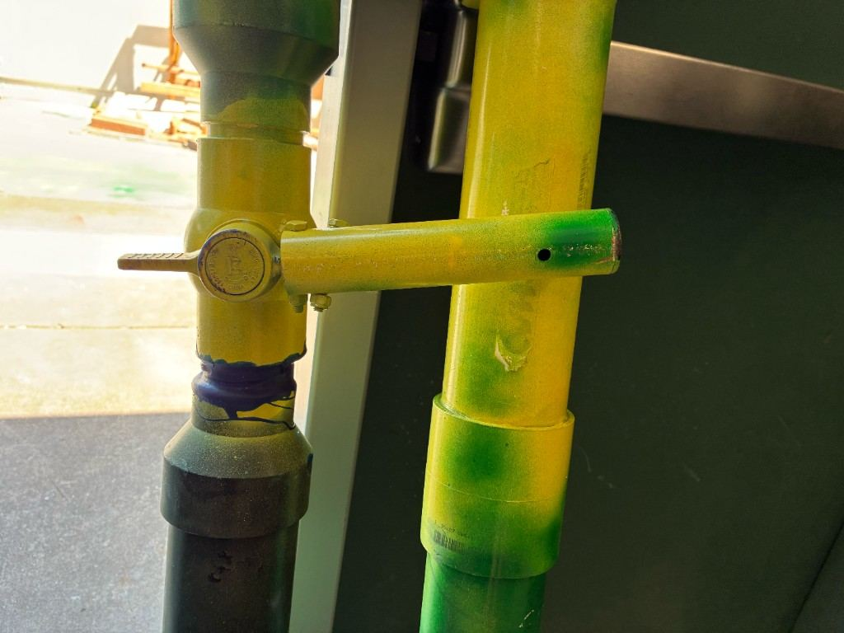
Slide 10
Release Handle
• Handle gives the operator a simple control point.
• Control is placed away from the launch opening.
• A clear handle makes the firing step easier to teach.
Hudson Tien | PLTW Engineering Design and Development | Replace placeholder data before final submission

Slide 11
Slide 11
STEM Principles
• Pressure creates force: F = P x A.
• Launch angle affects range.
• Payload mass affects acceleration.
• Air leakage reduces repeatability.
• Safety factor limits operating pressure.
Hudson Tien | PLTW Engineering Design and Development | Replace placeholder data before final submission

Slide 12
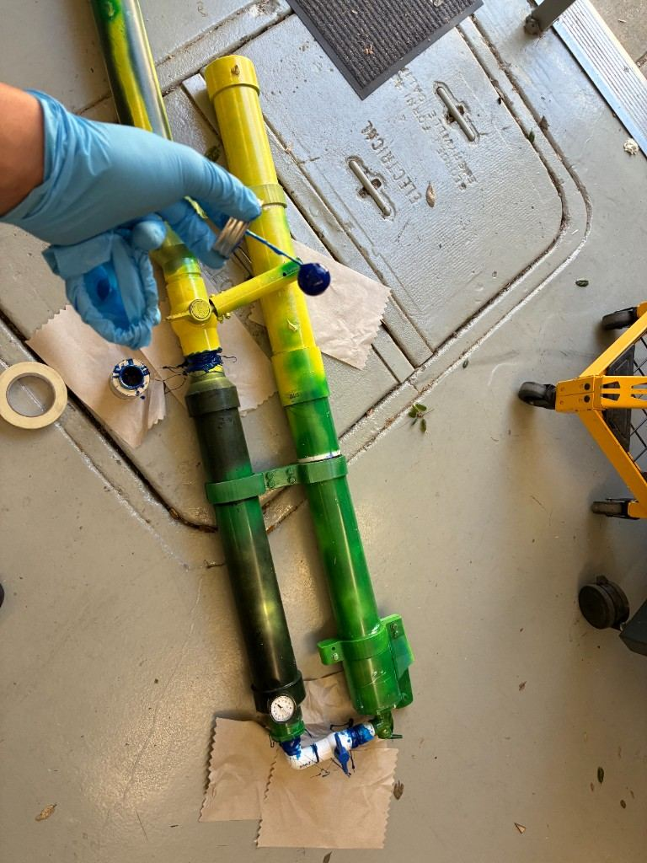
Slide 12
User Manual Cycle
• Fill: add air to selected safe pressure.
• Load: place the payload in the launch tube.
• Fire: aim into safe area and use release handle.
• Refill/Reload: reset valve path and prepare the next payload.
• Refire: repeat the same pressure and loading process.
Hudson Tien | PLTW Engineering Design and Development | Replace placeholder data before final submission

Slide 13
Slide 13
Testing Plan
• Range test at multiple pressure levels.
• Reload time test.
• Usability test with first-time user.
• Leak check before launch.
• Safety checklist review.
Hudson Tien | PLTW Engineering Design and Development | Replace placeholder data before final submission

Slide 14
Slide 14
Placeholder Testing Results
• 30 psi: 35 ft average
• 45 psi: 63 ft average
• 60 psi: 82 ft average
• Reload time: 35 seconds average
• User learning time: under 2 minutes
• Review: replace these with measured values.
Hudson Tien | PLTW Engineering Design and Development | Replace placeholder data before final submission

Slide 15
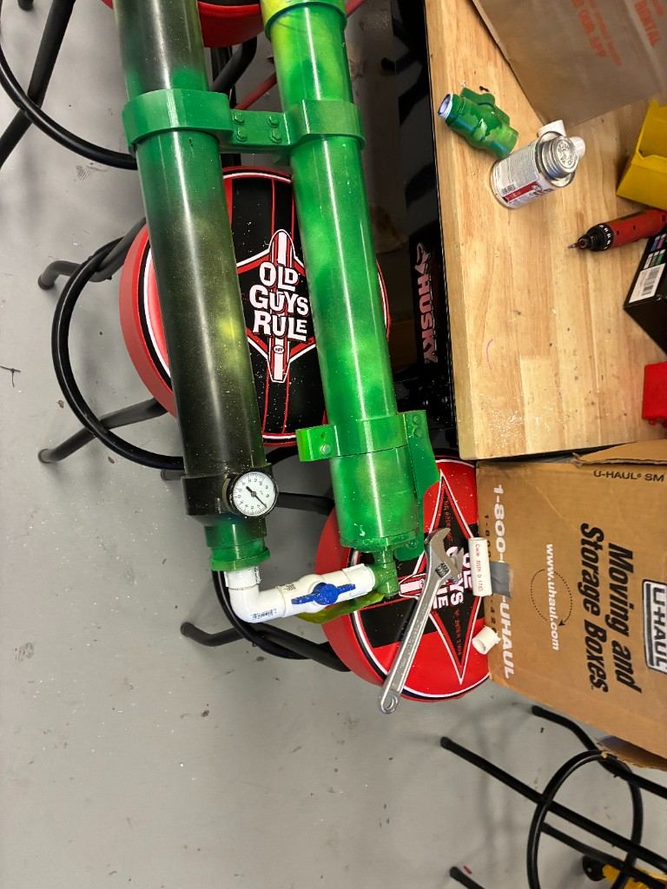
Slide 15
Feedback and Modifications
• Setup was clearer than the old cannon.
• Gauge made operation easier to understand.
• Range was useful for rallies and field events.
• Permanent safety labeling is needed.
• Next: brackets, checklist, payload testing, angle indicator, transport case.
Hudson Tien | PLTW Engineering Design and Development | Replace placeholder data before final submission

Slide 16
Slide 16
Conclusion
• A school event launcher is successful when users can operate it safely and consistently.
• The air pressure design better fits actual users than the original spring-loaded concept.
• The pivot was an engineering decision based on evidence.
Hudson Tien | PLTW Engineering Design and Development | Replace placeholder data before final submission

