Slide 1

Software Engineering
Group 11 – Silveros
Members:
Nguyễn Tiến Hoàng (Leader)
Lý Phương Anh
Doãn Văn Huy
Tạ Quang Hiệp
Nguyễn Tùng Anh
Nguyễn Hữu Dũng

Slide 2
Content
I. Project overview
II. What we have done during three months
III. UML Diagram and Lint

Slide 3
I. Project Overview

Slide 4
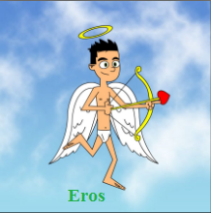
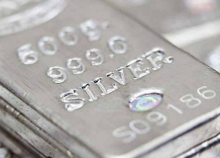
Purpose
Design a dating online website “Silveros”
Silveros

Slide 5
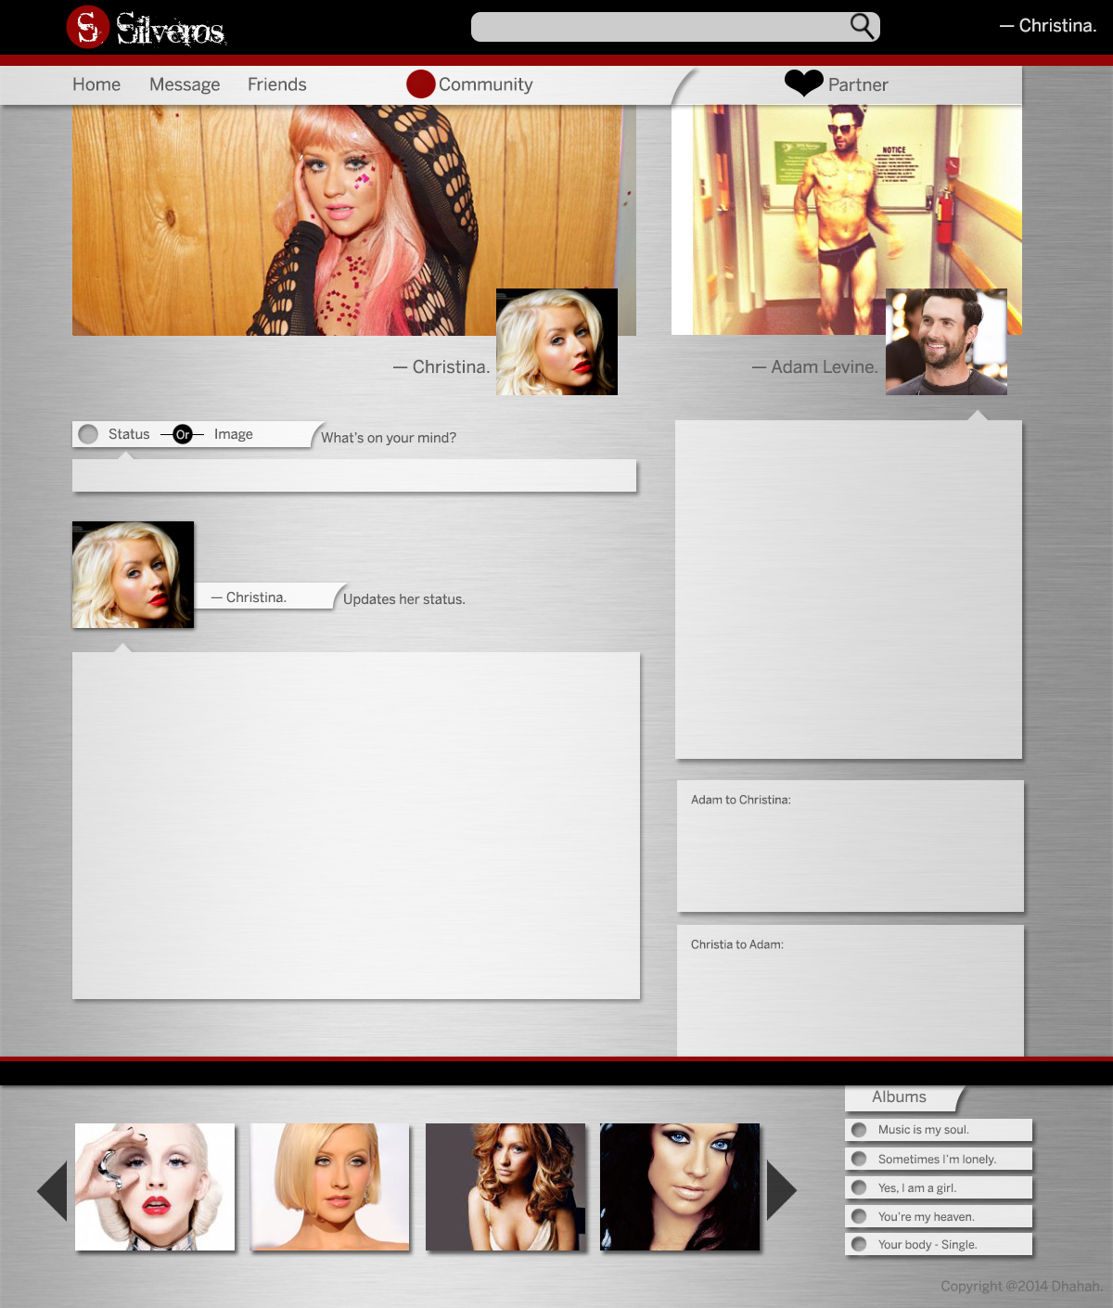
Interfaces

Slide 6
Silveros
Updating your status
Contacting with the community
Getting some amazing tips to go on a date.
Chatting with your friends

Slide 7
Making plan:
Start date: 1/3/2014
End date: 31/8/2014
Scrum:
Daily Scrum: Using group feature on Facebook.
Weekly Scrum: Meeting on Thursday afternoon.
Working:
Using Github: https://github.com/tienhoangna/G11-Silveros
Pivotaltracker: https://www.pivotaltracker.com/s/projects/1040850

Slide 8
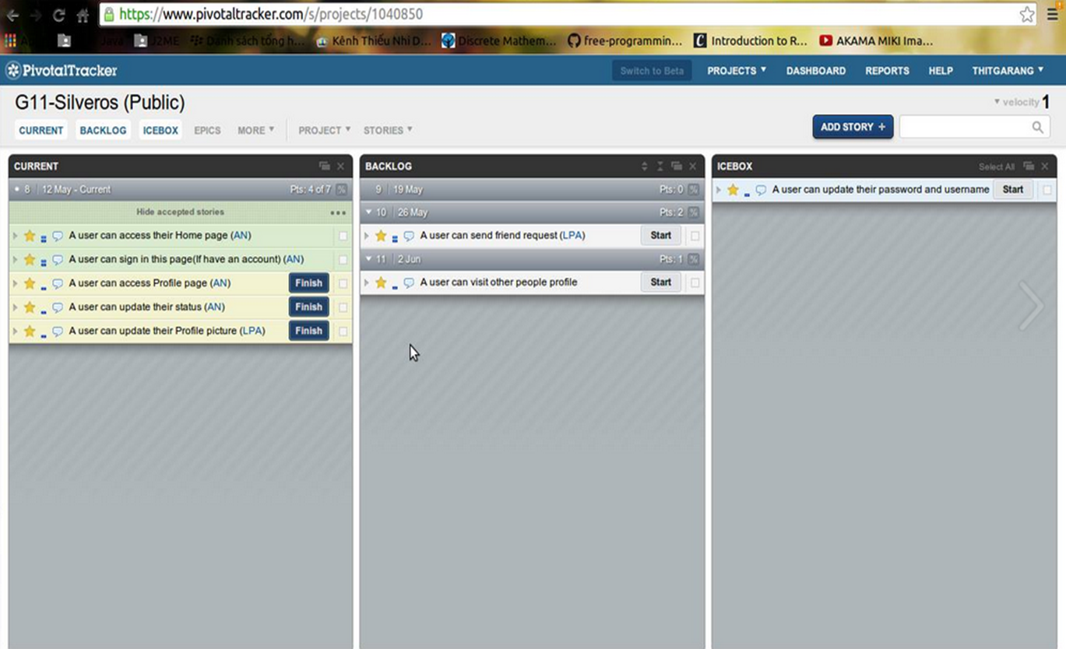
Pivotaltracker

Slide 9
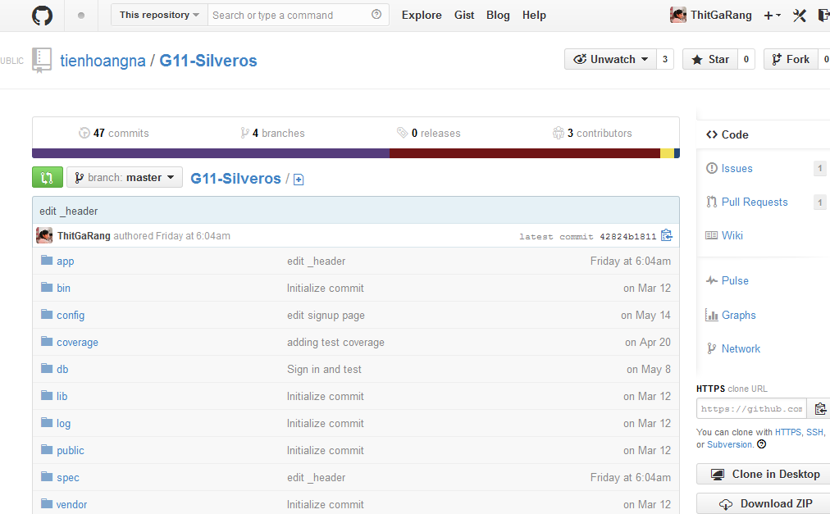
Github

Slide 10
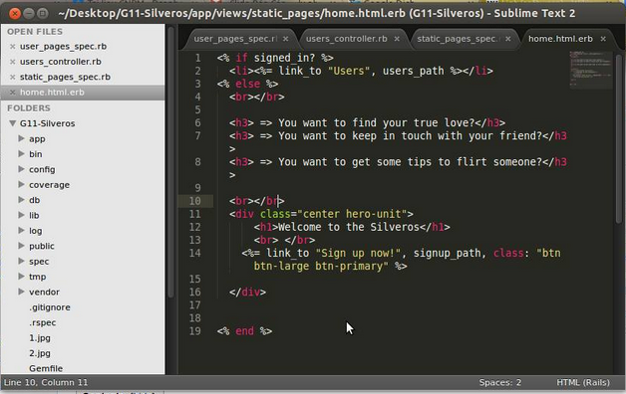
Ruby language with framework Rails
HTML, CSS and Javascript
Rspec for test
Text editor for code is Sublime Text

Slide 11
II. What we have done during three months

Slide 12
From February 21 to the end of this month:
Learn about Scrum
Create idea for project

Slide 13
From March 1 to 15, we had learned:
HTML
CSS
Javascript
From March 16 to the end of month:
Ruby language
Rails framework

Slide 14
In April, We divided our group into 2 small teams:
Team feature had finished first feature: sign in, sign up and sign out.
Team design had also finished Profile page interface.

Slide 15
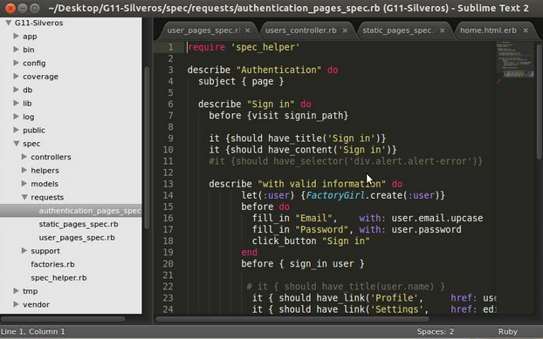
Small part of our test for sign in and sign up

Slide 16
From 1/5 to 12/5:
Editing Sign in, sign up page. (done)
Writing test for changing password, username and avatar. (done)

Slide 17
On 22/5/2014
Our product has been first released

Slide 18
III. UML Diagram and Lint

Slide 19
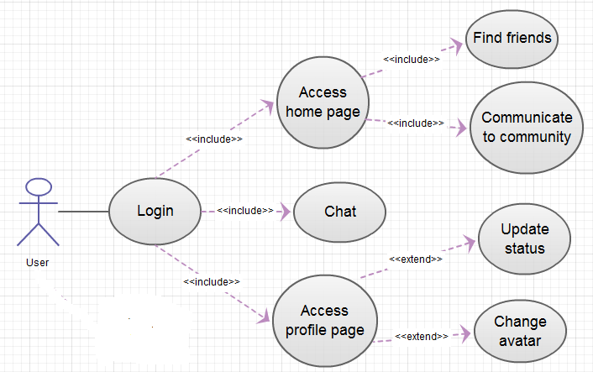
1. Use case Diagram

Slide 20
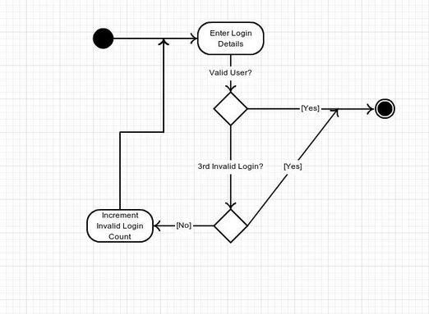
2. Activity Diagram

Slide 21
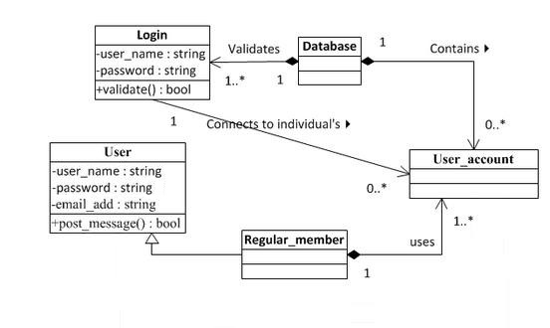
3. Class Diagram

Slide 22
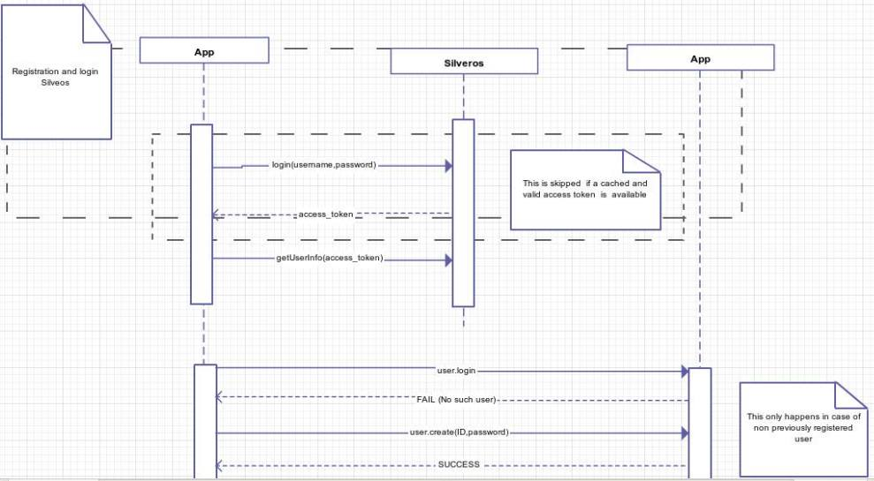
4. Sequence Diagram

Slide 23
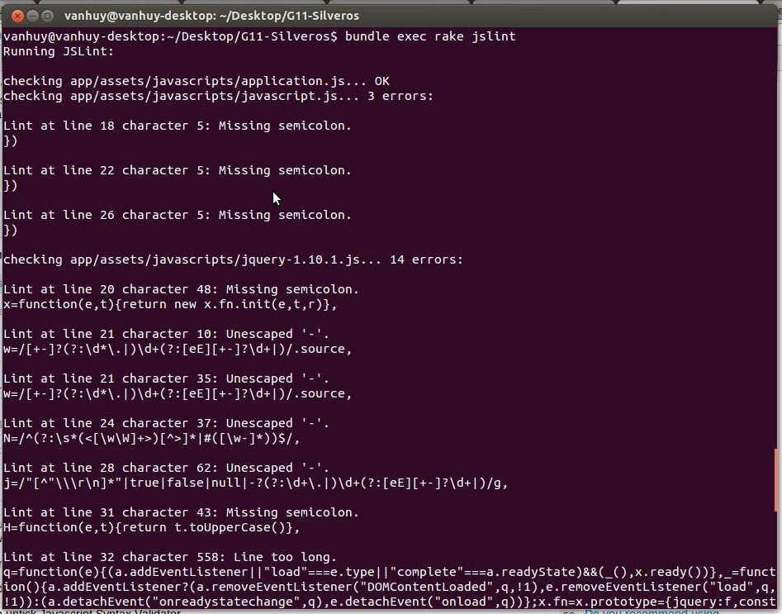
Lint

Slide 24
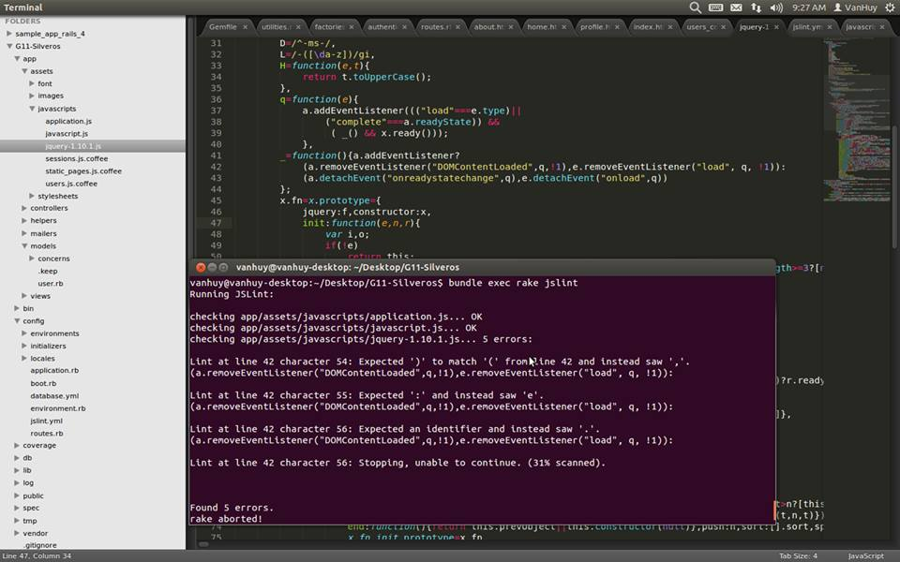

Slide 25
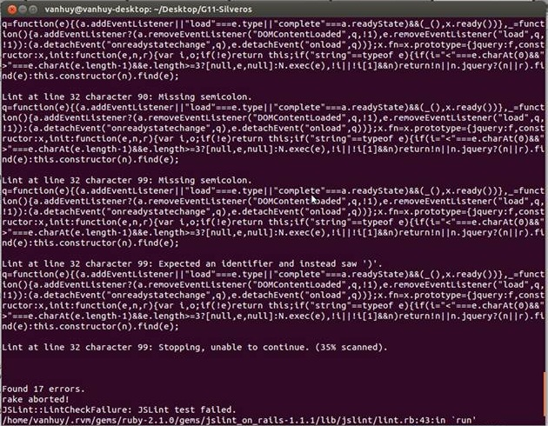

Slide 26
THE END
Thanks for watching :)

