Slide 1
Notes:
Good morning. Our project is the Orange problem of the EURO/ROADEF Challenge 2026.

Slide 2

T-Adaptive Segment Routing as a MILP
Mathematical Modeling · EURO/ROADEF Challenge 2026
Hoàng Tuấn Tài 20261083M
Lê Phạm Thuỷ Tiên 20261075M
Notes:
We model Orange's T-Adaptive Segment Routing problem as a MILP, solve it with HiGHS and test it on the 20 SetA instances.

Slide 3
Outline
Problem
1
Related work
2
Our approach
3
Results
4
Conclusion
5
3
Notes:
Five parts: the problem, related work, our approach, results, conclusion.

Slide 4
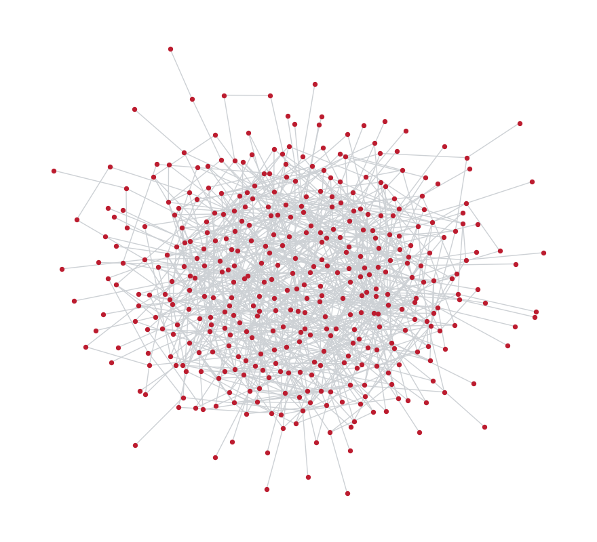
Why traffic engineering?
Orange operates national IP/MPLS backbones
thousands of routers, tens of thousands of demands
Traffic follows shortest paths for link weights ω
simple to run, but flows pile up on a few links
re-tuning ω is itself NP-hard [1]
Links are switched off for maintenance
shortest paths change, congestion moves
Goal: keep the most loaded link as low as possible
setA-20: 400 routers, 2000 arcs
[1] B. Fortz, M. Thorup. Internet traffic engineering by optimizing OSPF weights. INFOCOM 2000.
4
Notes:
Orange runs national IP backbones with thousands of routers and tens of thousands of demands. The picture is setA-20, one of the challenge networks. Traffic follows shortest paths for the operator's link weights. That is simple, but many flows end up on the same links, and re-tuning the weights is itself a hard problem. Links are also switched off for maintenance, which changes the shortest paths and moves the congestion.

Slide 5
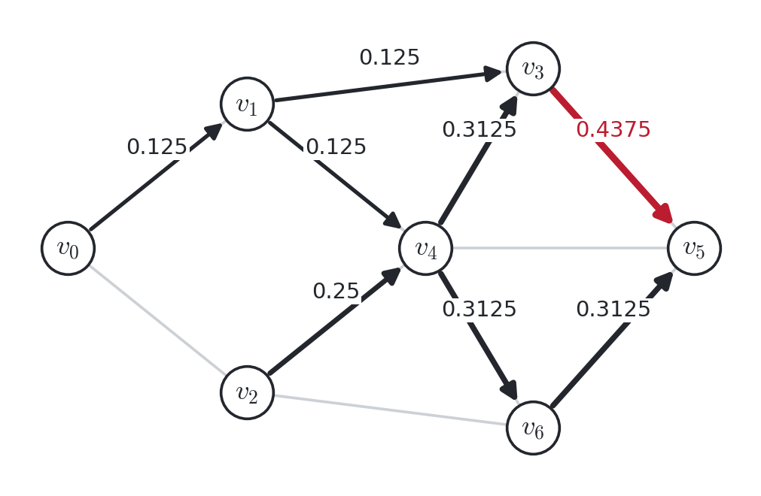
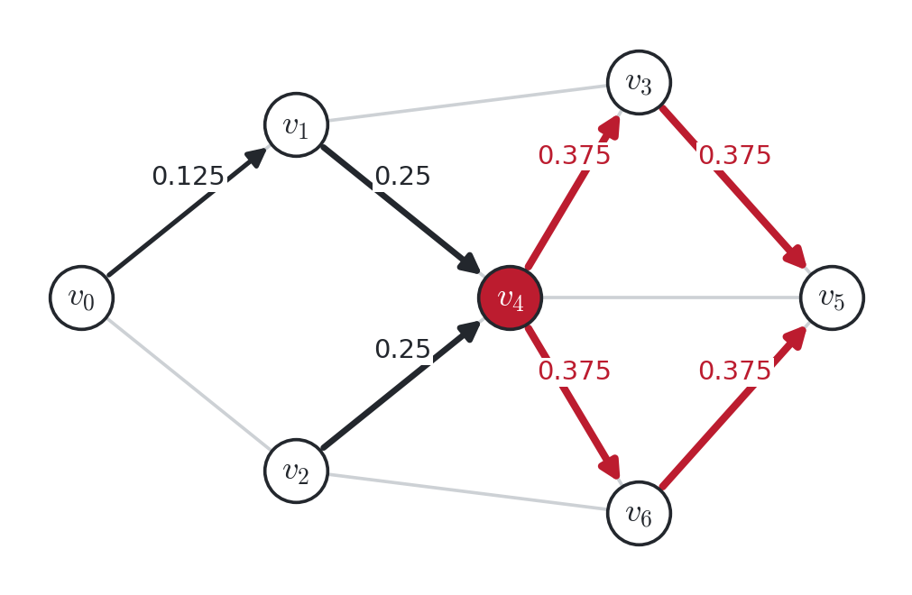
Segment Routing: one waypoint is enough
The source writes a list of waypoints in the packet header. Between two waypoints, packets follow shortest paths; ties are split equally at each node (ECMP).
(a) shortest paths only — MLU = 0.4375
(b) demand (v₀, v₅) via waypoint v₄ — MLU = 0.375
Toy instance of the subject, t = 0. Arc labels: load / capacity; red = most loaded arcs.
5
Notes:
With Segment Routing the source writes a list of waypoints in the packet header. Between two waypoints the packet follows shortest paths, and ECMP splits the flow equally at each node when there are ties. On the toy instance of the subject, shortest paths put 0.4375 of capacity on arc v3 to v5. Sending demand v0 to v5 through waypoint v4 spreads the load and the maximum drops to 0.375, which is optimal.

Slide 6
The T-ASR problem
Given
directed network G = (V, A), weights ω(a), capacities c(a)
demands d = (s_{d}, t_{d}) with volume ν(d, t), periods t = 0, …, h−1
maintenance: arcs q(t) switched off at period t
at most maxSeg segments per path, budget κ(t) on changes
Find
a segment path ⟨s_{d}, w₁, …, t_{d}⟩ for every demand and every period
Minimize
MLU = max_{a, t} load(a, t) / c(a)
The subject uses a lexicographic objective on all loads; MLU is its first and main term.
NP-hard and hard to approximate, even on very simple topologies [2].
[2] C. Bazgan, M. Chopin, A. Nichterlein, C. Richer. Parameterized complexity of segment routing. INFOCOM 2025.
6
Notes:
Formally, the T-Adaptive Segment Routing problem gives us a directed network with weights and capacities, demands whose volume changes over the periods, a maintenance schedule, a maximum number of segments, and a budget on how many segments can change between two periods. We choose a segment path for each demand and period. The subject uses a lexicographic objective; we minimise its first term, the maximum link utilisation. The problem is NP-hard and hard to approximate even on simple topologies.

Slide 7
Related work: 25 years of traffic engineering
2000
2015
2018
2021
2025
Fortz & Thorup
Hartert et al.
RFC 8402
Parham et al.
Bazgan et al.
OSPF weights:
NP-hard
DEFO, first SR
optimizer
SR
standardized
weights +
segments jointly
parameterized
complexity
2015
2017
2019
2023
2026
Bhatia et al.
Gay et al.
Jadin et al.
Callebaut et al.
Benhamiche; Jaumard
2 segments are
almost enough
sub-second
local search
CG4SR: column
generation
remove dominated
paths
T-ASR: time +
budget
Changes over time with a budget on reconfigurations only appear in 2026, with this challenge.
7
Notes:
A short history. In 2000 Fortz and Thorup showed that tuning OSPF weights is NP-hard and proposed local search. Segment Routing changed the question: in 2015 Bhatia et al. showed that two segments, so one waypoint, are almost enough to balance the load, and Hartert et al. built DEFO, the first centralized SR optimizer. Gay et al. then re-optimized large ISP networks in under a second with local search. SR was standardized in RFC 8402 in 2018, and CG4SR brought column generation in 2019. Later work combined weights and segments, and preprocessing removed dominated paths. In 2025 Bazgan et al. settled the complexity. The time-dependent version with a budget on changes only appears in 2026, with this challenge.

Slide 8
Related work: three families of methods
Exact: MILP / ILP
Column generation
Heuristics
DEFO 2015 · Schüller et al. 2018 · Li & Yeung 2020
CG4SR 2019 · Jaumard et al. 2026
Gay et al. 2017 · Bhatia et al. 2015 · Pereira et al. 2020
Optimal solution and a bound
≈ |D| · |V|² binaries
Size limited by memory
Master LP picks one path per demand
Pricing: path with ≤ maxSeg arcs (DP)
Near optimal, LP bound
Local search: few changes, sub-second
Restrict to 2 or 3 segments
No bound
This work
Before 2026 all of them handle one period; T-ASR adds periods, maintenance and a change budget.
8
Notes:
For the static problem, one period, three families exist. Exact models: MILP or ILP formulations like DEFO, Schüller et al. and Li and Yeung. They give optimal solutions and bounds, but they have about D times V squared variables. Column generation, as in CG4SR: a master LP picks segment paths and a pricing problem finds a new path with negative reduced cost; with at most maxSeg segments, pricing is a shortest path with a bounded number of arcs, solved by dynamic programming. And heuristics: local search changes few paths and runs in under a second, while Bhatia et al. and Pereira et al. restrict paths to two or three segments. Our work is in the first family.

Slide 9
Related work: the two T-ASR papers (2026)
Benhamiche et al. — the subject's authors
Jaumard, Tran, Ziazet
Same model (1)–(4) as ours
Lexicographic objective by a sequence of MILPs
ALEXA (permutations, big-M), STELA (thresholds)
STELA better on 109 / 115 instances
step 1 of both = min MLU
With a budget, the best path may need a loop
Tests: setAP, 10–50 nodes, Gurobi, 20 min
MLU + budget, like us
Period by period: t − 1 fixed → budget is linear
Column generation, then ILP on the columns
Only results on all of SetA
3.12%
13.05%
mean LP–ILP gap, t = 0
mean LP–ILP gap, t = 1
→ the budget makes period t = 1 much harder
Benhamiche et al., On the T-ASR problem, arXiv:2609.32896. Jaumard et al., SR-TE with time-based reconfiguration constraints, arXiv:2610.04759.
9
Notes:
Two papers work on T-ASR itself. Benhamiche et al., the authors of the challenge, give exactly the model we use. They handle the lexicographic objective with a sequence of MILPs, ALEXA and STELA; STELA wins on 109 of 115 instances, and the first step of both is min MLU, which is what we solve. They also show that with a budget the best path may contain a loop, so preprocessing for one period does not carry over. Their tests use small instances, up to 50 nodes. Jaumard et al. use the MLU and the budget like us, but solve period by period, which makes the budget linear, and use column generation. They are the only ones with results on all of SetA: the LP–ILP gap is 3.12 percent on average at t equals 0 but 13.05 percent at t equals 1, so the second period is clearly harder.

Slide 10
Where our work stands
Approach | Optimal | Bound | Budget | Scale | Key papers
Full MILP | yes | yes | yes, (4) | small | Benhamiche 2026
Period by period + MILP | per period | per period | yes | medium | Benhamiche; Jaumard 2026
Column generation | near | LP bound | yes | large | CG4SR 2019, Jaumard 2026
Local search | no | no | few changes | very large | Gay 2017, Hartert 2018
2 segments only | no | on submodel | yes | large | Bhatia 2015
This work | yes | MILP gap | yes, (4) | ≤ 5·10⁶ vars | subject's MILP, HiGHS
Our goal: true optimal values and gaps on SetA with an open-source solver
and an honest answer to “how far does the exact model go?”
10
Notes:
This table puts the approaches side by side. The full MILP is exact and gives a gap, handles the budget directly, but only scales to small instances. Solving period by period gives bounds for each subproblem but no global optimum. Column generation scales to all of SetA with an LP bound. Local search is very fast but has no bound, and restricting to two segments gives a smaller model. Our work is the full MILP of the subject: we want true optimal values and gaps on SetA with an open-source solver, and to see where this approach stops.

Slide 11
Our approach
Instance
Flow ratios r
MILP
Solve
Check
net, tm, scenario
(JSON)
Dijkstra + ECMP,
all node pairs
JuMP
HiGHS,
warm start
paths, loads,
budget
r(i, j, a, t) depends only on the graph of period t, not on the routing
computed once, before the solver; the load of every arc becomes linear in x
Exact model of the subject, objective min MLU
Routing without waypoints is always feasible
given to HiGHS as a warm start, so every run has an upper bound
11
Notes:
Our pipeline has five steps. We read the network, the traffic matrix and the scenario. We precompute the flow ratios r. We build the MILP in JuMP and solve it with HiGHS, starting from the routing without waypoints. Finally we read the segment paths back and recompute loads and changes. The key point is that r depends only on the graph, so the load of an arc is a linear function of the decision variables.

Slide 12
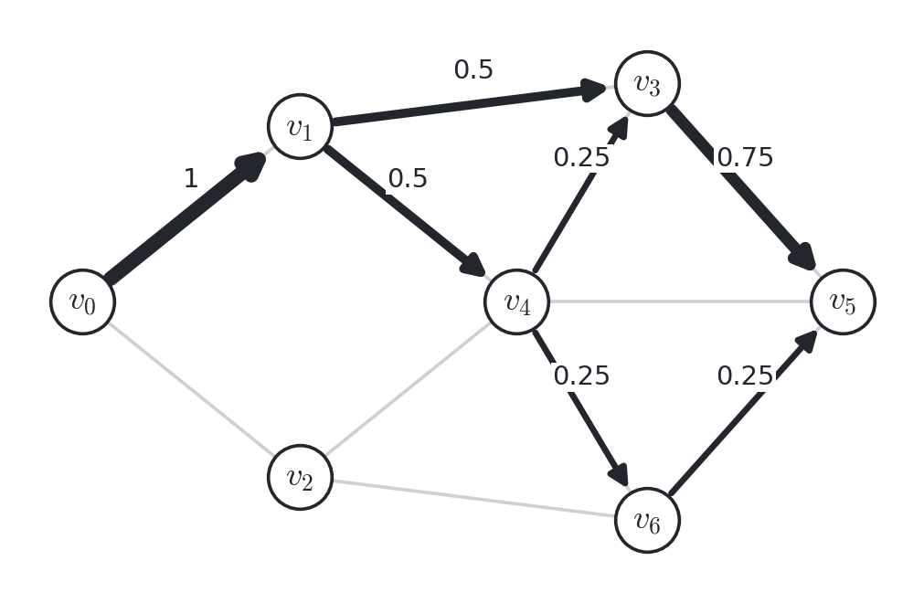
Flow ratios r(i, j, a, t)
Share of one unit of flow from i to j that crosses arc a in G_{t} = (V, A ∖ q(t)).
Dijkstra from every node → d_{ij}
a = (u, v) is on a shortest i–j path iff d_{iu} + ω(a) + d_{vj} = d_{ij}
Push one unit from i in decreasing d_{·j}; split equally at each node
Real-valued weights (setA-05, 08, 12, 14): compare with relative tolerance 10⁻⁹.
Counting shortest paths (σ_{iu}σ_{vj}/σ_{ij}) splits per path, not per node: 1/3, 2/3, 2/3 here.
r(v₀, v₅, a) on the toy instance — same as Table 2 of the subject
12
Notes:
r of i, j, a, t is the share of one unit of flow from i to j that crosses arc a in the graph of period t. Every node can be a waypoint, so we need it for all pairs. We run Dijkstra from every node, mark the arcs that lie on a shortest path, and push one unit of flow in topological order, splitting it equally at each node. With real-valued weights the test needs a tolerance. The picture is demand v0 to v5 of the toy instance: 0.5, 0.5 and 0.75 on arc v3 v5, as in Table 2 of the subject. The guide's formula that counts shortest paths gives one third, two thirds and two thirds instead, because it splits per path and not per node.

Slide 13
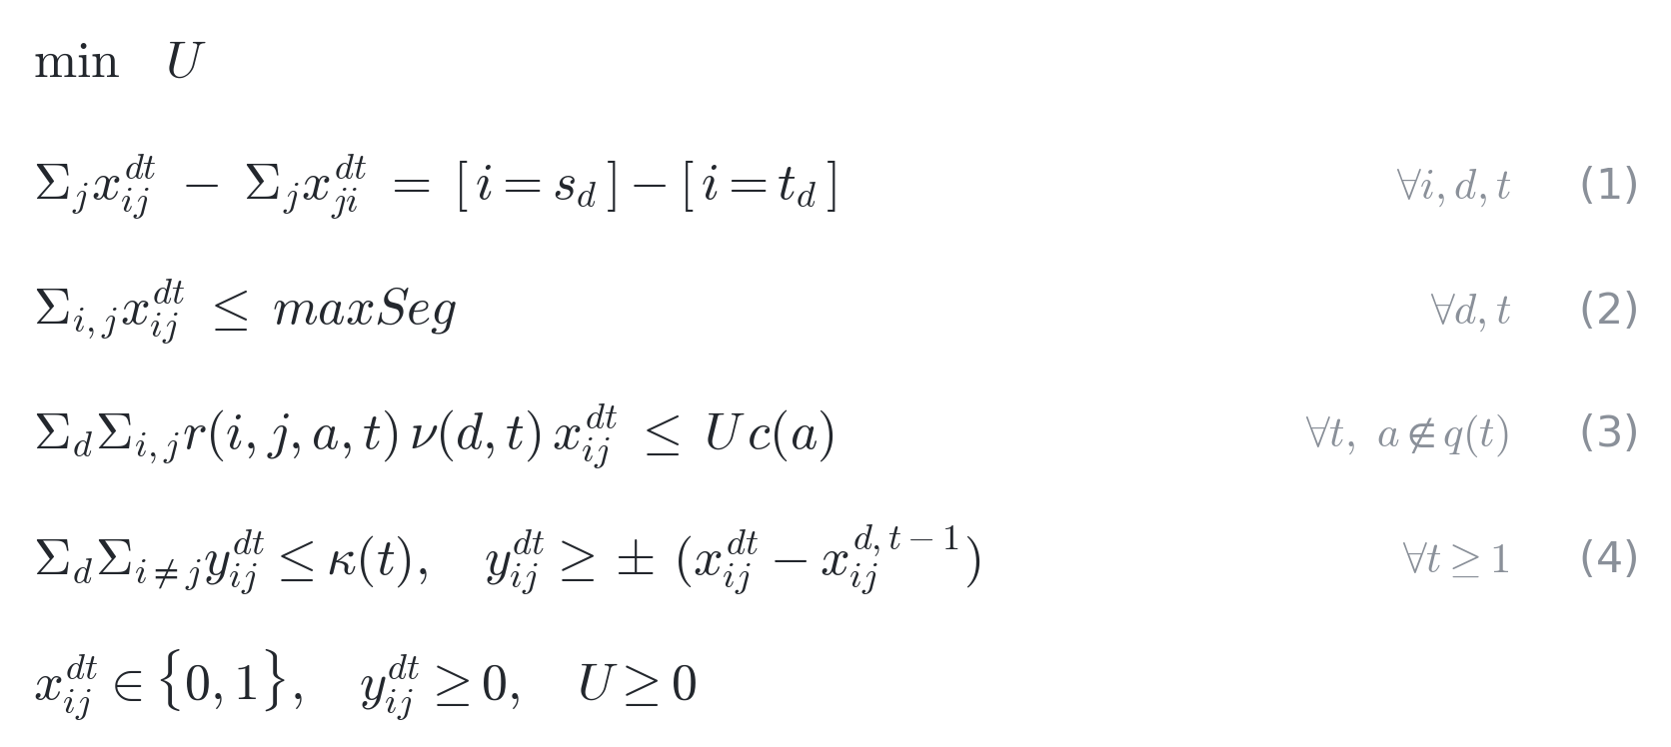
MILP formulation
Node pairs (i, j) are virtual arcs: a segment path is a path from s_{d} to t_{d}. x^{dt}_{ij} = 1 if demand d uses segment (i, j) at t.
(1) one segment path per demand (2) header size (3) arc load — linear, r and ν are data (4) budget, |x^{t} − x^{t−1}| linearized
One period (t = 0): (1)–(3). Two periods with budget: (1)–(4).
13
Notes:
We see every node pair i, j as a virtual arc, so a segment path for demand d is a path from its source to its destination in the complete graph. x says whether demand d uses segment i, j at period t, and U is the maximum utilisation. Constraint one: one segment path per demand. Two: the header size. Three: the load of each arc, linear because r and the volumes are data. Four: the budget; the absolute value of the change is linearised with y.

Slide 14
Is the model right?
Toy instance
Three things that bit us
t = 0: 0.4375 → 0.375 (Figure 4 of the subject)
t = 1: 0.375, budget κ(1) = 20 not binding
Brute force over all 206 segment paths per demand: same optima
Floating-point distances
with ==, more than half of the node pairs lose flow on setA-08, 12, 14
Disjoint cycles
(1) allows x_{ij} = x_{ji} = 1; we read paths with an Euler walk and recompute loads and budget
min MLU looks at one period only
the other period can stay high
14
Notes:
We first checked the model on the toy instance. Without waypoints the MLU at period zero is 0.4375; the model finds 0.375, the solution shown in Figure 4 of the subject, and 0.375 at period one as well. Enumerating all 206 segment paths per demand gives the same optima. Three details caught us during the implementation: floating-point distances, disjoint cycles that constraint one does not forbid, and the fact that min MLU only cares about the worst period.

Slide 15
Experimental setup
Instances: SetA (20)
Runs
20–400 nodes, 80–2000 arcs
20–6000 demands
h = 2 periods, maxSeg = 6
one arc switched off at t = 1
budget κ(1) between 1 and 90
binary variables: 1.5·10⁴ to 9.6·10⁸ per period
Intel Core 7 240H, 16 GB RAM
Julia 1.13, JuMP 1.32, HiGHS 1.15
Time limit 1800 s (t = 0), 3600 s (two periods)
mip_heuristic_effort = 0.3, warm start without waypoints
Up to 10 seeds per instance
Models above 5·10⁶ variables are not built
15
Notes:
SetA has 20 instances, from 20 to 400 nodes and from 20 to 6000 demands. All have two periods, at most six segments and one arc down at period one. We used a 16 GB laptop with Julia, JuMP and HiGHS, a time limit of 1800 seconds for one period and 3600 for two, a higher heuristic effort and a warm start. Each instance runs with up to ten seeds. Models above five million variables do not fit in memory, so we do not build them.

Slide 16
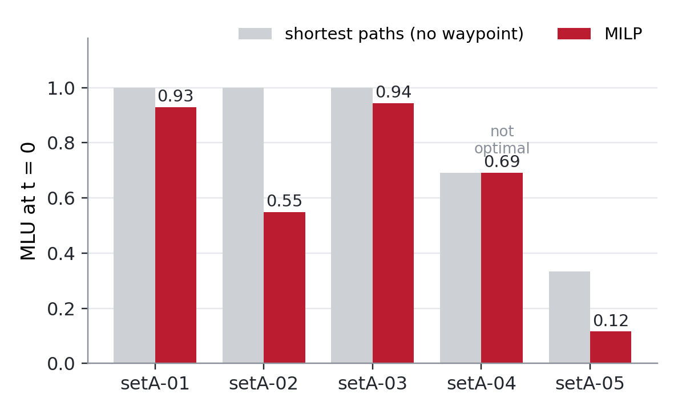
One period (t = 0): up to 65% lower MLU
Optimal on 01, 02, 03, 05
MLU −7.1%, −45.1%, −5.6%, −65.3%
0–1 branch-and-bound nodes
root bound already tight; time goes to the root LP and to finding a matching solution
Time depends on the seed
setA-01: 4.5 ± 8.9 s
04: no improvement in 1800 s (gap 33.6%)
16
Notes:
With one period, the model proves optimality on 01, 02, 03 and 05. The MLU drops by 7.1, 45.1, 5.6 and 65.3 percent compared with shortest paths. All seeds give the same optimum but the time varies a lot. The tree has zero or one node: the root bound is already tight, and the time goes into the root LP and into finding a matching integer solution. On 04 the solver does not improve the warm start in 1800 seconds.

Slide 17
Forbidding loops: faster, but not always
Subject's model (1)–(3)
+ each node at most once
 | Obj | CPU (s) | Gap | Obj | CPU (s) | Gap
setA-01 | 0.9294 | 4.5 | 0 | 0.9294 | 0.6 | 0
setA-02 | 0.5486 | 318.0 | 0 | 0.5486 | 16.4 | 0
setA-03 | 0.9435 | 58.2 | 0 | 0.9435 | 13.6 | 0
setA-04 | 0.6918 | 1800 | 33.6% | 0.4791 | 1800 | 4.2%
setA-05 | 0.1155 | 1706 | 0 | 0.3333 | 6037 | –
4–19× faster on 01–03; setA-04 improves from 0.6918 to 0.4791 → optimum in [0.4591, 0.4791]
setA-05: no root LP after 6037 s — so the main tables keep the subject's model
Not valid with a budget: the best path may need a loop
17
Notes:
With one period we can also forbid a segment path from visiting a node twice; this keeps the optimum because removing a loop never increases a load. It makes 01 to 03 four to nineteen times faster and finds 0.4791 on 04 instead of 0.6918, so the optimum of 04 is between 0.4591 and 0.4791. But on 05 HiGHS does not finish the root LP. Since the effect is mixed, the main results use the subject's model. With a budget the variant is not valid.

Slide 18
Two periods with a budget
 | κ(1) | MLU₀ | Obj | CPU (s) | Status
setA-01 | 51 | 1.0000 | 0.9294 | 163.9 | optimal
setA-02 | 63 | 1.0981 | 0.9031 | 172.4 | optimal
setA-03 | 53 | 1.0000 | 0.9435 | 704.2 | optimal
setA-04 | 44 | 1.0000 | 1.0000 | 9905* | no LP bound
setA-05 | 1 | 1.0000 | 1.0000 | > 10800 | stopped
01, 03: same as t = 0 alone
period 0 is the bottleneck
02: overload 109.8% at t = 1 → 90.3%
= optimum of t = 1 alone
The budget never binds
Solutions rechecked: paths valid, 0 / 0 / 8 changes ≤ κ(1)
MLU₀: no waypoint; Obj: max MLU over both periods.
* HiGHS overran the 3600 s limit inside the root LP.
18
Notes:
With two periods and a budget, the model is about three times larger; only 01 to 05 can be built and 01 to 03 are solved. On 01 and 03 the result equals the period-zero optimum: period zero is the bottleneck. On 02 the default routing overloads a link at 109.8 percent in period one, and the model brings it to 0.9031, the optimum of period one alone. So in no case is the budget the limit. We rechecked the solutions: all paths valid, MLU equal to U, and 0, 0 and 8 changes, within the budget.

Slide 19
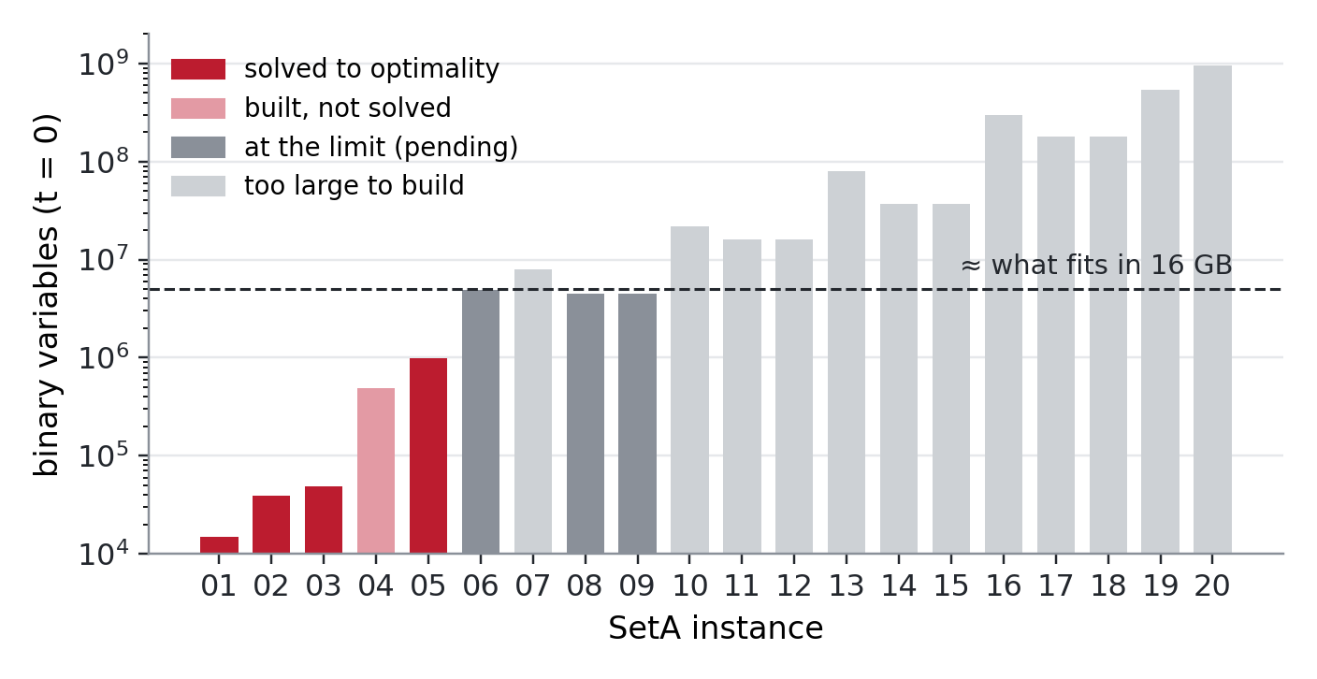
How far does the exact model go?
Size ≈ |D| · n² binaries per period
≈ 5·10⁶ fit in 16 GB
Optimal: 4 / 20 at t = 0, 3 / 20 with budget
The bottleneck is memory and the root LP, not branching
19
Notes:
This is the number of binary variables of the one-period model, on a log scale. It grows like the number of demands times n squared. About five million variables fit in 16 GB. Four instances are solved, 04 is built but not solved, 06, 08 and 09 sit at the limit, and the other twelve cannot be built. With the budget the model is three times larger.

Slide 20
Conclusion
What we did
Next steps
Exact MILP of T-ASR in Julia / JuMP / HiGHS
ECMP flow ratios, linearized budget, solution checker
Exact on the toy instance (brute force)
SetA: 4 optimal at t = 0 (MLU up to −65%), 3 with budget
Limit: |D| · n² variables
Remove dominated segment paths [Callebaut et al. 2023]
Column generation on the segment graph [CG4SR; Jaumard et al. 2026]
Full lexicographic objective: STELA, ALEXA [Benhamiche et al. 2026]
20
Notes:
To sum up: we implemented the subject's MILP with ECMP flow ratios and a linearised budget, and it is exact on the toy instance. On SetA it solves four instances with one period, with up to 65 percent lower MLU, and three with two periods. The limit is size. Next we would remove dominated segment paths, use column generation, and handle the full lexicographic objective.

Slide 21
THANK YOU!
Questions and discussion
Notes:
Thank you. We are happy to take questions.

