Slide 1
Request Office

Slide 2




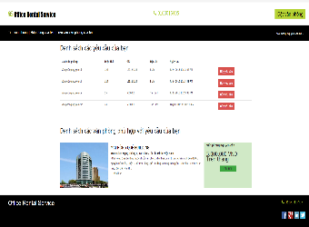
Office Rental Service
Schedule check
2
Send email
4
Email
Belong to
Return data
System
3
Database
Create request
1
5
Check request
Customer
Result page

Slide 3
Office Rental Service
System
Create request
1
Customer

Slide 4
Office Rental Service
Schedule check
2
Return data
System
3
Database
Create request
1
Customer

Slide 5
Office Rental Service
Schedule check
2
Send email
4
Email
Belong to
Return data
System
3
Database
Create request
1
Customer

Slide 6
Office Rental Service
Schedule check
2
Send email
4
Email
Belong to
Return data
System
3
Database
Create request
1
5
Check request
Customer
Result page

