Slide 1

Office Rental Service
Capstone Project Defense
Supervisor: Nguyễn Trọng Tài
Leader: Lê Xuân Tiến
Members: Nguyễn Vũ Hoàng Quốc
Trương Tiến Thành
Trần Lê Tuấn

Slide 2
Contents
Current Situation
Proposed Solution
Project Features
Search Office - Request Office
Request Appointment - Create Contract
Extend and Return contract
Request Rental/ Repair
Statistic and Management
Pros and Cons
Future Development
Notes:
Chia lại luồng search – appointment, accept – contract - extend contract, Repair request,

Slide 3
Current Situation
There are a lot of office rental websites in Vietnam but most of those websites only provide information of offices.
Lack of customer service.
Managing contracts manually.
(Dẫn chứng một số website)
Notes:
customer service: appointment, rental and repair service

Slide 4
Proposed Solution
Effective office matching and office request make customer easier to find suitable office.
System manage contract, so manager and customer can track the office status. This also provide effective customer service.
Effective notification by email and SMS.
(Vẽ mô hình hệ thống)
(Đưa chức năng chính)

Slide 5
Proposed Solution
Front-end application provide functions for customer to:
Search for office
Request new office and track their request
Make an appointment
Manage their contract, include request extend or return the contract
Create repair and rental request based on the contract

Slide 6
Proposed Solution
Web application for admin, manager and staff:
Manage user
Manage office
Manage contract
Manage requests from customer
View statistic
Manage office item and other materials
Mobile application for staff to manage their task list.

Slide 7




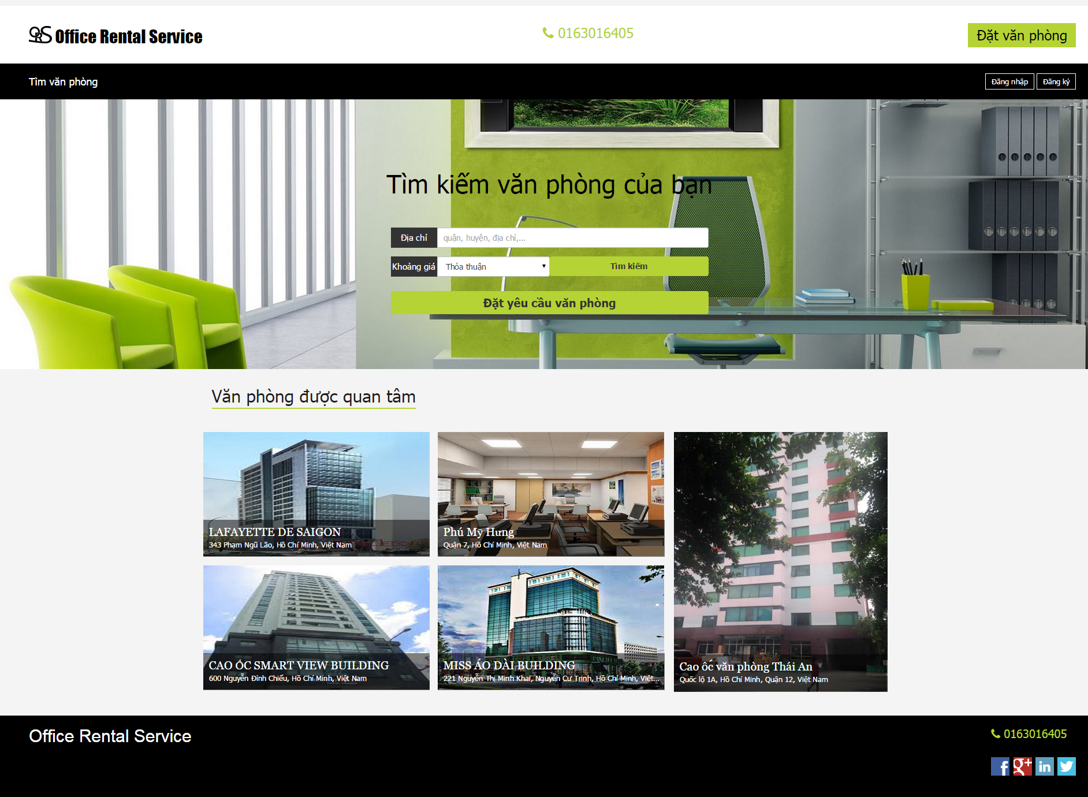

Project Features Create Contract
(5) Meet and check office
(6) Decide create contract
Customer
Staff
(1) Go to website
(4) Assign to staff
(2) Create appointment
Appointment
(8) Create Contract
Contract
(3, 7) Go to appointment
Website
Manager

Slide 8
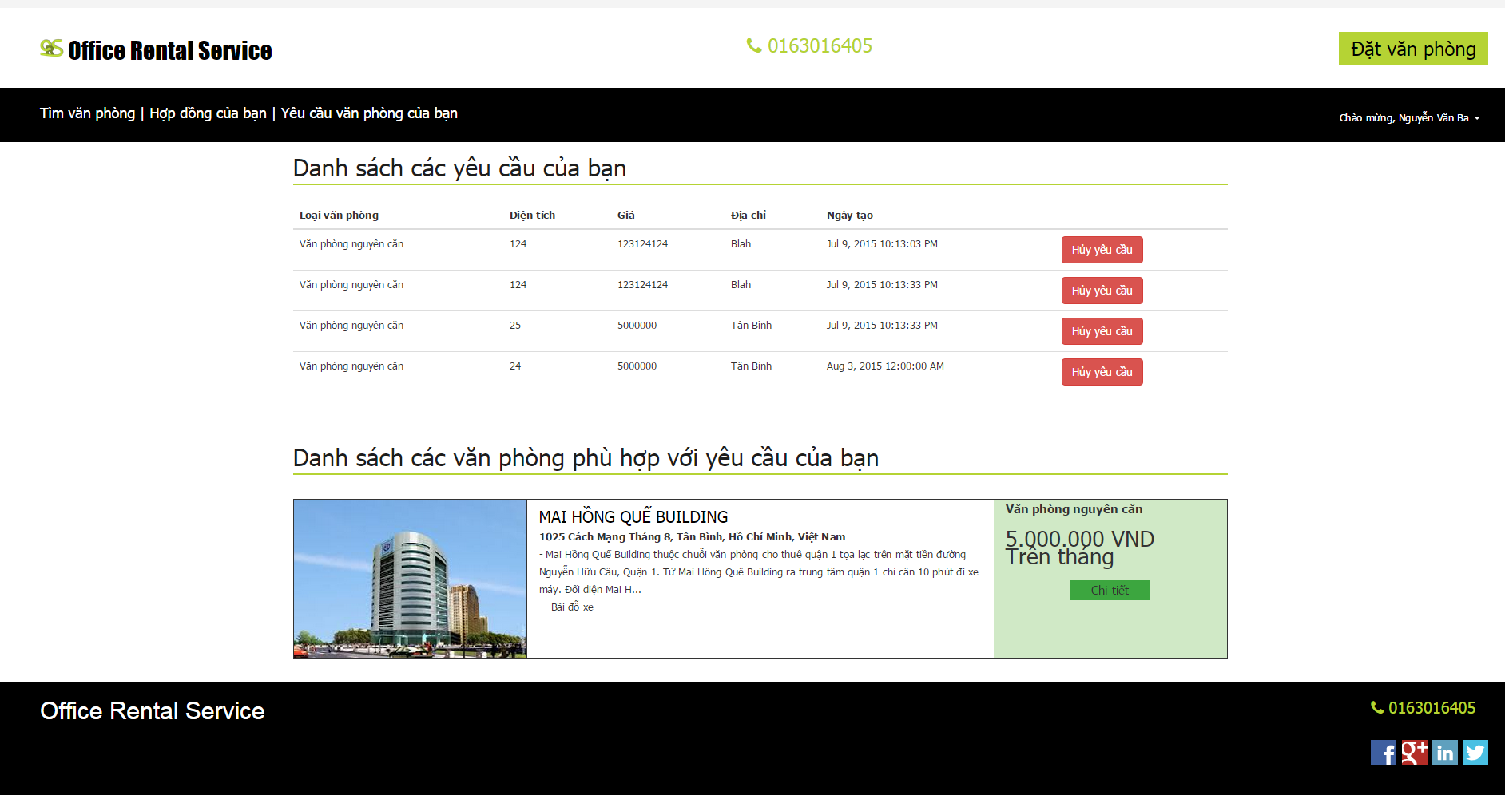



Project Features Request Office
Check request
Create request
Customer
Website
Result page
Check
Send email
Return data
Database
System
Customer’s email

Slide 9
Pros and Cons
Pros:
Providing search engines criteria: price, location, amenities...
Providing full information about the office. Support map for customers.
Making an appointment easily.
Tracking contract easily.
The customer’s requests are automatically suggest by system.
Helping staff easily to manage and update their jobs by mobile application.

Slide 10
Pros and Cons
Cons:
The partner who own the office must contact us to post their information.
The function of notification system is limited.
Only in Ho Chi Minh city.

Slide 11
Future Development
Mobile application provide creating office for staff.
Mobile application for customer.
New role for partner to create and manage their office.
Extend system for different locations.

