Slide 1

Office Rental Service
Capstone Project Defense
Supervisor: Mr. Nguyễn Trọng Tài
Members : Lê Xuân Tiến
Nguyễn Vũ Hoàng Quốc
Trương Tiến Thành
Trần Lê Tuấn

Slide 2
K-Means Algorithm

Slide 3
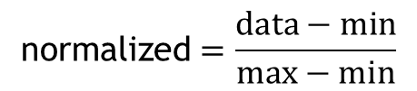

K-Means Algorithm
Start
K = $\sqrt{n}$
Calculate K
$$\text{normalized}=\frac{data−min}{max−min}$$
Normalize data
Group data in K groups

Slide 4
K-Means Algorithm
Start
Calculate K
Normalize data
Group data in K groups
Yes
Group changed?
Calculate the mean of each group
Group based on minimum distance to mean
No
End

Slide 5

KNN Algorithm
Start
Calculate K
K ≈ $\sqrt{n}/2$
Normalize query point
Calculate min K distance from query point to sample points
More than 1 most frequency
Yes
Return min distance group
No
End

Slide 6
Suggest Schedule
Start
Init schedule
Unassigned job
Suggest assign day (?)
Available staff in assign day?
No
Yes
Suggest assign to staff which have least jobs
Yes
Still have unassigned job
Update schedule
No
End

Slide 7


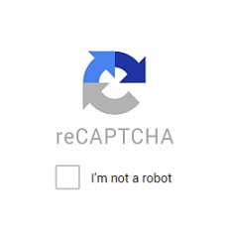
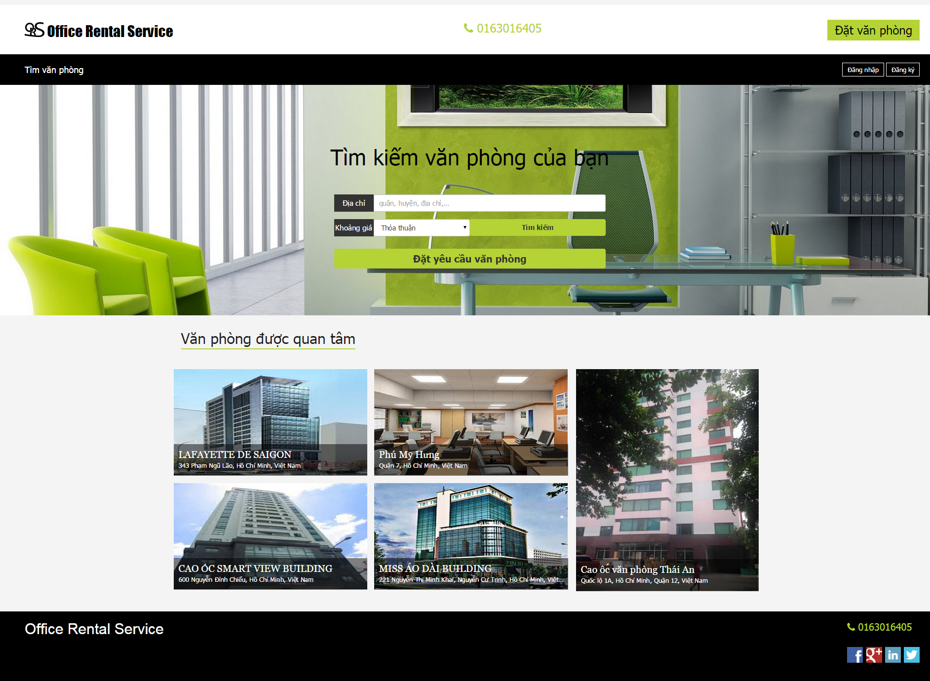
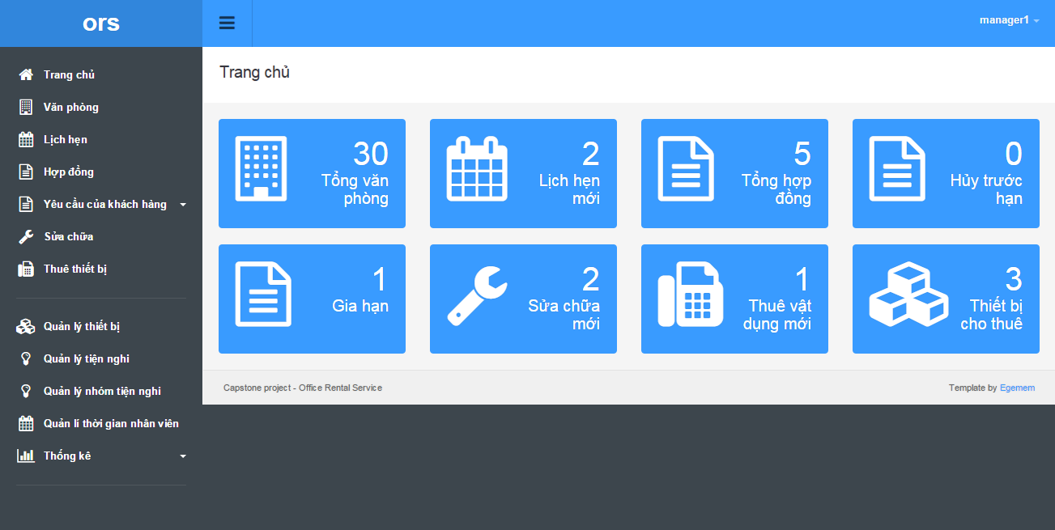

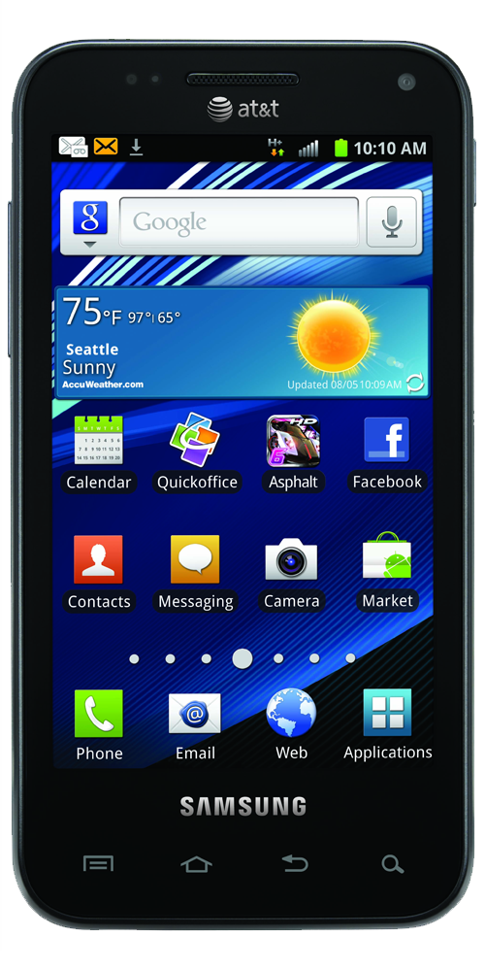


Technical behind the scene
Customer service
Back office service
Mobile

Slide 8
Thanks for your listening

