Slide 1

Office Rental Service
Capstone Project Defense
Supervisor: Nguyễn Trọng Tài
Leader: Lê Xuân Tiến
Members: Nguyễn Vũ Hoàng Quốc
Trương Tiến Thành
Trần Lê Tuấn

Slide 2
Contents
Current Situation
Proposed Solution
Project Features
Search Office - Request Office
Request Appointment - Create Contract
Extend and Return contract
Request Rental/ Repair
Statistic and Management
Pros and Cons
Future Development
Notes:
Chia lại luồng search – appointment, accept – contract - extend contract, Repair request,

Slide 3
Current Situation
There are a lot of office rental websites in Vietnam but most of those websites only provide information of offices.
Lack of customer service.
Managing contracts manually.
(Dẫn chứng một số website)
Notes:
customer service: appointment, rental and repair service

Slide 4



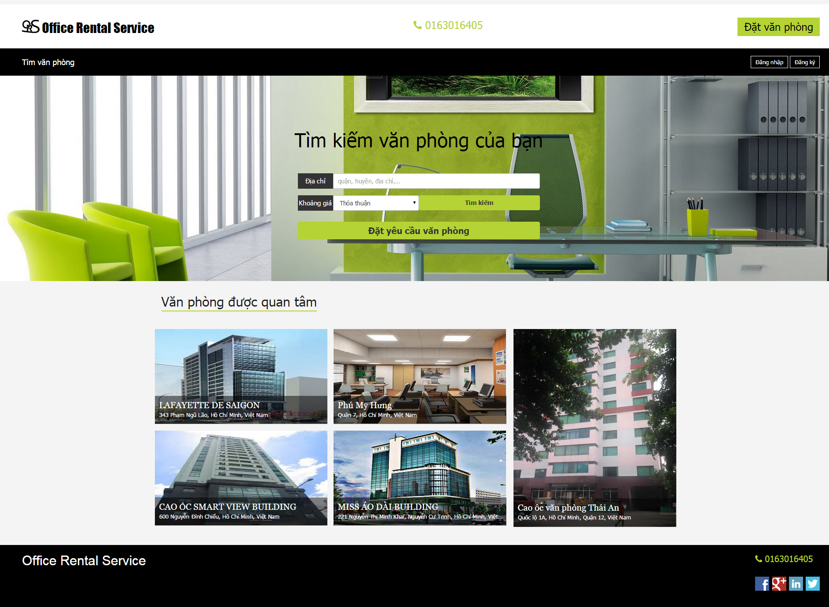

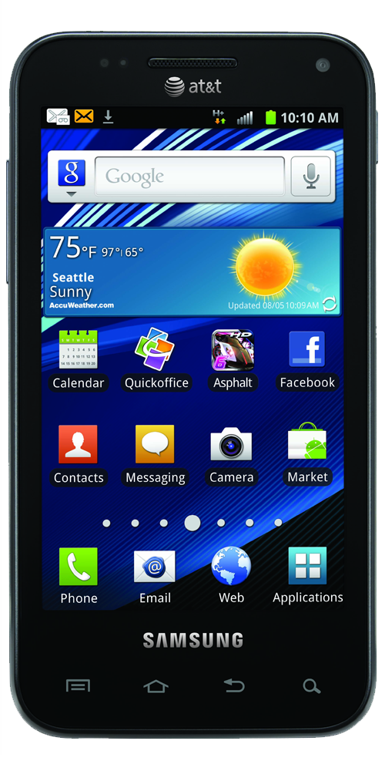
Proposed Solution
Search office
Manage office
Customer
Request office
Schedule request
Manager
Request appointment
Manage appointment
System
Website
Manage contract
Create contract
Staff
Request repair/ rental
Manage repair/ rental
Check appointment
Staff
Check assigned request
Mobile

Slide 5


Project Features Create Contract
(5) Meet and check office
(6) Decide create contract
Customer
Staff
(1) Go to website
(4) Assign to staff
(2) Create appointment
Appointment
(8) Create Contract
Contract
(3, 7) Go to appointment
Website
Manager

Slide 6
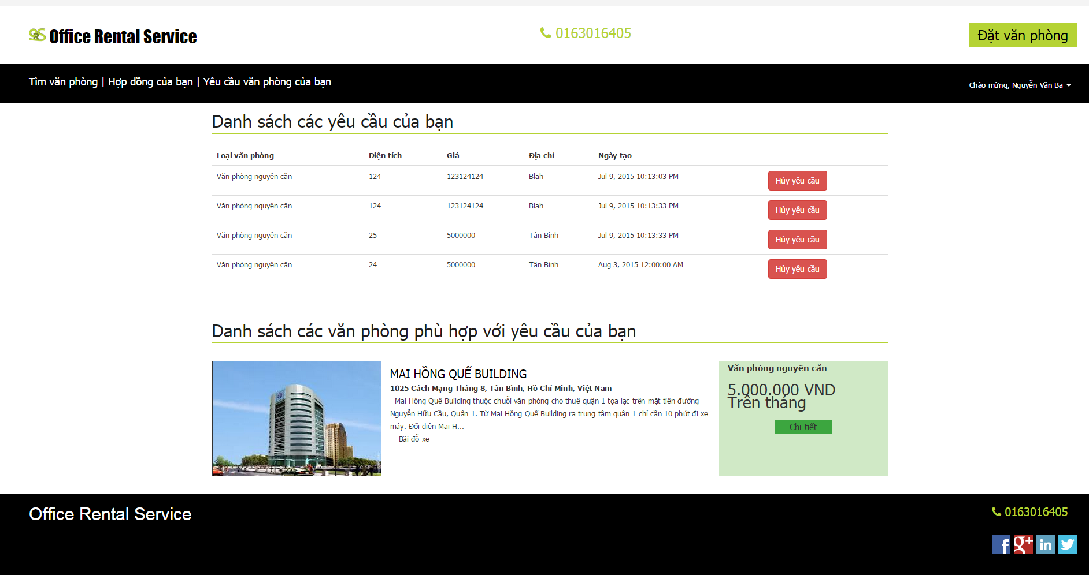


Project Features Request Office
Check request
Create request
Customer
Website
Result page
Check
Send email
Return data
Database
System
Customer’s email

Slide 7
Pros and Cons
Pros:
Providing search engines criteria: price, location, amenities...
Providing full information about the office. Support map for customers.
Making an appointment easily.
Tracking contract easily.
The customer’s requests are automatically suggest by system.
Helping staff easily to manage and update their jobs by mobile application.

Slide 8
Pros and Cons
Cons:
The partner who own the office must contact us to post their information.
The function of notification system is limited.
Only in Ho Chi Minh city.

Slide 9
Future Development
Mobile application provide creating office for staff.
Mobile application for customer.
New role for partner to create and manage their office.
Extend system for different locations.

