Slide 1
Project group 10 : Mindmap
Member :
1.Phan Xuân Tiến(leader)
2.Lê Viết Quản Trọng
3.Trịnh Thị Thu
4.Nguyễn Thị Thủy
5.Vũ Thị Trang
6.Đào Hải Long

Slide 2
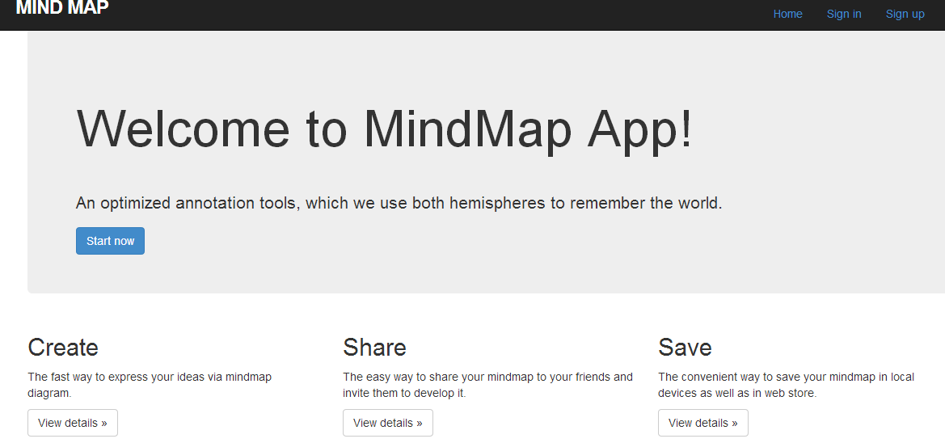
Mindmap
Deciption about mindmap
Mind map project is a web application that provides a convenient environment to creare, store, share , delete and search mind maps

Slide 3
Mindmap
Project process :
Agile method , Scrum process
Meeting on Thursday , Saturday , Sunday everyweek at 9p.m to 10 p.m
Each member reports work done in that week

Slide 4
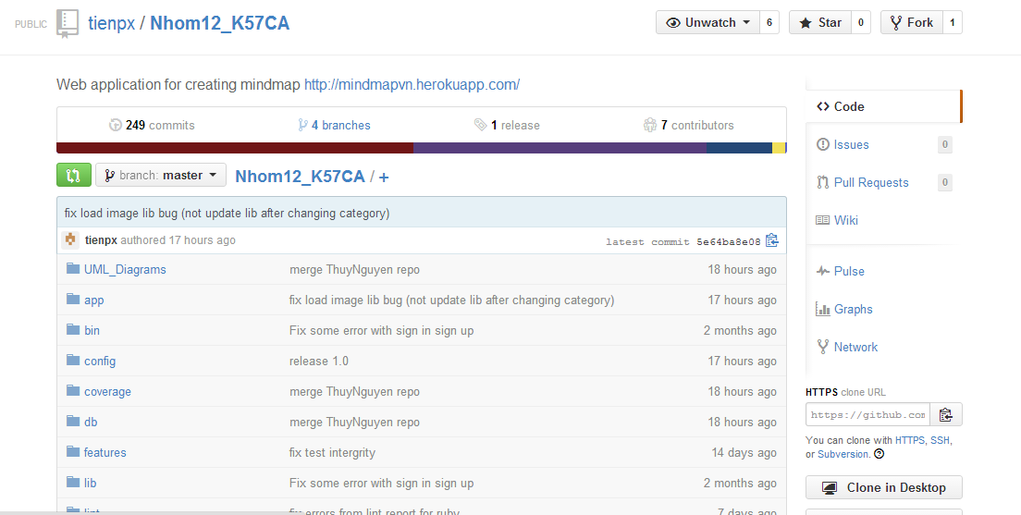
Mindmap
Github repository

Slide 5
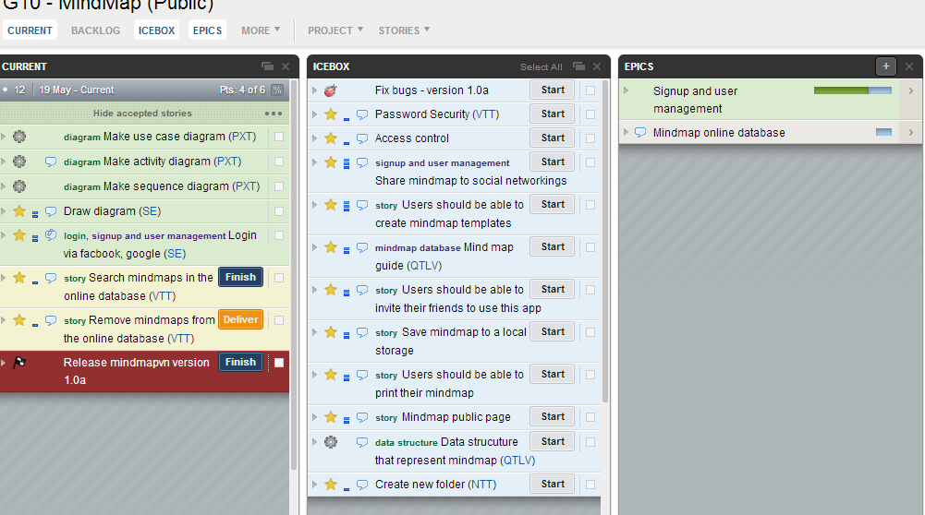
Mindmap
Pivotal Tracker

Slide 6
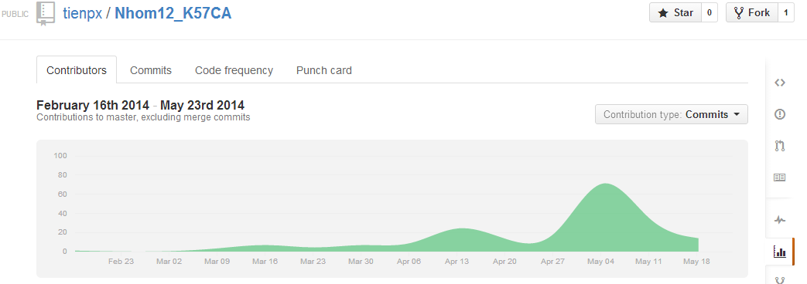
Mindmap
Contributors Graph

Slide 7
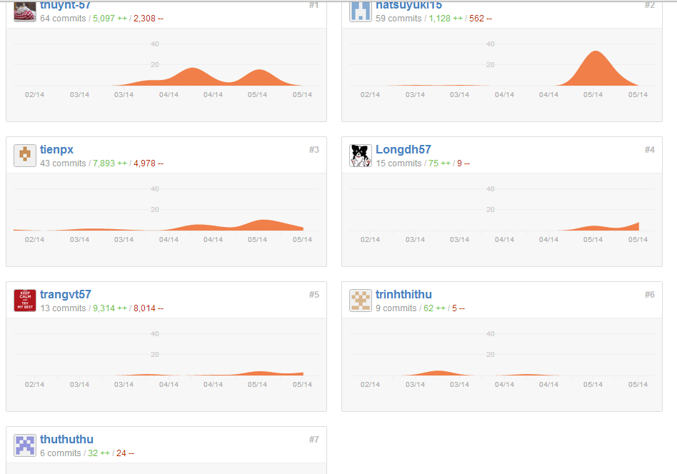
Mindmap

Slide 8
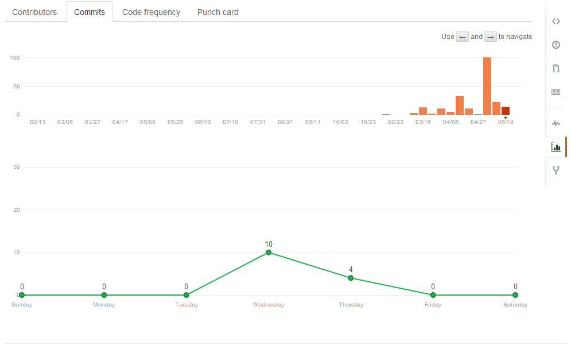
Mindmap
Github commits

Slide 9
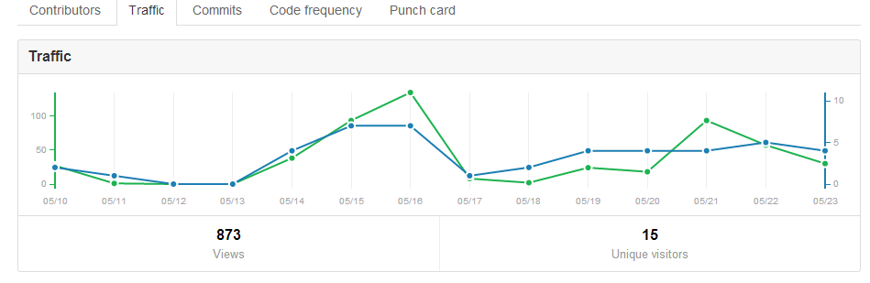
Mindmap
Graph traffic

Slide 10
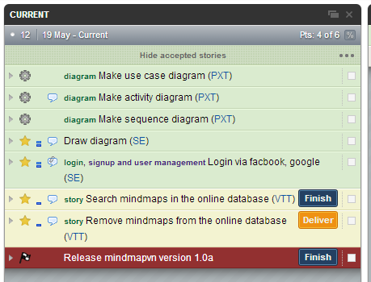
Mindmap
Pivotal Tracker : user stories

Slide 11
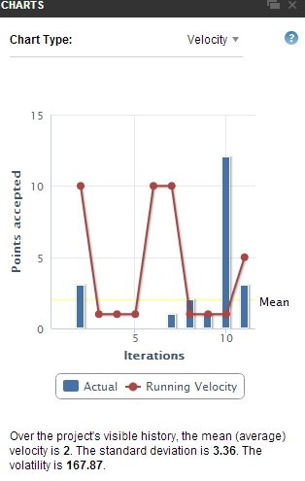
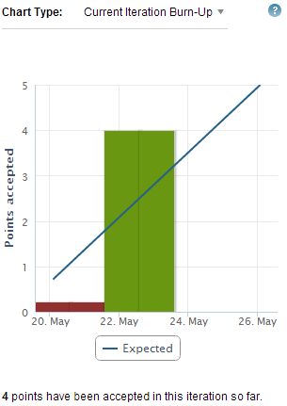
Mindmap
Userstories Chart

Slide 12
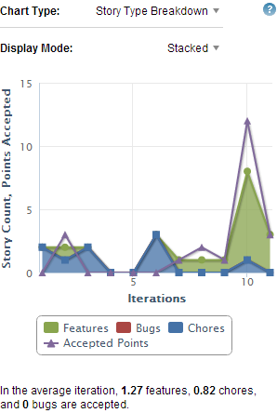
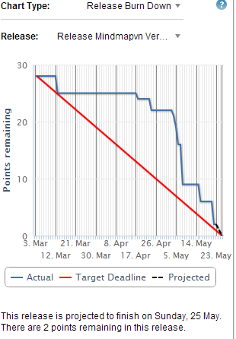
Mindmap
Charts Pivotal Tracker

Slide 13
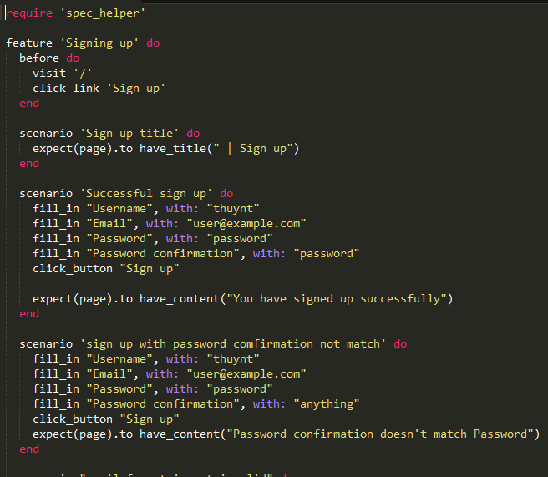
Mindmap
Example feature : Sign up

Slide 14
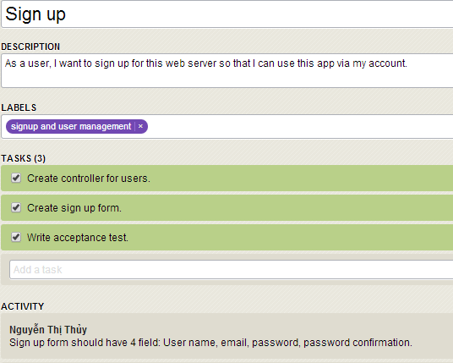
Mindmap
Feature : Sign up

Slide 15
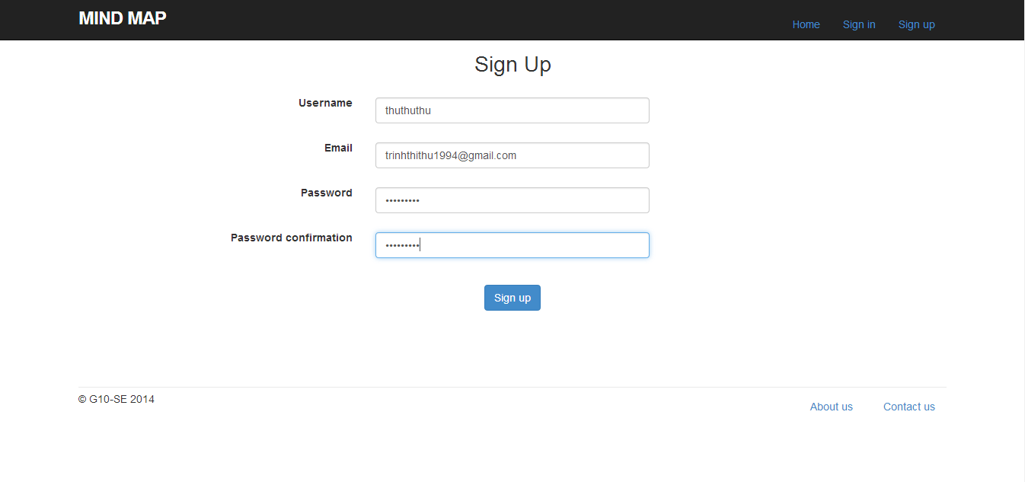
Mindmap : Demo
Signing up

Slide 16
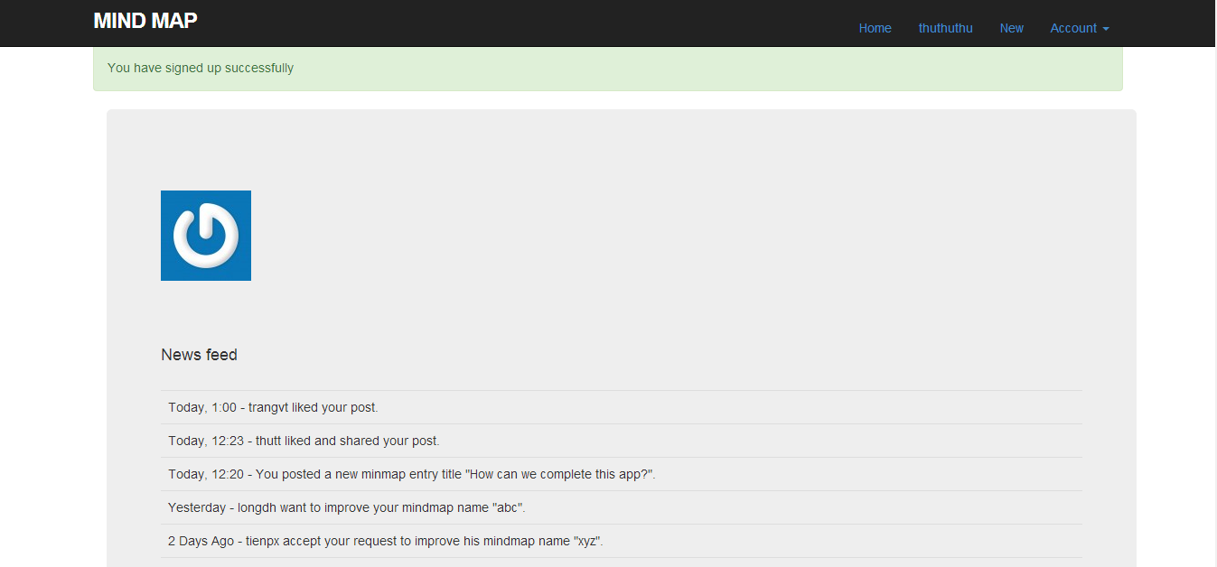
Mindmap : Demo
After signing up

Slide 17
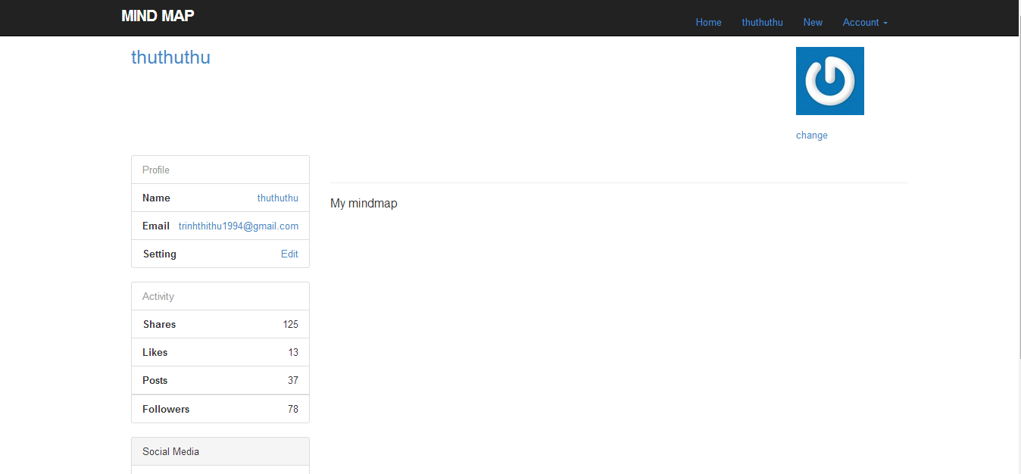
Mindmap : Demo
Profile

Slide 18
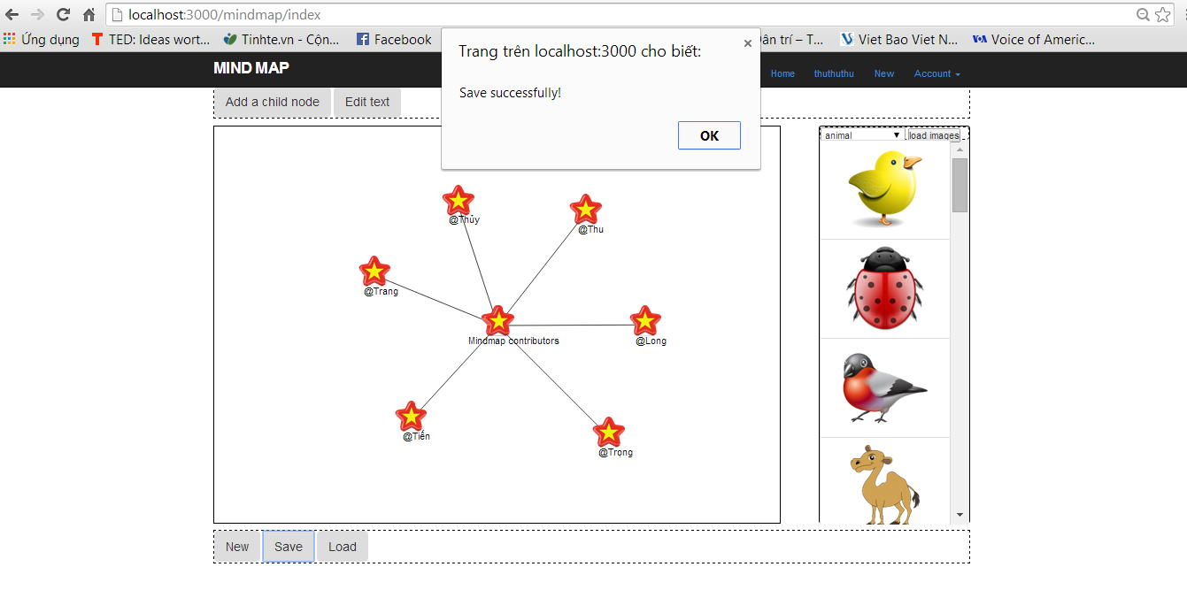
Mindmap : Demo
Drawing page

Slide 19
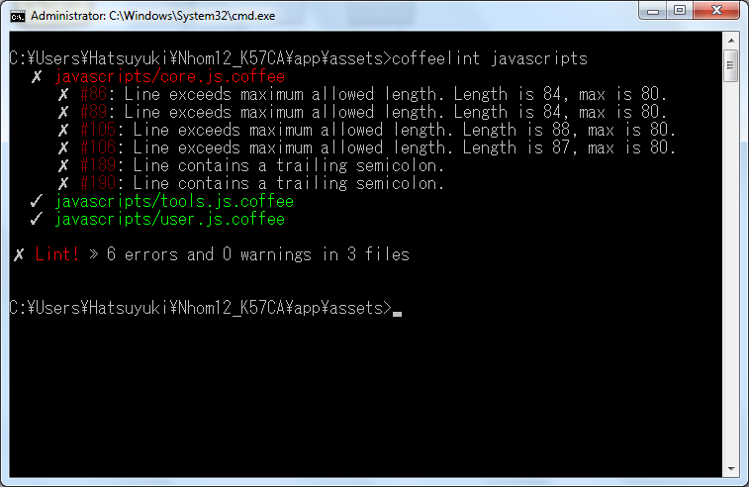
Mindmap
Lints Tool : before

Slide 20

Mindmap
Example :fix error maximum allow length

Slide 21
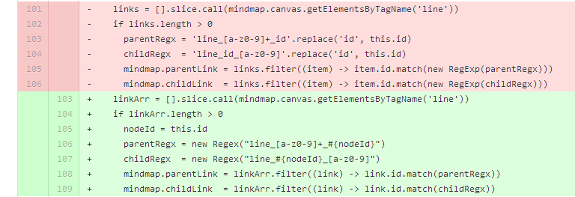
Mindmap
Example

Slide 22
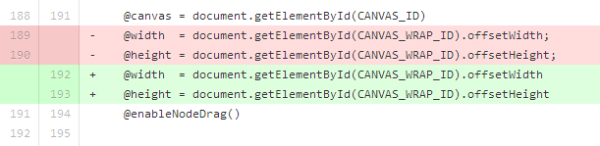
Mindmap
Example : Lints for line containing a training semicolon

Slide 23
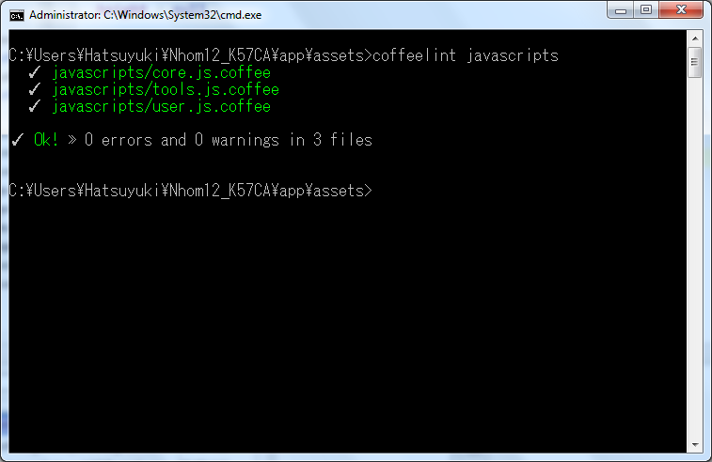
Mindmap
Lints Tool : after

Slide 24
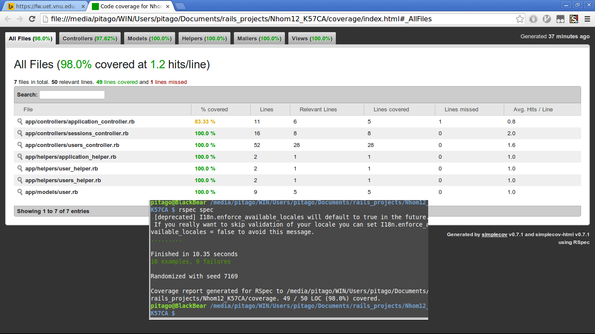
Mindmap
Test coverage

Slide 25
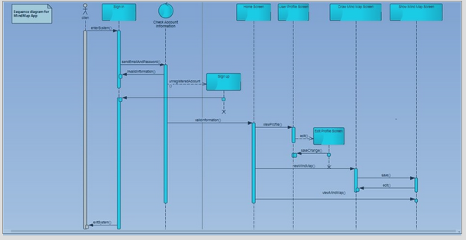
Mindmap UML Diagram
Sequence_Diagram

Slide 26
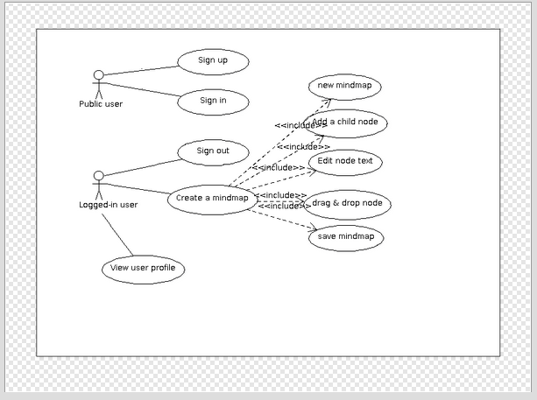
Mindmap UML Diagram
UseCase Diagram

Slide 27
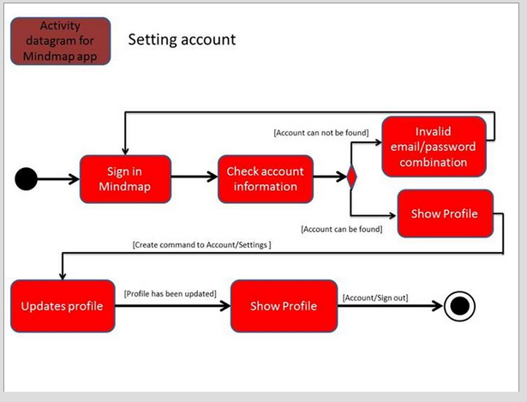
Mindmap UML Diagram
Activity Diagram

