Slide 1
Project group 10 : MINDMAP
Member :
1.Phan Xuân Tiến(leader)
2.Lê Viết Quản Trọng
3.Trịnh Thị Thu
4.Nguyễn Thị Thủy
5.Vũ Thị Trang
6.Đào Hải Long

Slide 2
Mindmap
*Description https://github.com/tienpx/Nhom12_K57CA/wiki
Mind map project is a web application that provides a convenient environment to creare, store, share , delete and search mind maps. When you own a account, you can :
Creare new mind maps. (Do it yourself or invite your friend to join with you.)
Store mind maps on local device as well as web account.
Share mind maps to social networking site (like facebook, Twitter..).
Search mind maps which have contents you wish in our website where other users store there mind maps and let them public.
*Platform : Ruby On Rails , Css, javascript

Slide 3
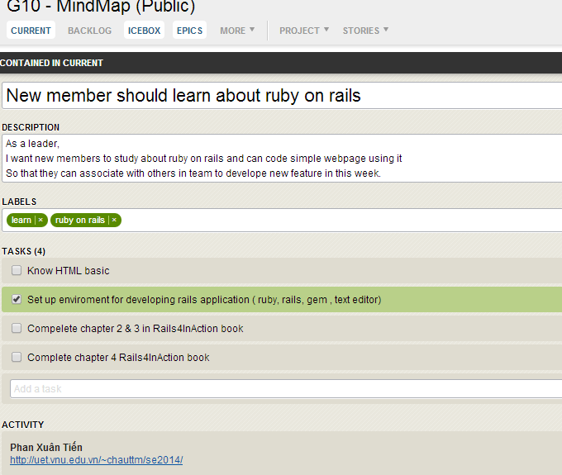
Mindmap
Duration : 12 weeks , 10 sprints coressponding , each one last 4 weeks.

Slide 4
Mindmap
2 first sprints : learning Ruby On Rails , js , css…
Status : done
Goals : learning Ruby on Rails, several framwork such as Css, Html , Javascript , Bootstrap
Responsibility for : all members
Result :
Done Completely
Member’s enthusiasm : good , all members learned in 2 weeks as planning
Problems :
Short time for learing
All members are newbie , so our skill are not well-trained

Slide 5
Mindmap
Sprint 3th : Welcome page’s interface
Begin : week 3th
Status : done ( in week 5th)
Goals :
create welcome page,that user can see the apps name
Create links for signing in, signing up
Be able to show several tools that support about apps, such as wiki, help,
Responsibility for :
Page interface : Phan Xuan Tien
Sign in, Sign up : Nguyen Thi Thuy
Result :
Done completely
Problems :
Smell code
Not following with Agile
Not good interface : image , layout.
Member’s enthusiasm : good

Slide 6
Mindmap
Sprint 4th : Create a new Mindmap
Begin : 5th week
Status : done in week 9th
Goals :
Be able to creat a new mindmap online
Create links from welcomepage to create mindmap
Create tools for drawing a new mindmap
Datebase saves mindmap information
Responsibility for :
Create mindmap : Phan Xuan Tien , Vu Thi Trang
Create links : Vu Thi Trang
Create tools : Trinh Thi Thu , Le Viet Quan Trong
Database : Le Viet Quan Trong
Result :
Essentially complete , applying Agile method
Problems : conflix code , difficuly deals with relative features
Member’s enthusiasm : good

Slide 7
Mindmap
Sprint 5th : Save minndmap on database
Begin : 6th week
Status : doing
Goals :
Be able to save data on database, so that the query operation will be fast
Responsibility for : Le Viet Quan Trong
Result :
Several steps completed
Problems : Ruby support SQLite , so SQL server , MySql will not be easy to use , test driven problems
Member’s enthusiasm : good

Slide 8
Mindmap
Sprint 6th : Adding, Editing , Deleting Mindmap
Begin : 7th week
Status : doing
Goals :
Adding a new mindmap
Editing mindmap, including name , description
Delete unused mindmap
Remove mindmap data from database
Responsibility for : Vu Thi Trang
Result :
Several steps completed
Problems : smell code ,conflix code with several members , because of relative features,
Member’s enthusiasm : good

Slide 9
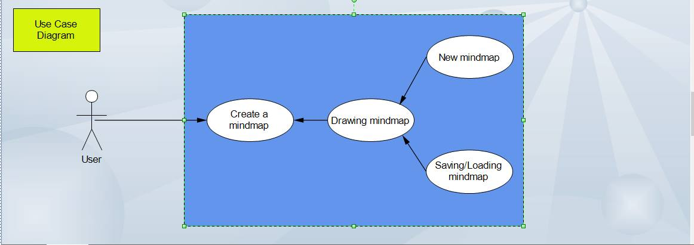
Mindmap

Slide 10
Mindmap
Sprint 7th : Adding, Editing , Deleting User Account
Begin : 8th week
Status : done
Goals :
User be able to create a new account
Editing account , including name, email..in profile
Deleting unused account
Responsibility for : Nguyen Thi Thuy
Result :
Essentially complete
Problems : smell code , testing , stick user with mindmap
Member’s enthusiasm : good

Slide 11
Mindmap
Sprint 8th : Create Tools, decorate the drawing page interface
Begin : 9th week
Status : done
Goals :
Implement some tools support for user when drawing page , such as easer , image..
Decorate page interface
Responsibility for : Trinh Thi Thu
Result :
Several steps completed
Problems :
not easy for testing html, css, boostrap
Implement may be difficult
Member’s enthusiasm : good

Slide 12
Mindmap
Sprint 9th : Adding feature for users
Begin : 10th week
Status : doing
Goals :
This apps be able to login with social network account such as facebook, gmail..
This apps can get user information from the other account
Responsibility for : Dao Hai Long
Result :
Several steps completed
Problems : several problems about interface, links
Member’s enthusiasm : good

Slide 13
Mindmap
Sprint 10th : Complete mindmap features
Begin : week 12th
Status : doing
Goals :
Complete several features for mindmap such as share mindmap on social network
Responsibility for : all members
Result :
Complete testing , refactor code
Problems : fixing conflix conflic beacause of relative features
Member’s enthusiasm : good

Slide 14
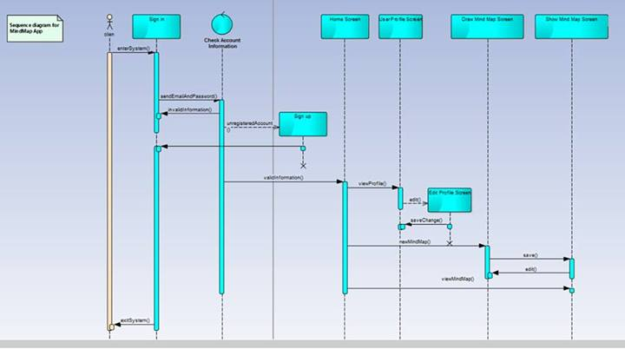
Mindmap

Slide 15
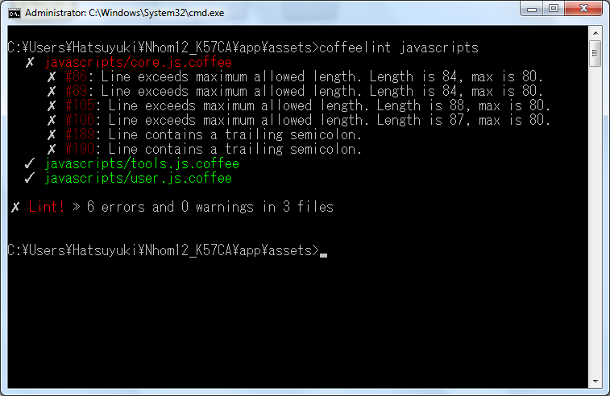
Mindmap
Using Lint for Ruby on Rails

Slide 16
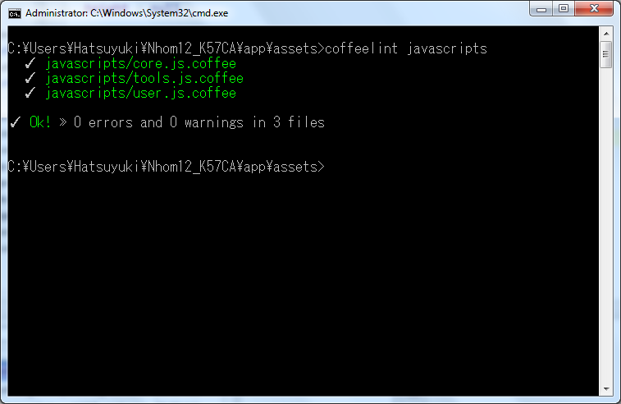
Mindmap

Slide 17
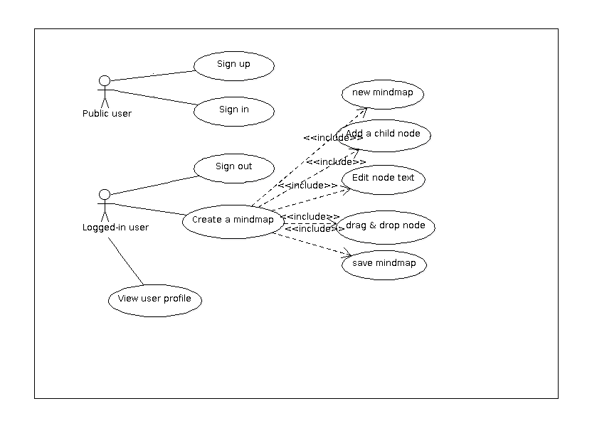
Mindmap
User case diagram

Slide 18
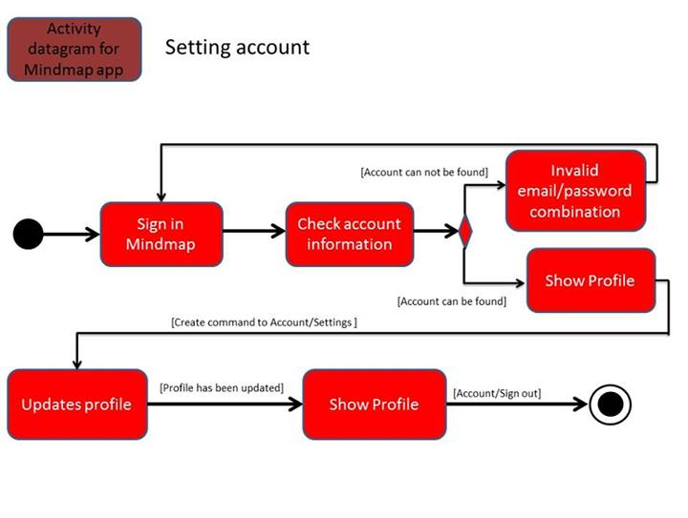
Mindmap
Activities sequence

