Slide 1
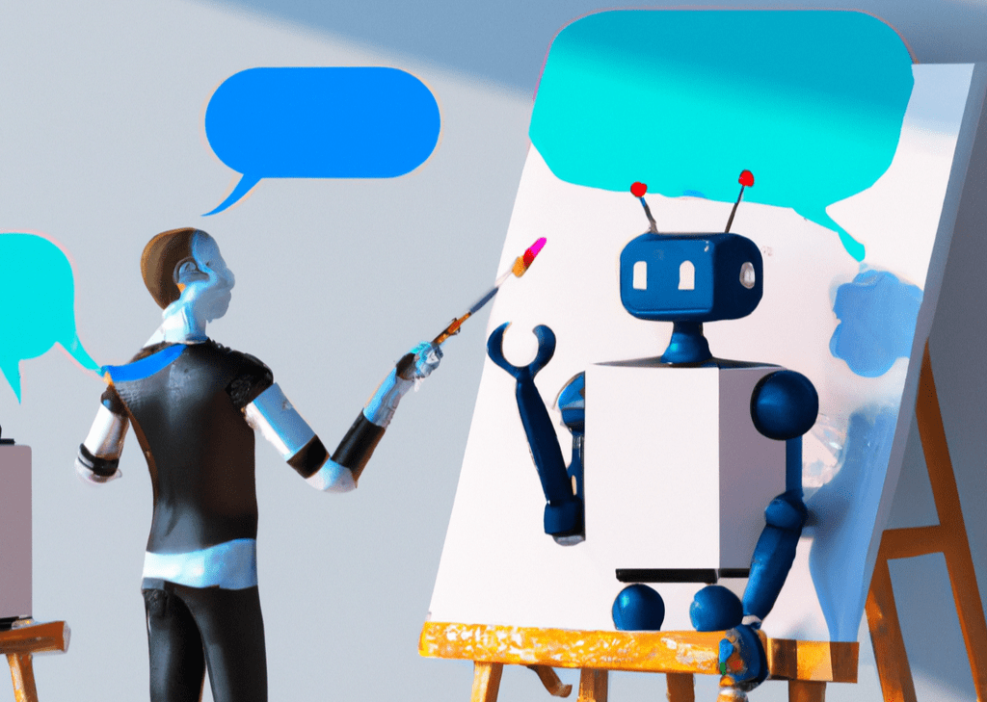
1
2
model
Auto-encoder
1
2
3
4
3
4
Synthetic data
art
5
Large language model
6
deep learning
5
6
7
8
7
8
Reinforcement learning
Style transfer
Stable diffusion
10
9
10
11
12
9
creativity
11
12
TỪ KHOÁ CHỦ ĐỀ: 12 kí tự
GENERATIVE AI

Slide 2
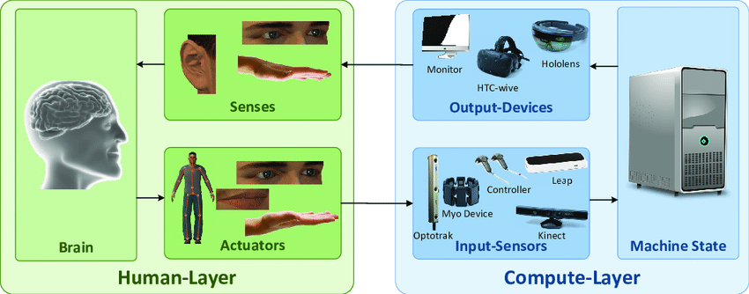
1
interface
Cognitive psychology
1
2
3
4
2
3
4
User experience
Virtual reality
5
6
Speech recognition
Haptic interface
5
6
7
8
7
8
Accessibility
Gesture recognition
User-Centered Design
10
9
10
11
12
9
mobile-computing
11
Virtual assitant
User modeling
12
TỪ KHOÁ CHỦ ĐỀ: 24 kí tự
HUMAN COMPUTER INTERACTION

Slide 3
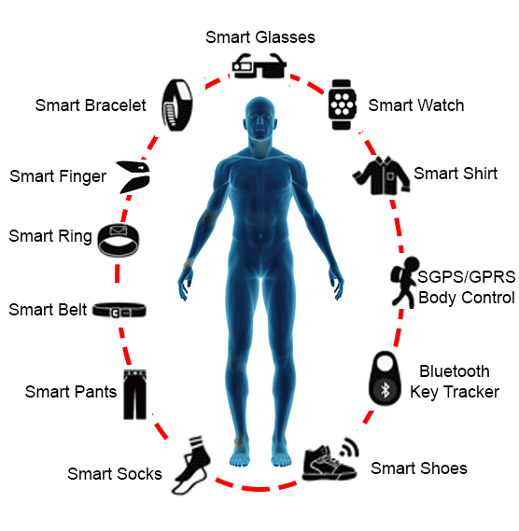
IoT
sensor
3
4
1
2
1
2
Biometric data
3
Apple Watch
4
biofeedback
6
5
Google glass
5
6
7
8
7
8
User experience
9
10
9
10
11
12
11
12
TỪ KHOÁ CHỦ ĐỀ: 18 kí tự
WEARABLE TECHNOLOGY

Slide 4
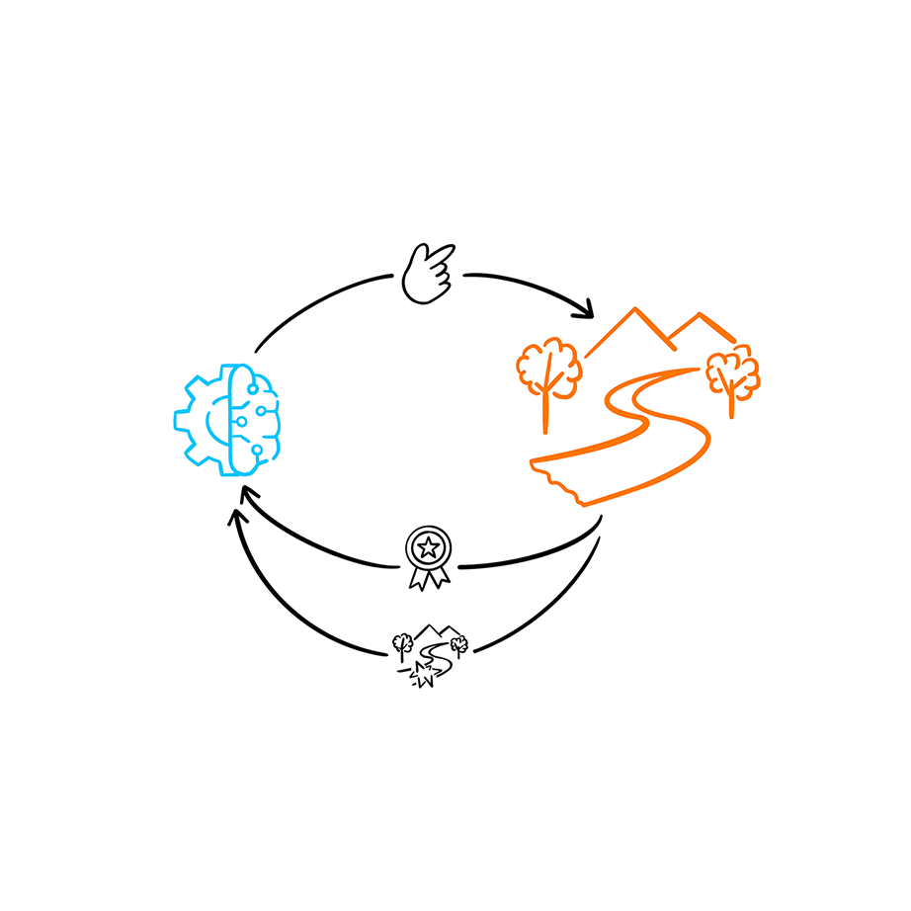
environment
2
1
AI
1
2
3
4
policy
4
3
agent
5
6
Exploration-Exploitation Tradeoff
interactive
5
6
7
8
7
8
Markov Decision Process
reward
9
10
9
10
11
12
11
12
TỪ KHOÁ CHỦ ĐỀ: 21 kí tự
REINFORCEMENT LEARNING

Slide 5
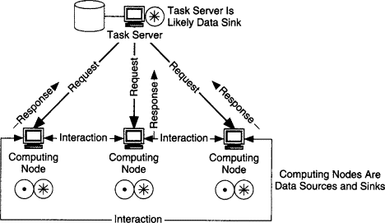
Multi-cluster
Large-scale resource
1
2
3
4
1
2
3
4
Grid computing
consensus
5
6
Multiple-computer
consistency
5
6
7
8
7
8
efficiency
Big data
9
9
10
11
12
Internet of Thing
Apache Hadoop
10
11
12
Fault tolerance
network
DISTRIBUTED COMPUTING
TỪ KHOÁ CHỦ ĐỀ: 20 kí tự

Slide 6
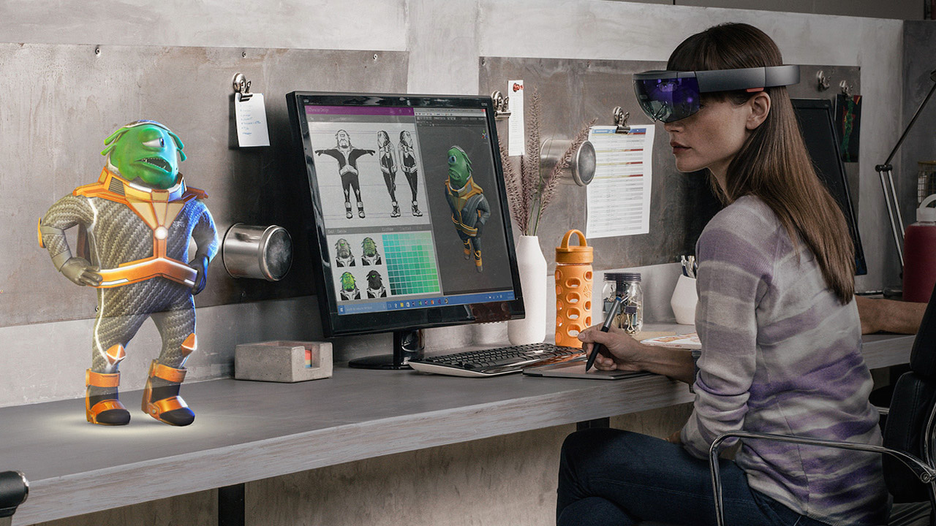
1
2
1
marker
SLAM
2
3
4
3
4
Image recognition
Simulations
5
6
MagicLeap
Real-Time Tracking
5
6
7
8
7
Interactive Interfaces
Hololens
8
9
10
9
10
11
12
Visual Intertial Odometry
vuforia
11
Sensor Fusion
12
AUGMENTED REALITY
TỪ KHOÁ CHỦ ĐỀ: 16 kí tự

Slide 7
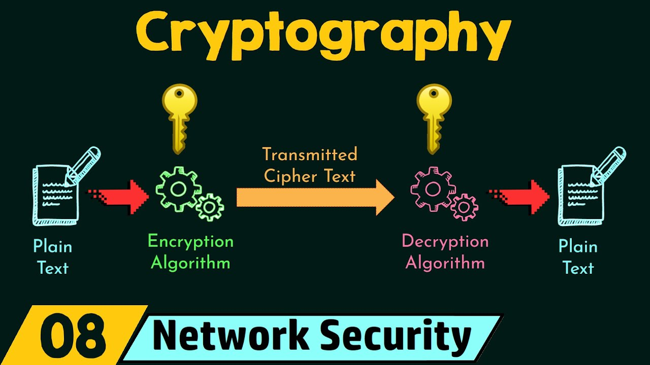
1
cipher
2
communication
1
2
3
4
3
Integer factorization
4
protect information
5
private
6
secure
5
6
7
8
7
Computational hardness
8
RSA
9
9
10
11
12
Information theory
10
Rijndae
11
12
CRYPTOGRAPHY
TỪ KHOÁ CHỦ ĐỀ: 12 kí tự

Slide 8
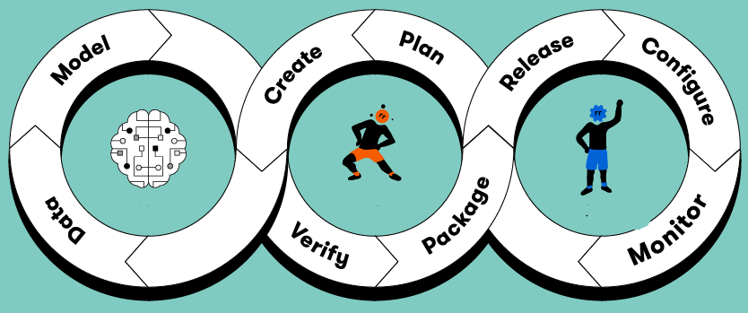
1
automation
2
Model testing
1
2
3
4
3
Model versoning
4
Feature store
5
Logging
6
Scalability
5
6
7
8
7
Model monitoring
8
Stream processing
9
9
10
11
12
Model deployment
10
Model validation
11
Feast
12
TỪ KHOÁ CHỦ ĐỀ: 25 kí tự
MACHINE LEARNING OPERATIONS

Slide 9
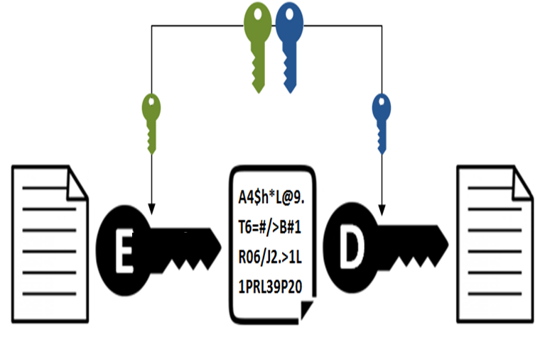
1
RSA
2
Key pairs
1
2
3
4
3
Elliptic curve
4
Digital signature
5
Diffie-Hellman
6
Message integrity
5
6
7
8
7
decryption
8
encryption
9
9
10
11
12
ElGamal
10
Key exhange
11
12
TỪ KHOÁ CHỦ ĐỀ: 22 kí tự
ASYMMETRIC CRYPTOSYSTEM

Slide 10

1
Biometrics
2
Passwordless authentication
1
2
3
4
3
personal information
4
digitalize
5
authorization
6
single sign-on
5
6
7
8
7
representation
8
Trust frameworks
9
9
10
11
12
certification authorities
10
11
12
DIGITAL IDENTITY
TỪ KHOÁ CHỦ ĐỀ: 15 kí tự

Slide 11
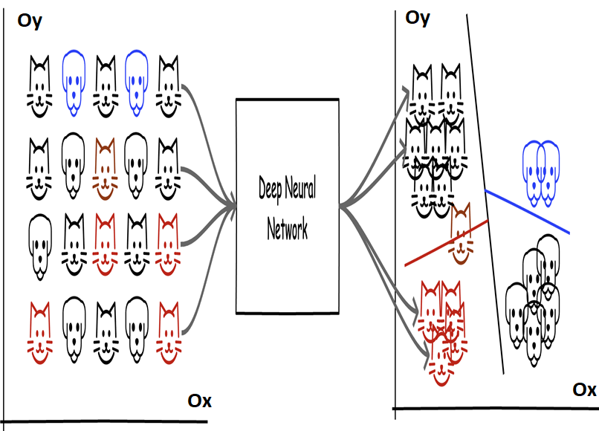
1
Feature vector
2
Neural network
1
2
3
4
3
Machine learning
4
Contrastive loss
5
embedding
6
SimCLR
5
6
7
8
7
Triplet loss
8
Dimensionality reduction
9
9
10
11
12
Latent space
10
11
12
TỪ KHOÁ CHỦ ĐỀ: 22 kí tự
REPRESENTATION LEARNING

Slide 12
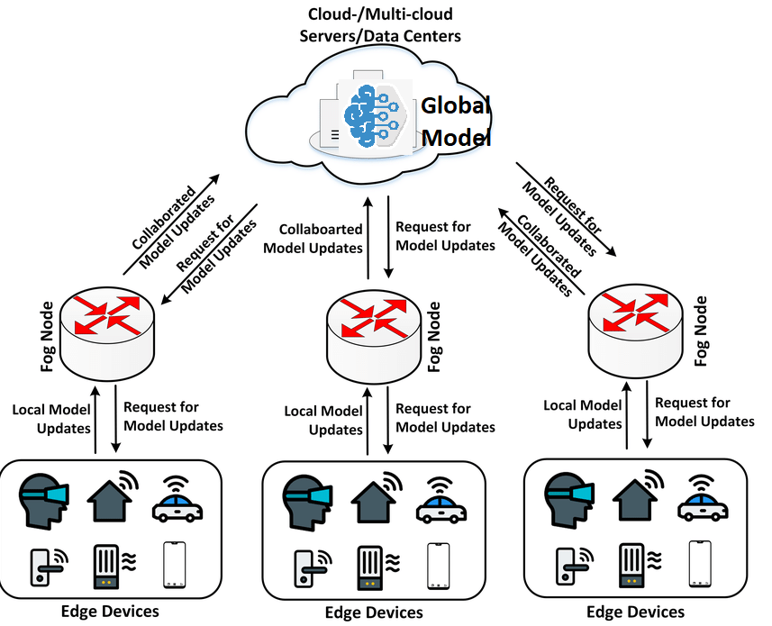
1
Decentralized computing
2
Local training
1
2
3
4
3
Data privacy
4
Smart manufacturing
5
Gradient aggeration
6
Edge computing
5
6
7
8
7
Diffusion model
8
IoT
9
9
10
11
12
Data security
10
Differential Privacy
11
12
FEDERATED LEARNING
TỪ KHOÁ CHỦ ĐỀ: 17 kí tự

Slide 13
1
2
1
2
3
4
3
4
5
6
5
6
7
8
7
8
9
10
9
10
11
12
11
12
TỪ KHOÁ CHỦ ĐỀ: 5 kí tự
ĐÁP ÁN

