Slide 1
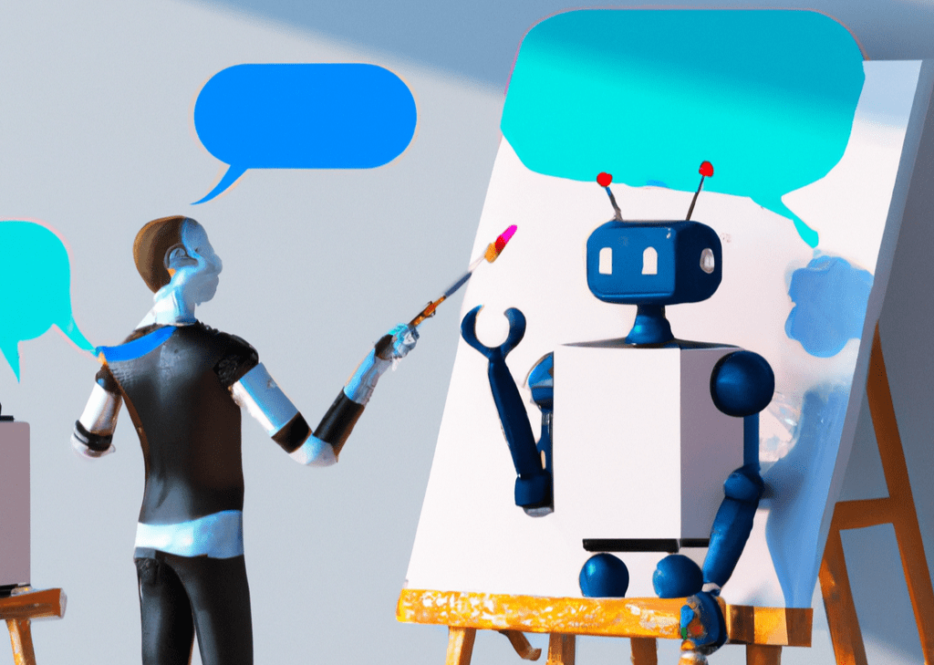
1
2
model
Auto-encoder
1
2
3
4
3
4
Synthetic data
art
5
Large language model
6
deep learning
5
6
7
8
7
8
Reinforcement learning
Style transfer
Stable diffusion
10
9
10
11
12
9
creativity
11
12
TỪ KHOÁ CHỦ ĐỀ: 12 kí tự
GENERATIVE AI

Slide 2
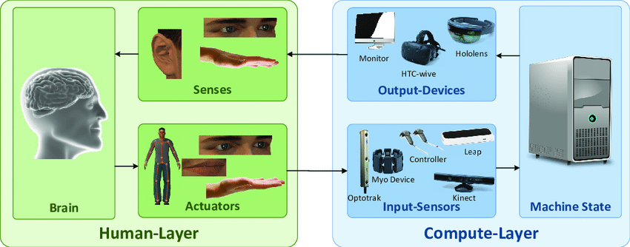
1
interface
Cognitive psychology
1
2
3
4
2
3
4
User experience
Virtual reality
5
6
Speech recognition
Haptic interface
5
6
7
8
7
8
Accessibility
Gesture recognition
User-Centered Design
10
9
10
11
12
9
mobile-computing
11
Virtual assitant
User modeling
12
TỪ KHOÁ CHỦ ĐỀ: 24 kí tự
HUMAN COMPUTER INTERACTION

Slide 3
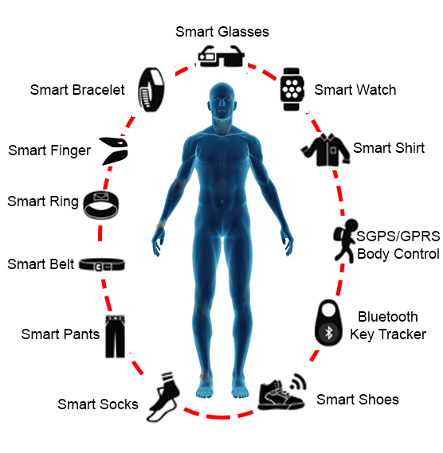
IoT
sensor
3
4
1
2
1
2
Biometric data
3
Apple Watch
4
biofeedback
6
5
Google glass
5
6
7
8
7
8
User experience
9
10
9
10
11
12
11
12
TỪ KHOÁ CHỦ ĐỀ: 18 kí tự
WEARABLE TECHNOLOGY

Slide 4
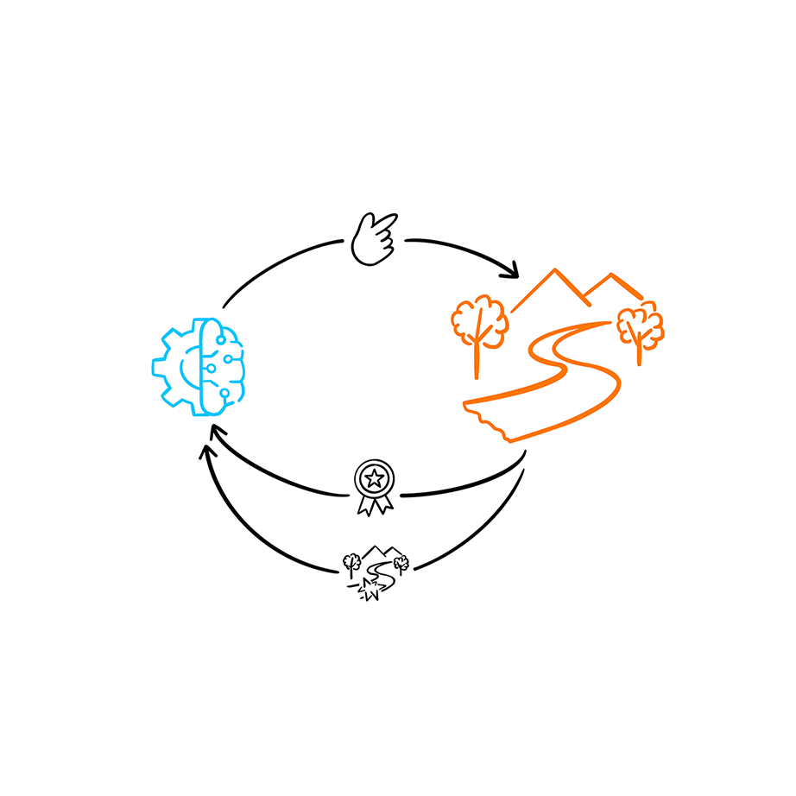
environment
2
1
AI
1
2
3
4
policy
4
3
agent
5
6
Exploration-Exploitation Tradeoff
interactive
5
6
7
8
7
8
Markov Decision Process
reward
9
10
9
10
11
12
11
12
TỪ KHOÁ CHỦ ĐỀ: 21 kí tự
REINFORCEMENT LEARNING

Slide 5
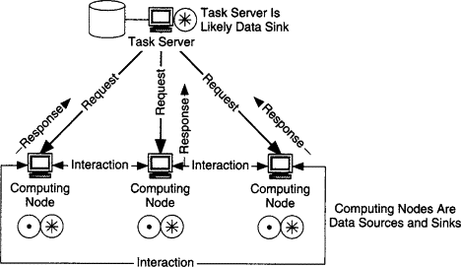
Multi-cluster
Large-scale resource
1
2
3
4
1
2
3
4
Grid computing
consensus
5
6
Multiple-computer
consistency
5
6
7
8
7
8
efficiency
Big data
9
9
10
11
12
Internet of Thing
Apache Hadoop
10
11
12
Fault tolerance
network
DISTRIBUTED COMPUTING
TỪ KHOÁ CHỦ ĐỀ: 20 kí tự

Slide 6
1
2
1
2
3
4
3
4
5
6
5
6
7
8
7
8
9
10
9
10
11
12
11
12
TỪ KHOÁ CHỦ ĐỀ: 5 kí tự
ĐÁP ÁN

