Slide 1
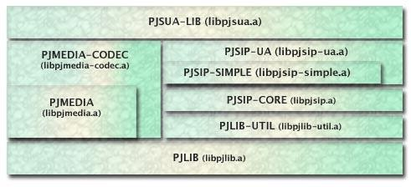
PJSIP lib

Slide 2
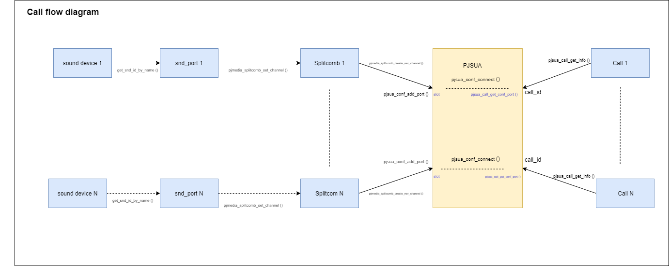
Multiple sound device and call flow
Notes:
Create a reverse phase media port for the specified channel number. For channels with reversed phase, when application calls put_frame() to the splitter/combiner, the splitter/combiner will only put the frame to a buffer. Later on, when application calls get_frame() on the channel's media port, it will return the frame that are available in the buffer. The same process happens when application calls put_frame() to the channel's media port, it will only put the frame to another buffer, which will be returned when application calls get_frame() to the splitter's media port. So this effectively reverse the phase of the media port.

Slide 3
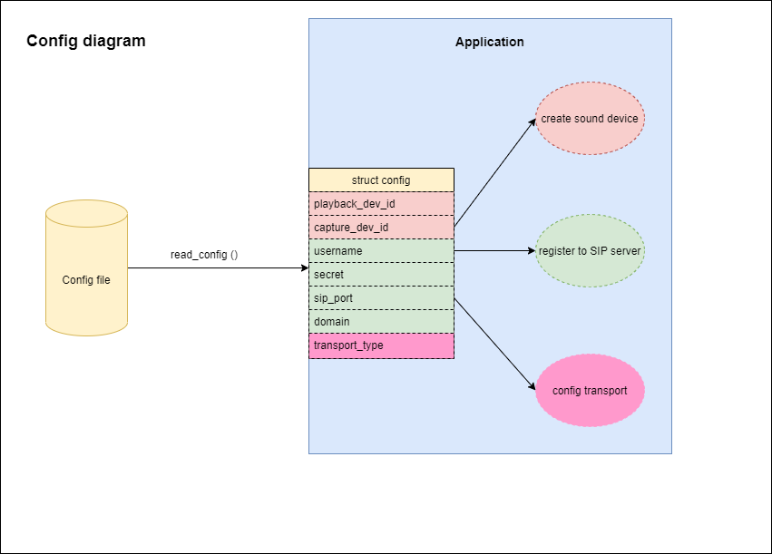
Config

Slide 4
SPI

