Slide 1
ENDLESS ZOMBIE
Class Name: GD1305
Project II Presentation
Members: Vu Viet Tien & Chu Van Thai
Notes:
[Sources]
- Project2_GD1305_Endless_Zombie_Report_EN.pdf (user-provided report)
- GD1305 - Group MoonStone - Presentation Project II.pptx (user-provided structure and visual template)

Slide 2
OBJECTIVES
Project Introduction
Analyze System Requirements
Design Details
Test
Installation Instructions

Slide 3
Project Introduction
Project Name: Endless Zombie
Project Description:
Endless Zombie is a third-person survival shooter built with Unity. The player survives escalating enemy waves, switches weapons, gains EXP and gold, and selects upgrades during each run.
Objective: survive as long as possible while managing weapons, upgrades, and enemy pressure.

Slide 4
Project Introduction
Core Gameplay
Defeat enemies to collect EXP and gold.
Choose upgrades when leveling up.
Buy and upgrade stats each run.
Enemy waves become increasingly difficult.

Slide 5

Project Introduction
Development Tools
Tool | Purpose
Unity 6000.3.10f1 | Game engine
Universal RP 17.3.0 | Rendering pipeline
Entities / DOTS 1.4 | High-volume enemy simulation
Input System 1.18.0 | Player input and controls

Slide 6
II. ANALYZE SYSTEM REQUIREMENTS
System Overview
The project is organized into five main areas:
Enemy System - spawning, navigation, collision, animation, and attacks.
Wave System - scales difficulty and coordinates spawn timing.
Progression - EXP, gold, leveling, and upgrades.
Canvas UI - main menu, HUD, settings, and level-up panels.

Slide 7
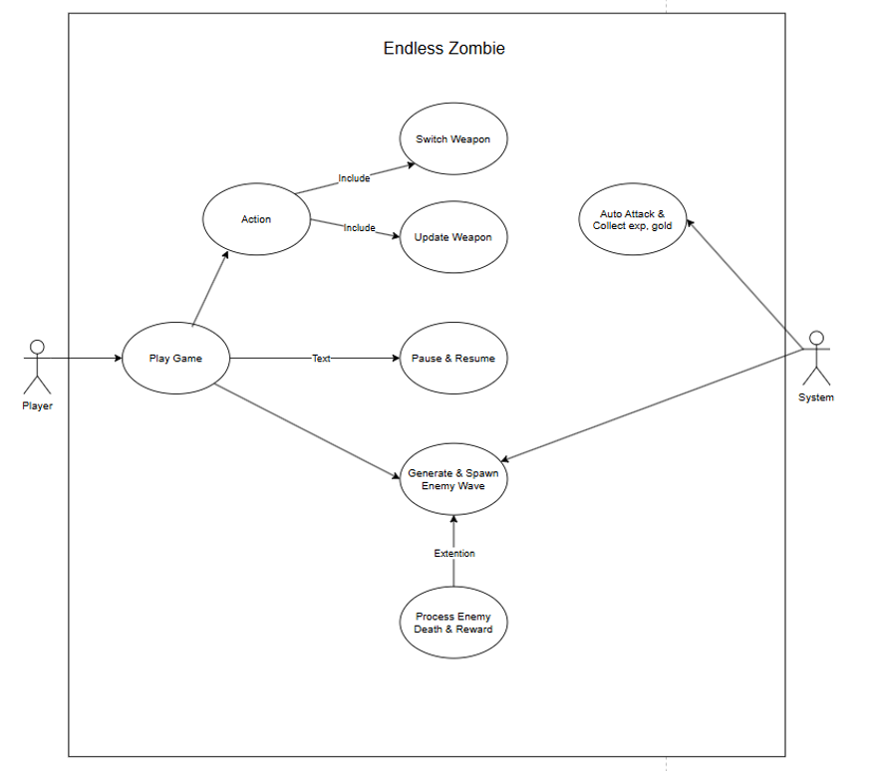
II. ANALYZE SYSTEM REQUIREMENTS
Use Case Diagram

Slide 8
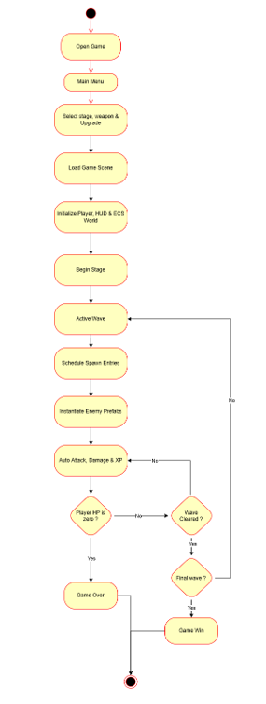
II. ANALYZE SYSTEM REQUIREMENTS
Activity Diagram

Slide 9
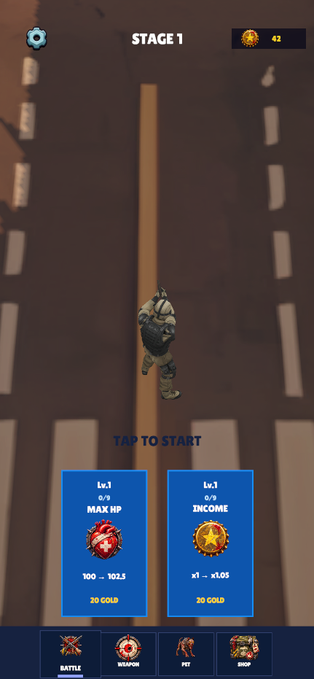
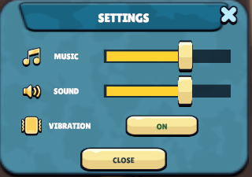
III. DESIGN DETAIL
Menu and Settings UI

Slide 10
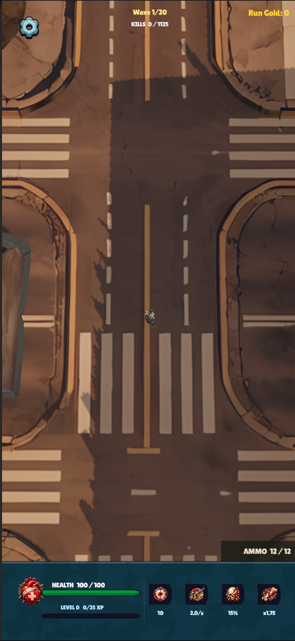
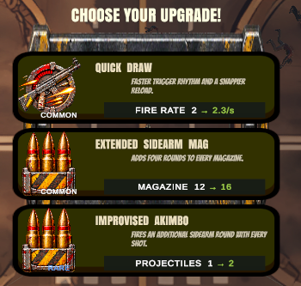
III. DESIGN DETAIL
In-Game HUD and Level Up

Slide 11
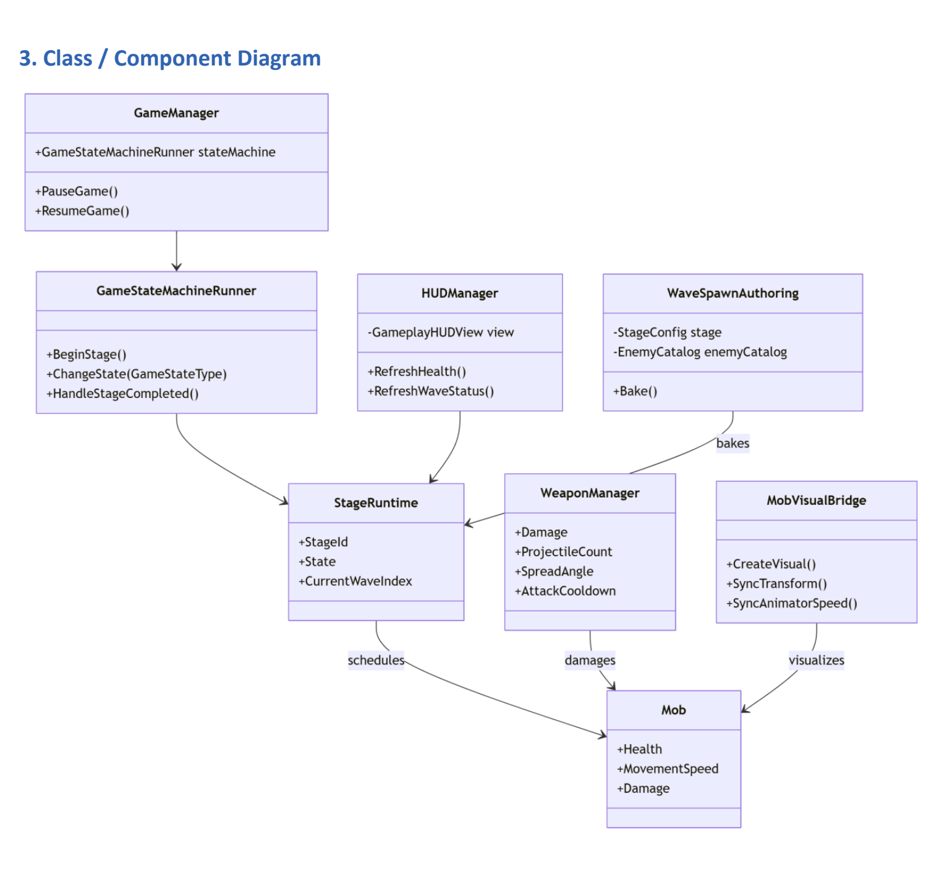
III. DESIGN DETAIL
Class Diagram

Slide 12
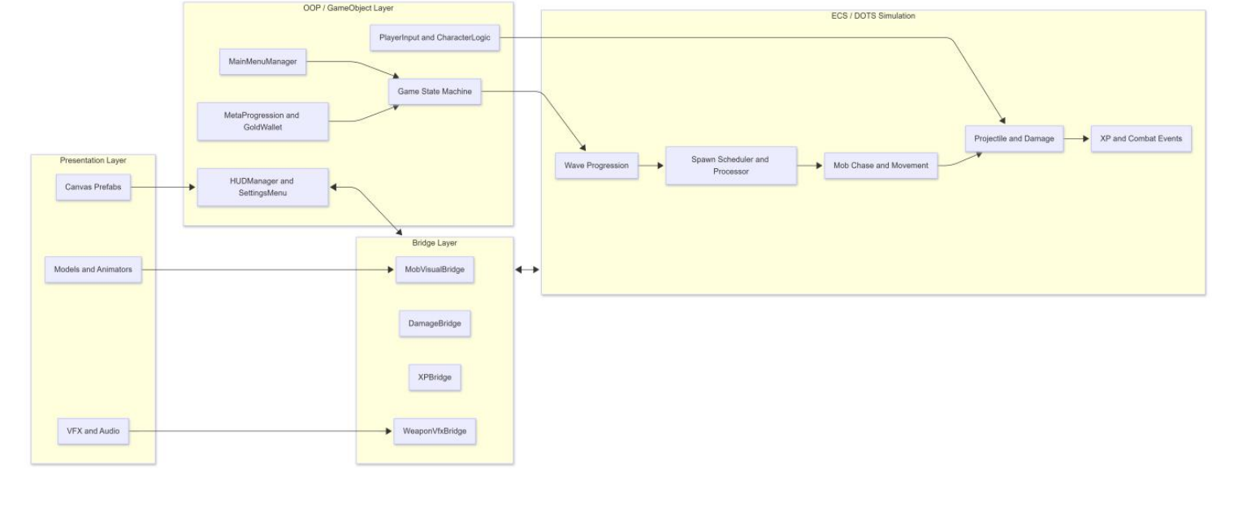
III. DESIGN DETAIL
System Architecture
- Hybrid MonoBehaviour + DOTS

Slide 13
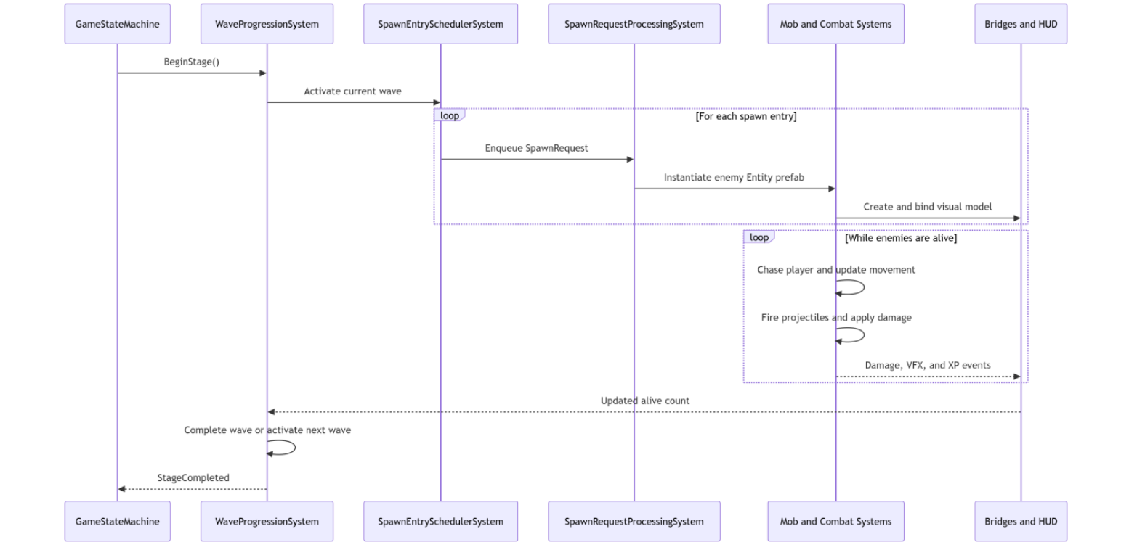
III. DESIGN DETAIL
Sequence Diagram
- Complete Gameplay Flow

Slide 14
III. DESIGN DETAIL
Data Model
Runtime data stores:
Player - health, weapons, EXP, and gold
Enemy - health, speed, target, attack state
Wave - enemy types, count, timing, scaling
UI - reads state without owning combat logic

Slide 15
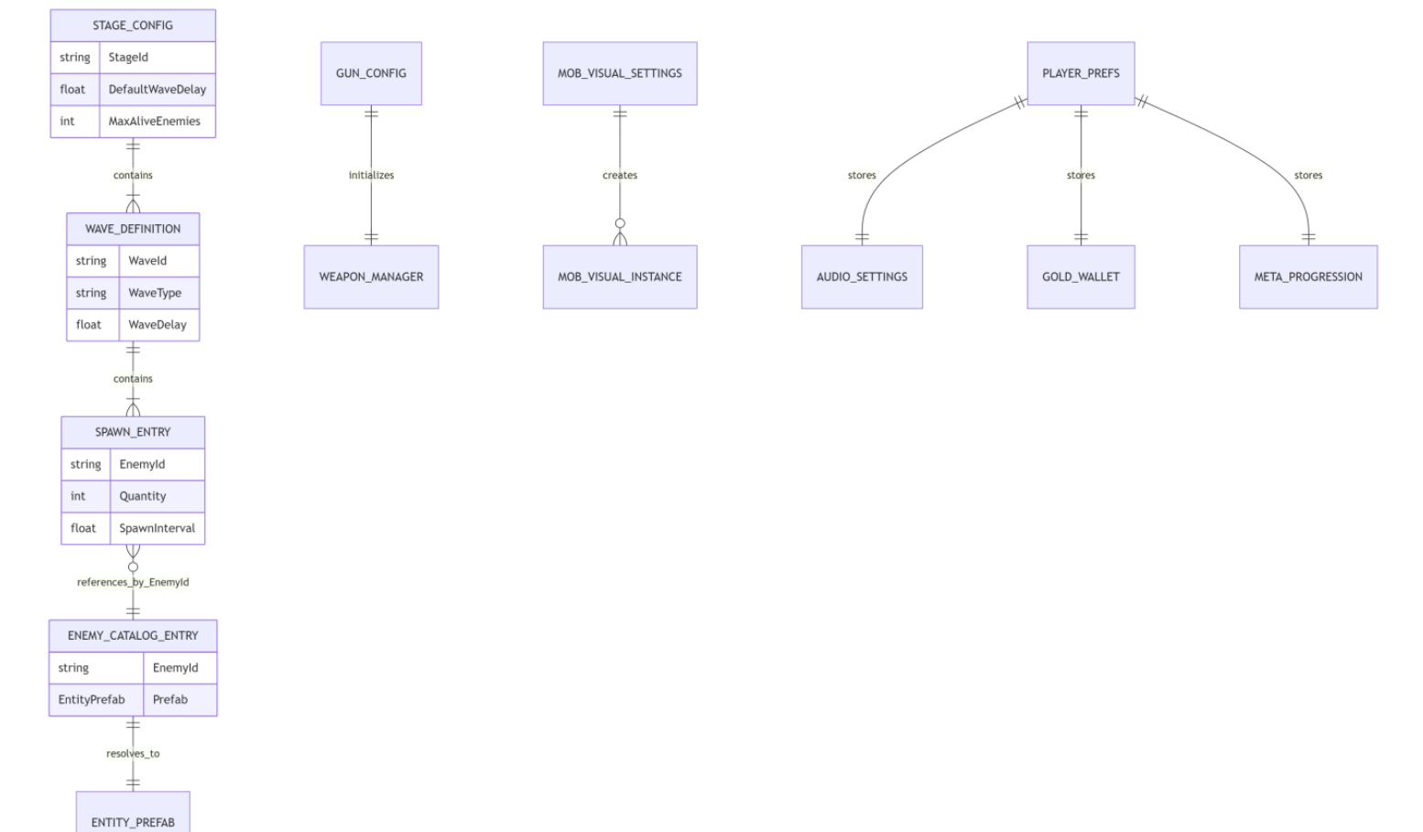
III. DESIGN DETAIL
Data Model
Core Data Relationships

Slide 16
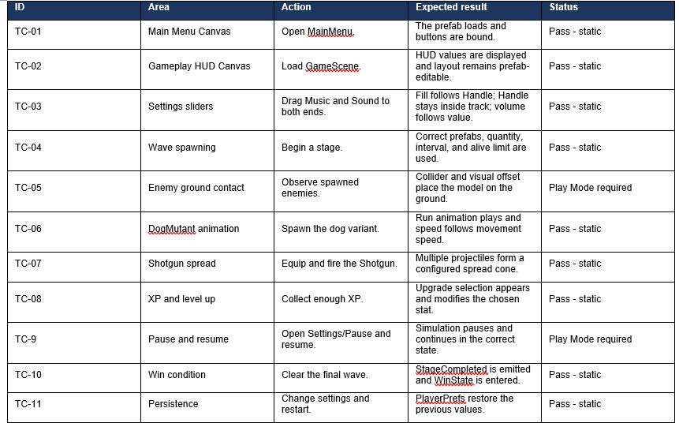
IV. TEST

Slide 17
V. Installation Instructions
PREREQUISITES
Unity Hub
Unity Editor 6000.3.10f1
Android Build Support
INSTALLATION STEPS
1. Open the Endless Zombie project in Unity Hub.
2. Confirm URP, Entities/DOTS, and Input System packages.
3. Open the main scene and test in Play Mode.
4. Switch the build target to Android.
5. Configure package name and player settings.
6. Build the APK and install it on an Android device.

Slide 18


Slide 19
Q & A

