Slide 1
CAPSTONE PROJECT • GD1305
ENDLESS
ZOMBIE
PROJECT
REPORT
Unity 6000.3.10f1
Android Mobile
Hybrid OOP + ECS
Survival Shooter / Action Roguelite
The MoonStone
Vu Viet Tien • Chu Van Thai
Notes:
[Sources]
- C:/Users/Vu Tien/Desktop/Project2_GD1305_Endless_Zombie_Report_EN.pdf (pages 1)

Slide 2
I. PROJECT INTRODUCTION
Endless Zombie combines survival pressure with persistent growth
PROJECT OVERVIEW
A top-down Android survival shooter where the player survives increasingly difficult waves through movement, automatic targeting, weapon choice, XP, and upgrades.
DEPLOYMENT ENVIRONMENT
Platform
Android mobile devices
Engine
Unity 6000.3.10f1
PROJECT SCOPE
Rendering
URP 17.3.0
• Canvas-based Main Menu, HUD, Settings, and Level Up UI
Data stack
Entities / DOTS 1.4
• Data-driven enemy waves and prefab spawning
Language
C#
• Weapon profiles including multi-projectile Shotgun
Input
Unity Input System 1.18
• DogMutant visual and synchronized run animation
GD1305 • THE MOONSTONE
02
Notes:
[Sources]
- C:/Users/Vu Tien/Desktop/Project2_GD1305_Endless_Zombie_Report_EN.pdf (pages 3)

Slide 3
II. SYSTEM REQUIREMENTS ANALYSIS
The requirements cover gameplay, scalability, UI, and persistence
FUNCTIONAL REQUIREMENTS
NON-FUNCTIONAL REQUIREMENTS
• Start a selected stage and load GameScene
• Stable performance with many Entity enemies
• Acquire targets and process projectiles, damage, death, and XP
• Inspector-editable Canvas prefabs
• Spawn enemies by wave, prefab, schedule, and alive limit
• Display Canvas HUD and level-up choices
• ScriptableObject-driven gameplay values
• Pause, resume, configure settings, and persist progression
• Movement-synchronized visual animation
• Finish a stage with Win or Game Over
• Safe local defaults and wave validation
GD1305 • THE MOONSTONE
03
Notes:
[Sources]
- C:/Users/Vu Tien/Desktop/Project2_GD1305_Endless_Zombie_Report_EN.pdf (pages 5)

Slide 4
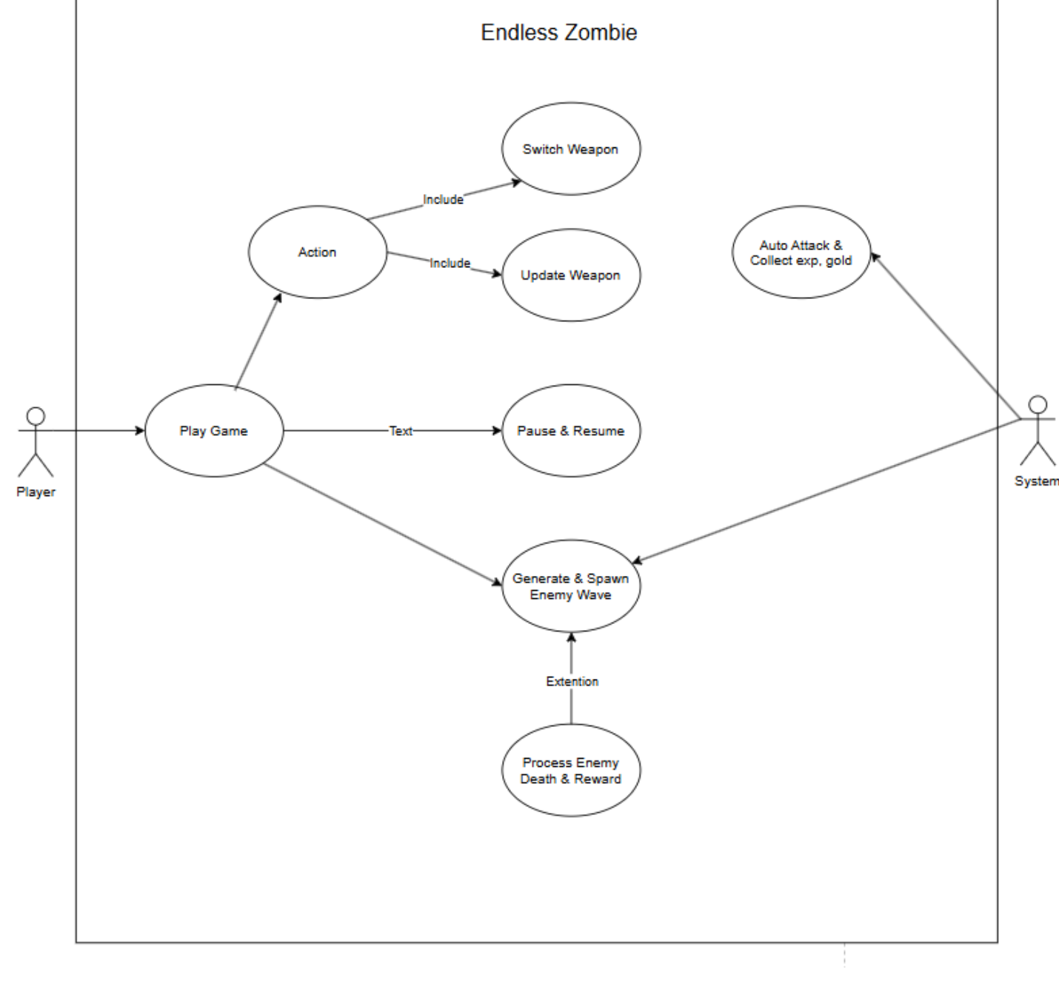
II. SYSTEM REQUIREMENTS ANALYSIS
4. Use Case Diagram
GD1305 • THE MOONSTONE
04
Notes:
[Sources]
- C:/Users/Vu Tien/Desktop/Project2_GD1305_Endless_Zombie_Report_EN.pdf (pages 6)

Slide 5
II. SYSTEM REQUIREMENTS ANALYSIS
5. Use Case Descriptions
UC-01 to UC-04 • Player entry and progression
UC-01
UC-02
Play Game
Action
Player • Enter the gameplay loop and initialize the stage.
Player • Move, avoid enemies, and interact during Running state.
UC-03
UC-04
Switch Weapon
Upgrade Weapon
Player • Select another valid weapon and apply its current statistics.
Player • Choose a weapon modifier at an upgrade opportunity.
Player actions are ignored while paused, during Level Up selection, or after Win / Game Over.
GD1305 • THE MOONSTONE
05
Notes:
[Sources]
- C:/Users/Vu Tien/Desktop/Project2_GD1305_Endless_Zombie_Report_EN.pdf (pages 6–9)

Slide 6
II. SYSTEM REQUIREMENTS ANALYSIS
5. Use Case Descriptions
UC-05 to UC-08 • Session and enemy lifecycle
UC-05
UC-06
Pause & Resume
Generate & Spawn Enemy Wave
Player • Suspend the simulation, adjust settings, and return to Running.
Game System • Schedule entries, resolve EnemyId, and instantiate prefabs.
UC-07
UC-08
Auto Attack & Collect EXP, Gold
Process Enemy Death & Reward
Game System • Acquire targets, fire projectiles, and generate rewards.
Game System • Remove defeated enemies and continue wave progression.
Invalid spawn or reward data must never leave the current wave permanently blocked.
GD1305 • THE MOONSTONE
06
Notes:
[Sources]
- C:/Users/Vu Tien/Desktop/Project2_GD1305_Endless_Zombie_Report_EN.pdf (pages 9–12)

Slide 7
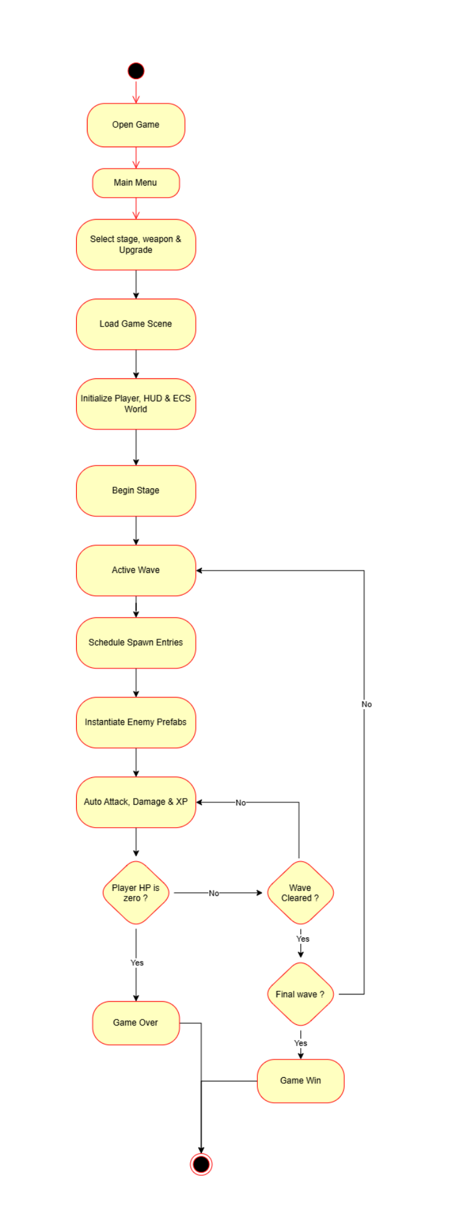
II. SYSTEM REQUIREMENTS ANALYSIS
6. Activity Diagram
The diagram follows the complete path from Main Menu to Stage Win or Game Over, including the repeated wave branch.
GD1305 • THE MOONSTONE
07
Notes:
[Sources]
- C:/Users/Vu Tien/Desktop/Project2_GD1305_Endless_Zombie_Report_EN.pdf (pages 13)

Slide 8
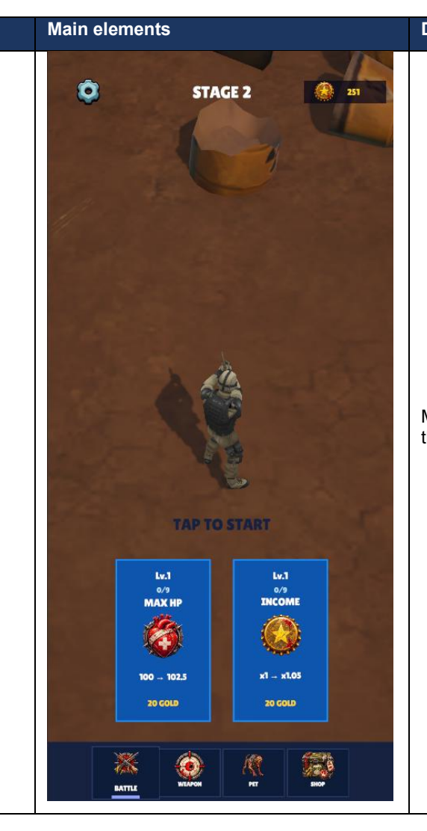
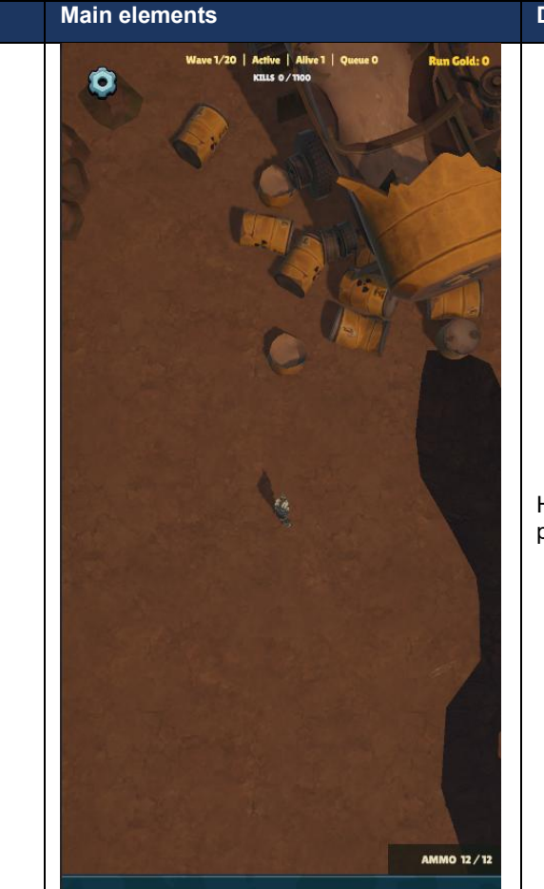
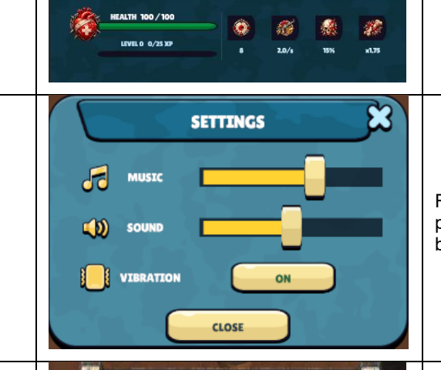
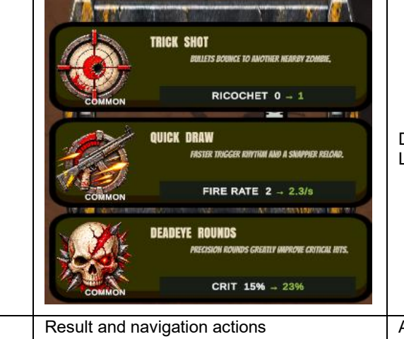
III. DETAILED DESIGN
1. UI Design
Settings Menu
Level Up Menu
MainMenuManager and HUDManager bind data and events; the Canvas prefabs own layout and remain editable in the Inspector.
Main Menu Canvas
Gameplay HUD
GD1305 • THE MOONSTONE
08
Notes:
[Sources]
- C:/Users/Vu Tien/Desktop/Project2_GD1305_Endless_Zombie_Report_EN.pdf (pages 14–15)

Slide 9
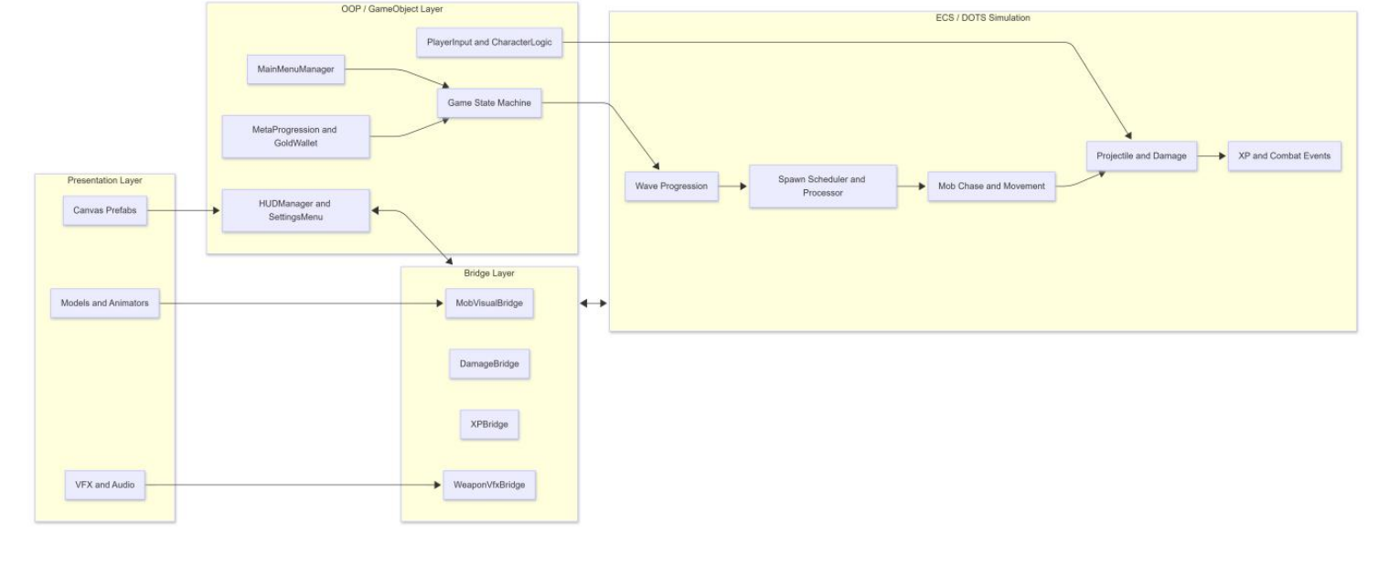
III. DETAILED DESIGN
2. Hybrid Architecture Diagram
GD1305 • THE MOONSTONE
09
Notes:
[Sources]
- C:/Users/Vu Tien/Desktop/Project2_GD1305_Endless_Zombie_Report_EN.pdf (pages 16)

Slide 10
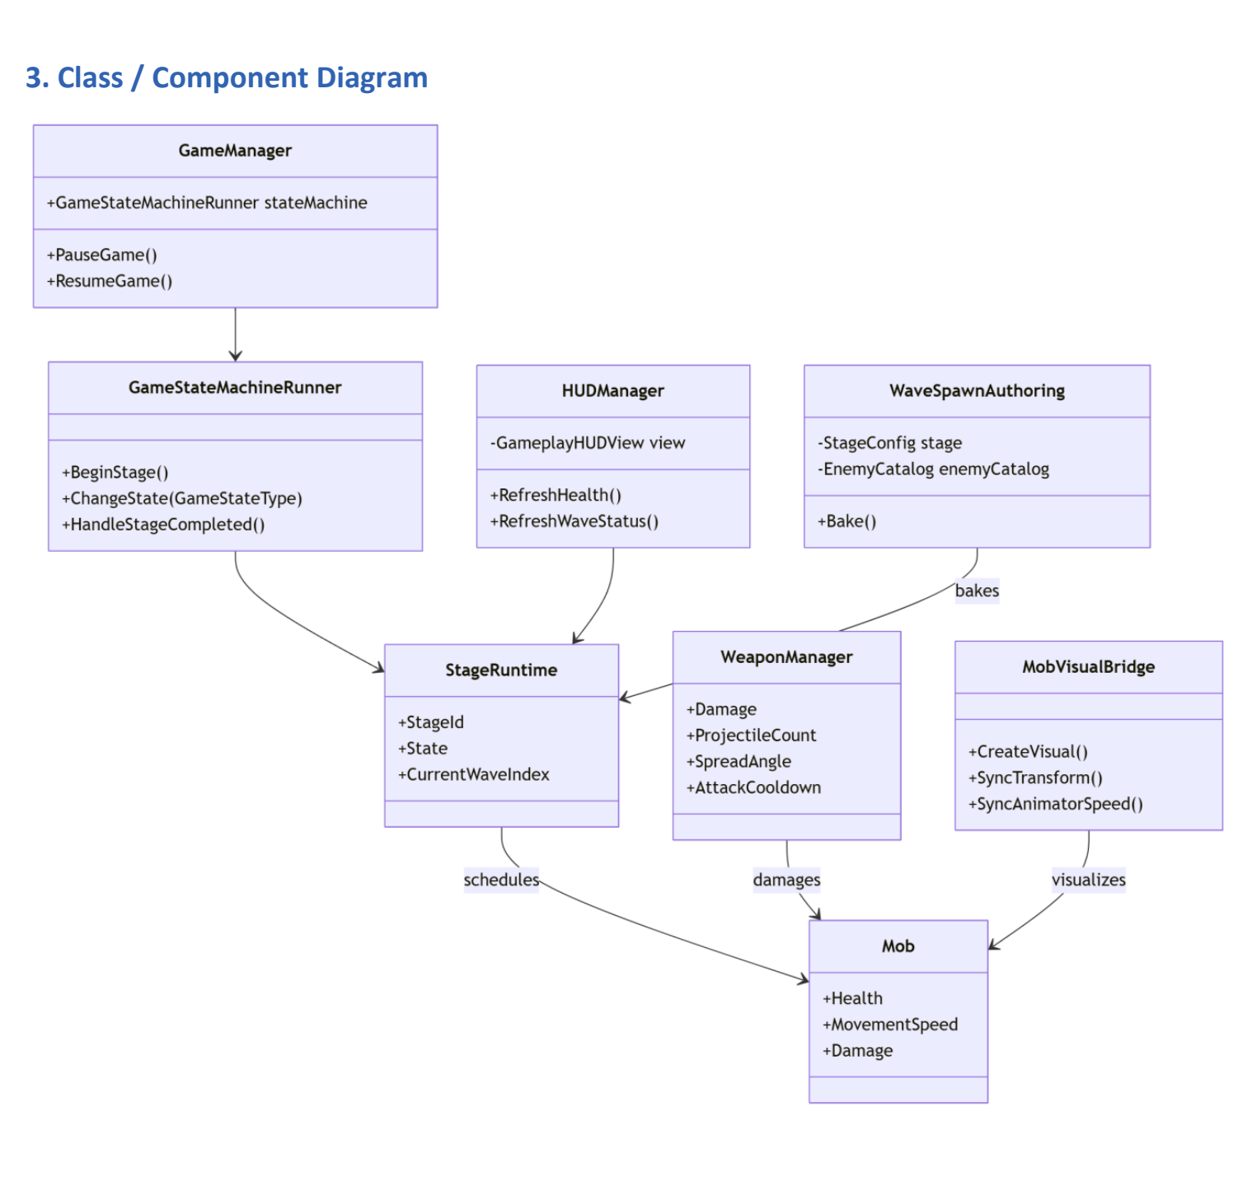
III. DETAILED DESIGN
3. Class / Component Diagram
GD1305 • THE MOONSTONE
10
Notes:
[Sources]
- C:/Users/Vu Tien/Desktop/Project2_GD1305_Endless_Zombie_Report_EN.pdf (pages 16)

Slide 11
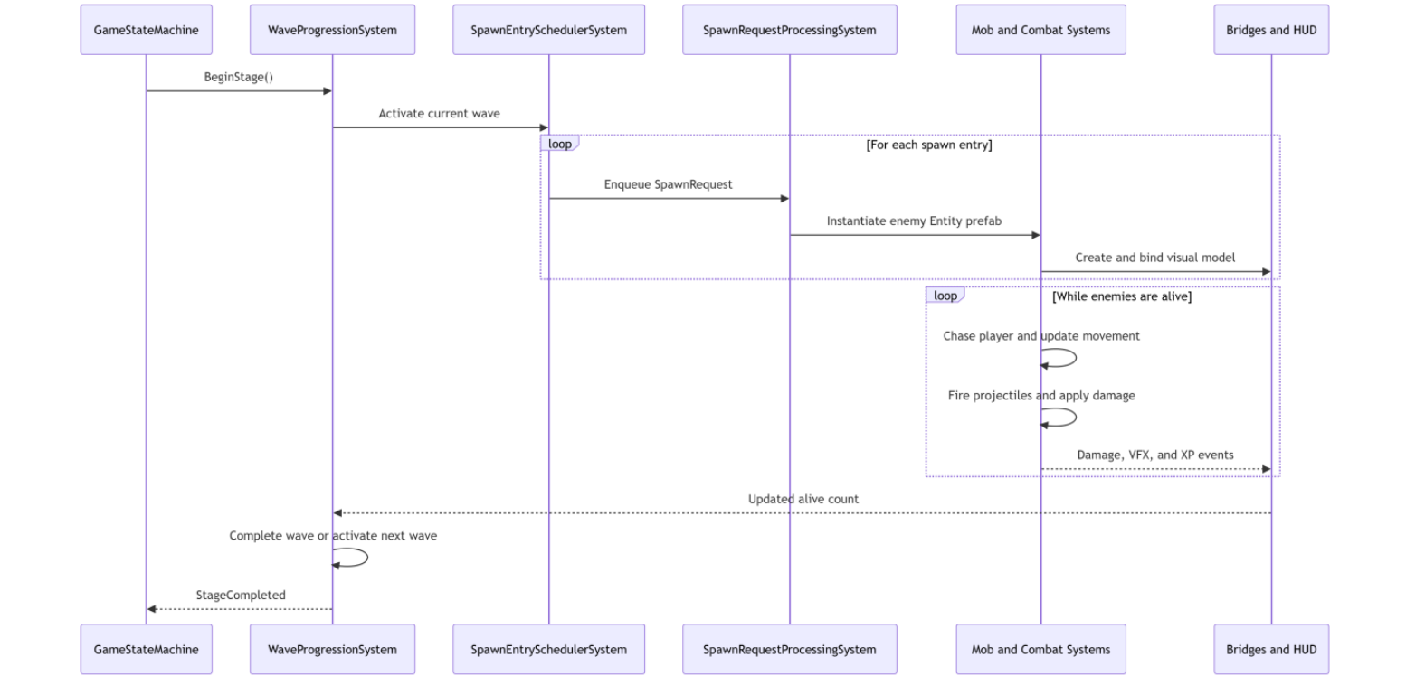
III. DETAILED DESIGN
4. Sequence Diagram
GD1305 • THE MOONSTONE
11
Notes:
[Sources]
- C:/Users/Vu Tien/Desktop/Project2_GD1305_Endless_Zombie_Report_EN.pdf (pages 17)

Slide 12
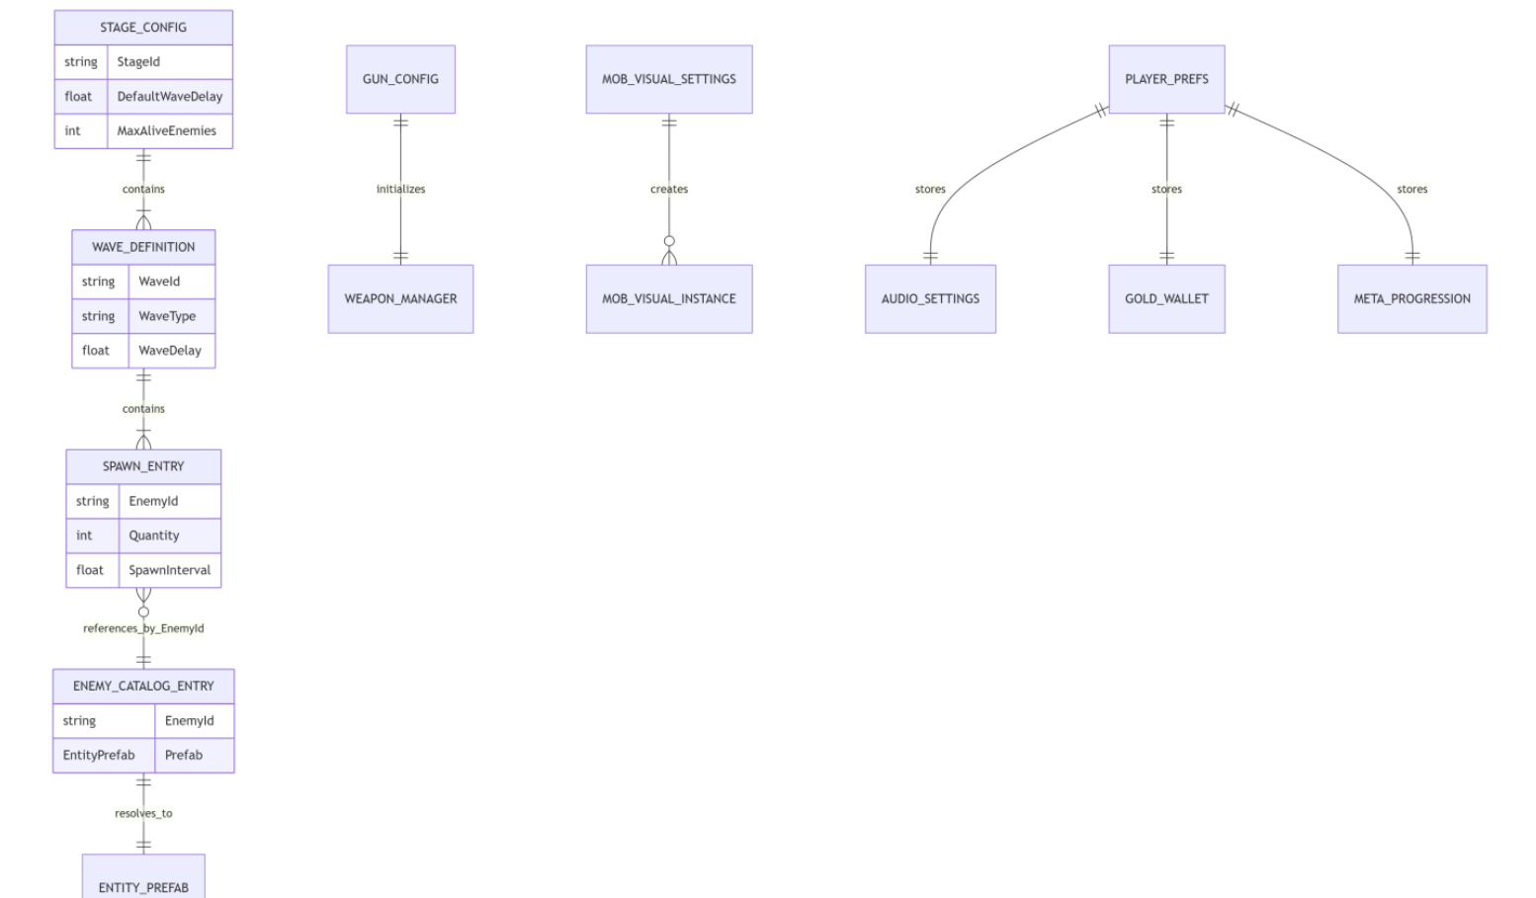
III. DETAILED DESIGN
6. Data Model
GD1305 • THE MOONSTONE
12
Notes:
[Sources]
- C:/Users/Vu Tien/Desktop/Project2_GD1305_Endless_Zombie_Report_EN.pdf (pages 17–18)

Slide 13
IV. TESTING
Static checks are complete; runtime evidence remains explicit
9
3
RUNTIME CHECKS
• Player movement
PASS — STATIC
PLAY MODE REQUIRED
• Enemy ground contact
• Pause and resume
ACCEPTANCE CRITERIA
• No compile errors
• No spawn-time visual flashing
• DogMutant speed stays synchronized
• Settings sliders remain clamped
• Final wave reaches a terminal state
GD1305 • THE MOONSTONE
13
Notes:
[Sources]
- C:/Users/Vu Tien/Desktop/Project2_GD1305_Endless_Zombie_Report_EN.pdf (pages 19)

Slide 14
V. TASK ASSIGNMENT
The work is divided across core systems, UI, and delivery
VU VIET TIEN
CHU VAN THAI
• Requirement analysis and architecture design
• OOP/ECS implementation support
• OOP/ECS gameplay, waves, combat, and XP
• Main Menu, HUD, and Settings Canvas
• Testing, bug fixing, and report writing
• Enemy and DogMutant visuals / animation
Final Play Mode regression remains pending before delivery.
GD1305 • THE MOONSTONE
14
Notes:
[Sources]
- C:/Users/Vu Tien/Desktop/Project2_GD1305_Endless_Zombie_Report_EN.pdf (pages 20)

Slide 15
VI. INSTALLATION INSTRUCTIONS
Build and verify the project on Android
1. PREREQUISITES
2. OPEN & RUN
3. BUILD AND TEST
• Unity Hub and Editor 6000.3.10f1
• Add project from disk
• Switch platform to Android
• Android Build Support
• Restore packages
• Add MainMenu and GameScene
• SDK, NDK, OpenJDK
• Open MainMenu.unity
• Configure Player Settings
• Android device or emulator
• Press Play and verify systems
• Build APK/AAB or Build and Run
Device verification must cover UI scaling, touch input, audio, wave spawning, and game states.
GD1305 • THE MOONSTONE
15
Notes:
[Sources]
- C:/Users/Vu Tien/Desktop/Project2_GD1305_Endless_Zombie_Report_EN.pdf (pages 21)

Slide 16
VII. CONCLUSION AND FUTURE DEVELOPMENT
The complete survival loop is in place
Stage entry, wave spawning, automatic combat, XP and upgrades, and Win / Game Over now operate within a hybrid Unity architecture.
BOSSES
PERFORMANCE
New archetypes and explicit attack states
Pooling, profiling, and GC reduction
DEPTH
QUALITY
More stages, weapon synergies, and progression
Automated Play Mode and accessibility tests
THE MOONSTONE • GD1305 CAPSTONE PROJECT
Notes:
[Sources]
- C:/Users/Vu Tien/Desktop/Project2_GD1305_Endless_Zombie_Report_EN.pdf (pages 21–22)

