Slide 1
Legen From Below
Class Name: GD1305
Group Name: The MoonStone
Members: Vũ Việt Tiến

Slide 2
OBJECTIVES
Project Introduction
Analyze System Requiments
Design Details
Test
Installation Instructions

Slide 3
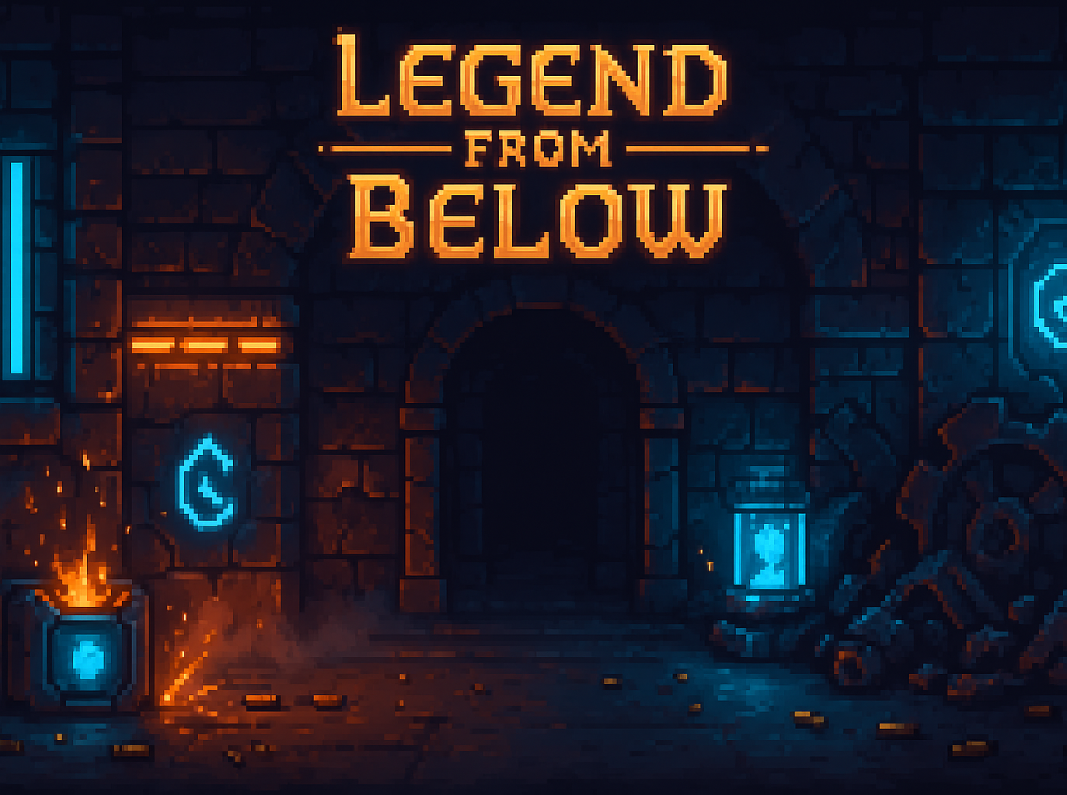
Project Introduction
Project Name: Legend From Below
Project Description:
Legend From Below is a dungeon shooter game inspired by Soul Knight, developed using Unity.
Story: A mysterious warrior awakens in an unknown underground dungeon filled with enemies and traps.
Objective: Survive, fight through multiple dungeon levels, and conquer the depths.
Gameplay: fast-paced combat, dodge rolls, random chests, and resource management.

Slide 4
Project Introduction
Core Gameplay
Player must dodge enemy bullets using roll mechanics.
Collect and switch weapons dynamically.
Clear rooms to progress through dungeons.
Treasure chests may appear randomly after clearing a room.
Six dungeon levels, each with unique enemies and challenges.

Slide 5

Project Introduction
Development Tool
Tool | Purpose
Unity 6000.0.58f | Core Game engine
Visual Studio Code | Scripting C#
Aseprite | Sprite and Animation Design
GitHub | Version Control

Slide 6
II. ANALYZE SYSTEM REQUIREMENTS
System Overview
The game is structured into three main modules:
Player Control Module
Handles movement, rolling, shooting, and weapon switching.
Enemy Spawner Module
Manages spawning logic, kill counts, and room-clear events.
Dungeon Builder Module
Constructs interconnected rooms and manages spawn points.

Slide 7
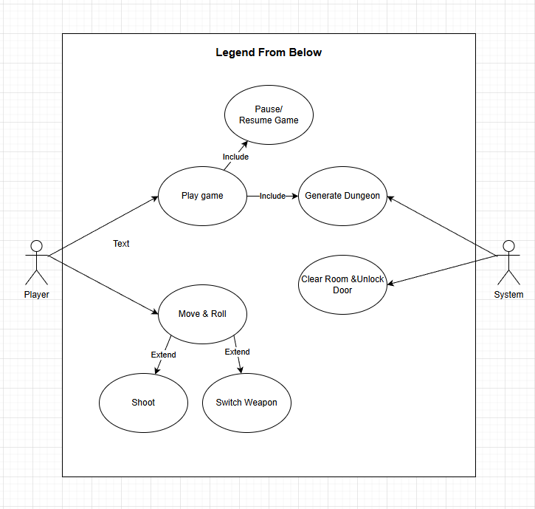
II. ANALYZE SYSTEM REQUIREMENTS
Use Case

Slide 8
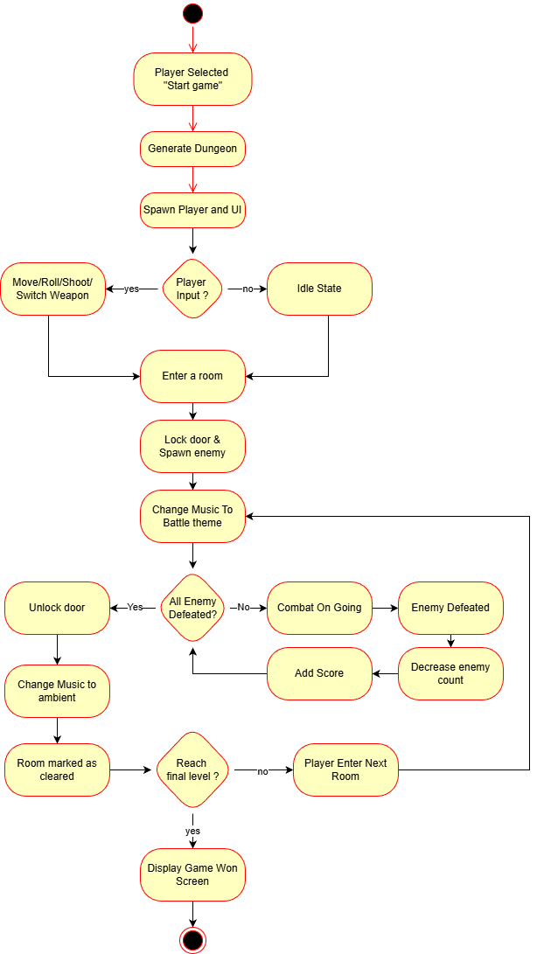
II. ANALYZE SYSTEM REQUIREMENTS
Activity Diagram:

Slide 9
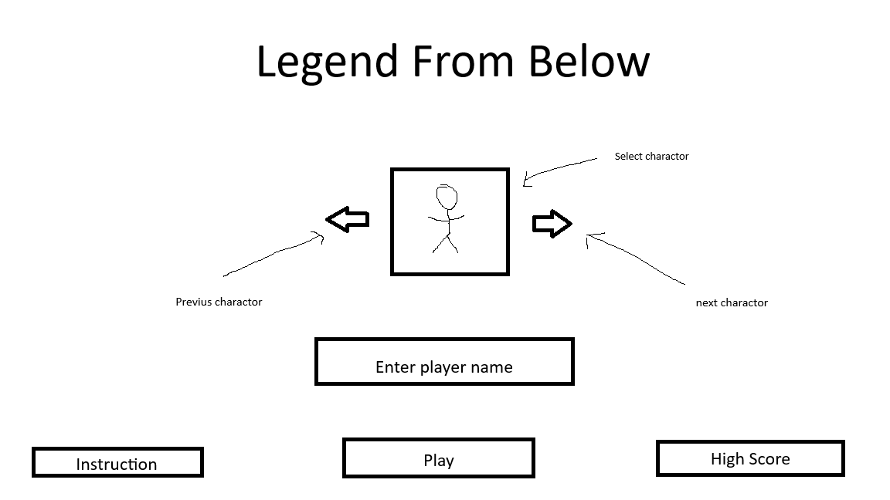
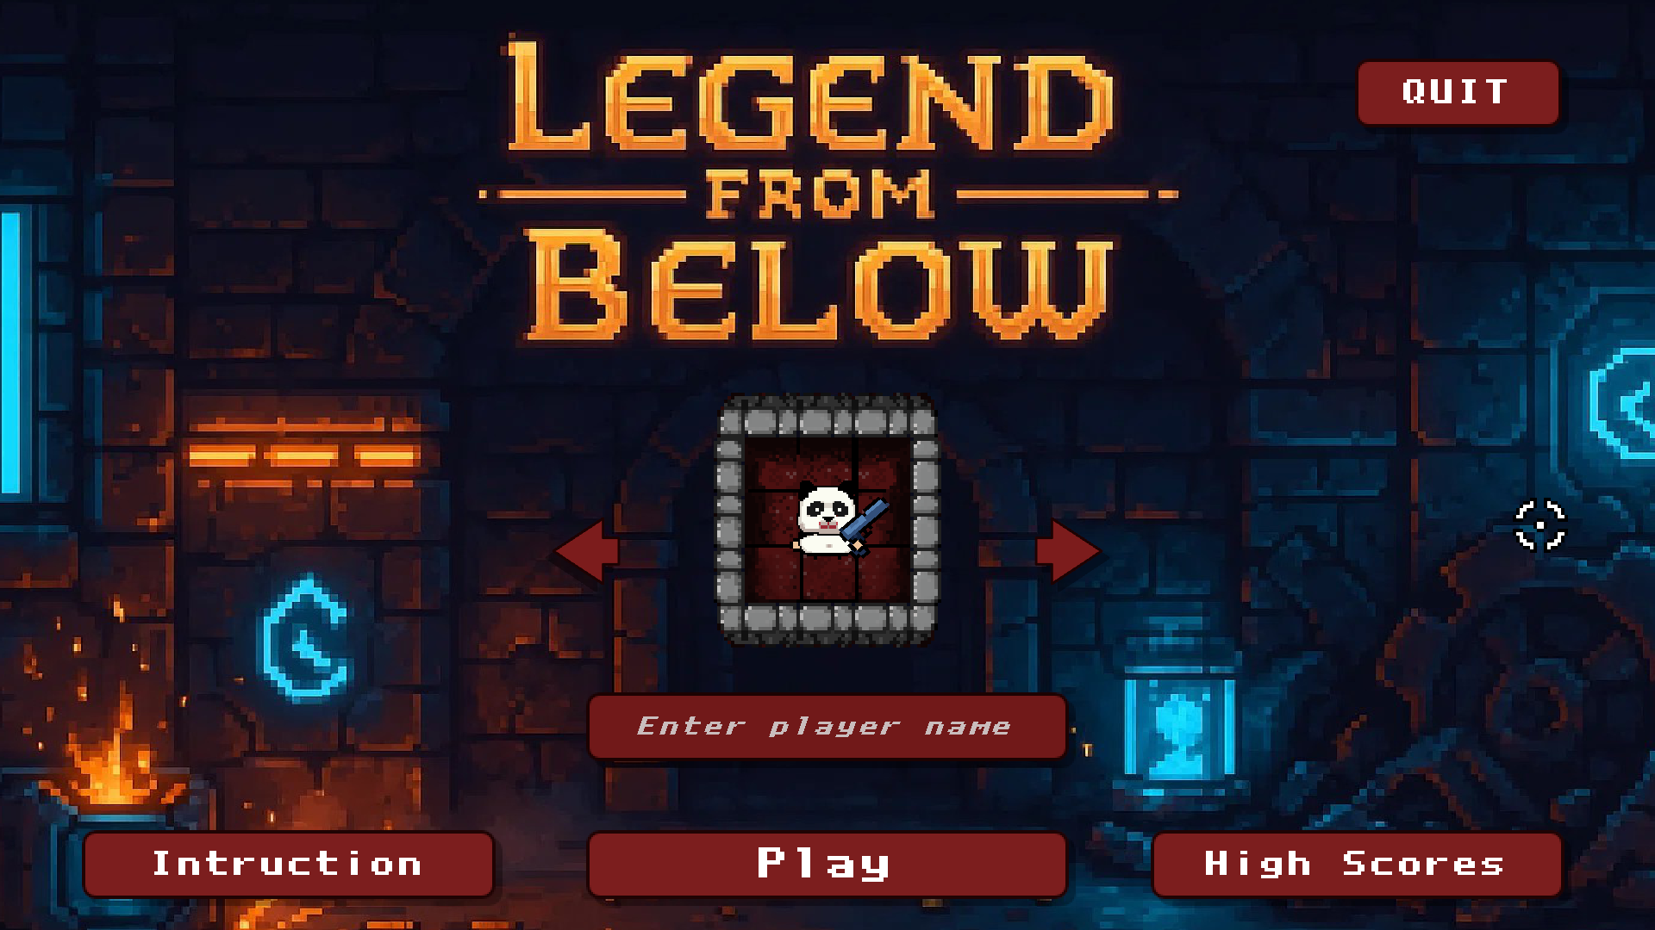
III. DESIGN DETIAL
Menu

Slide 10
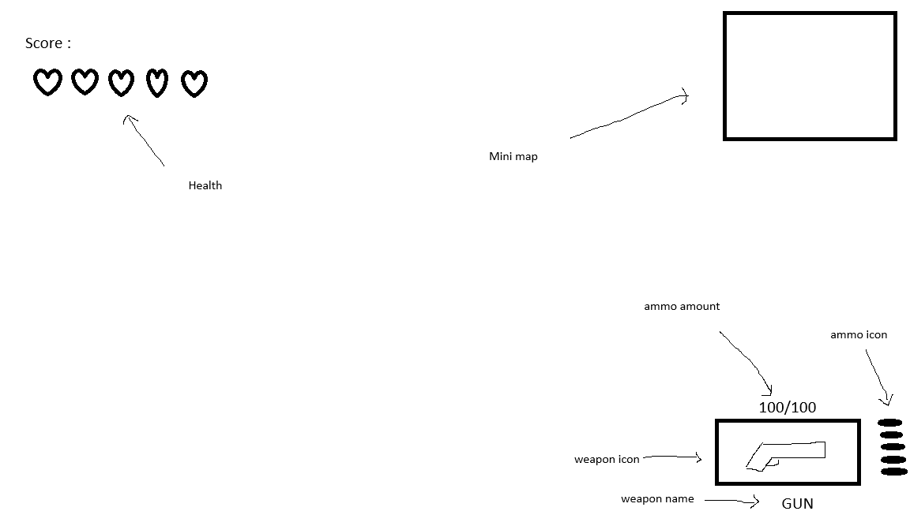
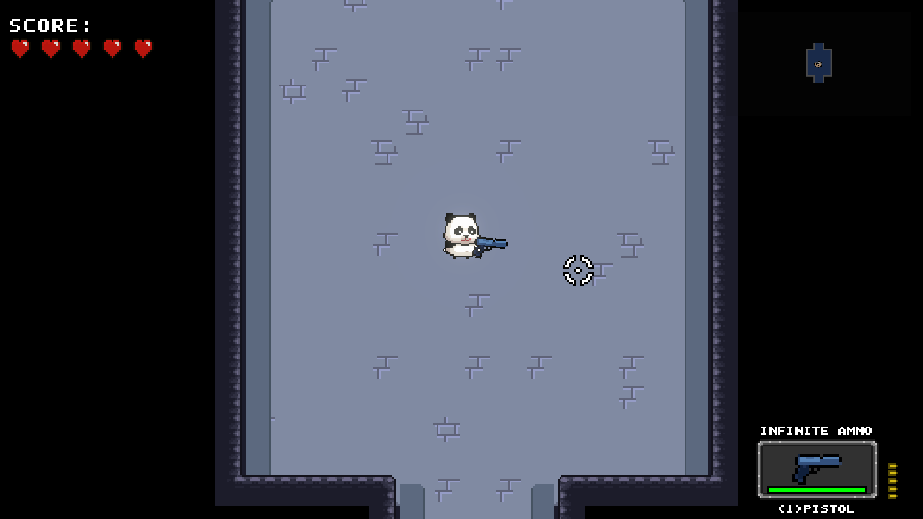
III. DESIGN DETIAL
In Game

Slide 11
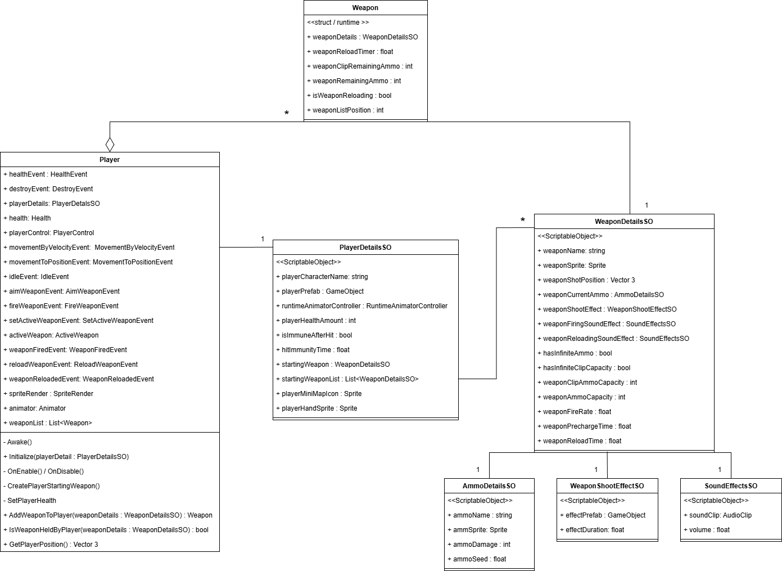
III. DESIGN DETIAL
Class Diagram

Slide 12
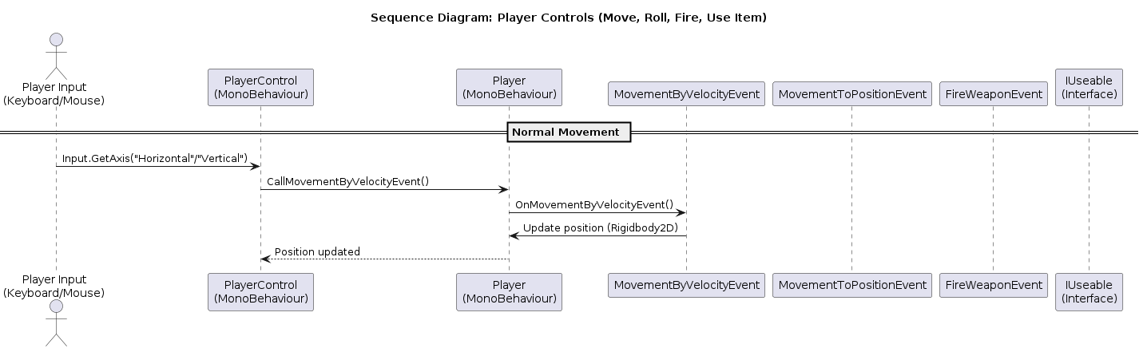
III. DESIGN DETIAL
Sequence Diagram
- Movement

Slide 13
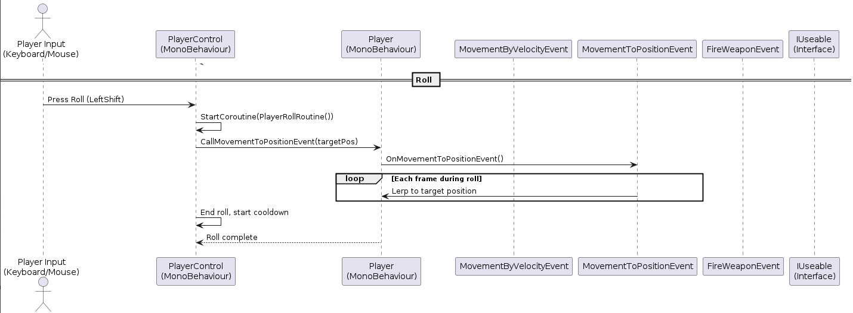
III. DESIGN DETIAL
Sequence Diagram
- Roll

Slide 14
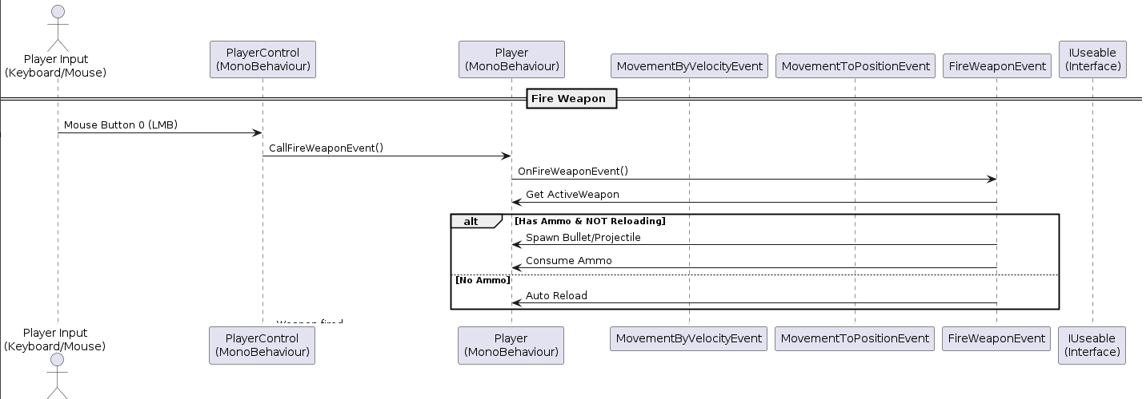
III. DESIGN DETIAL
Sequence Diagram
- Fire Weapon

Slide 15
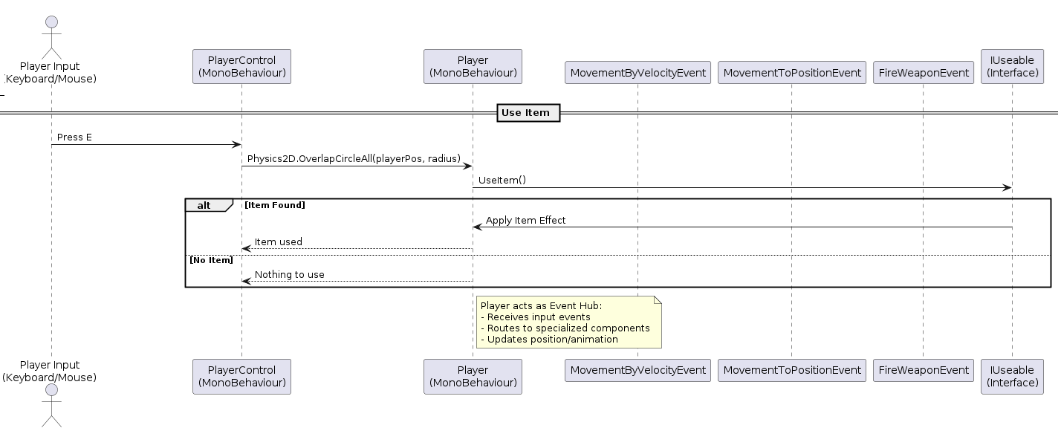
III. DESIGN DETIAL
Sequence Diagram
- Use Item

Slide 16
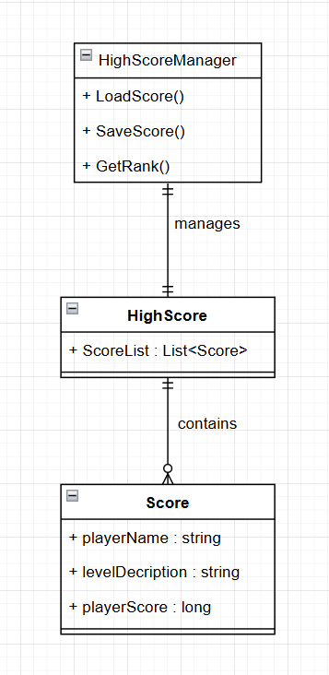
III. DESIGN DETIAL
Database Design
Entity Relationship Diagram
HighScoreManager: manages score persistence. Data Storage: .dat binary file using BinaryFormatter. Structure:
HighScoreManager → Controller
HighScore → Entity
Score → Records with playerName, levelDescription, playerScore.

Slide 17
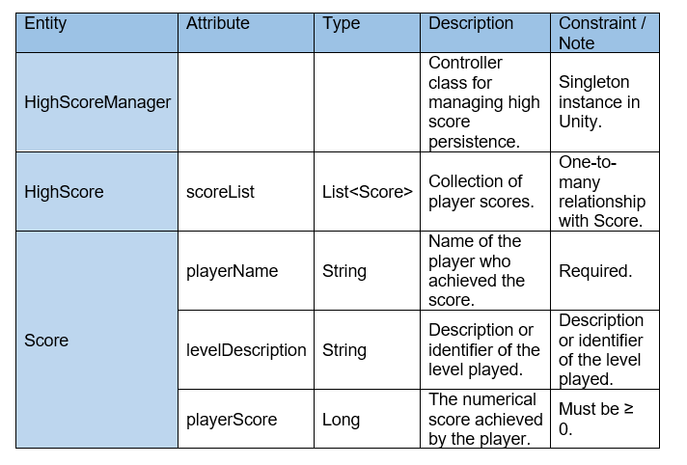
III. DESIGN DETIAL
Database Design
Database Design Detail :

Slide 18
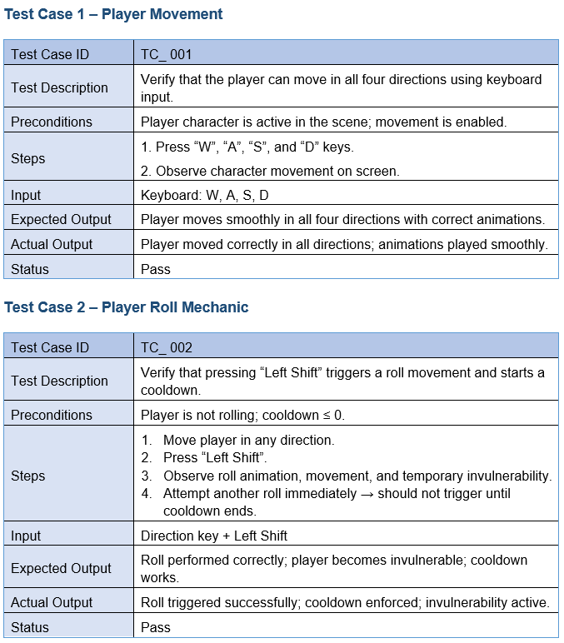
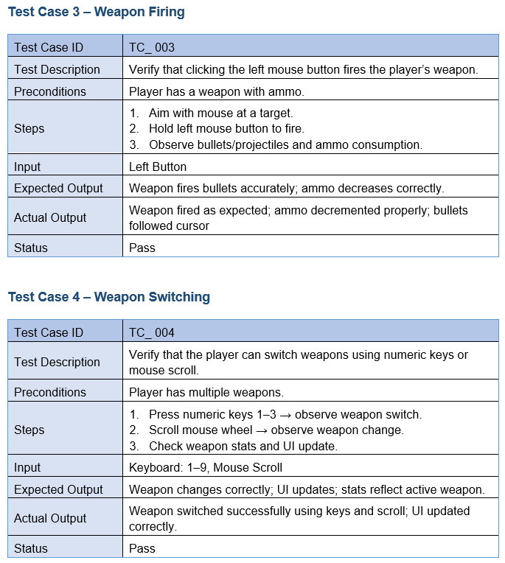
IV. TEST

Slide 19
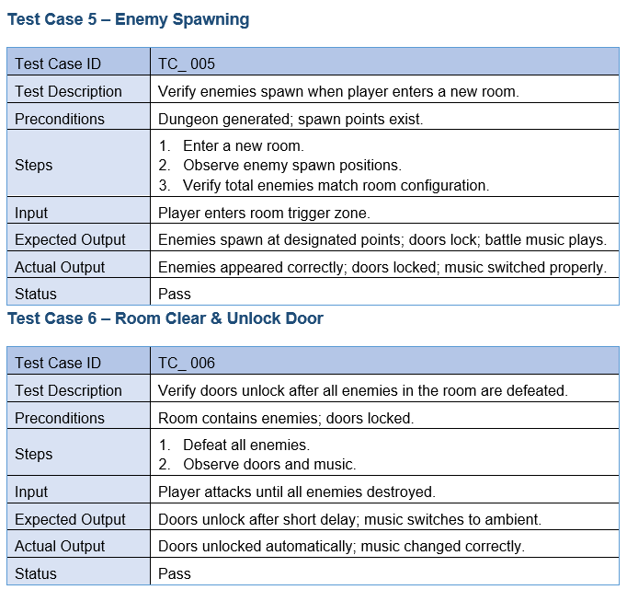
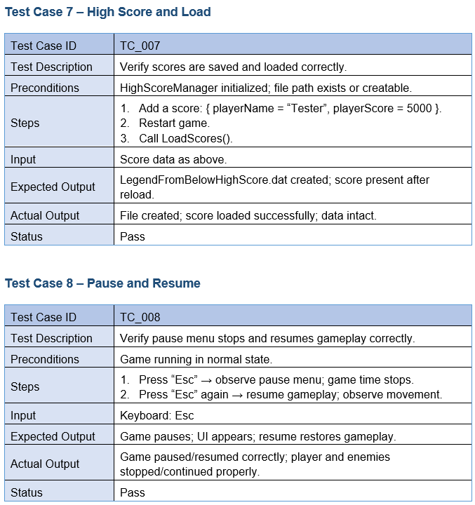
IV. TEST

Slide 20

V. Installation Instructions
PREREQUISITES
Unity Hub – Download
Unity Editor 6000.0.58f or later (LTS)
Git (Optional, for version control)
INSTALLATION STEPS
Step 1: Clone or Download Project
Git clone https://github.com/Vutien1406/Assignment/settings
Or Download ZIP :
Step 2: Open in Unity Hub
Open Unity Hub
Click "Add" → Select project folder
Choose Unity 6000.0.58f
Click "Open"
Step 3: Build and Run
Platform: PC
Target: Windows
Click Build → Choose folder
Run .exe

Slide 21


Slide 22
Q & A

