Slide 1
PEDAC1
Sam Chung, Tyler Maklebust, Wan Kim,
CJ Cummings, Mark Velez

Slide 2
Overview
Software Engineering CSE 435
Michigan State University
Fall 2016
Team Members:
Project Manager: Sam Chung
Project Facilitator: Tyler Maklebust
Customer Liaison: Wan Kim
Configuration Manager: Mark Velez
Security/Safety Expert: CJ Cummings
Client:
Mr. David Agnew
Professor:
Dr. Betty H.C. Cheng

Slide 3
Project Overview
Autonomous driving systems
Must exhibit basic driving capabilities
Stay in lane
Brake at intersections
Remain in control during maneuvers
PEDAC
Implemented in fully autonomous vehicles
Avoids collisions with pedestrians
Minimizes the time lost while doing so

Slide 4
Motivation
This type of system is required with a vehicle that is fully autonomous
Ensuring safety
All pedestrian collisions must be avoided
Maximizing efficiency
Measured by time lost from avoiding any collisions
Avoiding collisions while minimizing time lost

Slide 5
Features
Uses camera sensor output to determine if a pedestrian collision is possible
If a possible collision is detected, speed is reduced enough to maintain a safe stopping distance
Minimum deceleration amount needed is calculated in order to reduce time lost and increase efficiency

Slide 6
Domain Research
Investigated technology used in avoiding collisions in autonomous vehicles
Toyota Automatic Pedestrian Collision Avoidance

Slide 7
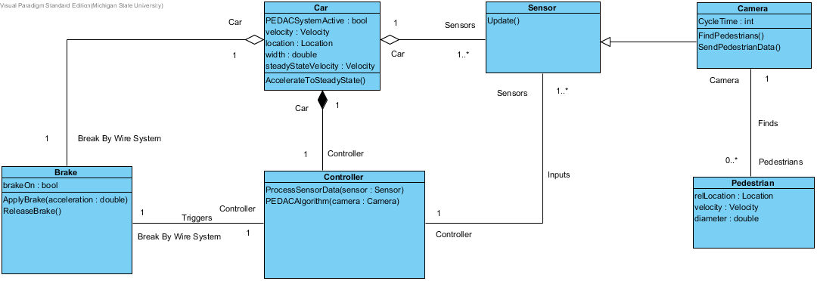
CLASS DIAGRAM

Slide 8

Demonstration
http://www.cse.msu.edu/~cse435/Projects/F2016/Groups/PEDAC1/web/prototype.html

Slide 9
Acknowledgements
We gratefully acknowledge and appreciate the participation of our customer, Mr. David Agnew from Hyundai Mobis NA
Special thanks to Dr. Betty Cheng

