Slide 1

React & Typescript

Slide 2
Agenda
Statefull & Stateless
Lifecycle
Hook

Slide 3
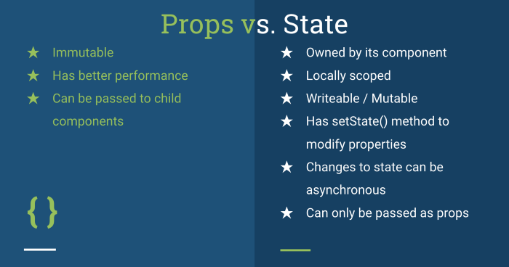
Statefull & Stateless
Notes:
https://medium.com/@cgcrutch18/stateful-vs-stateless-react-components-13f647f7fc4

Slide 4
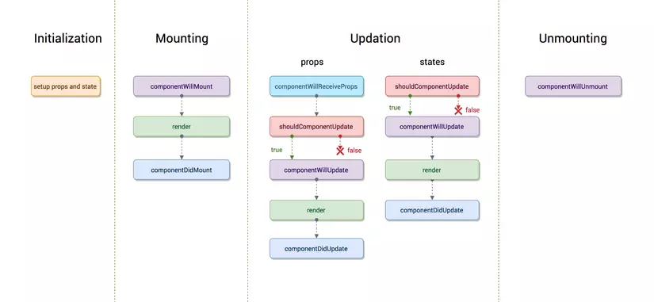
Lifecycle

Slide 5
Hooks
They let you use state and other React features without writing a class
useState
useEffect
…

Slide 6
Resources
https://github.com/tiepnx/learning
https://react-typescript-cheatsheet.netlify.app/docs/basic/setup

Slide 7

Thank you

