Slide 1
☄ METEOR
Multi-task Estimation of Traffic Elements, Objects & Roads
From Raw Surround-View Recordings to a Seven-Task Driving Network
without Human Labels or Human-Written Code
Dan Umeda — TIER IV, Inc.
Built on CoMET, the autolabeling foundation of the Co-MLOps project
github.com/tier4/METEOR · NVIDIA GTC 2026 (S81897)

Slide 2
The problem: perception is built one labeling campaign at a time
• Every task needs its own annotation effort — boxes, masks, lanes, occupancy…
• Labeling is the dominant cost, and every new task restarts the cycle
• Meanwhile, fleets already record everything: 8 cameras + LiDAR + cm-level ego-motion
– these raw recordings implicitly contain almost everything the labels would say
What if we never labeled — and never even wrote the code?

Slide 3
The recipe
Record everything → autolabel everything → train one network
• Input: raw Co-MLOps DRS recordings (8 synchronized cameras, LiDAR, ego-pose,
– machine-generated 2D panoptic labels) — https://co-mlops.tier4.jp/
• CoMET autolabel foundation → factory distills SEVEN supervision signals, zero humans
• One camera-only network learns all seven tasks jointly (no LiDAR at inference)
• Hard constraint: TensorRT-safe operators only — deployable as-is
• Second constraint (an experiment): all code written by an LLM agent, Claude Fable 5

Slide 4
Seven tasks, one forward pass
# | Task | Output | Head cost
1 | BEV lane segmentation | 9 cls · 160×100 m @0.2 m | 1.2 M / 933 G
2 | Metric depth | 64 bins × 8 cams | 3.3 M / 1093 G
3 | 3D oriented boxes | vehicles + VRU | 0.4 M / 82 G
4 | 2D segmentation | 21 classes × 8 cams | 4.2 M / 219 G
5 | 2D detection | 10 classes · 3 scales | 2.9 M / 219 G
6 | E2E driving | 3 s path + steer/accel/brake | 4.0 M / 37 G
7 | 3D occupancy | 10 cls · 16×200×200 @0.4 m | 0.7 M / 55 G
38.3 M params
3.1 TFLOPs @ 8×768×432
adding a task costs < 5%

Slide 5
The autolabel factory
10 stages per scene · resumable · runs concurrently with training
• BEV lanes — LiDAR × panoptic accumulated in the map frame → vectorized polylines
• Metric depth — LiDAR splats + interpolation inside merged road+paint segments
• 3D boxes — LiDAR annotations kept only when geometrically camera-confirmed
• 2D seg (21 cls) & 2D boxes (10 cls) — CSV-driven taxonomies from panoptic masks
• E2E targets — trajectory / steering / accel / brake from ego-pose alone (no CAN)
• 3D occupancy — multi-sweep labeled LiDAR + ray-carved free space
– quality gates: scene-end trim · stationary-spot filter · indoor rejection · intersection guard

Slide 6
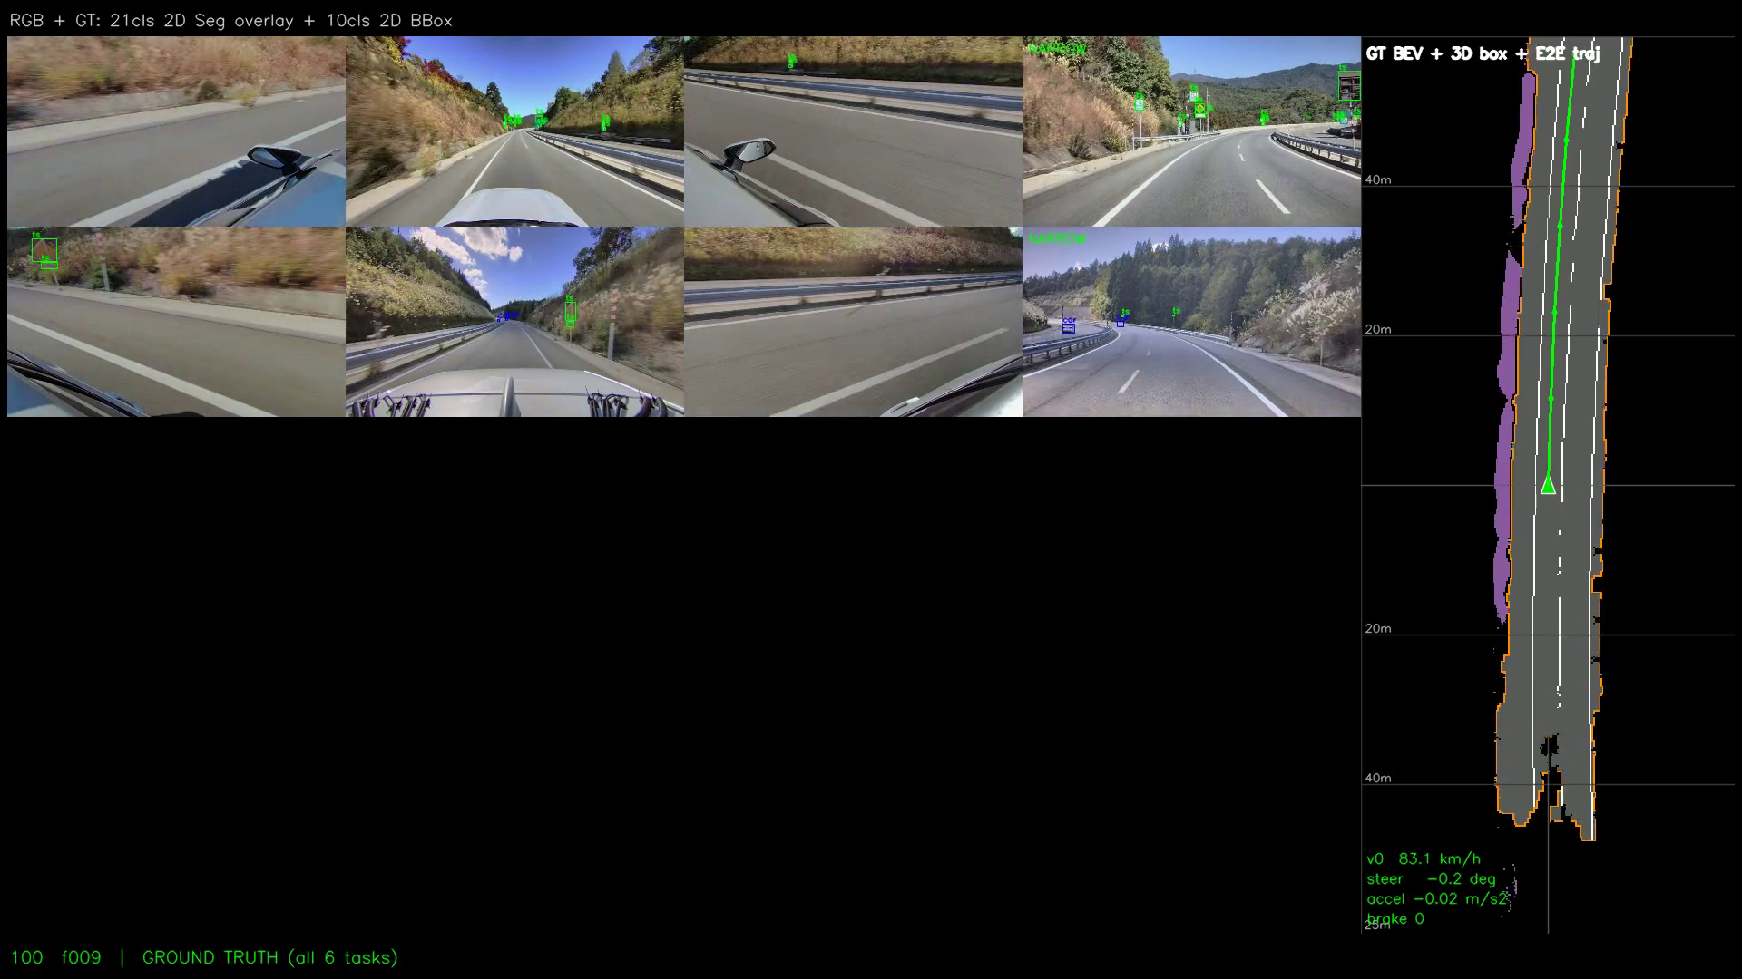
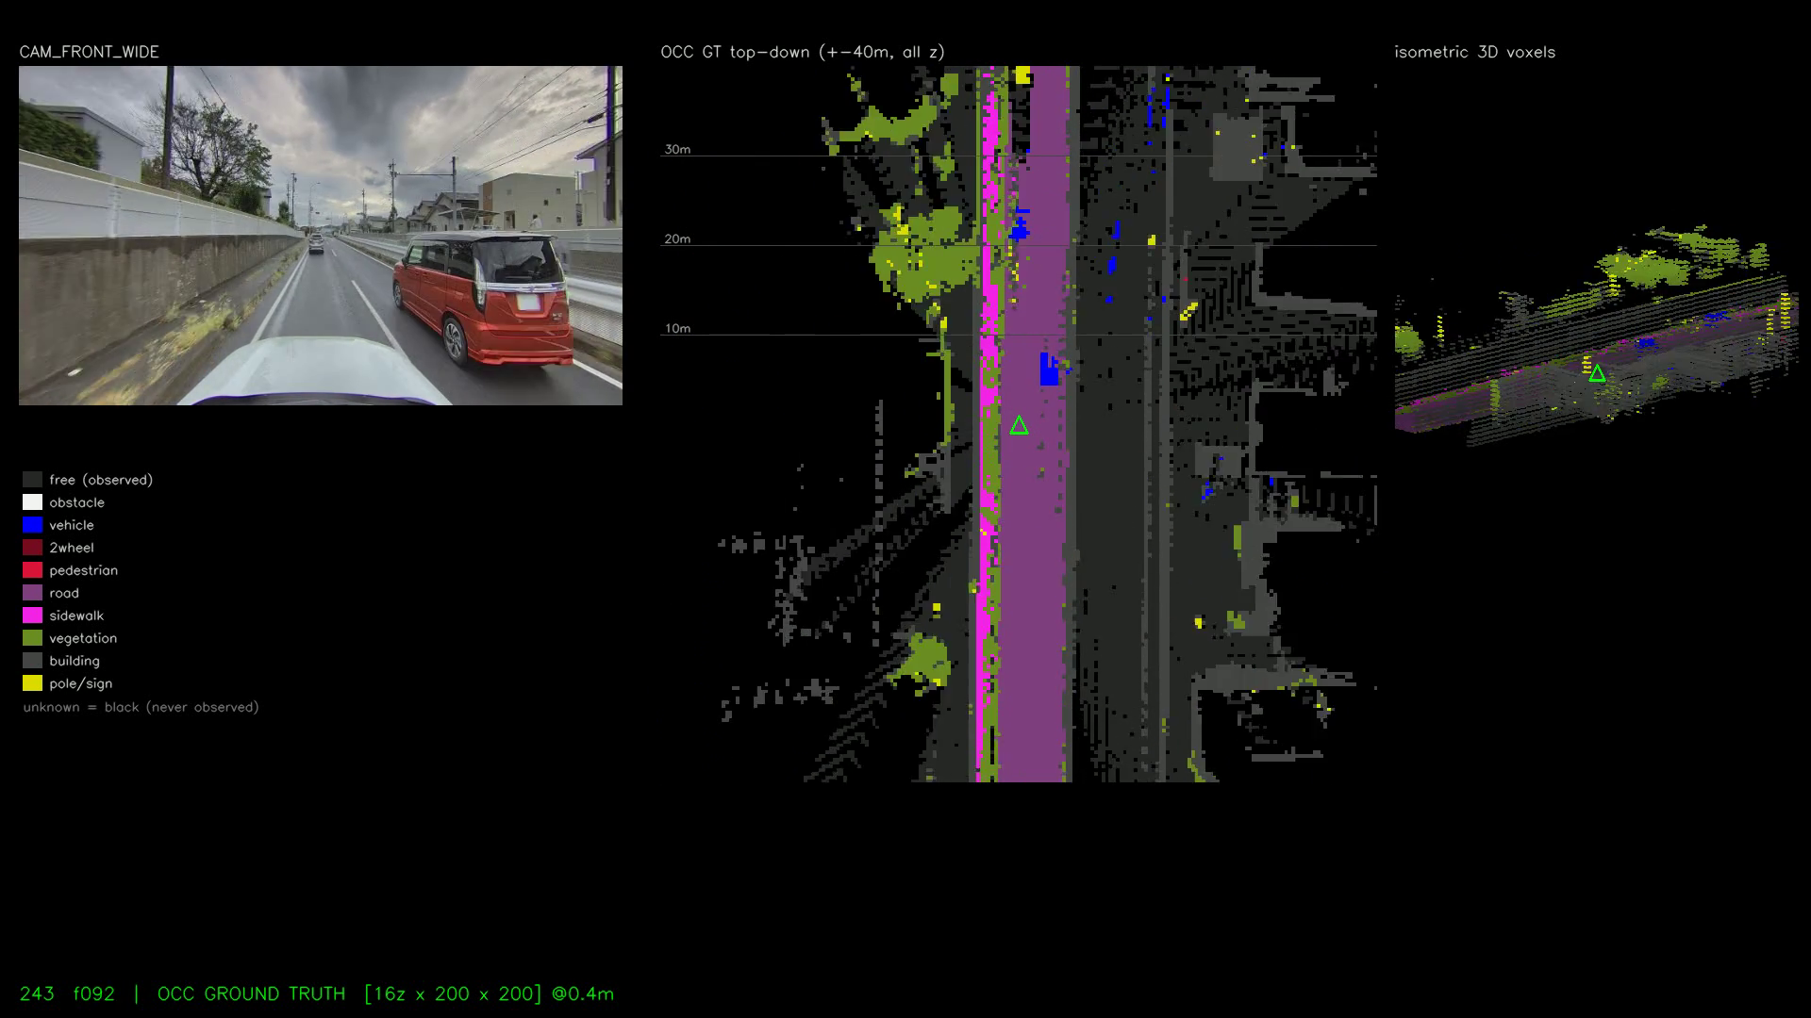
Ground truth, entirely machine-made
✓ 21-class 2D seg
✓ 10-class 2D boxes
✓ oriented 3D boxes
✓ BEV lanes
✓ E2E trajectory + controls
✓ 3D occupancy (top + iso)
0 boxes drawn by humans

Slide 7
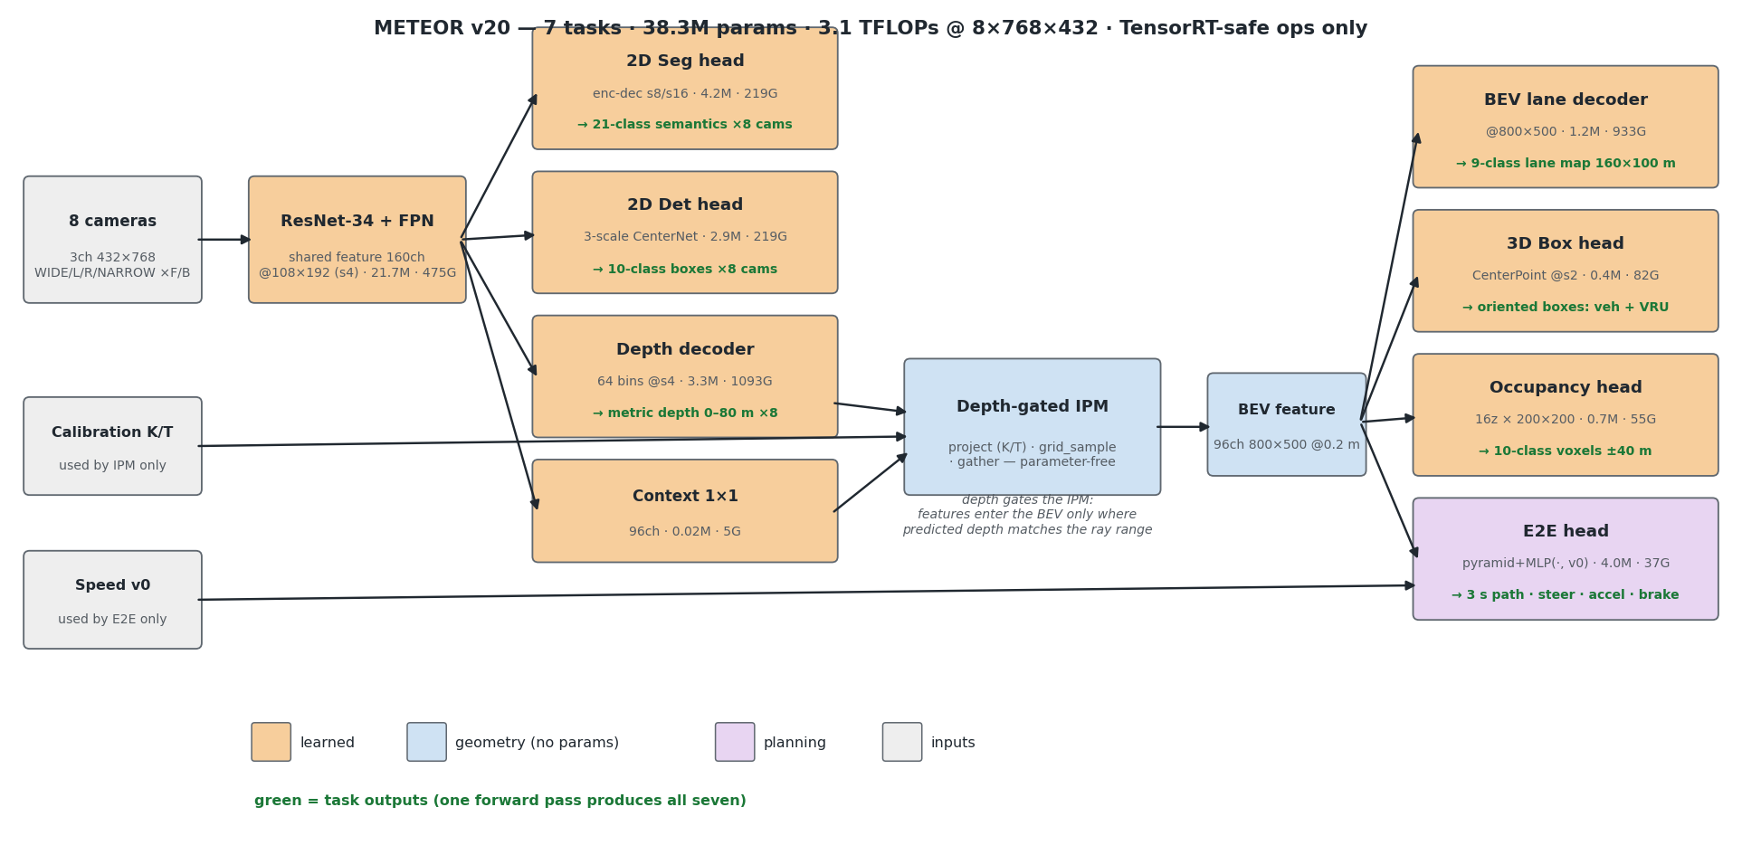
Architecture

Slide 8
Depth-gated IPM
depth as a visibility valve for geometric projection
• Project BEV ground points into every camera with calibrated K/T
• grid_sample context features and the predicted depth distribution
• gather the depth probability at each point's true range:
– w = P(depth = range) + 0.05 → features flow only where depth agrees
• Weighted average over 8 cameras → 96-ch BEV feature (800×500 @ 0.2 m)
• Parameter-free · pull-based (LSS inverted: gather, not scatter) · no attention
– suppresses occlusion bleed-through that plagues plain IPM; exports to TensorRT unchanged

Slide 9
Design rule: parameters at low resolution, compute at high resolution
• Naive stride-4 conv heads = worst FLOPs/params corner
• 2D heads redesigned: heavy channels at s8/s16, 1×1 laterals touch s4
– 18× more parameters for ~2× FLOPs
• Result (one round): 2D-seg mIoU 0.375 → 0.451, pole IoU 0.244 → 0.449
• 3-scale detection (YOLO-style size assignment) turned on small classes:
– traffic lights, distant signs, cones — previously never fired
• Model total: +37% params for +10% FLOPs

Slide 10
Rolling rounds
conversion, GT refinement and training run concurrently
Round | Date | Change | BEV mIoU
r2 | 07-11 | 4-task baseline | 0.283
r4 | 07-12 | + new-vehicle data | 0.286
r5 | 07-12 | + 2D detection (v17) | 0.286
r7 | 07-12 | + E2E head (v18) | 0.287
r8 | 07-12→13 | capacity re-balance (v19) | 0.292
r9 | 07-13 | + occupancy, curve-weighted E2E (v20) | 0.290
r10 | 07-13 | small-object / near-VRU / side-cam weights | running
9 rounds
4 new heads
3 days

Slide 11
Fix what you can measure
every loss correction started as a quantified failure
• E2E learned to go straight: 83% of frames near-straight, lon/lat scale 18×
– curve ADE 2.29 m vs 0.62 m straight — invisible in aggregate ADE
– fix: lateral L1 ×4 + curvature sample weight → curve ADE 2.31 → 1.07 → 0.72 m
• Thin classes vanished from GT: lane line ≈ 0.3 px after 4× downsample
– fix: coverage-based rasterisation (+49% lane pixels, connected dashes)
• Small objects silently truncated: box budget 32 dropped 29% of annotations
– fix: budget 96 + per-class positive weights → cones / lights / unknowns detected
• NaN-safe aux losses: all-ignore batches return a graph-preserving zero

Slide 12
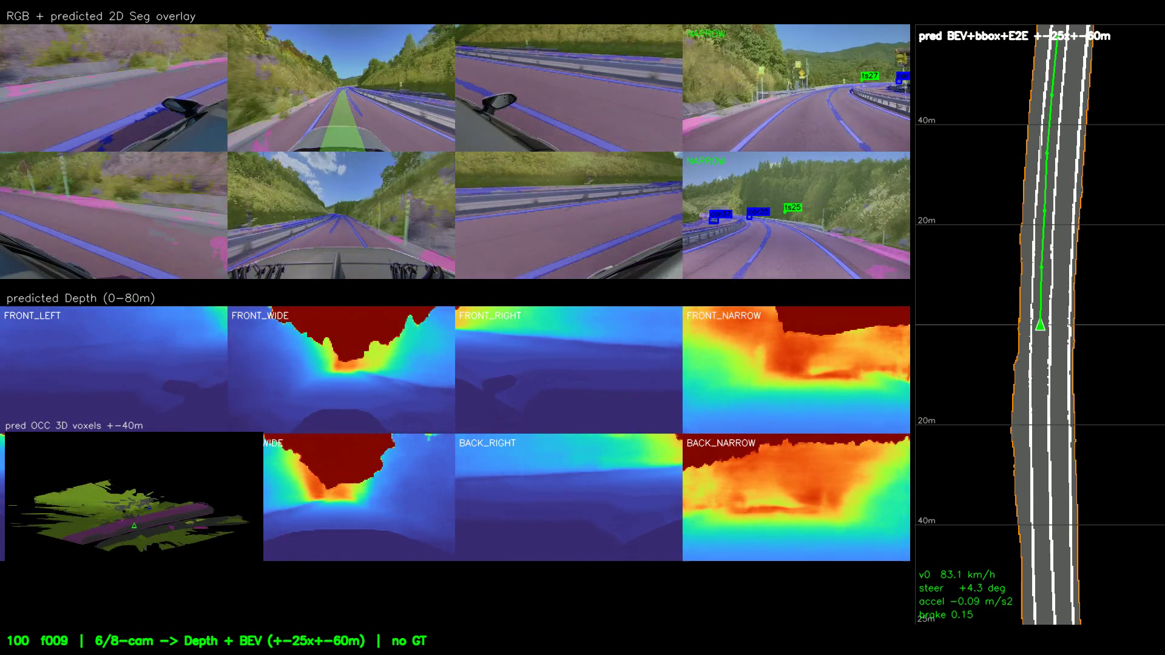
Results
held-out recording · zero human labels
Metric | Value
BEV lane mIoU | 0.292
2D segmentation mIoU (21 cls) | 0.451
Depth MAE (0–80 m) | 1.60 m
E2E ADE / FDE (3 s) | 0.76 / 1.65 m
E2E curve ADE (|lat|>2 m) | 0.72 m
Steering MAE / brake acc. | 0.027 rad / 0.81
Occupancy road IoU (0–40 m) | 0.63–0.64

Slide 13
Zero human-written code
the second automation axis
• Every artefact — 10 GT extractors, 20 model variants, trainer, demos, docs,
– the paper, this deck — written by Claude Fable 5 (Anthropic), autonomously
• Humans: ~70 natural-language instructions + review of videos & metrics
• Agent: design, implementation, launches, monitoring, diagnosis, iteration
– several fixes originated from the agent's own measurements (e.g. box-budget analysis)
• Division of labour: humans specify WHAT · the agent implements and explains HOW
– cadence: nine training rounds and four new task heads in three days

Slide 14
Takeaways
• Fleet recordings already contain the labels — a factory can extract all of them
• One shared BEV representation carries seven tasks; new tasks cost <5%
• Deployment constraints (TensorRT ops) and capacity rules are design inputs, not afterthoughts
• Measure per-condition (curves, ranges, classes) — aggregates hide the failures that matter
• LLM agents can own the full engineering loop when the metrics are automated
a task used to cost a labeling campaign — now it costs a prompt and a GPU-day

Slide 15
☄ METEOR
github.com/tier4/METEOR
paper · code · docs · demo videos — all in the repository
Co-MLOps: https://co-mlops.tier4.jp/
NVIDIA GTC 2026 session S81897
Labels by machines. Code by Claude Fable 5. Direction by humans.

