Slide 1
„Let‘s Chat“ Chat Server & Client
Alina Aldea, Joffrey Schneider
Cloud Computing WS18/19

Slide 2
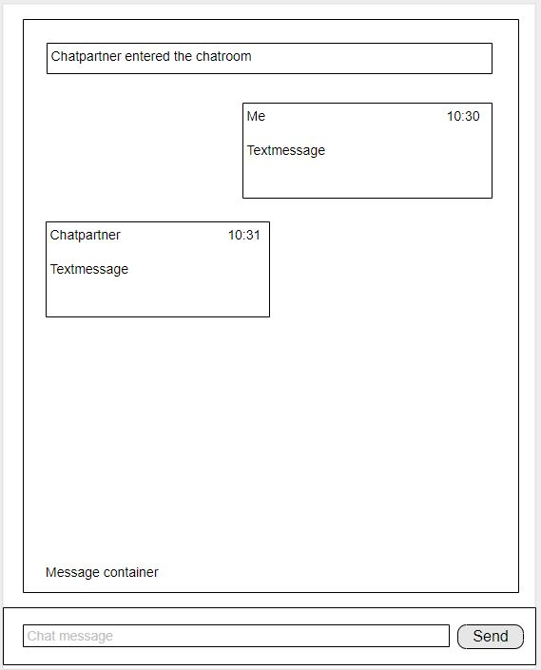
Mockup

Slide 3
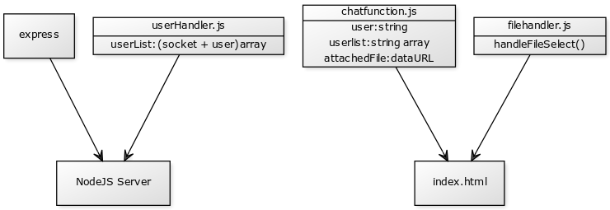
Component Diagram

Slide 4
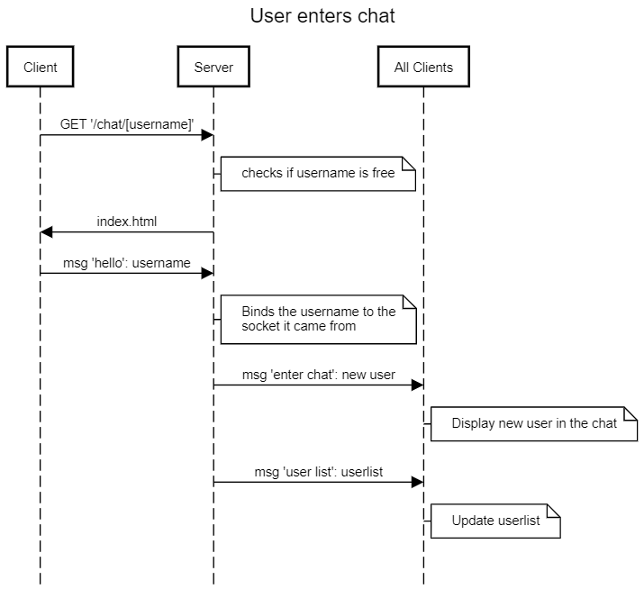
Sequence Diagram

