Slide 1
„Let‘s Chat“ Chat Server & Client
Alina Aldea-Ionescu
Joffrey Schneider
Cloud Computing WS18/19

Slide 2
Lesson learned
At first, it was difficult to understand how to communicate with the server to transport and handle information correctly.
A chat message in „Let‘s Chat“ is built by the following object structure:
var msg = {
recipient,
sender,
time,
text,
file
};
So we can send everything at once as a single object.

Slide 3
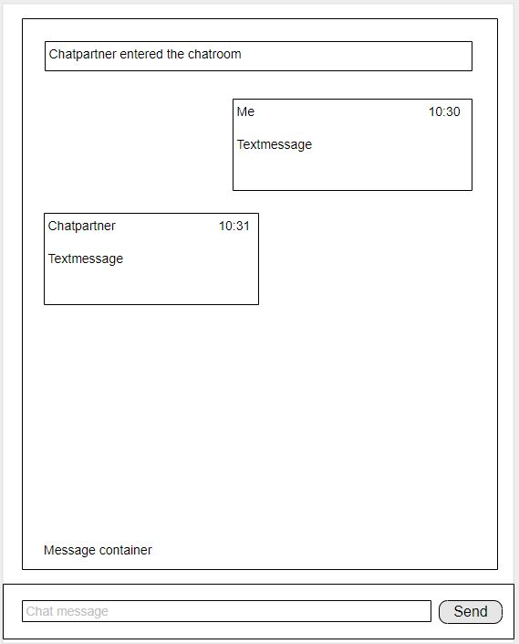
Mockup

Slide 4
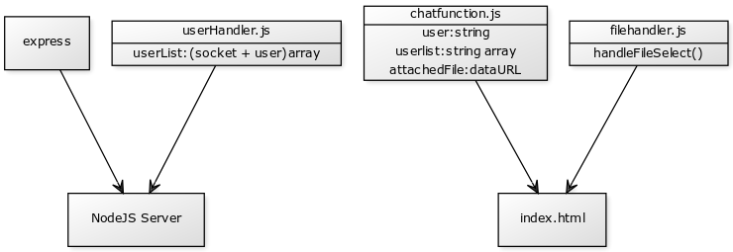
Component Diagram

Slide 5
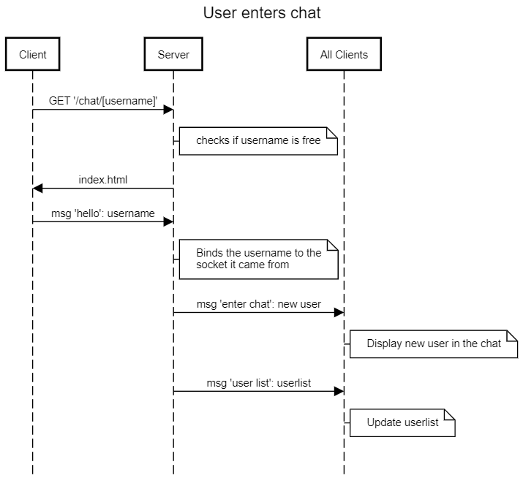
Sequence Diagram

