Slide 1
The AHTEG allocation methodology (see 17/6 & 17/6/Add.2)
Equality Base plus weighted criteria for allocations to recipient Parties
Equality Base
Weighted criteria
Remaining allocation pool
50%
+
A Biodiversity richness (IUCN/GEF STAR indexes)
Starting pool divided equally
between recipient Parties
B Geographic origin of DSI (DSI Scientific Network)
C Capacity needs for conservation and sustainable use
D Traditional knowledge and IP & LC Indicators
Country allocation = Equality Base + w1·CA + w2·CB + w3·CC + w4·CD
Criterion C is either inverted GNI or Inverted UN Scale of Assessments. Criterion B remains a placeholder pending suitable data.

Slide 2
Criterion C: inverted GNI per capita or IUSAF?
Strengths and trade-offs of the two options in the AHTEG report
Both are economic proxies. They do not directly measure biodiversity capacity needs (no known measure for that).
Inverted GNI per capita
IUSAF (banded UN scale)
Option 1: Equality Base uplift of 25% for LDCs and SIDS
Option 2: equal Equality Base, plus six capacity bands
STRENGTHS
STRENGTHS
Direct link to average income per person.
Uses the agreed, GNI-based UN capacity-to-pay reference.
Weight is fine grained per country.
Incorporates debt and low per capita income adjustments.
Avoids directly penalising countries for a larger population.
Bands set an explicit ratio for the capacity component.
LIMITATIONS / CHOICES
LIMITATIONS / CHOICES
AHTEG identified bias against LDCs/SIDS, prompting a 25% base uplift.
Input still reflects economy size and UN contribution rules.
Results depend on inversion, normalisation and data choices.
Band cut-offs create jumps and equal scores within bands.
GNI alone omits debt burdens and within-country inequality.
Weights and ratio are a policy choice.

Slide 3
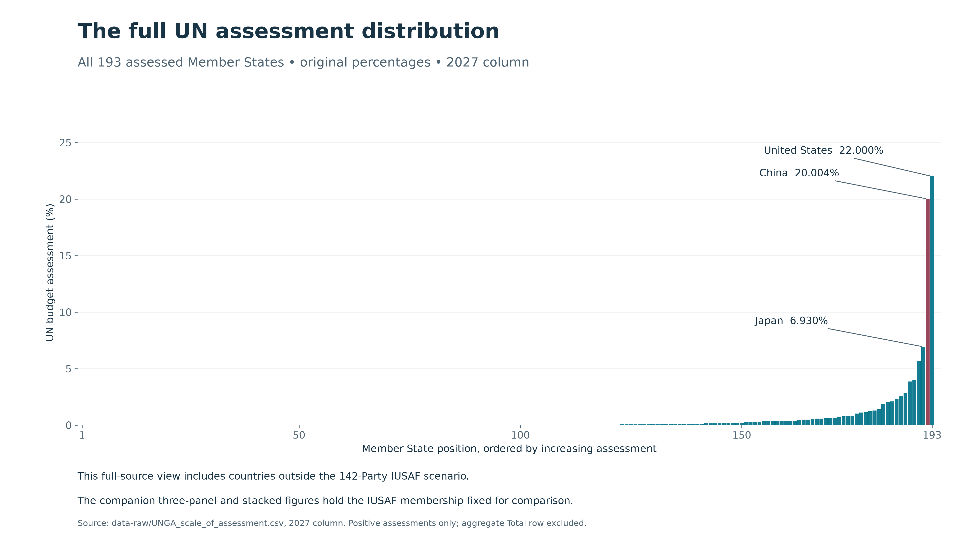

Slide 4
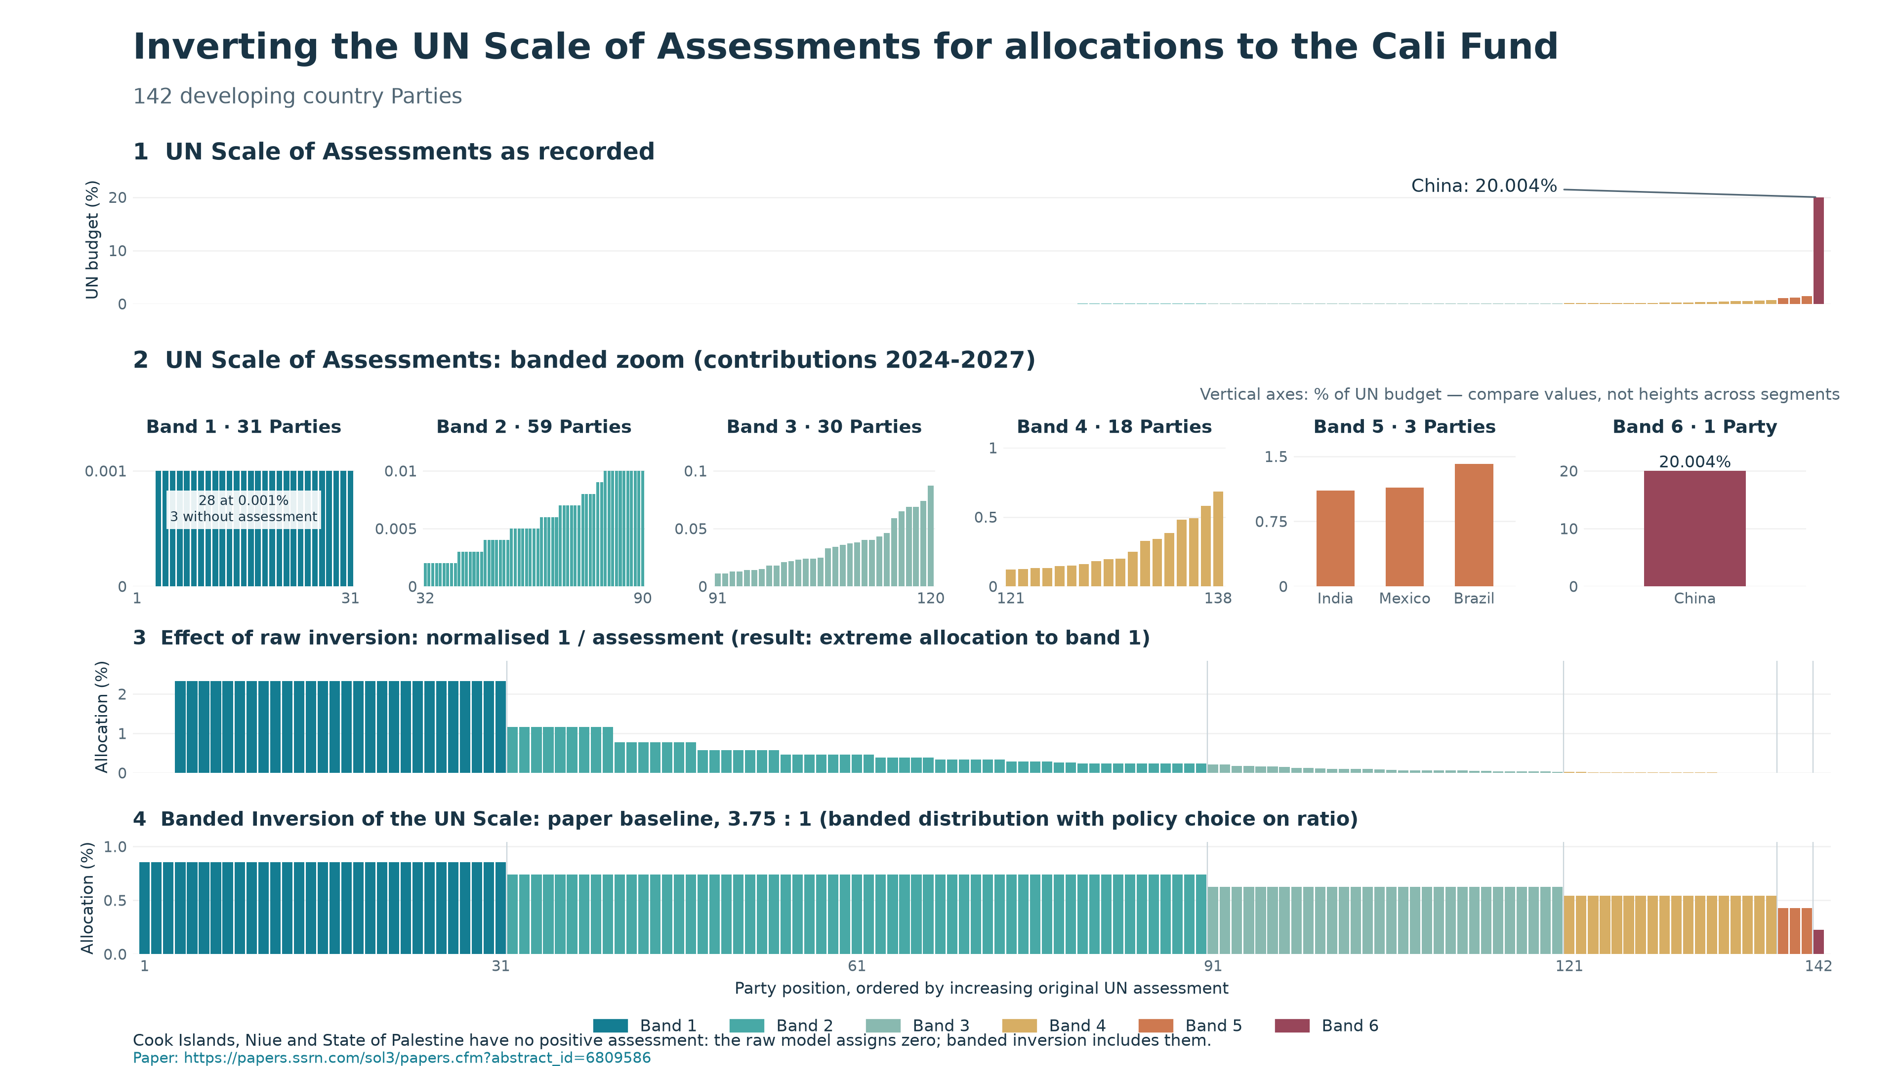

Slide 5
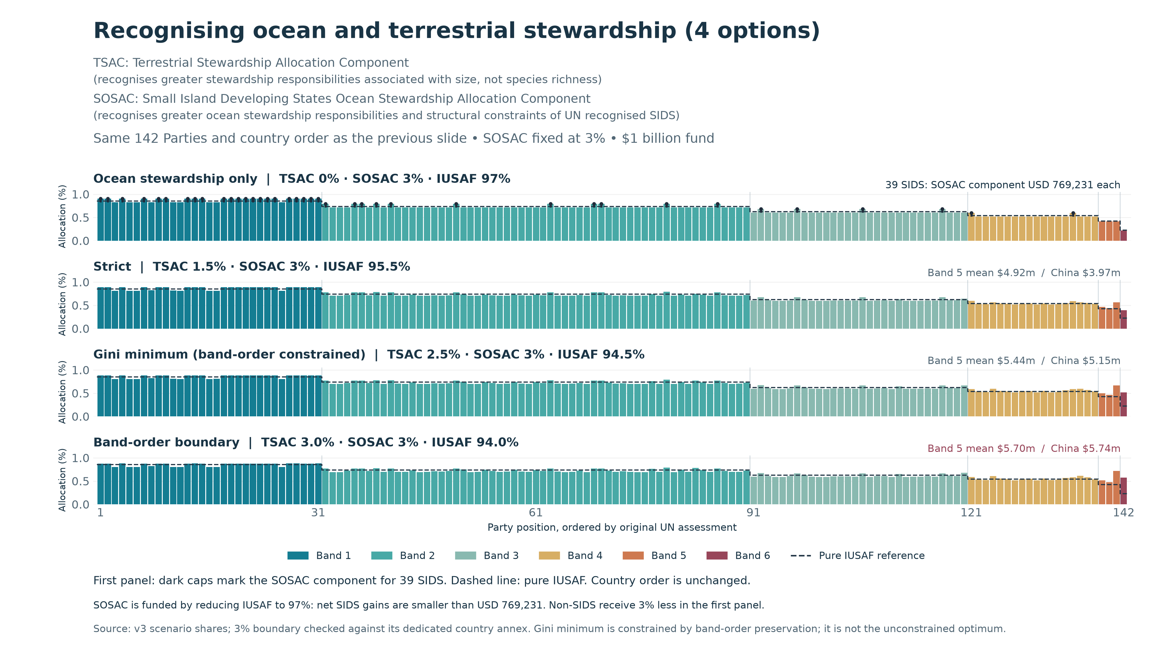

Slide 6
A possible approach to allocation methodology
As the interim approach use economic capacity, then add Biodiversity Stewardship Index after IPBES Assessment
EQUALITY AND ECONOMIC CAPACITY
IPBES Rapid Assessment
Equality Base + Criterion C
Equal share between Parties + economic capacity
A: Species B: DSI D: Traditional knowledge
IUSAF
+
Biodiversity Stewardship Index
Inverted UN Scale of Assessments
Combines criteria A, B and D
Combined allocation

Slide 7
Issues for Consideration
01
Should Parties accept the IUCN/GEF STAR index weightings (GEF8/GEF9)?
02
Where is the allocation for indigenous peoples and local communities, including in developed countries?
03
What would the time frame and cost be for an IPBES Rapid Assessment towards creating a Party controlled Biodiversity Stewardship Index?
04
What should be used in the interim, knowing that interim measures tend to become permanent?
05
Is there an opportunity for Parties to use a UN Scale and oversee the development of a Biodiversity Stewardship Index under the Convention in which everyone can have confidence?

