Slide 1
The AHTEG allocation framework
Equality Base plus weighted criteria for allocations to recipient Parties
Equality Base
Weighted criteria
Remaining allocation pool
50%
+
A Biodiversity richness
Starting pool divided equally
between recipient Parties
B Geographic origin of genetic resources underlying DSI
C Capacity needs for conservation and sustainable use
D Traditional knowledge and IP & LC contributions
Country allocation = Equality Base + w₁Cₐ + w₂Cᵦ + w₃C꜀ + w₄Cᴅ
The GNI option adjusts the Equality Base for LDCs and SIDS. Criterion B remains a placeholder pending suitable data.
Notes:
Based on user-supplied cali-allocation-blocks.pptx slide 1 and CBD/DSI/AHTEG/2026/2/3 Annex II. https://www.cbd.int/doc/c/db87/84a9/9022dd04f7afc8880d009149/dsi-ahteg-2026-02-03-en.pdf . This slide concerns the recipient-Party allocation pool, not a division of the whole fund between Parties and indigenous peoples and local communities. Equality Base is spelled out to distinguish it from criterion B. The original 50% base is modified by a 25% base uplift for LDC/SIDS under the GNI option. Weights and other details follow the report, including the current lack of applicable data for criterion B. This is a summary redrawn for widescreen, not an exact reproduction of the original block slide.

Slide 2
Criterion C: inverted GNI per capita or IUSAF?
Strengths and trade-offs of the two options in the AHTEG report
Both are economic proxies. Neither directly measures biodiversity capacity needs.
Inverted GNI per capita
IUSAF (banded UN scale)
Option 1: Equality Base uplift of 25% for LDCs and SIDS
Option 2: equal Equality Base, plus six capacity bands
STRENGTHS
STRENGTHS
Direct link to average income per person.
Uses the agreed, GNI-based UN capacity-to-pay reference.
Continuous scores can retain differences between countries.
Incorporates debt and low per capita income adjustments.
Avoids directly penalising countries for a larger population.
Bands set an explicit ratio for the capacity component.
LIMITATIONS / CHOICES
LIMITATIONS / CHOICES
AHTEG identified bias against LDCs/SIDS, prompting a 25% base uplift.
Input still reflects economy size and UN contribution rules.
Results depend on inversion, normalisation and data choices.
Band cut-offs create jumps and equal scores within bands.
GNI alone omits debt burdens and within-country inequality.
Weights and ratio are a policy choice.
Notes:
Sources and interpretation (12 October 2026):
UN Committee on Contributions, scale of assessments 2025–2027: https://www.un.org/en/ga/contributions/budget.shtml and https://www.un.org/ldcportal/node/933 . GNI is the starting point, with debt-burden and low-per-capita-income adjustments, minimum assessment and ceilings. The UN agreement concerns contributions, not adoption of IUSAF for Cali allocations.
World Bank, GNI per capita methodology and limitations: https://datahelpdesk.worldbank.org/knowledgebase/articles/378831-why-use-gni-per-capita-to-classify-economies-into and https://datahelpdesk.worldbank.org/knowledgebase/articles/378832-what-is-the-world-bank-atlas-method . GNI per capita does not describe within-country inequality. Atlas conversion smooths but does not eliminate exchange-rate effects. Data availability and reference-year choices require checking under either approach.
IUSAF banding and 3.75:1 ratio: user's paper and modelling files previously inspected in this task, https://papers.ssrn.com/sol3/papers.cfm?abstract_id=6809586 . IUSAF here means the banded version, not raw reciprocal UN assessments.
Analytical deductions: with equal treatment of Parties and normalized reciprocal weighting, inverse total GNI favours smaller economies whereas inverse per-capita GNI favours lower income per person. Raw reciprocal sensitivity and concentration depend on data spread. Continuous differentiation applies before introducing bands. Band thresholds and within-band equality are consequences of the banded model.
Fair comparison: distinguish the capacity indicator from the transformation. Either GNI or UN assessments can be banded, smoothed or given a chosen ratio range. Neither input directly measures biodiversity stewardship. Both require explicit treatment of missing data, allocation normalization, and integration with the Equality Base and other criteria. AHTEG report CBD/DSI/AHTEG/2026/2/3, Annex II paragraphs 4(c) and 5 (pages 10–11): https://www.cbd.int/doc/c/db87/84a9/9022dd04f7afc8880d009149/dsi-ahteg-2026-02-03-en.pdf . The report specifies per-capita GNI. The 25% uplift is relative to the base allocation, not 25 percentage points of the fund. Paragraph 28 discusses the weak biodiversity-specific connection of these proxies. Exact inversion and normalisation should be checked in the implementation before quantitative comparisons. No numerical ranking or claim of superiority is made.

Slide 3
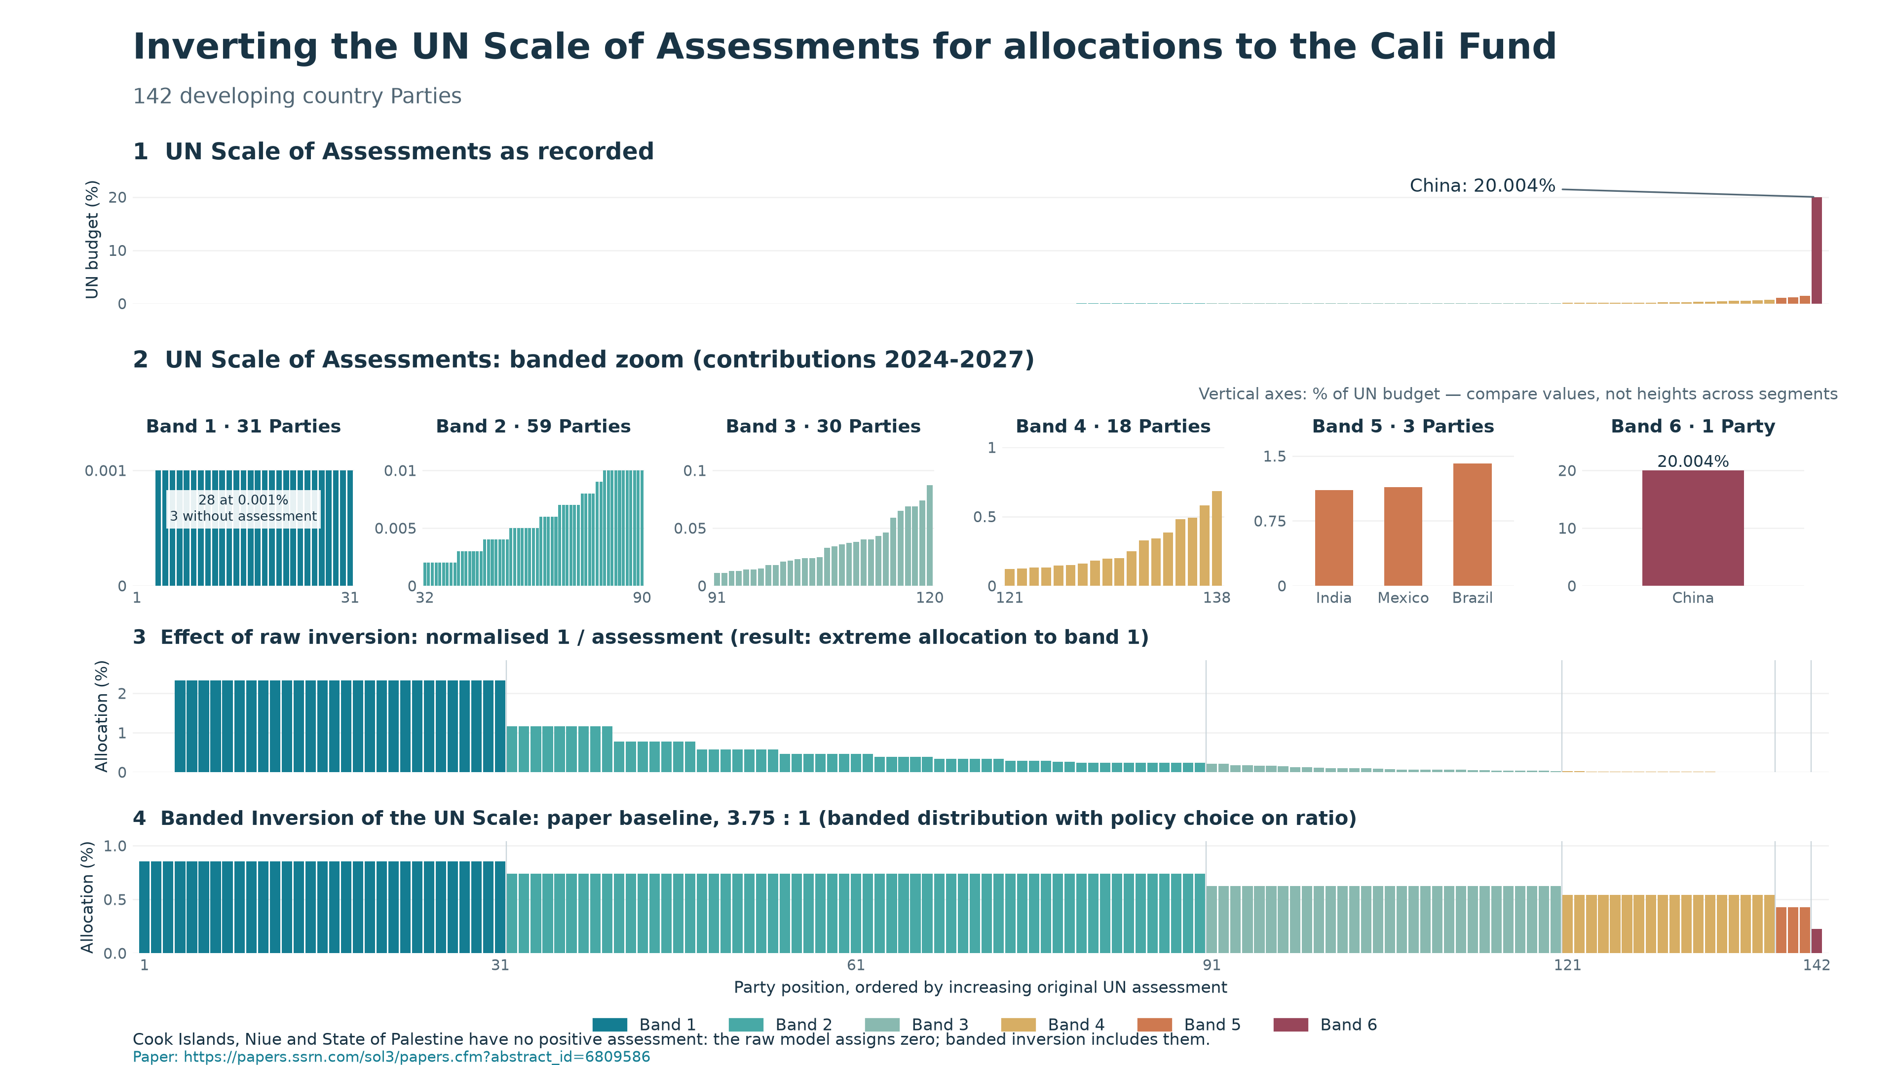
Notes:
Recorded UN assessments, banded zoom, raw inversion and banded IUSAF. Independent vertical scales within the zoom.
Existing figure from this task. Sources and data: outputs/iusaf-distribution/README.md and figure-data.csv; stewardship details in stewardship-notes.md. Figures retain their existing labels. The UN input is the repository 2027 column. The assessment period is 2025–2027, although the four-panel figure retains the user-requested 2024–2027 label.

Slide 4
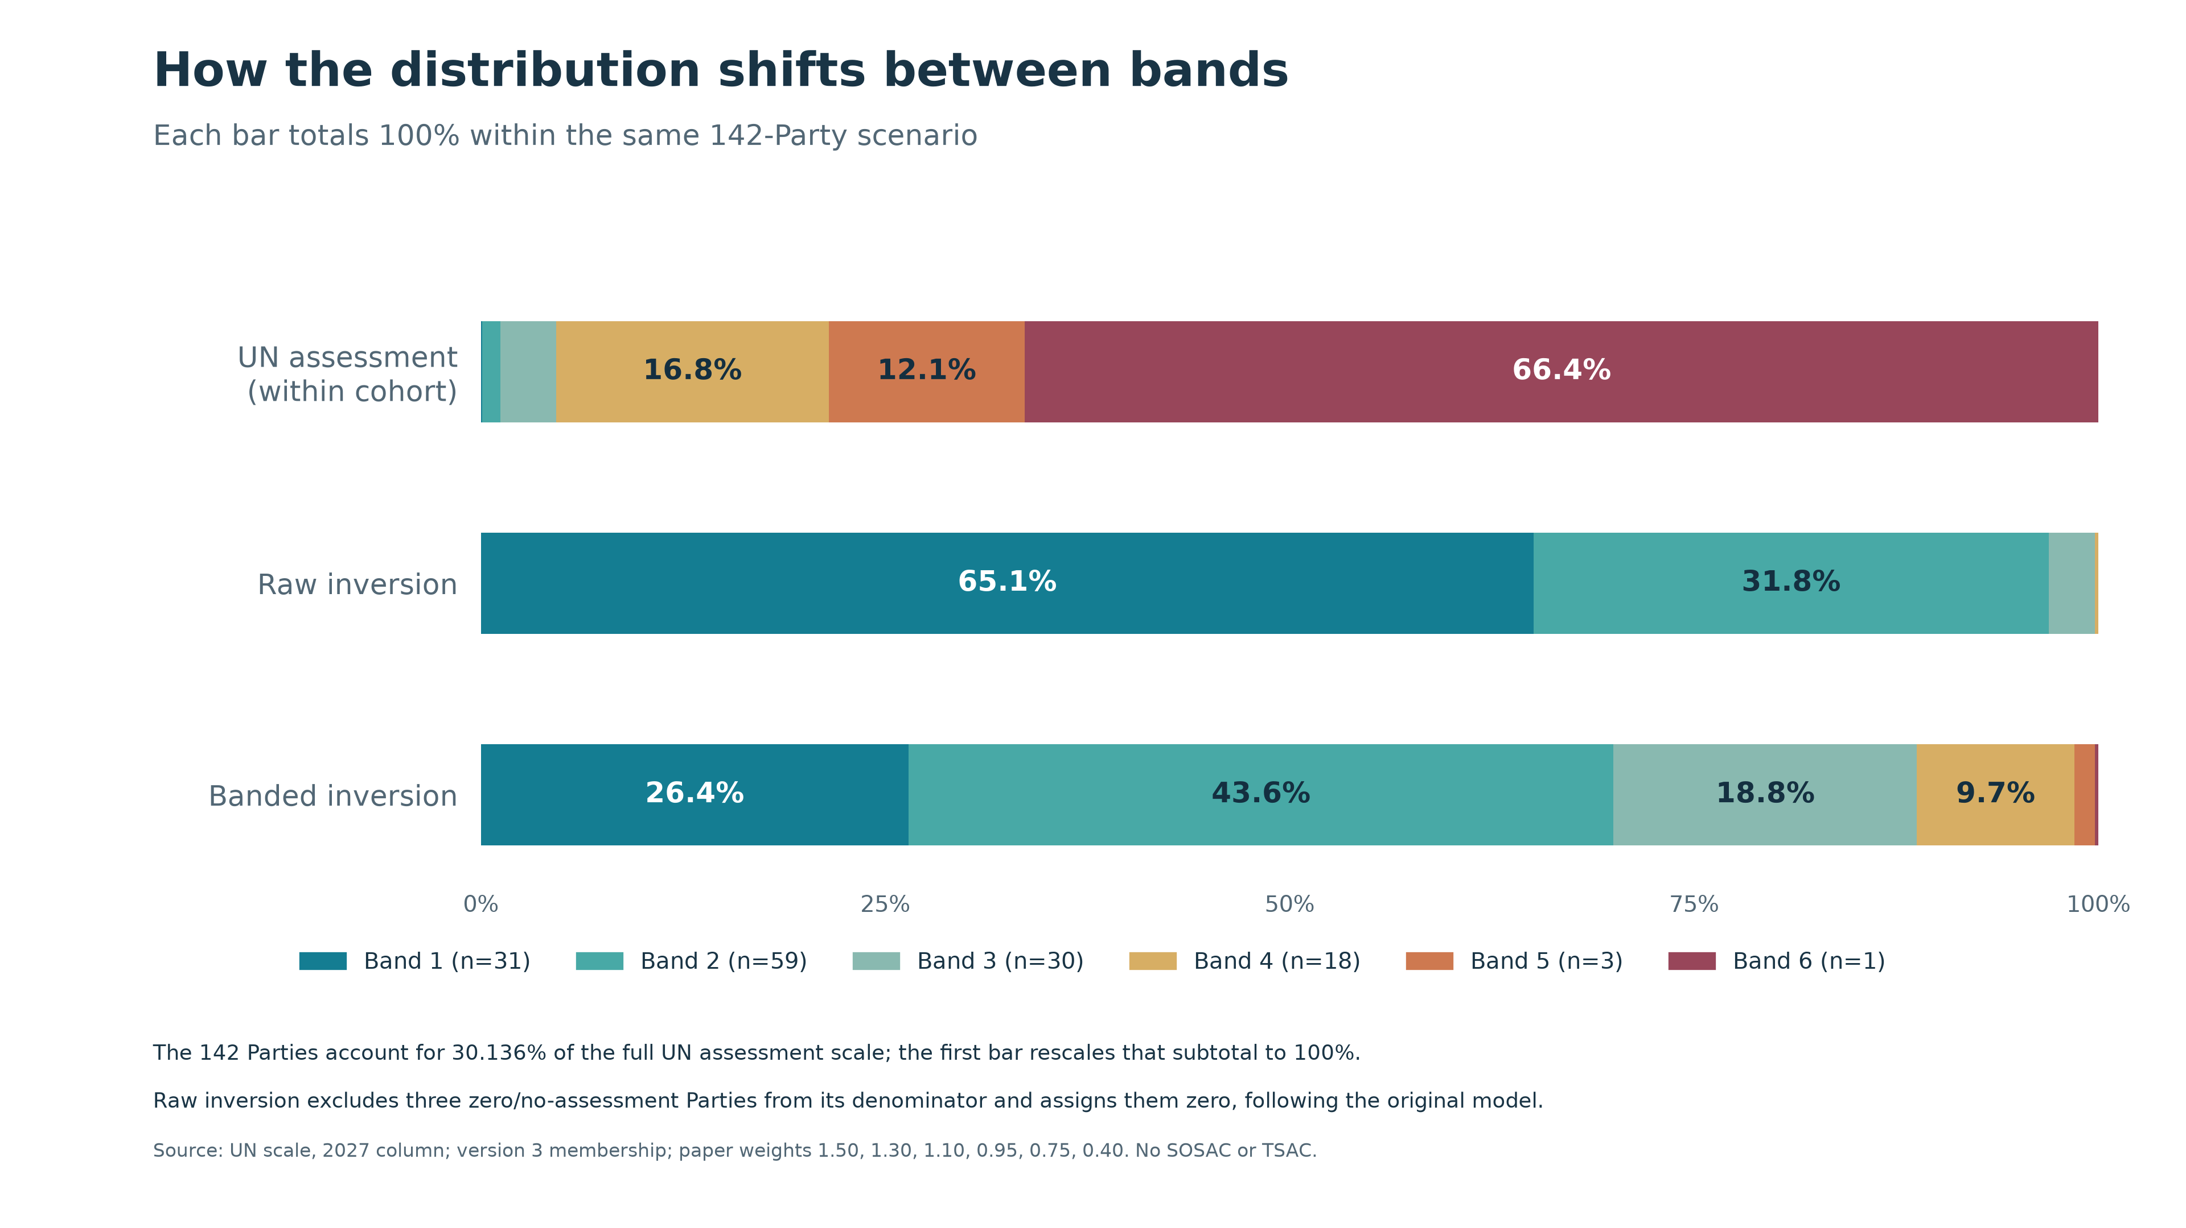
Notes:
Total shares by band within the 142-Party cohort. UN assessment shares normalized within the cohort for this comparison.
Existing figure from this task. Sources and data: outputs/iusaf-distribution/README.md and figure-data.csv; stewardship details in stewardship-notes.md. Figures retain their existing labels. The UN input is the repository 2027 column. The assessment period is 2025–2027, although the four-panel figure retains the user-requested 2024–2027 label.

Slide 5
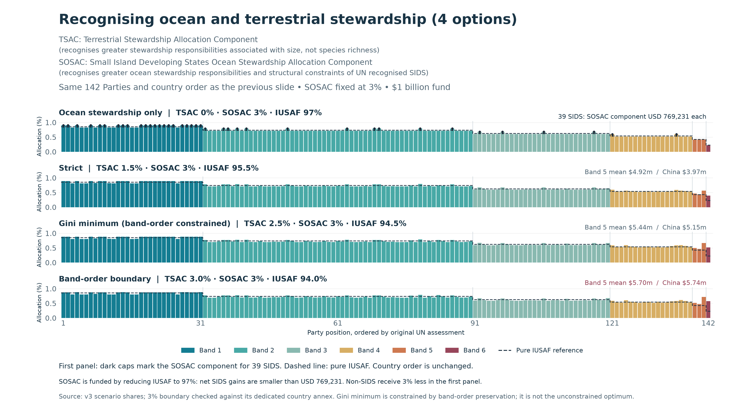
Notes:
Four stewardship scenarios with SOSAC 3% and TSAC 0%, 1.5%, 2.5% and 3%. The 3% boundary marginally reverses Band 5 and Band 6 mean ordering.
Existing figure from this task. Sources and data: outputs/iusaf-distribution/README.md and figure-data.csv; stewardship details in stewardship-notes.md. Figures retain their existing labels. The UN input is the repository 2027 column. The assessment period is 2025–2027, although the four-panel figure retains the user-requested 2024–2027 label.

Slide 6
A possible Cali Fund allocation approach
Equality Base and economic capacity, combined with biodiversity stewardship
EQUALITY AND ECONOMIC CAPACITY
IPBES Rapid Assessment
Equality Base + Criterion C
Equal share between Parties + economic capacity
A: Species B: DSI D: Traditional knowledge
IUSAF
+
Biodiversity Stewardship Index
Inverted UN Scale of Assessments
Combines criteria A, B and D
Combined allocation
Notes:
Source: user-supplied cali-allocation-blocks.pptx, slide 2, and subsequent user clarifications. This is a possible solution, not an assertion of an adopted AHTEG allocation formula. Equality Base is distinct from criterion B (DSI). The user requested teal for Equality Base plus criterion C through IUSAF, gold for Biodiversity Stewardship Index criteria A, B and D, and a grey IPBES Rapid Assessment process block feeding the index. No component weights, 50:50 split, country scores or disbursement mechanism are implied. DSI = digital sequence information.

Slide 7
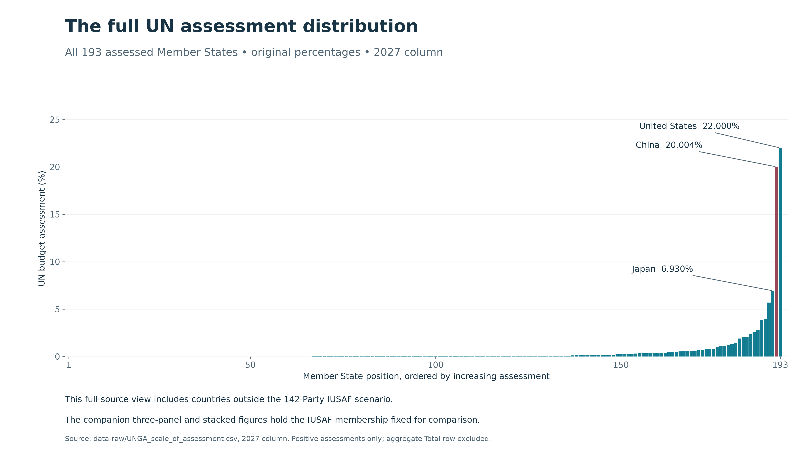
Notes:
Appendix: full UN assessment distribution for 193 assessed Member States, before recipient eligibility filtering.
Existing figure from this task. Sources and data: outputs/iusaf-distribution/README.md and figure-data.csv; stewardship details in stewardship-notes.md. Figures retain their existing labels. The UN input is the repository 2027 column. The assessment period is 2025–2027, although the four-panel figure retains the user-requested 2024–2027 label.

