Slide 1
The AHTEG allocation framework
Equality Base plus weighted criteria for allocations to recipient Parties
Equality Base
Weighted criteria
Remaining allocation pool
50%
+
A Biodiversity richness
Starting pool divided equally
between recipient Parties
B Geographic origin of genetic resources underlying DSI
C Capacity needs for conservation and sustainable use
D Traditional knowledge and IP & LC contributions
Country allocation = Equality Base + w1·CA + w2·CB + w3·CC + w4·CD
The GNI option adjusts the Equality Base for LDCs and SIDS. Criterion B remains a placeholder pending suitable data.
Notes:
Based on user-supplied cali-allocation-blocks.pptx slide 1 and CBD/DSI/AHTEG/2026/2/3 Annex II. https://www.cbd.int/doc/c/db87/84a9/9022dd04f7afc8880d009149/dsi-ahteg-2026-02-03-en.pdf . This slide concerns the recipient-Party allocation pool, not a division of the whole fund between Parties and indigenous peoples and local communities. Equality Base is spelled out to distinguish it from criterion B. The original 50% base is modified by a 25% base uplift for LDC/SIDS under the GNI option. Weights and other details follow the report, including the current lack of applicable data for criterion B. This is a summary redrawn for widescreen, not an exact reproduction of the original block slide.

Slide 2
Criterion C: inverted GNI per capita or IUSAF?
Strengths and trade-offs of the two options in the AHTEG report
Both are economic proxies. Neither directly measures biodiversity capacity needs.
Inverted GNI per capita
IUSAF (banded UN scale)
Option 1: Equality Base uplift of 25% for LDCs and SIDS
Option 2: equal Equality Base, plus six capacity bands
STRENGTHS
STRENGTHS
Direct link to average income per person.
Uses the agreed, GNI-based UN capacity-to-pay reference.
Continuous scores can retain differences between countries.
Incorporates debt and low per capita income adjustments.
Avoids directly penalising countries for a larger population.
Bands set an explicit ratio for the capacity component.
LIMITATIONS / CHOICES
LIMITATIONS / CHOICES
AHTEG identified bias against LDCs/SIDS, prompting a 25% base uplift.
Input reflects economy size and UN contribution rules.
Results depend on inversion, normalisation and data choices.
Bands create steps and equal scores within bands.
GNI alone omits debt burdens and within-country inequality.
Weights and ratio are a policy choice.
Notes:
Sources and interpretation (12 October 2026):
UN Committee on Contributions, scale of assessments 2025–2027: https://www.un.org/en/ga/contributions/budget.shtml and https://www.un.org/ldcportal/node/933 . GNI is the starting point, with debt-burden and low-per-capita-income adjustments, minimum assessment and ceilings. The UN agreement concerns contributions, not adoption of IUSAF for Cali allocations.
World Bank, GNI per capita methodology and limitations: https://datahelpdesk.worldbank.org/knowledgebase/articles/378831-why-use-gni-per-capita-to-classify-economies-into and https://datahelpdesk.worldbank.org/knowledgebase/articles/378832-what-is-the-world-bank-atlas-method . GNI per capita does not describe within-country inequality. Atlas conversion smooths but does not eliminate exchange-rate effects. Data availability and reference-year choices require checking under either approach.
IUSAF banding and 3.75:1 ratio: user's paper and modelling files previously inspected in this task, https://papers.ssrn.com/sol3/papers.cfm?abstract_id=6809586 . IUSAF here means the banded version, not raw reciprocal UN assessments.
Analytical deductions: with equal treatment of Parties and normalized reciprocal weighting, inverse total GNI favours smaller economies whereas inverse per-capita GNI favours lower income per person. Raw reciprocal sensitivity and concentration depend on data spread. Continuous differentiation applies before introducing bands. Band thresholds and within-band equality are consequences of the banded model.
Fair comparison: distinguish the capacity indicator from the transformation. Either GNI or UN assessments can be banded, smoothed or given a chosen ratio range. Neither input directly measures biodiversity stewardship. Both require explicit treatment of missing data, allocation normalization, and integration with the Equality Base and other criteria. AHTEG report CBD/DSI/AHTEG/2026/2/3, Annex II paragraphs 4(c) and 5 (pages 10–11): https://www.cbd.int/doc/c/db87/84a9/9022dd04f7afc8880d009149/dsi-ahteg-2026-02-03-en.pdf . The report specifies per-capita GNI. The 25% uplift is relative to the base allocation, not 25 percentage points of the fund. Paragraph 28 discusses the weak biodiversity-specific connection of these proxies. Exact inversion and normalisation should be checked in the implementation before quantitative comparisons. No numerical ranking or claim of superiority is made.

Slide 3
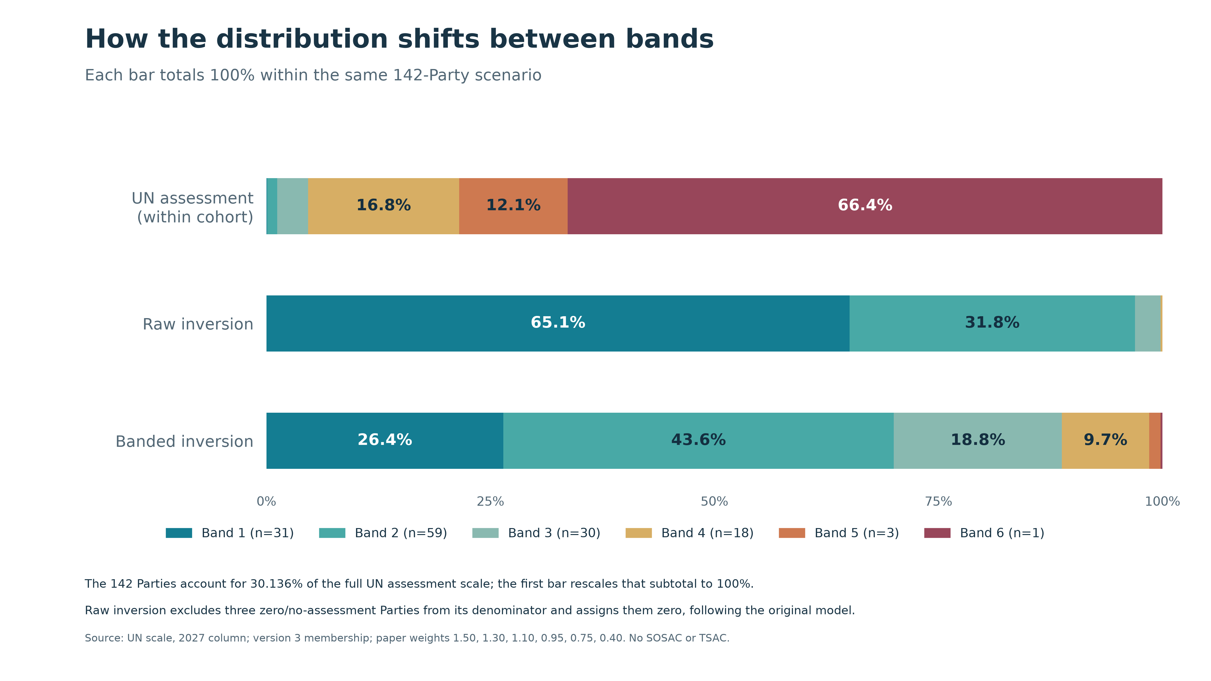
Notes:
Total shares by band within the 142-Party cohort. UN assessment shares normalized within the cohort for this comparison.
Existing figure from this task. Sources and data: outputs/iusaf-distribution/README.md and figure-data.csv; stewardship details in stewardship-notes.md. Figures retain their existing labels. The UN input is the repository 2027 column. The assessment period is 2025–2027, although the four-panel figure retains the user-requested 2024–2027 label.

Slide 4
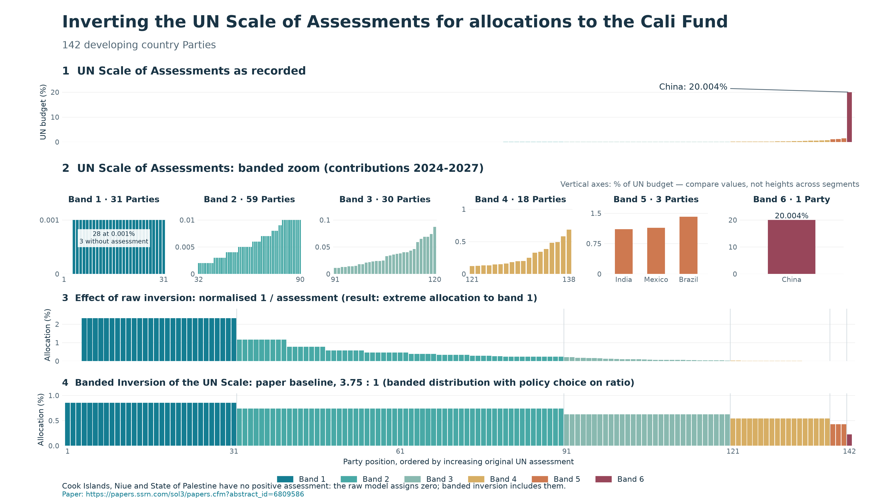
Notes:
Recorded UN assessments, banded zoom, raw inversion and banded IUSAF. Independent vertical scales within the zoom.
Existing figure from this task. Sources and data: outputs/iusaf-distribution/README.md and figure-data.csv; stewardship details in stewardship-notes.md. Figures retain their existing labels. The UN input is the repository 2027 column. The assessment period is 2025–2027, although the four-panel figure retains the user-requested 2024–2027 label.

Slide 5
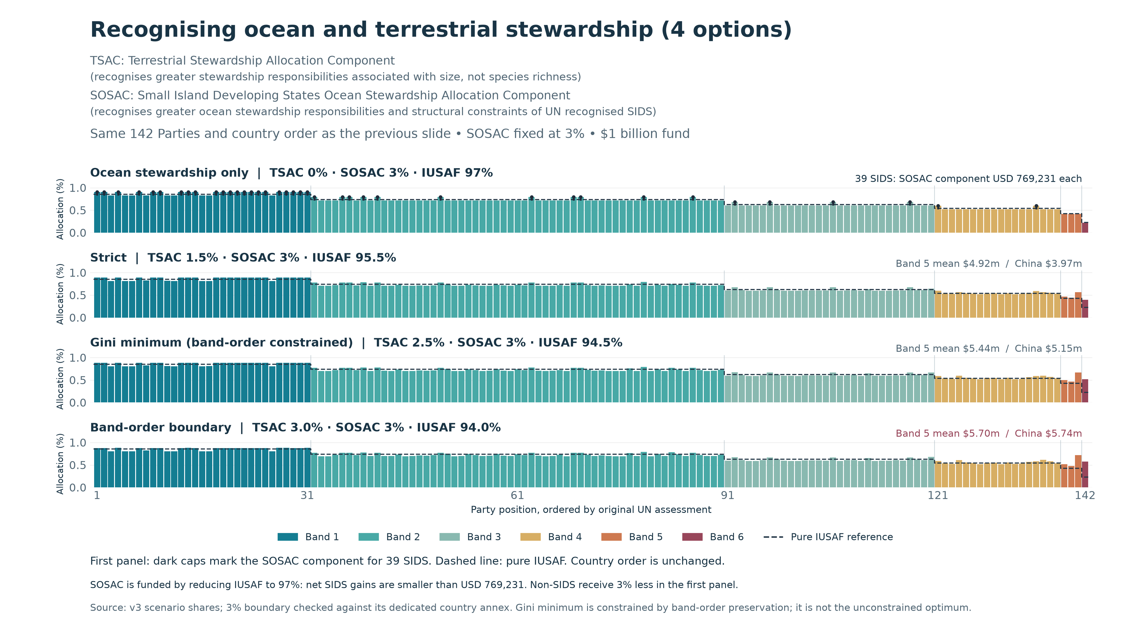
Notes:
Four stewardship scenarios with SOSAC 3% and TSAC 0%, 1.5%, 2.5% and 3%. The 3% boundary marginally reverses Band 5 and Band 6 mean ordering.
Existing figure from this task. Sources and data: outputs/iusaf-distribution/README.md and figure-data.csv; stewardship details in stewardship-notes.md. Figures retain their existing labels. The UN input is the repository 2027 column. The assessment period is 2025–2027, although the four-panel figure retains the user-requested 2024–2027 label.

Slide 6
A possible Cali Fund allocation approach
Equality Base and economic capacity, combined with biodiversity stewardship
EQUALITY AND ECONOMIC CAPACITY
IPBES Rapid Assessment
Equality Base + Criterion C
Equal share between Parties + economic capacity
A: Species B: DSI D: Traditional knowledge
IUSAF
+
Biodiversity Stewardship Index
Inverted UN Scale of Assessments
Combines criteria A, B and D
Combined allocation
Notes:
Source: user-supplied cali-allocation-blocks.pptx, slide 2, and subsequent user clarifications. This is a possible solution, not an assertion of an adopted AHTEG allocation formula. Equality Base is distinct from criterion B (DSI). The user requested teal for Equality Base plus criterion C through IUSAF, gold for Biodiversity Stewardship Index criteria A, B and D, and a grey IPBES Rapid Assessment process block feeding the index. No component weights, 50:50 split, country scores or disbursement mechanism are implied. DSI = digital sequence information.

Slide 7
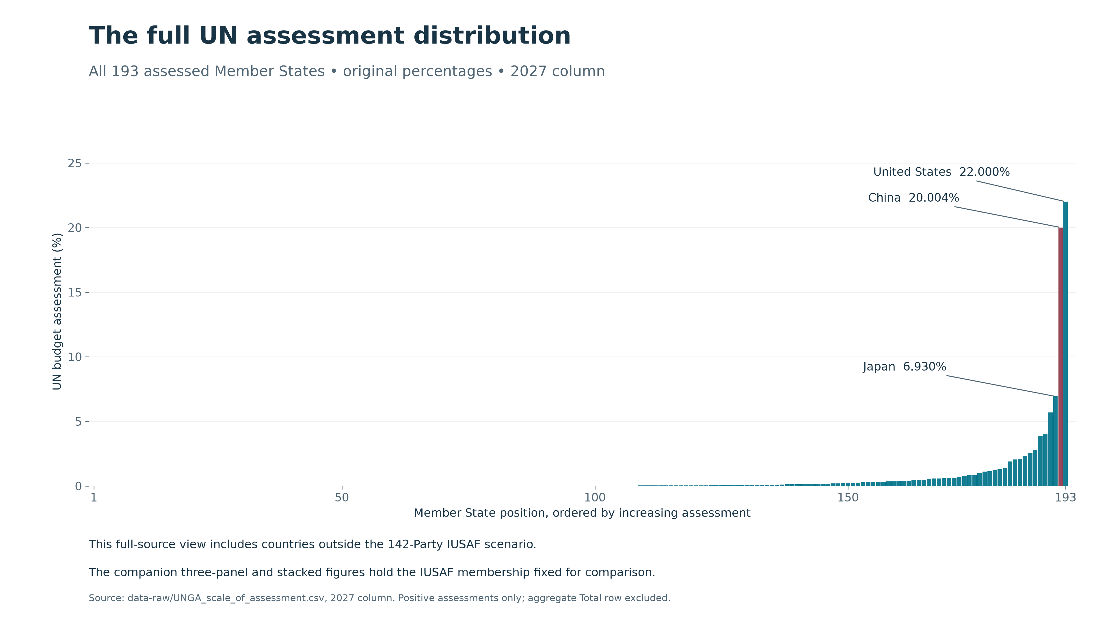
Notes:
Appendix: full UN assessment distribution for 193 assessed Member States, before recipient eligibility filtering.
Existing figure from this task. Sources and data: outputs/iusaf-distribution/README.md and figure-data.csv; stewardship details in stewardship-notes.md. Figures retain their existing labels. The UN input is the repository 2027 column. The assessment period is 2025–2027, although the four-panel figure retains the user-requested 2024–2027 label.

