Slide 1
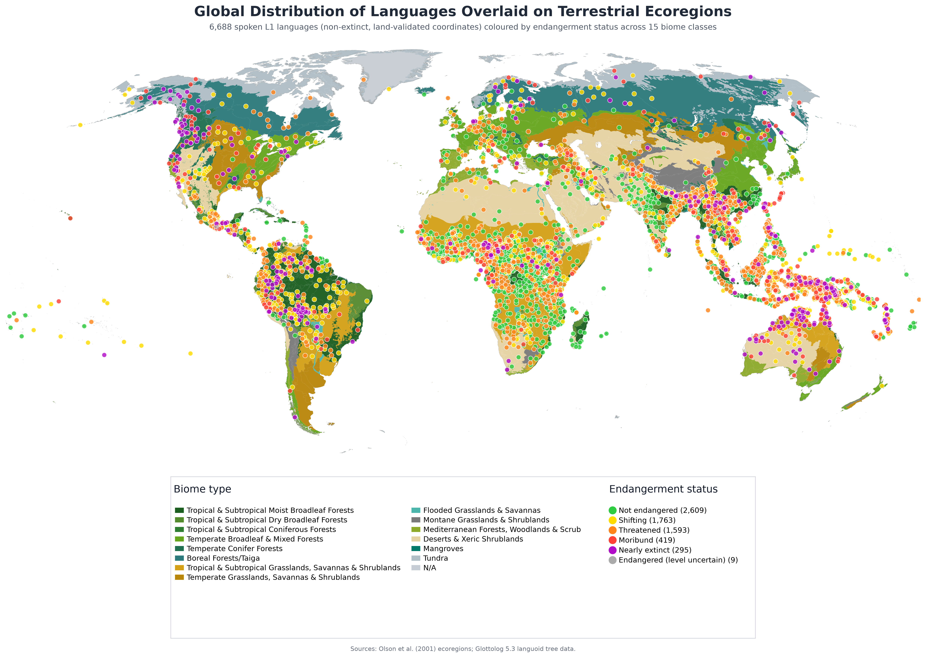
Linguistic Diversity [DRAFT]
Source: Glottolog 5.3 language data overlaid on Ecoregions (Olsen, 2001) data
Jasmine Kindness, TierraViva AI

Slide 2
What is Linguistic Diversity?
Linguistic diversity refers to the presence and variety of different languages and language varieties within a geographical area
Recent estimates place the number of languages spoken globally between 7,000 (Boissonneault & Hammarström, 2026) and 7,700 (Glottolog 5.3, 2026)
However linguistic diversity is declining
Approximately half of languages are ‘endangered’ with a language lost every 1-3 months.
Most endangered languages are estimated to have 10,000 speakers or less (UNESCO)
The rate of language loss is expected to increase (Bromham et al., 2022)
Sources: Boissonneault & Hammarström (2026); Hammarström et al. (2026, Glottolog 5.3); Bromham et al. (2022)

Slide 3
Biocultural Diversity
Biodiversity and cultural diversity are interrelated and interdependent
Traditional Ecological Knowledge (TEK) describes detailed local knowledge about plants, animals and ecological processes learned over millennia including how to manage natural resources sustainably
TEK is expressed and transmitted through languages
Studies show that areas with high linguistic diversity correlate with high biodiversity – nearly 70% of the world’s languages are spoken in biodiversity hotspots (Gorenflo et al., 2012).
Linguistic diversity can be used as a proxy for TEK and the protection of TEK is closely linked to the protection of biodiversity
Sources: Terralingua (2018); Gorenflo et al. (2012)

Slide 4
Causes of ‘Language Endangerment’
Language endangerment may be the result of external forces such as military, economic, religious, cultural or educational subjugation
It may be caused by internal forces, such as a community’s negative attitude towards its own language and culture, associating it with their disadvantaged social position.
Internal pressures often have their source in external ones, and both halt the intergenerational transmission of linguistic and cultural traditions.
Source: UNESCO (2003), Language Vitality and Endangerment

Slide 5
Language ‘Endangerment’ and ‘Vitality’
Language vitality concerns the overall condition of a language and the social, demographic, institutional and linguistic circumstances that sustain or undermine its continued use and transmission
Language endangerment concerns the degree to which a language is at risk of falling out of use or becoming ’extinct’.
They overlap because endangerment is one aspect of a language's vitality, but vitality is broader: it encompasses positive as well as negative conditions, including the resources and circumstances that can support language maintenance and revitalisation.
Negative framing: A focus on ‘language death’ and descriptions of languages as ‘severely endangered’ or ‘extinct’ can unduly constrain possible actions for language vitality
Perley suggests using ‘sleeping’ and ‘emergent vitalities’ arguing that this is especially critical for indigenous communities living in their ancestral homelands where remembering ancestral voices plays a significant role in possible futures for indigenous languages
Source: Perley (2012), cited in https://doi.org/10.1075/slcs.142.13per

Slide 6
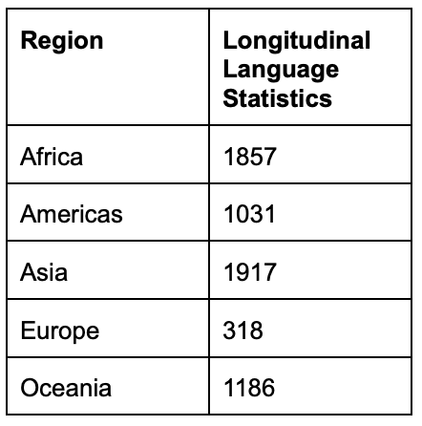
Ethnologue Catalogue
Began as an initiative of the missionary organisation Summer Institute of Linguistics (now SIL International), as part of a program to identify target languages for bible translation;
The 2024 edition contained data on 7,168 languages of which 6,213 languages have at least two distinct data points. This is a large increase on the last time the Index of Linguistic Diversity was done;
Ethnologue data is the basis of ISO 639: 2023 codes for languages;
Not free, requires a paid subscription or licensing for full access;
Despite criticisms, acknowledged as best data source available and is continuously updated.
29th edition, released February 2026 documents 7,170 living languages worldwide. Link
Number of languages where longitudinal language data is now available (2024 edition)

Slide 7
Index of Linguistic Diversity
Developed by Terralingua (BIP partner)
Based on longitudinal data from Ethnologue on counts of speakers from 1970 to 2005 - derived from a variety of sources
Calculates changes in any language’s share of the global population of language speakers – tracking proportional change
Does not calculate endangerment decline in number of speakers for any unique language
Last conducted in 2010 Based on a sample of 1,500 languages
The current indicator adopted by COP 13/28
Now included in the KMGBF Global Monitoring Framework as one of the four TK Indicators

Slide 8
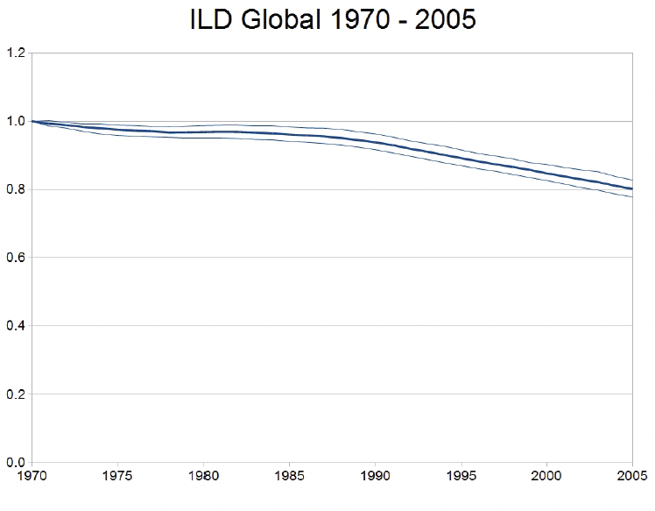
Harmon and Loh 2010 The Index of Linguistic Diversity: A New Quantitative Measure of Trends in the Status of the World’s Languages. Showing estimated decline in global linguistic diversity from 1970-2005

Slide 9
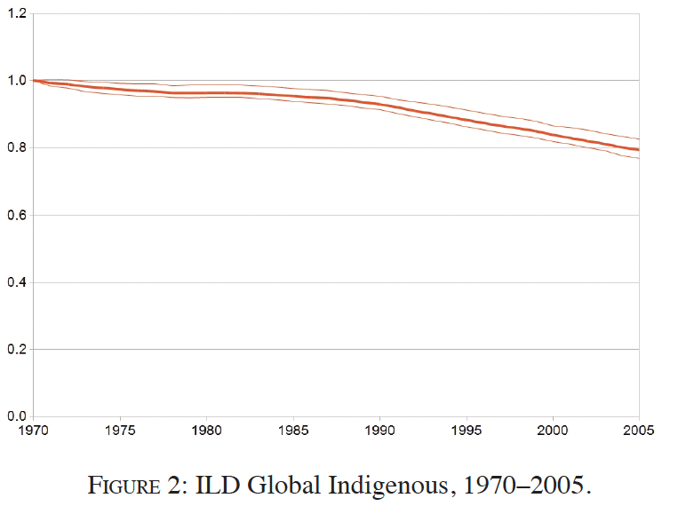
The estimated change in the share of Indigenous languages as a proportion of languages spoken globally between 1970 and 2005

Slide 10
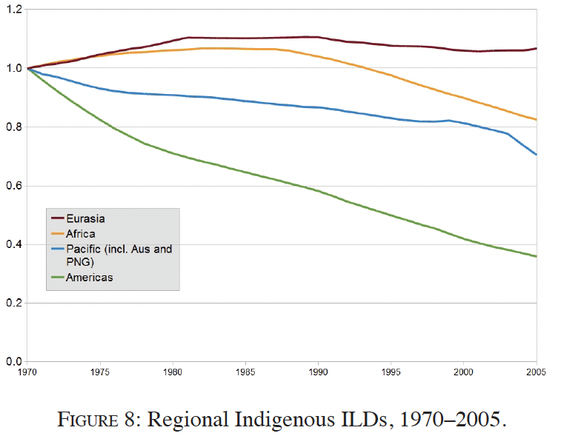
The estimated change in the share of Indigenous languages as a proportion of languages spoken by region between 1970 and 2005

Slide 11
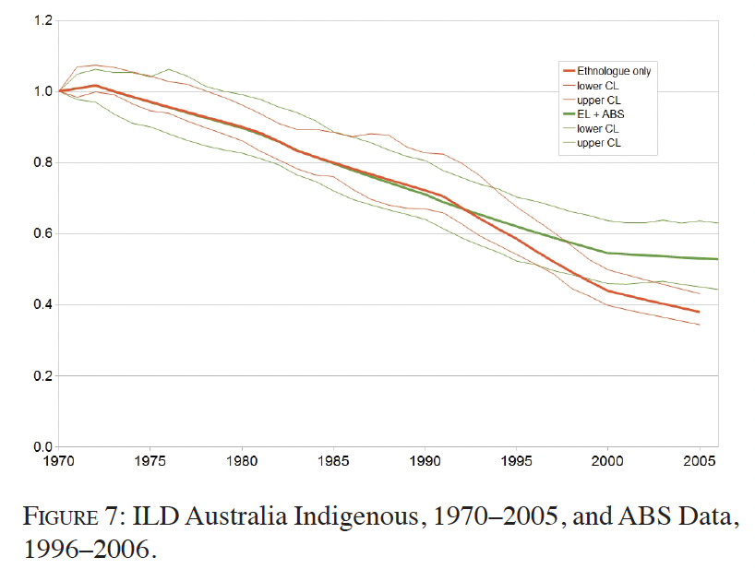
The estimated change in the share of Australian Indigenous languages as a proportion of languages spoken by region between 1970 and 2005. This was done as an example, changes were not calculated for each country.

Slide 12
Issues & Proposal
Index of Linguistic Diversity not updated since 2010 (but lots more data now available)
Too high level, not available per country yet
Need to refocus on language vitality rather than just endangerment
National level testing would allow for cooperation between national stats organisations, indigenous peoples organisations, NGOs and linguists
Outcome: An indicator that is directly relevant to indigenous peoples, local communities and governments

Slide 13
Joint Programme on Biocultural Diversity
Joint programme between CBD and UNESCO on Biocultural Diversity
2022-2032 is the United Nations International Decade of Indigenous Languages (UNESCO is the lead)
Opportunities to use the Article 8(J) programme of work as a forum for further indicator development, for creating partnerships, and sharing experience and best practice in in language vitality
A range of other important initiatives such as Indigenous Navigator, Endangered Languages Project, Glottolog and others could become involved in data generation and experience sharing

Slide 14
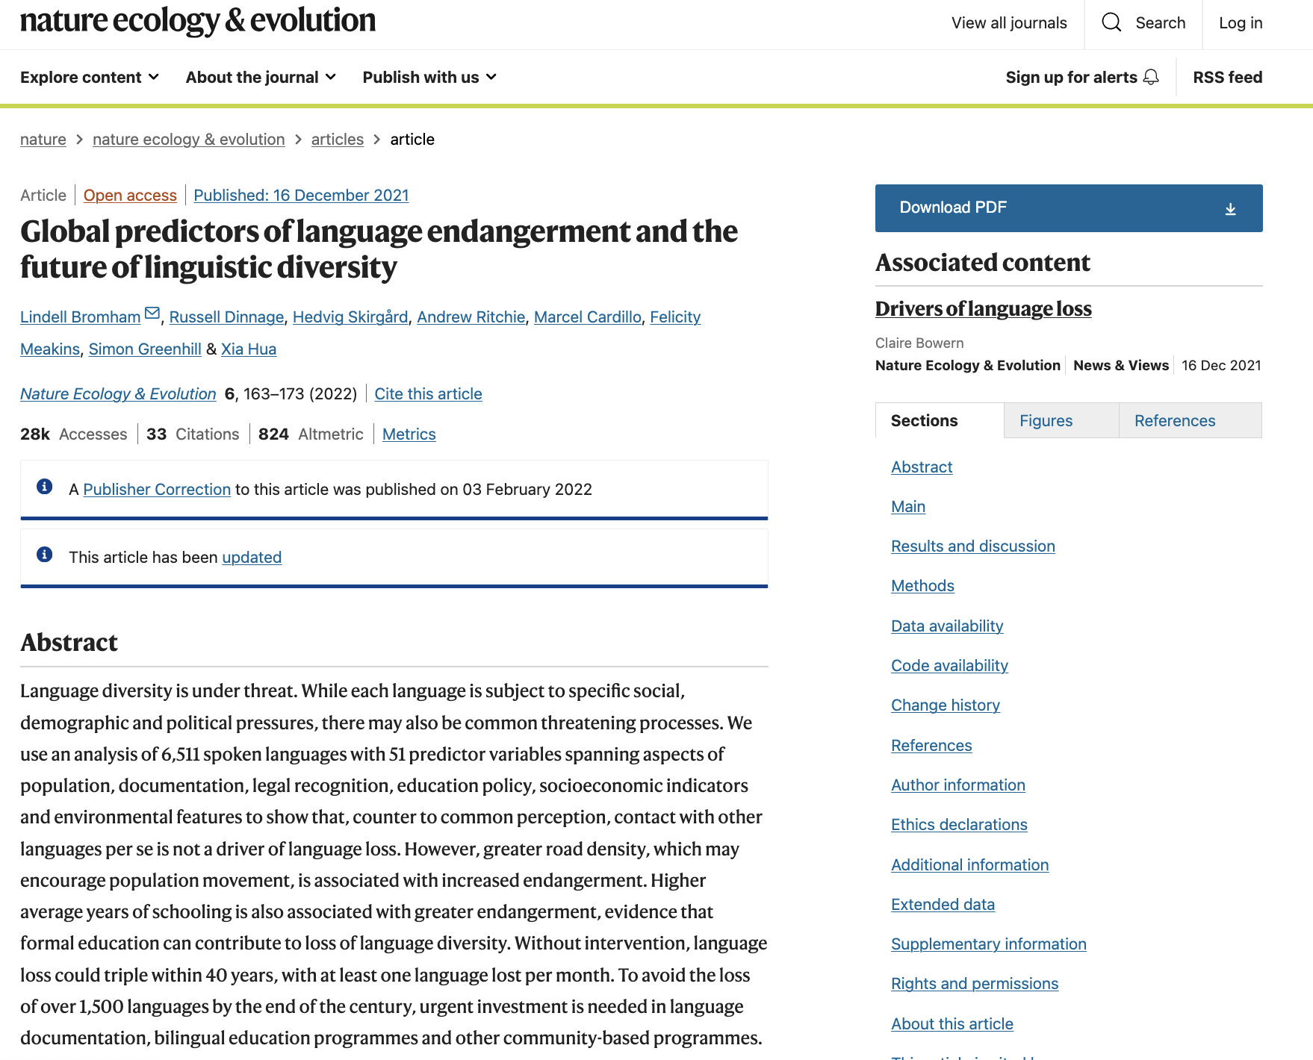

Slide 15
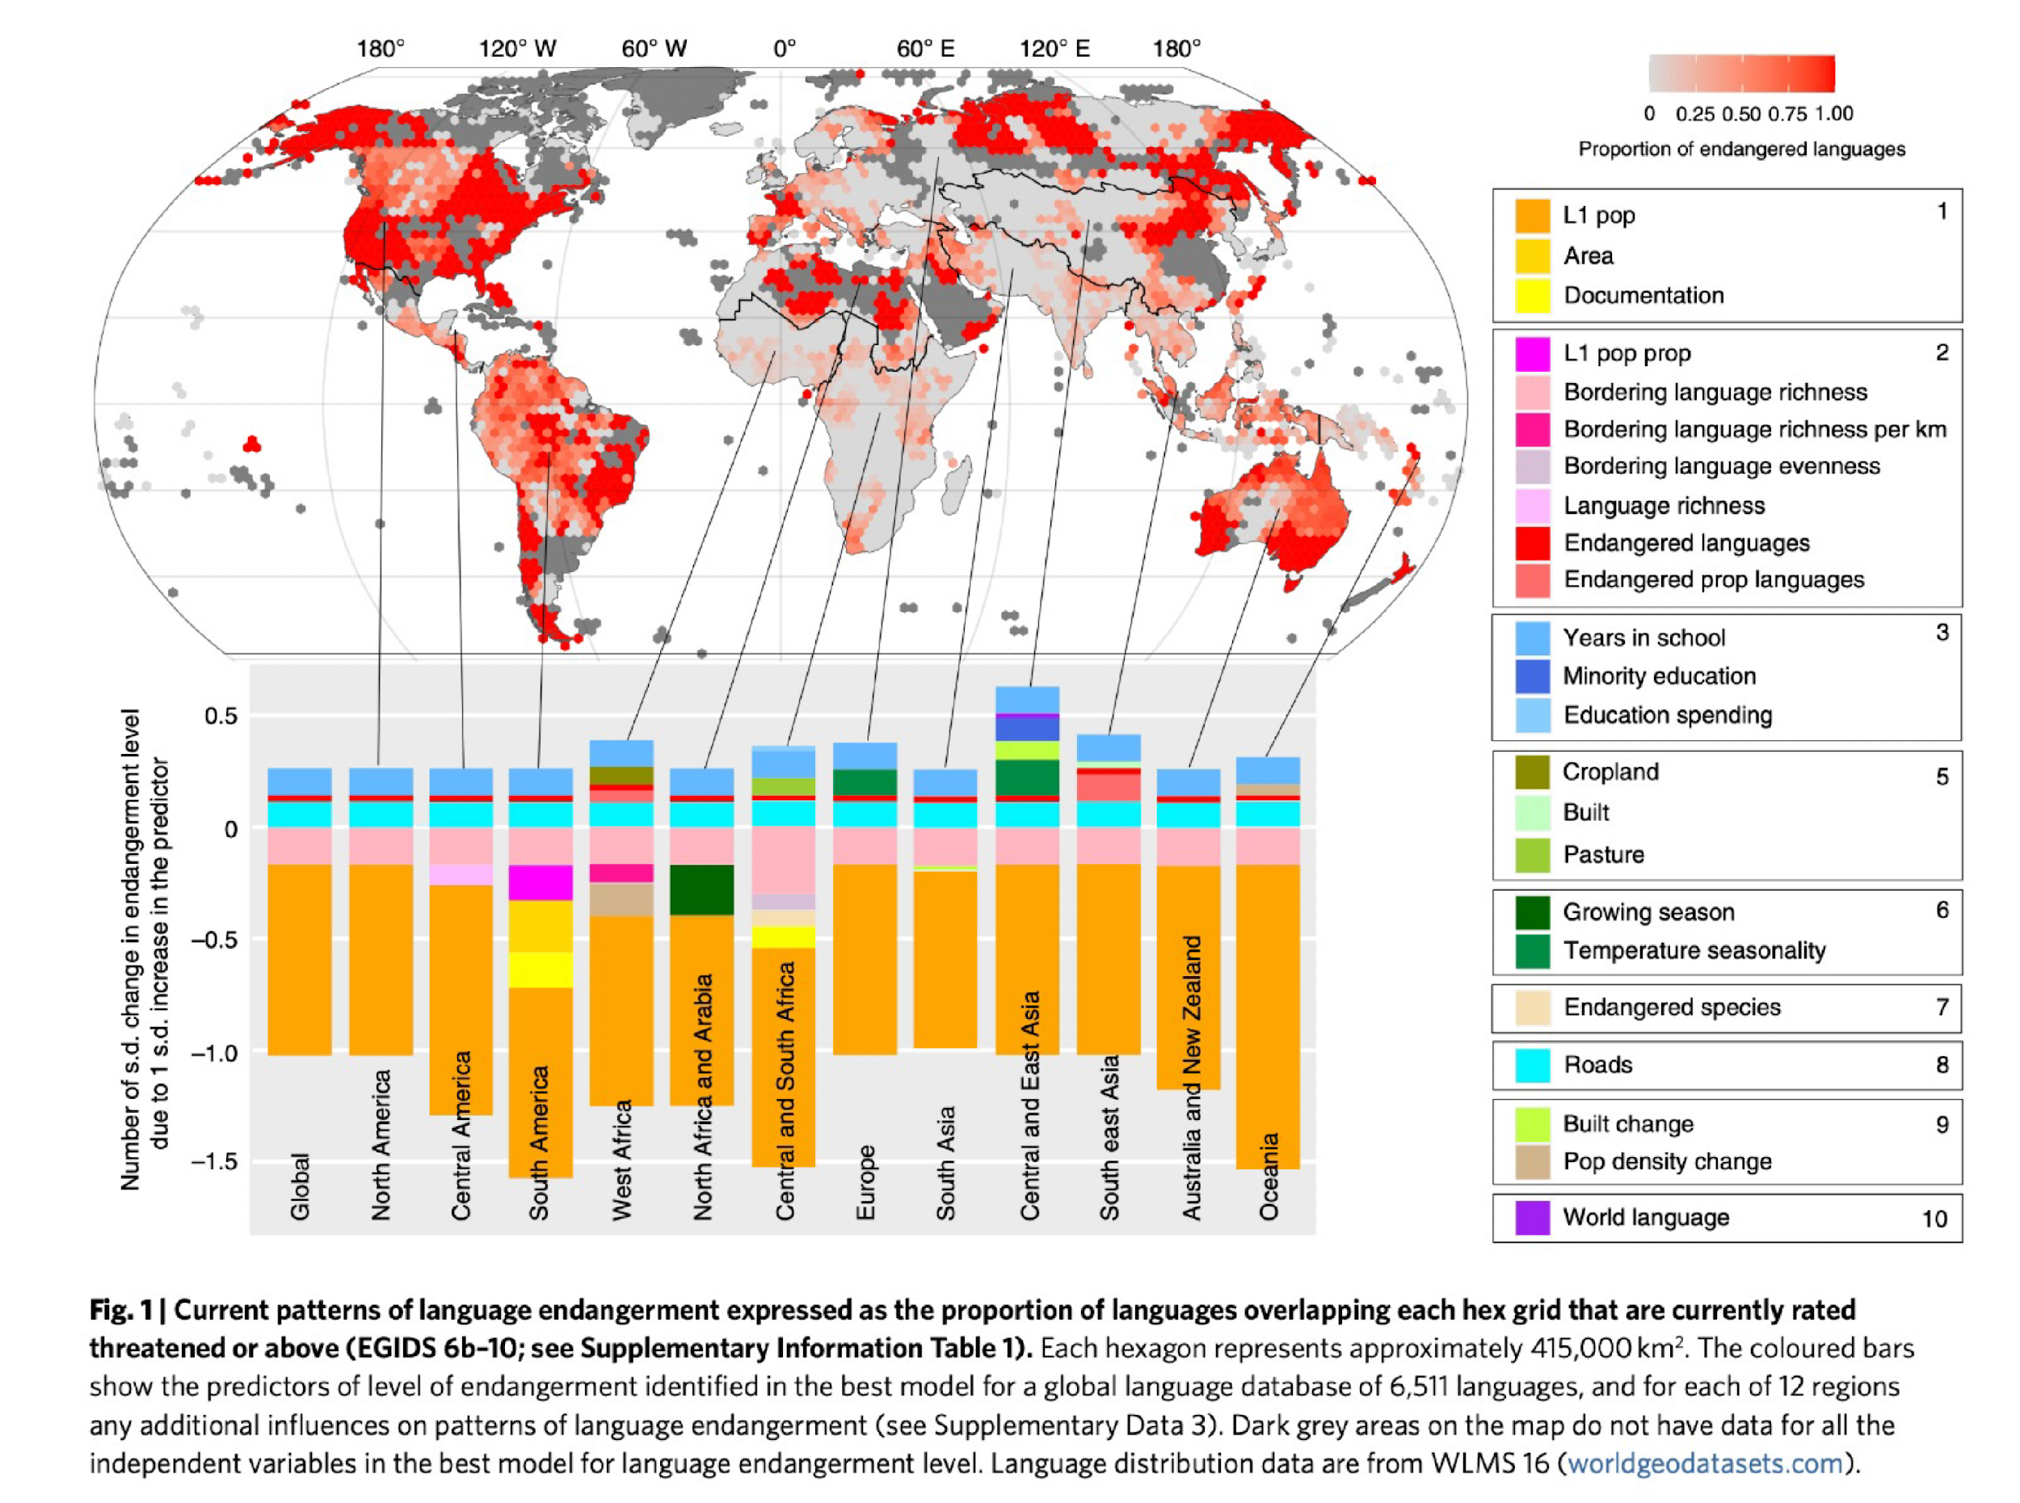
Bromham et al 2022

Slide 16
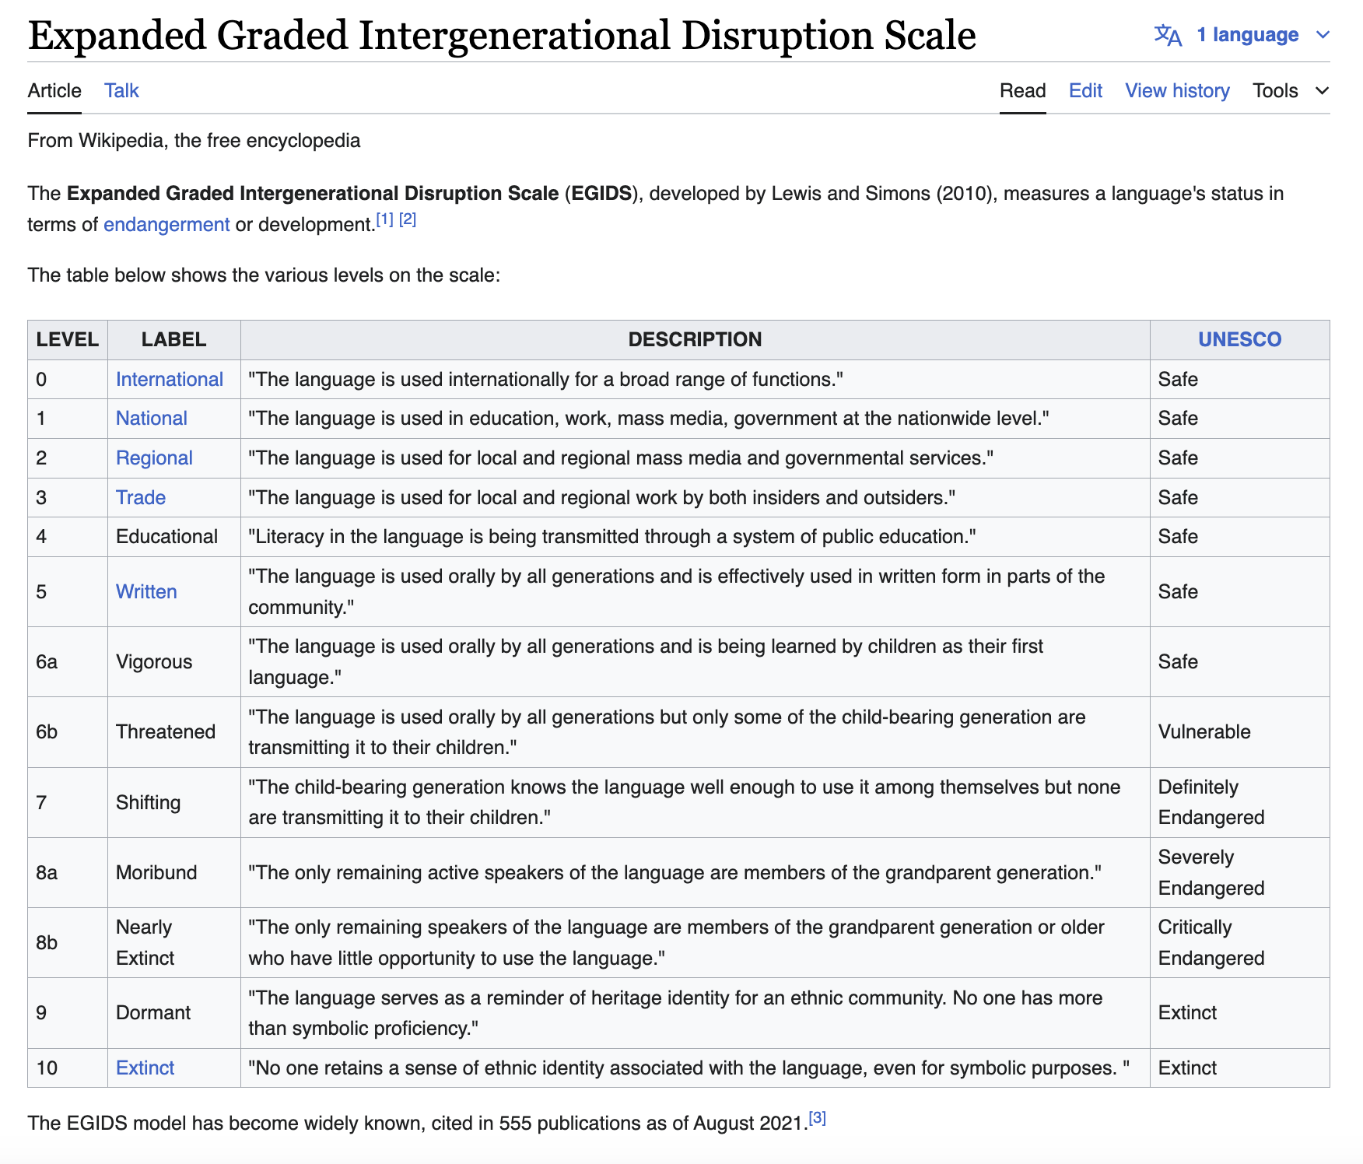

Slide 17
Glottolog
An initiative of the Max Planck Institute for Evolutionary Anthropology, Glottolog is an open source database of 7,674 spoken L1 languages (Glottolog 5.3, accessed 22 April 2026) with extensive academic referencing.
It does not include speaker numbers, although it does calculate endangerment level based on an amalgamation of other endangerment scales
A calculation of documentation levels (e.g. Is a grammar or wordlist for this language available) is also available by endangerment level.
Many of these sources include ISO codes, which provides an opportunity when it comes to data aggregation and analysis.

Slide 18
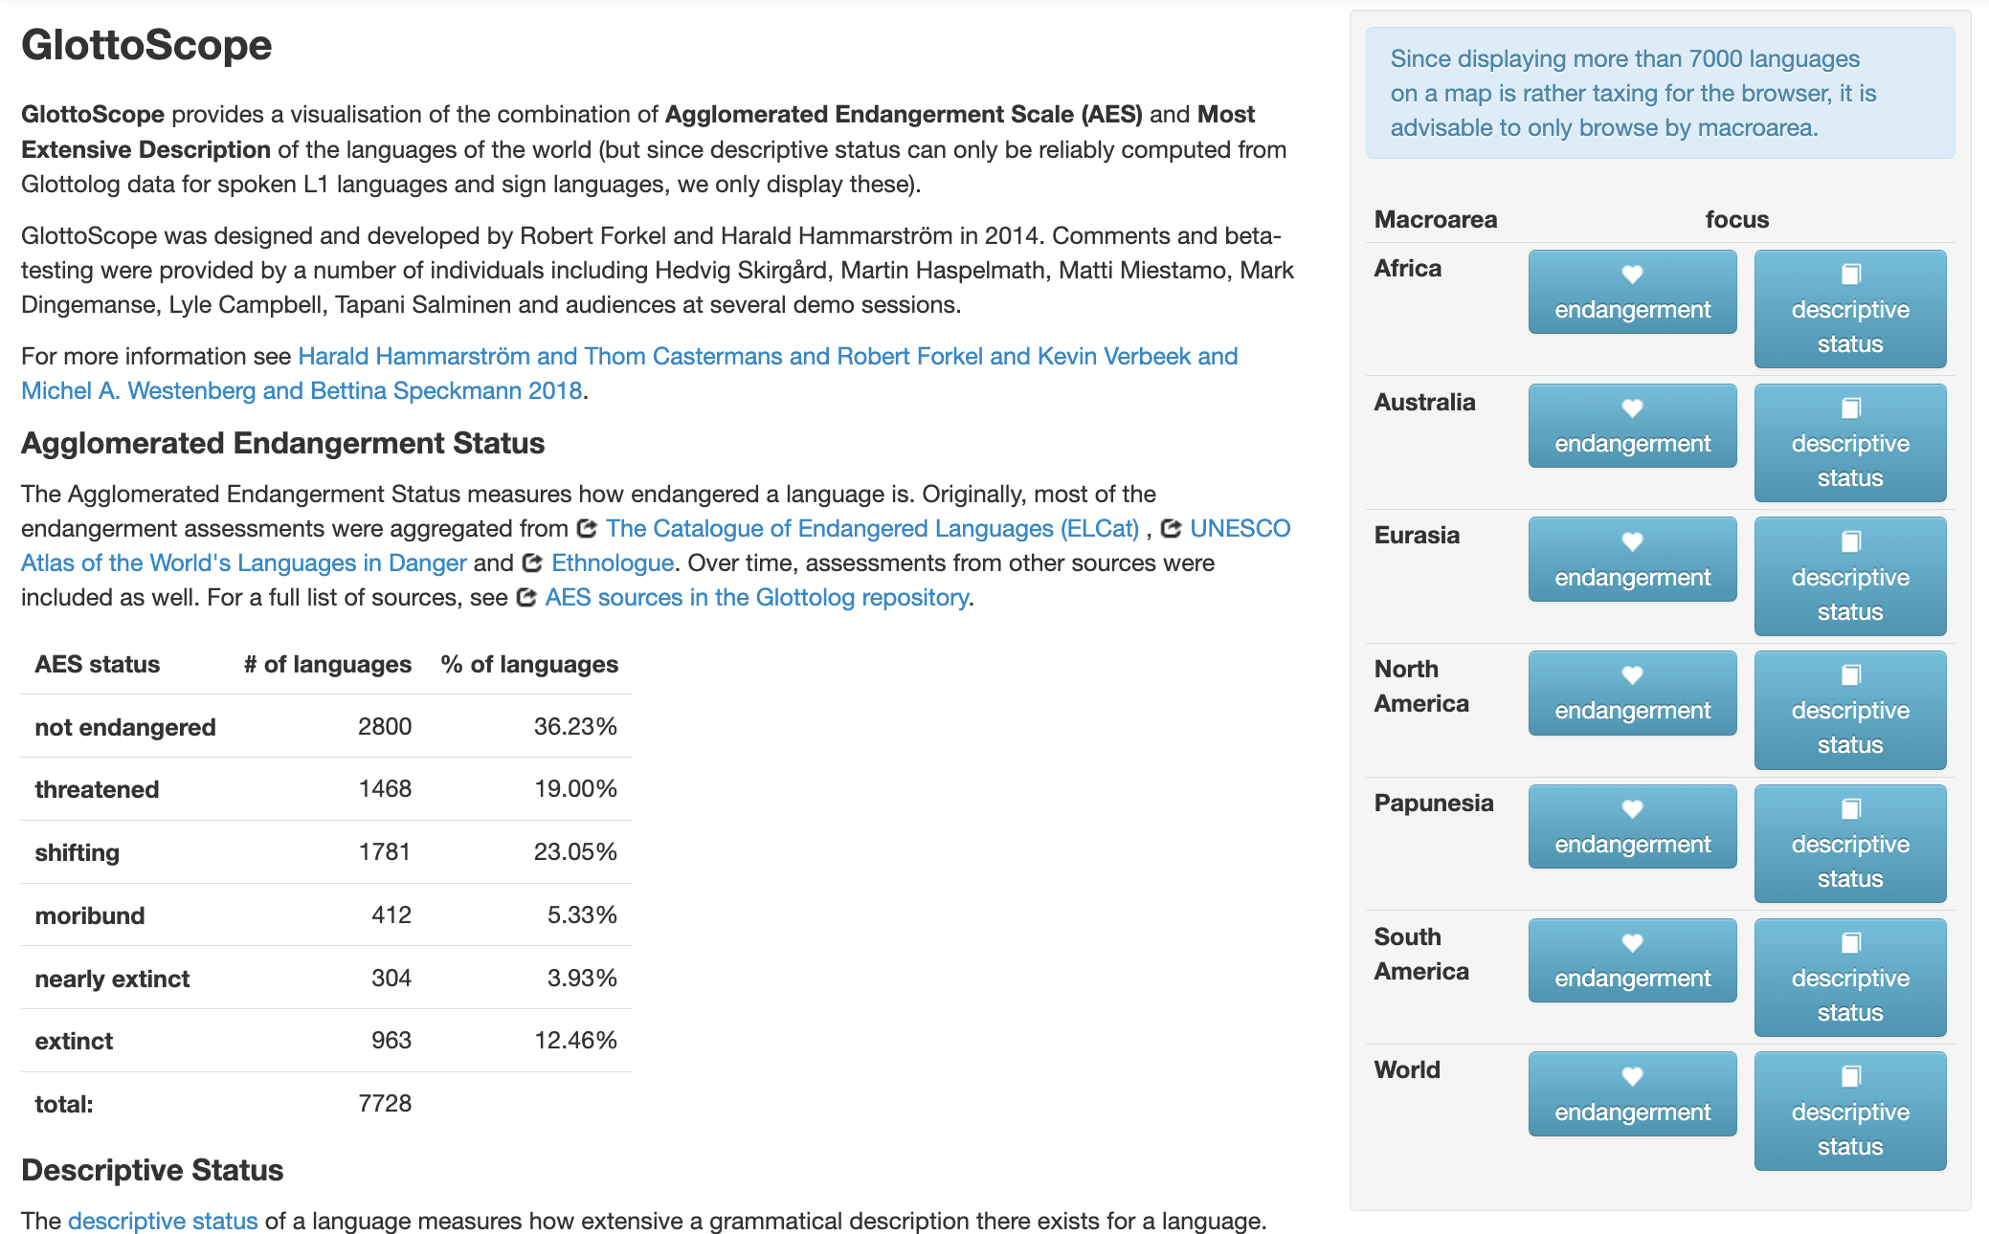

Slide 19
Mapping Glottolog Data
Glottolog 5.3: Global reference database of languages with standardized IDs, classifications, and geographic coordinates; used to map language distributions and analyse endangerment patterns.
Total language-level entries: 8,618 (Spoken L1: 7,674)
Spoken L1 with coordinates: 6,696
Spoken L1 with country data: 6,694
Endangered spoken L1 languages: 4,075 (60.8%)
Each language is represented by a single centroid co-ordinate which could represent the geographic centre-point of a single population, a demographic centre-point or a historical location

Slide 20
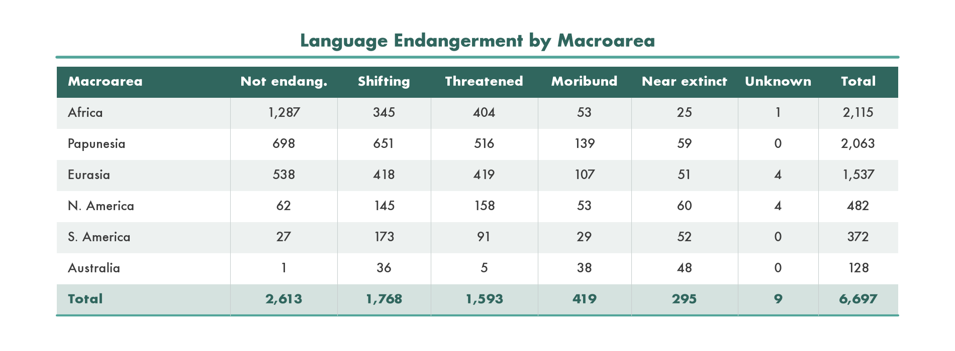
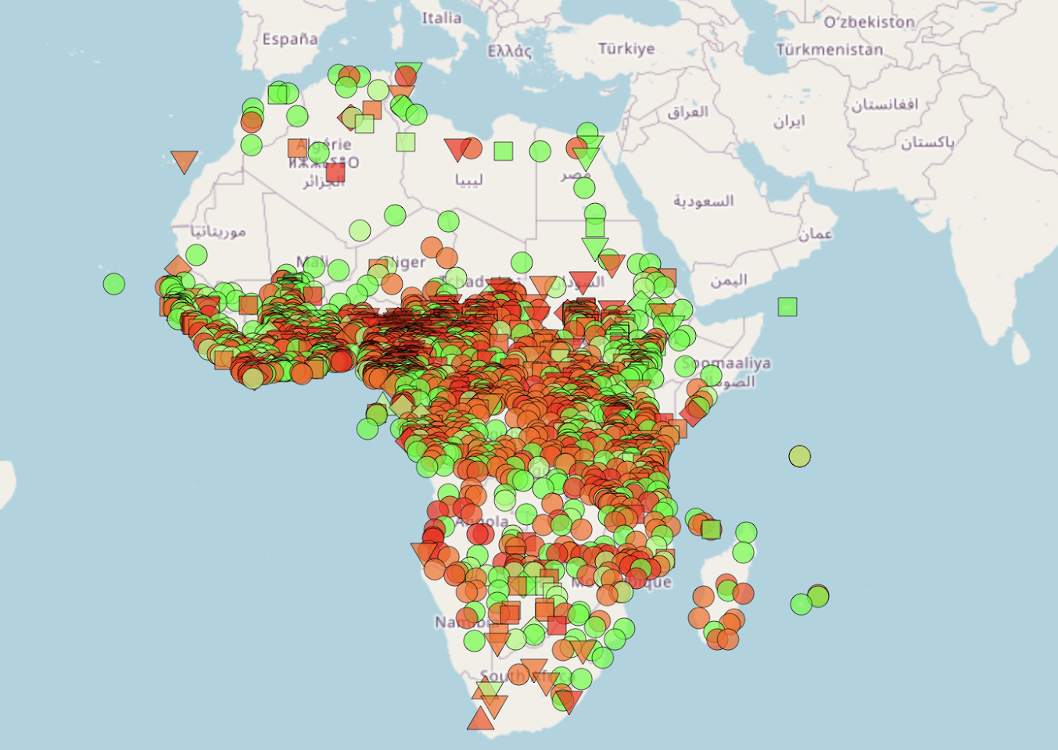
Language Endangerment by Macroarea (Glottolog 5.3, spoken L1, non-extinct)

Slide 21
Global map of terrestrial ecoregions (Olsen 2001) overlaid with Glottolog 5.3 language data

Slide 22
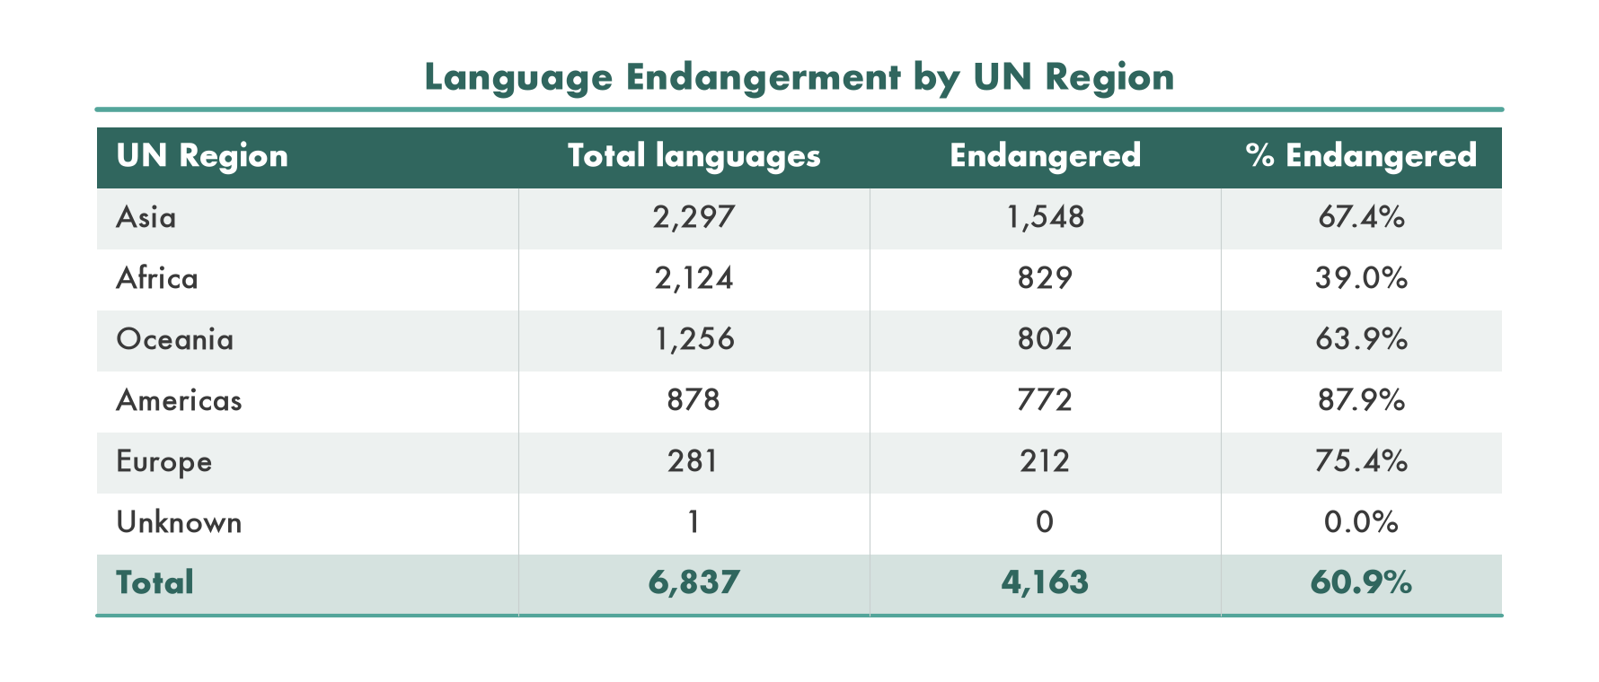
Language Endangerment by UN Region

Slide 23
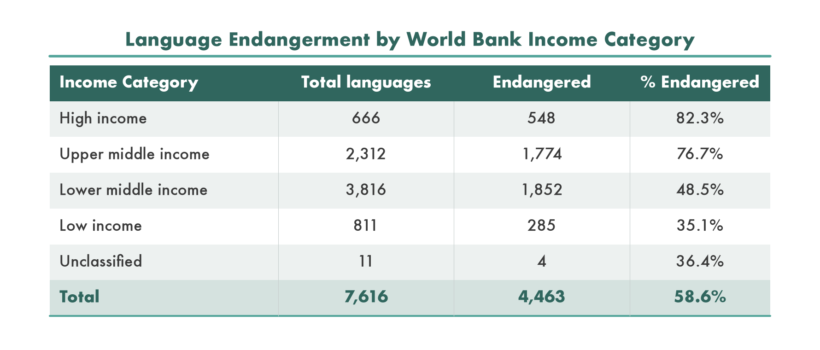
Language Endangerment by Income

Slide 24
A Human Rights Based Approach
Language rights are fundamental human rights (UN Convention on the Rights of the Child)
Intergenerational transmission of languages is key for language vitality
There is a need to refocus on the intergenerational transmission of languages (and therefore knowledge) that people can do something about
We need indicators that are relevant to the communities that they are supposed to serve. Which enable those on the ground to feel that through their actions, they are making a positive contribution that can be shared, recognised and celebrated.
The linguistic diversity indicator, in our view, could, in conjunction with the other TK indicators, become such an indicator.

Slide 25
A Human Rights Based Approach
A human rights based approach was adopted in the Global Biodiversity Framework (COP decision 15/4 C para 7(d))
Article 30.1: UNDRIP “Indigenous peoples have the right to revitalise, use, develop and transmit to future generations their histories, languages, oral traditions, philosophies, writing systems and literatures, and to designate and retain their own names for communities, places and person”
Article 14.1: UNDRIP Indigenous peoples have the right to establish and control their educational systems and institutions providing education in their own languages, in a manner appropriate to their cultural methods of teaching and learning”
Article 19: Universal Declaration on Human Rights - freedom of expression as a human right
Article 30: 1990 United Nations Convention on the Rights of the Child “In those States in which ethnic, religious or linguistic minorities or persons of indigenous origin exist, a child belonging to such a minority or who is indigenous shall not be denied the right, in community with other members of his or her group, to enjoy his or her own culture, to profess and practise his or her own religion, or to use his or her own language.”
As such, the indicator on linguistic diversity should be seen in light of the complementary policy framework of human rights and as part of the human rights based approach adopted in the Global Biodiversity Framework (COP decision 15/4 C para 7(d)).
Section C: Considerations of the KMGBF: a) contribution and rights of Indigenous peoples and local communities
Section g: Human rights based approach
Section n: Intergenerational equity

Slide 26
UNESCO World Atlas of Languages
Replaced UNESCO’s Atlas of the World’s Languages in Danger (1996, 2001, 2010), billed as an “online version” of the initiative
Member states upload statistics which are then reviewed by an Ad Hoc Expert Committee which evaluates the quality, consistency and completeness of data. After review, feedback is passed onto focal points for any necessary updates.
Presently there are 129 nominated country focal points, approximately 94 of these contribute data regularly.
Lack of progress: This tool is still in development. Summary statistics on this data are currently unavailable. The languages available through the online portal refer to a fraction of the 7,000+ unique languages UNESCO identifies
For some countries, no language data is available
UNESCO is leading on the International Decade through the UNESCO Global Plan of Action on the International Decade of Indigenous Languages

Slide 27
Headlines on ILD for the KMGBF
Rerun the existing Index of Linguistic Diversity (ILD) based on counts speakers as is (using the Ethnologue Catalogue);
Refocus the indicator on the national level (testing and refinement) then aggregate up;
Progressively shift the focus from language endangerment to language vitality (positive outcomes) as an urgent task to conserve and promote knowledge;
Engage possible partners, UNESCO, UNICEF on multi-lingual education, UNSD (census data), ECLAC/CEPAL, national statistics offices and of course indigenous peoples organisations and NGOs.

Slide 28
Headlines on ILD for the Cali Fund
Linguistic diversity and biodiversity are closely linked
Linguistic diversity reflects Indigenous stewardship of biodiversity
Incorporating a human rights-based approach into resource allocation
The ILD is already incorporated into the KMGBF monitoring framework
Including the ILD in Cali Fund criteria directs benefits to areas of high biocultural diversity

Slide 29
Sources and References
Boissonneault, M. & Hammarström, H. (2026). What do we know about the language extinction rate? Cambridge Prisms: Extinction.
Bromham, L. et al. (2022). Global predictors of language endangerment. Nature Ecology & Evolution, 6, 163-173.
Gorenflo, L.J. et al. (2012). Co-occurrence of linguistic and biological diversity. PNAS, 109(21), 8032-8037.
Hammarström, H. et al. (2026). Glottolog 5.3. Max Planck Institute for Evolutionary Anthropology.
Harmon, D. & Loh, J. (2010). The Index of Linguistic Diversity. Language Documentation & Conservation, 4: 97-151.
Perley, B. (2012). Zombie linguistics. Anthropological Forum, 22(2), 133-149.
Terralingua (2018). Biocultural Diversity Toolkit, Vol. 1.
UNESCO (2003). Language Vitality and Endangerment.
Code and data: https://github.com/tierravivaai/linguistic_diversity
Olsen et al. (2001) ecoregions

