Slide 1



Python商業應用Final report
binance encrypted coin analysis
10844126 賴映竹
10844172 池同發
10811210 何易承
10844138 方怡晴

Slide 2

Investment trend
In addition to stocks, virtual currencies have gradually become a popular investment method.
Why we make this program?
Analyze investment timing
Decide whether to invest now by watching long-term trends

Slide 3


You can see binance encrypted coin
Highest point
lowest point
Opening price
Closing price
Total transaction volume
What can this program do?

Slide 4

binance encrypted coin
Chinese-English comparison
#BTCUSDT 比特幣
#ETHUSDT 以太坊
#BNBUSDT 幣安幣
#DOTUSDT
#DOGEUSDT 狗狗幣
#SRMUSDT
#LTCUSDT 萊特幣
#ZILUSDT 泰達幣

Slide 5
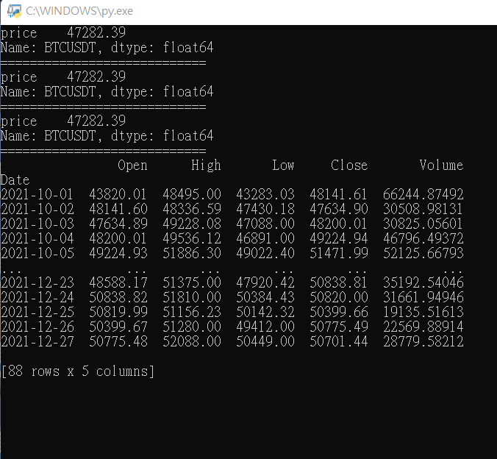
You can select the date and binance encrypted coin
you want to display in the program.
Current price
Detailed daily value

Slide 6
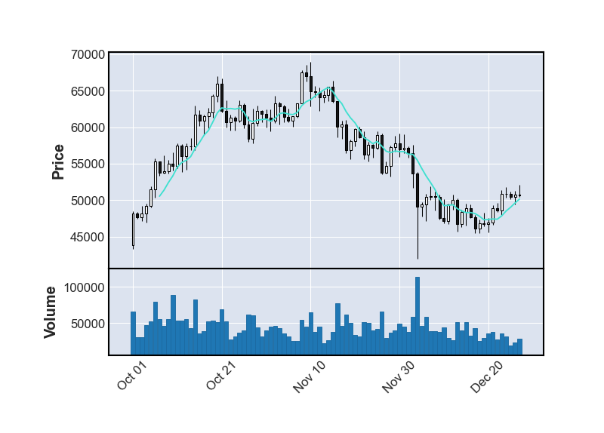
You can see the trend of binance encrypted coin from this graph.
The price dropped suddenly and rapidly.
Because there are a lot of people trading on this day.

