Slide 1

OpenMeetings Moodle Integration
Welcome to OpenMeetings Presentation
MoodleMoot Bari 2010

Slide 2
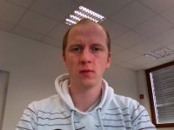
OpenMeetings Moodle Integration
About the speaker:
Name: Sebastian Wagner
Vitea:
- Studying Business Information Systems at University of Applied Science in Pforzheim
- Member of Open Source Project OpenLaszlo
- Founder of Project OpenMeetings – Open Source Web-Conferencing
- Consultant in IT-Services, Video Streaming and Collaboration
Company name and address
Webbase-Design
Haid-Und-Neu-Straße 7 (Technologiefabrik)
76133 Karlsruhe - Germany
0721-255 1990
seba.wagner@gmail.com
MoodleMoot Bari 2010

Slide 3
OpenMeetings Moodle Integration
Presentation:
1) Web-Conferencing + Demo
2) Moodle Integration
3) Scale and Payed Services
MoodleMoot Bari 2010

Slide 4
OpenMeetings Moodle Integration
What is Web-Conferencing?
Skype with workspace
Virtual Meeting
… anytime and anyplace
MoodleMoot Bari 2010
-1-

Slide 5
OpenMeetings Moodle Integration
What are the Main-Features?
Audio/Video
Whiteboard
Presentation/Documents
Screensharing
Text-Chat
Recording
MoodleMoot Bari 2010
-2-

Slide 6
OpenMeetings Moodle Integration
How to use Web-Conferencing in E-Learning
Virtual Classroom
Schooling
Additional offerings for Students
...
MoodleMoot Bari 2010
-3-

Slide 7
OpenMeetings Moodle Integration
OpenMeetings – Open Source Web-Conferencing
Lizenz: Open Source EPL / LGPL
Start Late 2005
Current Version 1.3
http://openmeetings.googlecode.com
MoodleMoot Bari 2010
-4-

Slide 8
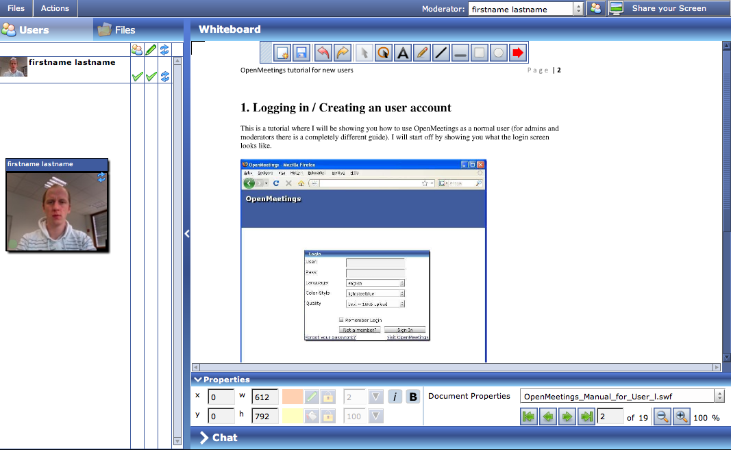
OpenMeetings Moodle Integration
OpenMeetings – Standard Installation
MoodleMoot Bari 2010
-5-

Slide 9
OpenMeetings Moodle Integration
OpenMeetings – Main Features
Audio/Video
Whiteboard
Documents Importer
Screensharing
Recording
Integration
MoodleMoot Bari 2010
-6-

Slide 10
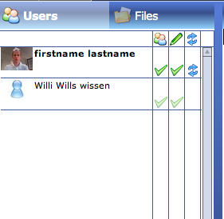
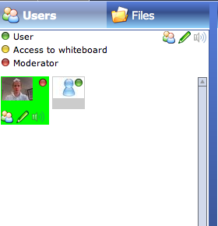
OpenMeetings Moodle Integration
OpenMeetings – Roomtypes
Conference Modus
Event Modus
2 – 50 participants, 2 Videos
Recorded and mixed into a
Single one
Similar to Event Modus
But with some right restrictions
Larger User-Groups
Interview Modus
Restricted/Webinar Modus
MoodleMoot Bari 2010
-7-

Slide 11
OpenMeetings Moodle Integration
OpenMeetings – Users in Roomtypes
Conference Modus
Restricted/Webinar Modus
50 Participants
100-200 Participants
Collaborative
Moderated
Example: Every participant
Can turn on Video
Example: Moderator decides
Which Audio/Video is visible
Workgroup
Webinar
MoodleMoot Bari 2010
-8-

Slide 12
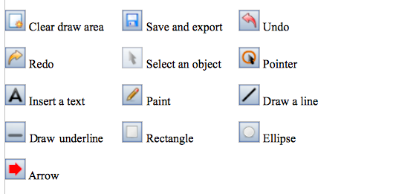
OpenMeetings Moodle Integration
OpenMeetings – Whiteboard
Tools
MoodleMoot Bari 2010
-9-

Slide 13
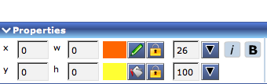

OpenMeetings Moodle Integration
OpenMeetings – Whiteboard
Property Editor
Document Properties
MoodleMoot Bari 2010
-10-

Slide 14
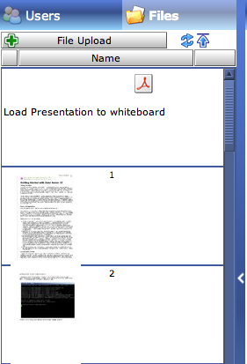
OpenMeetings Moodle Integration
OpenMeetings – Documents
Supported Types:
Images (JPG, PNG, GIF, TIFF,...)
Presentation (PPT, ODP)
Documents (PDF, DOC, XLS, ...)
MoodleMoot Bari 2010
-11-

Slide 15
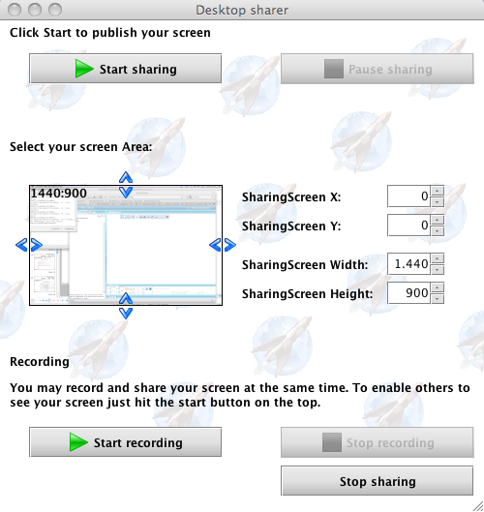
OpenMeetings Moodle Integration
OpenMeetings – Screen Sharing
View of Sharer + Recorder
Adjust the Screen + Quality
MoodleMoot Bari 2010
-12-

Slide 16
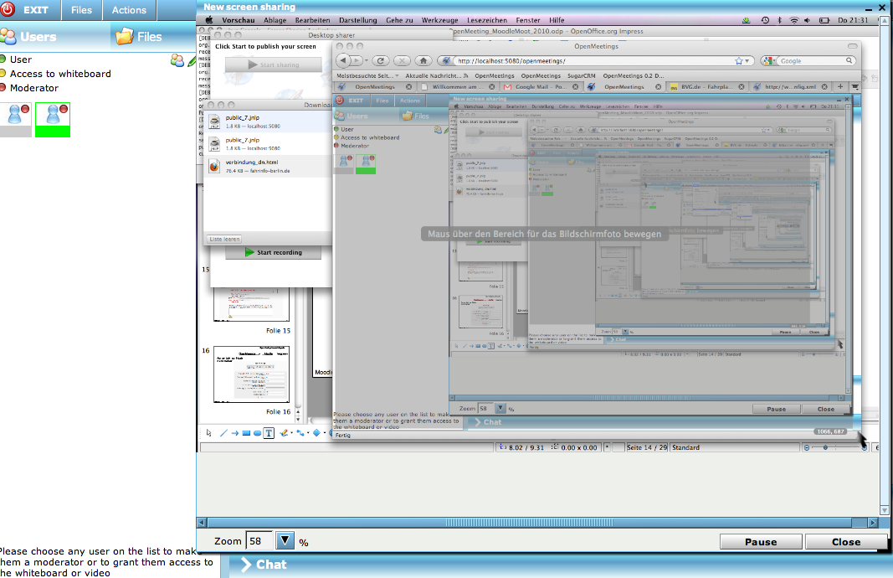
OpenMeetings Moodle Integration
OpenMeetings – Screen Sharing
View of Viewer in Meeting-Room
MoodleMoot Bari 2010
-13-

Slide 17
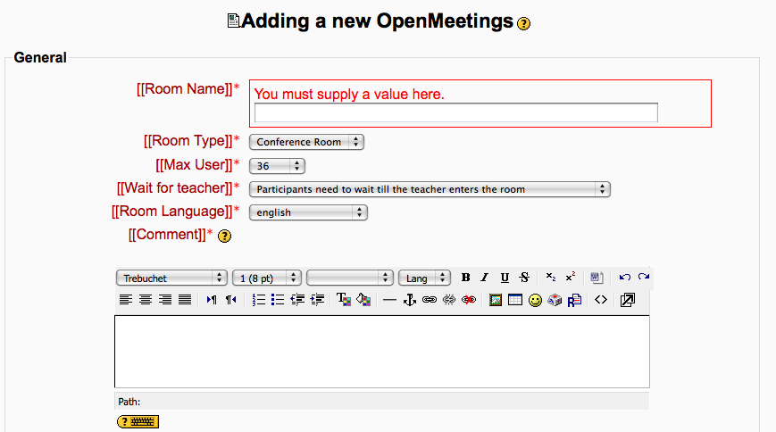
OpenMeetings Moodle Integration
OpenMeetings – Moodle Integration
View of teacher in Moodle to add a new Conference room to
A Moodle Course:
MoodleMoot Bari 2010
-14-

Slide 18
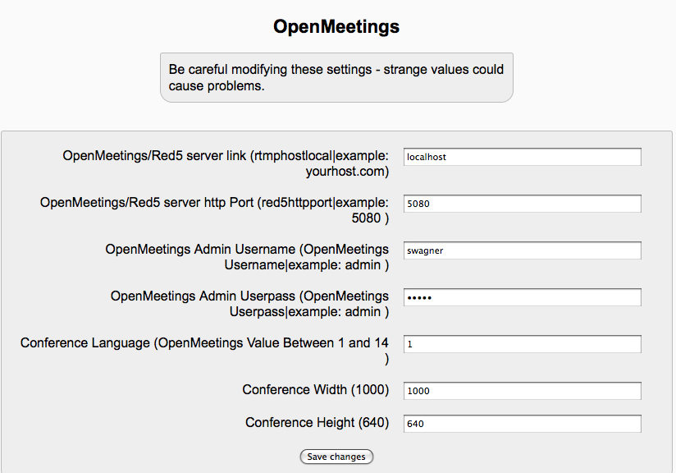
OpenMeetings Moodle Integration
OpenMeetings – Moodle Integration
View of Moodle Administrator
MoodleMoot Bari 2010
-15-

Slide 19
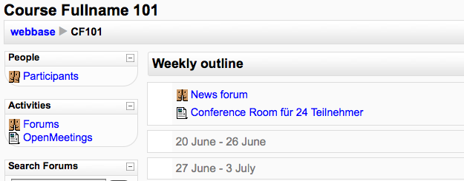
OpenMeetings Moodle Integration
OpenMeetings – Moodle Integration
View of Moodle User in Course Page:
MoodleMoot Bari 2010
-16-

Slide 20
OpenMeetings Moodle Integration
OpenMeetings – Moodle Integration
Technology and Scalability
Integration using OpenMeetings Web-Service Gateway
500-1000 concurrent User-Sessions per Server
Scale Up with multiple Conference Servers
MoodleMoot Bari 2010
-17-

Slide 21
OpenMeetings Moodle Integration
OpenMeetings – Moodle Integration
Documentation
Moodle Plugin can be downloaded from Project Website as well as OpenMeetings Platform.
Own extensions can be integrated with the Web-Service Gateway.
MoodleMoot Bari 2010
-18-

Slide 22
OpenMeetings Moodle Integration
OpenMeetings – Anpassungen
Configuration, Customization, Layout changes
Colors, Logos can be changed with the config
Around 26 languages available
Own or custom implementations can be integrated easily
MoodleMoot Bari 2010
-19-

Slide 23
OpenMeetings Moodle Integration
OpenMeetings – additional Functions
Usergroups, Schedule Meetings, Invitations, Paypal
Make usergroups and finetune access to Conference Rooms
Send Invitations from each conference room
Plan Meetings with the integrated Calendar
Paypal Module available for custom installations
MoodleMoot Bari 2010
-20-

Slide 24
OpenMeetings Moodle Integration
OpenMeetings – Architecture
OpenMeetings Server
Red5
Flash Streaming
Desktop Sharing
Flash SWF
Client
Flash SWF
Client
OpenLaszlo
OpenOffice
Service
Convertion
ImageMagick
GhostScript
SWFTools
Datenbank
Datenbank
Datenbank
SOAP-Gateway
Moodle, Portale,
Intranet, …
MoodleMoot Bari 2010
-21-

Slide 25
OpenMeetings Moodle Integration
OpenMeetings – Roadmap
What's next? What's new?
System Backup including uploaded Files (done in v1.3)
Remote Desktop Control (will come with v 1.4)
MoodleMoot Bari 2010
-22-

Slide 26
OpenMeetings Moodle Integration
OpenMeetings – Future Steps
Planned features for upcoming versions
VoIP integration, Dial in Number for Conference Rooms
Online Repositories to easily apt-get or yum
Hosted edition and with integration packs and online store (using Cloud and SaaS)
Various improvement on Moderation and user request focus on large Webinars with 100++ Users
MoodleMoot Bari 2010
-23-

Slide 27
OpenMeetings Moodle Integration
OpenMeetings – Cost and Service
What are costs?
No cost for Licensing, just Service, Add-Ons, customization
Basic Installations-Service OpenMeetings
500 Euro (includes Branding and color change + logo)
Moodle Integration Plugin Installation
250 Euro
Custom Modules:
Start by 250 Euro, depending on effort custom calculation
MoodleMoot Bari 2010
-24-

Slide 28
OpenMeetings Moodle Integration
OpenMeetings – System Requirements
Sample Server Calculation
You rent server on your own:
500 Concurrent Users:
2-3 Ghz CPU
4 GB RAM
Operation System:
Linux (Debian, CentOS, Fedora,...) , Windows, OSx
MoodleMoot Bari 2010
-25-

Slide 29
OpenMeetings Moodle Integration
OpenMeetings – Service
Who can I hire?
Sebastian Wagner, seba.wagner@gmail.com
Other consultants can be found at our Website:
http://code.google.com/p/openmeetings/wiki/Jobs
MoodleMoot Bari 2010
-26-

Slide 30
OpenMeetings Moodle Integration
Thank you very much
OpenMeetings presentation by
Sebastian Wagner
MoodleMoot 2010 Bari
MoodleMoot Bari 2010

